Slide 1
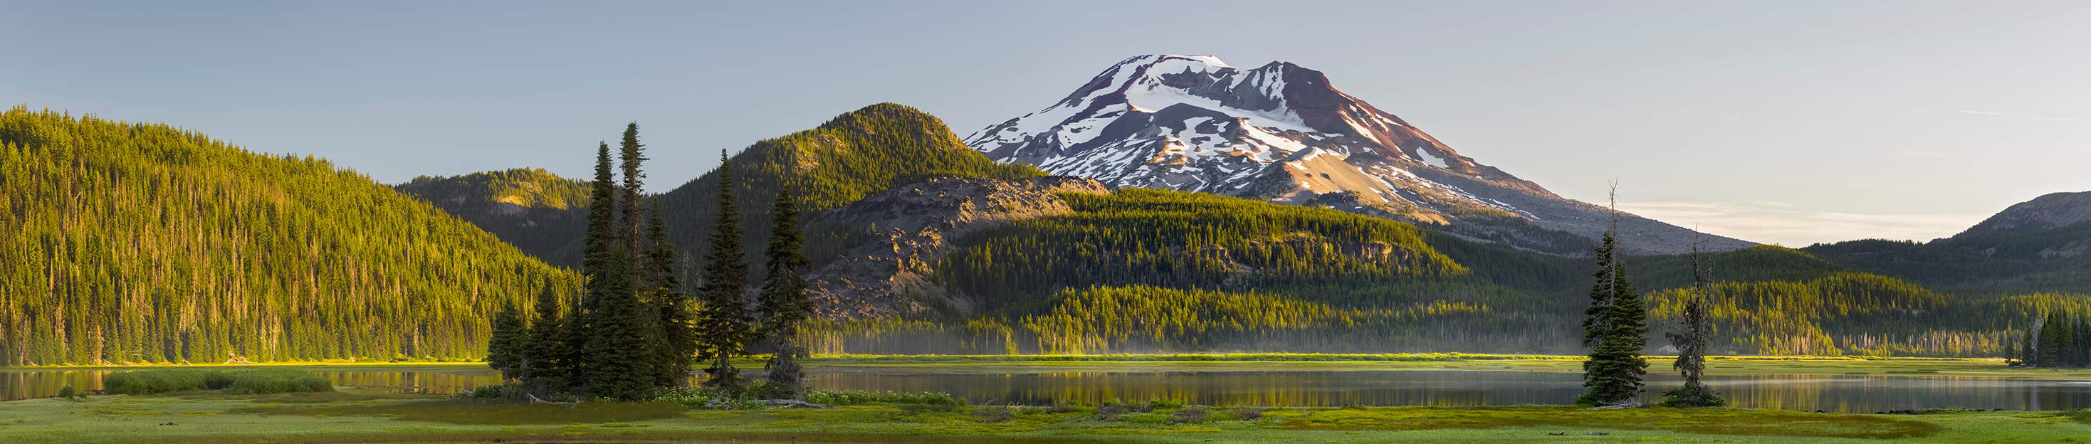


Oregon Smoke Management Rulemaking Update
Air Quality
Jennifer Horton – DEQ
Tim Holschbach – ODF
Gabriela Goldfarb – OHA
Sept. 10, 2026
EQC Meeting – DEQ Headquarters

Slide 2
Agenda
Wildfire and prescribed fire in Oregon
Health impacts from smoke
Community Response Plans
West Bend Prescribed Fire Pilot
Oregon Smoke Management Program
Rulemaking update, timeline and next steps
2

Slide 3
Wildfire in Oregon
3
2026 acreage as of Aug. 31, 2026

Slide 4
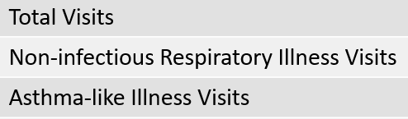

Statewide
Total visits: Within expected levels
NI Resp illness and asthma-like illness visits: Within expected levels
Data current through:
Aug. 4, 2026*
Visits include emergency department and urgent care center visits from reporting facilities
Syndromic surveillance data are for situational awareness
NI Resp illness: Elevated, ages 18-44 on 08/04 (Morrow)
Asthma: Elevated, ages 18-44 on 08/04 (Morrow)
NI Resp illness: Elevated, ages 18-44 on 08/03-08/04 (Columbia)
Asthma: Elevated, ages 18-44 on 08/04 (Columbia)
NI Resp illness: Elevated, ages 18-44 on 08/03-08/04 (Multnomah)
Asthma: Elevated, ages 18-44 on 08/03-08/04 (Multnomah)
Asthma: Trending up, ages 18-44 on 08/04 (Clackamas)
NI Resp illness: Elevated, ages 18-44 on 08/04 (Wasco)
Asthma: Elevated, ages 18-44 on 08/04 (Wasco)
NI Resp illness: Trending up, ages 45-64 on 08/04 (Polk)
Asthma: Trending up, ages 18-44 on 08/04 (Marion)
NI Resp illness: Elevated, ages 18-44 on 08/04 (Crook)
Asthma: Trending up, ages 18-44 on 08/04 (Crook)
NI Resp illness: Elevated, ages 45-64 on 08/03 (Lake)
Asthma: Trending up, ages 0-4 on 08/04 (Lane)
For more information see:
Oregon ESSENCE
Summer Hazards Dashboard
NI Resp illness visits: Elevated, ages 65+ on 08/04 (Josephine)
Asthma: Elevated, ages 65+ on 08/04 (Josephine)
Oregon.ESSENCE@odhsoha.oregon.gov
4
*Data are preliminary and subject to change.
HPR Health Preparedness Regions

Slide 5
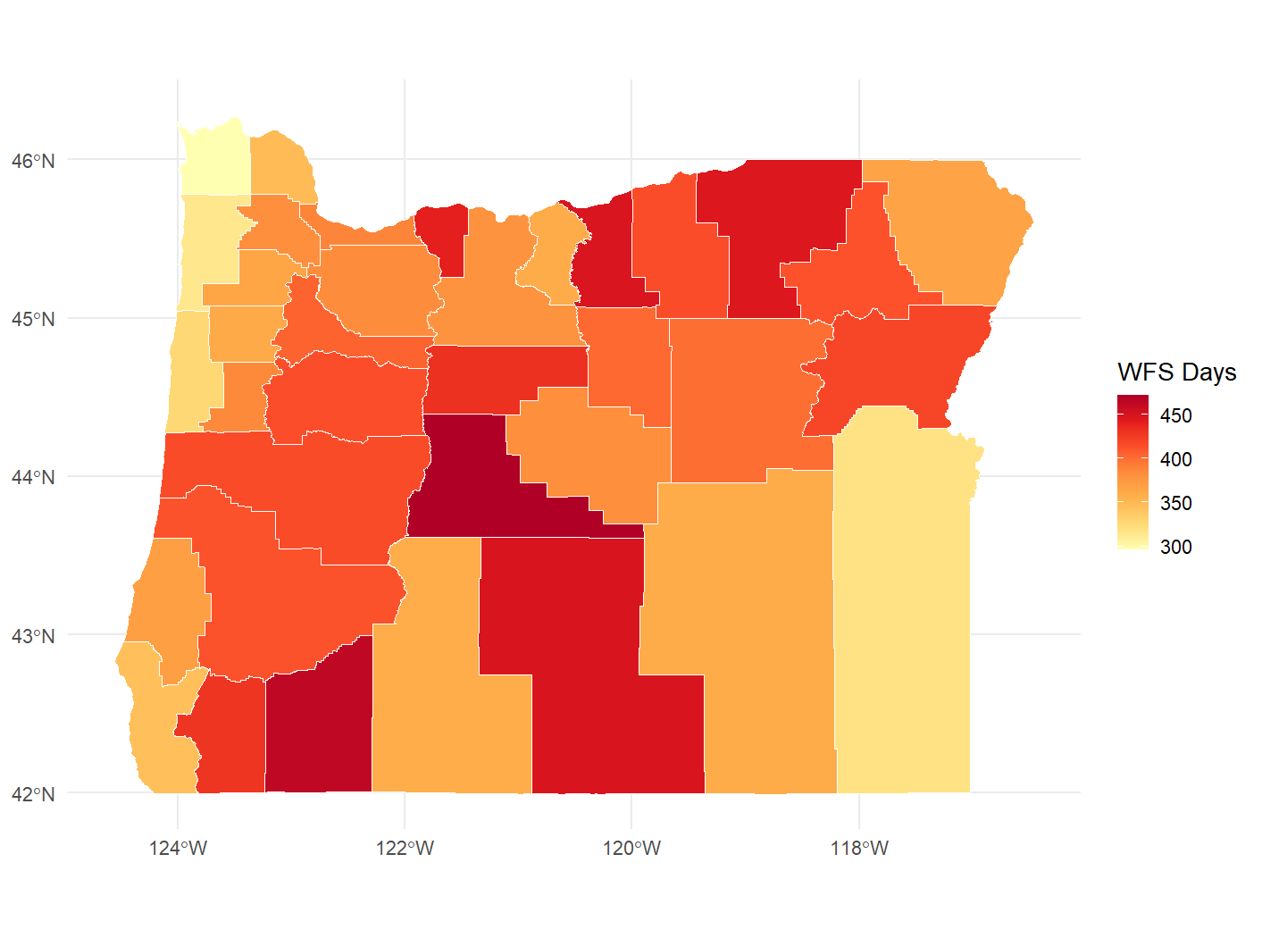
Smoke and Health: Increasing Wildfire Smoke Days
Wildfire Smoke Day: Any day when an area was determined to be influenced by wildfire smoke, as indicated by PM2.5 and satellite smoke plumes
Oregon’s Five-Year Averages
2006–2010: 11 Days
2021–2025: 33 Days
Eight of the highest annual averages for WFS days during the entire 20-year period occurred within the past nine years
5

Slide 6
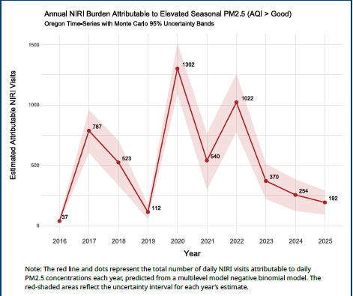
Smoke and Health: Health Outcomes
2016-2025 annual emergency department and urgent care “Non-Infectious Respiratory Illness” visits attributable to high particulate matter (PM 2.5) concentrations during wildfire seasons (May 1 to Oct. 31)
Peak numbers are from impacts to populated areas:
2017 Eagle Creek (Portland metro)
2020 Labor Day (Statewide)
2022 Cedar Creek (Deschutes, Lane)
6

Slide 7
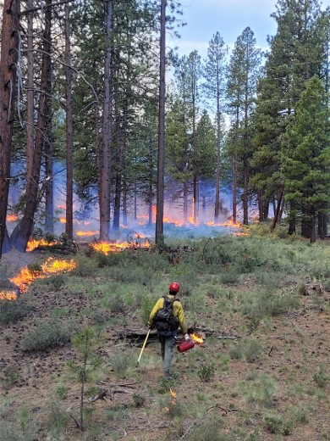
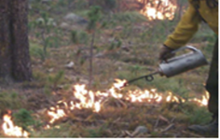
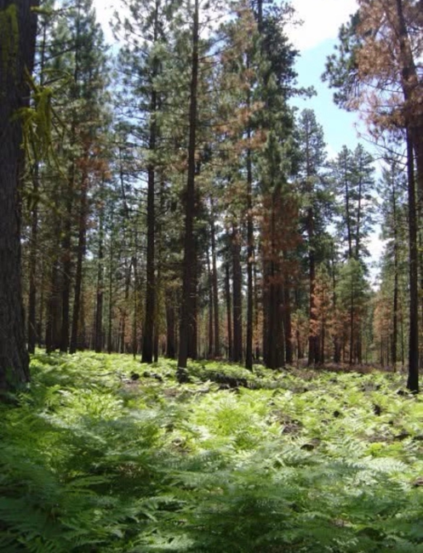
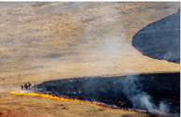
Prescribed Fire in Oregon
7

Slide 8
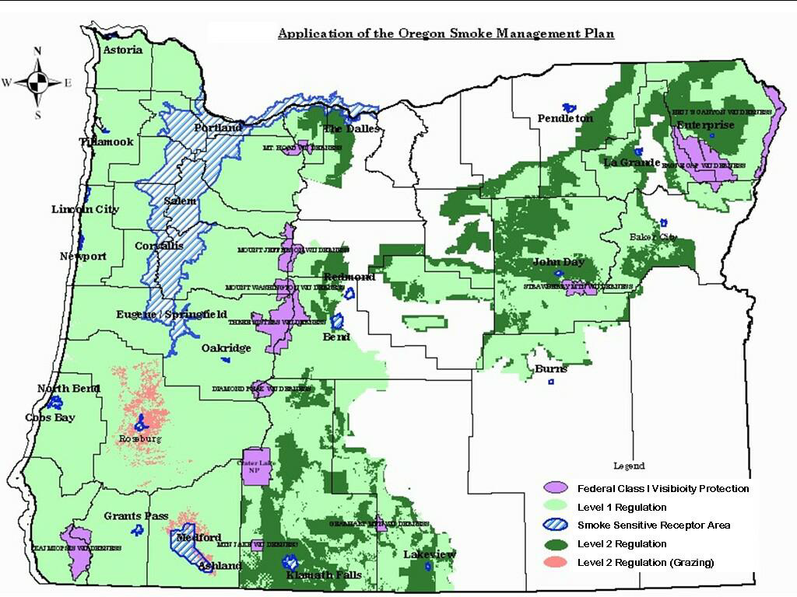
Oregon Smoke Management Program Overview
Adopted as a regulatory program in 1972
Implemented by ODF in collaboration with DEQ and OHA
Purpose of the program is to allow for the safe implementation of prescribed fire while protecting public health and air quality
Rule review and update required every 5-10 years, last update in 2019
8

Slide 9
Oregon Smoke Management Program Evolution
Pre-2019:
Any amount of smoke entering a community was considered a smoke intrusion
Limit on size of polyethylene covers on piles
Only a definition for “smoke intrusion” – “smoke incident” was not in place
Post-2019:
Updated definitions of “intrusion” and added “incident” and added “vulnerable populations”
Added Community Response Plans and one-hour intrusion exemptions
Smoke Intrusion Threshold
PM2.5 average at or above 70 ug/m3 for one-hour and/or averages at or above 26 ug/m3 for a 24-hour period
9

Slide 10
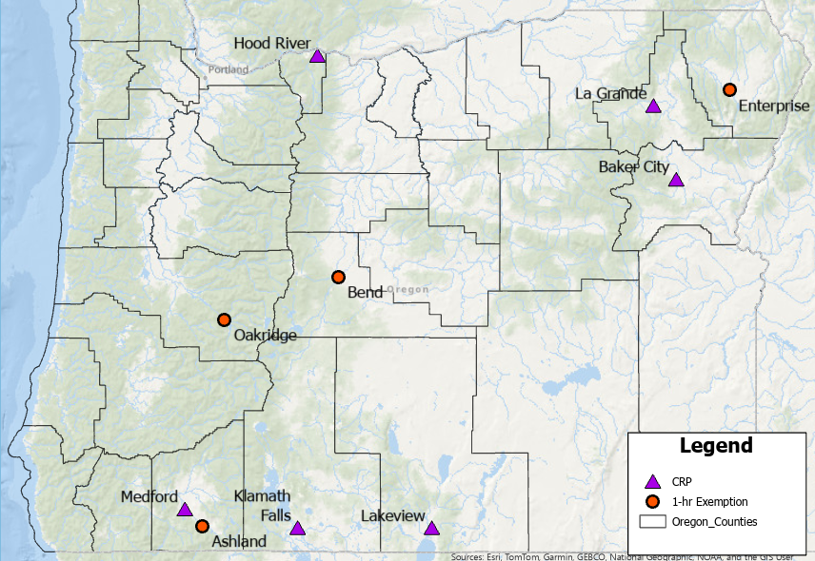
Community Response Plans
80% of SSRAs do not have a formal community response plan for smoke events
CRP requirements in OAR 629-048-0180
SB 762 funded four new CRPs and the implementation of five existing CRPs
10

Slide 11
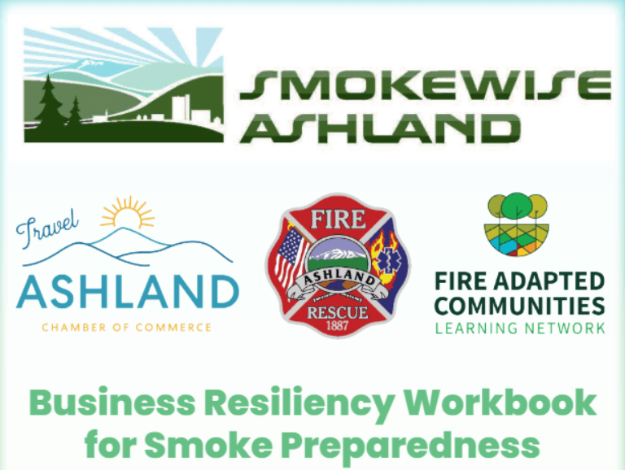
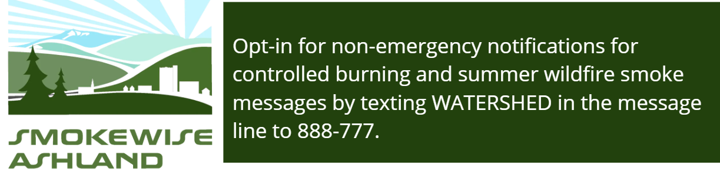
Building Smoke Resilient Communities
Proactive planning between land managers and local public health
Creating connections with local entities that provide services and support
Messaging tailored to the needs of the community
11

Slide 12

West Bend Pilot
Participating agencies are members of the Pacific Northwest Joint Group on Prescribed Fire and Smoke Management
Support putting mechanisms and regulations in place that allow land managers to implement prescribed fire on a larger scale while making every effort to ensure that vulnerable populations and communities are protected by pursuing increased public health interventions
Pilot included increased air quality monitoring, increased public communication, and increased smoke forecasting for burns
12

Slide 13

13

Slide 14
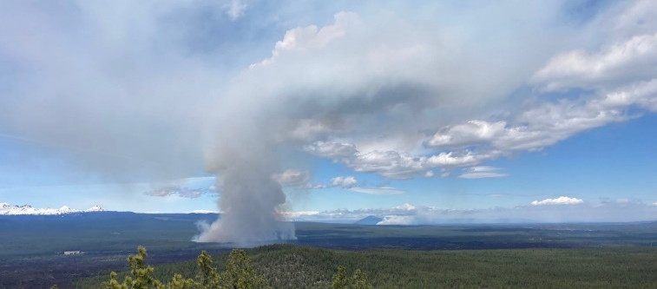
Implementing Lessons Learned
West Bend Pilot showed:
Increase in outreach pre-burn resulted in more acres treated with few observable health impacts
Regional, year-round communication builds preparedness and trust within communities
Room for additional collaboration and improvements to additional smoke modeling and forecasting
Planning for smoke needs to include all burns occurring in the airshed, not just the project area
14

Slide 15
Goal of 2026 Rulemaking
Align smoke management rules with EO 25-26 by increasing opportunities to conduct prescribed burns while protecting public health
Continue to promote methods that minimize emissions
Create space for larger burns through additional planning, collaboration, and communication with the public
Continue to support increased communication between prescribed fire practitioners and the community
Provide pathways for communities to be prepared to respond to impacts from prescribed fire smoke and, by extension, wildfire smoke
15

Slide 16
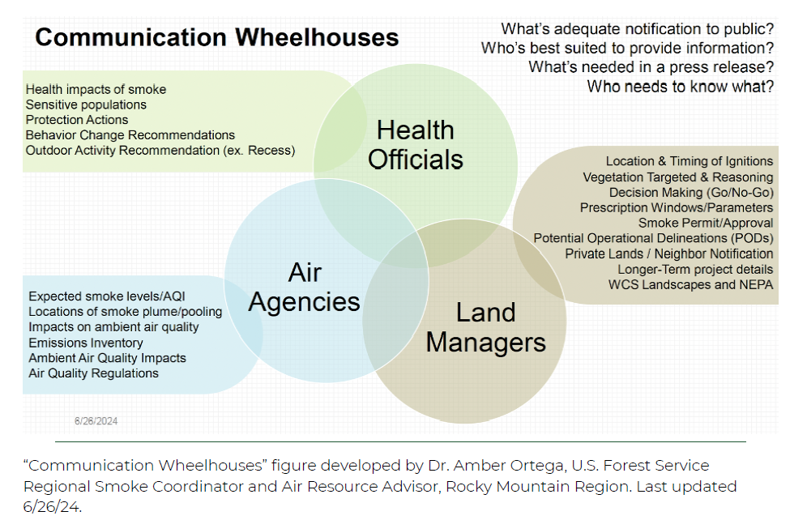
Creating Space for Prescribed Fire
Proposed new section to allow for increased scale of prescribed fire near an SSRA with enhanced planning and public outreach
16

Slide 17
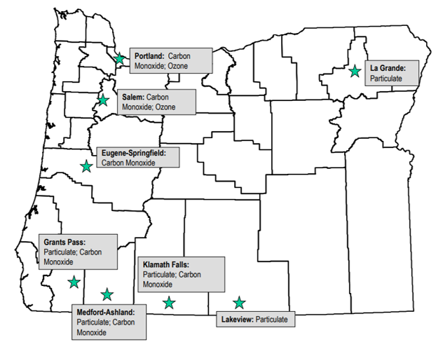
National Ambient Air Quality Standards and
State Implementation Plans
Criteria Pollutants:
Particulate Matter (PM 10 and PM 2.5)
Carbon monoxide
Lead
Nitrogen dioxide
Ozone
Sulfur dioxide
17

Slide 18
2026 Rulemaking Timeline
RAC meetings
Request BOF approval to conduct rulemaking
Informational update to EQC
Public comment period
August – October 2026
January 2027
January 2027
January – March 2027
Present revised rules to EQC
Proposed final rules to BOF for adoption
Proposed final rules to EQC with request to submit SIP
Final SIP to EPA
May 2027
June 2027
July 2027
July 2027
18

Slide 19
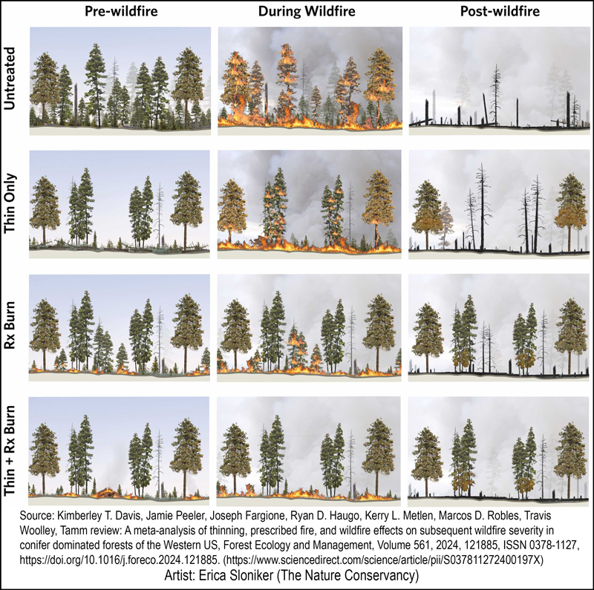
Key Take-Aways
Building off the 2019 philosophy and momentum
Large contingent of shared interests advising (22 RAC members)
Supporting strong communications, community protection, and supporting the practitioners of the work being completed on the landscape
Consistent with the direction of Executive Order 25-26
19

Slide 20
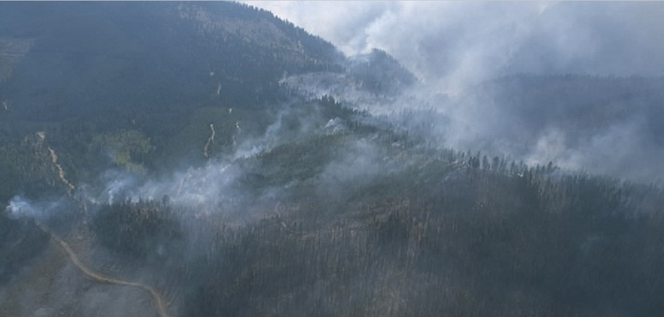

Questions?
DEQ – Jennifer Horton
OHA – Gabriela Goldfarb
ODF – Tim Holschbach
20

Slide 21
Title VI and Alternate Formats
DEQ does not discriminate on the basis of race, color, national origin, disability, age, sex, religion, sexual orientation, gender identity, or marital status in the administration of its programs and activities.
Visit DEQ’s Civil Rights and Environmental Justice page.
Español | 한국어 | 繁體中文 | Pусский | Tiếng Việt | العربية
Contact: 800-452-4011 | TTY: 711 | deqinfo@deq.oregon.gov
21

