Slide 1

Toxic Air Contaminant Review and Update Rulemaking
Cleaner Air Oregon
Apollonia Riberdy (DEQ), David Farrer (OHA), J.R. Giska (DEQ)
Environmental Quality Commission Meeting – Informational Item
Sept. 10, 2026
Portland, Oregon

Slide 2
Overview
CAO and Rulemaking Background
Scientific Review and ATSAC
Rulemaking Process
RAC Member Feedback
Next Steps

Slide 3
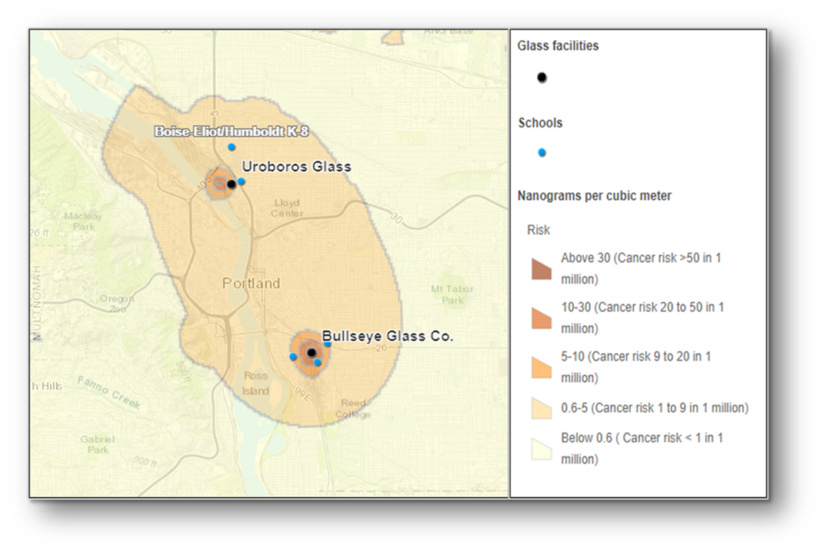
Glass, Metals, and Moss
High levels of heavy metals found in moss studies
Art glass manufacturers and the “HAP Gap”
2016 – Cease and desist, CAO rulemaking begins
2018 – CAO program rules adopted by EQC, implementation begins

Slide 4
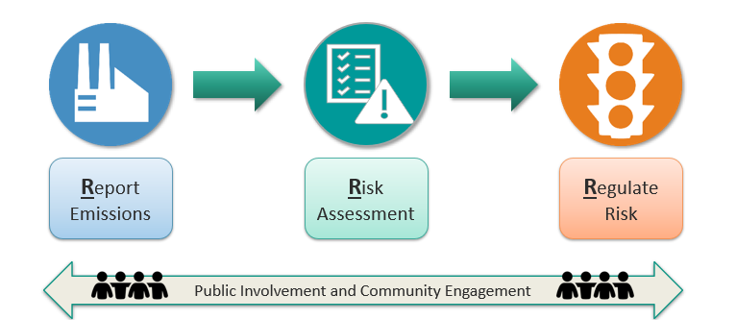
CAO Program Overview

Slide 5
CAO Rulemaking History Post Program Establishment
2020
Cleaner Air Oregon Hazard Index Rulemaking
2021
Air Toxics Alignment Rulemaking
Established a new standards division, Division 247, and the process to update those standards
Established more protective regulatory levels for noncancer health effects from exposure to TACs expected to cause developmental or other severe human health effects
Now
Updating the Priority List of Chemicals and the Toxicity Reference Values, as articulated in Division 247
Toxic Air Contaminant Review and Update Rulemaking

Slide 6
TRV Updates Required Under Division 247
  Triennial review of TRVs to ensure latest science used
  Authoritative Sources that DEQ used:
    United States Environmental Protection Agency (EPA)
    United States Agency for Toxic Substances and Disease Registry (ATSDR)
    California Environmental Protection Agency (CalEPA)
    DEQ in consultation with the Air Toxics Science Advisory Committee (ATSAC)
  Air Toxics Science Advisory Committee role and member qualifications
  Public petition process for the revising TRVs

Slide 7





Current Rulemaking Process – Two Phases
Scientific Review
Rulemaking Process
Rules Committee
Public Comment
ATSAC
DEQ and OHA consider ATSAC’s feedback
Fiscal Committee
Proposed rules presented to EQC for action
2022-2025
2026
2027
We are here

Slide 8
Scientific Review and Air Toxics Science Advisory Committee

Slide 9
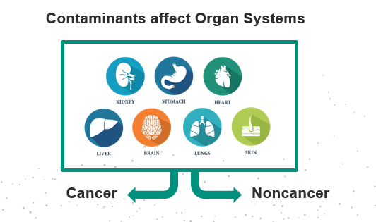
Health Effects from Contaminants

Slide 10
What is a Toxicity Reference Value (TRV)?
TRV is the amount of an air contaminant that may cause health problems when inhaled
  Cancer
    Value corresponds to an excess cancer risk of 1 in 1 million
  Noncancer – chronic and acute
    Value above which relevant noncancer health effects might occur in humans following environmental exposure
IMPORTANT: There can be up to three TRVs for a single TAC

Slide 11
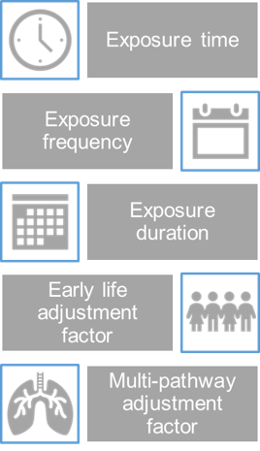
TRVs to Regulatory Values in CAO
TRVs
Health risk-based standards
Used in multiple AQ programs
Non-regulatory
Regulatory
*Adjustment Factors
AQ Monitoring
Air Toxics Program
CAO Program
Adjustments* made to TRVs
Different exposure locations
Risk-Based Concentrations

Slide 12
Division 247 Rules Governing ATSAC
Composed of five to seven volunteer members
Threshold qualifications:
  Toxicology and toxicity assessment
  Environmental and atmospheric chemistry
  Epidemiology and biostatistics
No actual or potential conflicts of interest
Advisory role only

Slide 13
ATSAC’s Role
Primary role: Review and provide feedback on the overall scientific process and approach for updating TRVs
  Example: What criteria to apply when deciding between TRVs from different sources for the same chemical
Secondary role: Specific TRVs
  Examples: Diesel particulate matter, manganese, acetone, acrolein

Slide 14




ATSAC Members
Member | Affiliation
John Budroe, PhD | Recently retired from
Qiaoxiang (Daisy) Dong, PhD
John Stanek, PhD
Susan Tilton, PhD
John Vandenberg, PhD | Recently retired from

Slide 15
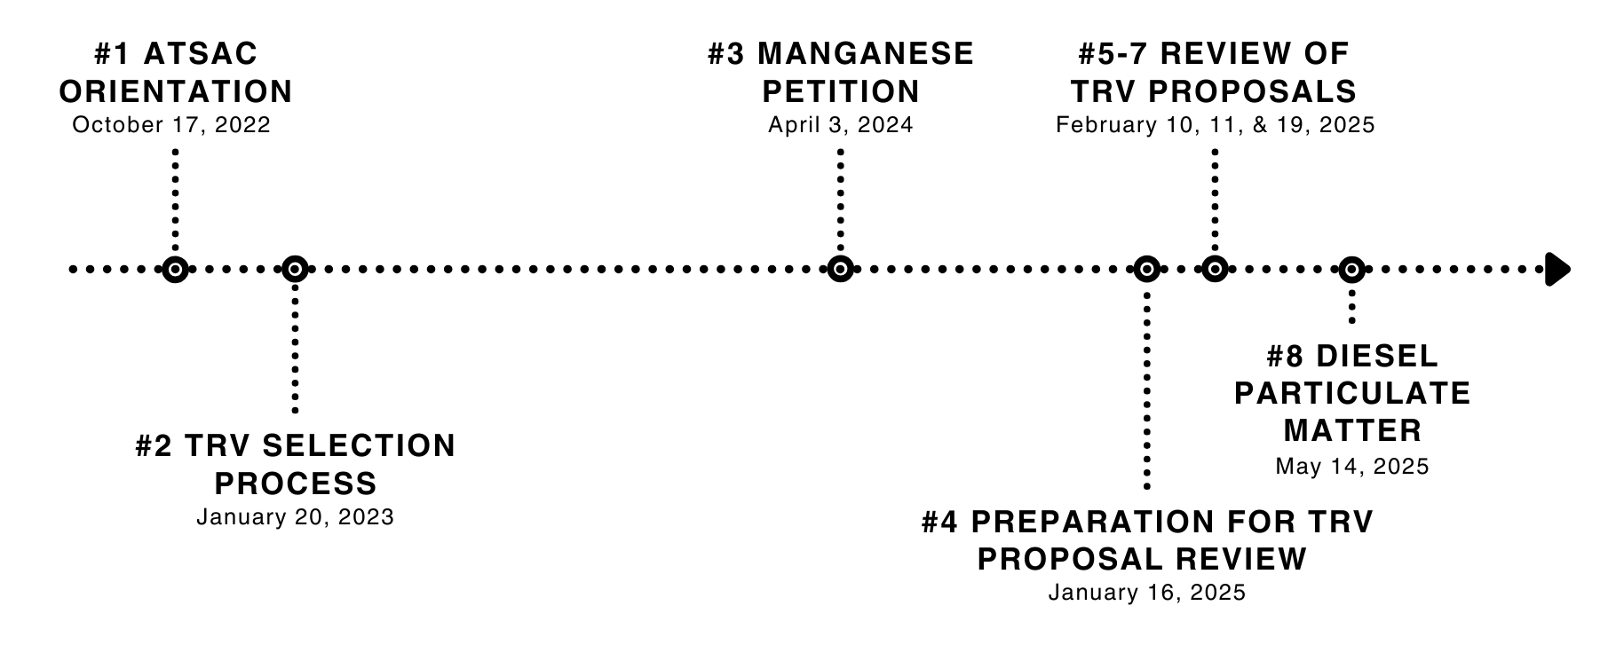
ATSAC Meeting Timeline

Slide 16
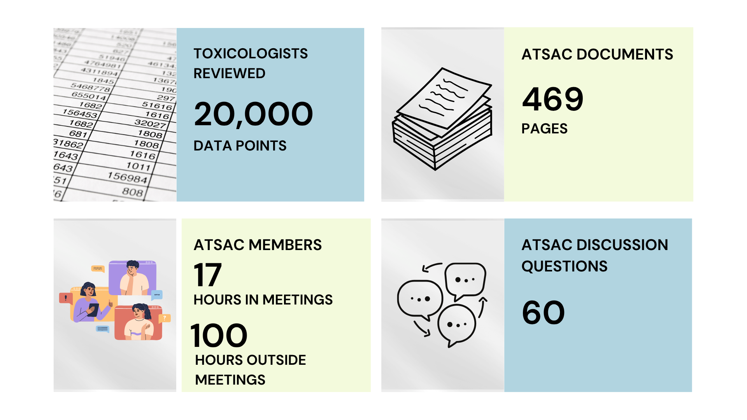
Technical Work Highlights

Slide 17
TRV Proposal Changes from ATSAC
ATSAC feedback resulted in changes to over 100 TRVs
ATSAC feedback also led to many changes to the display and communication of TRV information in OHA’s TRV materials
Reference: Appendix A in OHA’s TRV Support Document

Slide 18
Rulemaking Process

Slide 19
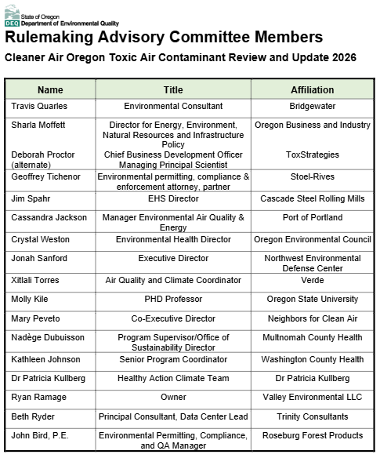
RAC Membership
16 Committee Members:
Permitted Sources
Environmental Advocates
Health Advocates
County Health Representatives
Environmental Consultants
Business Advocates
Academic Representative
*Alternates did serve for some members

Slide 20
RAC Timeline
Meeting 1:
Jan. 12, 2026
Meeting 2 & 3:
May 18 & 21, 2026
Meeting 4:
June 30, 2026
RAC Comments Due:
July 31, 2026
Meeting 5:
*October 2026
1
2
3
4
C
5
Office hours available by DEQ/OHA
Meeting 1:
Scope
Materials to review
Expectations and timeline
Meetings 2 & 3:
Priority List changes
TRV proposals
MPAF updates
RBC proposals
Rule language updates
Meeting 4:
Implementation
Fiscal Impact Statement
Meeting 5:
Implementation
Fiscal Impact Statement

Slide 21
Proposed TRV Changes Presented to RAC
Total of 623 TRV proposals for 377 toxic air contaminants
21% are changes to the 2018 TRV
47% are the same as the 2018 TRV
32% are new TRVs
(no TRV in 2018)

Slide 22
Proposed TRV Changes Presented to RAC
There are 276 proposed TRVs where TRVs are available from more than one authoritative source
There are 237 proposed TRVs where DEQ in consultation with ATSAC is the authoritative source
Reference: Chapter 2 in OHA’s TRV Support Document

Slide 23
Priority List and RBC Updates
TRVs
377 Toxic Air Contaminants
623 proposed TRVs
Adjustment Factors
Priority List
95 contaminants added
93 are new TRVs
RBCs
Majority updates from TRVs
Updates to modifications

Slide 24
Proposed Rule Language Updates
Frequency of TRV rulemaking (Division 247)
  Proposal to increase time between TRV updates to beyond three years
Level 4 Risk Assessment Exemption (Division 245)
  Allow modifications to age-related adjustments to RBCs at specific exposure locations without requiring a L4 assessment

Slide 25
CAO Implementation Proposal
After rule adoption:
DEQ will not require the following to assess risk using new RBCs
Permitting actions required to assess risk using new RBCs
Existing source call-in
Applications received for permit modifications and renewals*
In-progress and completed risk assessments
Applications received for new permits
* For sources that previously completed a risk assessment

Slide 26
Draft Fiscal Impact Statement
No new or revised program fees proposed
Sources may have increased/decreased program fees and cost of compliance based on revised risk
Proposed rule language for not requiring Level 4 assessments in specific cases – potential decrease in cost of compliance
Potential economic benefits from positive impacts to public health

Slide 27
RAC Member Feedback

Slide 28
RAC Feedback: OBI and ToxStrategies
OBI and ToxStrategies requested ATSAC feedback on 10 TRVs
Acute noncancer TRV | Chronic noncancer TRV | Cancer TRV
Arsenic | Silica, respirable | Arsenic*
Lead and compounds | Hydrogen chloride
Naphthalene | PFAS (10 TRVs total)
Nickel and compounds and nickel oxide | Phosgene
Phosgene
*Also requested review of Arsenic residential cancer RBC

Slide 29
RAC Feedback: OBI
For sources with previously approved RAs
  Provide 18 months notice prior to risk reassessment
  Only assess any new activities with new RBCs for modifications
Petition process – use of RBCs
  Sources should be able to use in RA before adoption by EQC
Fiscal Impact Statement underestimated costs of compliance

Slide 30
RAC Feedback: Env Advocacy Groups
Rigorous scientific process
  Review and preparation of TRV information
  ATSAC review process
DEQ must conclude this rulemaking promptly as it is well past the three-year frequency required under rule
Support revised cancer TRV
Current science supports PFAS TRVs – do not withdraw

Slide 31
RAC Feedback: Env Advocacy Groups
Fiscal Impact Statement underestimated costs to the public:
  Did not account for many hidden health care costs to individual Oregonians and the state
  Cumulative risks at single location from being exposed to multiple sources
  No cost benefit analysis of installing controls vs public benefit
Existing source assessments take too long – revise process

Slide 32
Next Steps

Slide 33
Agency Response to Feedback
Engaged ATSAC for requested feedback
  10 TRVs and information provided by ToxStrategies and OBI
Convene additional RAC meeting
  Including implementation language in rule
  Revising deadlines for existing source risk assessment submittals
Revise Fiscal Impact Statement

Slide 34
Next Steps – ATSAC Review and RAC #5
Scientific Review
Rulemaking Process
Rules Committee
Public Comment
ATSAC
DEQ and OHA consider ATSAC’s feedback
Fiscal Committee
Proposed rules presented to EQC for action
2022-2025
2026
2027
ATSAC review of materials
RAC #5 -
October 2026

Slide 35
Title VI and Alternate Formats
DEQ does not discriminate on the basis of race, color, national origin, disability, age, sex, religion, sexual orientation, gender identity, or marital status in the administration of its programs and activities.
Visit DEQ’s Civil Rights and Environmental Justice page.
Español | 한국어 | 繁體中文 | Pусский | Tiếng Việt | العربية
Contact: 800-452-4011 | TTY: 711 | deqinfo@deq.oregon.gov

