Slide 1

Temporary rules: Recycling Modernization Act
Presented to the Oregon Environmental Quality Commission
Sept. 11, 2026

Slide 2
Refresh: Recycling Modernization Act 101
Applies to packaging, printing and writing paper, food serviceware
Statewide access to consistent and high-quality recycling
Responsible end markets
Social equity
Fee incentives for more sustainable products
Waste prevention and reuse fund

Slide 3
Why temporary rules?
Fee-setting timelines versus administrative rulemaking process timelines
  Producer Responsibility Organization Board: September 2026, fees effective Jan. 1, 2027
  DEQ rulemaking: Jan. 14-15, 2027; changes effective no earlier than Feb. 15, 2027
Responsive program actions based on updated data

Slide 4
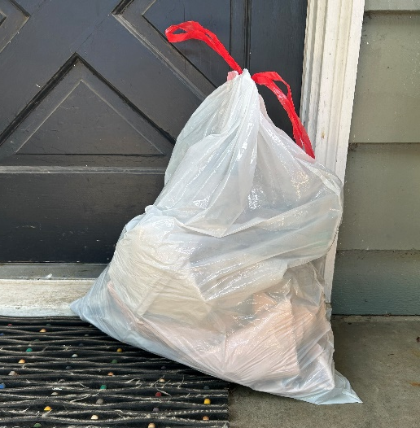
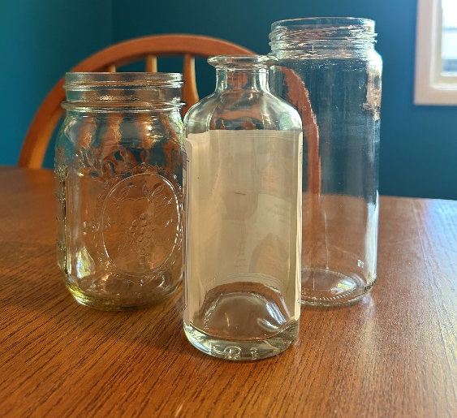
Overview of proposed temporary rules
Exemption from definition of “covered product” for garbage bags, with several qualifications
Changes to the obligations of local governments and the Producer Responsibility Organization for the collection of glass packaging

Slide 5
Exemption for garbage bags
New exemption
Not defined as covered products
  Must not market any garbage bag products as intended for recycling
  Must not allow others to do that kind of marketing for their products
A+ Garbage Bags
Now stronger!
A+ Garbage Bags
Recycling,
too!

Slide 6
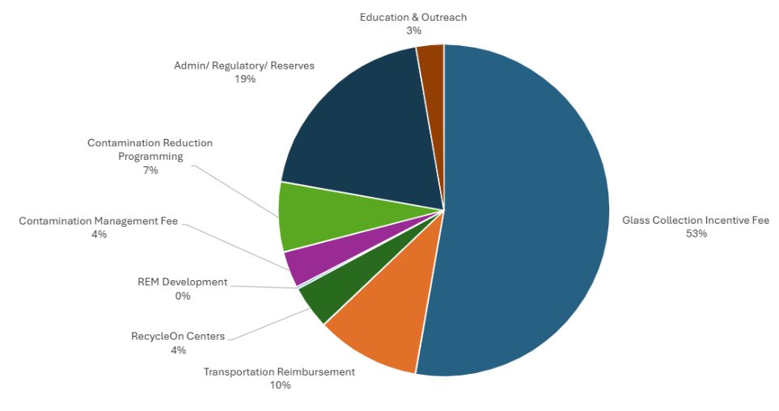
2026 glass packaging fees, by category
Provided by Circular Action Alliance

Slide 7
Glass packaging collection obligations
Adds local government acceptance obligations (except 10 named counties)
  Not on Uniform Statewide Collection List, treated similarly to motor oil
Reduces PRO obligations
  Only PRO-provided collection in 10 named counties
Maintains exemptions for very small transfer stations/depots

Slide 8
What’s next?
Public comment: September and October 2026
Informational item: Nov. 12-13, 2026
Action item, permanent rules: Jan. 14-15, 2027

Slide 9
Proposed motion language
“I move that the Environmental Quality Commission:
Determine that failure to act promptly would result in serious prejudice to the public interest or the interests of the parties concerned as provided under the Justification section of the staff report.
Adopt temporary rules as proposed in Attachment A1 of the staff report for this item as part of chapter 340 of the Oregon Administrative Rules, to be effective on filing with the Oregon Secretary of State.
Adopt temporary rules as proposed in Attachment A2 of the staff report for this item as part of chapter 340 of the Oregon Administrative Rules, to be effective July 1, 2027.”

Slide 10
Thank you!
Project manager: Stephanie Caldera
  Rulemaking email: RMARulemaking3@DEQ.Oregon.gov
Rulemaking website: https://www.oregon.gov/deq/rulemaking/Pages/rma2026.aspx
Title VI and alternate formats
DEQ does not discriminate on the basis of race, color, national origin, disability, age, sex, religion, sexual orientation, gender identity, or marital status in the administration of its programs and activities. Visit DEQ’s Civil Rights and Environmental Justice page.

