Slide 1
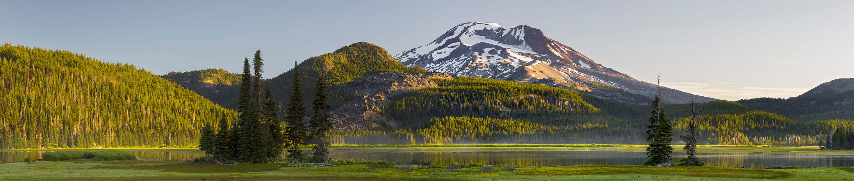
Climate Protection Program Update
Office of Greenhouse Gas Programs
Nicole Singh and Colin McConnaha
July 9, 2026, Environmental Quality Commission Meeting
Astoria, Orgon

Slide 2
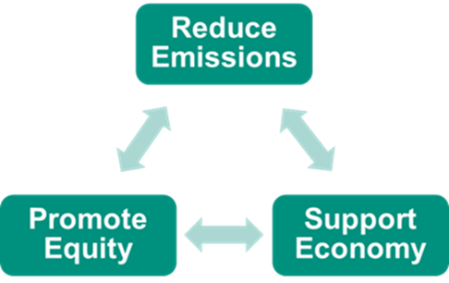
Climate Protection Program
A central policy for decarbonizing Oregon’s economy
Supported by other climate programs
  Vehicle standards
  Fuel standards
  Building codes and efficiency programs
  Heat pumps and other incentive programs

Slide 3
Program implementation update
2025 compliance instrument distribution
November 2024
EQC adopts program
First equity advisory committee meeting
Outreach to EITEs
EITE data collection
October 2025-January 2026
September 2025
March-April 2026
January 2025
July 2025
First compliance period starts (2025-2027)
Placeholder for EITE rulemaking
Fuel supplier outreach
December 2025
Begin requests for CCI entities
Listening sessions in preparation for EITE rulemaking
December 2026
Target for approved CCI entity(ies)
May 2026
EITE rulemaking begins
June 2026
2026 compliance instrument distribution
October 2026
2025 emissions

Slide 4

Program emissions cap

Slide 5
Compliance periods
Compliance period 1
Compliance period 2+
2025
2026
2027
First compliance demonstration fuel suppliers
December 2028
First compliance demonstration EITE
2028
2029
December 2030
Covered fuels suppliers first demonstrate compliance in 2028
Emissions-intensive trade-exposed industries first demonstrate compliance in 2030

Slide 6









Community climate investments (CCI)
CCI entities implement projects in Oregon
Reduce anthropogenic greenhouse gas emissions
Projects in residential, industrial, commercial transportation, sectors
15% of funds benefit Tribes and Tribal communities in Oregon
$
$
$
Covered entities can earn community climate investment credits by contributing funds
Can meet 15% of compliance obligation at program start, rises to 20%
Projects reduce GHGs in communities, prioritizing environmental justice
Equity Advisory Committee works with DEQ to ensure CCI investments benefit Oregon’s environmental justice communities
6

Slide 7
CCI entity oversight and monitoring
Fee on CCI third-parties, as directed by ‘23 Legislature
Ensure agency oversight, administration, implementation
Allow for greater transparency on investments and impacts
Funds internal and external audits

Slide 8
CCI implementation updates
January - March 2026
Request for applications (RFA) opens
April - May 2026
Initial evaluation
June - July 2026
DEQ complete agreement with provisional CCI entity or entities
RFA closes March
August - December 2026
Select provisional CCI entity or entities
DEQ post approved CCI entity or entities
CCI entities able to receive funds from companies
Additional evaluation round
Equity advisory committee provides feedback on applications

Slide 9

First evaluation committee
From DEQ:
Colin McConnaha, Manager, Office of Greenhouse Gas Programs, DEQ
Nicole Singh, Manager, Climate Protection Section, Office of Greenhouse Gas Programs, DEQ
Whitney Dorer, Community Engagement Coordinator, Climate Protection Section, DEQ
Allan Rempel, Accountant, DEQ

Slide 10
First evaluation committee
From Environmental Quality Commission, Equity Advisory Committee, Governor Tina Kotek’s Office:
Matt Donegan, Chair, Environmental Quality Commission
Mark Healy, Coquille Indian Tribe Climate Resilience Task Force member, Equity Advisory Committee
Jamie Pang, Deputy Director of Policy and Programs, Oregon Just Transition Alliance, Equity Advisory Committee
Amy Schlusser, Climate and Energy Policy Advisory to Governor Tina Kotek

Slide 11
Application evaluation areas
Evaluation Areas
Financial Experience | 35
Project Experience | 25
Comprehensive Management Plan and Proposed Projects | 20
Key Person and Subcontractors | 15
References | 5

Slide 12
Second evaluation round
Opportunity to interview
Questions developed with feedback from first evaluation committee and Equity Advisory Committee
Second evaluation committee
  Amy Schlusser, Climate and Energy Policy Advisory to Governor Tina Kotek
  Colin McConnaha, Manager, Office of GHG Programs, DEQ
  Nicole Singh, Manager, Climate Protection Section, DEQ
  Leah Feldon, Director, DEQ
  Mark Webb, Commissioner, Environmental Quality Commission

Slide 13
Next steps
Complete agreement with provisional CCI entity or entities by end of 2026
CCI entity or entities able to receive contributions from regulated entities in early 2027
CCI entity or entities develop work plan for DEQ approval after receiving $5 million in community climate investments

Slide 14

Break for questions

Slide 15
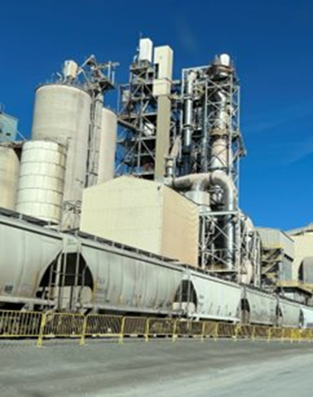
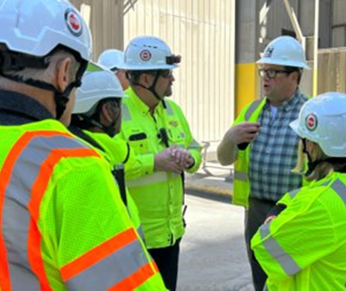
Key takeaway from program development
As directed by EQC better protect emissions-intensive-trade exposed (EITE) industrial sectors
  Central to Oregon’s economy
  Play an important role in local communities
  Diverse range of industries
Better measures to address potential leakage of emissions and manufacturing production

Slide 16
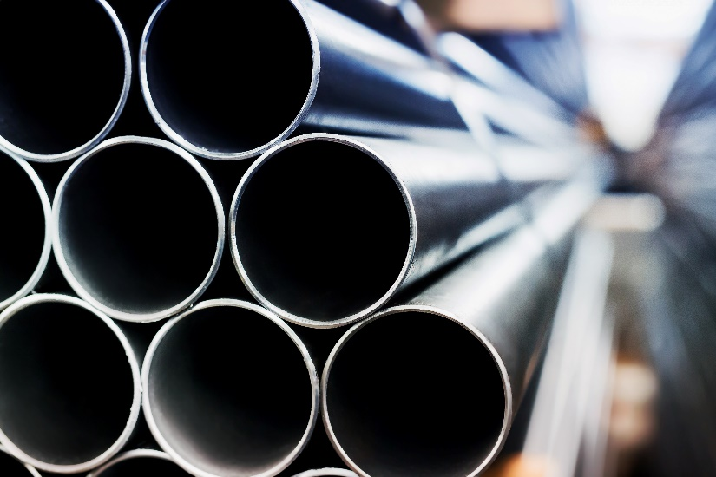
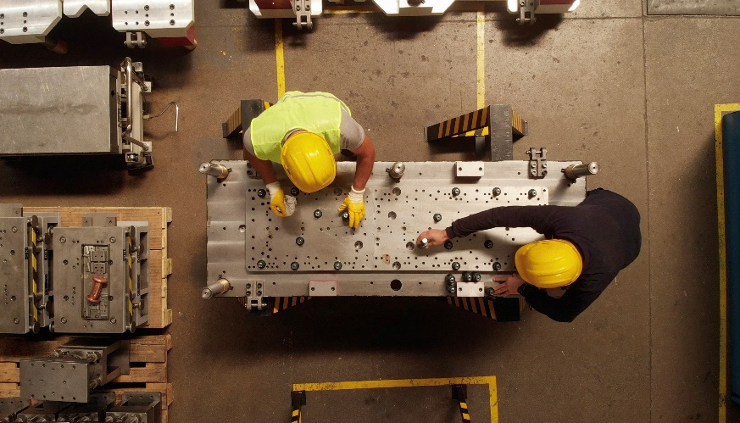
Emissions-intensive trade exposed (EITE) sources
Approximately 37 EITE facilities
  No compliance obligations for first three years
  Slower pace of emission reductions compared to other regulated entities
  Lower threshold than other state programs to include more facilities
  CPP EITE rulemaking

Slide 17
CPP EITE rulemaking objectives
Emission intensity benchmarks
Reduction schedules
Benchmarks for new EITE sources
Regulate facilities with emissions and production data

Slide 18
Emissions intensity benchmarks
Intensity benchmark
x reduction schedule
x number of units
= compliance instrument distributed
Emissions per unit produced
Rate of decrease in compliance instrument distribution per unit of production
Illustrative Example
2.041 tons emissions/unit of product x 98% x 200 units
=
400 compliance instruments distributed

Slide 19
Establishing benchmarks discussions
Principles DEQ should use in setting benchmarks
Benchmark types
  Industry specific benchmarks (same for all facilities in a sector)
  Source-specific benchmarks for all emissions at a facility
  Multiple product benchmarks at a single facility
  Same product benchmarks at multiple facilities
  Combinations and others

Slide 20

Establishing benchmarks discussions
3) Approach for selecting data years for setting benchmark
  Multiple years or single year
  Average across years
  Highest or lowest intensity year
  Same data years for all sources or different years for different sources
  Allow source to petition for a different data year
  Incorporate more recent but not yet reported data

Slide 21

Reduction schedule discussions
Schedule could be annual or every compliance period
Start in 2029 or the next compliance period (2030-31)
Non-uniform rates of reduction (more reductions earlier or more later)
Same reduction schedule for all facilities or industry, source, or product specific

Slide 22
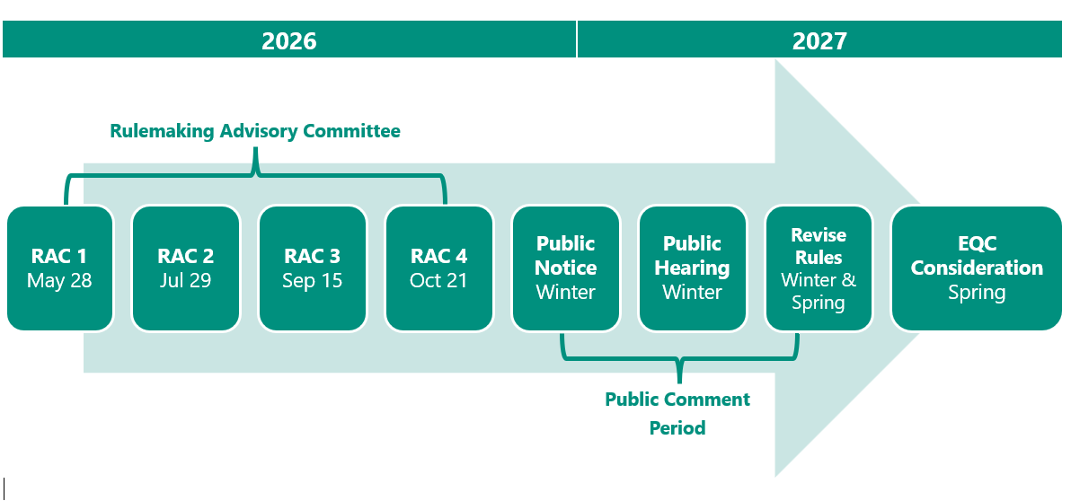
CPP EITE rulemaking timeline
22

Slide 23

Program updates to EQC
DEQ will:
  Update the EQC on ongoing program implementation
  Provide updates annually at a minimum
  Provide additional report on community climate investments
    Request input on implementation and potential program improvements
    Submit first report by August 30, 2027, then every two years
  Provide program report five years after program adoption

Slide 24
Questions?
Climate Protection Program
https://www.oregon.gov/deq/ghgp/cpp/Pages/default.aspx

Slide 25
Title VI and alternate formats
DEQ does not discriminate on the basis of race, color, national origin, disability, age, sex, religion, sexual orientation, gender identity, or marital status in the administration of its programs and activities.
Visit DEQ’s Civil Rights and Environmental Justice page.
Español | 한국어 | 繁體中文 | Pусский | Tiếng Việt | العربية
Contact: 800-452-4011 | TTY: 711 | deqinfo@deq.oregon.gov
25

