Slide 1

Informational item: Recycling Modernization Act updates
Presented to the Oregon Environmental Quality Commission
July 9, 2026

Slide 2
Presentation overview
What is the Recycling Modernization Act?
How does RMA function, and who’s involved?
Why is Oregon modernizing its recycling system?
How does RMA relate to the agency’s Strategic Plan?
What is the commission’s role related to RMA?
What’s next?

Slide 3
A glossary of helpful terms
RMA: Plastic Pollution and Recycling Modernization Act
Covered products: Packaging, printing and writing paper, food serviceware
  Food serviceware: Paper or plastic plates, wraps, cups, bowls, pizza boxes, cutlery, straws, lids, bags, aluminum foil or clamshells or similar containers that are generally intended for single use
PRO: Producer Responsibility Organization, a nonprofit entity that operates key aspects of the system using funds from producers
CAA: Circular Action Alliance, the one PRO for Oregon’s modernized recycling system

Slide 4
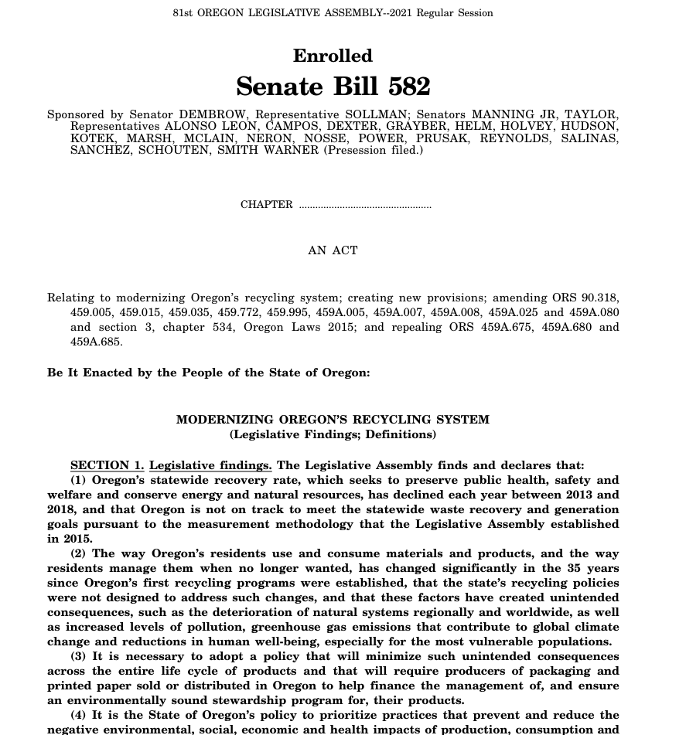
What is the Recycling Modernization Act?
“It is the State of Oregon’s policy to prioritize practices that prevent and reduce the negative environmental, social, economic and health impacts of production, consumption and end-of-use management of products and packaging across their life cycle, and that it is the obligation of producers to share in the responsibility to reduce those impacts.”

Slide 5









Extended producer responsibility
production
extraction
extracting - processing
manufacturing
transportation
disposal
use
distribution
end-of-life management
consumption

Slide 6








How does RMA function, and who’s involved?
Recycling facilities
Responsible end markets
Oversight and integration
Oregon Recycling System Advisory Council

Slide 7
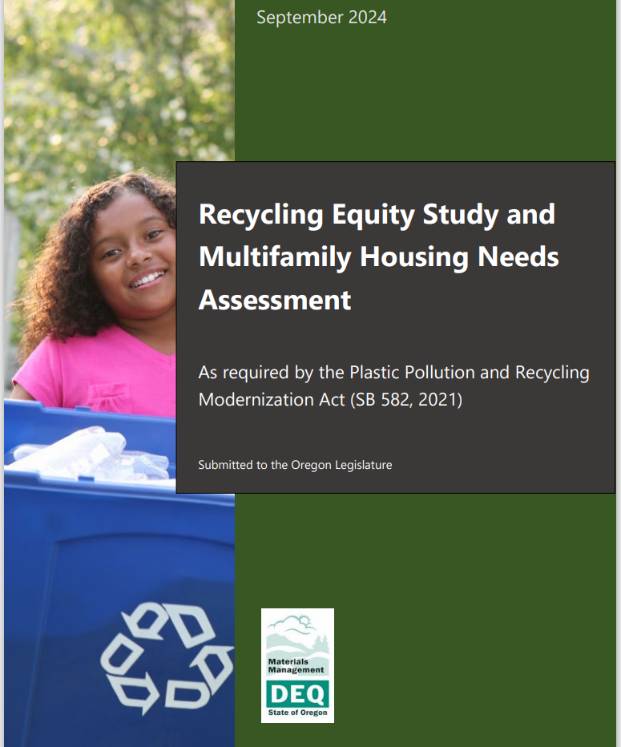
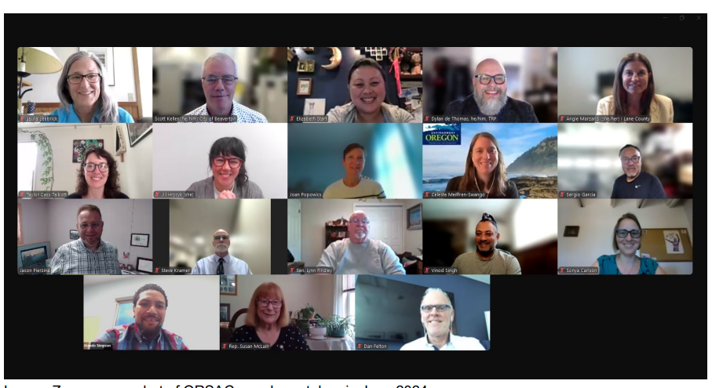
Accountability and reporting
ORSAC members meeting via Zoom, June 2024

Slide 8
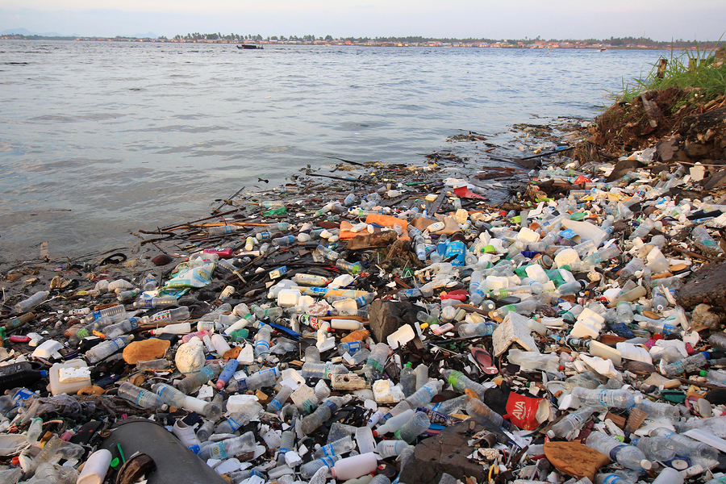
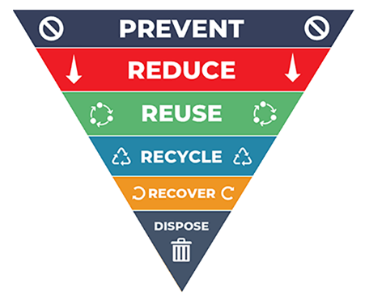
Why is Oregon modernizing its recycling system?

Slide 9
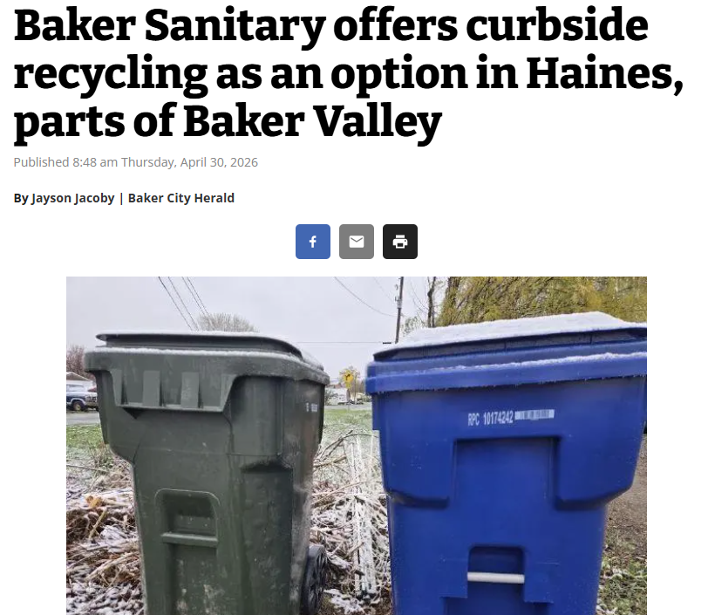

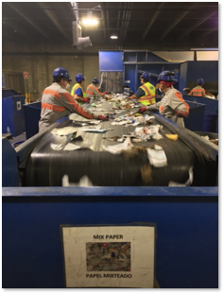
RMA’s “Big 5”
Statewide access to consistent and high-quality recycling
Responsible end markets
Social equity
Fee incentives for more sustainable products
Waste prevention and reuse fund

Slide 10
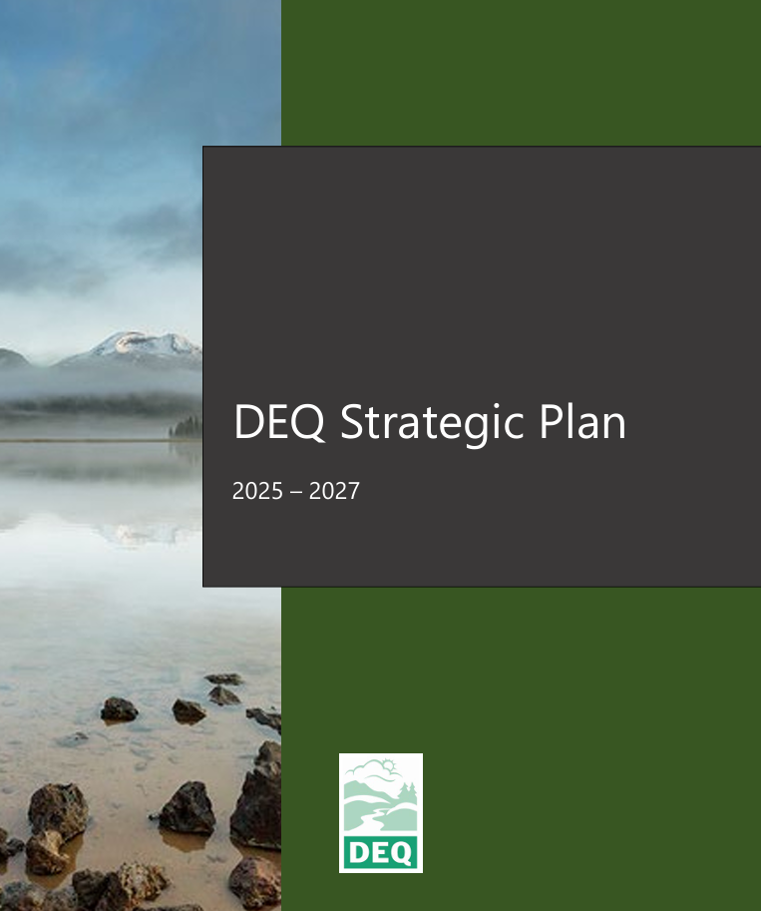
How does RMA connect to the agency Strategic Plan?
Goal 3: Ground DEQ work in environmental justice to address disproportionate environmental and health impacts.
Goal 4: Proactively address complex environmental challenges today and in the future through technology, modernization and innovation within and across programs.

Slide 11
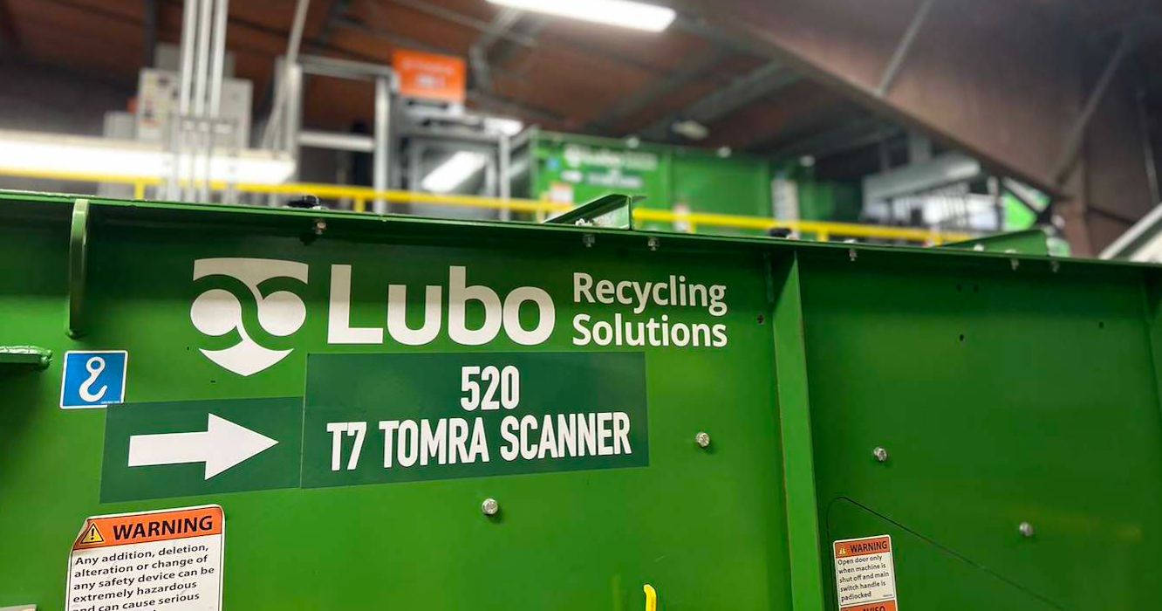
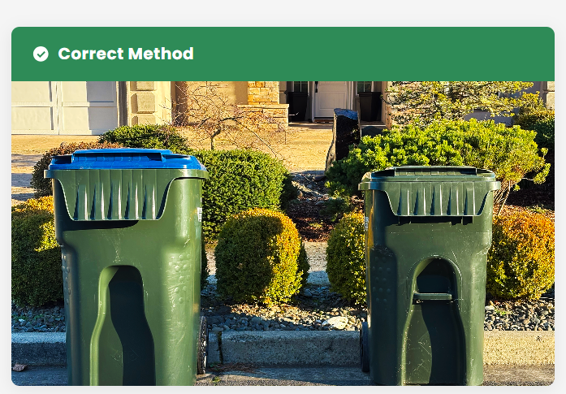
Implementation updates
Image from Roseburg Disposal, placement for improved on-route pickup. Recycling cart on left (blue lid).
Example of an optical scanner used at a recycling processing facility.

Slide 12


What is the commission’s role in RMA?
Rulemaking 1: Adopted November 2023
Rulemaking 2: Adopted November 2024
Rulemaking 3: In-progress, proposed action in January 2027
  Temporary rulemaking in September 2026

Slide 13
What’s next?
September 2026
November 2026
January 2027
Ongoing program implementation

Slide 14
Contact information
Project manager: Stephanie Caldera
  Rulemaking email: RMARulemaking3@DEQ.Oregon.gov
Rulemaking website: https://www.oregon.gov/deq/rulemaking/Pages/rma2026.aspx

Slide 15

Thank you!
Title VI and alternate formats
DEQ does not discriminate on the basis of race, color, national origin, disability, age, sex, religion, sexual orientation, gender identity, or marital status in the administration of its programs and activities. Visit DEQ’s Civil Rights and Environmental Justice page.

