Slide 1

2027-2029 Agency Request Budget Certification
Environmental Quality Commission
July 9-10, 2026

Slide 2
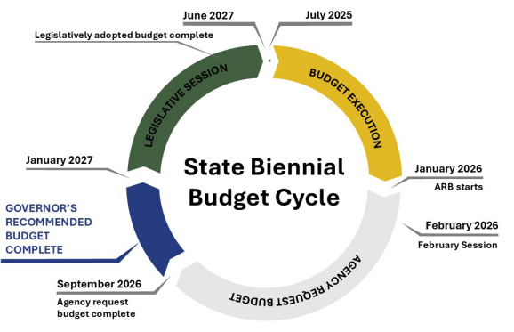
State Budgeting Process

Slide 3
2027-29 Agency Request Budget
ARB
Base Budget
POPs/LC’s
Reduction Options
Revenue Shortfalls

Slide 4
Quality Control Continuum
Base Budget
Continuing Service Level Budget
Agency Request Budget
Modified Continuing Service Level Budget
Iterative Audit Process

Slide 5
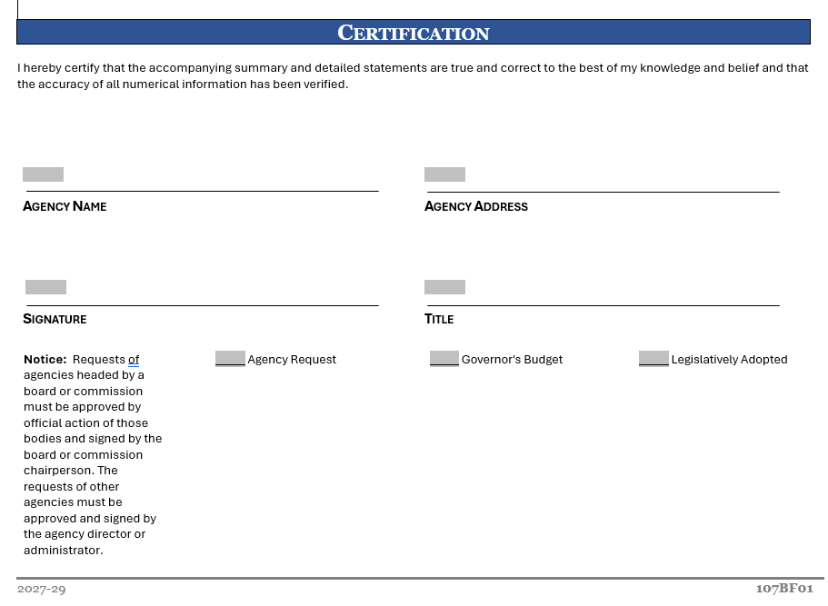
Certification Form

Slide 6
Proposed Motion Language
“I move that the Oregon Environmental Quality Commission authorize Chair Donegan to sign the DEQ 2027-29 Agency Request Budget certification form on behalf of the commission as part of the agency’s budget submittal to the Governor.”

Slide 7
Title VI and Alternate Formats
DEQ does not discriminate on the basis of race, color, national origin, disability, age, sex, religion, sexual orientation, gender identity, or marital status in the administration of its programs and activities.
Visit DEQ’s Civil Rights and Environmental Justice page.
Español | 한국어 | 繁體中文 | Pусский | Tiếng Việt | العربية
Contact: 800-452-4011 | TTY: 711 | deqinfo@deq.oregon.gov

