Slide 1
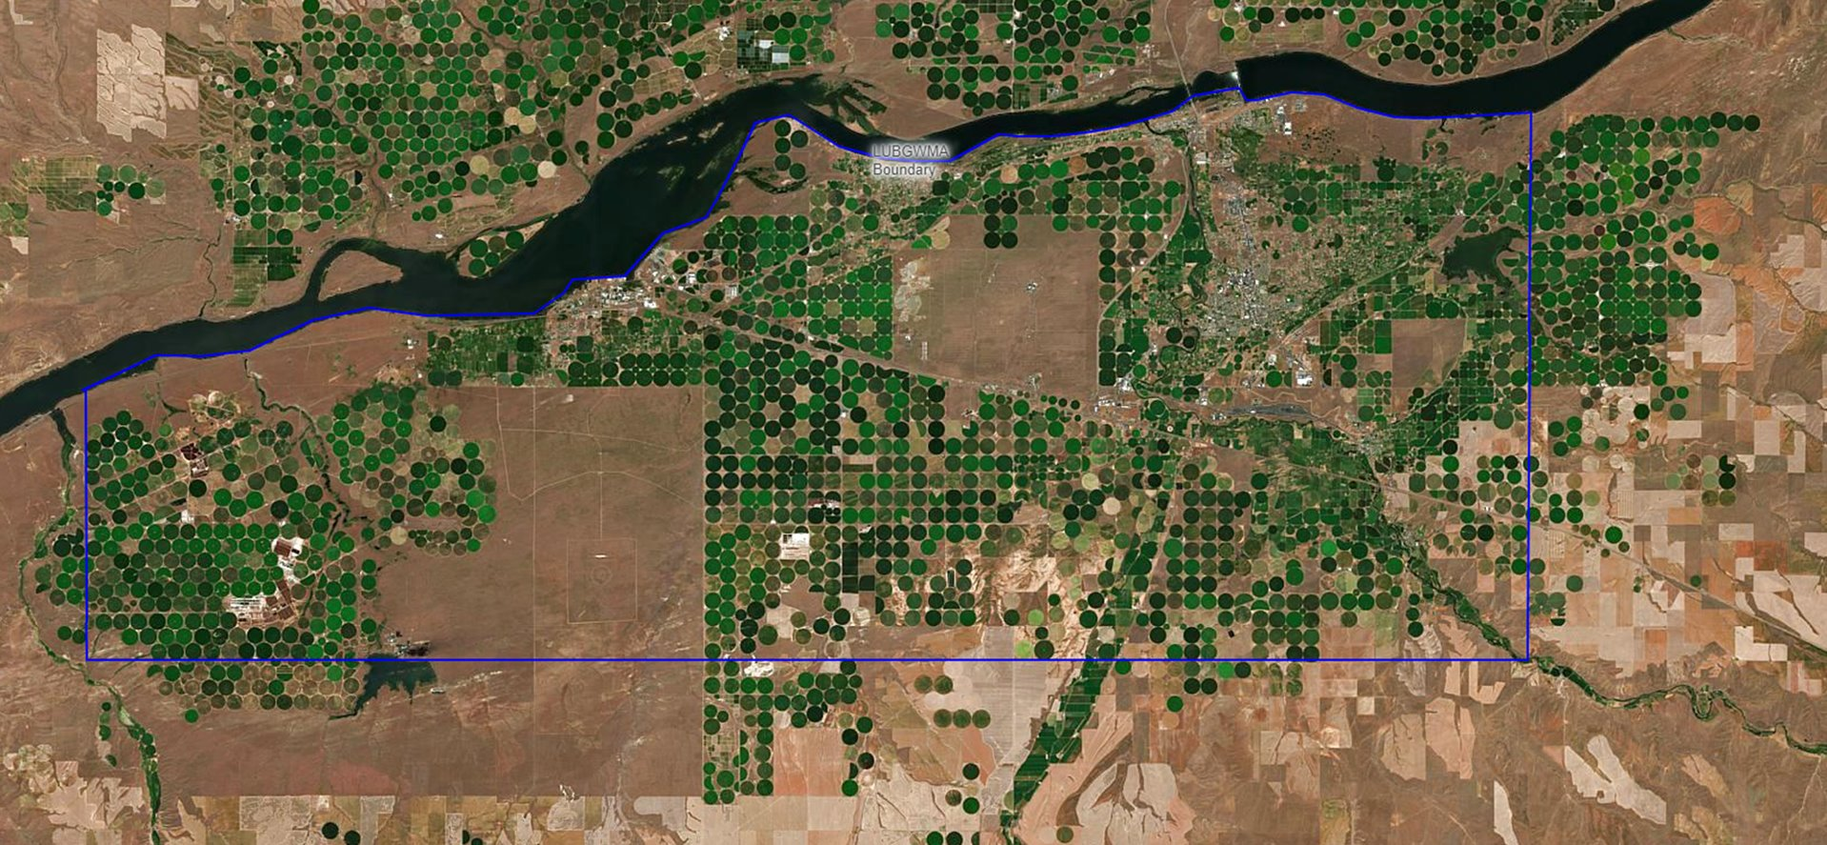

Lower Umatilla Basin Groundwater Management Area (LUBGWMA) Update
Oregon Environmental Quality Commission Meeting
Laura Gleim, DEQ
Isaak Stapleton, ODA
Chris Kowitz, OWRD
Gabriela Goldfarb, OHA
May 14, 2026

Slide 2
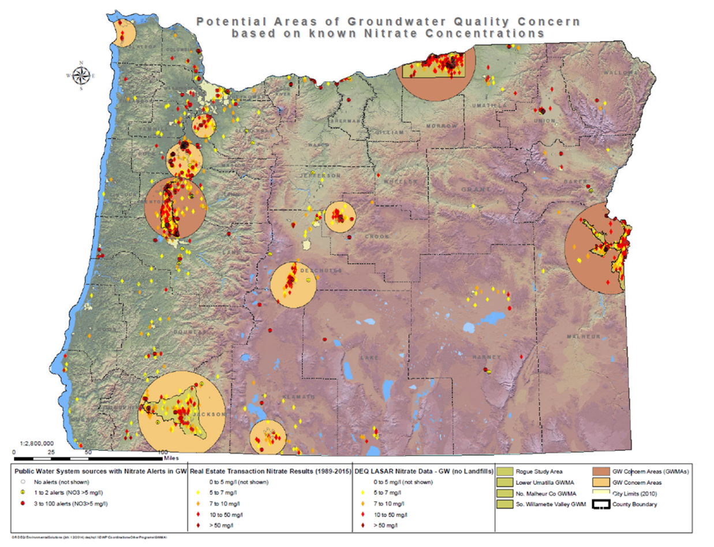
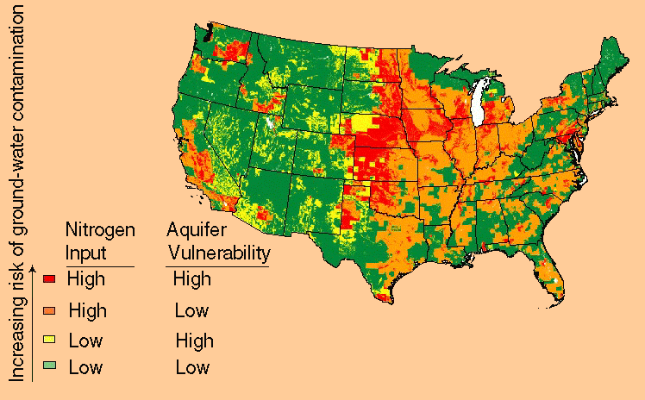
Nitrate in Groundwater, Oregon and Nationally
Image From: National look at nitrate contamination of Ground Water (usgs.gov)

Slide 3
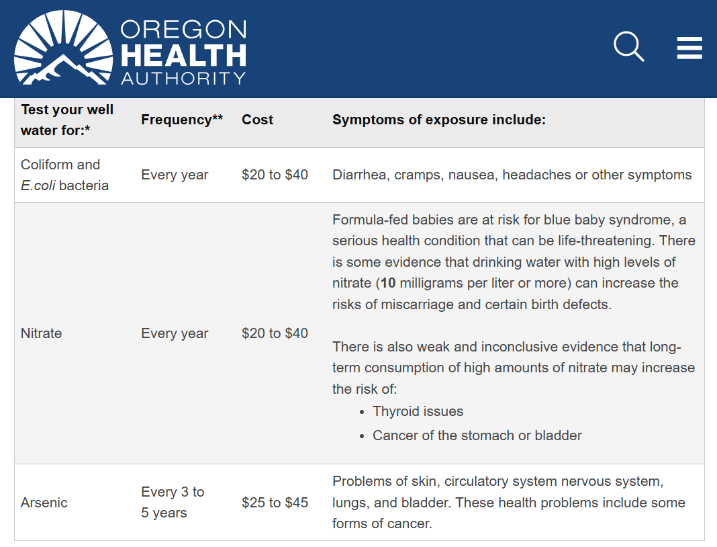

Well Water and Health

Slide 4
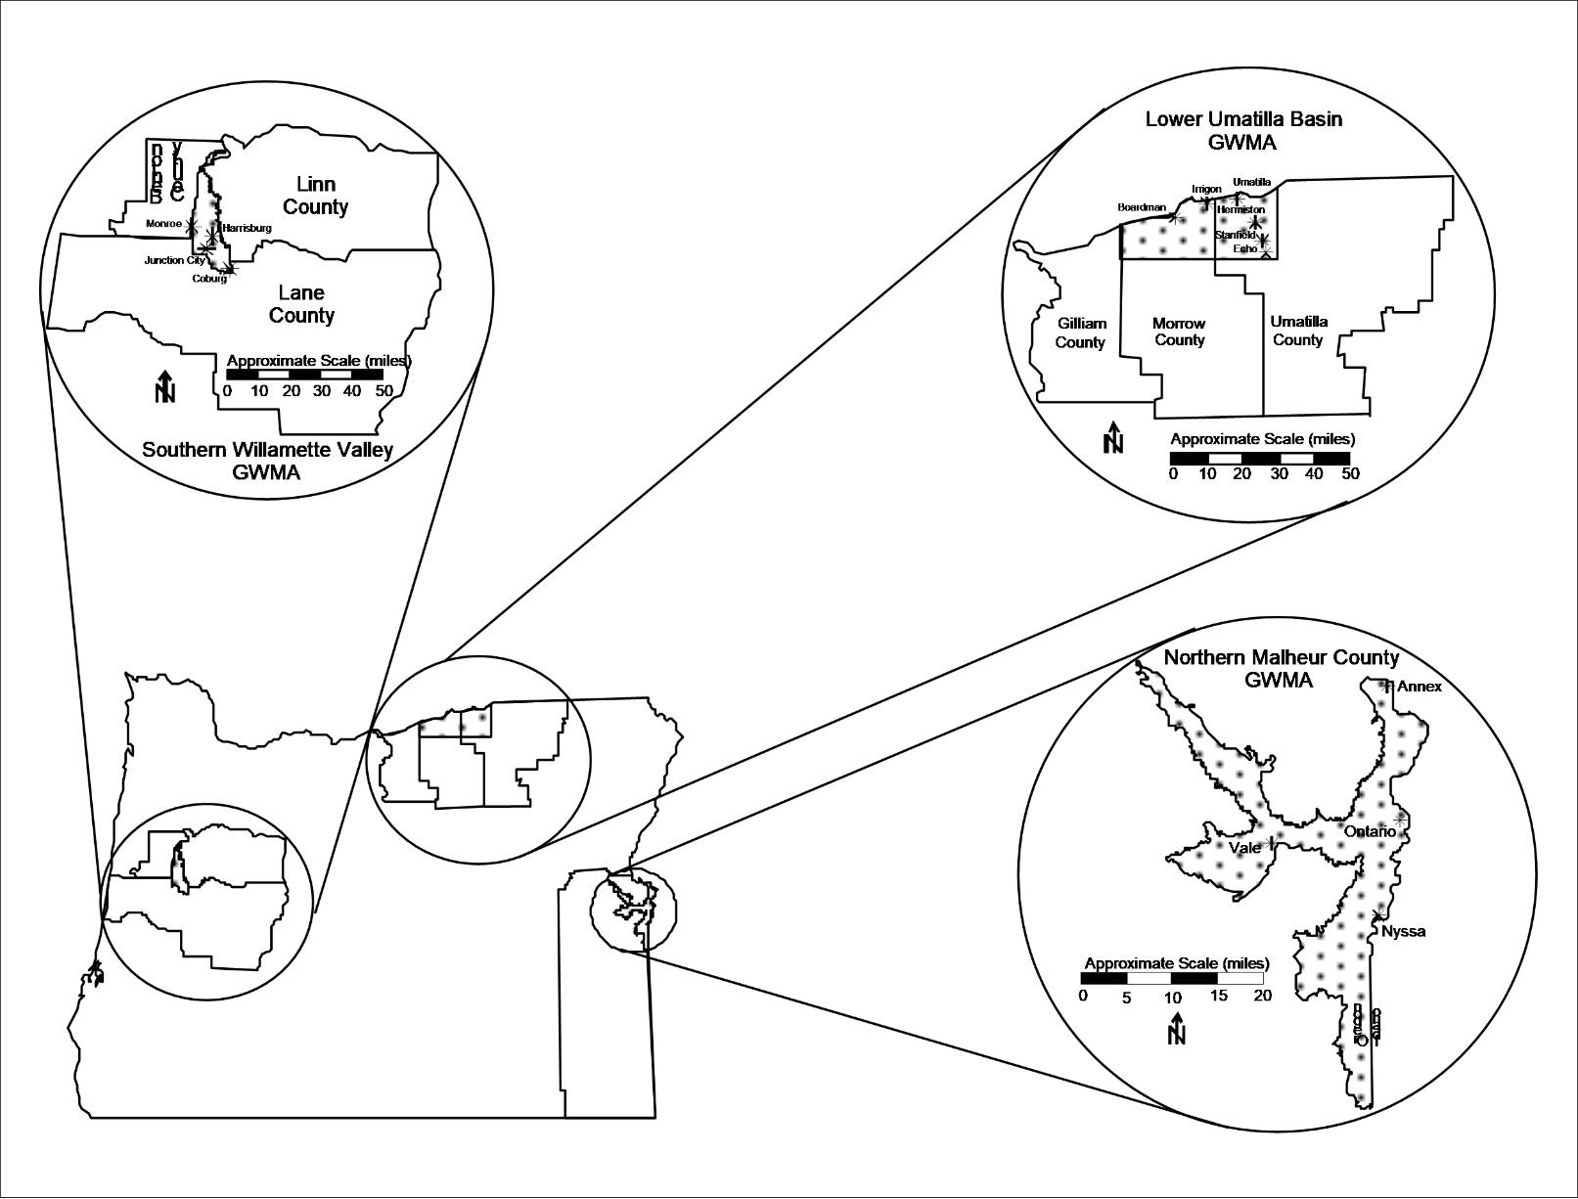
Oregon’s Groundwater Management Areas
Northern Malheur County (1989)
Lower Umatilla Basin (1990)
Southern Willamette Valley (2004)

Slide 5
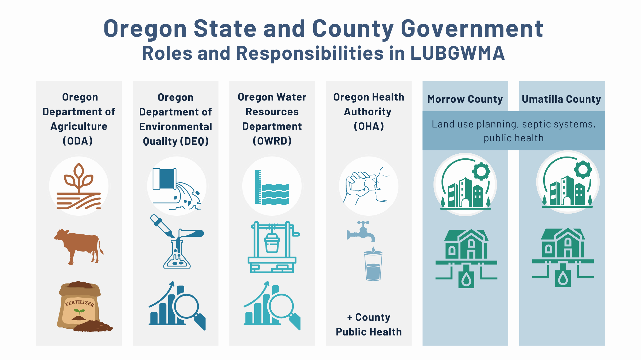
5

Slide 6
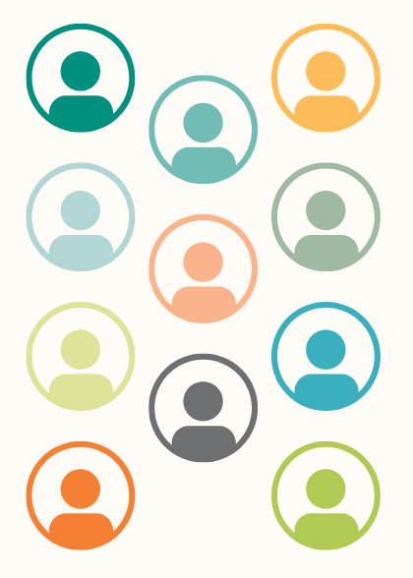
Nitrate Reduction Plan for LUBGWMA
DEQ, ODA, OWRD, OHA in collaboration with:
  U.S. Environmental Protection Agency (EPA)
  Confederated Tribes of the Umatilla Indian Reservation (CTUIR)
  Morrow and Umatilla counties
  City governments
  Businesses
  Residents
  Community groups
https://ordeq.org/NitratePlan

Slide 7
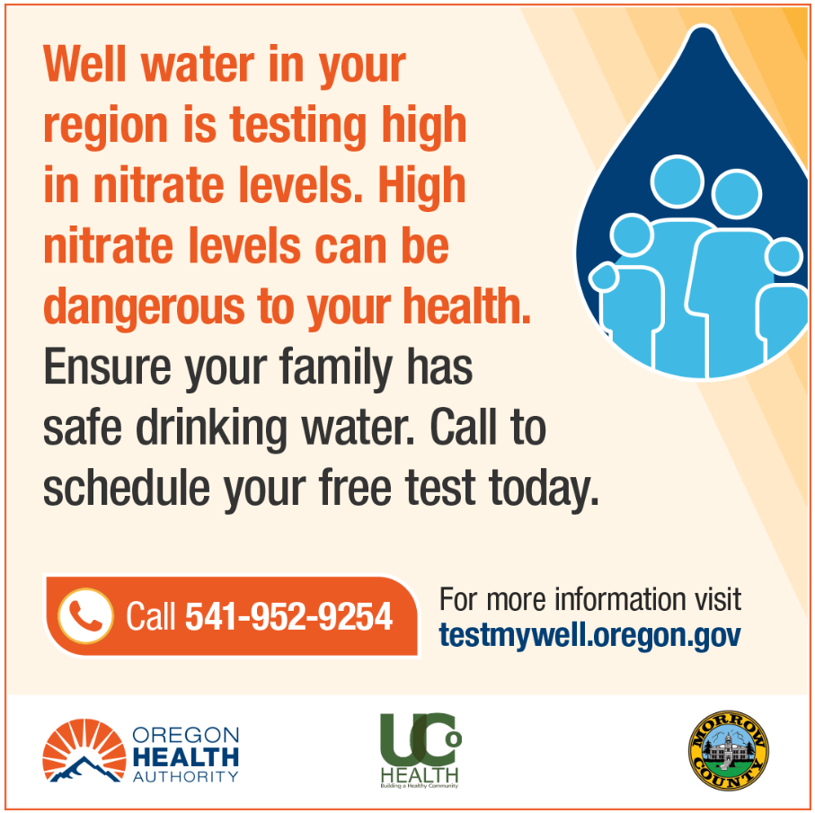
OHA Safe Water Services
Immediate Services
Identified 3,300 well-dependent households
Health risk education and outreach
Free well water testing
Free water delivery
Kitchen-tap treatment system installation/maintenance
Retesting
Funding partners
Robust data system
Intermediate Solutions
Technical/funding assistance for public water system extension and creation
Oversight for all public water systems (four or more connections)

Slide 8
OHA: Annual Progress Highlights
Enhanced community partnerships: Outreach and engagement grant awards/client service contracts (four CBOs) – funding contracts with Morrow and Umatilla Co. Public Health
Quarterly newsletter to LUB residents – 395 subscribers as of December 2025
Well tests: 38% of untested households with initial test by Dec. 31, 2025 (Goal: 30.3%)
Re-tests: 84% of identified at-risk households retested (Goal: 75% or greater)
Treatment systems: 289 treatment systems installed as of December 2025 – currently 298 installed and 136 additional eligible households (all have been contacted to schedule) – roughly 8% decline rate on offer
Water delivery: 615 households receiving water delivery services
Public water systems: Technical assistance to Morrow/Umatilla Counties Drinking Water Road Map – $581,640 to Morrow Clean Water Consortium

Slide 9
Nitrate Reduction Strategies by Source
  Irrigated Agriculture
  Confined Animal Feeding Operations (CAFOs)
  Livestock Grazing
  Land Application of Industrial and Domestic Wastewater
  Rural Residential

Slide 10
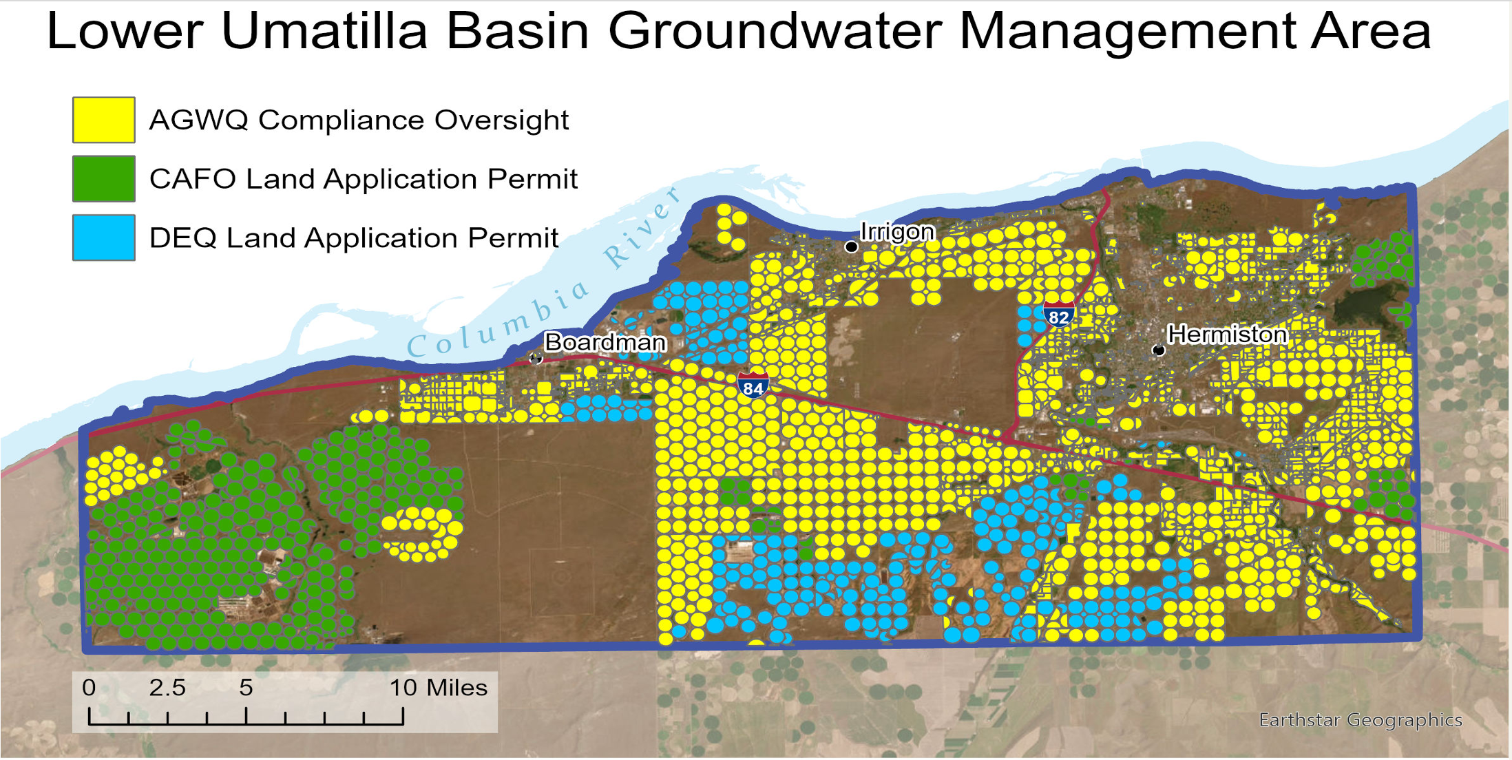
ODA: Annual Progress Highlights

Slide 11
ODA: Annual Progress Highlights
Water Quality Groundwater Rules: Permanent Rules filed March 13, 2026
Water Quality Compliance: Investigation updates
BMPs/Livestock Inventory: Future development of resource hub for growers
CAFOs: General NPDES permit renewal
Strategic Implementation Area (SIA): On track with second SIA in planning

Slide 12
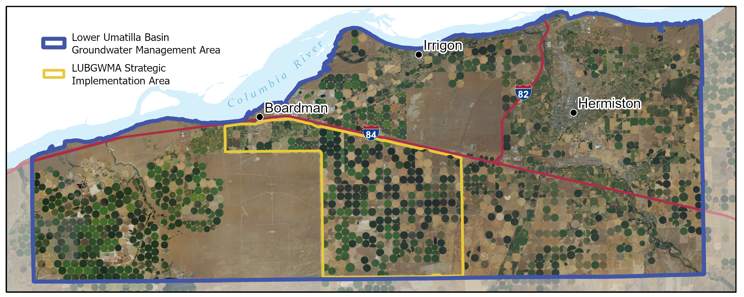
ODA: Annual Progress Highlights

Slide 13
OWRD: Annual Progress Highlights
Well inspections: Inspected 96% of all new, altered, or abandoned wells
Update to 1995 Hydrogeologic Conceptual Model: Drafted and sent out for peer review
Quarterly sampling: Continued collecting quarterly groundwater level data
Backflow prevention: Developed and launched comprehensive backflow prevention device program
Awarded congressional funds to install new monitoring wells, well assessments, and quantify consumptive use trends

Slide 14
DEQ: Annual Progress Highlights
Wastewater permits: All facilities on track to meet compliance schedules
Wastewater infrastructure funding: 10 active, completed, or pending public projects through CWSRF
Septic funding: Three septic loans through nonprofit lender – program didn't receive additional legislative allocations
Quarterly sampling and larger-scale synoptic completed
Trends analysis report published January 2025

Slide 15
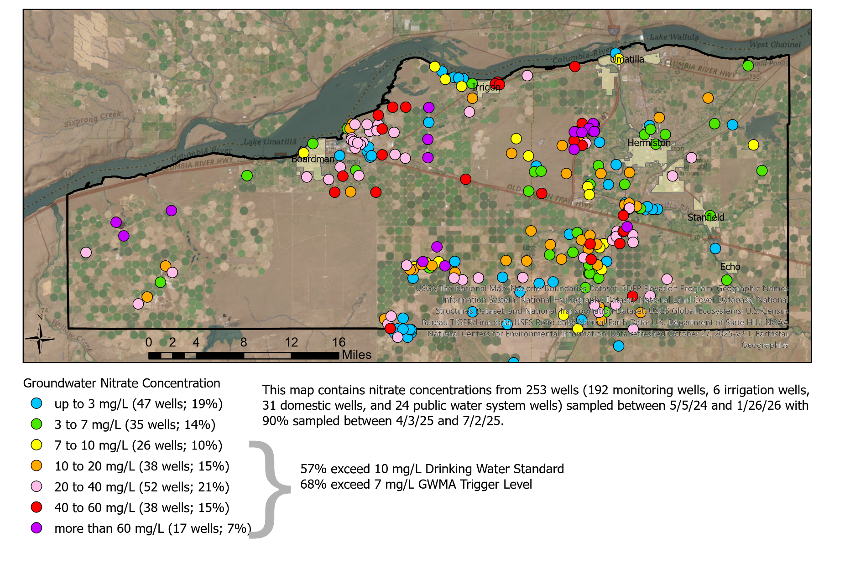
Groundwater Nitrate Concentrations

Slide 16
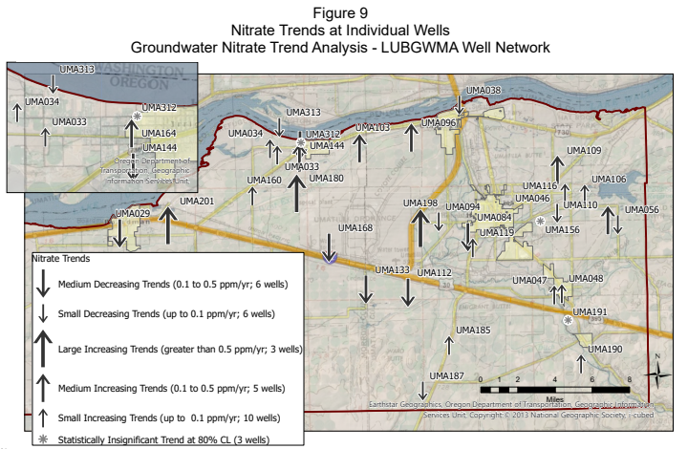
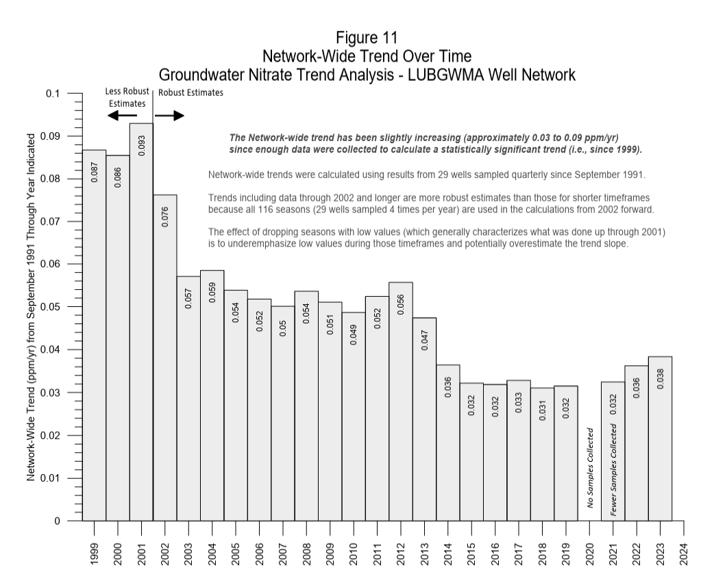
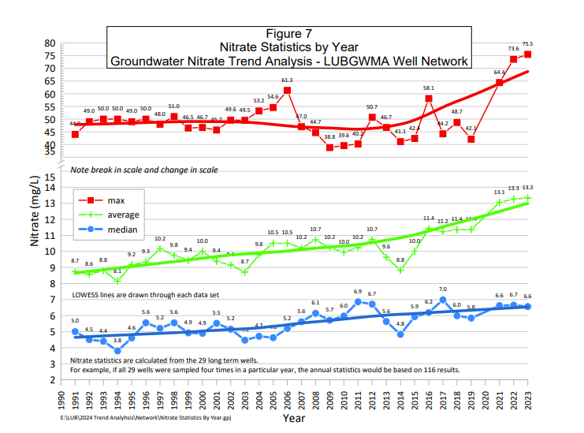
Updated Nitrate Trend Analysis
https://ordeq.org/NitrateTrend

Slide 17
Thank you!
Laura Gleim, DEQ, laura.gleim@deq.oregon.gov, 503-577-3697
Gabriela Goldfarb, OHA, gabriela.goldfarb@oha.oregon.gov, 971-673-3284
Isaak Stapleton, ODA, isaak.stapleton@oda.oregon.gov, 503.931.5608
Chris Kowitz, ORWD chris.c.kowitz@water.oregon.gov , 541-278-5456

Slide 18
Title VI and Alternate Formats
DEQ does not discriminate on the basis of race, color, national origin, disability, age, sex, religion, sexual orientation, gender identity, or marital status in the administration of its programs and activities.
Visit DEQ’s Civil Rights and Environmental Justice page.
Español | 한국어 | 繁體中文 | Pусский | Tiếng Việt | العربية
Contact: 800-452-4011 | TTY: 711 | deqinfo@deq.oregon.gov

