Slide 1

Item H: 2027-2029 Agency Request Budget Development
Environmental Quality Commission
May 14, 2026

Slide 2
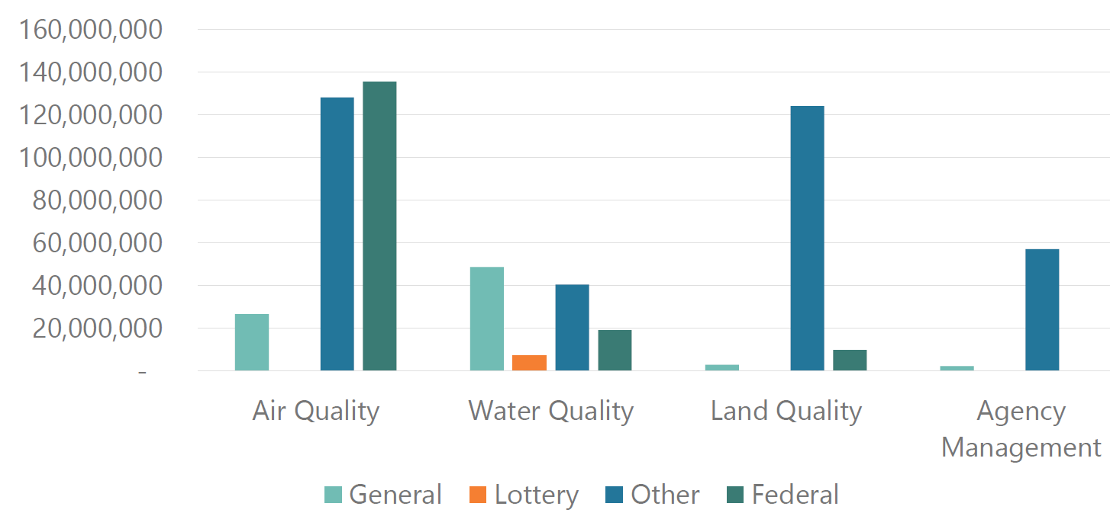
DEQ Budget by Fund Type

Slide 3
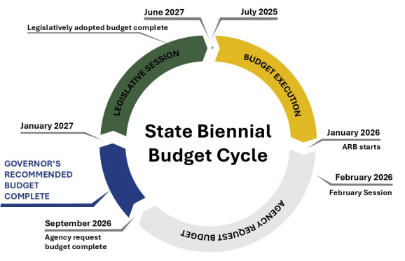
Budget Development and Legislative Cycle

Slide 4
Agency Request Budget – Timeline
Identify Needs
Internal Review
Update EQC
Prioritize and Finalize
EQC Certification
Submit to the Governor
(Aug. 31)
Engage Communities and Interested Parties

Slide 5
2027-29 Agency Request Budget
ARB
Base Budget
POPs/LC’s
Reduction Options
Revenue Shortfalls

Slide 6
Agency-Wide Priorities and Considerations
Assure financial stability in fee-funded programs
Deliver on existing work and mandates
Support Governor Kotek’s priorities and initiatives
Alignment with DEQ Strategic Plan

Slide 7
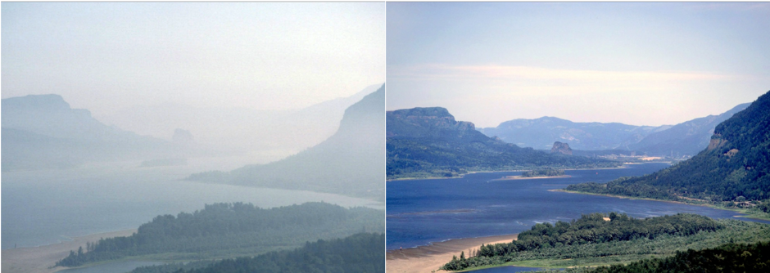
Air Quality Division
Legislative Concept(s):
Oregon Clean Vehicle Rebate Program
Policy Option Package(s):
Supporting Cleaner Air Oregon

Slide 8

Land Quality Division
Legislative Concept(s):
Stabilizing Hazardous Waste Program
(placeholder)
Stabilizing Underground Storage Tank Program (placeholder)
Policy Option Package(s):
Hazardous Waste Fees Increase
Underground Storage Tank Fees Increase
Industrial Orphan Bond Authority Request
Position Authority Package

Slide 9
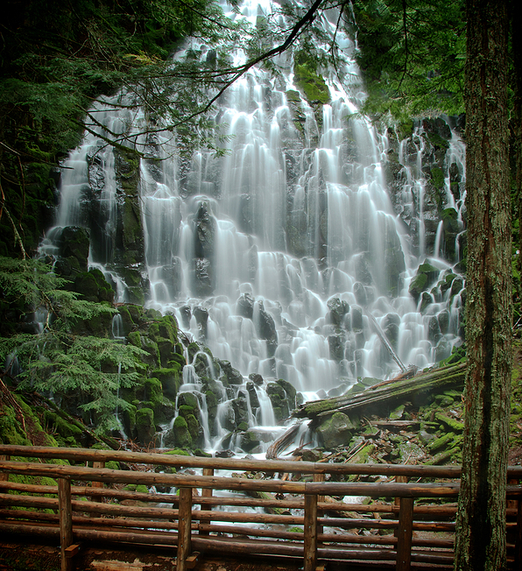
Water Quality Division
Legislative Concept(s):
Wastewater Operator Certification Reciprocity
Applicability of permits under appeal (placeholder)
Policy Option Package(s):
Fee increases to maintain current service level (NPDES/WPCF)
Clean Water State Revolving Fund (Debt Service)
Interagency adjustment of Pesticide Stewardship Partnership funding

Slide 10

Agency Management
Legislative Concept(s):
Cost Recovery
Policy Option Package(s):
Laboratory LIMS System (Bond)
Transitioning Payroll Functions to DAS
Position Reclassifications

Slide 11

Investment Concepts (under consideration)
Restore Federal Fund Shortfall Staffing Reductions (WQ/AQ)
Smoke Resilient Communities
Emergency Response
Cleanup 2050 Vision
Groundwater Quality Protection
WQ Permitting Program Improvements
Clean Watershed Restoration (TMDL) Planning and Implementation

Slide 12
Title VI and Alternate Formats
DEQ does not discriminate on the basis of race, color, national origin, disability, age, sex, religion, sexual orientation, gender identity, or marital status in the administration of its programs and activities.
Visit DEQ’s Civil Rights and Environmental Justice page.
Español | 한국어 | 繁體中文 | Pусский | Tiếng Việt | العربية
Contact: 800-452-4011 | TTY: 711 | deqinfo@deq.oregon.gov

