Slide 1

Agenda item G: EV Rebates 2026 Rulemaking (Action)
Oregon Clean Vehicle and ZERO Fleet Rebate Programs
Rachel Sakata, Dalton Sheppard and Erica Timm
May 14, 2026
EQC Meeting, SAGE Center, Boardman, OR

Slide 2
2026 rulemaking timeline
November 2025
RAC Meeting #1
Jan. 20 – Feb. 25, 2026
Notice of Proposed Rulemaking and Public Comment Period
March 12, 2026
EQC Info Item
December 2025
RAC Meeting #2
May 14, 2026
EQC Action Item
= EQC Engagement

Slide 3
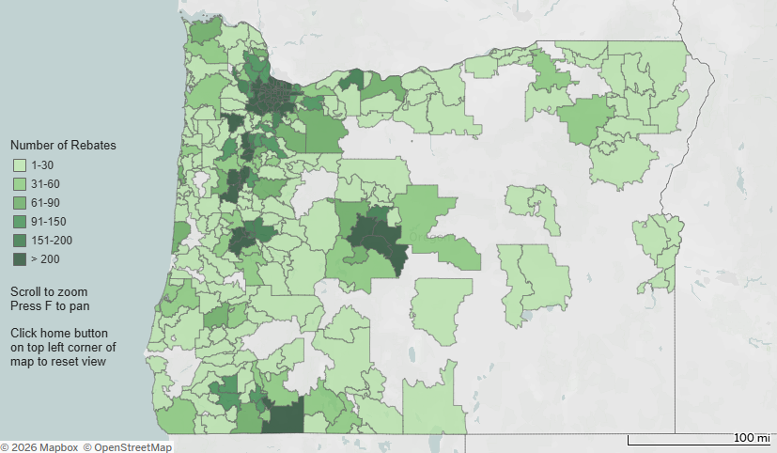
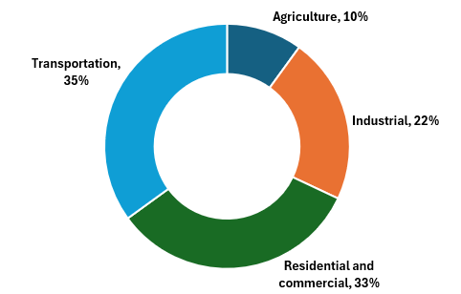

Oregon Clean Vehicle Rebate Program
Established by 2017 Legislature to accelerate adoption of electric vehicles
Rebates for the purchase or lease of a light-duty zero-emissions vehicles
Advances state EV goal of 25% of registered vehicles being EVs by 2030
2018 – 2025: OCVRP Rebates by Zip Code
2023 Oregon GHG Emissions by Sector

Slide 4
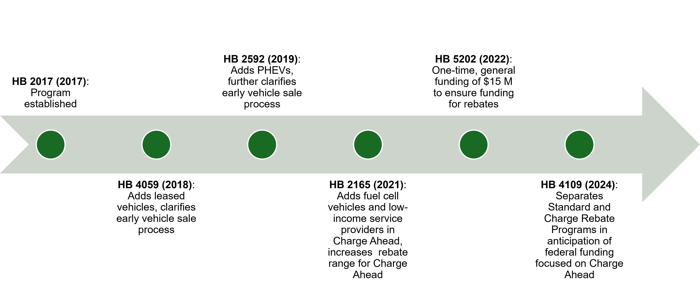
OCVRP: Legislative and rulemaking timeline
December 2018: Program Opened
= EQC Action

Slide 5
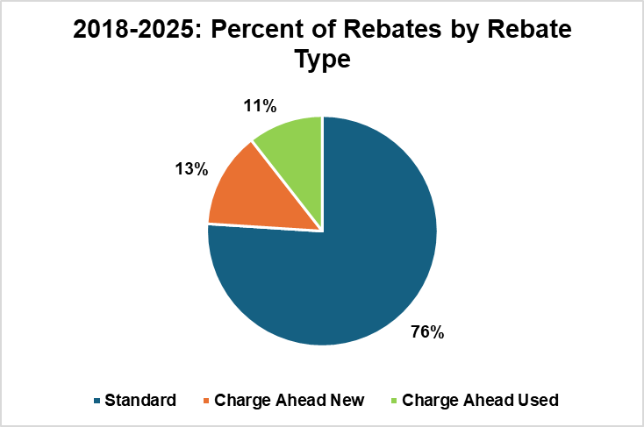
Oregon Clean Vehicle Rebate Program Statistics
Issued over 42,000 rebates equaling $138 million
2025 open periods:
  Standard Rebate:
    May 22 – Sept. 8, 2025
  Charge Ahead Rebate:
    May 22 – Dec. 4, 2025

Slide 6

OCVRP proposed rulemaking overview
Adjusting rebate amounts to stretch limited funds
Limiting the number of rebates per individual to enable more people to participate
Updating outdated references and clarifying program definitions and processes

Slide 7

OCVRP rebate amount considerations
Rebates are important to most recipients and especially important to Charge Ahead Rebate recipients
Decreasing new vehicle affordability
Used EVs nearing price parity
RAC’s interest to consider emissions
Public comment:
  Support and opposition to adjustments
  Include PHEV tiered amounts for Charge Ahead Rebates

Slide 8
OCVRP: Charge Ahead new rebates
Rebate type | Oregon law requirement | Current rebate amount | Proposed future rebate amount
Charge Ahead (new vehicles) | $2,500 - $7,500 | BEV: $7,500 PHEV: $7,500 | BEV: $7,500 PHEV: $5,000
New vehicle prices are increasing
Survey indicates rebates are important to Charge Ahead recipients
Changes in response to public comments:
  Prioritize vehicles that provide the greatest emission reductions, so moderate reduction in rebate for PHEVs

Slide 9
OCVRP: Charge Ahead used rebates
Rebate type | Oregon law requirement | Current rebate amount | Proposed future rebate amount
Charge Ahead (used vehicles) | $2,500 - $5,000 | BEV: $5,000 PHEV: $5,000 | BEV: $4,000 or no more than 30% vehicle price PHEV: $2,500 or no more than vehicle purchase price
Used EVs nearing price parity
Affordability in Oregon is still in progress
Rebates especially important to Charge Ahead recipients
Changes in response to public comments:
  Prioritize emissions reductions

Slide 10
OCVRP: Standard Rebates
Rebate type | Oregon law requirement | Current rebate amount | Proposed future rebate amount
Standard (battery capacity 10kWh+) | $1,500 - $2,500 | BEV: $2,500 PHEV: $2,500 | BEV: $2,000 PHEV: $1,500
Standard (battery capacity less than 10 kWh) | $750 - $1,500 | $1,500 | $750
Standard (motorcycle) | $375 - $750 | $750 | $375
New vehicle prices are increasing
Survey indicates Standard Rebate recipients are slightly less impacted by the rebate
Prioritize vehicles that provide the greatest emission reductions
No changes made in response to public comment

Slide 11


OCVRP: Limiting individual rebates
Goal: Conserve funding and increase access
Proposal: Limit two total per individual
Most previous rebate recipients eligible for a second rebate
Most EV drivers say their next vehicle will be an EV
Public comment:
  Diverse feedback
  No change in response comments

Slide 12


OCVRP: Rule clarifications
Update citations and processes
Clarify definitions and requirements
Enable appeals to be submitted by email
Public comment:
  Used vehicle definition update to ensure PHEVs qualify

Slide 13

Additional OCVRP public comment
Support of the rule in general and/or specific elements
Majority of comments on rebate amounts and individual rebate cap
Additional implementation and other comments outside the scope of the rule

Slide 14
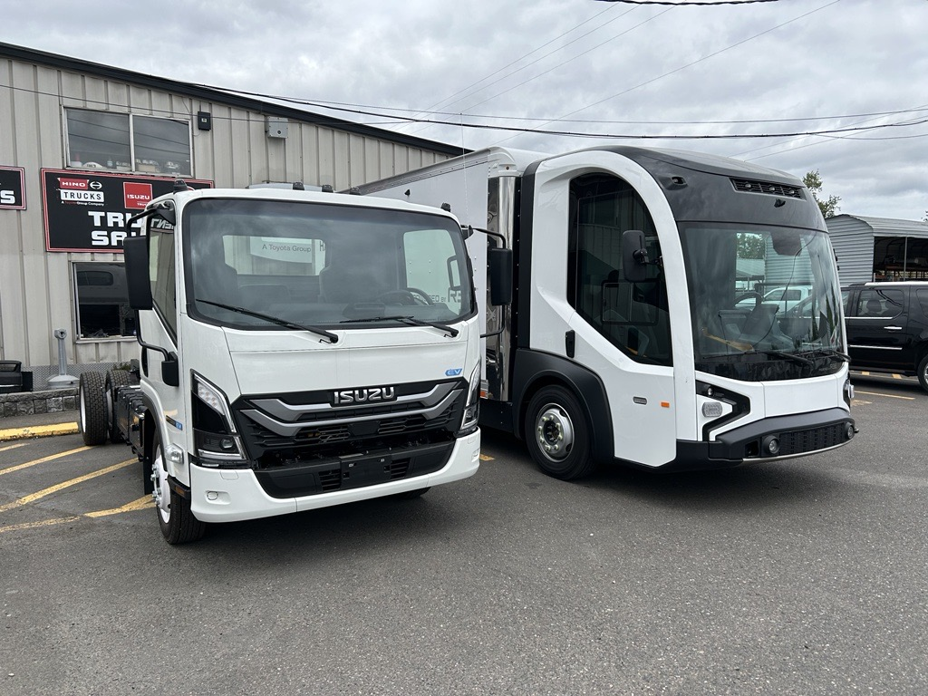
Background: ZERO Fleet
Established by HB 3409 (2023) to accelerate transition to cleaner-emitting medium- and heavy-duty vehicles
Provides rebates to Oregon businesses and fleets for the purchase or lease of a medium- or heavy-duty ZEVs
  Gross Vehicle Weight Rating Class 2b – 8
$17 million one-time allocation – state and federal funds

Slide 15
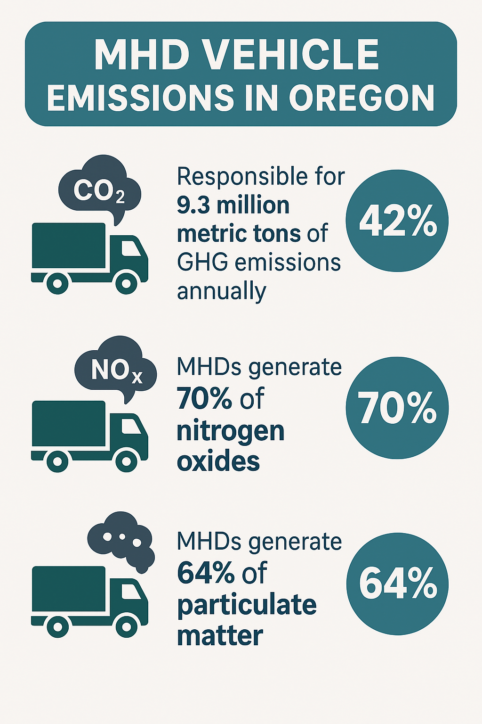
ZERO Fleet:
MHD emissions
MHD vehicles responsible for 9.3 million metric tons of ghg emissions in Oregon annually (42%)
MHDs generate 70% of nitrogen oxides
MHDs generate 64% of particulate matter

Slide 16
ZERO Fleet: ​
Rebate amounts by GVWR class
GVWR Class ​ | Rebate Amount ​
Class 2b (8,501 – 10,000lbs)​ | $2,500​
Class 3 (10,001 – 14,000lbs)​ | $45,000​
Class 4 (14,001 – 16,000lbs)​ | $60,000​
Class 5 (16,001 – 19,500lbs)​ | $60,000​
Class 6 (19,501 – 26,000lbs)​ | $85,000​
Class 7 (26,001 – 33,000lbs)​ | $85,000​
Class 8 (33,000+lbs)​ | $120,000​

Slide 17
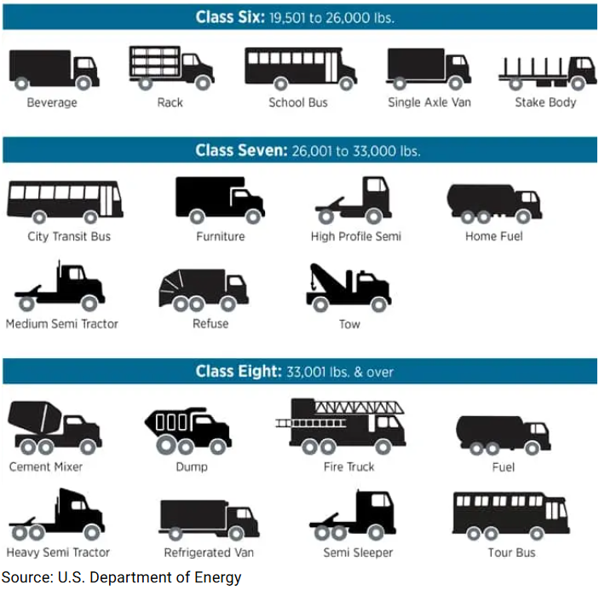
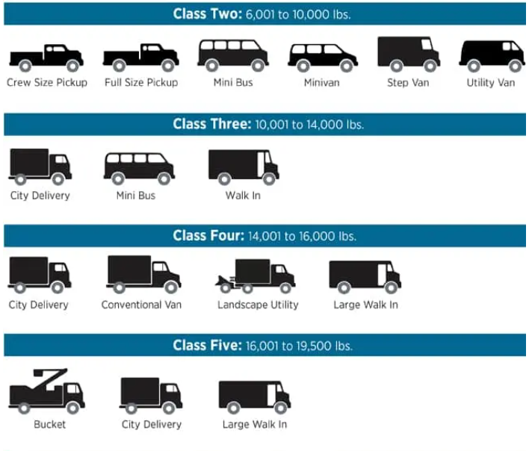
ZERO Fleet: Types of vehicles by class

Slide 18
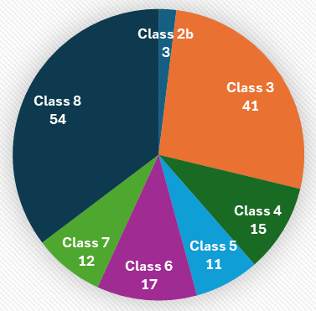
ZERO Fleet: Statistics
Number of ZERO Fleet rebates issued by class
Over $13 million obligated since Dec. 17, 2025
  153 rebates reserved
Approximately $4 million remaining
Approximately 55% of funds reserved for heavy-duty ZEVs

Slide 19
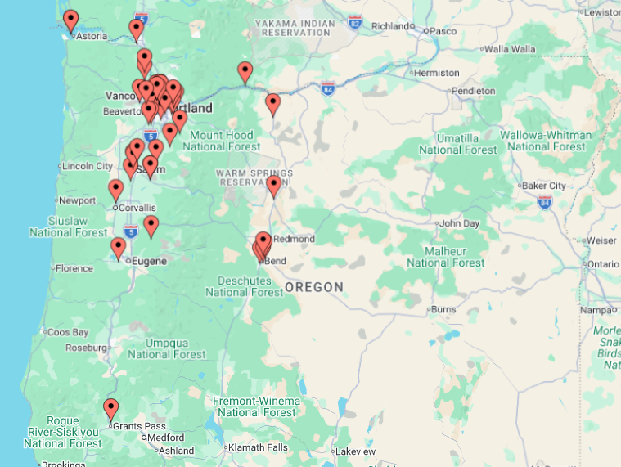
ZERO Fleet: Rebated vehicles across Oregon
Rebated Vehicles Map

Slide 20

ZERO Fleet: Proposed rulemaking need and overview
Improve and further clarify ZERO Fleet Rebate Program rules
Focus funding on vehicles with vocational use (freight, delivery, mass transport)
Account for long build and delivery times
Enhance transparency and protect funds
Support affordability and choice

Slide 21
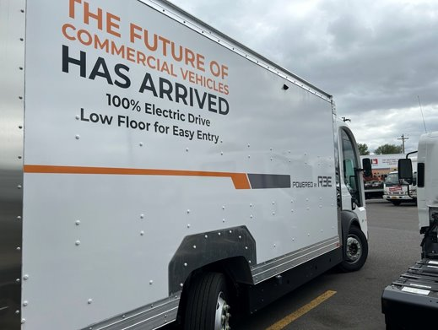
ZERO Fleet: Vehicle eligibility list
Establish a list of approved eligible vehicles – includes:
  Fleet vehicles
  Vocational use only, e.g., freight, delivery, mass transportation

Slide 22
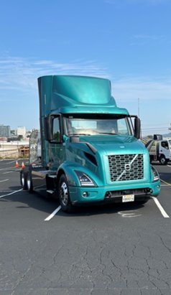
ZERO Fleet: ​
Application review process
Clarify review process for ZERO Fleet rebate applications:
  Provides clearer eligibility guidance
  Minimizes risk of duplicate claims
  Ensures rebates support intended vehicle use

Slide 23
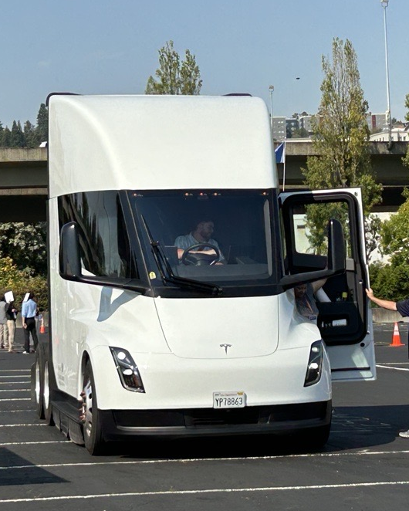
ZERO Fleet: Rebate extension
Accounts for extended build and delivery time
Allows an additional 6-month extension
  Up to 24 months total

Slide 24
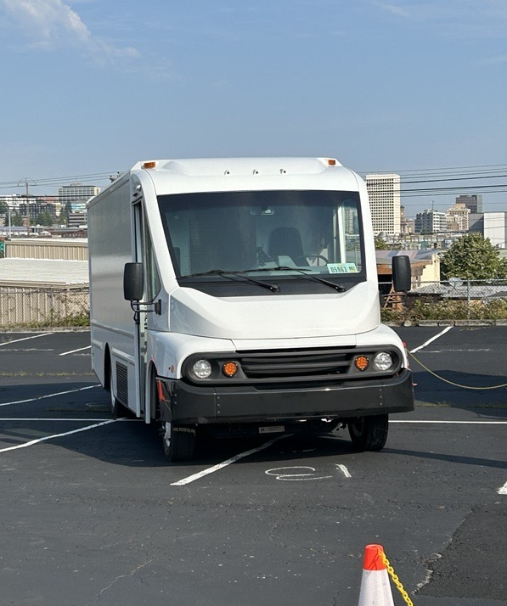
ZERO Fleet: Vouchers
Introduce a voucher-style rebate, allowing applicants to reserve funding while they shop
Funds will be reserved for selection process

Slide 25
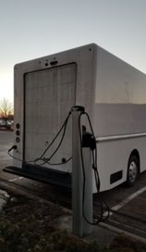
ZERO Fleet: Public comment
Support of the rule in general and/or specific elements
Highlighted that vouchers increase purchaser choice and reflect market changes
Noted importance of exposure to diesel emissions

Slide 26
Proposed motion language
"I move that the Environmental Quality Commission adopt the proposed rule amendments in Attachment A as part of chapter 340 of the Oregon Administrative Rules.”

Slide 27
Title VI and alternate formats
DEQ does not discriminate on the basis of race, color, national origin, disability, age, sex, religion, sexual orientation, gender identity, or marital status in the administration of its programs and activities.
Visit DEQ’s Civil Rights and Environmental Justice page.
Español | 한국어 | 繁體中文 | Pусский | Tiếng Việt | العربية
Contact: 800-452-4011 | TTY: 711 | deqinfo@deq.oregon.gov

