Slide 1

Recognizing DEQ’s Ambassadors of Public Service
2026 Theme: Leading with Purpose
Environmental Quality Commission Meeting May 14, 2026

Slide 2
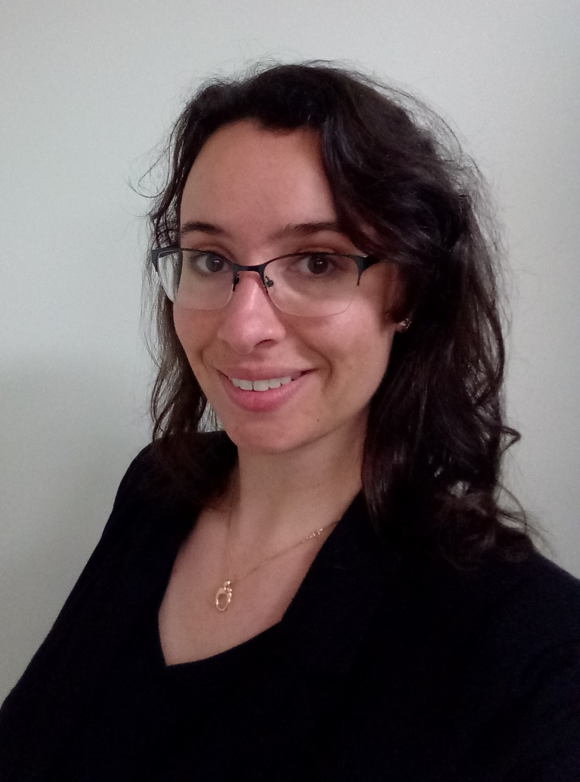
Aliana Britson, Senior Permit and Policy Consultant
“Through technical leadership, a collaborative approach, and a commitment to teamwork, Aliana advances Oregon’s most complex water quality permitting challenges. She mentors permit writers and subject matter experts statewide and collaborates across programs and regions to strengthen consistency and shared understanding. Aliana's ability to turn complexity into clarity and drive meaningful results makes her a standout leader in Oregon’s water quality work.”

Slide 3
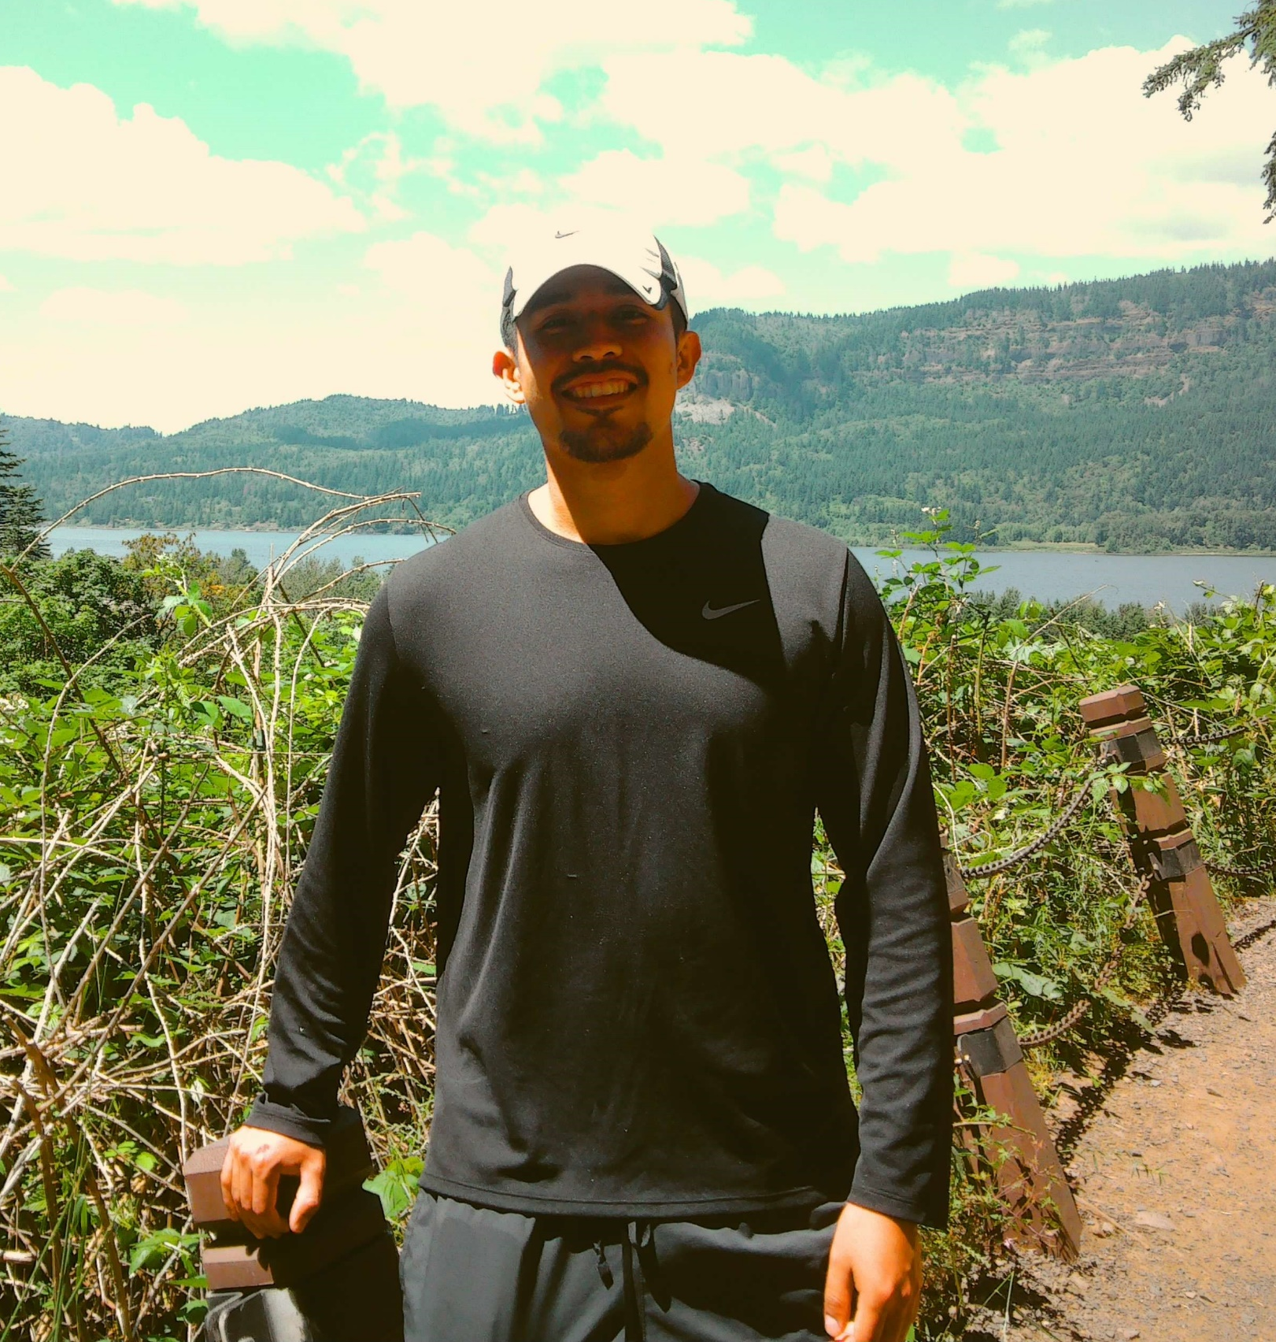
Juan Rivera-Hernandez, Senior Budget Analyst
“What truly sets Juan apart is the joy and authenticity he brings to his role. Whether he is walking someone through a budget process or helping a teammate think through a problem, he brings a sense of curiosity, patience and good humor that makes people want to engage and learn. Juan reminds us that public services can be rigorous, collaborative and joyful all at once.”

Slide 4
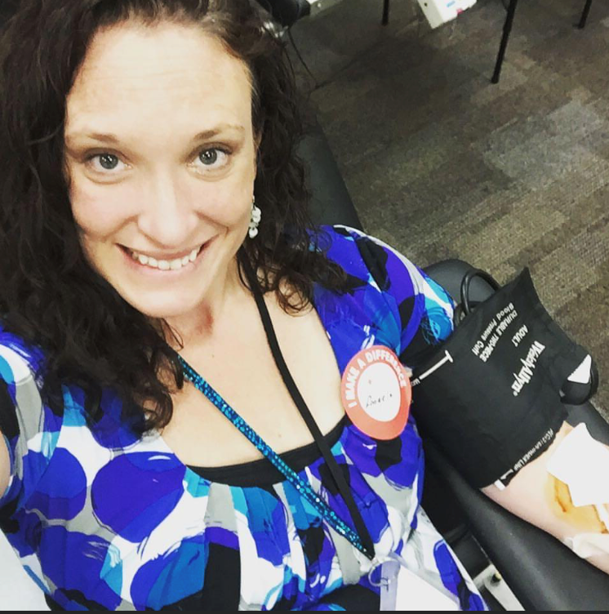
Angela Rowland, Continuity of Operations Planner
“Angela approaches her work with heart and purpose. She is committed to excellence, and her own and others’ resilience in the face of adversity. To support this, she engages in continuing education, shares information with others, and steadily builds DEQ’s continuity plans and practices so that we can continue to provide important services to Oregonians during adverse events.”

Slide 5
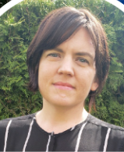
Lindsay Hoyt, Enterprise Projects Team Manager
“Since joining DEQ, Lindsay has consistently demonstrated purposeful leadership. She exemplifies integrity, vision, empathy, and strong communication skills. Through her guidance, Lindsay motivates teams toward shared objectives and fosters an environment of growth and learning by viewing challenges as opportunities.”

Slide 6
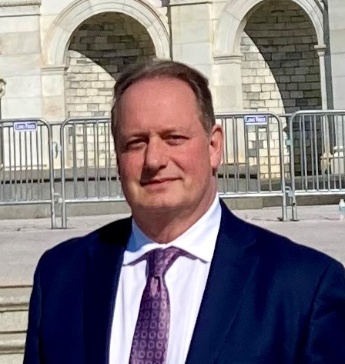
Chris Marko, CWSRF Program Coordinator
“Chris is recognized for his deep subject matter expertise of the Clean Water State Revolving Fund program and his dedication to building relationships that promote a public service mindset. Chris is an excellent public service ambassador committed to collaborative leadership that benefits DEQ, our partner agencies, and communities large and small throughout Oregon.”

Slide 7
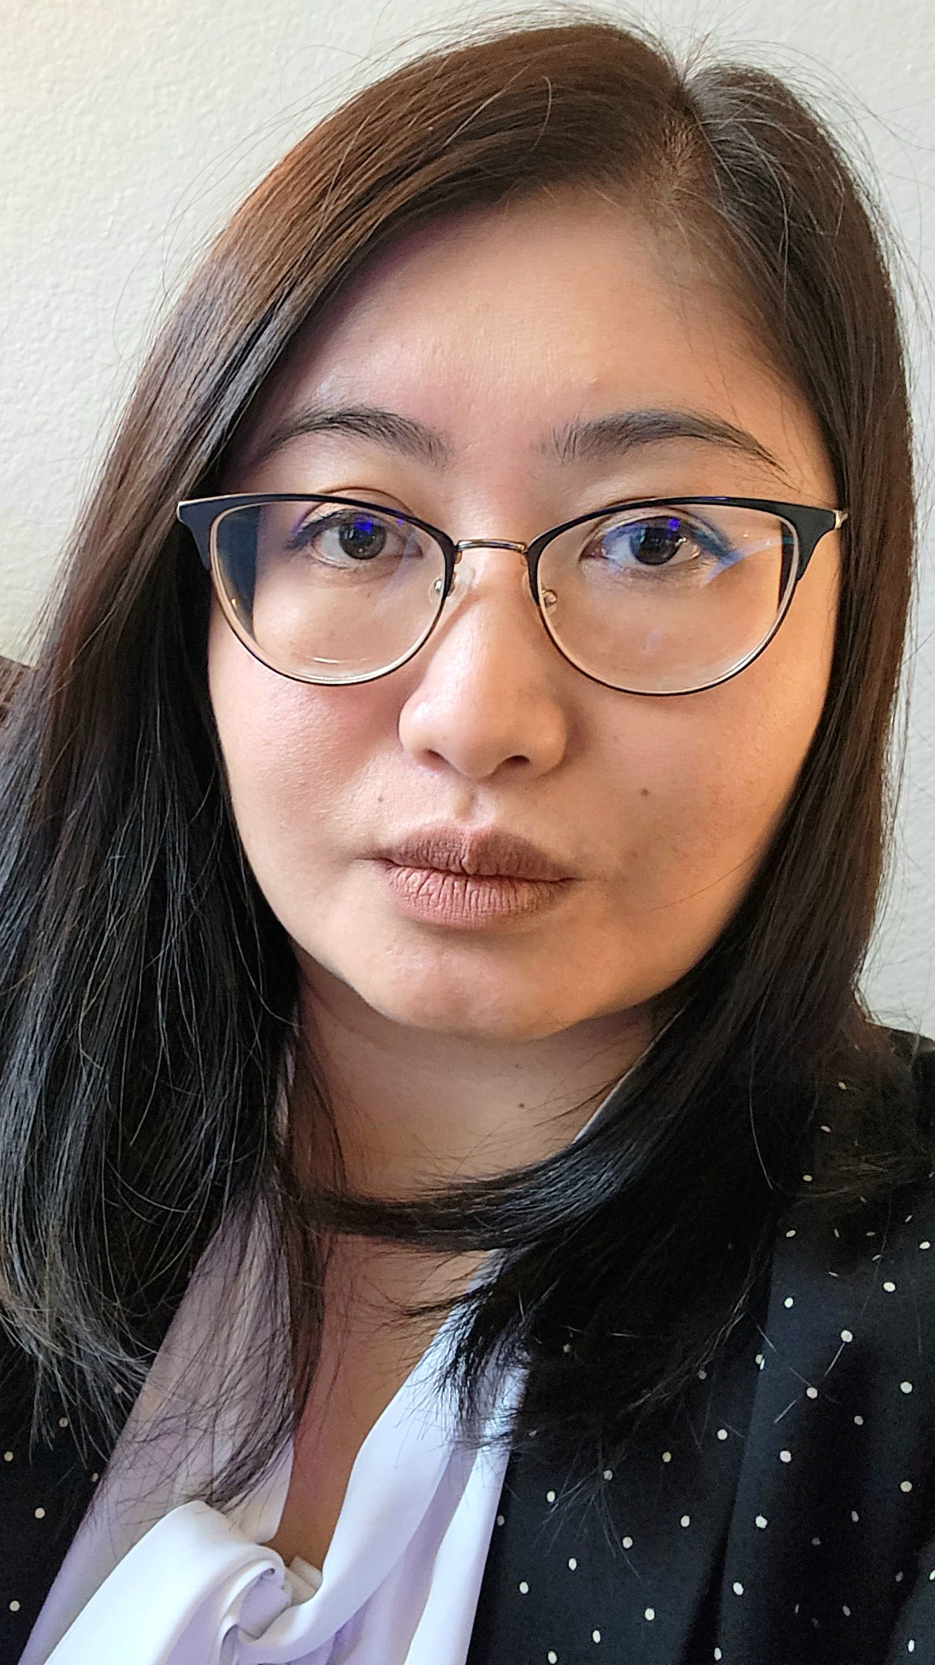
Hoang-Van Nguyen, Environmental Justice Council Policy and Program Coordinator
“Through thoughtful planning, clear communication, and consistent follow-through, Hoang-Van has built systems and structures that allow Oregon Environmental Justice Council members to focus on meaningful and substantive issues. Her coordination and persistence has been essential to the council’s success and their work to design a statewide Environmental Justice Mapping tool, informed by EJ communities’ lived experiences.”

Slide 8
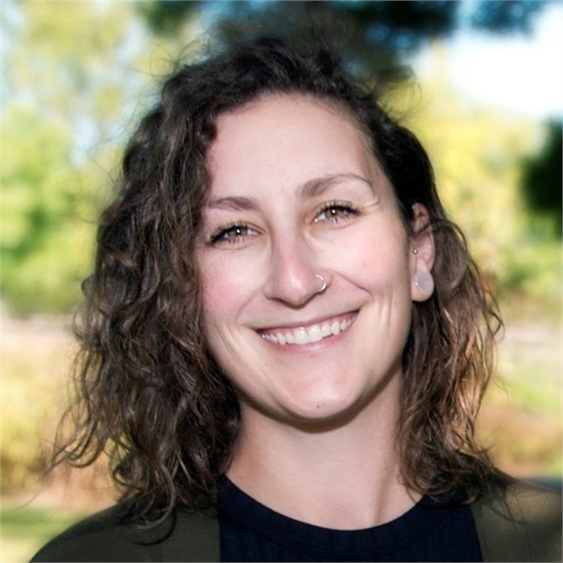
Sarah Van Glubt, Cleanup Project Manager and Data Analyst
“By leading the inclusion of PFAS chemicals on the list of Hazardous Substances that are regulated in Oregon, Sarah contributed to important efforts that support environmental protection and public health across the state. Her work reflects a deep commitment to ensuring that Oregon’s policies continue to evolve in response to emerging risks and scientific knowledge. Through her diligence, professionalism, and dedication to public service, Sarah exemplifies the spirit of leading with purpose.”

Slide 9
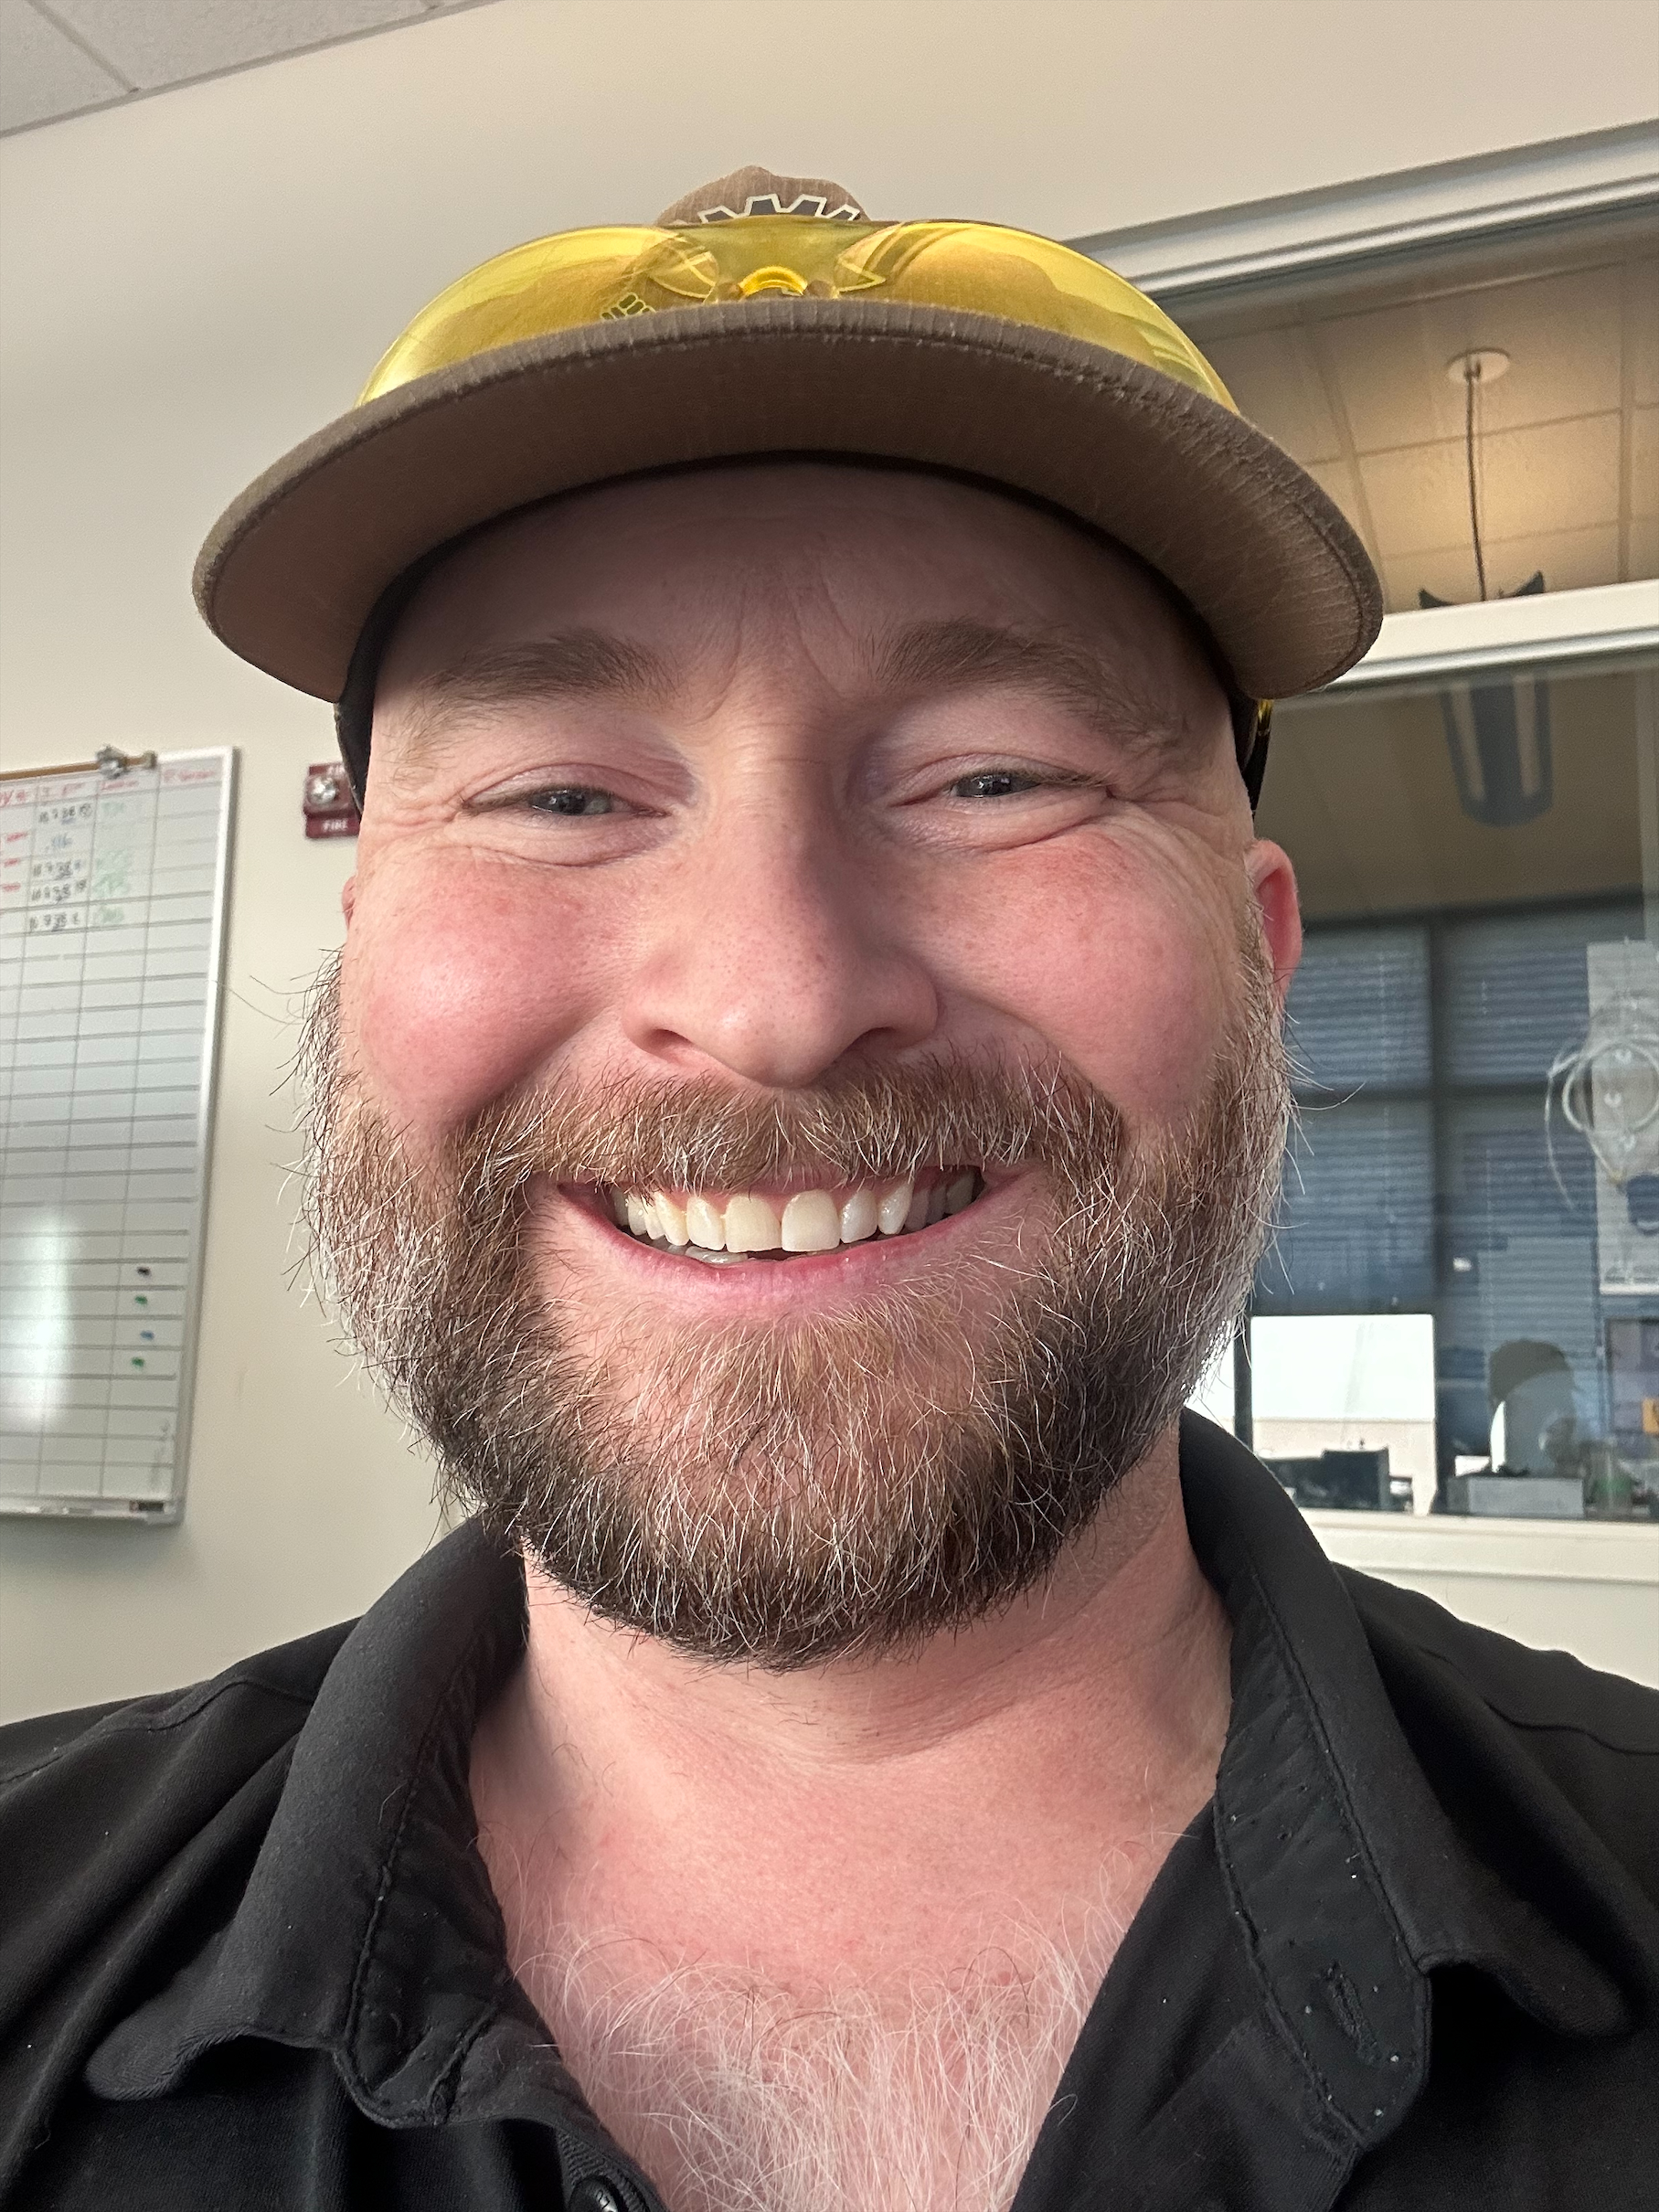
Chase Sobocinski, Air Quality Monitoring Specialist
“Working on particularly complicated, interdisciplinary, open-ended projects, Chase continually asks the right questions to get to clarity of purpose and move a project closer to its objectives. He sees problems or ways a project or process could work better and immediately sets to work finding ways to make them better, while asking the hard questions needed to keep the focus on Air Quality Monitoring’s ultimate objective – serving the public interest.”

Slide 10
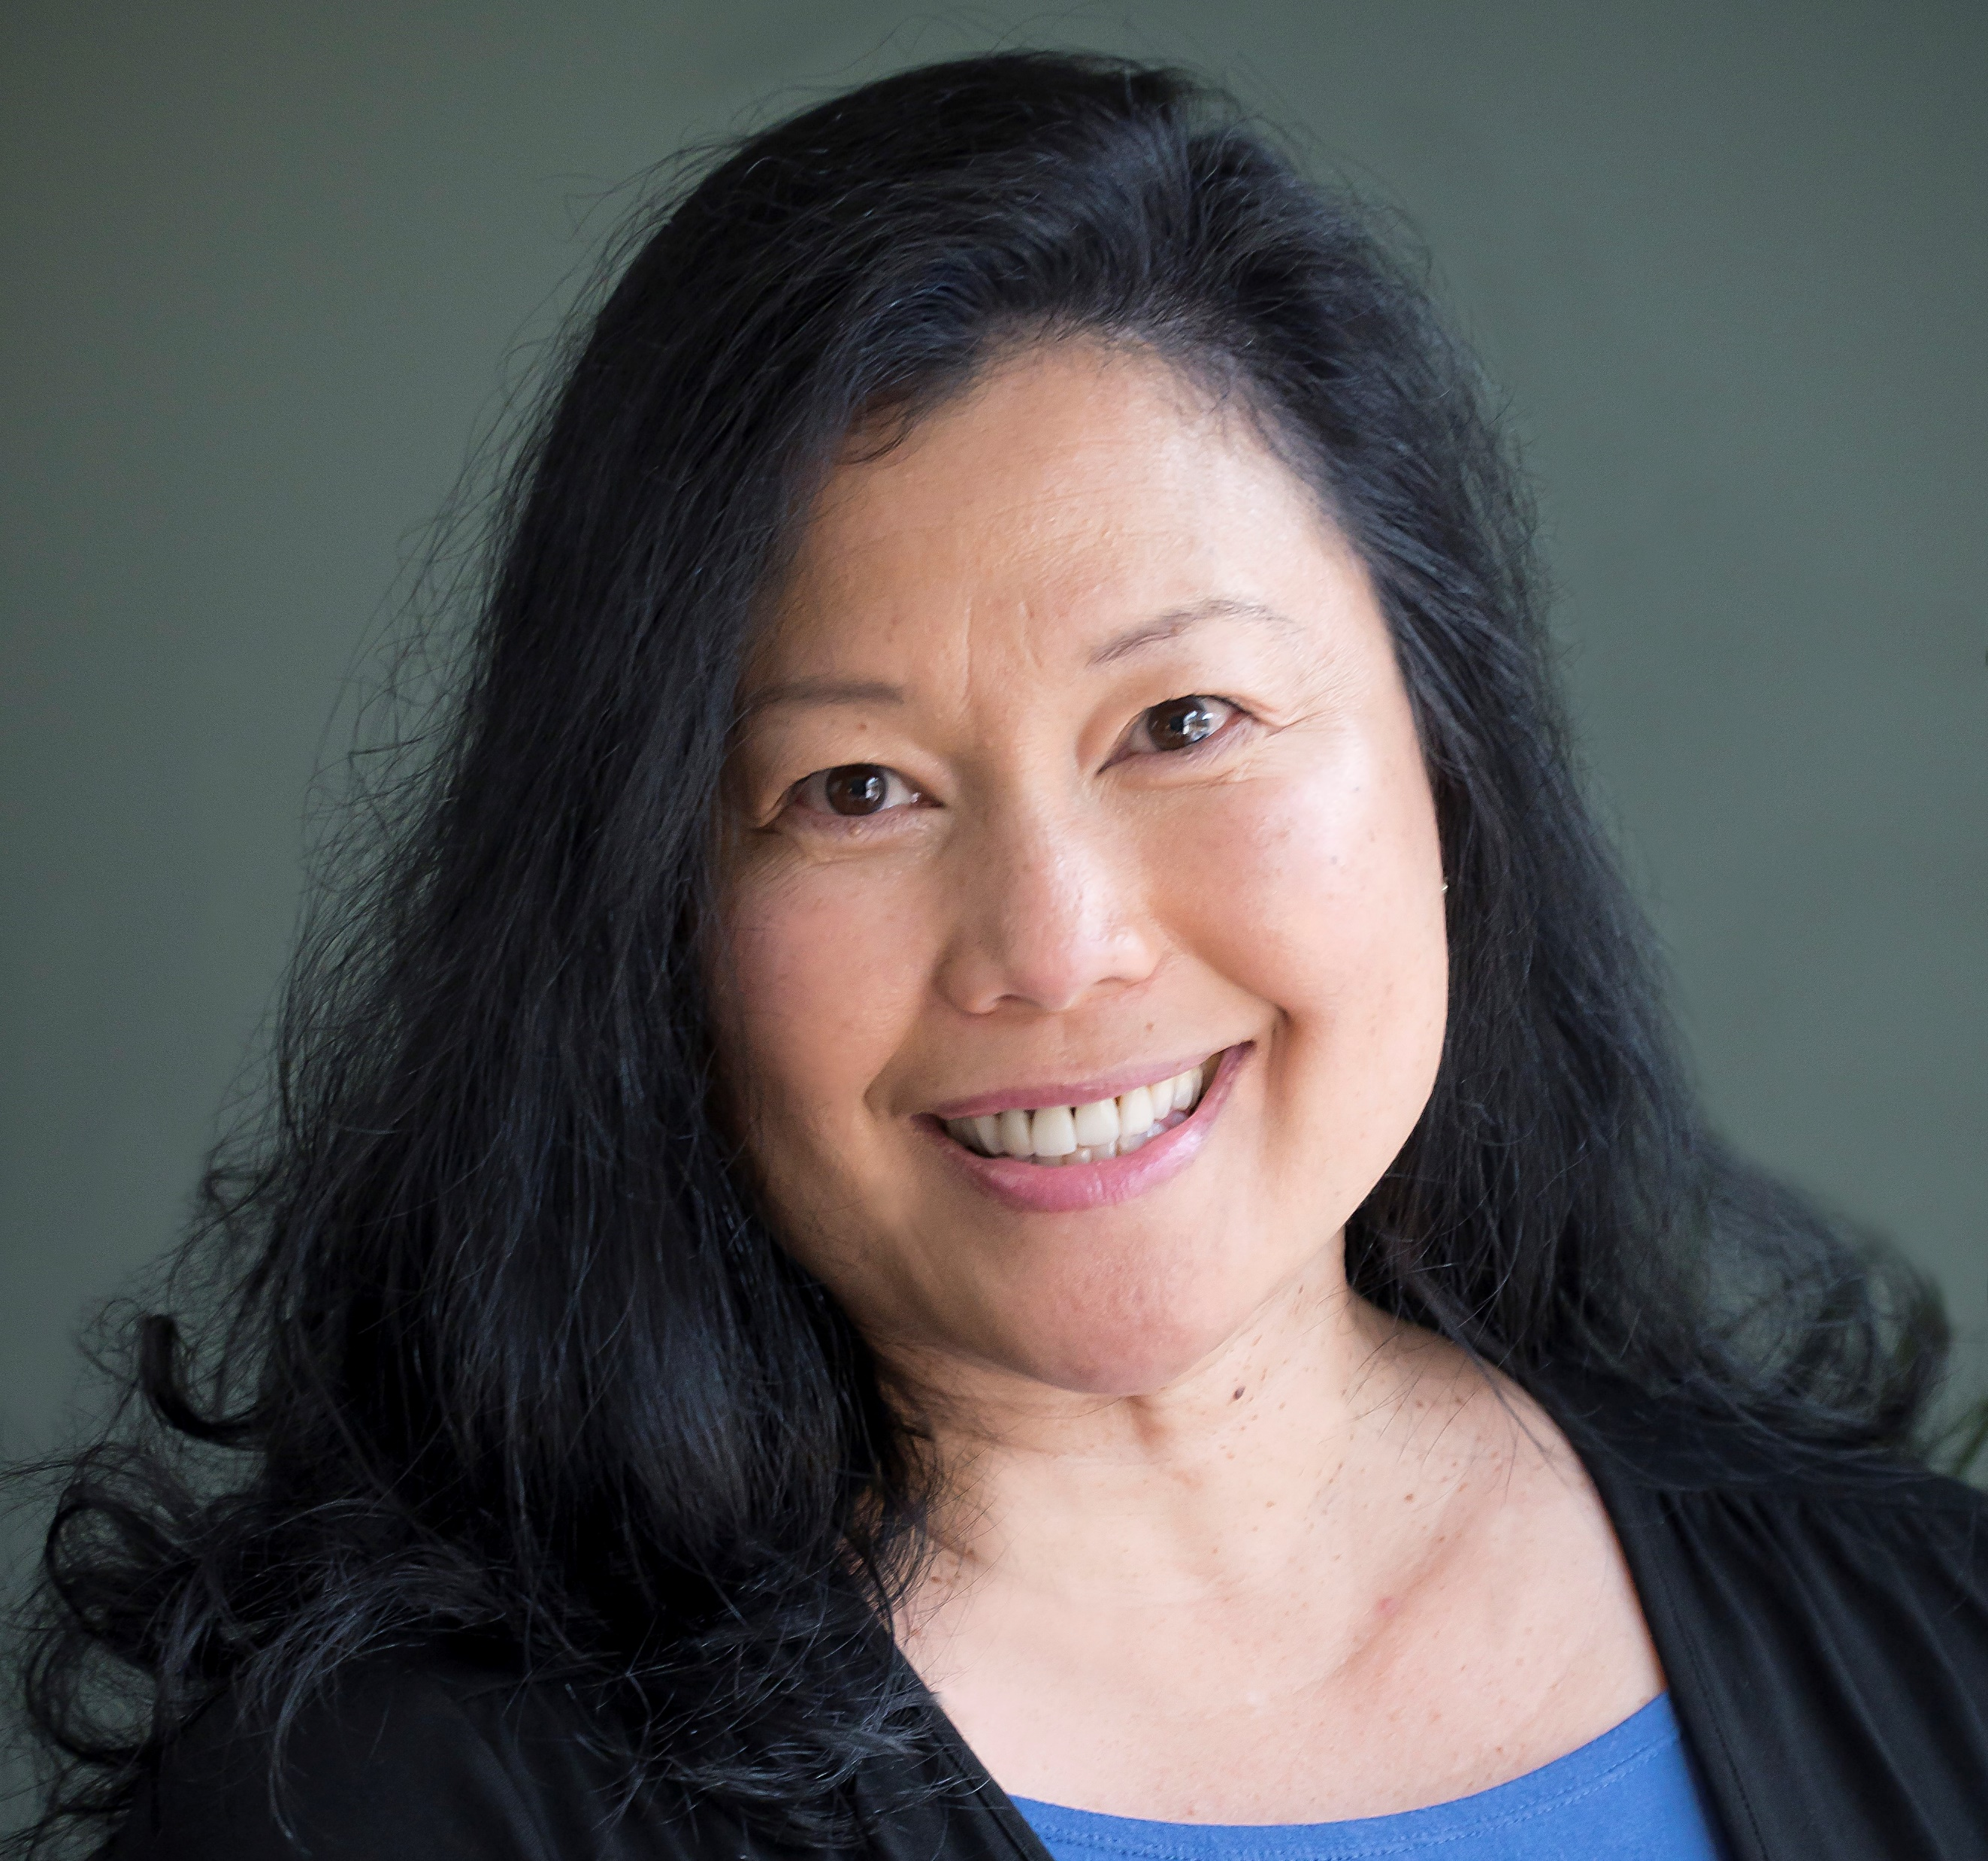
Jen Persons, Executive Assistant
“Jen is kind, genuine, giving and always willing to help. She is thoughtful and intentional in how she shows up for others, leads by example, and models patience, diplomacy, and determination. Her leadership comes not from authority, but from the way she supports people, brings teams together, and moves forward with care and purpose.”

Slide 11
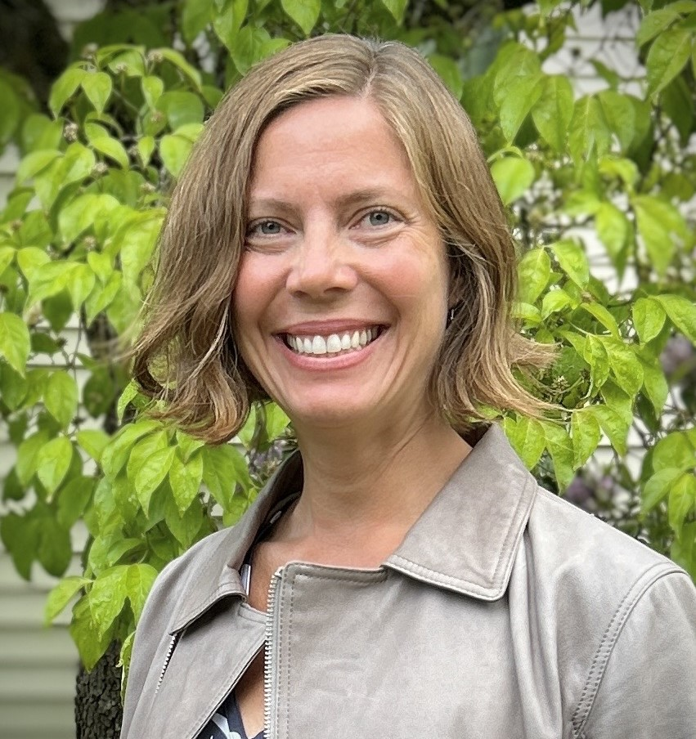
Laura Gleim, Regional Solutions Specialist
“Laura persistently identifies and seeks collaborative solutions that many rural communities face when it comes to the intersection between environmental protection and compliance, and local economic development. Laura continually seeks to identify the shared benefits that occur when communities understand the reasons behind DEQ's rules and authorities.”

Slide 12
Congratulations, 2026 DEQ Ambassadors of Public Service!

Slide 13
Title VI and alternate formats
DEQ does not discriminate on the basis of race, color, national origin, disability, age, sex, religion, sexual orientation, gender identity, or marital status in the administration of its programs and activities.
Visit DEQ’s Civil Rights and Environmental Justice page.
Español | 한국어 | 繁體中文 | Pусский | Tiếng Việt | العربية
Contact: 800-452-4011 | TTY: 711 | deqinfo@deq.oregon.gov

