Slide 1
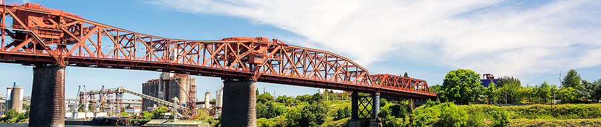

Presentation Name
DEQ Rulemaking
Presenter name
Date

Slide 2
Background
What is the goal of this rulemaking?
What is triggering this rulemaking (legislative, legal, programmatic identified need, federal requirement, etc.)?
What rules are being updated, created, or removed (if known)?

Slide 3
Roles and Responsibilities
Role in Project | Team Member
Sponsor
Program Manager
Project Manager
Rule Writer(s)
Subject Matter Expert(s)
Implementation Project Manager
Communications Representative
Note: this represents the decision-making body to consult should an issue or change arise.

Slide 4
Tentative Timeline
Activity | Expected Completion Date
Develop/finalize Project Charter EPIC Memo
Develop list of advisory committee members
Complete RAC Roster and RAC Member Director Memo
Complete RAC Appointment Letters and RAC Charter
Draft rules
Hold Advisory Committee Meeting 1
Complete Fiscal Impact Statement
Hold Fiscal Advisory Committee Meeting
Complete Public Notice of Proposed Rulemaking
Open Public Comment period
Hold Public Hearing meeting
Complete EQC Staff Report
Present at EQC Meeting
IMPLEMENTATION STEPS

Slide 5
Project Plan
[Include link to project planning tool, for example Microsoft Planner Template]
[Discuss how planning tool will be utilized by team, for example should team members check off items directly, message Project Manager when completed, etc.]

Slide 6
Rulemaking Service Agreement
[Link to project’s Rulemaking Service Agreement document. Review in real-time with team.]

Slide 7
Team Agreements – what will collaboration look like?
Question | Answer
How often should this team, or a subset of this team, meet?
How do we want to share project status? (For example: weekly email report, create Teams chat, etc.)
Where will documents for this project live? | [Link folder]
How do we want to collaborate on editing documents?
Anything else?

Slide 8
Community Engagement and Public Outreach
What parties are we inviting to the RAC? Will industry and community be present?
Is there a potential knowledge gap between industry and community?
What will we do to bring community "up to speed" with industry? EX: educational materials, separate meetings with community on complex topics
If topic is very complex, is there space to let industry present on a topic?

