Slide 1



Budget Committee – November 12, 2025
Preliminary CIP & LRFP
Lane Transit District | LTD.org
Notes:
Title Slide 1 - Calibri Bold, 26pt to 30pt (delete if using Title Slide 2)
Date or Sub-Header Content – Calibri Light, 6 to 8 pts smaller than header
The bulk of the important information is on slide 4. Read this before deleting unwanted slide pages.

Slide 2
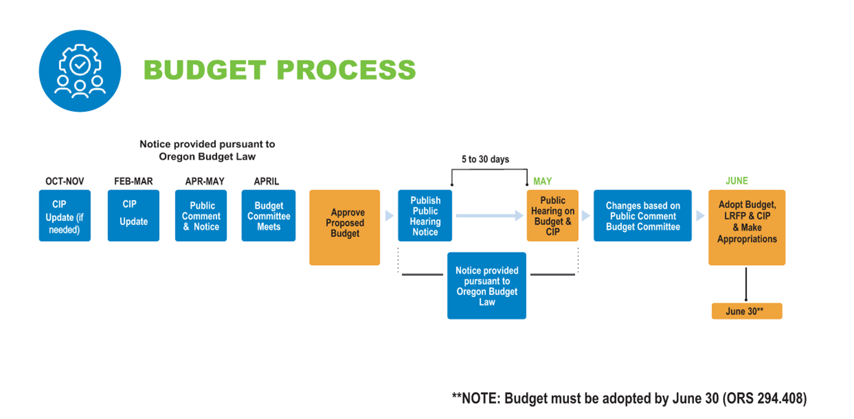
Budget Timeline
2
Notes:
Section Slide – Use the blue rectangular graphic.
Header: Calibri Light 40pt or smaller. . (Be consistent throughout. If it is smaller here, use throughout presentation.)
This is set in title case, not all capsBody: Calibri Light 28pt or smaller. Sometimes you must use bullet points. If there is no time to have your presentation designed, use square bullet points.
Icon: Use icon appropriate for section if using icons.
Avoid
1.) Making copy too small. The slide should not be a wall of text, but brief information leading the audience as the presenter speaks. Notes or large bodies of text are meant to go in this section.
2.) Avoid creating another slide to continue information. If necessary, make a two column text box and simplify the text.
Images
Need help with images? Start here: Q:\SP&M\Graphics External\Photo Archive\LTD Professional Image Library
These are images approved for public use, are professional and properly represent and support LTD’s mission, values and goals. This library will continue to grow so be sure to continue to check it.
There is a lot missing from this template, but it’s enough to get you started. As we continue to make updates, please download the template from SharePoint each and every time you create a presentation. This will ensure the most up-to-date template is being used even if a change has been made.

Slide 3
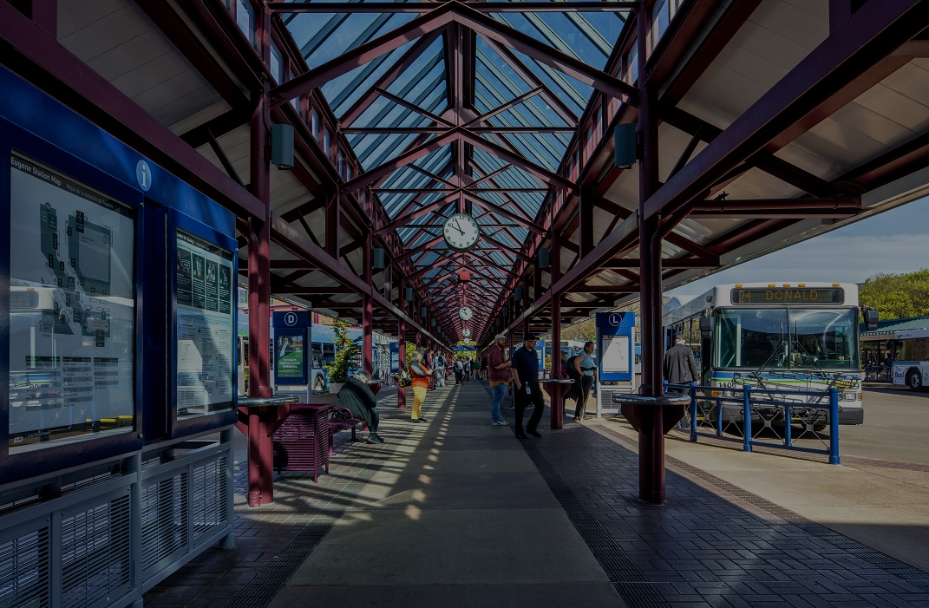
Community Investment Plan – FY 27-36
11/12/2025 – Budget Committee
Lane Transit District | LTD.org
Notes:
Title Slide 1 - Calibri Bold, 26pt to 30pt (delete if using Title Slide 2)
Date or Sub-Header Content – Calibri Light, 6 to 8 pts smaller than header
The bulk of the important information is on slide 4. Read this before deleting unwanted slide pages.

Slide 4




Agenda
Framework | Guiding Principles
Highlight projects complete or underway
Highlight new projects
Funding strategy update
4
Notes:
Header Slides – Calibri 40 pt
Not every slide must have the logo. (If you find you need more space or have a photo collage)
Every presentation should have an agenda.
List what is being presented, talk about what’s being presented and recap about what was presented.
Icons are not necessary but offer appeal. LTD will have a list of available icons at a later date. Until then if you would like the icons, ask Graphics to generate them. You may use your own, be sure to adjust to the necessary size and properly align. Avoid bullet points.

Slide 5
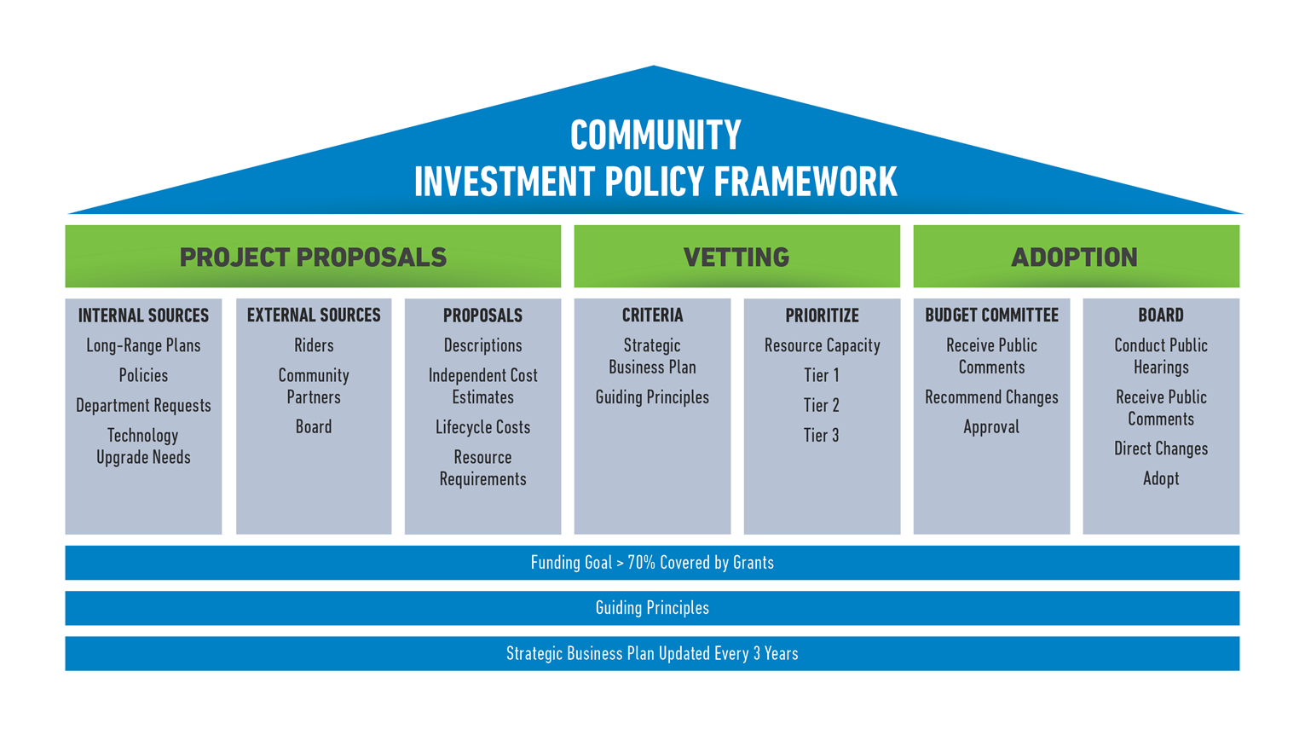
CIP Framework
5
Notes:
Section Slide – Use the blue rectangular graphic.
Header: Calibri Light 40pt or smaller. . (Be consistent throughout. If it is smaller here, use throughout presentation.)
This is set in title case, not all capsBody: Calibri Light 28pt or smaller. Sometimes you must use bullet points. If there is no time to have your presentation designed, use square bullet points.
Icon: Use icon appropriate for section if using icons.
Avoid
1.) Making copy too small. The slide should not be a wall of text, but brief information leading the audience as the presenter speaks. Notes or large bodies of text are meant to go in this section.
2.) Avoid creating another slide to continue information. If necessary, make a two column text box and simplify the text.
Images
Need help with images? Start here: Q:\SP&M\Graphics External\Photo Archive\LTD Professional Image Library
These are images approved for public use, are professional and properly represent and support LTD’s mission, values and goals. This library will continue to grow so be sure to continue to check it.
There is a lot missing from this template, but it’s enough to get you started. As we continue to make updates, please download the template from SharePoint each and every time you create a presentation. This will ensure the most up-to-date template is being used even if a change has been made.

Slide 6
CIP Guiding Principles
To deliver safe, equitable and dependable transportation services and facilities in an affordable, efficient, and cost-conscious manner
To invest in a transparent, financially sustainable manner that is able to withstand annual revenue fluctuations
To adjust to changes in community service needs and strategic business plan priorities
To comply with all local, state and federal regulatory requirements
To be a part of the climate change solution while building community resiliency
6
Notes:
Section Slide – Use the blue rectangular graphic.
Header: Calibri Light 40pt or smaller. . (Be consistent throughout. If it is smaller here, use throughout presentation.)
This is set in title case, not all capsBody: Calibri Light 28pt or smaller. Sometimes you must use bullet points. If there is no time to have your presentation designed, use square bullet points.
Icon: Use icon appropriate for section if using icons.
Avoid
1.) Making copy too small. The slide should not be a wall of text, but brief information leading the audience as the presenter speaks. Notes or large bodies of text are meant to go in this section.
2.) Avoid creating another slide to continue information. If necessary, make a two column text box and simplify the text.
Images
Need help with images? Start here: Q:\SP&M\Graphics External\Photo Archive\LTD Professional Image Library
These are images approved for public use, are professional and properly represent and support LTD’s mission, values and goals. This library will continue to grow so be sure to continue to check it.
There is a lot missing from this template, but it’s enough to get you started. As we continue to make updates, please download the template from SharePoint each and every time you create a presentation. This will ensure the most up-to-date template is being used even if a change has been made.

Slide 7
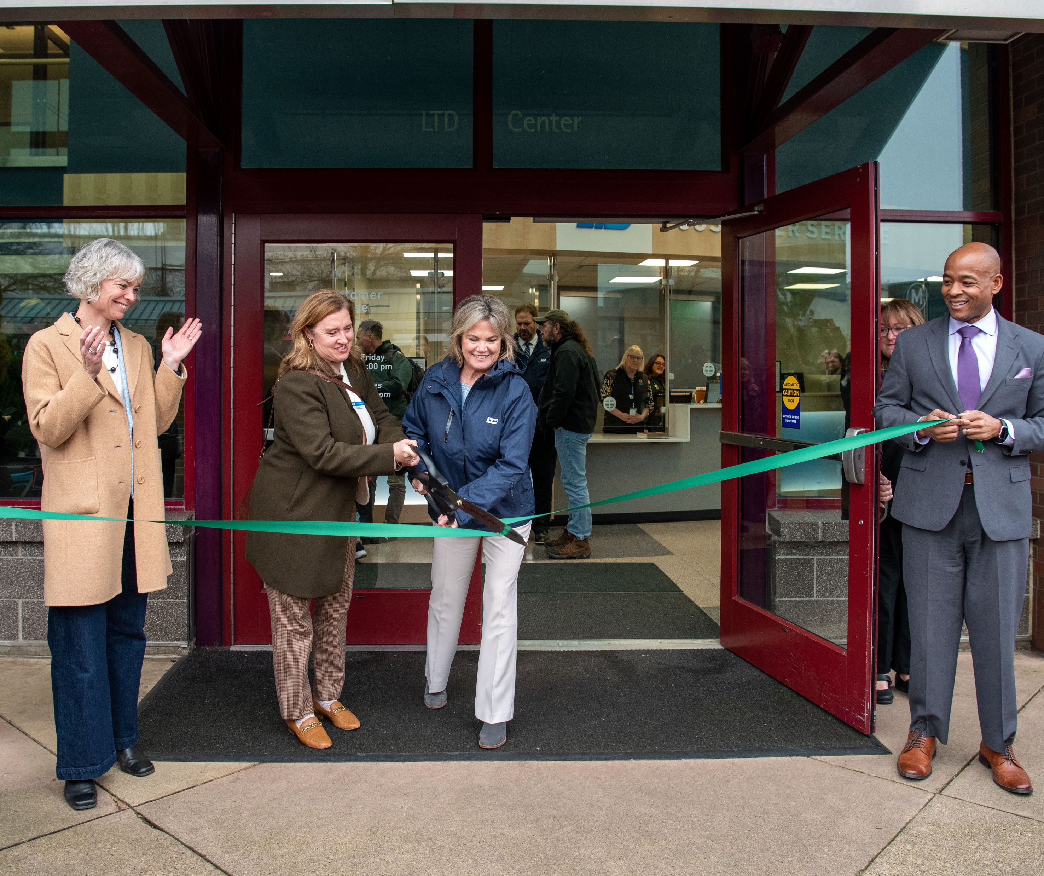
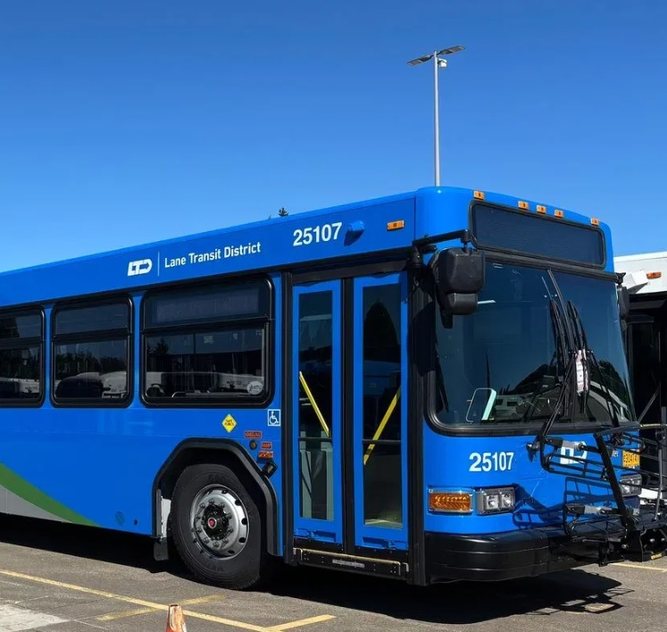
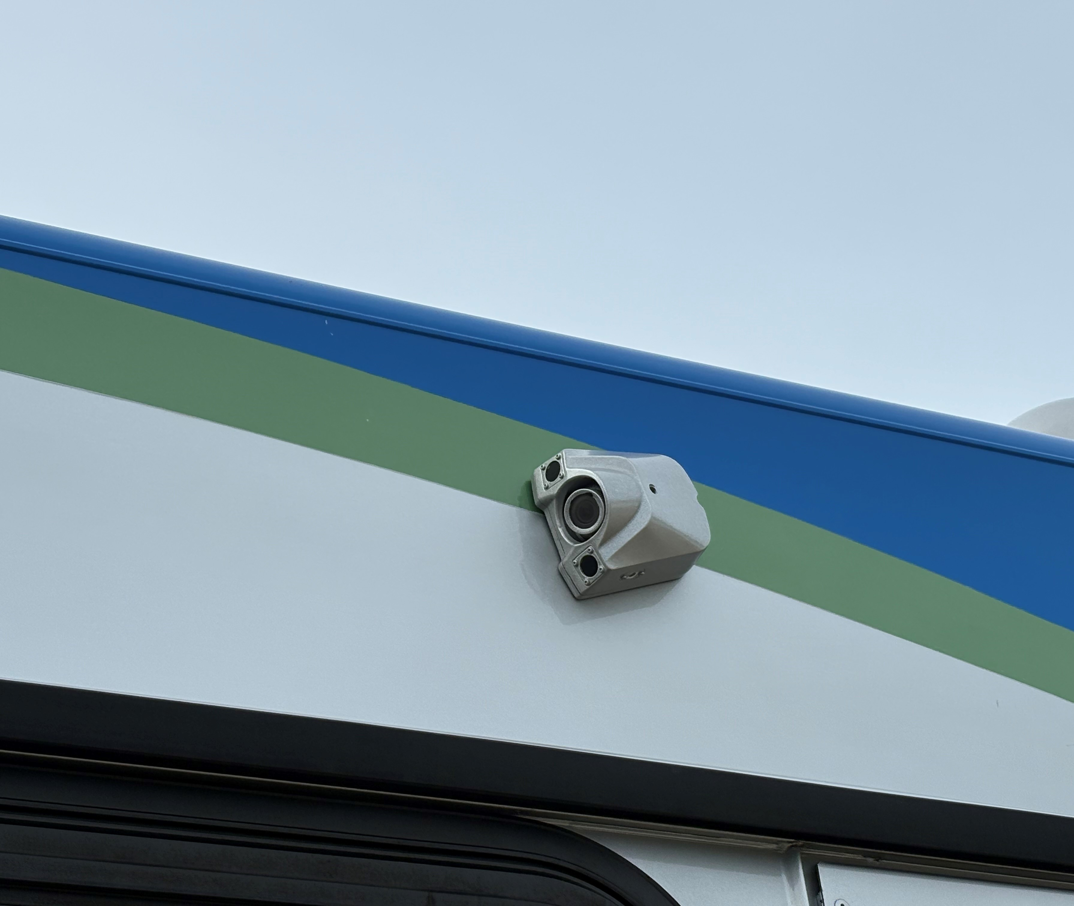
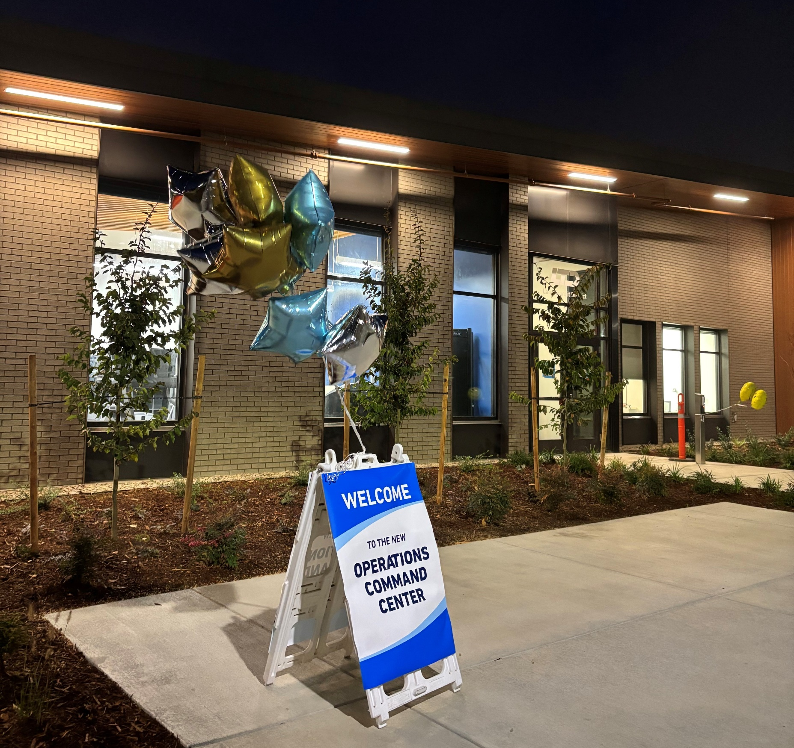
Existing Projects
Eugene Station Modernization
Grand re-opening January 2025 Improved restrooms, wayfinding, customer service counter, updated employee facilities $5million
Fleet Replacement
Replace buses to maintain reliable service, based on the condition of vehicles and available funds
ITS Video System Replacement
Update underway for mobile video system, provide a singular mobile video solution, increasing safety and support for riders and operators $900k
Operations Command & Control
Completed October 2025 Provide modern operations dispatch, operator report area, training classroom, restrooms/showers, and operator rest areas $12million
7

Slide 8
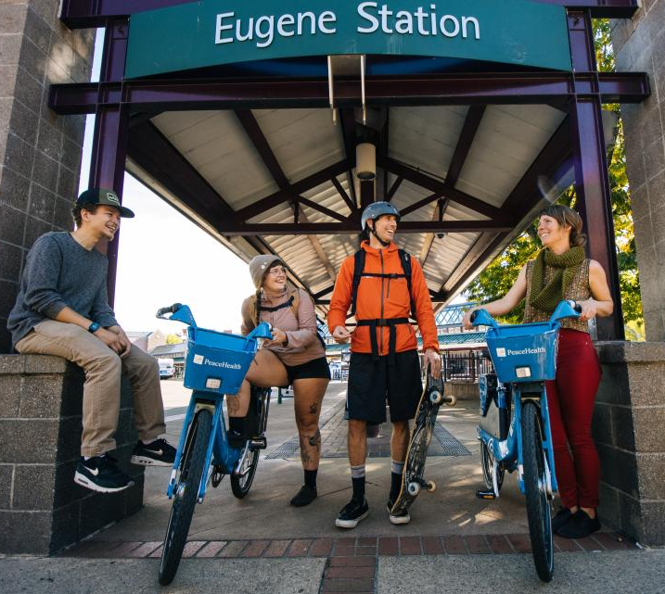
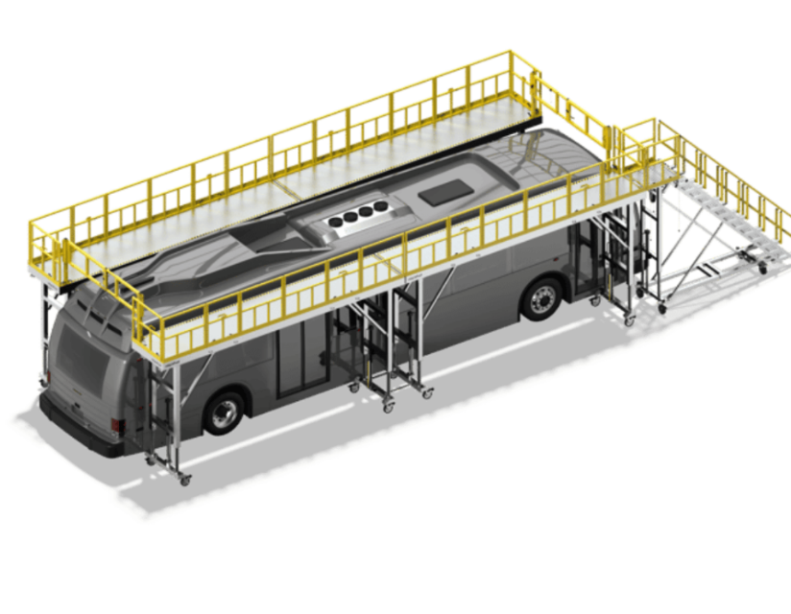
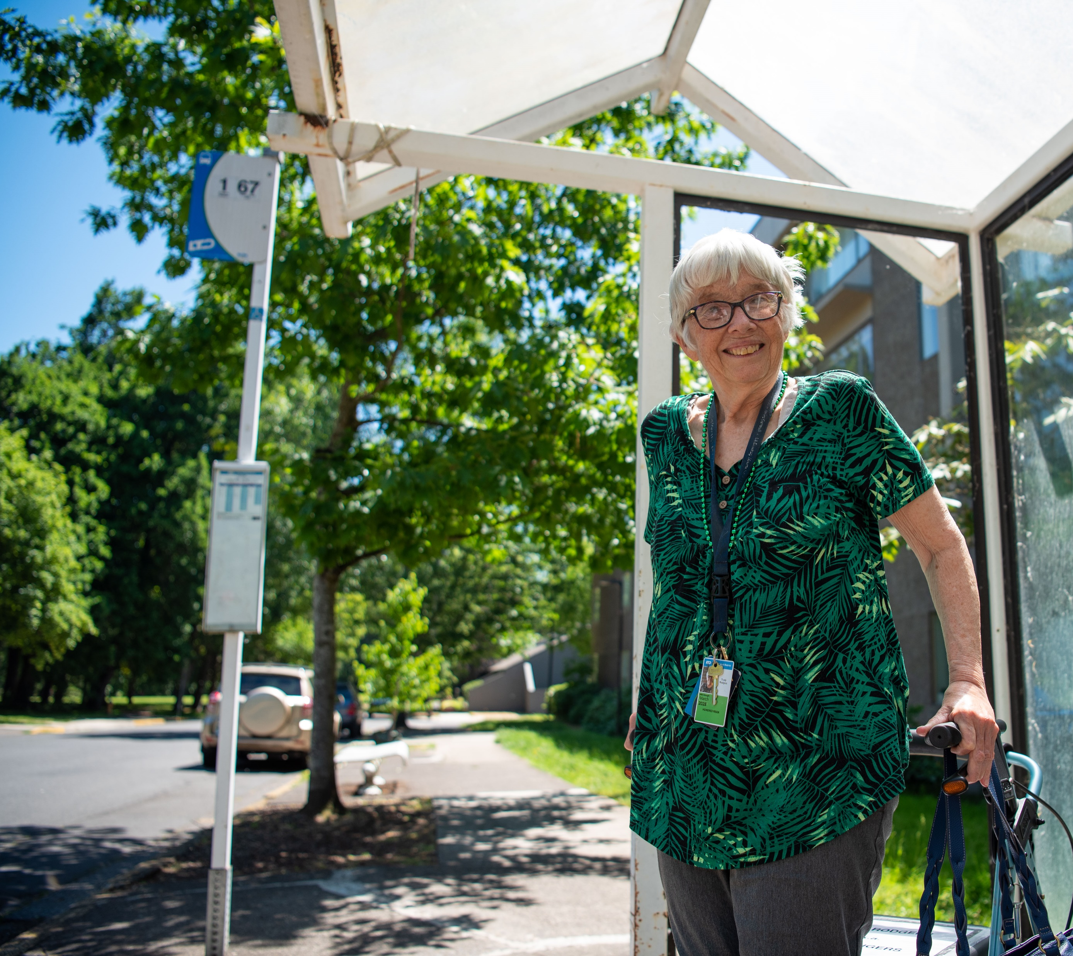
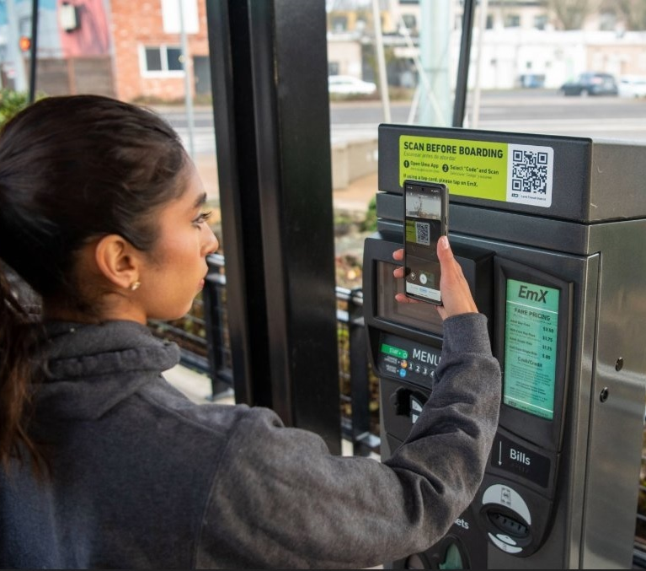
Existing Projects
Transit-Shared Mobility Integration & Modernization
Replacement fleet of pedal-assist electric bicycles, integrated charging and docking stations distributed throughout Eugene and Springfield
Fleet Crane & Fall Protection
Currently underway Provide for safe working environment on top of the bus, and capability to lift components to and from bus roof $972k
Fixed Route Infrastructure Rehabilitation
Assess bus stops for ADA compliance, make necessary improvements for stops found non-compliant and in poor condition, increasing accessibility, comfort and passenger safety
Fare Systems
Scoping underway, Implement a new fare system across LTD's mobility services, replace aging fare technology and hardware, enabling more seamless travel between modes
8

Slide 9




New Projects
Body Shop
Create a dedicated facility for performing paint, bodywork, cosmetic repairs, enhancing in-house maintenance capabilities, reduced vehicle downtime, and extending the service life of the fleet
ITS Radio
Replacement and modernization of radio communications system, ensuring consistent, reliable, and interoperable communications across the organization, and regional partner coordination
Fluid Management System
Replace system for dispensing and tracking shop fluids such as Diesel, ATF, coolant, engine oil, and DEF
Eugene Station Roof Replacement
Replacement of the existing metal roofing and skylights, preventing water intrusion, improving natural lighting, enhancing building performance, energy efficiency, and occupant comfort while preserving the structure’s long-term integrity
9
Notes:
Try using columns with graphics to separate information versus using bullet points.

Slide 10
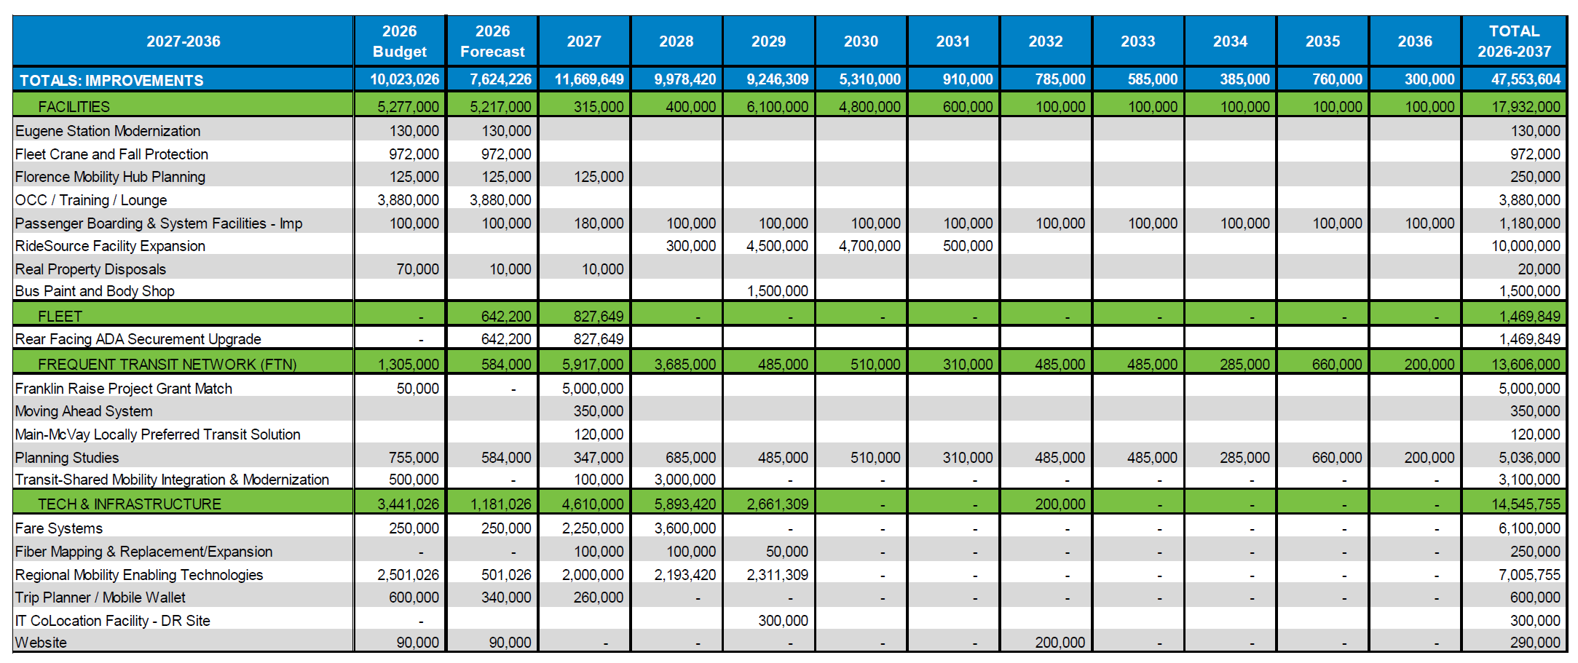
CIP Improvement – Project List
10
Notes:
Section Slide – Use the blue rectangular graphic.
Header: Calibri Light 40pt or smaller. . (Be consistent throughout. If it is smaller here, use throughout presentation.)
This is set in title case, not all capsBody: Calibri Light 28pt or smaller. Sometimes you must use bullet points. If there is no time to have your presentation designed, use square bullet points.
Icon: Use icon appropriate for section if using icons.
Avoid
1.) Making copy too small. The slide should not be a wall of text, but brief information leading the audience as the presenter speaks. Notes or large bodies of text are meant to go in this section.
2.) Avoid creating another slide to continue information. If necessary, make a two column text box and simplify the text.
Images
Need help with images? Start here: Q:\SP&M\Graphics External\Photo Archive\LTD Professional Image Library
These are images approved for public use, are professional and properly represent and support LTD’s mission, values and goals. This library will continue to grow so be sure to continue to check it.
There is a lot missing from this template, but it’s enough to get you started. As we continue to make updates, please download the template from SharePoint each and every time you create a presentation. This will ensure the most up-to-date template is being used even if a change has been made.

Slide 11
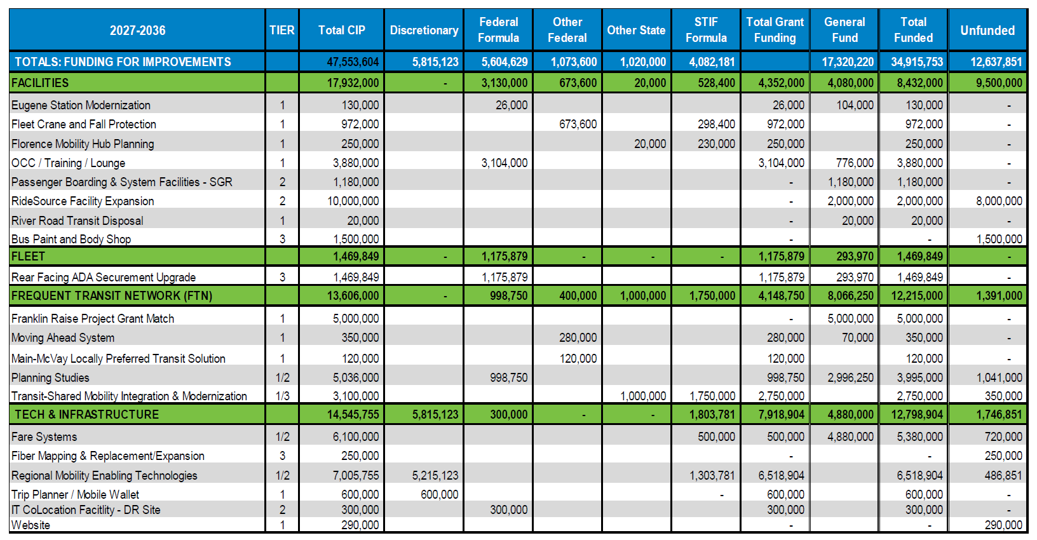
CIP Improvement – Funding Plan
11
Notes:
Section Slide – Use the blue rectangular graphic.
Header: Calibri Light 40pt or smaller. . (Be consistent throughout. If it is smaller here, use throughout presentation.)
This is set in title case, not all capsBody: Calibri Light 28pt or smaller. Sometimes you must use bullet points. If there is no time to have your presentation designed, use square bullet points.
Icon: Use icon appropriate for section if using icons.
Avoid
1.) Making copy too small. The slide should not be a wall of text, but brief information leading the audience as the presenter speaks. Notes or large bodies of text are meant to go in this section.
2.) Avoid creating another slide to continue information. If necessary, make a two column text box and simplify the text.
Images
Need help with images? Start here: Q:\SP&M\Graphics External\Photo Archive\LTD Professional Image Library
These are images approved for public use, are professional and properly represent and support LTD’s mission, values and goals. This library will continue to grow so be sure to continue to check it.
There is a lot missing from this template, but it’s enough to get you started. As we continue to make updates, please download the template from SharePoint each and every time you create a presentation. This will ensure the most up-to-date template is being used even if a change has been made.

Slide 12
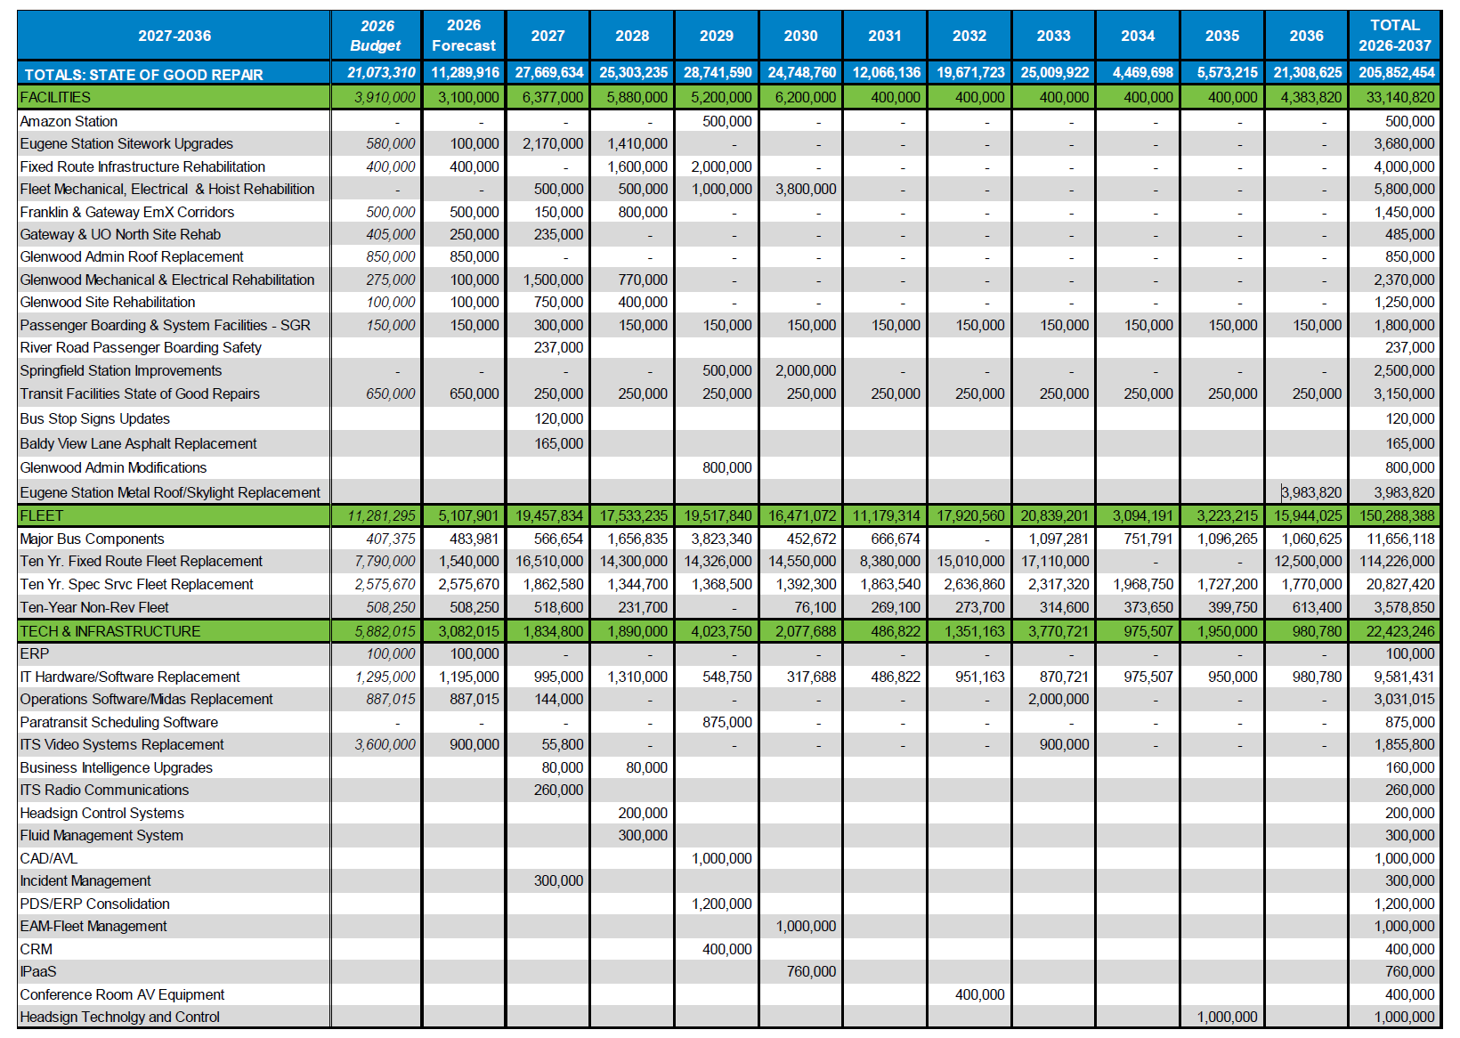
State of Good Repair – Project List
12
Notes:
Section Slide – Use the blue rectangular graphic.
Header: Calibri Light 40pt or smaller. . (Be consistent throughout. If it is smaller here, use throughout presentation.)
This is set in title case, not all capsBody: Calibri Light 28pt or smaller. Sometimes you must use bullet points. If there is no time to have your presentation designed, use square bullet points.
Icon: Use icon appropriate for section if using icons.
Avoid
1.) Making copy too small. The slide should not be a wall of text, but brief information leading the audience as the presenter speaks. Notes or large bodies of text are meant to go in this section.
2.) Avoid creating another slide to continue information. If necessary, make a two column text box and simplify the text.
Images
Need help with images? Start here: Q:\SP&M\Graphics External\Photo Archive\LTD Professional Image Library
These are images approved for public use, are professional and properly represent and support LTD’s mission, values and goals. This library will continue to grow so be sure to continue to check it.
There is a lot missing from this template, but it’s enough to get you started. As we continue to make updates, please download the template from SharePoint each and every time you create a presentation. This will ensure the most up-to-date template is being used even if a change has been made.

Slide 13
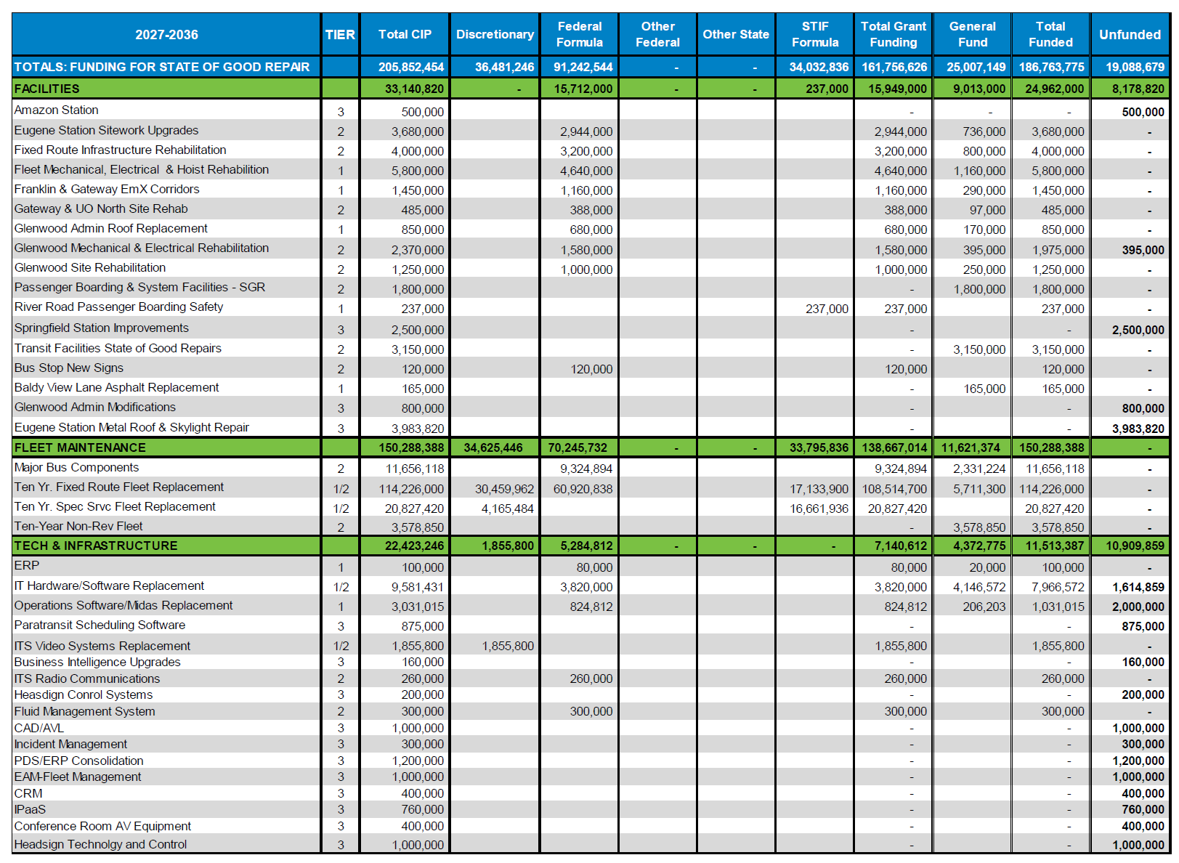
State of Good Repair – Funding Plan
13
Notes:
Section Slide – Use the blue rectangular graphic.
Header: Calibri Light 40pt or smaller. . (Be consistent throughout. If it is smaller here, use throughout presentation.)
This is set in title case, not all capsBody: Calibri Light 28pt or smaller. Sometimes you must use bullet points. If there is no time to have your presentation designed, use square bullet points.
Icon: Use icon appropriate for section if using icons.
Avoid
1.) Making copy too small. The slide should not be a wall of text, but brief information leading the audience as the presenter speaks. Notes or large bodies of text are meant to go in this section.
2.) Avoid creating another slide to continue information. If necessary, make a two column text box and simplify the text.
Images
Need help with images? Start here: Q:\SP&M\Graphics External\Photo Archive\LTD Professional Image Library
These are images approved for public use, are professional and properly represent and support LTD’s mission, values and goals. This library will continue to grow so be sure to continue to check it.
There is a lot missing from this template, but it’s enough to get you started. As we continue to make updates, please download the template from SharePoint each and every time you create a presentation. This will ensure the most up-to-date template is being used even if a change has been made.

Slide 14




Funding Strategy
FTA Funds
Federal Transportation Administration (FTA) formula funds are applied to projects such as operations, capital projects or buses, and bus facilities. LTD pursues federal discretionary grants and works with local and state representatives to get congressionally directed funding.
STIF
Oregon’s Statewide Transportation Improvement Fund (STIF) has formula and discretionary apportionments. LTD uses STIF funding for pilot service projects, rural services, match for federally-funded projects, ADA service support, and bus purchases.
General Fund
The goal for every project is to be at least 70% covered by grants, leaving no more than 30% to be paid from the General Fund transfer. Some CIP Planning projects or vehicles used by maintenance and facilities cannot be covered by grants, thus are 100% funded from an annual General Fund transfer.
Capital Budget
The full cost of projects planned for that fiscal year make up the Capital Budget. If projects are Tier 2 (funding identified but not secured) those budgeted amounts are withheld and not spent until funding is secured. The portion of the project budgets not grant funded are covered by a transfer from the General Fund to the Capital Projects Fund.
14
Notes:
Try using columns with graphics to separate information versus using bullet points.

Slide 15

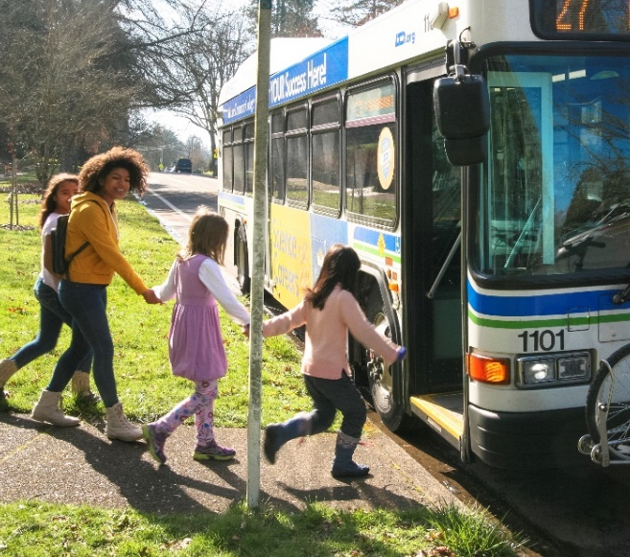
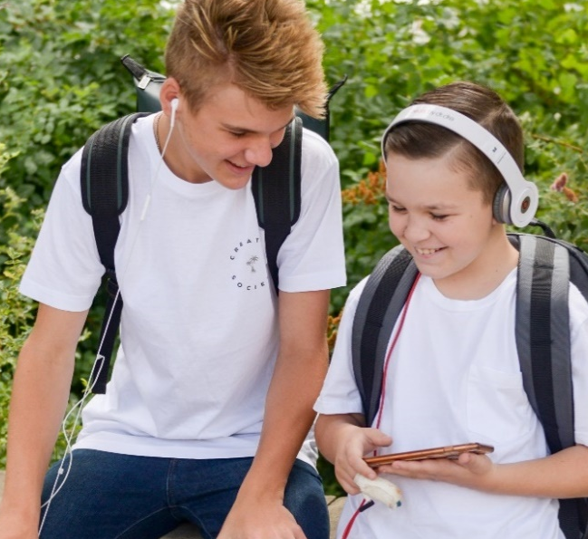
Questions
15
Notes:
Align and cop photos for optimal composition when possible.

