Slide 1
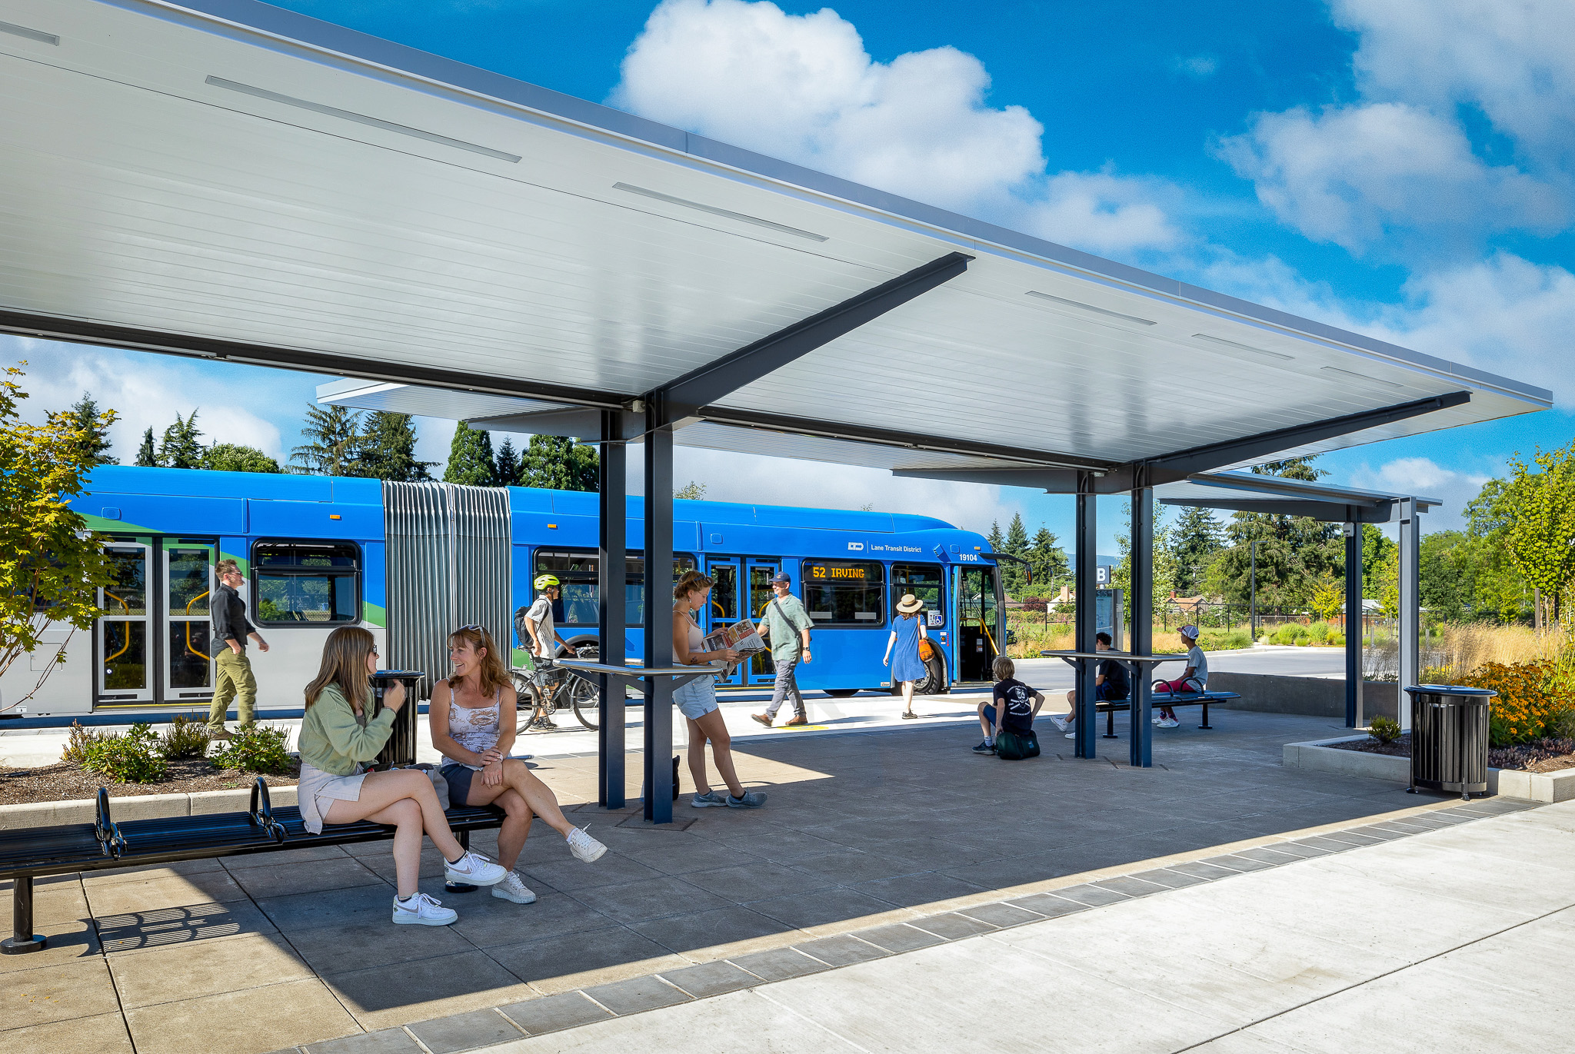
CEO Report | October Board Meeting
October 15, 2025
1
Lane Transit District | LTD.org

Slide 2
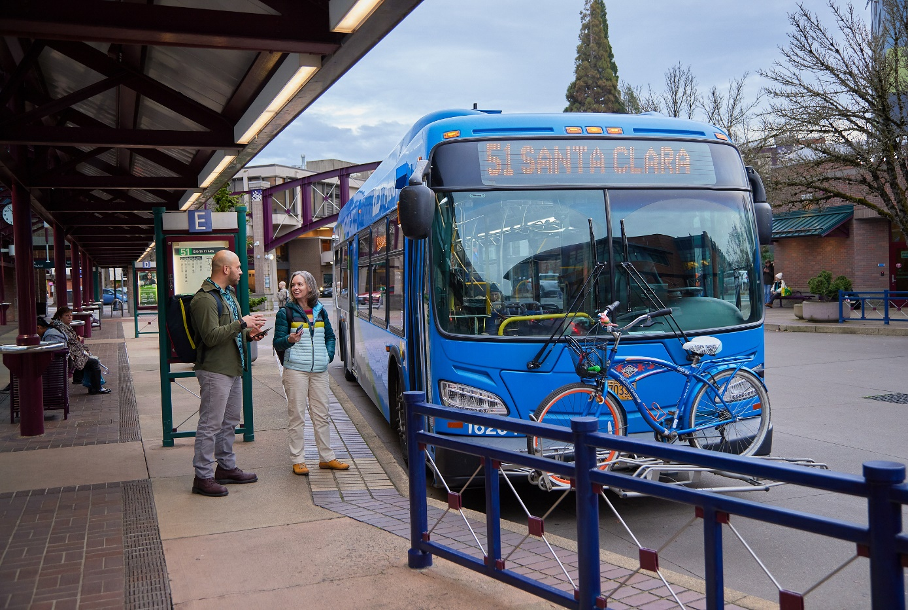

Battery Electric Bus Updates
Battery Recall on Electric Buses
Los Angeles Metro Bus Transfer
2

Slide 3
System Review Final Implementation Progress Report
Service Restoration: Four major service change intervals to restore and expand post-pandemic service
More frequent service on key routes: EmX, 12 (Gateway), and new 1 (Downtown Loop)
Expanded coverage to Willow Creek, Royal Ave., and downtown Eugene
Simpler network with route realignments and retired low-ridership routes
Community-focused: Guided by data and public feedback to match where people live, work, and learn
3

Slide 4
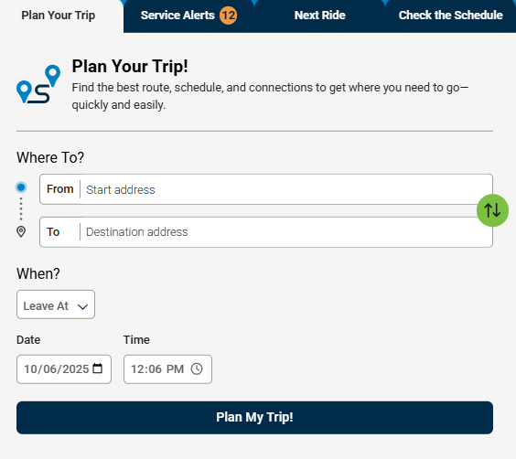
Website Launch
Launch: October 1, 2025
Key Updates:
Trip Planner
Real-time Route Information
Plans & Projects
Improved Accessibility
4

Slide 5
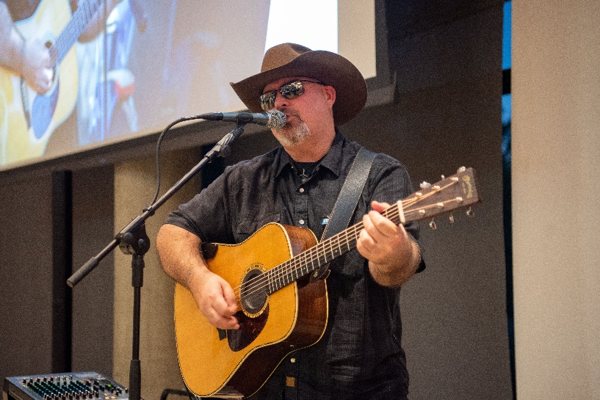
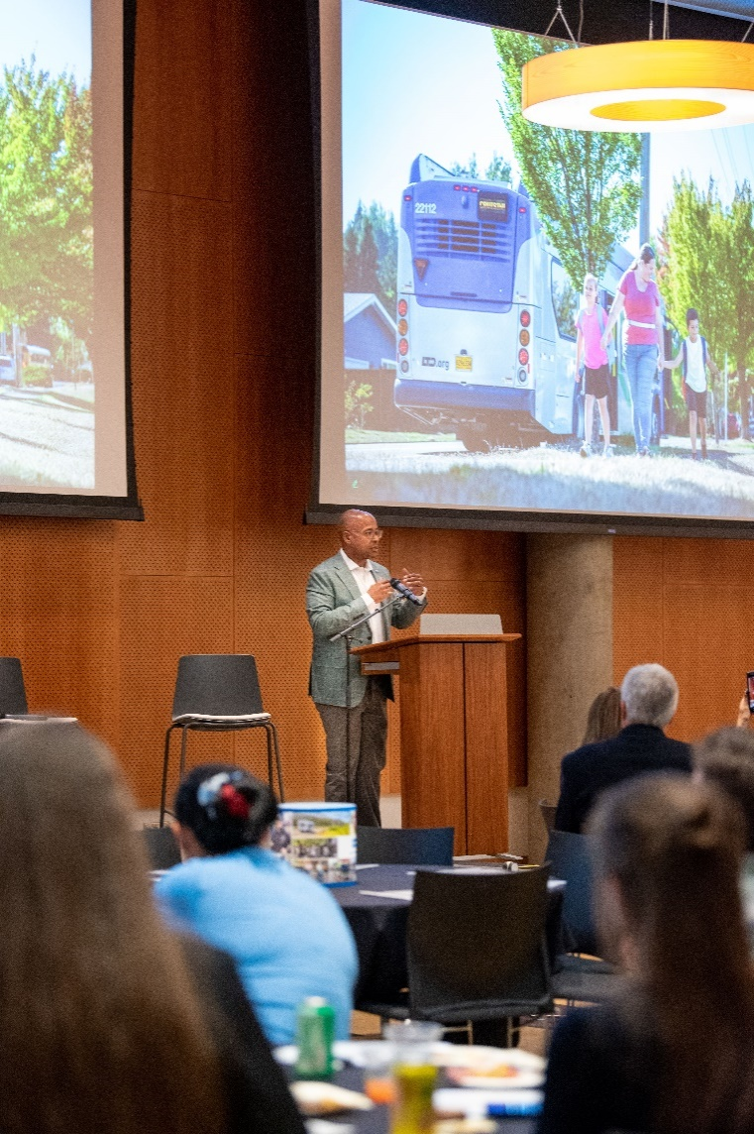
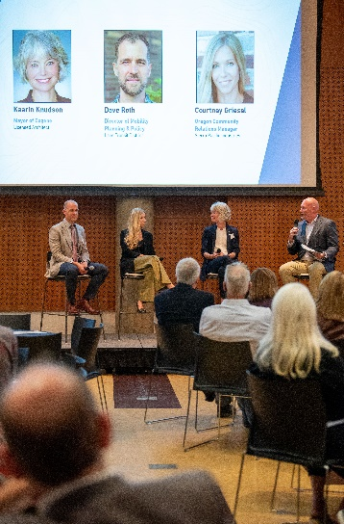
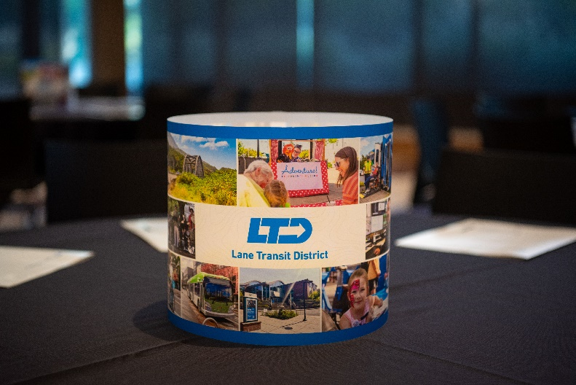
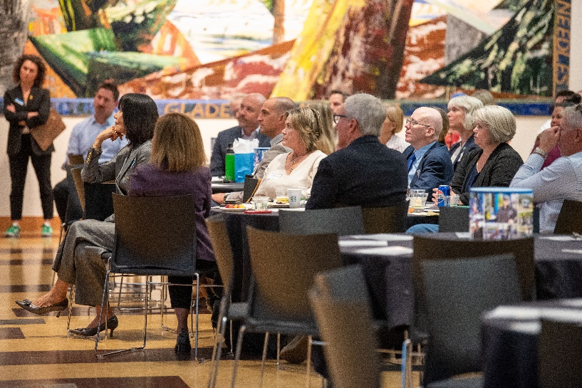
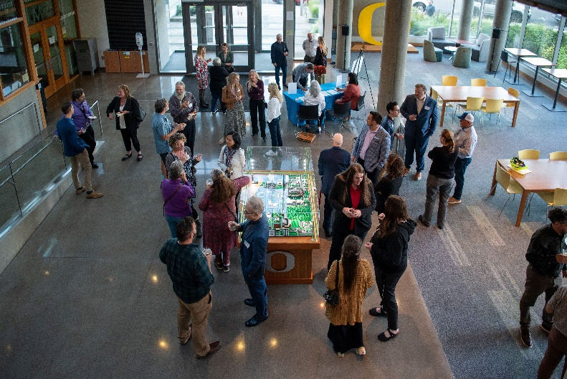
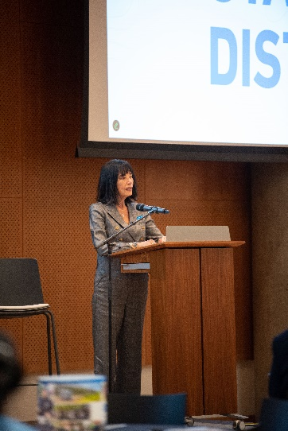
2025 State of the District Debrief
5

Slide 6
CEO Review Process & Timeline
Annual review: Aligns CEO performance with LTD’s values and strategic goals
Self-evaluation: CEO rates progress in leadership, administration, finance, Board support, and goal achievement
Timeline:
Oct 15: CEO completes self-evaluation
Oct 22–Nov 5: Directors complete evaluations
Nov 12: Final report shared with Board and CEO
Nov 19: Board conducts executive session; results summarized in open session
Next Steps: Contract update and new goals set for next year
6

