Slide 1
GROUNDWATER SOURCE CONTROL OVERVIEW NW Natural “Gasco” Site and Siltronic Corporation Facility
May 23, 2013

Slide 2
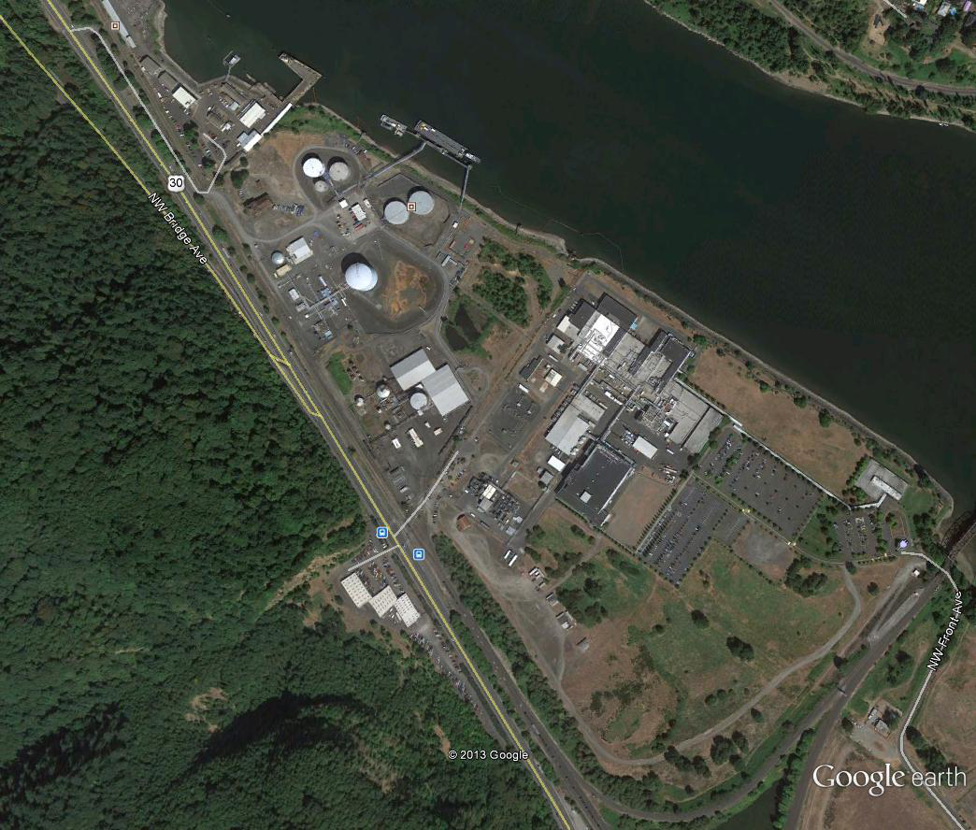
NW Natural & Siltronic Properties

Slide 3
Former Gasco MGP & Siltronic Site Background
NW Natural and Siltronic properties occupy approximately 45 and 85 acres, respectively
Properties are located between river mile 6 and 7.5
NW Natural (then known as Portland Gas & Coke [PG&C]) operated the Gasco MGP from 1912 until 1956, including using the northern portion of the Siltronic Property as an effluent overflow pond
During plant’s operational life, nearly 3 billion gallons of heavy residual fuel oil were processed into approximately 300 billion cubic feet of gas for heating and lighting Portland
Site produced MGP waste was placed in piles (lampblack, spent oxide, and gas purifier piles) and discharged to ponds (effluent discharge, settling, storage, and overflow ponds) located in non-production areas

Slide 4
Former Gasco MGP & Siltronic Site Background (cont.)
Siltronic Corporation (then Wacker Siltronic) purchased the property in 1978 for purposes of silcon-wafer manufacturing which commenced in 1980
Trichloroethene (TCE) was used from 1980-1984 during steps in the silicon wafer etching/lapping process
From 1980-1984 approximately 760,000 lbs of TCE was used annually
TCE was managed in a solvent underground storage tank system (Former TCE UST System)
Releases from the Former TCE UST System have contaminated groundwater beneath the property and commingled with MGP waste and contamination in the northern portion of Siltronic property

Slide 5
Gasco MGP Site, mid 1950’s

Slide 6
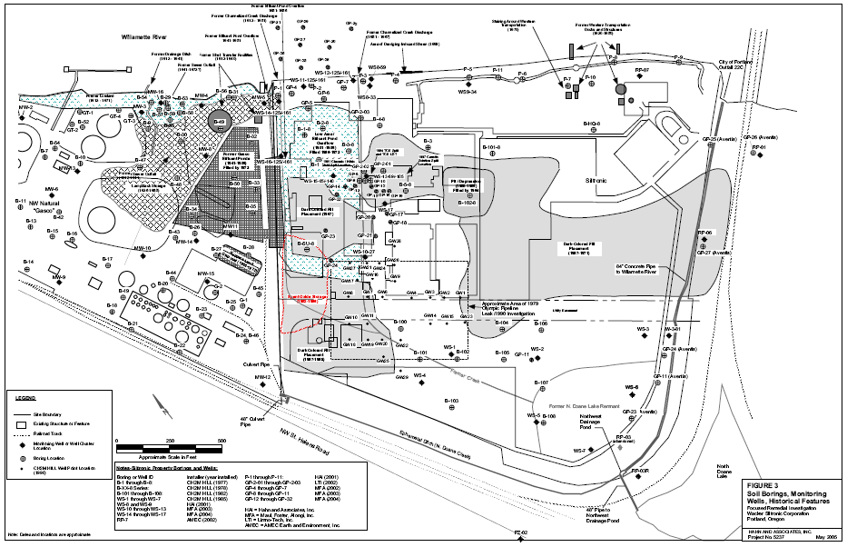
Historic Operations and Upland Source Areas of MGP Contamination

Slide 7
Naphthalene (ug/L, looking towards river)

Slide 8
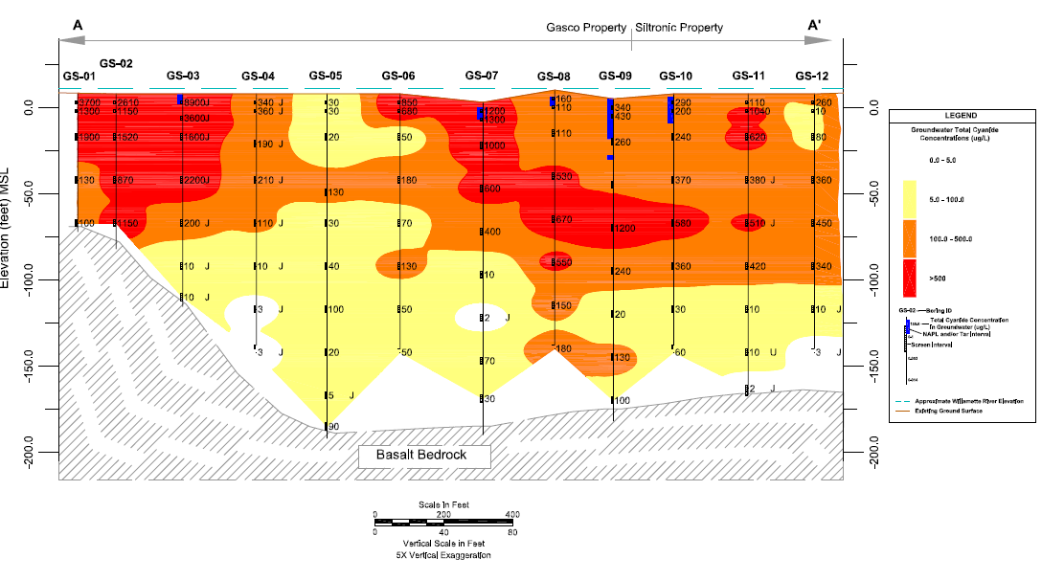
Total Cyanide (ug/L, looking towards river)

Slide 9
Total Cyanide (ug/L, looking downstream)

Slide 10
Siltronic Current Operations & VOC Plume

Slide 11
Upland COIs
NW Natural – PAHs, BTEX and TMBs, Acid Extractables & Phenolics (e.g., carbazole, dibenzofuran, 2-methylnaphthalene, phenol), metals (As, Cd Cr, Cu, Pb, Ni, Va, Zn), Total & Free CN
Siltronic – TCE, cis-1,2-DCE, trans-1,2-DCE, 1,1-DCE, vinyl chloride
Depending on location and media, COIs generally exceed JSCS SLVs by factors greater than 10 to 1000 or more

Slide 12
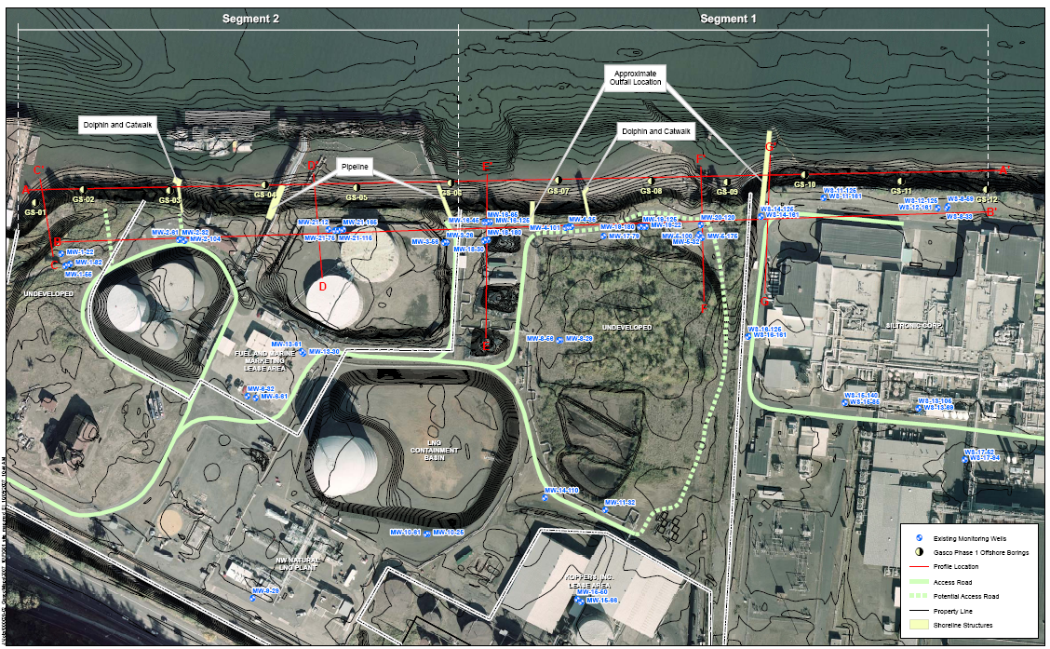
Groundwater Source Control - Shoreline Segments 1 and 2

Slide 13
Groundwater Source Control - Shoreline Segment 1 & 2 (cont.)
The shoreline of the former Gasco site and the northern portion of the Siltronic Property were identified as high priorities for source control and divided into two segments:
Segment 1: Coincides with the heaviest MGP-related impacts identified near the river, including DNAPLs, impacted riverbank soils, and contaminated groundwater
Also includes groundwater contamination caused by Siltronic that has commingled with MGP-related DNAPL and groundwater contamination
Segment 2: Extends downstream to the property line with US Moorings, identified as a high priority based on concentrations of MGP chemicals of interest (COI), particularly cyanide, in riverbank soils and groundwater.

Slide 14
Groundwater Source Control RAOs
Prevent migration of contaminated groundwater from the uplands to the Willamette River along shoreline segments 1 and 2; and
Minimize potential DNAPL mobilization resulting from operating groundwater SCMs along the portion of Segment 1 where DNAPLs occurs.

Slide 15
Groundwater SCMs
Fill WBZ, Segments 1 & 2 – current preferred alternative is a fully-penetrating interceptor trench
Alluvium WBZ, Segments 1 & 2 - hydraulic control/containment (HC&C) of contaminated groundwater
Alluvium WBZ, portion of Segment 1 where DNAPL occurs) –upper tier of gradient control/offset wells
Groundwater treatment and discharge
Riverbank SCMs
Riverbank soils SCMs (e.g., repair, stabilization, and removal) will be designed and implemented during in-water sediment action under EPA oversight

Slide 16
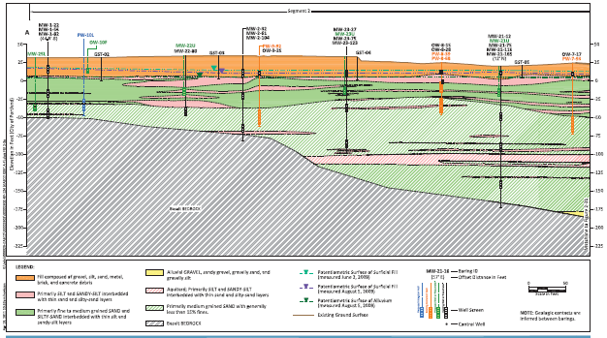
Alluvium WBZ HC&C System

Slide 17
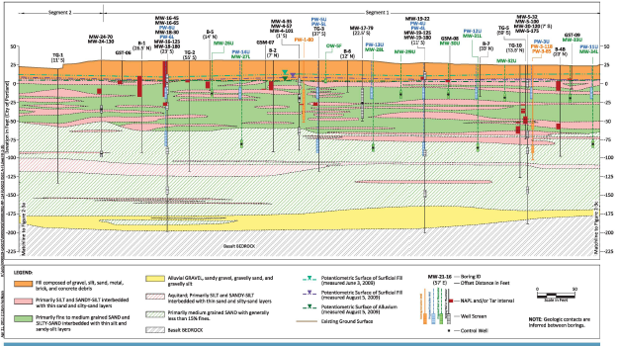
Alluvium WBZ HC&C System (cont.)

Slide 18
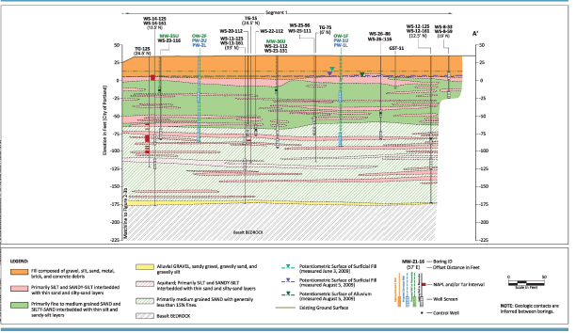
Alluvium WBZ HC&C System (cont.)

Slide 19
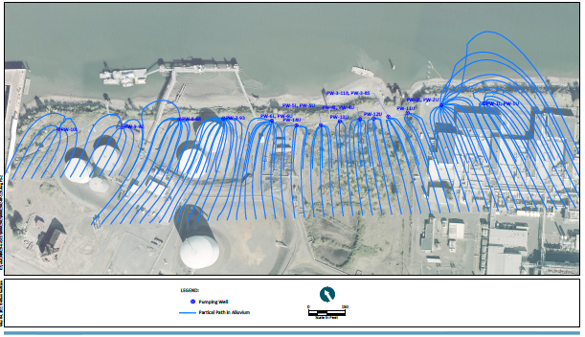
Alluvium WBZ HC&C System – Capture Zone

Slide 20
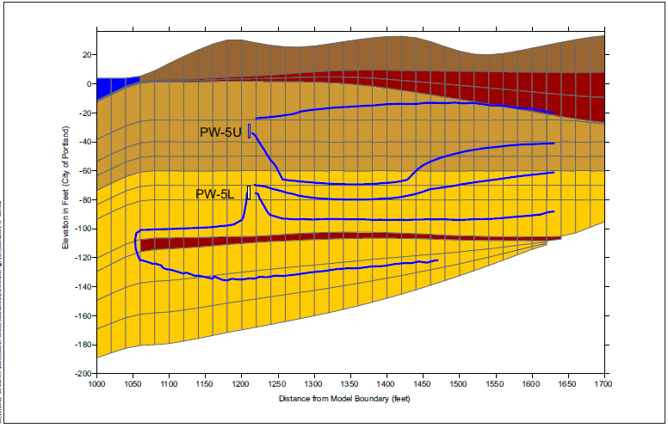
Alluvium WBZ HC&C System – Capture Zone (vertical)

Slide 21
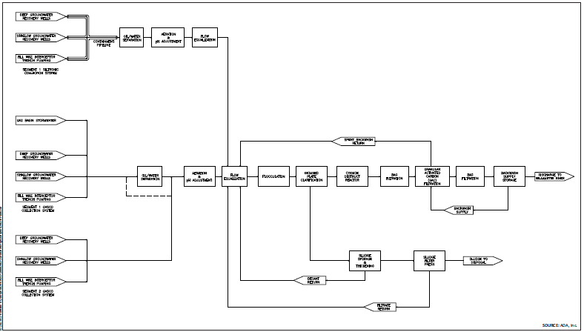
Treatment System Process Flow Diagram

Slide 22
Groundwater Source Control Implementation
Final design process initiated in the winter of 2011 and completed in early fall 2012
Extraction wells and performance monitoring wells in place
Treatment system building and piping under construction
Initial testing phase anticipated for late-summer/early-fall
Initial testing phase will transition into a long-term testing period with full-time operation to follow

Slide 23
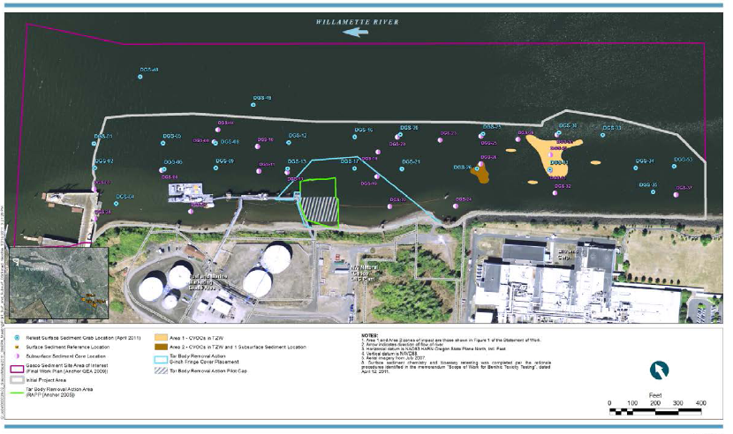
In-water Sediment Project Area

Slide 24
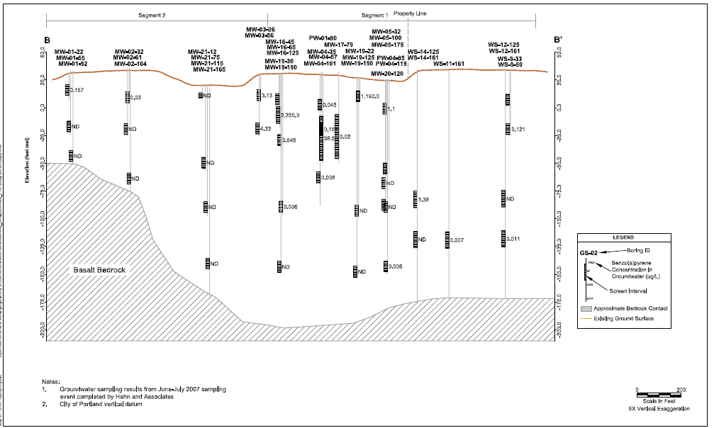
Benzo(a)pyrene (ug/L)

Slide 25
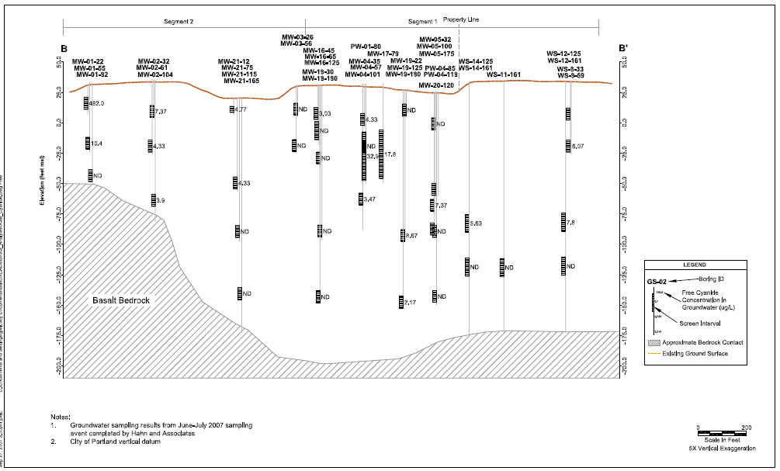
Free Cyanide (ug/L)

Slide 26
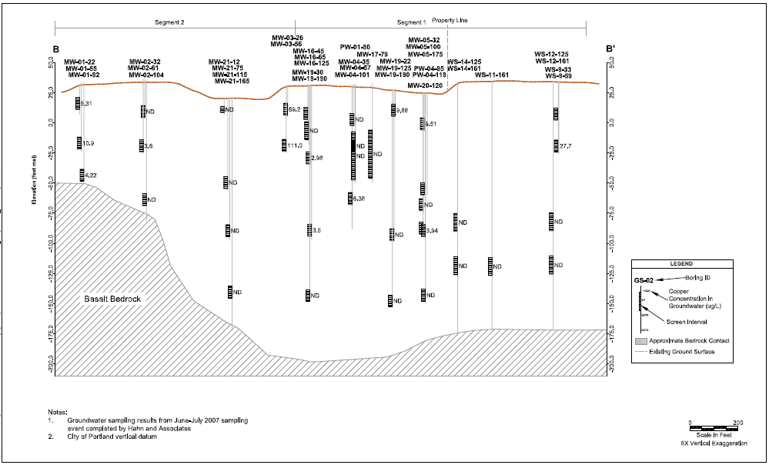
Copper (ug/L)

Slide 27
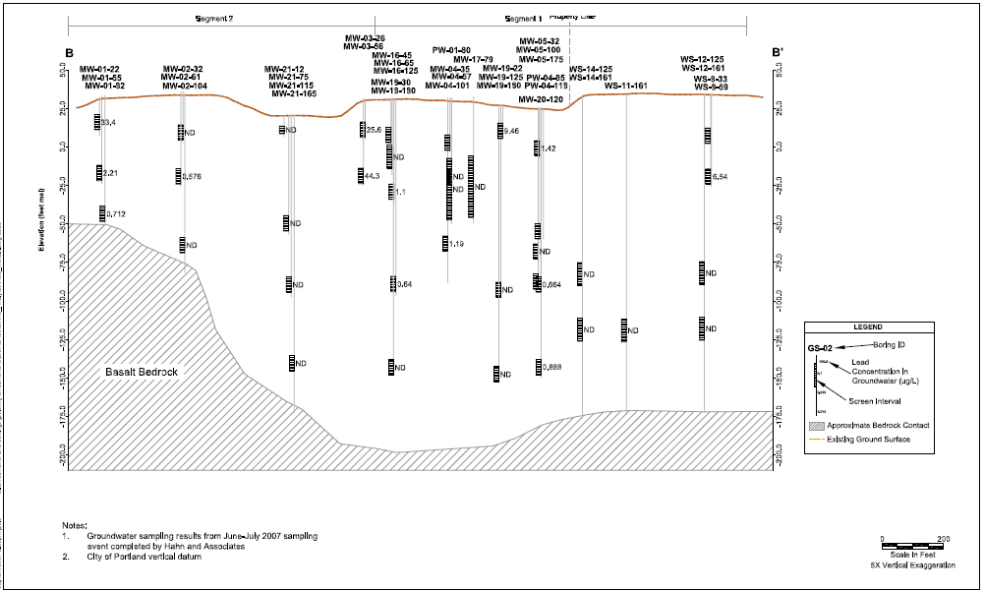
Lead (ug/L)

Slide 28
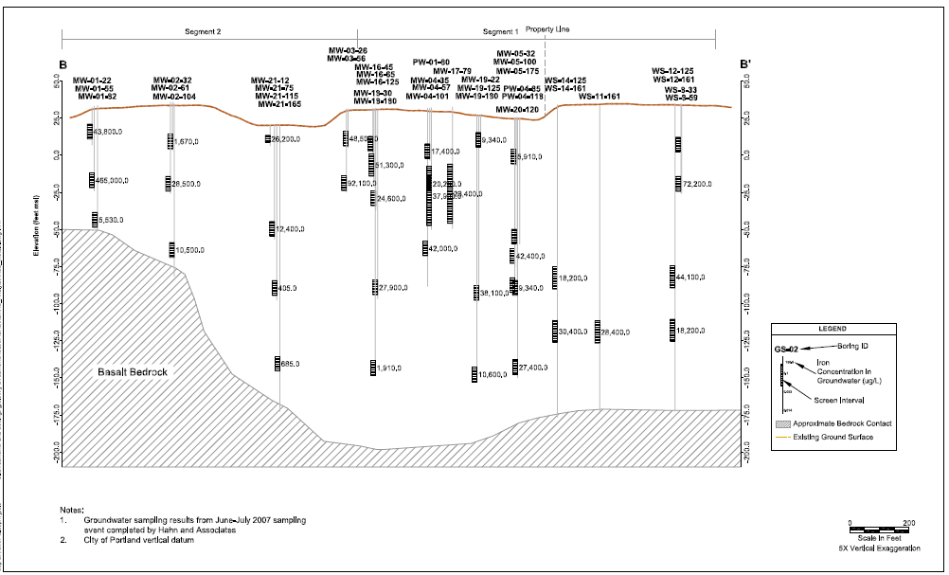
Iron (ug/L)

