Slide 1
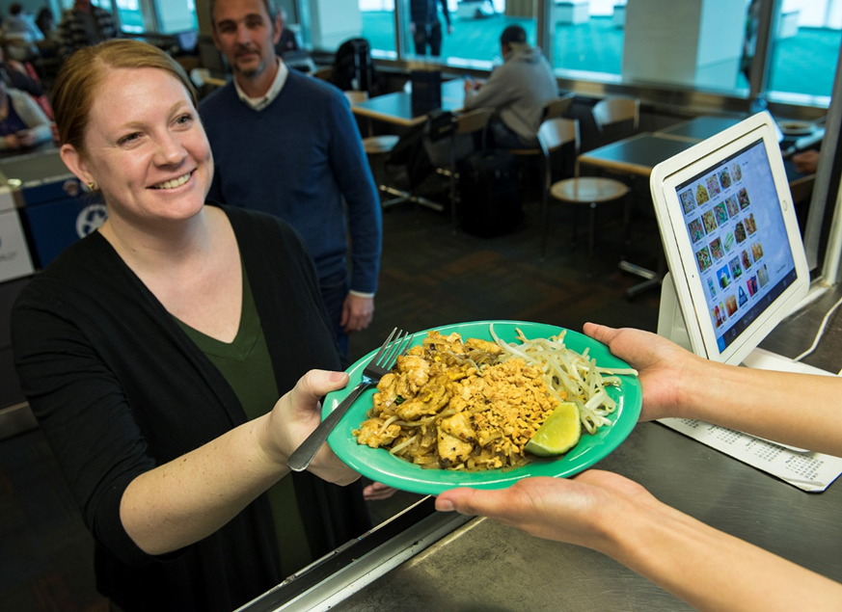
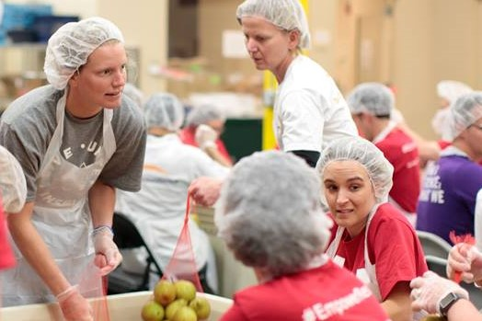
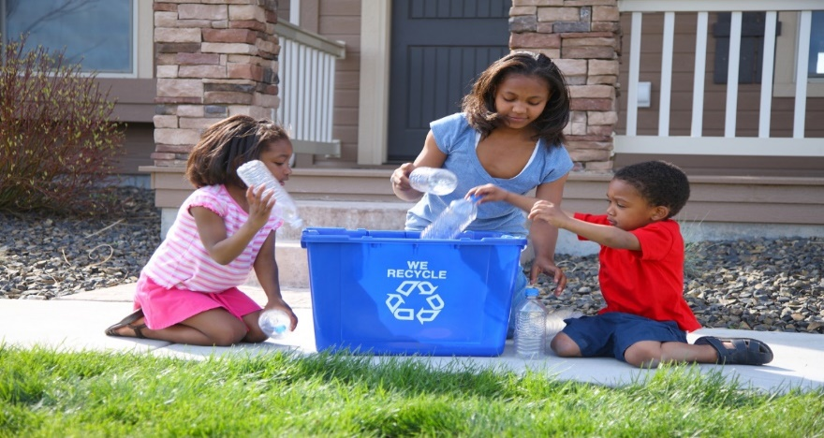


Materials Management Grants
Environmental Quality Commission Meeting
May 17, 2019
Shannon Davis, Materials Management Manager
Julie Derrick , JD’s Shoe Repair Founder
Marie Diodati, Grants Coordinator

Slide 2
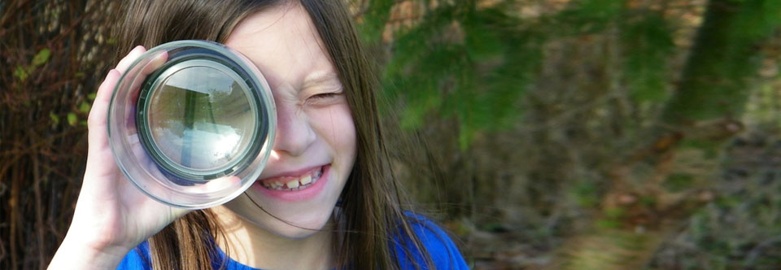
Agenda
Background
Grant Program Structure and Themes
Workforce Development Grant Projects
JD’s Shoe Repair Project
2018 Materials Management Grants
Supporting projects that promote
waste prevention, reuse and recovery
to strengthen Oregon communities and protect our environment.
Photo of 2018 recipient Oregon Green Schools

Slide 3
materials management conserving resources · protecting the environment · living well
Materials Management Research
Materials Management Projects
Grants
Notes:
Annual program

Slide 4
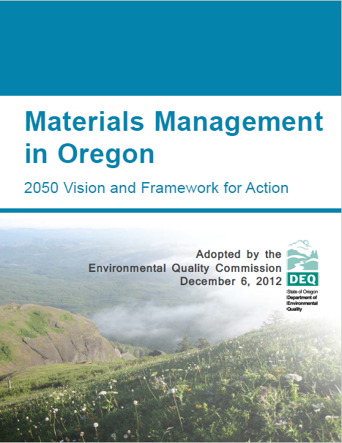
Background
Embody Materials Management’s 2050 Vision
Support project grants
Support planning grants
Keep products in service longer
Create new paid jobs to increase/grow the reuse and repair industries

Slide 5
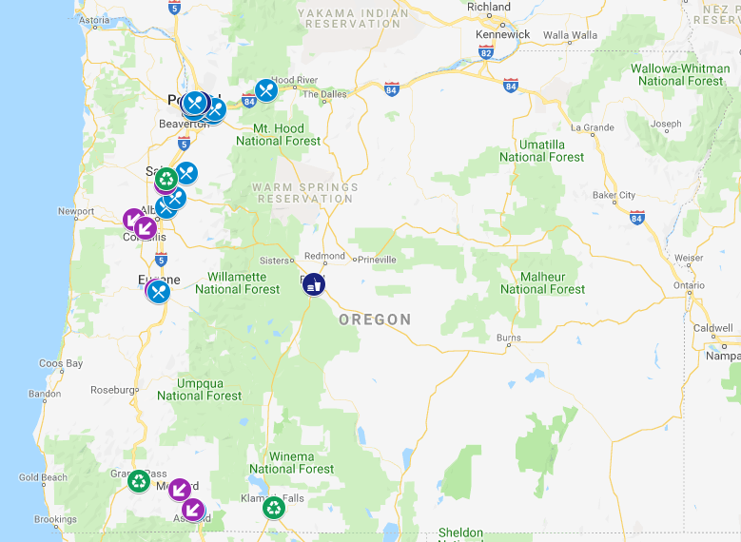
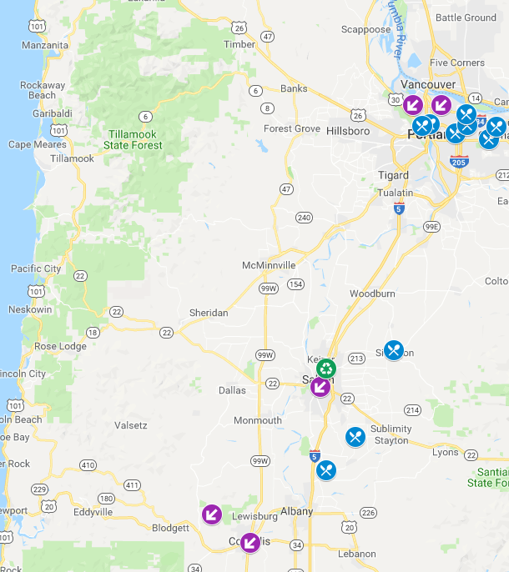
2017-2018 Reach
Notes:
https://www.google.com/maps/d/edit?hl=en&mid=1J5o12C4zwNiny94hR2VbKpYw2r01OpNc&ll=45.15918239858602%2C-122.90809305194341&z=9

Slide 6
Grant Summaries
Since 1991 over 8 million dollars in grants
Since Oregon’s Materials Management 2050 Vision, 2015-2018,:
  90 projects
  Over $3.1M allocated funds
  Average median amount/grant: $33,000
2018 general grant program
  16 projects
  $600,000
2017 workforce development grant program supporting reuse and repair
  5 projects
  $50,000

Slide 7






Focus Areas
Workforce development in a reuse and repair businesses
Prevent the wasting of food
Reduce solid waste generation
Establish, restore, or enhance recycling infrastructure or composting infrastructure (i.e., facilities and equipment) in rural communities
Help a local government exceed its waste prevention and/or reuse requirements of the Opportunity to Recycle Act.
Serve economically distressed or otherwise distressed communities

Slide 8
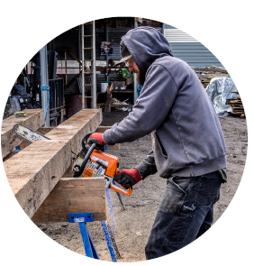
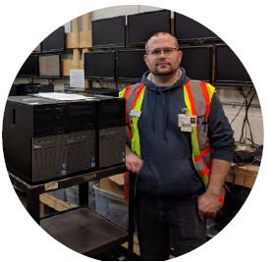
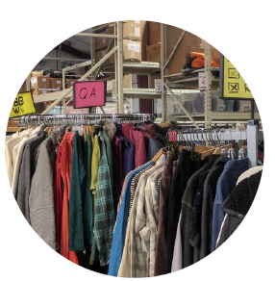
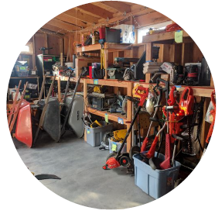
Workforce Development Grants in Reuse and Repair Industry
Portland
Salem
Garten Recycling
Provides large-scale recycling for communities and job training and employment opportunities for adults with intellectual and/or cognitive disabilities
Trained two adults with disabilities
Salvage Works
Reclaimed wood business
Offers a curated selection of heritage lumber, distinct wall cladding and custom furniture
Hired a new employee to increase capacity for reusing salvaged wood
Cascade Locks
The Renewal Workshop
Works with outdoor apparel companies and manage factory defects
Two employees hired
Increased repair capacity by 25%
Added three new sewing machines
Eugene
The Toolbox Project
Nonprofit, volunteer-driven tool- lending library
Hired an operations manager to improve financial self-sufficiency and expand services
Membership increased by 42%

Slide 9
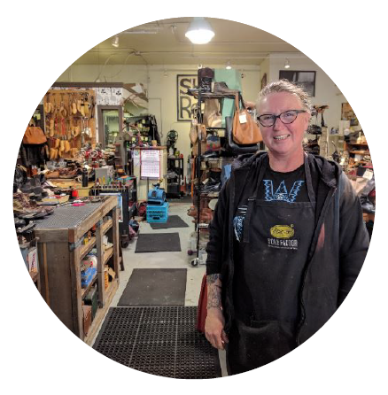
JJD’s Shoe Repair, Portland, $10,000
Grantee from the Workforce Development Grant Program
How did this grant help your business?
What is the most successful part of your grant project?
How did this grant affect you personally?
Thank you, Julie!

