Slide 1
Salmon, Spill, and the Flexible Spill Agreement
Tucker Jones
Oregon Department of Fish and Wildlife
17 May 2019

Slide 2
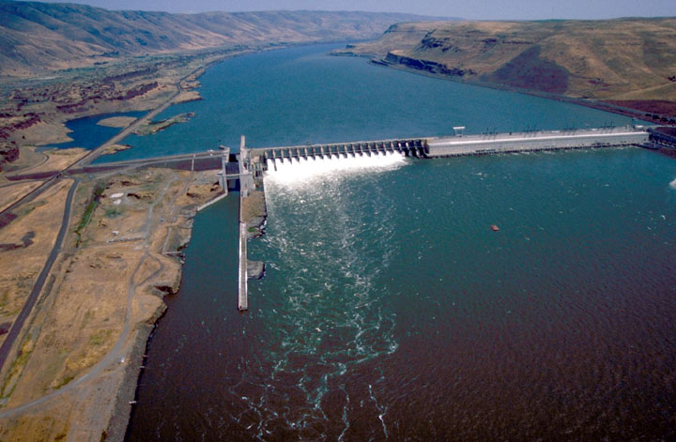
What is Spill?
Flow over spillway
Power house flow
John Day Dam

Slide 3
Snake River Wild Spring/Summer Chinook
Survival
Survival (median ln(S/S))
Kcfs @ Lower Granite Dam
Spill
Smolt Migration Year

Slide 4
Snake River Wild Spring/Summer Chinook
SARs as a function of FCRPS operations
Smolt-to-Adult Return
(SAR)
Prospective model results from Comparative Survival Studies (CSS)

Slide 5
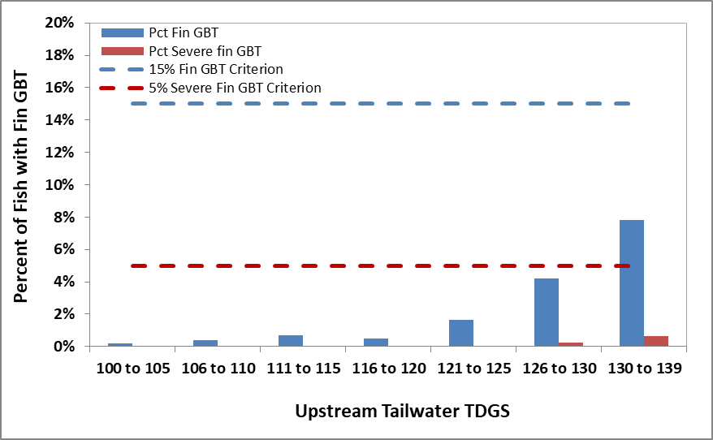
Spill Effects on Salmon
Summary of Gas Bubble Trauma Samples (1995-2018) as a function of TDG

Slide 6
Balancing Spill and Power
Spill is good for fish, but not power
Changing power markets and a surge of renewables (e.g., solar) provide a unique opportunity to increase spill for fish conservation w/out increasing power costs
The Agreement provides a more flexible approach to spill and power production to benefit fish, power and integration of renewables
  Prioritize spill for fish conservation when hydropower profitability is lower
  Reduce spill and prioritize power production when hydropower is most profitable

Slide 7
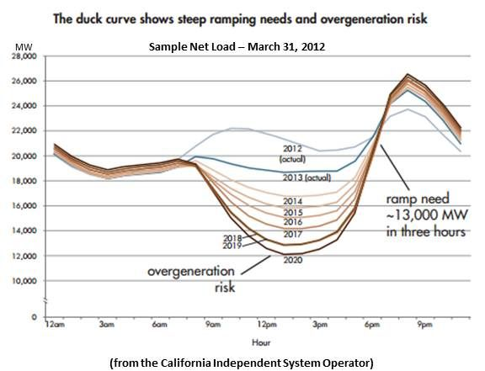
Balancing Spill and Power

Slide 8
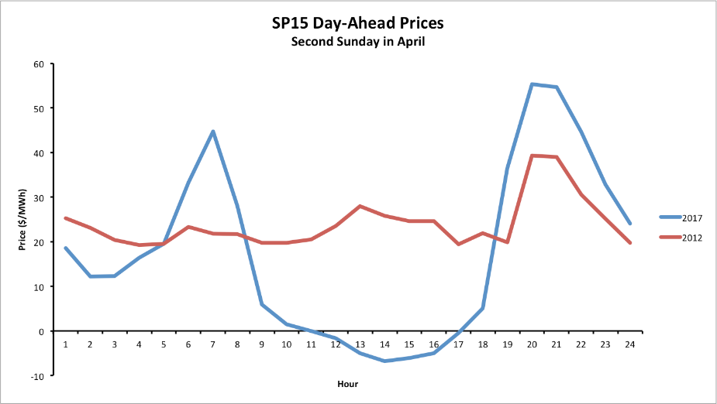
Balancing Spill and Power
Less Spill (4hr)
Less Spill (4hr)
More Spill (8hr)
More Spill (8hr)

Slide 9
Prospective models: Average SARs
Chinook salmon
Duck 125%
Smolt-to-Adult Return
(SAR)
FCRPS Spill Operation

Slide 10
Flexible Spill and Power
For this approach to work, must optimize benefits of spill during hours when hydropower is least profitable
  Agreement is contingent on WA and OR modifying water quality allowances for 125% TDG during these priority spill hours
Preliminary analyses
  2019: fish benefits > injunction spill; power > injunction
  2020-21: fish benefits > injunction spill; power > injunction
3-yr Agreement, forebear litigation, focus on NEPA process

Slide 11
Next Steps
Agreement Signed
Dec 2018
WA 120% TDG Modification
March 2019
OR/WA 125% TDG Modification*
Flex Spill Evaluated in the CRSO EIS
Flex Spill Operations April 2020*
Flex Spill Operations
April 2019
* Next steps contingent on future TDG modifications

