Slide 1
Environmental Quality Commission Meeting
  Renewal of the Columbia River
  Total Dissolved Gas Modified Standard
Agenda Item K, Information Item
May 17, 2019
Portland
Environmental Quality Commission Meeting
Paula Calvert | Oregon Department of Environmental Quality

Slide 2
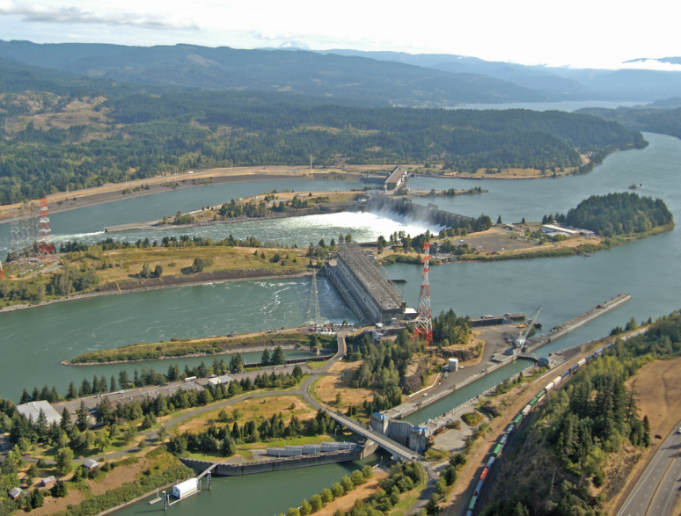
Overview
Modified standard renewal
Definitions
Clean Water Act
Endangered Species Act
Standard modification seeks to create regulatory balance
Next steps
Questions and discussion

Slide 3
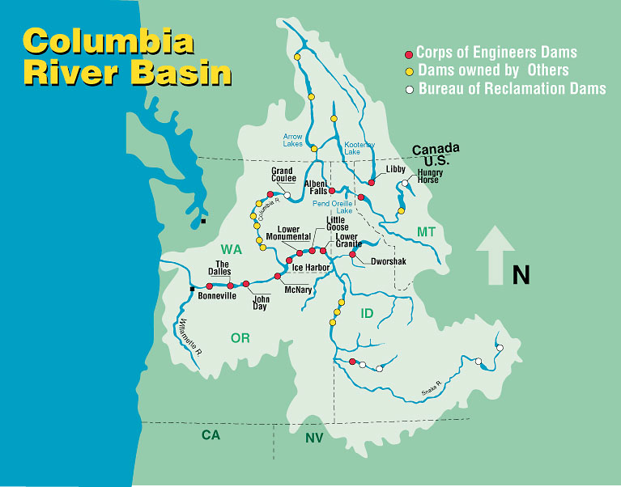
Columbia River Total Dissolved Gas Modified Standard
Lower Columbia River Dams
McNary
Environmental Quality Commission Meeting

Slide 4
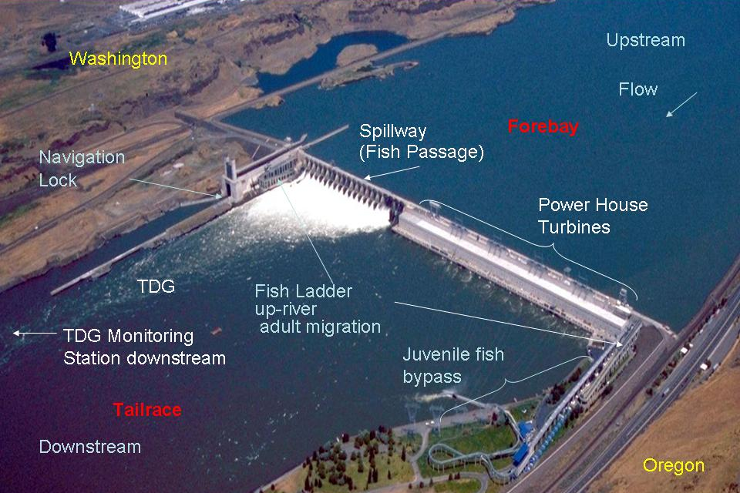
Columbia River Total Dissolved Gas Modified Standard
John Day Dam – Fish passage
Environmental Quality Commission Meeting

Slide 5
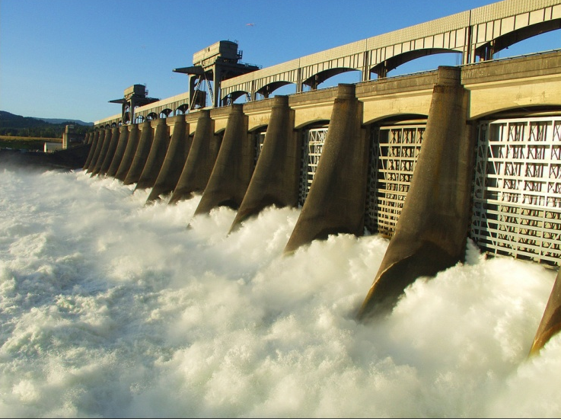
Definitions
Total dissolved gas
  Air (oxygen and nitrogen) dissolved in water
  Caused by
    Plunging water that entrains air
    Water pressure forcing air into solution
  High levels can be detrimental to fish health
Spill
  Water passing over the spillway
  Increases total dissolved gas
  Improves survivorship of juvenile salmonid migration past dams

Slide 6
Definitions
Gas bubble trauma
  Caused by gas bubbles forming in the cardiovascular system
  Gas bubbles block
    Blood flow
    Respiratory gas exchange
  GBT is a function of total dissolved gas level and exposure length
    Total dissolved gas levels above 110 percent of saturation can cause gas bubble trauma in fish

Slide 7
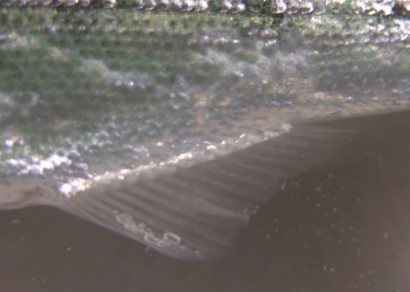
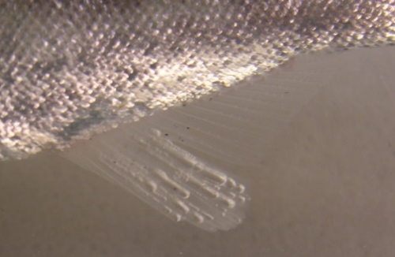
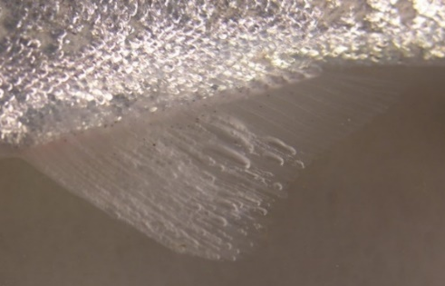
Definitions
Increasing severity of gas bubble trauma
Photos curtesy of Fish Passage Center
Notes:
These photos show increasing severity of GBT and are used by Fish Passage Center during biological monitoring training. The GBT shown here is from artificially induced high TDG and exposure time in tanks for the purpose of getting these photos for training.

Slide 8
Columbia River Total Dissolved Gas Modified Standard
Current modified standard
  120 percent total dissolved gas
  In effect 2015-2019, in the tailrace during the April 1 to August 31 spill season
Renewed modified standard expected request
  2018 agreement between states, federal agencies and Nez Perce tribe
    125 percent total dissolved gas
    April 1, 2020, is start of seasonal juvenile salmonid migration

Slide 9
Clean Water Act
Applicable regulations
  110 percent, except
    During flood flow conditions
    In hatchery-receiving waters and other waters less than two feet deep (105 percent)
  Commission has authority to issue orders to modify total dissolved gas for benefit of salmon migration in the Columbia River

Slide 10
Clean Water Act
Applicable regulations
  The Commission must find that
    Failure to act would result in greater harm to salmonid stock survival through in-river migration than would occur by increased spill;
    The modified total dissolved gas criteria associated with the increased spill provides a reasonable balance of the risk of impairment due to elevated total dissolved gas to both resident biological communities and other migrating fish and to migrating adult and juvenile salmonids when compared to other options for in-river migration of salmon;
    Adequate data will exist to determine compliance with the standards; and
    Biological monitoring is occurring to document that the migratory salmonid and resident biological communities are being protected.

Slide 11
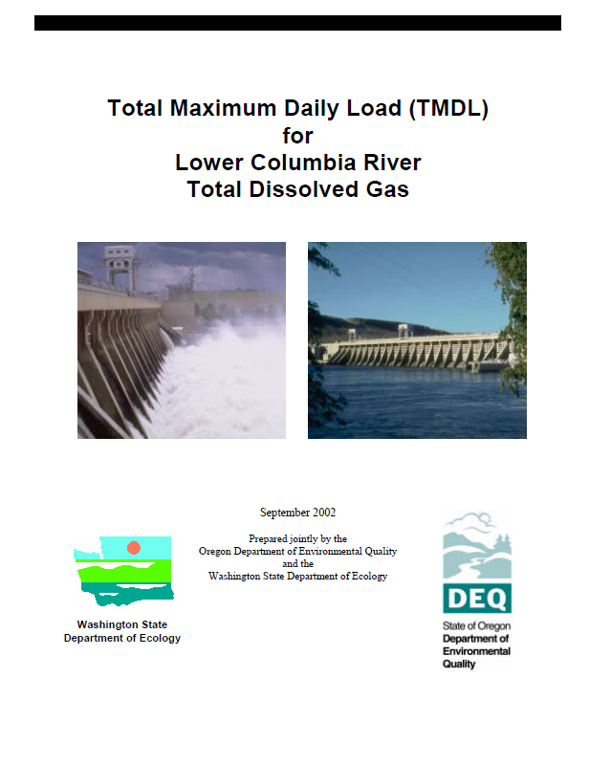
Clean Water Act
Total Maximum Daily Load
  Issued by Oregon and Washington with EPA approval in 2002
  Meet 110 percent total dissolved gas criteria while allowing voluntary fish passage spill by 2020
  Corps implements operational and structural modifications

Slide 12
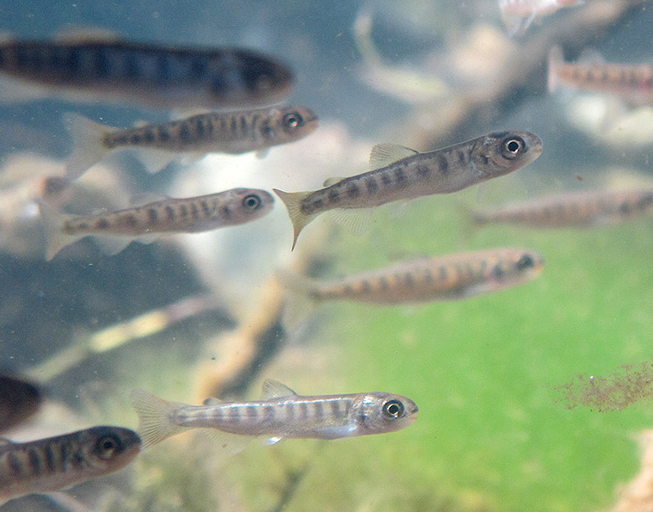
Endangered Species Act
Biological Opinion for the Federal Columbia River Power System
  13 endangered salmonid evolutionarily significant units
  Issued 2008, with 2014 supplemental opinion
  Identifies performance measures and criteria
  Reasonable and prudent alternative actions
    Minimum spill amounts to assist juvenile salmonid migration

Slide 13
Columbia River Total Dissolved Gas Modified Standard
Modified standard seeks regulatory balance
Clean Water Act
  Reduces risk associated with spill
  Total dissolved gas standard modification used to set maximum spill levels
Endangered Species Act
  Increases benefit associated with spill
  Biological Opinion RPA action sets minimum spill levels

Slide 14
Columbia River Total Dissolved Gas Modified Standard
Current modified standard
  120 percent total dissolved gas applies during
    April 1 – August 31 for fish passage
    Outside of fish passage season
      Maintenance activities
      Biological or physical studies of spillway structures
  Requirements
    Physical monitoring of total dissolved gas
      Spill reduction upon water quality exceedance
    Biological monitoring for gas bubble trauma
      Spill program halts with specific degrees of gas bubble trauma
    Annual reporting

Slide 15
Columbia River Total Dissolved Gas Modified Standard
2019-2021 Spill Operation Agreement
  Request for 125 percent standard modification
  Entered on December 14, 2018, by
    State of Oregon
    State of Washington
    Nez Perce Tribe
    Bonneville Power Administration
    Bureau of Reclamation
    US Army Corps of Engineers

Slide 16
Next Steps
US Army Corps of Engineers to submit formal request
DEQ will work with the Corp and ODFW to evaluate factors associated with justification of 125% total dissolved gas standard modification
August - 30-day public comment period
September EQC meeting – DEQ and co-presenters will present an informational item
November EQC meeting - modified standard request presented as an action item

Slide 17
Columbia River Total Dissolved Gas Modified Standard
EQC Questions
and
Discussion
Thank you
Paula Calvert
Columbia River Coordinator

