Slide 1
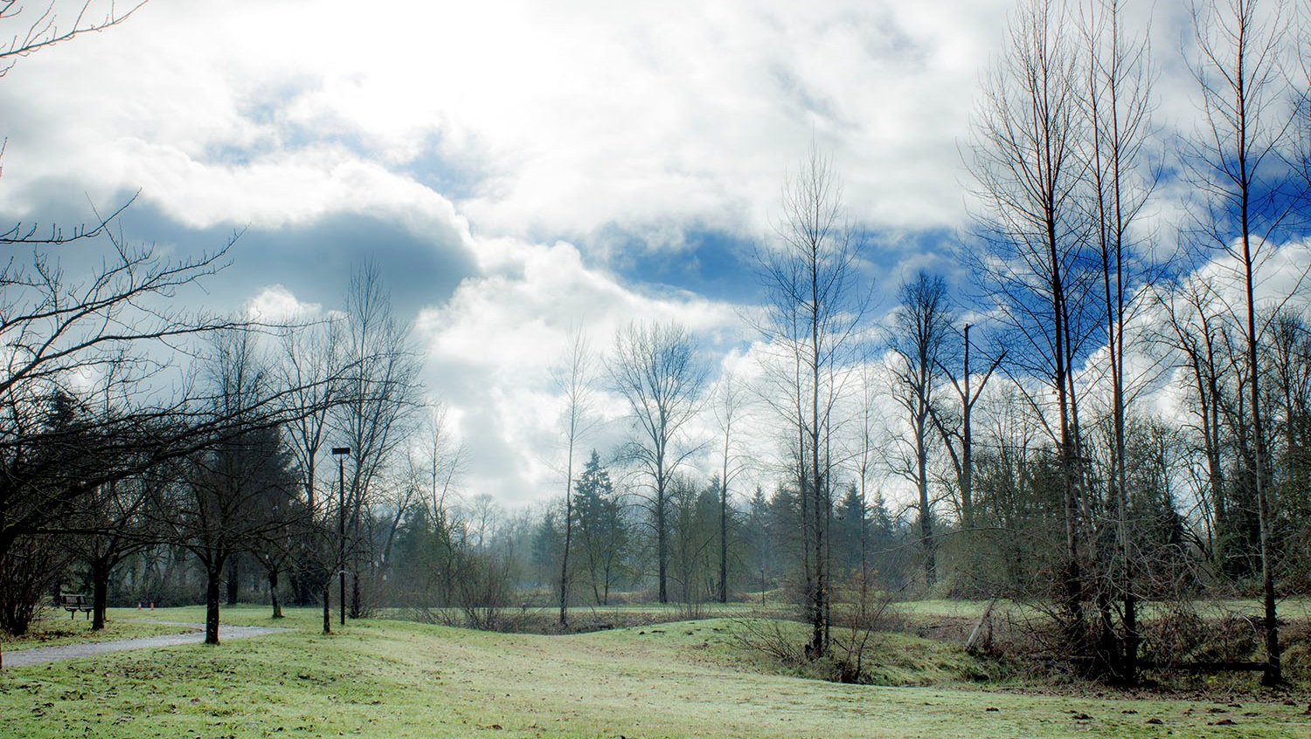

Proposal to Incorporate LRAPA Cleaner Air Oregon Rules into the Oregon SIP
May 16-17, 2019 EQC Meeting

Slide 2
LRAPA Rules – Background and What is Proposed
LRAPA regulates air quality in Lane County
The Cleaner Air Oregon(CAO) program rules have been in effect in Lane County since adopted by the Commission on November 15, 2018
LRAPA rules are effectively equivalent to DEQ rules
DEQ’s role is to review LRAPA rules to determine compliance with state law and the federal Clean Air Act
EQC’s role is to approve the LRAPA rules if they comply and direct DEQ to submit to EPA for approval as SIP amendments
Rule Amendments:
  LRAPA administrative rule changes to synchronize existing rules with EQC-adopted CAO rules.
  LRAPA Board adopted staff’s proposed CAO changes on March 14, 2019

Slide 3
LRAPA Rules – Cleaner Air Oregon
Implement OAR 340 division 245 – Cleaner Air Oregon without changes
  Due to the scope, detail, public input and technical expertise that went into the creation of the new, risk-based toxics program, LRAPA will implement OAR 340 division 245 - Cleaner Air Oregon by reference without any changes.
LRAPA’s rule revisions are administrative changes to synchronize existing rules with the new CAO program.
  Adds definitions, enforcement clarifications, and a fee table.
The LRAPA Board of Directors adopted the proposed rule revisions on March 14, 2019.
Four (4) people submitted comments. One comment resulted in changes to an aspect of the enforcement rules in LRAPA’s title 15 to more closely align with DEQ’s corresponding division 12.

Slide 4
Recommended motion
“I move that the Oregon Environmental Quality Commission:
  Approve the LRAPA rule amendments as seen in Attachment A under ORS 468A.135(2); and
  Approve incorporating the LRAPA rule amendments as seen in Attachment B into the Oregon Clean Air Act State Implementation Plan under OAR 340-200-0040; and
  Adopt the proposed SIP rule revision in Attachment C as part of Chapter 340 of the Oregon Administrative Rules; and
  Direct DEQ to submit the SIP revisions to the U.S. Environmental Protection Agency for approval.”

Slide 5
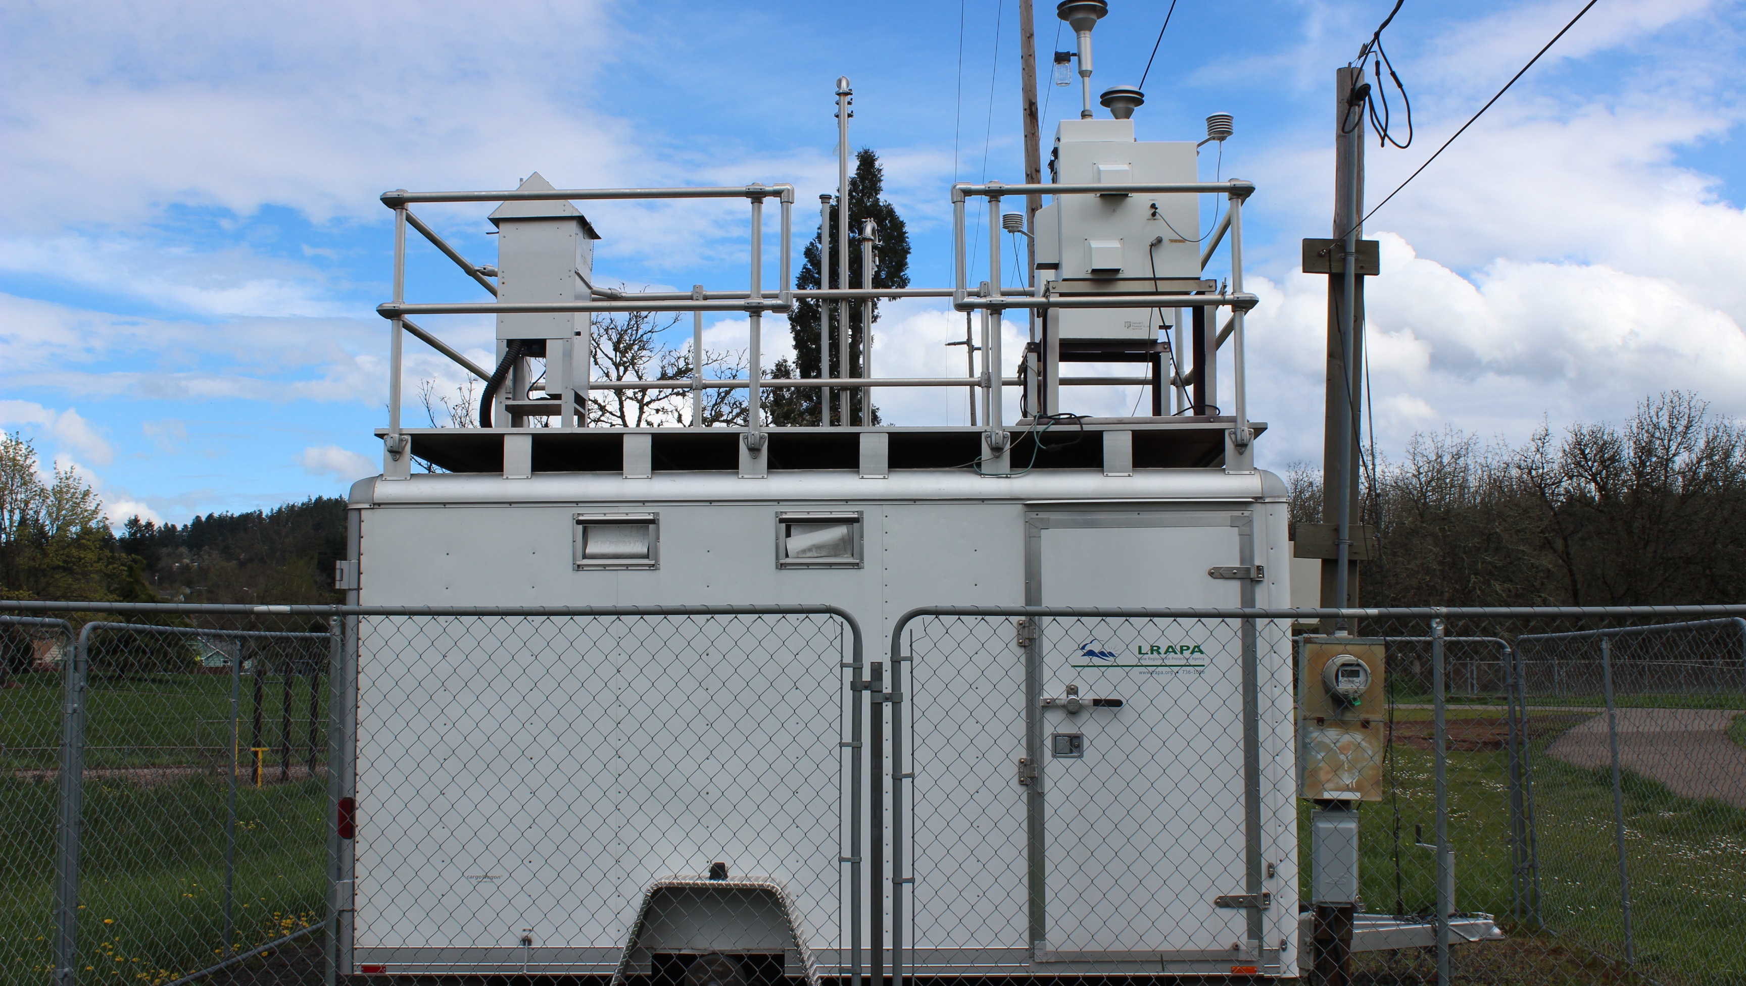
LRAPA Rules – Questions and Contact Information
Max Hueftle
Permit Section Manager
Lane Regional Air Protection Agency
1010 Main St.
Springfield, OR 97477
541-736-1056, ext. 216
www.lrapa.org

