Slide 1
Environmental Quality Commission meeting
DEQ Rulemaking Process
Agenda Item F, Informational Item
May 16, 2019
Portland
Meyer Goldstein | Oregon Department of Environmental Quality

Slide 2
Framework
Legal requirements
Public transparency
Making quality rules

Slide 3
Legal Steps for Rule Adoption
Notice to the Public
Opportunity for Public to Comment
Public Hearing
EQC Adoption
File with Secretary of State
Retain the rulemaking record

Slide 4
What do rules do?
Rules are an extension of legislatively adopted statutes
Rules have the power of law
Rules tell affected parties:
What they may do
What they must do
What they may not do

Slide 5
-program need
-legislative action
-citizen petition
-federal requirement
DEQ Rule Project Approval Process
Program manager and DA agree on need
Program completes planning documents
Leadership Team approves
Project placed on DEQ Rulemaking Plan
Notes:
How many lawyers in the room
How many people have worked on DEQ rulemaking
How many people think rulemaking is fun and interesting
Why do we make rules
What is a rule
What is the difference between a rule and an order
Why rulemaking is important to staff
DEQ rule development process
DEQ rule tools
How can staff know what is happening in rulemaking
How can the public be involved in rulemaking
Cleanup rulemaking

Slide 6
Rulemaking Sequence
Planning
Public Involvement
Adoption
Planning Form | Advisory Committee | EQC Staff Report
Schedule | Public Notice | Responses to Comments
Resources | Public Hearing | EQC Presentation
Considerations | Public Comment

Slide 7
Public Input - Advisory Committees
Discretionary for DEQ, not legally required
Can help:
Obtain stakeholder/public input
Address technical issues
Aid transparency
Fiscal Impact
Review DEQ Fiscal Impact Statement
Assess fiscal impact on small businesses
Notes:
Advisory Committee
Technical, policy, community input
Appointed by deq
Public can attend but does not participate
Technical experts
Affected parties
Advocacy groups
Public Comment Period
6-8 weeks from open of notice
Online comment web page
Conventional mail
Public Hearing
All can attend
In person and teleconference
Written comments
Oral testimony
EQC Meeting
Public can attend
Commission has discretion to allow public participation
5 member commission votes whether to adopt

Slide 8
Rulemaking Timeline

Slide 9
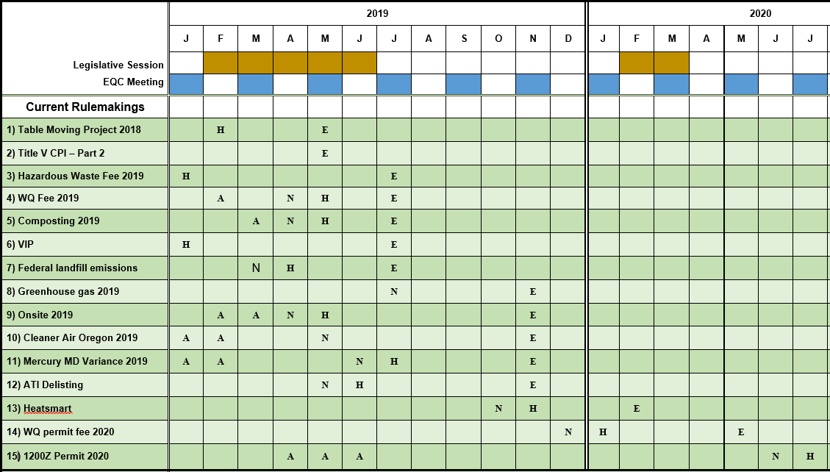
DEQ Rulemaking Plan

Slide 10
Finding DEQ Rulemaking

Slide 11
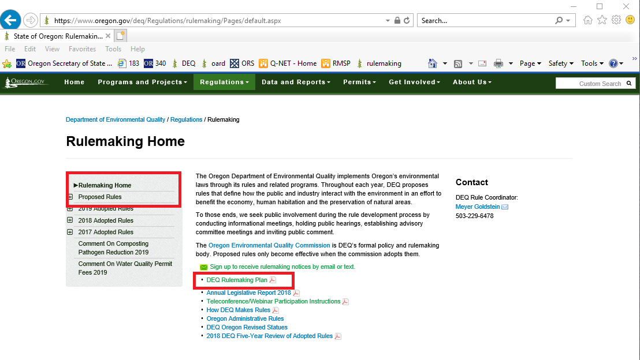
Finding DEQ Rulemaking

Slide 12
DEQ can provide documents in an alternate format or in a language other than English upon request. Call DEQ at 800-452-4011 or email deqinfo@deq.state.or.us.

