Slide 1
Environmental Quality Commission meeting
Rule Table Attachments 2019
Agenda Item E, Action Item
May 16, 2019
Portland
Meyer Goldstein | Oregon Department of Environmental Quality

Slide 2
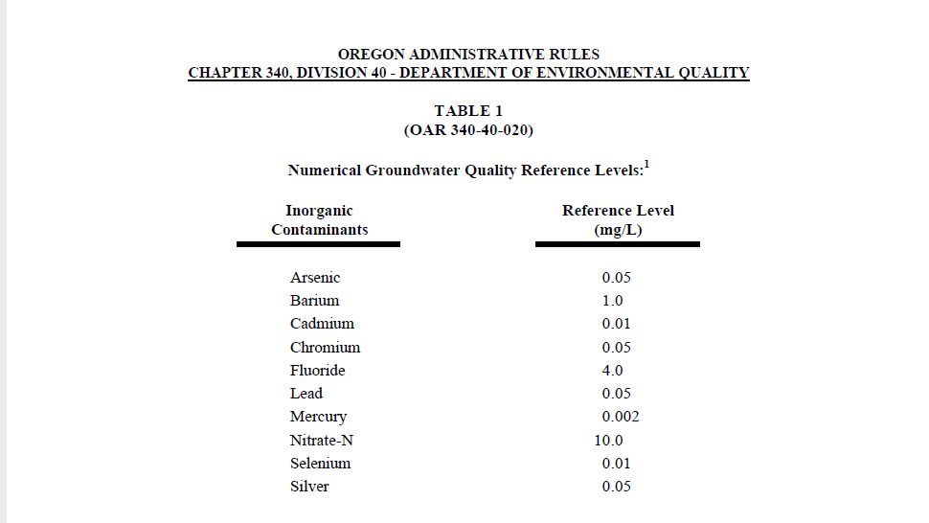
Meyer Goldstein | Oregon Department of Environmental Quality

Slide 3
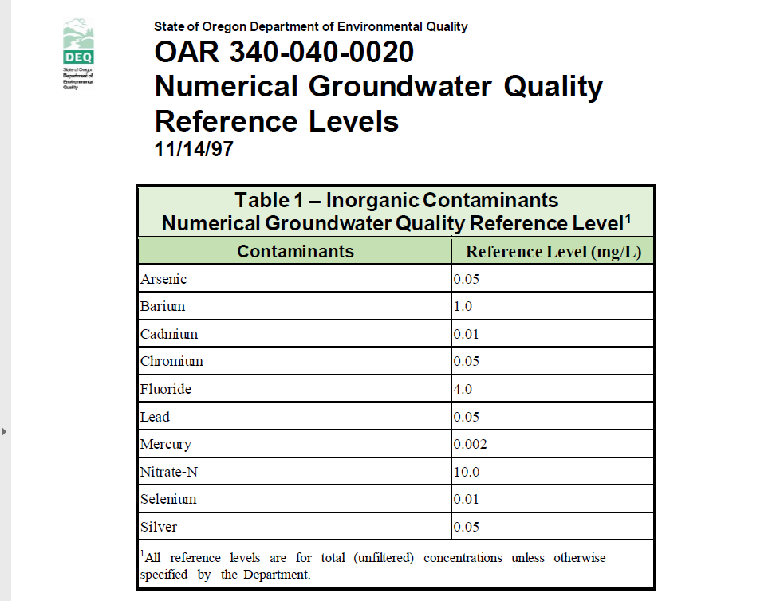
Meyer Goldstein | Oregon Department of Environmental Quality

Slide 4
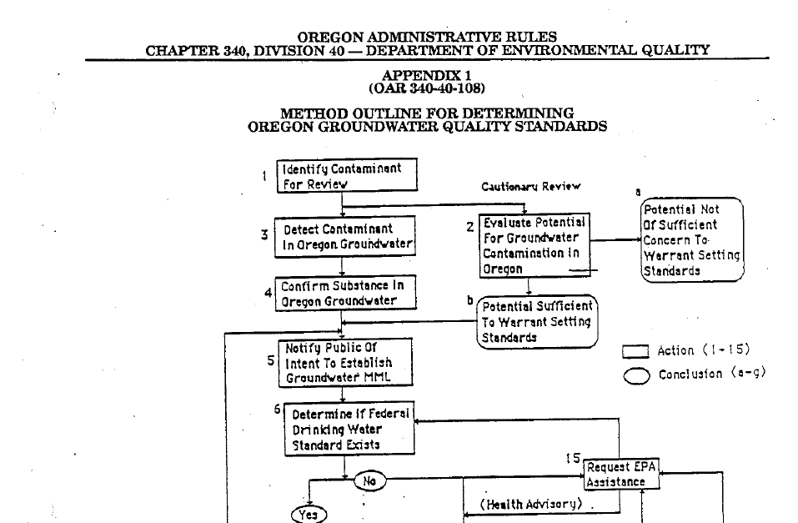
Meyer Goldstein | Oregon Department of Environmental Quality

Slide 5
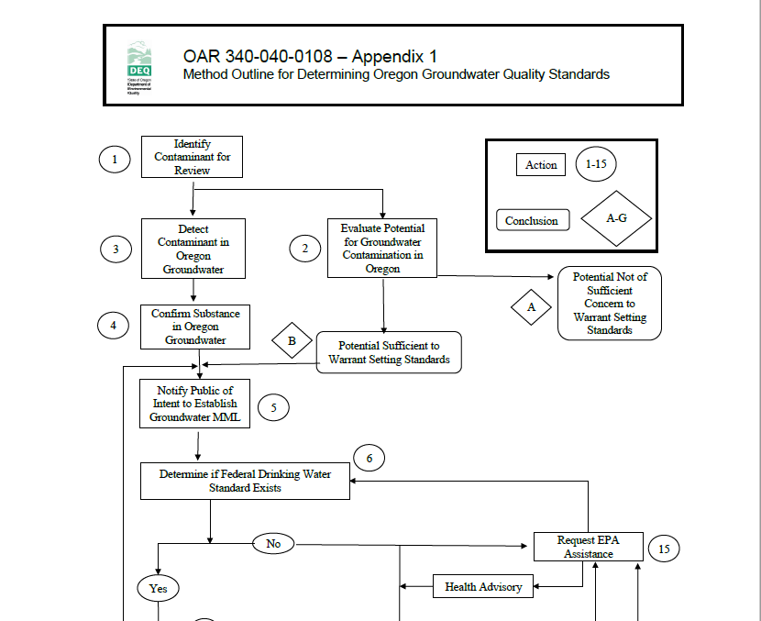
Meyer Goldstein | Oregon Department of Environmental Quality

Slide 6
Recommendation
DEQ recommends that the Environmental Quality Commission adopt the proposed rules and associated attachments, included as Attachment A to the DEQ staff report for this item, as part of Chapter 340 of the Oregon Administrative Rules.
Meyer Goldstein | Oregon Department of Environmental Quality

