Slide 1

Air Quality Division
Item C, Informational Item
Vehicle Inspection Program
Proposed Updates and Fee Increase
Environmental Quality Commission Meeting
May 16, 2019
Portland, Oregon
Karen Williams| Oregon Department of Environmental Quality
Notes:
Ali: Introduce self, Mike, Karen and highlight the importance of the Vehicle Inspection program
VIP is effective at reducing pollutants
VIP provides good, cost-effective customer service – we have 97% approval rating and average wait time in Portland is 10 minutes.
VIP is necessary to keep because ozone has exceeded national standard in last two years in Portland
Karen
Chair George and members of the Commission. My name is Karen Williams and I am an air quality planner and policy analyst. Over the last few months, DEQ has been working on revising rules associated with implementation of our Vehicle Inspection Program, including updates to reflect current program operations and a fee increase for a certificate of compliance. Today, the program manager, Michael Skorupka and I will provide an overview of the vehicle inspection program and how it helps Oregon maintain compliance with air quality standards before presenting the particulars of the fee increase proposal and rule revisions. Because a fee increase must first be approved by the Legislature, we will not be asking the commission to take any action today. If the Legislature approves the fee increase, we will bring the revised rules to you in July for adoption.

Slide 2
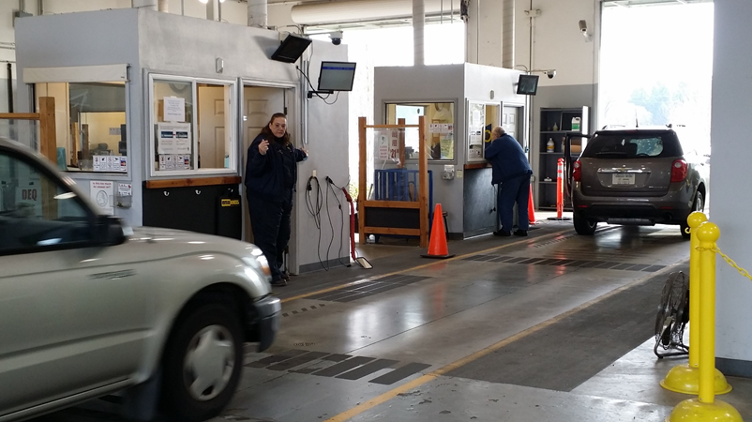
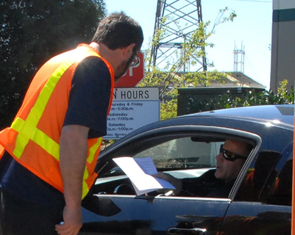
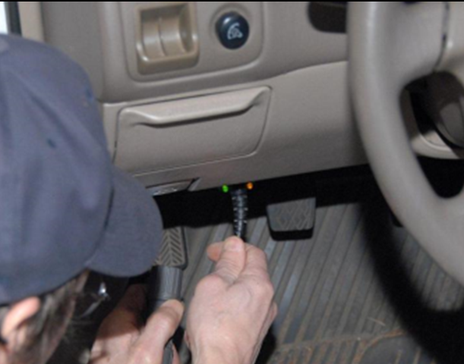
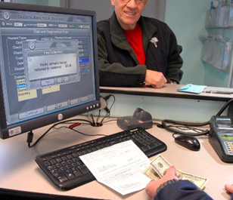
Vehicle Inspection and Maintenance Program Overview
Portland and Medford areas
1.3 million biannual tests
7 stations
90 staff people
Oregon Department of Environmental Quality
Notes:
Mike:
The Vehicle Inspection Program is an Inspection and Maintenance program (I/M) and ensures that vehicle pollution control systems are functioning properly. Passing vehicles receive a certificate of compliance that is required to renew their vehicles’ registration every two years in the Portland and Medford areas.
VIP performs about 1.3 million tests per biennium on light and heavy duty gasoline vehicles and on passenger diesel vehicles. Generally, with vehicles newer than 1997, VIP can test pollution control functionality via on-board diagnostic computers. VIP retains a basic tailpipe test for older vehicles. New vehicles within their first four models years have a grace period and testing is not required.
VIP operates 6 facilities in the Portland area one in Medford. About 90 staff manage administrative roles, inspect vehicles, follow up with customers, and maintain facility operations. VIP certificates issued include those through mobile on-site testing – where VIP inspectors visit dealerships – and a relatively new program called DEQ Too, in which more than 150 businesses across the state have devices that can obtain data from a cars’ on-board computers and transmit it to DEQ.
_____________________________________________________________________________
Additional information that could be shared:
Portland: 1975 and newer model years
Medford: 20-year and newer model years
OBD Test: 1996 and newer gasoline vehicles up to 8,500 lbs. 1997 and newer diesel vehicles up to 8,500 lbs.
Older vehicles that tend to have more miles on them, fail at a higher rate than vehicles with fewer miles For example, in 2017, 16 percent of 1986-1996 vehicles failed, but only 8 percent of 1997 – 2002 vehicles failed.
Emission reduction benefits of VIP are not simply because the inspections reveal faulty pollution control systems. The benefits come from seeing their check engine light come on and having their cars repaired before they come in for an emissions test.

Slide 3
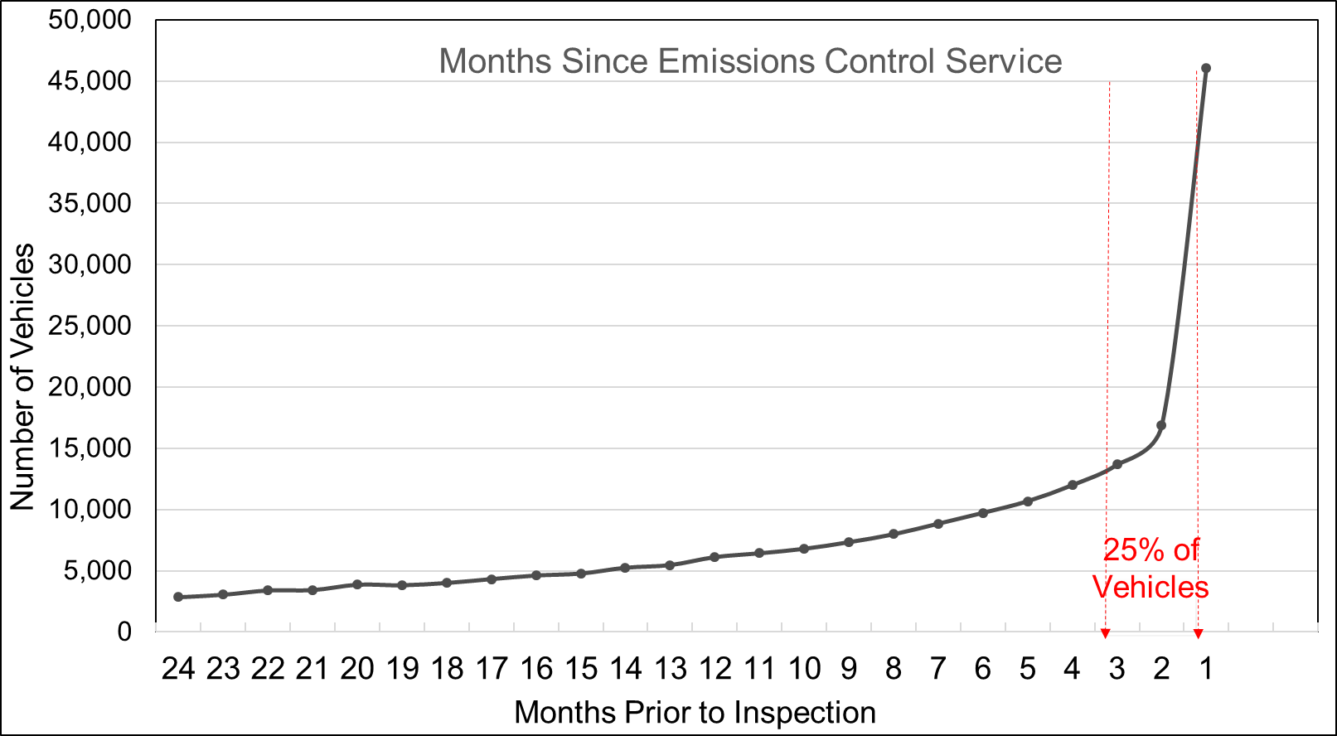
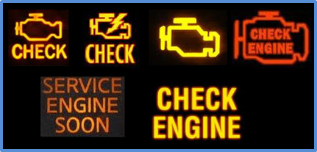
Vehicle Inspection and Maintenance Benefits
Oregon Department of Environmental Quality
Notes:
Mike:
As an I/M program, the purpose of the VIP is not to “catch” dirty cars, rather it is to ensure cars (and their emissions control systems) are maintained.
Approximately 4-5% of vehicles fail upon their first test. The older the vehicle – with corresponding higher mileage - the more likely it is to fail. However, the failure rate is not the true indicator of the program’s effectiveness.
A better indicator of effectiveness is the percent of cars being serviced/maintained in anticipation of the test. To measure this outcome, DEQ reviews data on when a vehicle’s On-Board Diagnostic (OBD) system codes were most recently cleared. The clearing of OBDs is an indication the vehicle was serviced.
This chart shows the volume of tests based on the numbers of months since their emissions control systems were serviced. 25% or 1 in 4 cars gets serviced between receiving their registration renewal reminder (90 days before expiration) and coming to a VIP station.
______________________________________________
Additional information that could be shared:
In 2014, DEQ tested the emissions systems of cars inside and outside the VIP boundaries. Within the boundary, the failure rate was on average about 5.2 percent. Outside the boundary, the average failure rate was about 22%.
And we also know, based on emission measurements from cars that fail the VIP test, that a car without a maintained pollution control system may put about 4 times the emissions of a properly maintained car.

Slide 4
Maintaining Federal Standards
Ozone Precursors
Oregon Department of Environmental Quality
Notes:
Karen
So, why did VIP come about in the first place? In the mid-1970s and 1980s, air quality in the Portland and Medford areas of the state did not meet federal standards for ozone and carbon monoxide. Ozone forms in hot weather and sunlight from nitrogen oxides and volatile organic compounds, both of which are emitted by gasoline and diesel powered vehicles. On-road vehicles are also the largest source of carbon monoxide. The dark gray portion at the base of these bars represents the percentage contribution of on road sources to federally regulated pollutants in the Portland area.
DEQ was required to develop plans to reduce these pollutants and have them approved by EPA. When not in compliance with air quality standards, a state will be subject to sanctions on new construction and federal funding.
VIP began in Portland in 1975 and in Medford in 1986 and has been very successful. The Portland and Medford areas are currently in attainment for ozone and carbon monoxide and VIP continues to be an important pollution control strategy to maintain air quality.
______________________________________________________________________________________________________
Additional information….
For the Portland area, DEQ developed and updated its ozone maintenance plan in 1996 and 2007. DEQ developed the Portland carbon monoxide maintenance plan in 1994 and 2004.
For the Medford area, DEQ developed and updated CO maintenance plans in 2001 and 2015.
For the Medford area, EPA did not designate the area nonattainment for ozone, so there was not a Medford ozone plan.

Slide 5
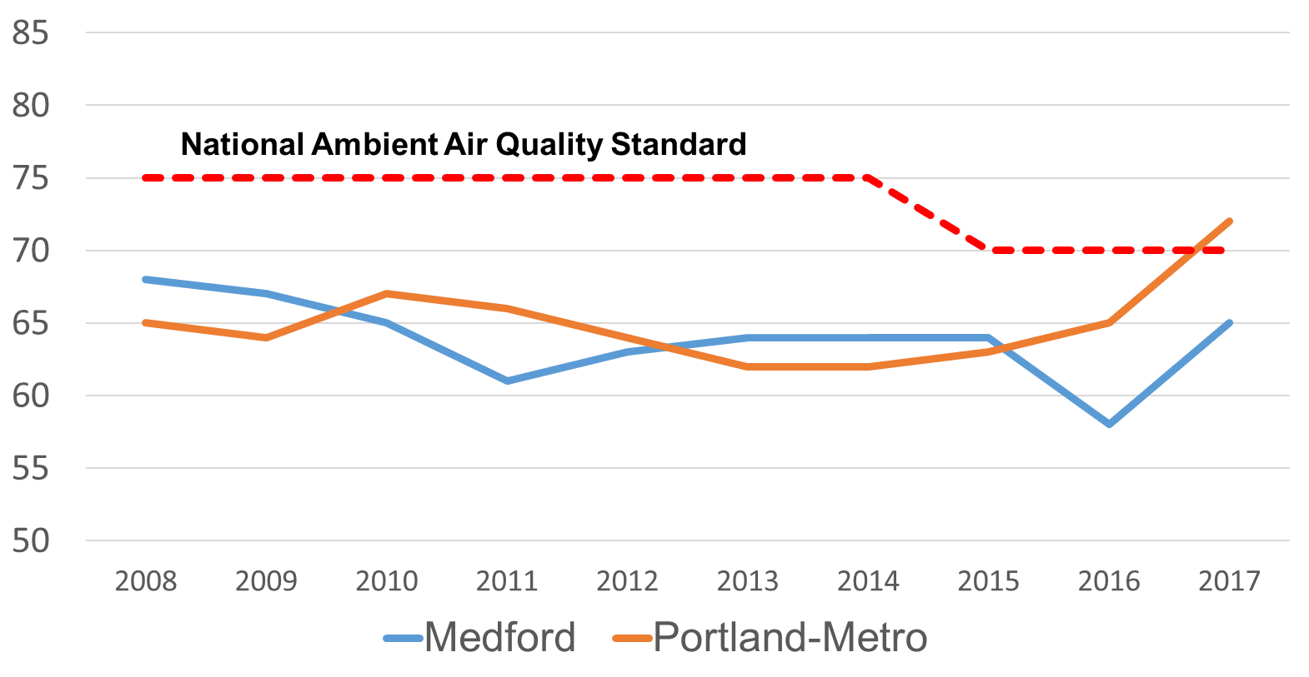
Ozone Status
Oregon Department of Environmental Quality
Notes:
Karen:
This picture shows ozone measurements from Portland and Medford between 2007 and 2017. Portland met the ozone standard of 70 parts per billion through 2016 but the measurements can occasionally exceed 65 ppb and this is a concern. It’s a concern because EPA must review the ozone standard every five years. In 2015, they lowered the standard from 75 parts per billion to 70 parts per billion, although they considered standards as low as 60 ppb.
Because of pollution controls, like VIP, we’ve been able to comply with the ozone standard even as it has been lowered, but in 2017, the Portland ozone level exceeded 70 ppb – possibly reflecting the influence of wildfires.
Though EPA still considers Oregon in attainment with the ozone standard, DEQ is concerned about public health effects of ozone exceedance, regardless of cause, and wants to reduce the sources we can control.
___________________________________________________________________________________
If needed…
The Carbon monoxide standard is a maximum of 9 parts per million in 8-hours and that has been retained in the last several reviews, most recently 2011.
EPA has retained the annual average Nox standard of 53 parts per billion and added a 1-hr daily maximum standard of 100 parts per billion in 2010.

Slide 6
Pollution Prevention – On-road sources Portland
Oregon Department of Environmental Quality
Notes:
Karen:
Vehicles also contribute air toxic pollutants. For example, in the Portland area, on road sources contribute more than 20% of several air toxics.
DEQ completed a model in 2018 that estimates several air pollutant emissions – including air toxics – that DEQ’s I/M program prevents. Our analysis showed that if the vehicle inspection program were not operating, overall on-road air toxics emissions in the Portland and Medford areas would increase 6 to 20 %.
Emissions of Criteria pollutants – like nitrogen oxide and ozone precursors - would increase 5 to 19 percent.
The percentage increases we’d see in Medford are less than Portland because in Medford we test a younger vehicle fleet.
____________________________________________________________________________________________________
DEQ’s technical services staff started with an EPA model that states use to quantify emissions from on road sources. This model is called the motor vehicle emission simulator model – or MOVES. DEQ set up model input to quantify the criteria pollutants – such as nitrogen oxides and volatile organic compounds, and also 16 toxics that are associated with mobile emissions.
DEQ looked at two scenarios – what the pollution emissions are from on-road sources with and without the vehicle inspection program in place.
DEQ staff then looked at how those vehicle emissions compared to all emissions from all sources in the emissions inventory. Total emissions include onroad and off road sources (like construction equipment), point sources (like permitted industry) and non-point sources (such as an autobody paint shop).

Slide 7
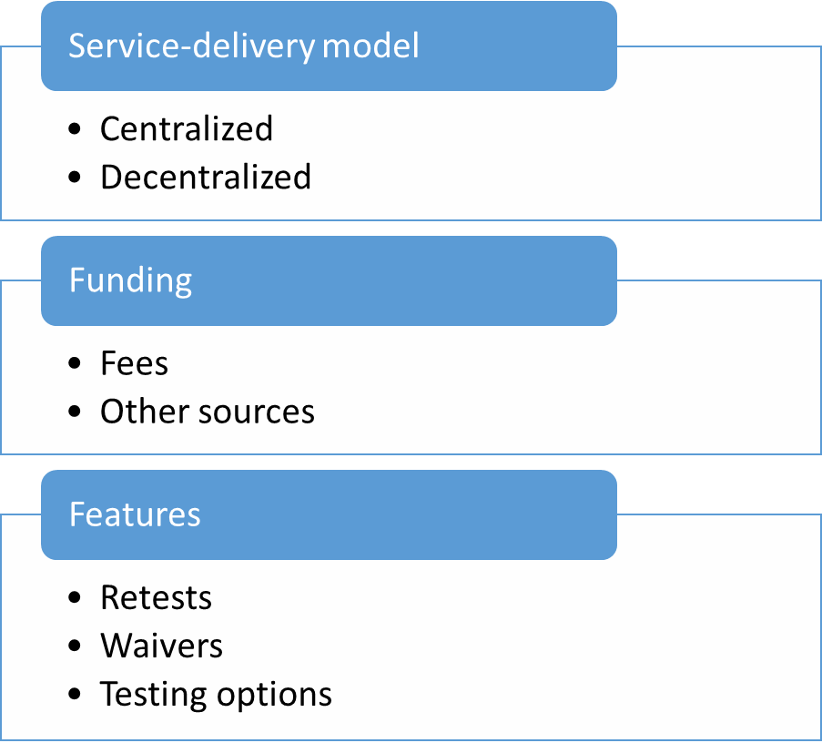
Fee Evaluation Methodology
Oregon Department of Environmental Quality
Notes:
Mike:
That was an overview of the vehicle inspection program and how it helps reduce federally regulated and air toxics pollutants. The scope of the changes we will be proposing in July through rulemaking includes an increase in the fee charged for a certificate of compliance. As part of the fee increase process, DEQ needed to demonstrate the program’s cost effectiveness.
The methodology used by DEQ to address cost effectiveness of its VIP program included a comparison of Oregon’s program to 38 other programs in the U.S. and Canada, looking at the organization model, fees charged, and services provided. Data came from the National Center for Automotive Science and Technology at Weber State University and a survey. The cost-effectiveness report is in the commission’s information packet.
___________________________________
Additional if needed:
DEQ also distributed a survey, with 20 programs supplying requested details. With this information supporting its analysis, DEQ first considered whether the centralized model or the de-centralized, or fully-privatized model, produced more cost effective programs. Here, DEQ found that centralized programs such as the Oregon VIP charge customers on average one-third the amount charged customers under the decentralized model. Also, the decentralized model avoids many conflict of interest and compliance issues related to the outsourcing of this work to the private sector. Within the second prong of the analysis, DEQ found that the Oregon VIP program is cost effective relative to its centralized program counterparts. Within the 11 programs, DEQ’s fee is mid-range, but it service offerings exceed those of other states. This is important, as the dynamic nature of the DEQ VIP program enables it to remain cost effective in the short and long term.

Slide 8
Testing Models – Centralized vs Decentralized
Oregon Department of Environmental Quality
Notes:
Mike:
DEQ’s I/M program is centralized, though the cost effectiveness study compared DEQ fees to both centralized and decentralized programs.
The primary characteristic of a centralized testing program is its few, larger sized stations that are dedicated to addressing emissions through vehicle testing. Centralized programs, including Oregon, operate within the public model to avoid the additional costs and risks associated with the needed monitoring and oversight.
Decentralized, or more fully private, testing programs have multiple small locations that are typically repair garages. A decentralized environment relies on the competitive nature of garages located throughout the state.
In comparing fees across the different programs, VIP used a weighted average approach to represent inspection fees when different fee rates are used by a program. Using this weighted average approach to compare fees, we found that the centralized model programs charge, on average, $18.05 per biennium, whereas the decentralized programs charge $59.34 per biennium.
Oregon’s fee of $20.04 used in this analysis represents an average fee assessed when considering the number of inspections performed at $10 in Medford, $21 in the Portland areas, and $26 for mobile testing. This weighted average biennial fee of $20.04 is roughly one-third of the $59.34 weighted average fee assessed by the service providers in decentralized programs. If adjusted for the fact that Oregon offers unlimited free re-tests our fee is actually closer to $16.44.
STOP__________________________________________________________________________
If needed…
In addition to the straight-fee comparison, it’s important to consider features unique to Oregon that enhance the customer experience. These include:
Oregon’s program offers unlimited free re-tests. This is unique in that we only charge the fee once the vehicle passes the emissions tests. If adjusted to account for free retests, Oregon’s average price is $16.44. Far below the average cost of all programs and below the costs of “like” centralized-publicly operated programs.
Oregon DEQ partners with United Way to offer subsidized, and often times free, repairs for low-income motorists. This ensures the air quality benefits are achieved without disproportionately impacting lower-income communities.
The Oregon VIP program is the only program in the country that is currently offering both self-service lanes and remote testing – innovations I’ll discuss further in a moment.
Our entire cost-effectiveness analysis was submitted to the record for Legislative review. Our primary finding is that Oregon’s fee remains among the lowest of programs nationally. In addition, our dynamic programmatic design, including traditional lane testing, double-lane testing, self-service testing, mobile fleet testing, and now even remote testing through independent service providers, cannot be overstated. This broad array of services and willingness to innovate positions the program for inevitable future technological change, and for continued evolution.

Slide 9
Cost Effectiveness Findings
Centralized Programs
Oregon VIP
Services
Provided
Cost-competitive within the centralized programs
Fees and compliance risks are lower.
Oregon VIP provides services others don’t.
Oregon Department of Environmental Quality
Notes:
Mike…
Overall, from the cost-effectiveness study, DEQ drew three primary conclusions:
A centralized model produces lower fees and has reduced compliance risks.
Oregon VIP fees are mid-range within this subgroup of 10 other programs. It’s also notable that Oregon VIP does not receive supplemental funding as do other centralized programs, and we do not charge for retests.
And third, the cost effectiveness of VIP is even greater when you consider that Oregon VIP offers many services other programs do not. For example, Oregon is the one of the few programs offering customers self-service lane options, and the only program using the remote OBD/DEQ Too approach. Oregon also offers mobile testing services not used in many other programs.
The dynamic nature of the Oregon VIP ensures the program is structured for any needed future evolution. This ensures that the program is most cost effective now, and in the future, when technologies, customer requirements and other operating circumstances change.
Stop___________________________________________________________
For purposes of the analysis, DEQ considered program fee and operational information from the National Center for Automotive Science and Technology at Weber State University, funded through a U.S. Environmental Protection Agency (EPA) grant.
DEQ also distributed a survey, with 20 programs supplying requested details. With this information supporting its analysis, DEQ first considered whether the centralized model or the de-centralized, or fully-privatized model, produced more cost effective programs. Here, DEQ found that centralized programs such as the Oregon VIP charge customers on average one-third the amount charged customers under the decentralized model. Also, the decentralized model avoids many conflict of interest and compliance issues related to the outsourcing of this work to the private sector. Within the second prong of the analysis, DEQ found that the Oregon VIP program is cost effective relative to its centralized program counterparts. Within the 11 programs, DEQ’s fee is mid-range, but it service offerings exceed those of other states. This is important, as the dynamic nature of the DEQ VIP program enables it to remain cost effective in the short and long term.

Slide 10
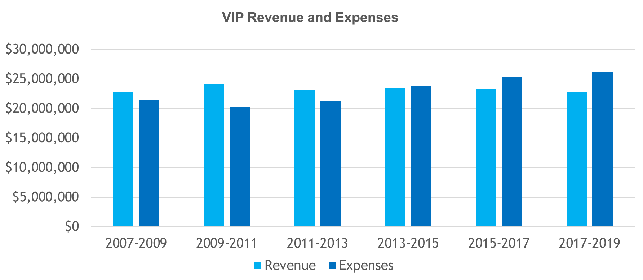
Vehicle Inspection Revenue and Expenses
Oregon Department of Environmental Quality
Notes:
Mike:
While VIP has been cost effective, there is now a revenue problem.
DEQ last increased its fee in 1997, when the enhanced dynamometer test began, and that was intended to support the program for 10 years.
Due to program efficiencies and innovations, careful spending, and reducing 7 position in 2017, the program has been able to sustain itself for an additional 11 years after it was intended.
It is notable that an inflation adjusted fee would now be about $34.
By July 2015, program expenses slightly exceeded revenue. And After July 2019, revenue that comes in from fees will no longer cover expenses for all the current program positions.
Since, DEQ must submit a balanced budget to the Legislature, for the 19-21 biennium that shortfall equates to 8 positions.
Losing those 8 positions may result in increased wait times and would decreases the amount of support supplied to the public (i.e. information via the phone) and the stations (maintenance staff). For example, if one fewer inspector is available at a station, we may have to close a lane and make customers in other lines wait longer. The program’s current average throughput time is only 10 minutes and this is an important part of customer satisfaction.
Because DEQ wants to maintain good customer service and low wait times, as part of the proposed rule revisions DEQ has proposed a fee increase.
If needed
Air Quality’s overall 17-19 budget approximately $99 million, 75% of which is made up of other fund revenue
The Vehicle Inspection Program fall within that 75% category of other fund, or fee revenue and has a 17-19 budget of approximately $24 million
The program currently receives about $1.4 million dollars per biennium from DMV to pay for the services that VIP provides for them at VIP stations (4% - 5%of revenue)
Expenses have been increasing largely due to the increase in personnel costs - COLA’s, additional step or wage increases, and the rising costs of medical and other fringe benefits.
Through advances in technology and careful spending, VIP has been able to accrue large ending balances. (Beginning balance for 17-19 was $4.1 million)
VIP has been covering expenses not covered by revenue by eating into its ending balance, or the funds that have remained over biennia and rolled into the next biennia. The amount of expenditures above revenues that has been covered by VIP’s ending balance has ranged from $400k to $3.4 million.
Side note: Legislature swept $2m in 2007 and $3m in 2012. In addition a 2011 budget note required VIP to lower the fee in the Portland Metro areas by $2 per test for a biennium, which roughly equaled $2m loss in revenue.

Slide 11
Proposed Biennial Fee Structure
Portland Metro Area - $25 per certificate; $4 increase
Medford–Ashland Area – $15 per certificate; $5 increase per biennium until 2023, when the fee reaches $25 per certificate.
Mobile On Site Dealer Testing - $30 per certificate; $4 increase
New fees to become effective upon Legislative approval
Anticipated to sustain the program through the 23-25 biennium.
Oregon Department of Environmental Quality
Notes:
Mike:
The biennial fee increase that DEQ has proposed is as follows.
Portland - $4 increase to $25 every two years - upon legislative approval
Phased in $5 per biennium in the Medford – Ashland area until 2023 when the certificate fee will then match the certificate fee in Portland at $25
Mobile Onsite Dealer Testing - $4 increase to $30 per certificate

Slide 12
Additional Rule Revisions
remove references to procedures no longer performed
enhanced dynamometer
noise control tests
update references, definitions and procedures to align with current operations
edit for plain language
Oregon Department of Environmental Quality
Notes:
Karen:
I also mentioned we are proposing to change other parts of the rules. These revisions would update and clarify language and remove references to obsolete information. First, there are two tests we no longer perform and are proposing to remove the references to those tests in our rules. Those tests are the enhanced dynamometer test, which ended in 2006 and noise testing, which VIP has not performed since 2008.
DEQ is also proposing to update several references and definitions to reflect current program procedures and characteristics of today’s vehicles.
We also took the opportunity to go over all the rules in Division 256 and edit them for plain language – to make our regulations as clear and understandable to the public as possible.
_________________________________________
Additional information if asked for more detail:
DEQ stopped performing the enhanced test because we could derive more complete emission information from the On Board Diagnostic test. Also, by 2006, the majority of vehicles were equipped with OBD systems.
We have not performed noise control tests as part of the vehicle inspection program since about 2008 for several reasons. In1991, the Legislature ended DEQ’s funding to implement the entire agency noise control program. The vehicle inspection program continued to perform the noise tests for several years as a public service, but the program found that the test methods were subjective because they relied on different inspectors’ hearing ability and inconsistent because of different constructions and conditions at each of the stations. DEQ had safety concerns for the inspectors performing the test. Our rules also did not allow for noise testing in Medford, and we wanted to have the inspection procedures be consistent in both the Portland and Medford areas. The noise control statutes are still on the books and are enforced by local government police or sheriff departments

Slide 13
Public Rulemaking Process So Far
Fiscal Advisory Committee met October 4, 2018
Action items | Date
Public Comment period | December 14, 2018 - February 4, 2019
Public Hearings | January 15 and 28, 2019
Legislative Approval | By June 30, 2019 (?)
Present rules to EQC | July 2019
Notes:
Karen:
DEQ has completed the public process for this rulemaking. We convened an advisory committee in October 2018 that also served as a fiscal advisory committee. We asked that committee if they believed our proposed rule revisions would have a fiscal impact and if so, would there be an adverse fiscal impact on small business.
The fiscal advisory committee found that the proposed fee increase will have a small fiscal impact on motorists and businesses with vehicles registered in the Portland and Medford inspection areas, auto dealerships participating in the mobile on site testing program and businesses participating in the DEQ Too program. Committee members spoke of adverse effects on some businesses, but also benefits to businesses and public health.
DEQ opened a public comment period on December 14, 2018 which extended until February 4, 2019. We held two public hearings on January 15 in Portland and January 28 in Medford – both were accessible by web and teleconference. We did not receive any public comment at either hearing but did receive 7 public comments submitted on line. DEQ’s response to each comment will be included in the staff report you receive in July.
We hope for legislative approval by the end of June and DEQ would bring the rule revisions and fee increase to EQC for a decision in July 2019.

Slide 14


Questions?
Oregon VIP
√
Dynamic and flexible
Outcome- and customer-focused
Cost Effective Long-term
Oregon Department of Environmental Quality
Notes:
This concludes our informational presentation.
Thank you for your time and we’d be happy to answer questions.

