Slide 1
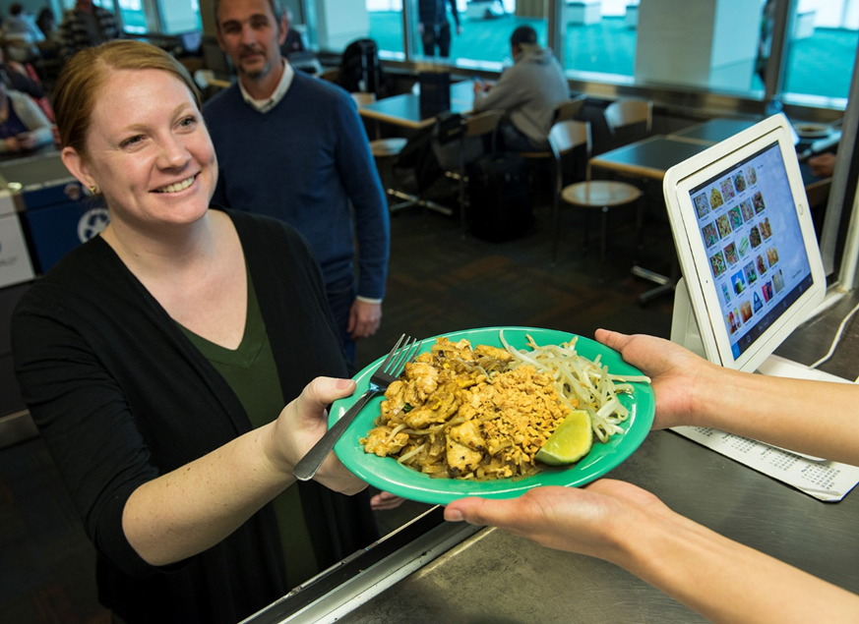
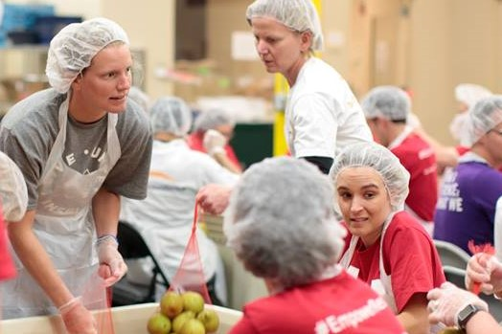
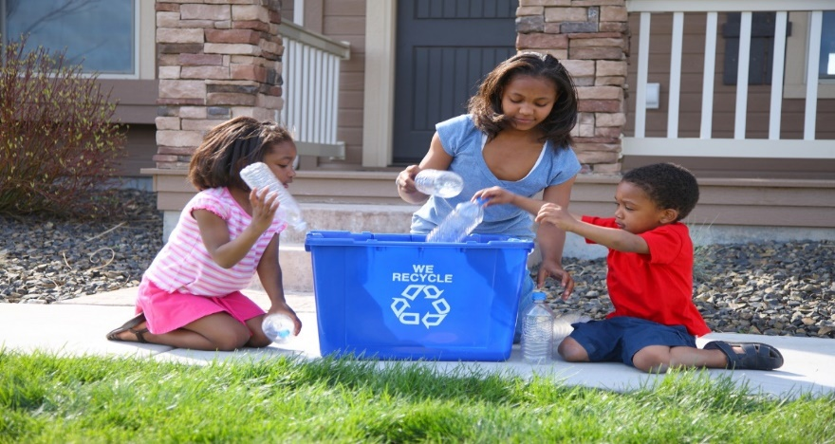


Materials Management Grants
Environmental Quality Commission Meeting
May 17, 2019
Shannon Davis, Materials Management Manager
Julie Derrick , JD’s Shoe Repair Founder
Marie Diodati, Grants Coordinator

Slide 2
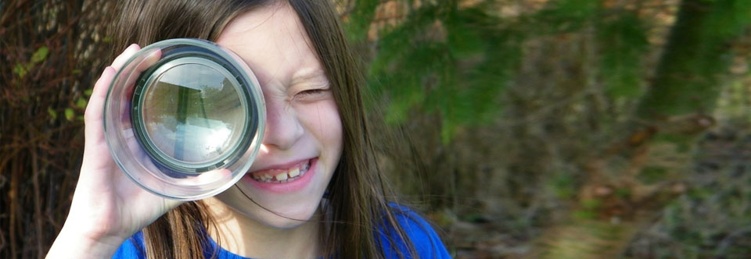
Agenda
Background
Grant Program Structure and Themes
Grant Process
Workforce Development Grant Projects
JD’s Shoe Repair Project
2018 Materials Management Grants Supporting projects that promote waste prevention, reuse and recovery to strengthen Oregon communities and protect our environment.
Photo of 2018 recipient Oregon Green Schools

Slide 3
materials management conserving resources · protecting the environment · living well
Materials Management Research
Projects
Grants

Slide 4
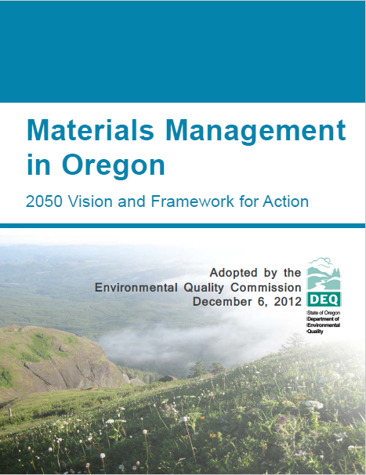
Background
Embody Materials Management’s 2050 Vision
Support project grants for projects that reduce waste generation, promote reuse, or recover solid waste through recycling, composting or anaerobic digestion.
Support planning grants for the development of local Solid Waste Management Plans and Materials Management Plans.
To keep products in service longer, therefore reducing environmental impacts of upstream production as well as reducing waste
To create new paid jobs to increase/grow the reuse and repair industries

Slide 5
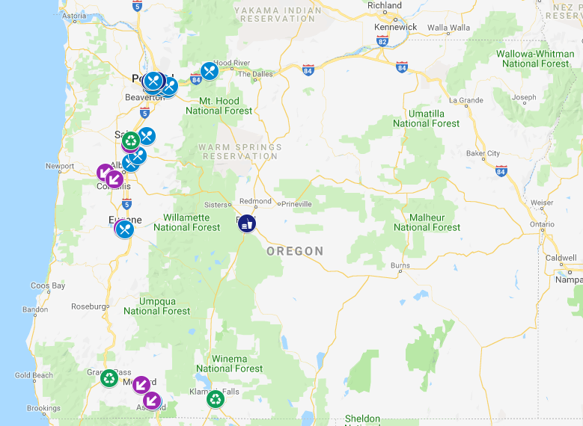
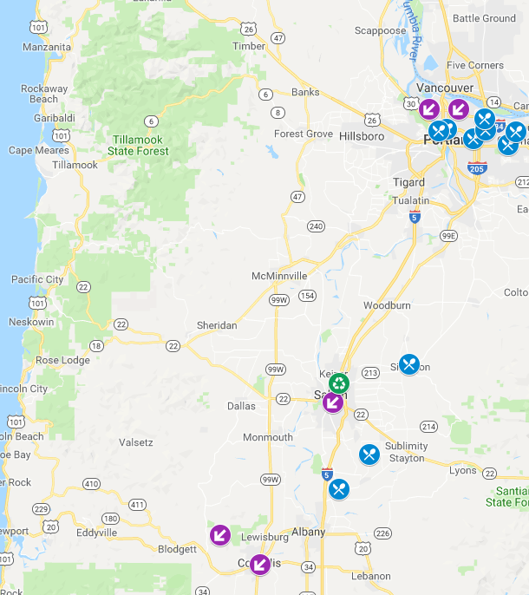
2017-2018 Reach
Notes:
https://www.google.com/maps/d/edit?hl=en&mid=1J5o12C4zwNiny94hR2VbKpYw2r01OpNc&ll=45.15918239858602%2C-122.90809305194341&z=9

Slide 6
Grant Summaries
Since 1991 over 8 million dollars in grants
Since Oregon’s Materials Management 2050 Vision, 2015-2018,:
90 projects
Over $3.1M allocated funds
Average median amount/grant: $33,000
2018 general grant program
16 projects
$600,000
2017 workforce development grant program supporting reuse and repair
5 projects
$50,000

Slide 7






Focus Areas
Workforce development in a reuse and repair businesses
Prevent the wasting of food
Reduce solid waste generation
Establish, restore, or enhance recycling infrastructure or composting infrastructure (i.e., facilities and equipment) in rural communities
Help a local government exceed its waste prevention and/or reuse requirements of the Opportunity to Recycle Act.
Serve economically distressed or otherwise distressed communities

Slide 8
Grant Process
Solicitation Process (Outreach, Questions and Webinars)
Scoring Process (SME Input)
Announcements
Regional Support
Cycle Review and Recommendations
Ongoing process

Slide 9
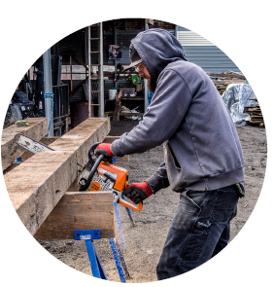
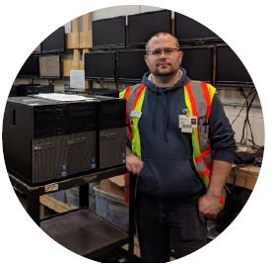
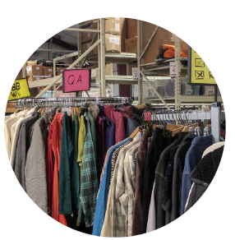
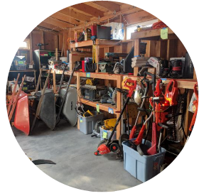
Workforce Development Grants in Reuse and Repair Industry
Portland
Salem
Garten Recycling has provided large-scale recycling for communities and job training and employment opportunities for adults with intellectual and/or cognitive disabilities. Trained two adults with disabilities to work in the careful disassembly and reuse of electronic components.
Salvage Works has been in the reclaimed wood business and offers a curated selection of heritage lumber, distinct wall cladding and custom furniture. They trained and hired a new employee to increase capacity for reusing salvaged wood.
Cascade Locks
The Renewal Workshop works with outdoor apparel companies and the management of factory defects. Two employees were hired. Increased their repair capacity by 25% and also able to add three new machines their workshop.
Eugene
The Toolbox Project is a nonprofit, volunteer-driven tool- lending library. Hired an operations manager to improve financial self-sufficiency and expand services. Their membership has increased by 42%.

Slide 10
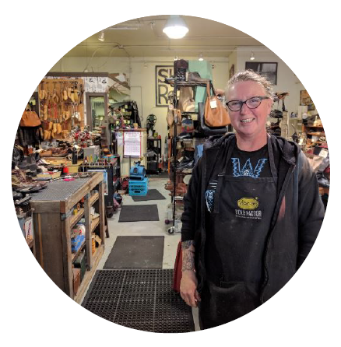
JJD’s Shoe Repair, Portland, $10,000
Grantee from the Workforce Development Grant Program
How did this grant help your business?
What is the most successful part of your grant project?
How did this grant affect you personally?
Thank you, Julie!

