Slide 1
Presentation to the Oregon Environmental Quality Commission
February 18, 2011

Slide 2
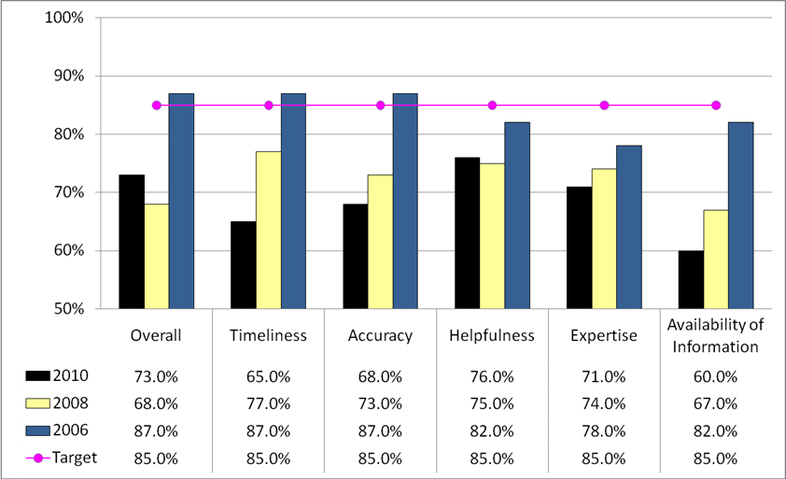
1. Customer service: Percent of customers rating their satisfaction with the agency's customer service as “good” or “excellent” - overall, timeliness, accuracy, helpfulness, expertise, availability of information.

Slide 3
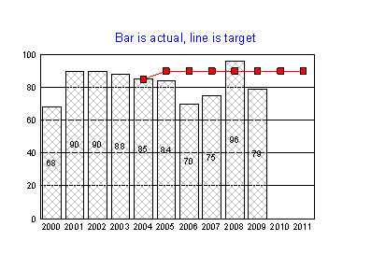
2. Permit timeliness: Percentage of air contaminant discharge permits issued within the target period.

Slide 4
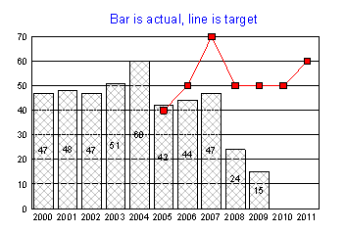
3. Permit timeliness: Percentage of individual wastewater discharge permits issued within 270 days.

Slide 5
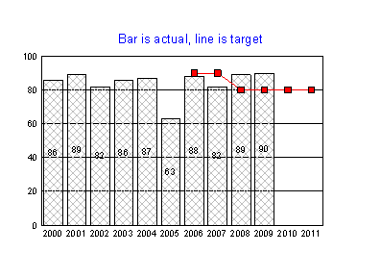
4. Updated permits: Percent of total wastewater permits that are current.

Slide 6
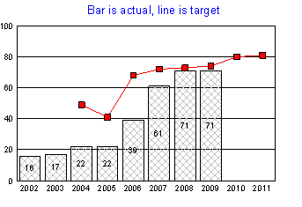
5. Water quality TMDLs: Percent of impaired waterbody miles for which a TMDL has been approved.

Slide 7
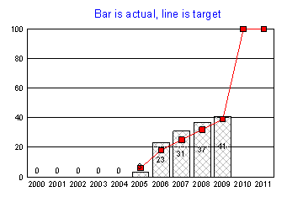
6. Umatilla: Cumulative percent of chemical agent destroyed at Umatilla Chemical Demilitarization Facility.

Slide 8
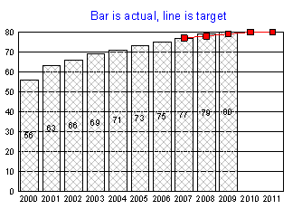
7a. Cleanup: Percent of identified Oregon hazardous waste sites cleaned up, overall.

Slide 9
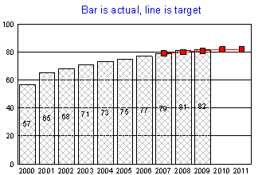
7b. Cleanup: Percent of identified Oregon hazardous waste sites cleaned up, tanks.

Slide 10
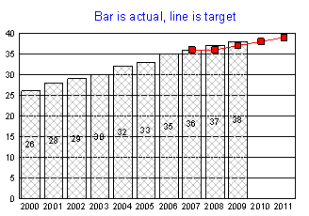
7c. Cleanup: Percent of identified Oregon hazardous waste sites cleaned up, hazardous substances.

Slide 11
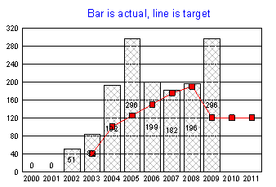
8. Toxics prevention and reduction: Pounds of mercury removed from the environment through DEQ's efforts.

Slide 12
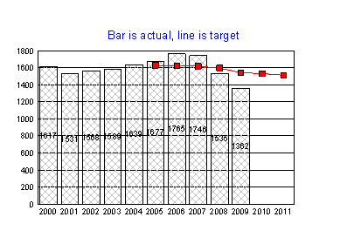
9. Solid waste: Pounds of municipal solid waste landfilled or incinerated per capita

Slide 13
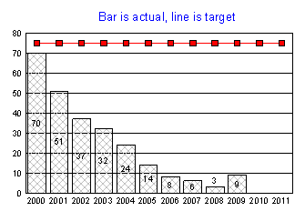
10a. Water quality conditions: Percent of monitored stream sites with significantly increasing trends in water quality

Slide 14
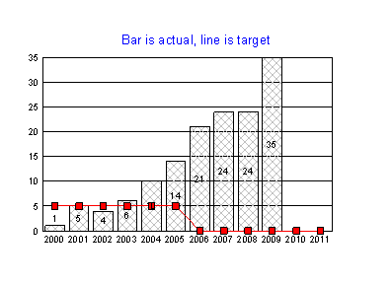
10b. Water quality conditions: Percent of monitored stream sites with decreasing trends in water quality

Slide 15
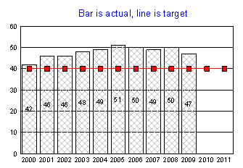
10c. Water quality conditions: Percent of monitored stream sites with water quality in good to excellent condition.

Slide 16
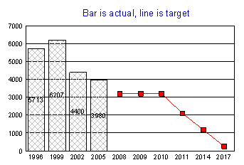
11. Air quality diesel emissions: Quantity of diesel particulate emissions.

Slide 17
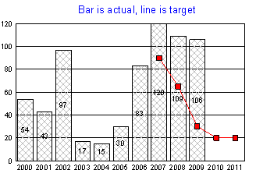
12a. Air quality conditions: Number of days when air is unhealthy for sensitive groups.

Slide 18
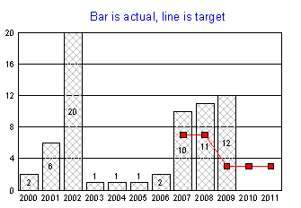
12b. Air quality conditions: Number of days when air is unhealthy for all groups

Slide 19
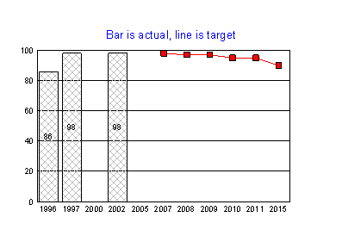
13a. Air quality – air toxics: Percent of Oregonians at risk from toxic air pollutants that contribute to cancer.

Slide 20

13b. Air quality – air toxics: Percent of Oregonians at risk from toxic air pollutants that contribute to respiratory problems and other non-cancer health effects.

Slide 21
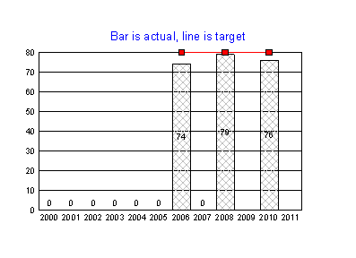
14. Economic Revitalization Team: Percent of local participants who rank DEQ involvement in Economic Revitalization Team process as good to excellent.

Slide 22
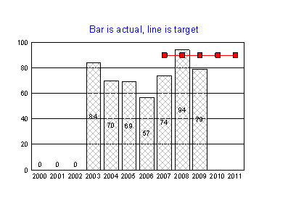
15. Permit timeliness: Percent of Title V operating permits issued with the target period.

Slide 23
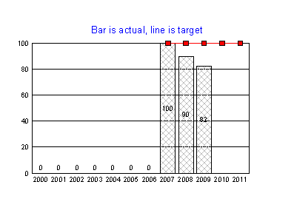
16. Boards and commissions: Percent of total best practices met by the Environmental Quality Commission.

Slide 24
Questions?
Comments?
Suggestions for the presentation to the Oregon Legislature Joint Ways and Means Committee?

