Slide 1
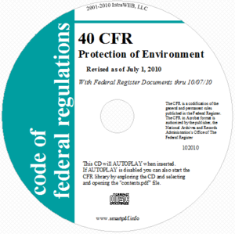
Federal Air Quality Regulations and Related Permit Rules
Jerry Ebersole
DEQ - AQ Division
Notes:
Good afternoon Chairman Blosser, Commissioners
As Andy mentioned, I’m here to present the Department’s proposed adoption of federal air quality regulations and related permit rules

Slide 2
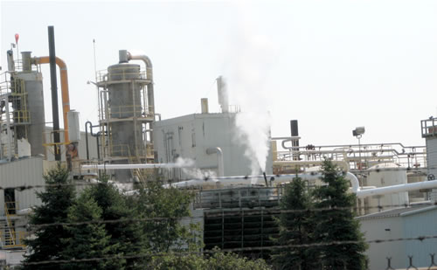
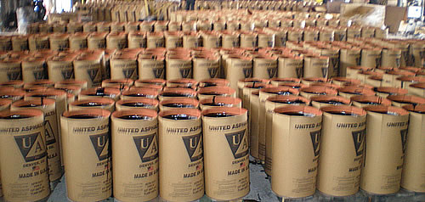
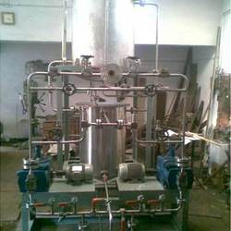

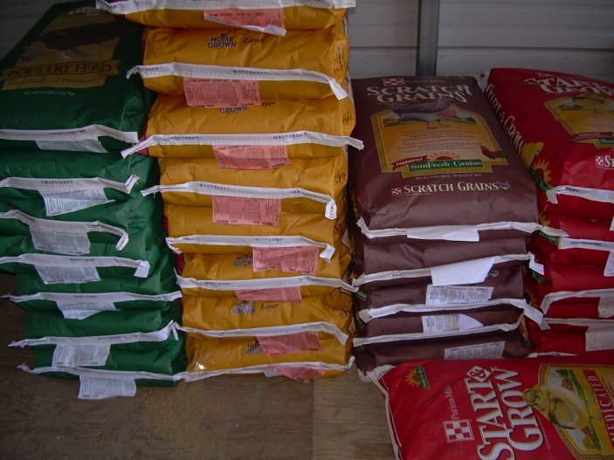
New Area Source NESHAPs
Asphalt Processing/Roofing (5)
Chemical Manufacturing (1)
Chemical Preparation (15)
Paint/Allied Product (48)
Prepared Feeds (18)
Notes:
This is the third rulemaking that proposes the adoption of federal area source NESHAPs;
This rulemaking proposes the adoption of five new area source NESHAPs, listed here
Unlike the previous rulemakings, these categories affect a limited number of sources, and many of them are already on a permit

Slide 3
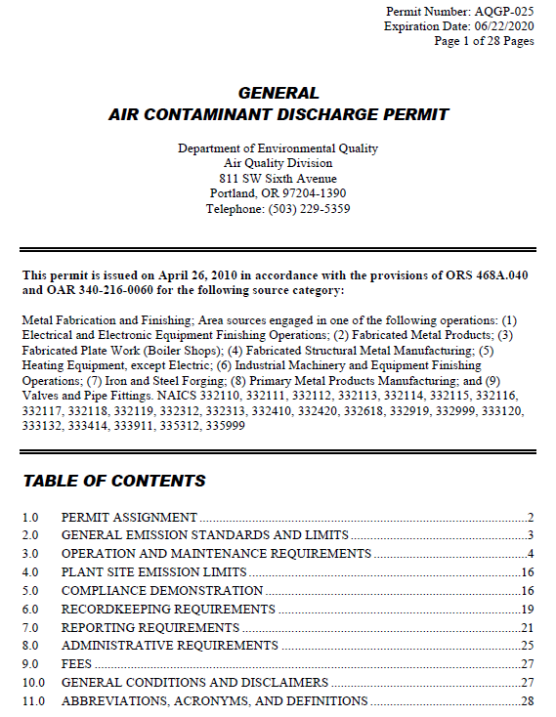
Air contaminant discharge permits
Paint and allied product manufacturing
General ACDP
General ACDP fee class
Application deferral
Defer for up to 12 months
Temporary deferral – August
Permanent
Notes:
The proposed rules make several changes to the air contaminant discharge permit program:
They make paint and allied product facilities eligible for a general permit and assigns them to a general permit fee class
They allow DEQ to defer the permit application submittal deadline for sources newly affected by an NSPS or NESHAP by up to 12 months
The EQC adopted this change as a temporary rule in August, this rulemaking would make this change permanent
This rulemaking would allow gasoline dispensing facilities to pay just one change of ownership fee
They currently pay a $360 fee to AQ and $75 fee to the underground storage tank program for ownership changes
If adopted, a portion of the AQ fee would be used to pay the statutory UST program fee
This rulemaking would also exempt commercial sterilizers that use less than one ton of ethylene oxide per year from permitting
These small sterilizers are only subject to recordkeeping

Slide 4
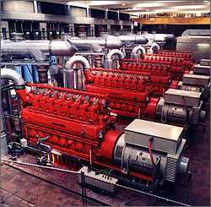
Stationary Internal Combustion Engines
Federal rules complicated
Excessive burden on DEQ
Repeal:
NSPS standards
NESHAP standards
May propose re-adoption after:
Identifying affected sources
Improving implementation plan
Notes:
This rulemaking proposes to repeal the adoption of NSPS and NESHAP standards for stationary internal combustion engines
The reasons for repealing these standards are the complexity of standards and the potential that there are thousands of affected engines in Oregon
In other words, DEQ is concerned that implementation of these standards would be an excessive burden
DEQ may propose re-adoption of these standards after working with EPA Region X to identify affected sources and narrowing implementation to a manageable level

Slide 5
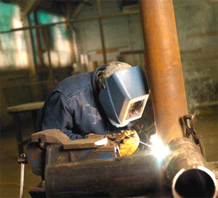
Metal Fabrication and Finishing Permits
Split category into 3 fee classes
Current fee - $1,296/year
Proposed fees:
Class 1 - $1,296/yr
Class 2 - $720/yr
Class 3 - $360/yr
Based on regulatory complexity
Exempt smallest facilities
Notes:
This rulemaking proposes changes to the permitting requirements for metal fabrication and finishing operations
The source category would be split into three fee classes based on the complexity of the standards
The standards for abrasive blasting, surface coating and large welding operations require emission controls and control device monitoring, which are more complex to comply with and for DEQ to determine compliance with
The standards for machining, machine grinding and polishing, and smaller welding operations require work practices and optional emission controls, which are less complex to comply with and for DEQ to determine compliance with
Facilities with more complex standards would pay more and facilities with less complex standards would pay less
This rulemaking also proposes to exempt extremely small facilities from permitting

Slide 6
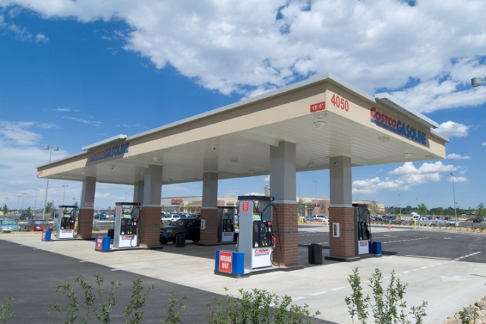
Gasoline dispensing facilities
Permit exemption for small GDFs
ASTs and non-retail facilities
Extend to USTs and retail facilities
Change of ownership fee
AQ - $360, UST - $75
AQ fee used to cover UST fee
Clarifications:
Dispensing into motor vehicles
Aviation gasoline
Monthly throughput
Compliance testing
Notes:
This rulemaking would extend the existing 10,000 gallon per month permit exemption for gasoline dispensing facilities
Currently the exemption only applies to non-retail facilities with above ground storage tanks
Extending the exemption to retail facilities and facilities with underground storage tanks would eliminate confusion and address complaints of unfairness and economic hardship
This rulemaking would also clarify that the gasoline dispensing rules apply to dispensing into motor vehicles
This rulemaking would clarify that the gasoline dispensing rules apply to aviation gasoline in the Portland, Salem, and Medford areas, to restore the stringency of the state implementation plan
The rulemaking would also clarify the calculation of monthly throughput and when testing is required

Slide 7
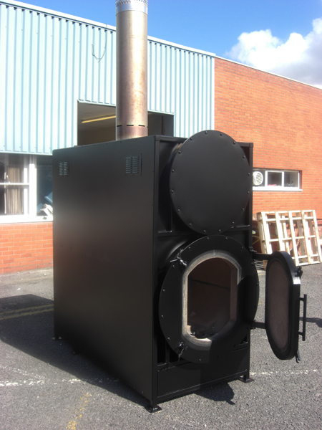
Federal Air Quality Regulations
Update adoption of NSPSs/NESHAPs
Repeal medical waste incinerator rules
No affected incinerators
New incinerators - separate rules
Notes:
Finally, this rulemaking would repeal the rules that implement the federal emission guidelines for hospital, medical, and infectious waste incinerators
The reason for the repeal is that Oregon does not have any incinerators subject to these rules
Any new incinerator in Oregon would be subject to the federal New Source Performance Standards, which are adopted by reference and not affected by the repeal

Slide 8
Public Comments
Tracking exempted sources
Public health impact of exempting sources
Notes:
One commenter commented on the proposed rules:
The commenter wanted to know how DEQ planned on tracking exempted sources to ensure that they comply with the rules and apply for a permit when they exceed an exemption threshold
Also concerned about the public health impact of exempting sources
DEQ response is that:
DEQ will track exempted facilities through audit inspections. If there is a high level of non-compliance, DEQ may require exempted facilities to periodically report their throughput and compliance information
DEQ considered health impacts and emission reductions when establishing the exemption thresholds. For instance:
Exempted ethylene oxide sterilizers are only subject to recordkeeping requirements
Emissions from exempted gasoline dispensing facilities and metal fabrications and finishing operations are below the level of concern

Slide 9
Questions?
Notes:
That is the end of my presentation, any questions?

