Slide 1
Rule Adoption: Temporary Revision of Division 45 Initiation Level Rule
February 17, 2011 EQC meeting
Presented by Neil Mullane, Jennifer Wigal and Cheryl Grabham

Slide 2

Background
Initiation Level Rule
  Passed June 2010
Effluent screening
  Results from first sampling event indicated few exceedances.
  Nearly all facilities had cholesterol and coprostanol above Plan Initiation Level.
Municipal Persistent Pollutant Reduction Plans
  Due July 1, 2011
Notes:
NEIL:
Initiation Level Rule
The EQC passed the Initiation Level Rule in June 2010
It requires Oregon’s 52 largest municipal wastewater treatment plants to develop Persistent Pollutant Reduction Plans for pollutants present above Plan Initiation Levels (PILs) in effluent.
SB 737 requires that these plans be incorporated into NPDES and WPCF permits on renewal.
Effluent Screening
Q: How and when did municipalities test their effluent for persistent pollutants?
Municipalities sampled their effluent for 117 persistent pollutants in summer and fall 2010.
They sampled twice to find out if there is a difference between summer and winter use patterns for certain products, and to catch any variability between wet and dry seasons.
DEQ’s lab performed the analysis, and coordinated the sampling schedule to accommodate 52 facilities.
During the summer and fall sampling events, sampling and analysis were grouped into 3 batches, spaced two weeks apart.
Results:
The first of two municipal sampling events revealed Plan Initiation Level (PIL) exceedances at nearly every location for cholesterol and coprostanol (kop-ros′tan-ol) , and only a handful of other PIL exceedances for other persistent pollutants.
The results from the second sampling event are similar. Therefore 47 of the 52 municipalities would be required to prepare a reduction plan for these two pollutants only.
Reduction Plans
The legislative intent of SB 737 was to address toxic pollutants that persist in the environment or accumulate in animals, with an emphasis on pollution prevention where feasible.
Municipalities’ plans must be submitted to DEQ by July 1, 2011.

Slide 3
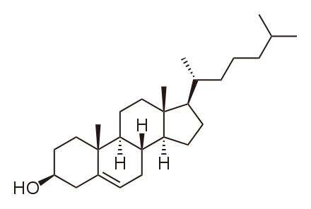
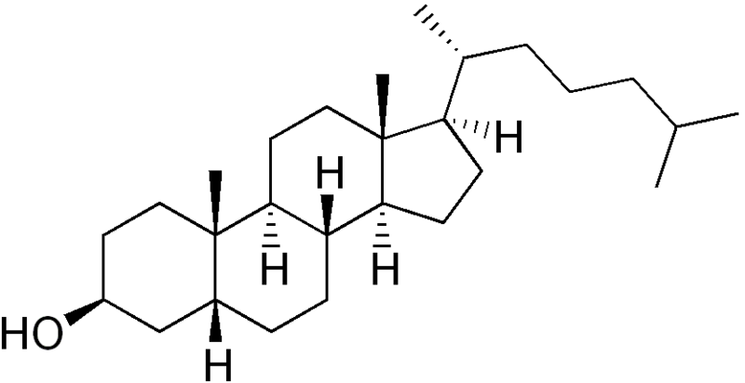
Cholesterol and Coprostanol
What are cholesterol and coprostanol?
Why are they on the P3 List?
Notes:
CHERYL:
Chair Blosser, members of the Commission, there are two main questions that people ask us when they see the sampling results.
Q: What are Cholesterol and Coprostanol?
Cholesterol and Coprostanol (kop-ros′tan-ol) are primarily naturally occurring byproducts of human (and animal) digestion, and are present in human waste regardless of what people eat. Even if everyone in the state became a vegetarian, cholesterol and coprostanol would be present in our wastewater treatment plants.
Q: Why are Cholesterol and Coprostanol on the P3 List?
SB 737 directed DEQ to develop a list of priority persistent pollutants that are toxic and either persist in the environment or bioaccumulate in animals.
In developing the list of priority persistent pollutants DEQ evaluated more than 2,000 chemicals using an EPA model to estimate toxicity.
There are a total of four sterols/stanols on the P3 List that all met the above criteria because they have a high estimated toxicity and persist in the environment.
NOTE: The requirement to develop the P3 List was not limited to pollutants that could be addressed through municipal wastewater treatment plants’ reduction plans.
The P3 List was intended to identify pollutants with certain characteristics regardless of potential source, and may be used by a variety of entities to inform many decisions about how to minimize the impact of persistent pollutants on human and aquatic life and the environment.

Slide 4

Temporary rule revision in a nutshell
Would suspend municipalities’ requirement to develop reduction plans for cholesterol and coprostanol.
Five municipalities would still need to develop reduction plans addressing arsenic, a PAH (pyrene) and a plant-based sterol (beta-sitosterol).
Notes:
The proposed rule revision would suspend the requirement for 47 of the 52 municipal wastewater treatment plants to develop persistent pollutant reduction plans.
There are 5 municipalities that would still be required to develop plans for pollutants detected above initiation levels.
Arsenic – Klamath Falls & Ontario
Pyrene – City of Portland, Columbia Blvd plant
Beta-Sitosterol – Hermiston and Oak Lodge
In the future newly identified majors may need to develop reduction plans. We’ll talk more about that later.

Slide 5

What options did DEQ Consider?
Minimal Reduction Plans
Revising the P3 List
Temporary Rule Revision
Notes:
DEQ considered how to comply with SB 737’s statutory requirements without a temporary rule.
DEQ considered whether minimal reduction plans could meet municipalities’ requirements under SB 737. For example, a minimal reduction plan might briefly state that no feasible municipal reduction actions exist to reduce the pollutant and indicate a facility’s intent to maintain or optimize existing treatment.
DEQ determined that incorporating brief reduction plans into NPDES and WPCF permits for these types of pollutants would yield a resource-intensive administrative process with little or no environmental benefit.
DEQ also considered revising the P3 List and determined that a rigorous and credible process would take far too long.
At the time DEQ evaluated options, we were looking at results from only one sampling event. Before revising the list, DEQ needs to be prepared to complete a thorough process using information from both sampling events, reconvening the science workgroup, and offering an extensive public process.
A revision process would have a much broader scope than the original list development, and would require at least a year of work.
Also, the P3 List was not developed specifically for municipalities. It is a list developed for the state of Oregon and may be used by a variety of entities for any number of purposes. Therefore the lack of feasible municipal reduction options is not reason enough to remove a pollutant from the list.
Finally, we considered a temporary rule revision suspending the requirement to develop plans for cholesterol and coprostanol.

Slide 6

Weighing Options
Pollution Prevention
  Primary focus of SB 737
Toxicity estimates
  Not corroborated by scientific literature
Also considered treatment
  Not cost-effective for cholesterol or coprostanol
Notes:
When evaluating which of the options would provide a timely solution, DEQ considered several factors.
Pollution prevention is the key to reducing persistent pollutants – reducing these pollutants before they enter the environment and need to be cleaned up.
DEQ assessed the availability of pollution prevention activities to reduce sterols and stanols.
Cholesterol and coprostanol are two naturally occurring byproducts of human digestion.
We were not able to identify potential municipal pollution prevention activities for these pollutants, because they are present in human waste regardless of what people eat, and therefore are not amenable to pollution prevention.
Toxicity: DEQ evaluated the extent to which specific information exists regarding the potential environmental and human health threats of discharging cholesterol and coprostanol into Oregon’s waters.
As I mentioned earlier, DEQ used a model estimate of toxicity to determine whether pollutants met the criteria for inclusion on the Priority Persistent Pollutant List.
DEQ relied heavily on public comment both during the list development and plan initiation level selection processes. DEQ received volumes of comments on many individual pollutants, but we did not receive any in-depth comments during either public comment period refuting model estimates for cholesterol and coprostanol. We focused our efforts re-examining pollutants for which we received comments.
After cholesterol and coprostanol were detected above Plan Initiation Levels at nearly all facilities, DEQ performed a focused evaluation of available information on these pollutants, as summarized in the technical memo “Aquatic Toxicity of Sterols and Stanols” (10/25/10, available on request).
DEQ concluded that there are few available studies regarding the potential environmental and human health threats of discharging cholesterol and coprostanol into Oregon’s waters, and those that do exist do not present conclusive information about their potential harmful effects on the well-being of humans, fish or wildlife.
Treatment: Although SB 737 focuses on pollution prevention, it does include language regarding technological controls. DEQ’s primary reliance was on the lack of pollution prevention options, but we wanted to be thorough regarding options available to municipalities.
DEQ evaluated availability and cost-effectiveness of treatment options where pollution prevention activities don’t exist.
DEQ reviewed relevant literature and affirmed that cost-effective treatment is not available, as outlined in the technical memo: “Treatment of Sterols and Stanols” (12/20/10, available on request).
After carefully considering options, DEQ determined that a temporary rule would provide a timely solution that makes sense.
DEQ views development of Persistent Pollutant Reduction Plans for cholesterol and coprostanol a disproportionate response for these types of pollutants.
Because Municipal Persistent Pollutant Reduction Plans are due July 1, 2011, there isn’t time for a permanent rulemaking process.

Slide 7

Public Outreach
Stakeholder Sounding Board
Contacted affected municipalities
Contacted Tribal Nations
Notes:
Stakeholder Sounding Board
The Department met with a volunteer Stakeholder Sounding Board twice this fall and winter for discussion and input regarding options to address cholesterol and coprostanol.
During the first meeting, EQ informed Sounding Board members that it was considering two options for addressing pollutants with no feasible municipal pollution prevention activities or treatment options:
minimal reduction plans focused on maintaining or optimizing existing treatment; or
a rule revision to suspend permittees’ requirement to develop Persistent Pollutant Reduction Plans for these pollutants.
DEQ offered Sounding Board members an informal opportunity to provide input on these two options, and evaluated input received.
After evaluating input and performing further research, DEQ indicated its intent to pursue a revised rule and provided Sounding Board members a draft copy of this staff report and supporting materials. DEQ accepted additional information from Sounding Board members that improved the documents’ accuracy.
A list of Sounding Board members who participated in these meetings is located in Attachment C.
Municipalities
DEQ contacted all affected municipalities regarding its intent to pursue a revised rule, and offered the opportunity to participate in the Stakeholder Sounding Board.
Tribal nations
DEQ updated tribal nations regarding the proposed rule revision at the January 2011 “State–Tribal Government-to-Government Natural Resources Workgroup Meeting.”
Natural resources representatives from 8 of the nine Federally-recognized Tribes in Oregon and staff from the Natural Resource agencies attended.
DEQ’s tribal liaison also sent more detailed information in an email following the meeting.

Slide 8
Questions and Issues Considered
Why suspend the requirement for only two pollutants?
Should DEQ consider available treatment options for cholesterol and coprostanol?
What will happen if DEQ doesn’t follow up with a timely permanent rule?
Notes:
Why only 2 pollutants?
Cholesterol and coprostanol are the only two pollutants on the Priority Persistent Pollutant List for which model estimates cannot be corroborated with scientific literature. They also lack pollution prevention activities and feasible treatment options. (Bruce Hope can explain more about why these are the only two that fit into this unique category.)
Beta-sitosterol is a plant-based sterol that occurs naturally.
It is found exclusively in plants and is therefore a normal constituent of human diet.
It appears in municipal effluent as a by-product of domestic and commercial human activity such as digestion and food preparation, and also in industrial effluent as a by-product of food processing or wood processing.
There is scientific literature that validates the selected plan initiation level, and there are potential pollution prevention activities to reduce beta-sitosterol.
Treatment
DEQ received input from stakeholders with diverse perspectives regarding the availability and cost-effectiveness of treatment options for cholesterol and coprostanol.
Some parties wanted DEQ to fully investigate effectiveness of options such as increased aeration and sludge retention time.
Others stated that the intent of SB 737 is pollution prevention, so DEQ should not consider treatment in its analysis.
DEQ’s primary reliance was on the lack of pollution prevention options, but we wanted to be thorough regarding options available to municipalities.
Permanent Rule
Some stakeholders are concerned about the need for permittees to prepare a reduction plan addressing cholesterol or coprostanol if the Department fails to follow through with a timely permanent rule or a revision of the P3 list after the temporary rule expires.
Legal counsel advised DEQ that, with few exceptions, permittees will not be required to go back and prepare reduction plans addressing cholesterol or coprostanol after the expiration of the temporary rule, as detailed in the legal memo from the Department of Justice (XX/XX/XXXX, available on request). For example, if municipalities don’t submit their plans for other pollutants by July 1, 2011, they would need to include cholesterol and coprostanol when submitting late plans.

Slide 9

Next Steps
Permanent Rule
Monitoring
Technical Assistance
Reduction Plan Review
Notes:
Permanent Rule
If adopted, DEQ plans to follow this temporary rule with a permanent rule to suspend the requirement for municipal wastewater treatment plants to develop reduction plans for cholesterol and coprostanol.
The tentative schedule includes: Posting the rule to the Secretary of State in mid-May,
And a June public comment period.
DEQ intends to bring the permanent rule back to Commission in fall / winter 2011.
Monitoring
DEQ’s lab just completed analysis of the second set of wastewater samples, and delivered provisional results to each facility.
Next the lab will evaluate and compile the results for all 52 facilities from both sampling events. These results will be available to individual facilities in late March.
Science takes time. When all the results are compiled and reviewed they’ll be available to the public (by late April 2011).
Technical Assistance
Five municipalities will be preparing reduction plans. DEQ will work with each municipality and regional permit staff to develop a reduction plan that meets the statutory requirements of SB 737 and also dovetails with existing permit requirements.
DEQ is in the process of sharing its expectations regarding what should be included in a plan, and will work with municipalities to identify measures of success to determine whether their reduction activities are effective over time.
Reduction Plan Review
DEQ has already begun to plan an administrative process for reviewing and approving reduction plans and incorporating municipal plans into permits.
Over the next few months DEQ will finalize this process and develop checklists for reviewers and permit writers.
Future of the Program
DEQ will continue to have discussions about the future of the P3 program, including revising the P3 List and future monitoring. Those discussions can begin after all the final effluent screening data are complete this spring.

