Slide 1
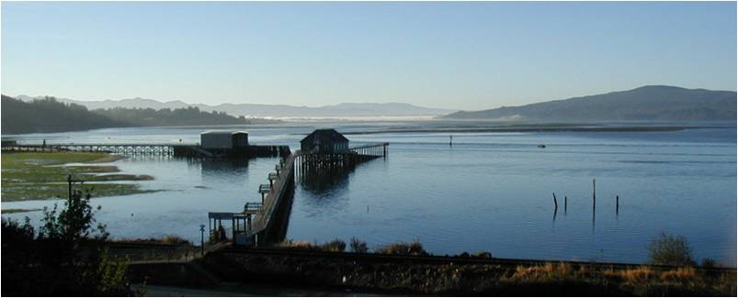
Tillamook Bay Watershed Water Quality Improvements for Bacteria

Slide 2
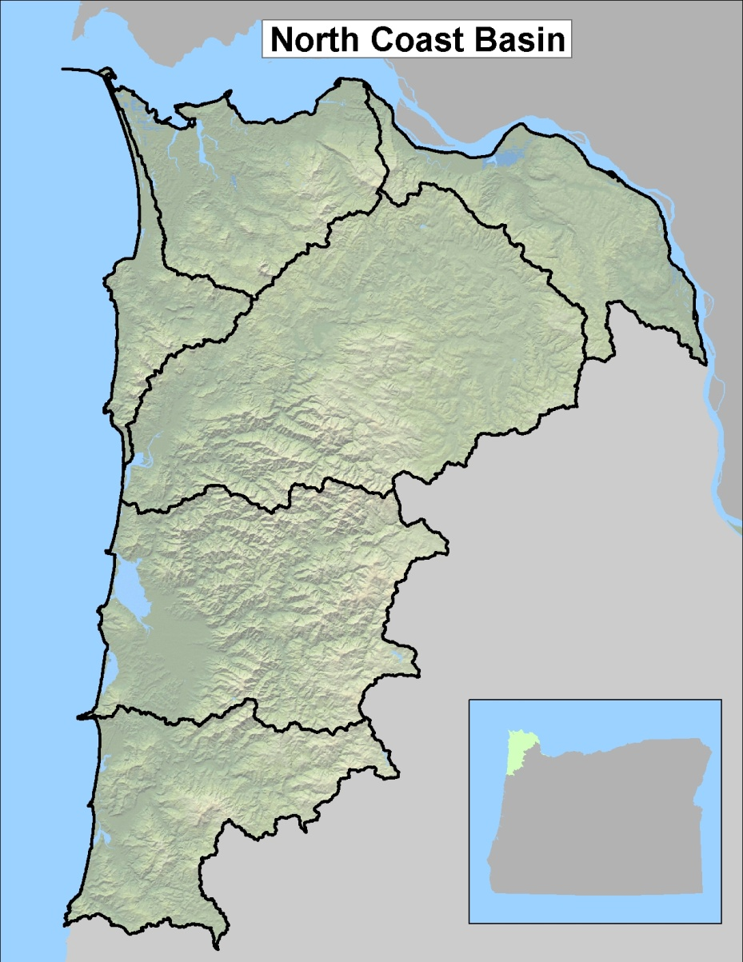
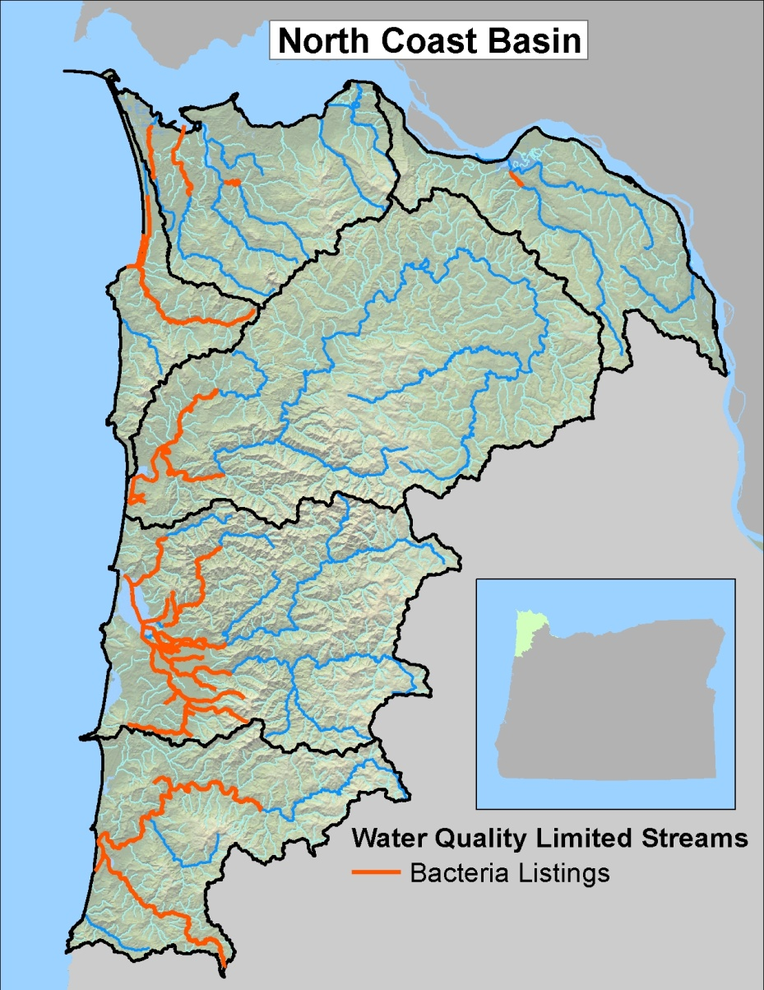
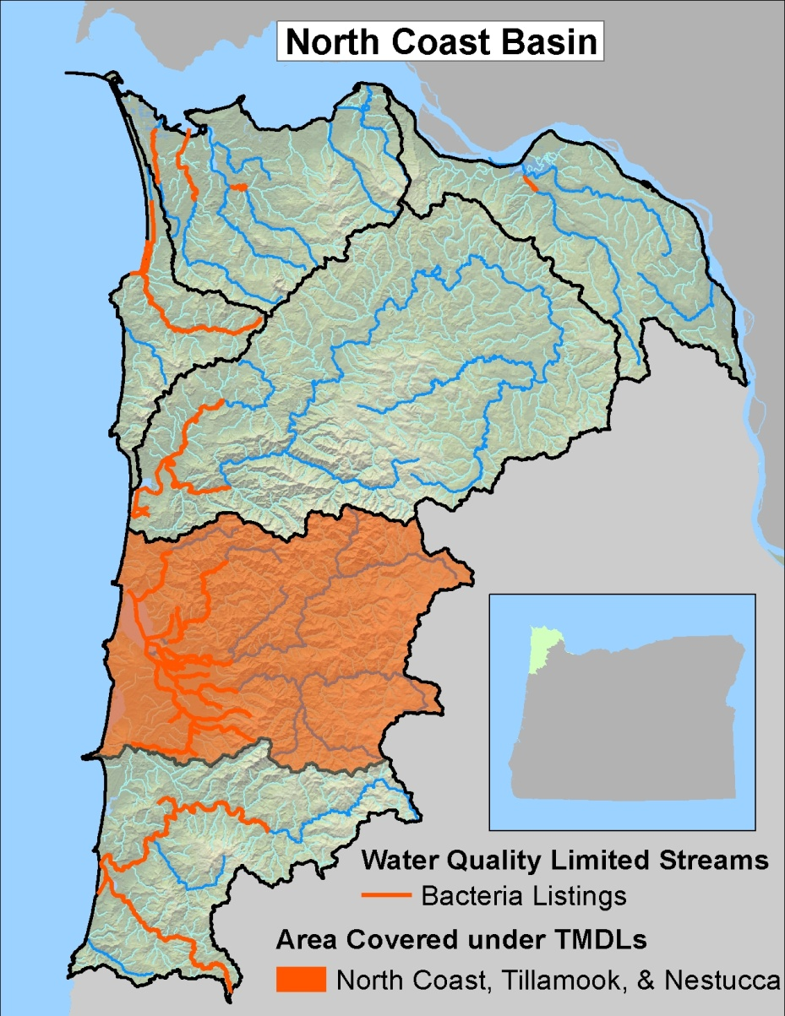
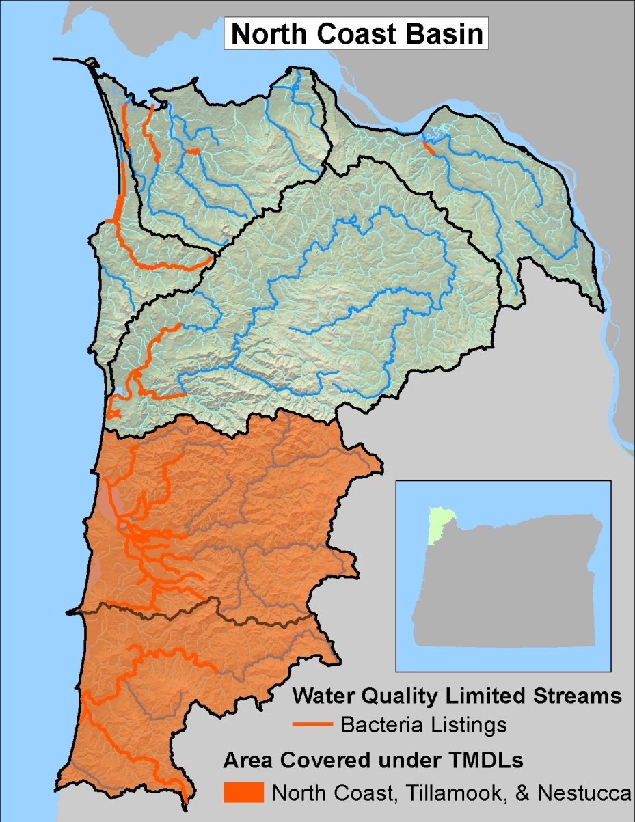
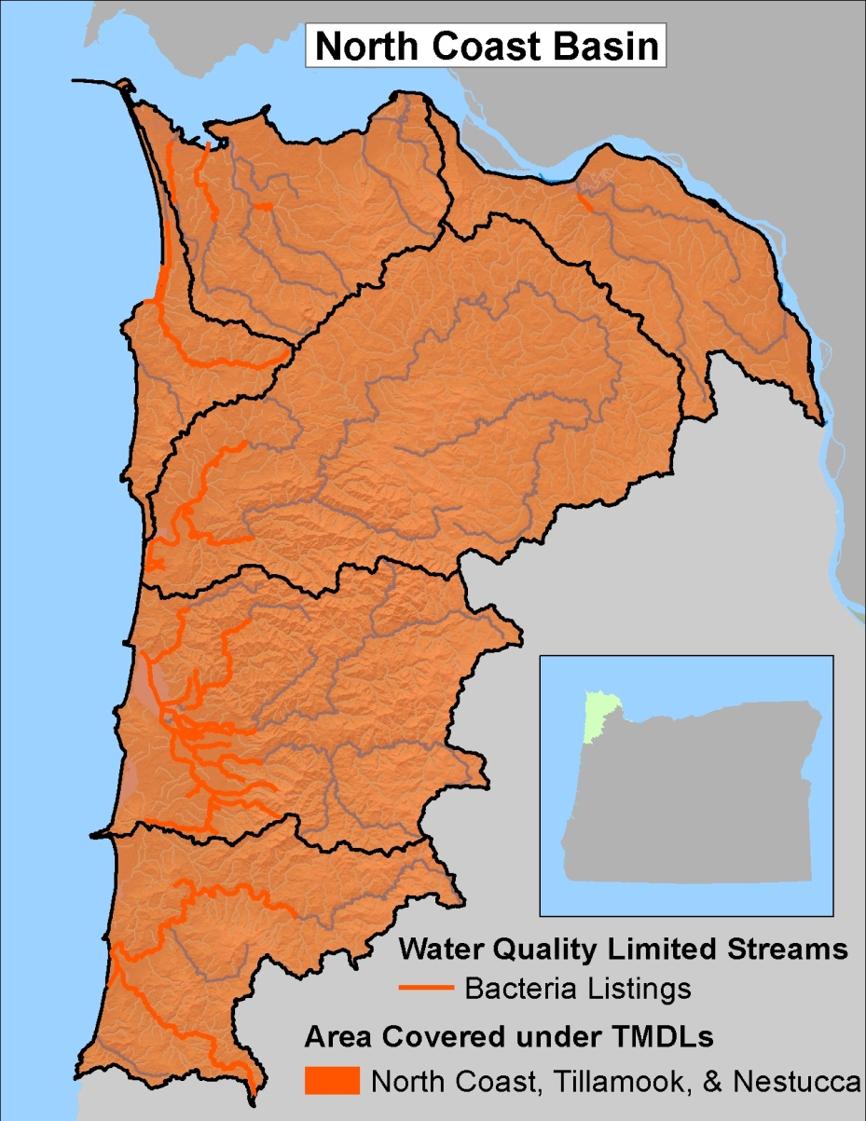
Water Quality History
1998 303(d) listed streams for Bacteria
319 grants started
Restoration projects
Building partnerships
Initial monitoring
TMDLs developed in 2001, 2002, and 2003
Lower Columbia
Necanicum
Nehalem
Tillamook
Nestucca
Notes:
Eric Nigg and Bruce Apple completed 3 TMDLs in 3 years for temperature, bacteria, and sediment. Bacteria TMDLs and implementation will be the focus for the rest of the information. Used 319 funds and local WC’s and TEP to collect data used in the TMDLs.

Slide 3
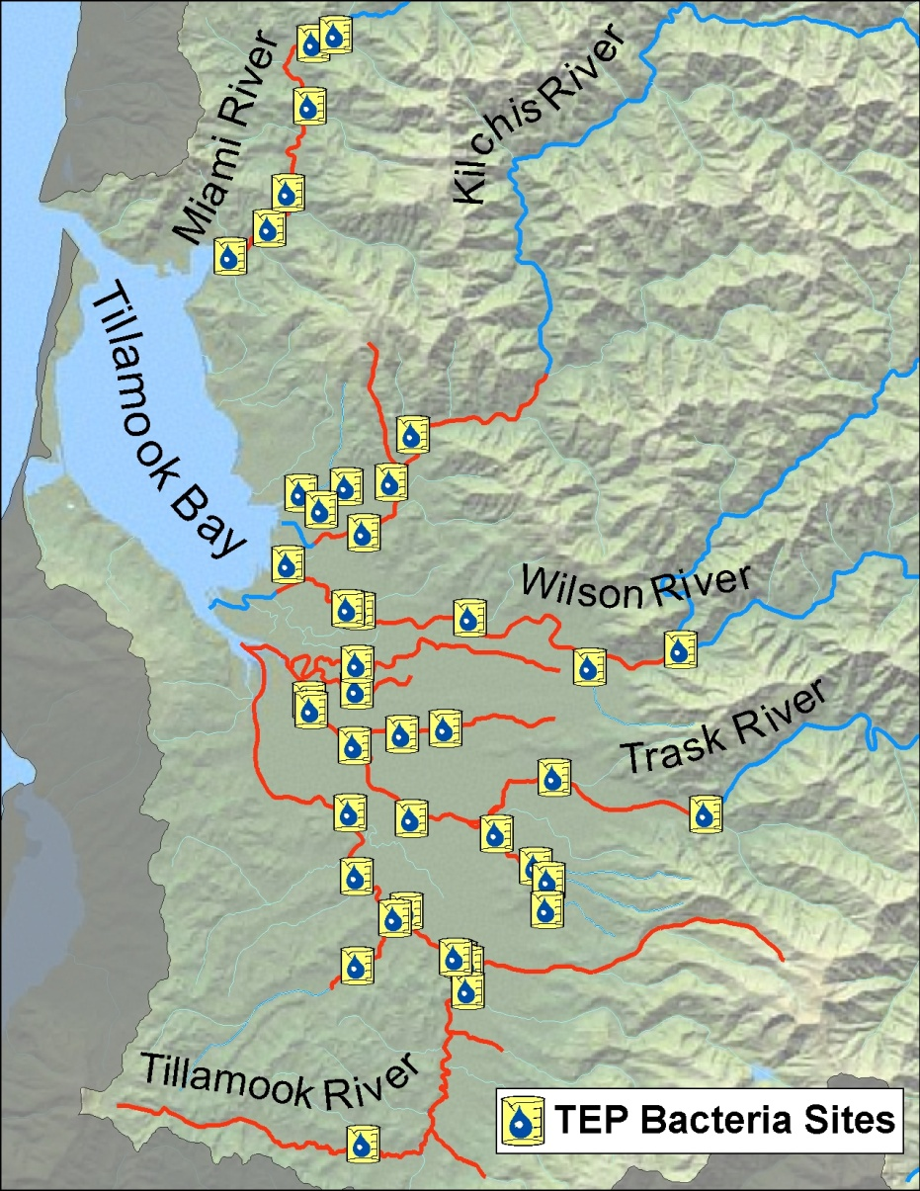
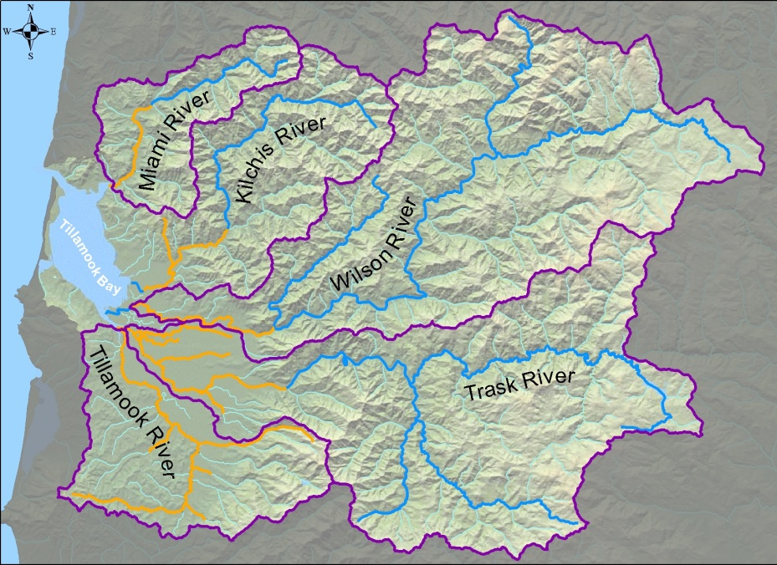
Tillamook Estuaries Partnership Volunteer Monitoring Program
Five volunteers
TCCA
42 sites sample twice a month year round
TEP lab analyzes for Escherichia coli (E. coli) bacteria
Over 19,000 bacteria results: 1997 to 2010
OSU bacteria DNA Study
Tillamook
Notes:
E. coli is use to compare to the recreational use standard.

Slide 4
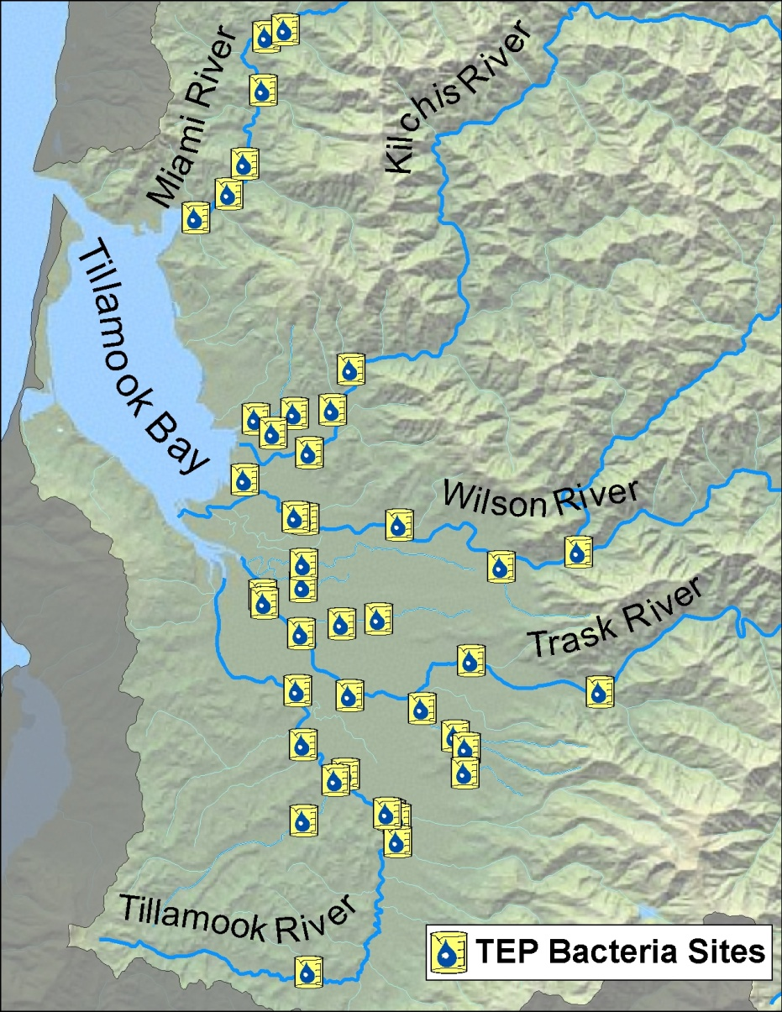
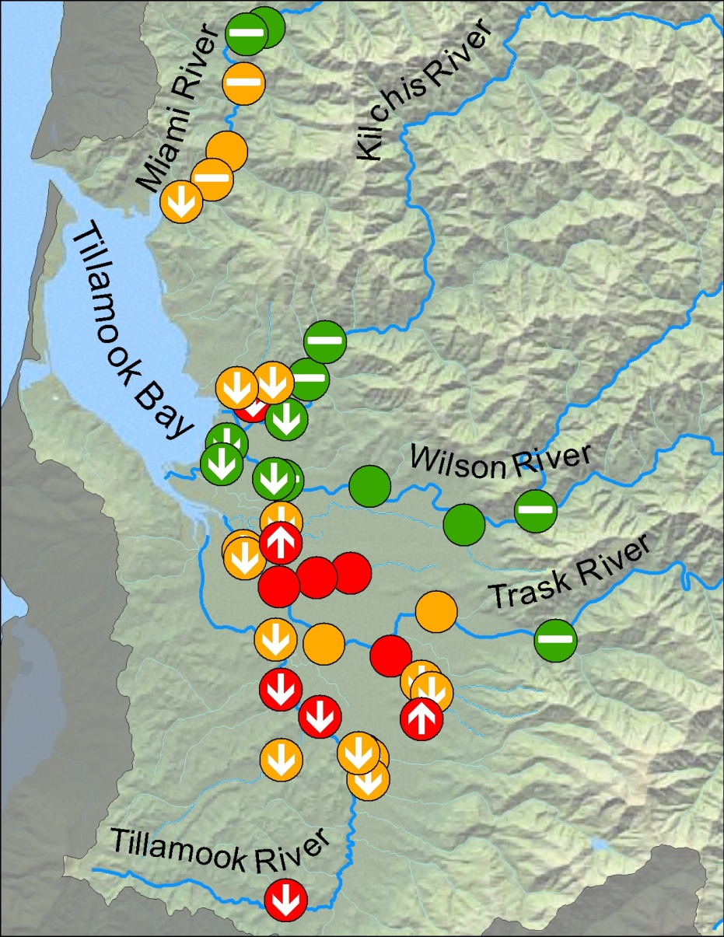
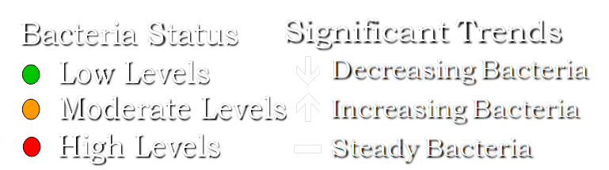
Volunteer Monitoring Program Bacteria Results
Wilson and Kilchis rivers are meeting Standards
Tillamook River all sites are improving
Hoquarten and Mill sites degrading
52% sites improving
Notes:
Wilson River has been meeting standards since 2005 and the Kilchis has been meeting standards since 2009.

Slide 5
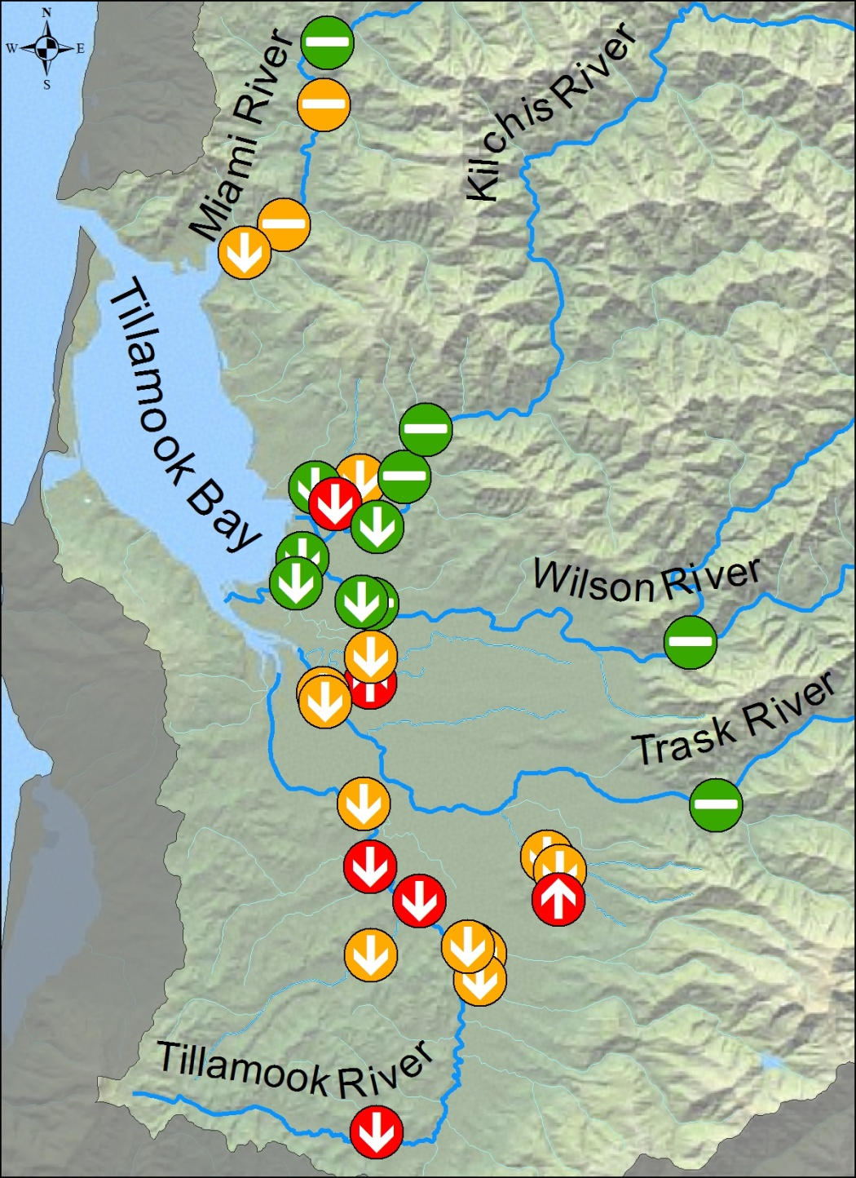
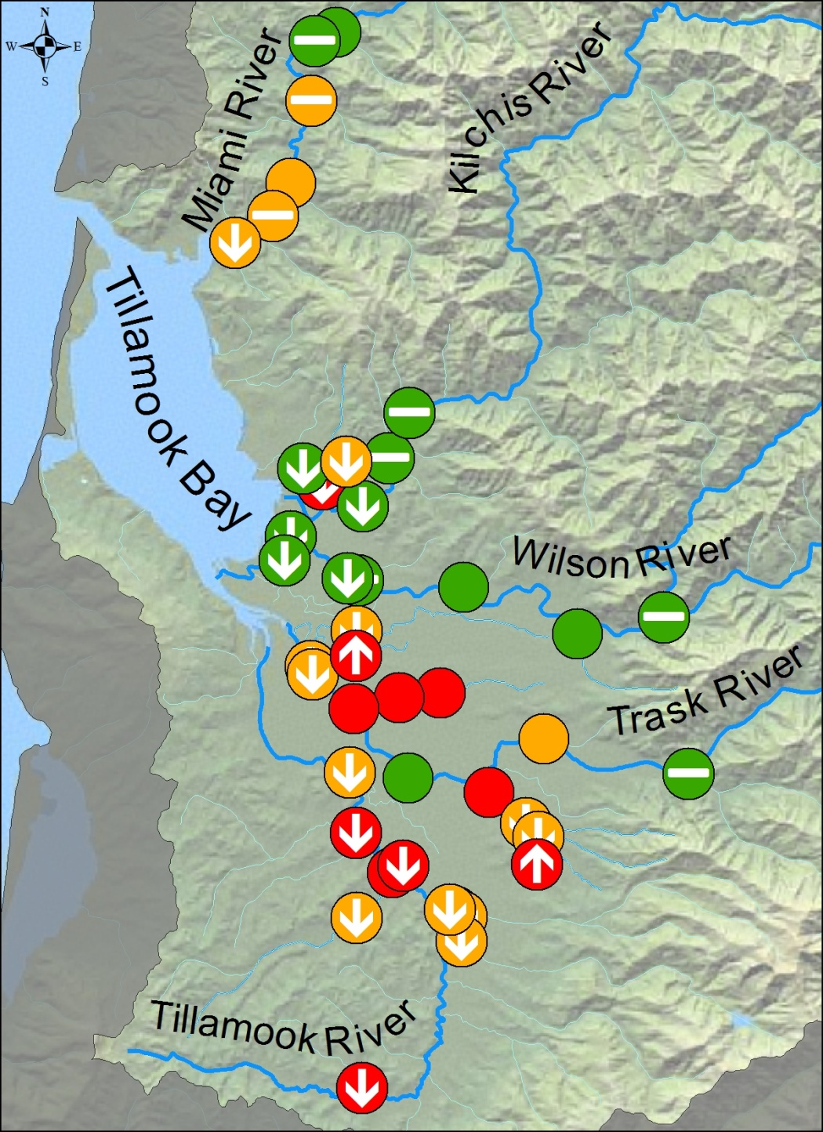
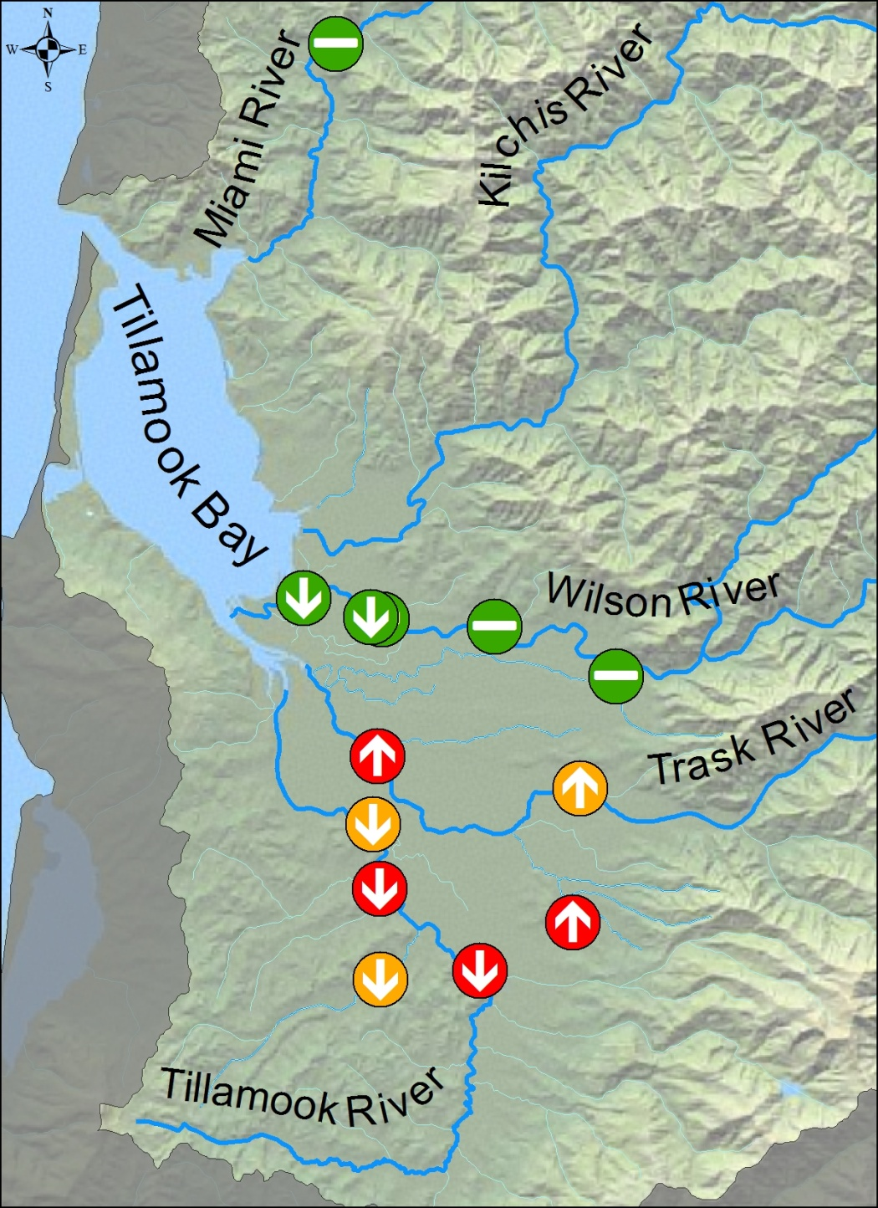
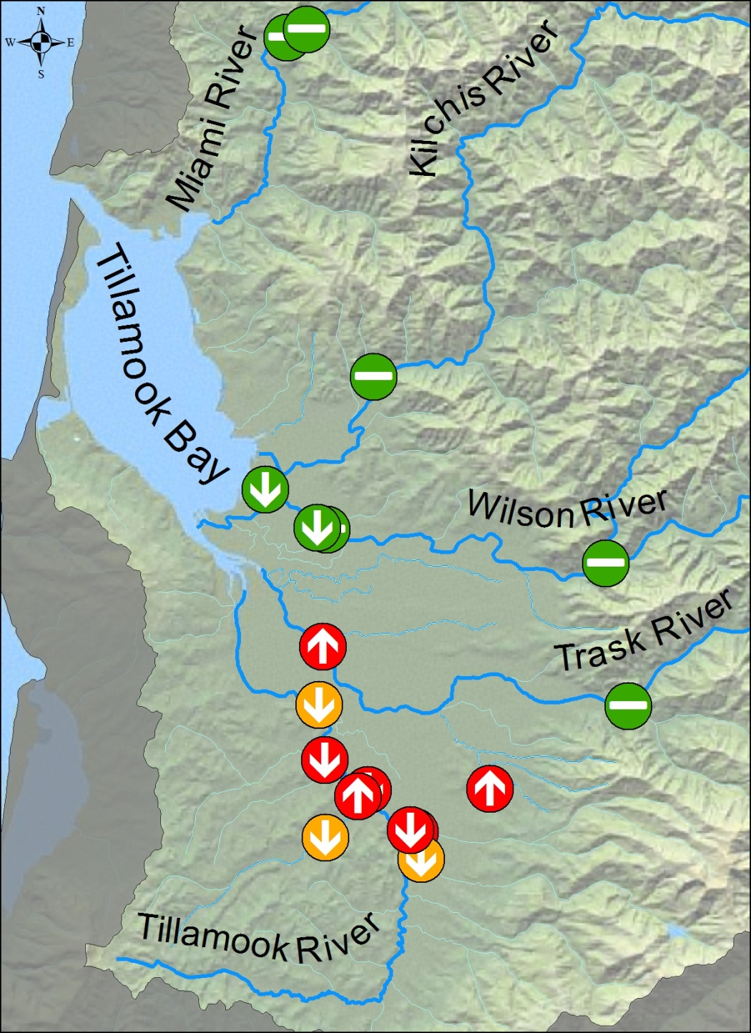
Volunteer Monitoring Program Bacteria Results
2010 significant trends
22 Decreasing Trends
2 Increasing Trends
2008 significant trends
9 Decreasing Trends
3 Increasing Trends
2006 significant trends
7 Decreasing Trends
3 Increasing Trends
Notes:
Water quality data has been used by partners as a tool to focus resources. This efficiency has led to increase improvements.

Slide 6
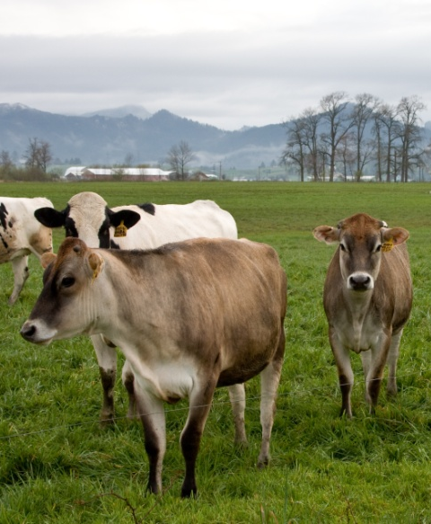
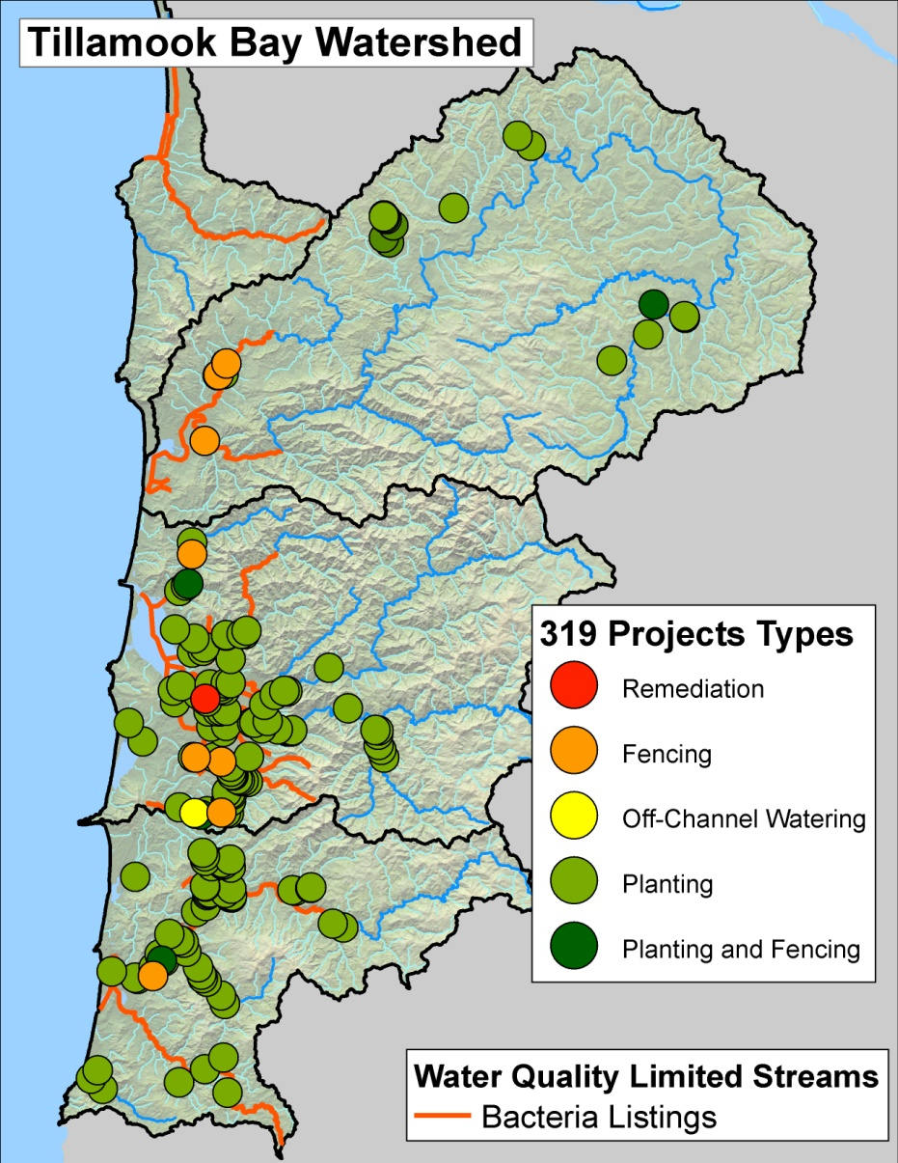
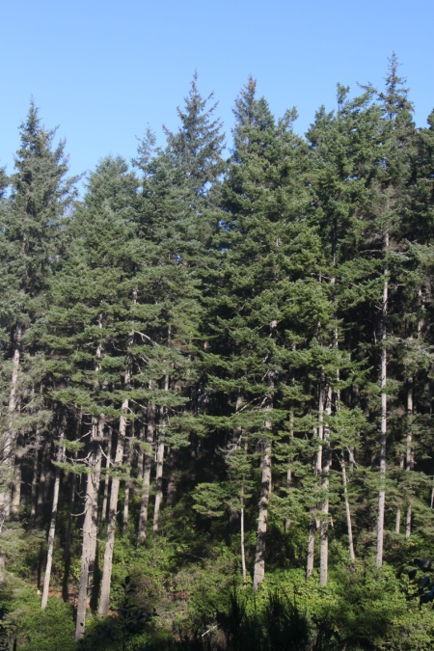
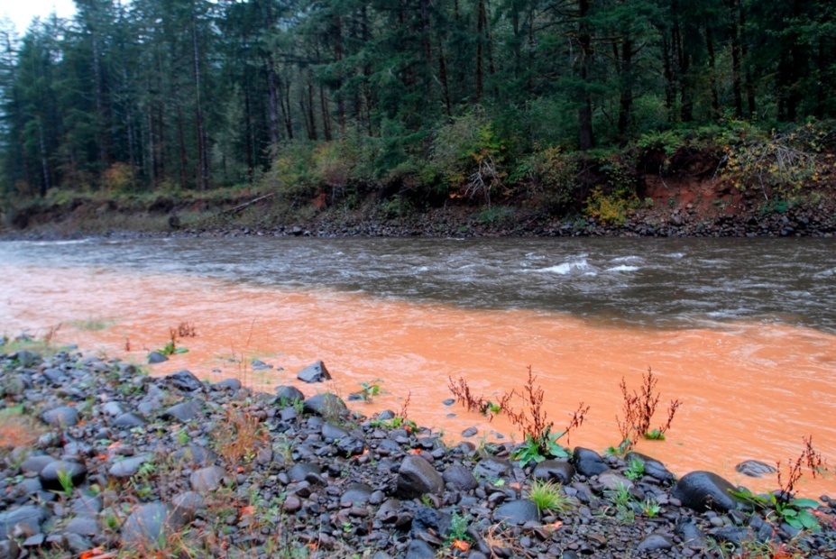
TMDL Implementation
Local Coordinator
Focus projects on TMDL water quality problems:
Bacteria (E. coli)
Temperature
Sediment
319 funds initiated TEP monitoring
Built partnerships with on-the-ground projects for 12+ years
Notes:
Having a local presence in the area and focusing a projects that have multiple water quality benefits is essential for success.

Slide 7
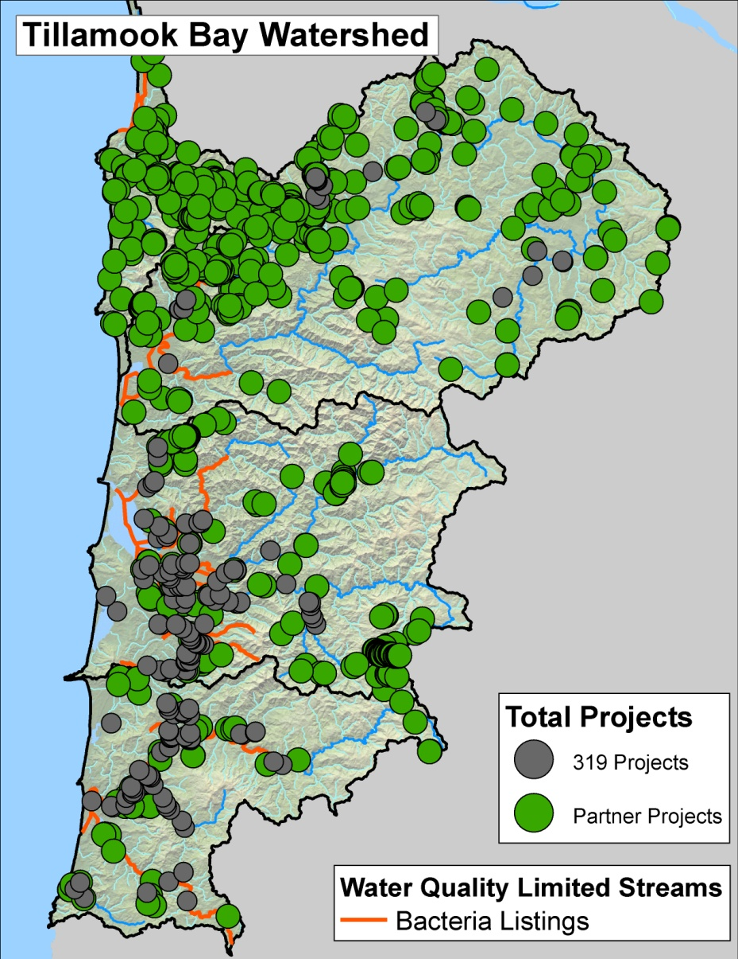
Restoration Efforts
172 projects, 319 funded
Restored 200 of 320 stream miles identified in TMDLs
Partner Projects and match to 319
TCCA facility upgrade, and fencing program
SWCD/NRCS manure management
CAFO management
Notes:
319 fund are small and limited but have been invaluable tool to bring partners and other resource to the area. WC’s, Tillamook SWCD, and TEP use 319 funds. Local business and agencies such as ODA and NRCS have also contributed. (Not all projects are represented by maps due to database limitations)

Slide 8
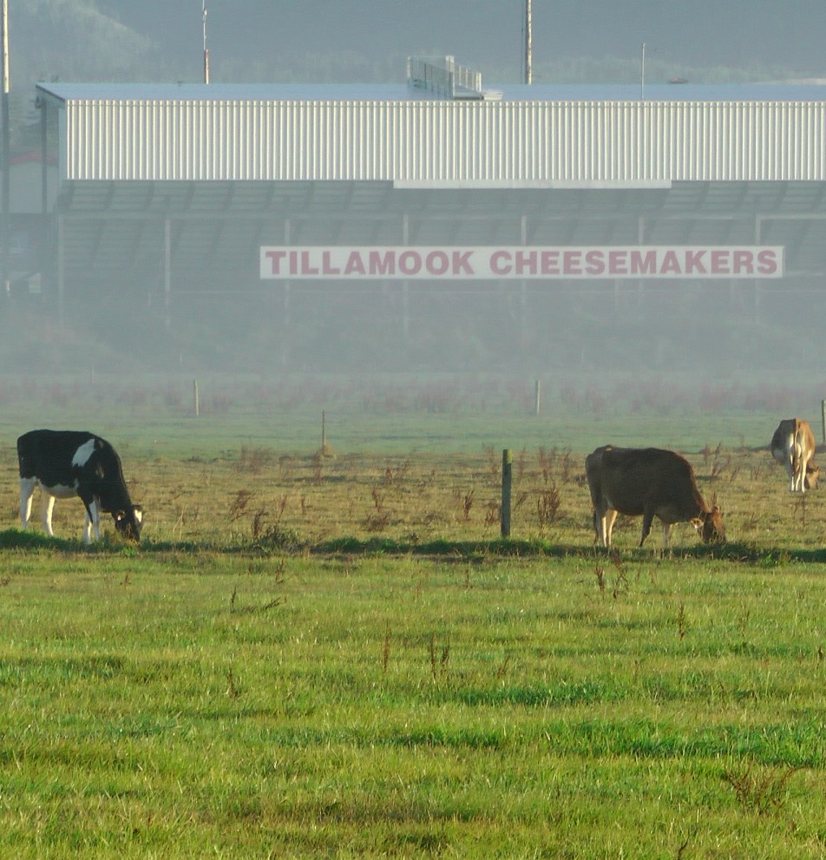
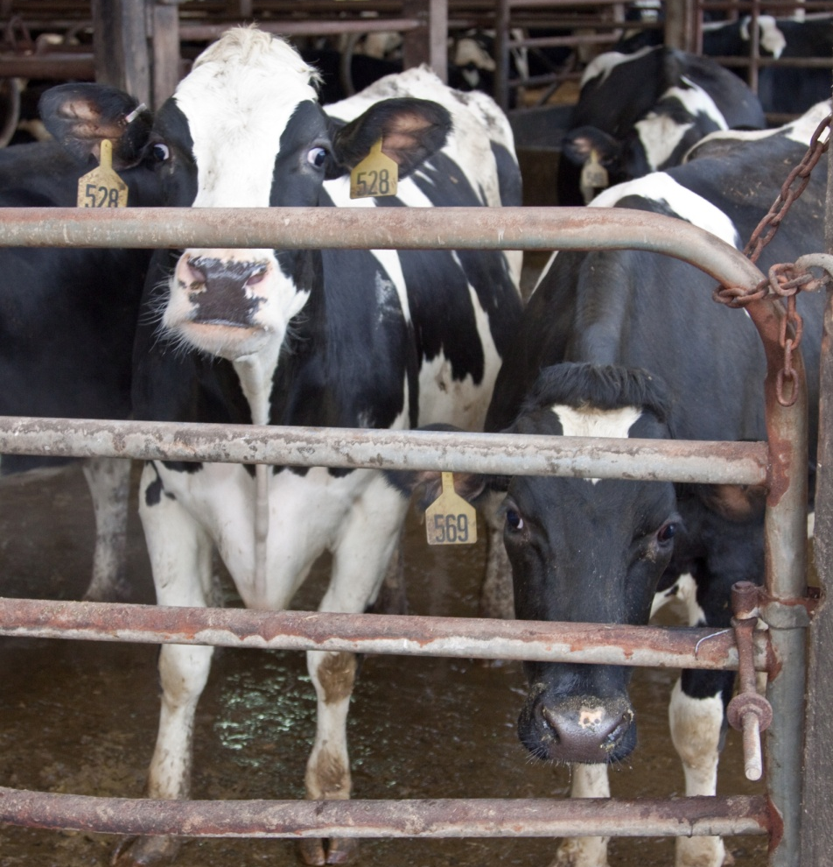
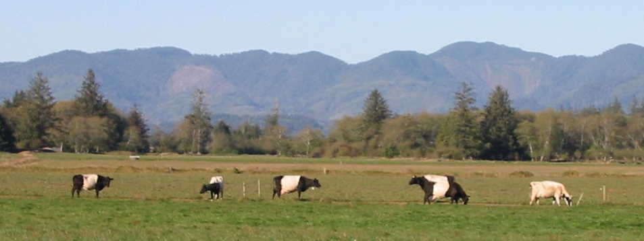
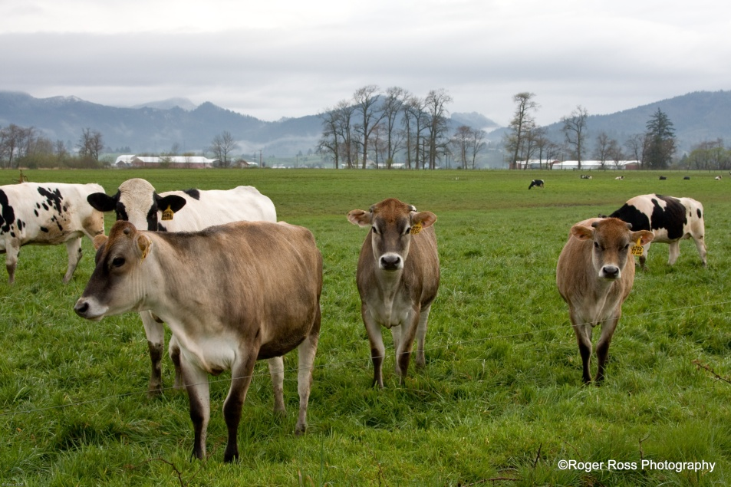
ODA Partner Program Efforts
Local inspector co-located with DEQ
ODA targets actions based on WQ data
Work with other Agriculture partners
NRCS, Tillamook SWCD, TCCA, and OSU Ext.
ODA/DEQ issue the NPDES CAFO Permit
CAFO has routine compliance inspections
Notes:
CAFO program has been and integral partner from the beginning and has made significant improvements.

Slide 9
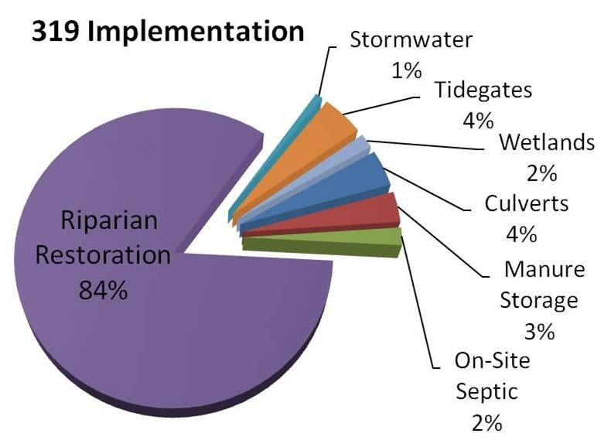
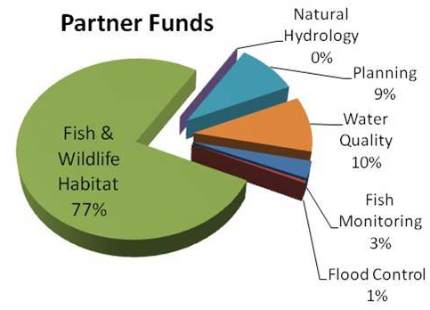
North Coast 319 Program Funding Summary
Government Performance and Results Act (GPRA) estimates $68 million total
Consistent funding has built a restoration economy
Approximately $2.6 million spent in the North Coast from 2000 to 2009
$4.4 million in match just for 319
Notes:
DEQ’s efforts on the North Coast have brought improvements in water quality as well as money to the local economy. Money does not equal success unless you have local dedicated individuals on the ground getting projects that make a difference.

Slide 10
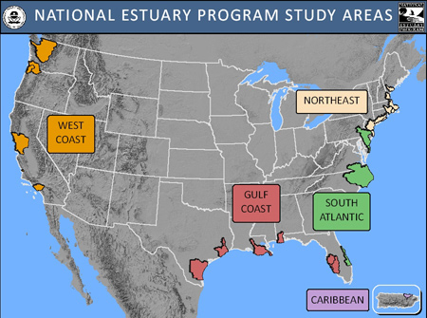
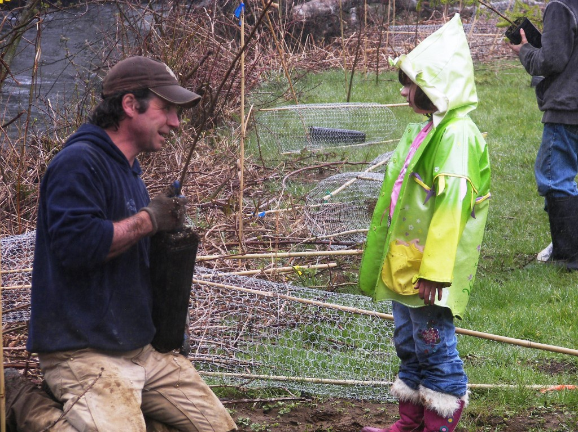
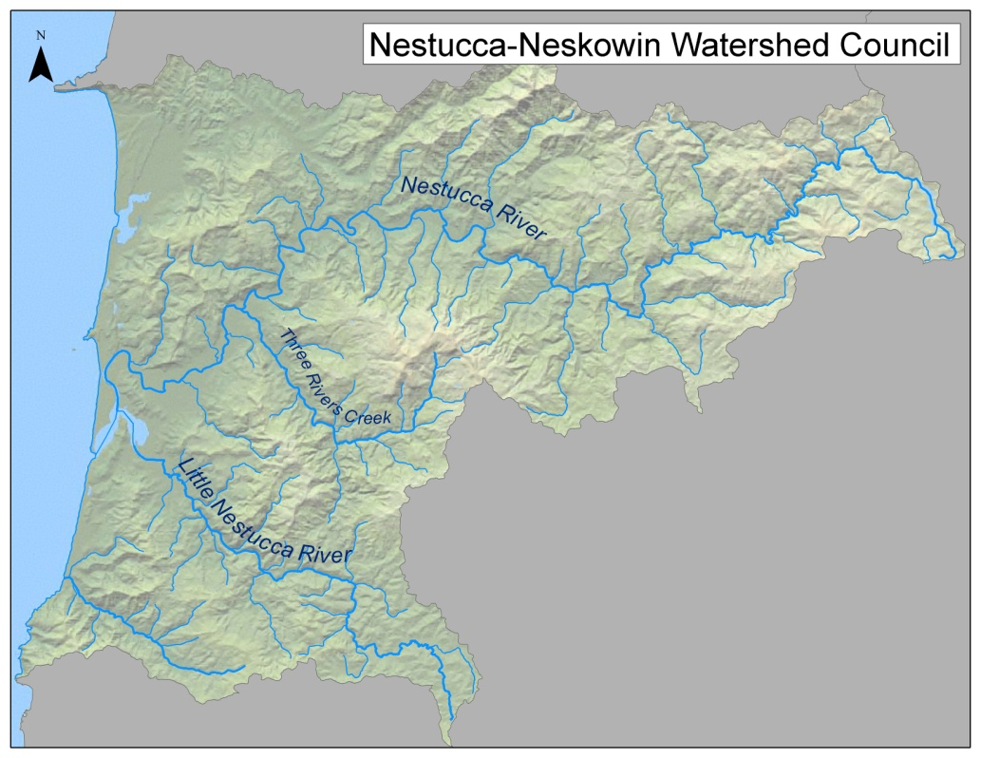
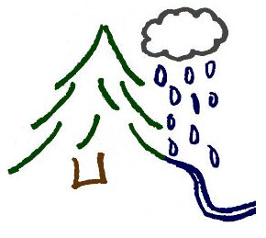
North Coast Restoration Coordination
Backyard Planting Program (BYPP)
CCMP guidance
TMDLs WQMP guidance
Nestucca-Neskowin Watershed Council
Riparian Enhancement Coordinator
Tillamook Estuaries Partnership
Notes:
Tom McDermott summary of organizations

Slide 11
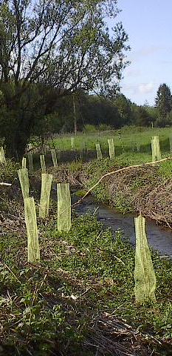
Program Description / Summary
319 with OWEB matching funds, TEP 320
Used 303d to guide priorities in lower watersheds
Addresses WQ pollution and fish habitat
DEQ: Bacteria, Temperature, Sediment
OWEB: LWD, diverse habitat
Key utility of 319 funds:
Strategic planning and recruitment
OWEB grants
Goal: Establish diverse native plant communities

Slide 12
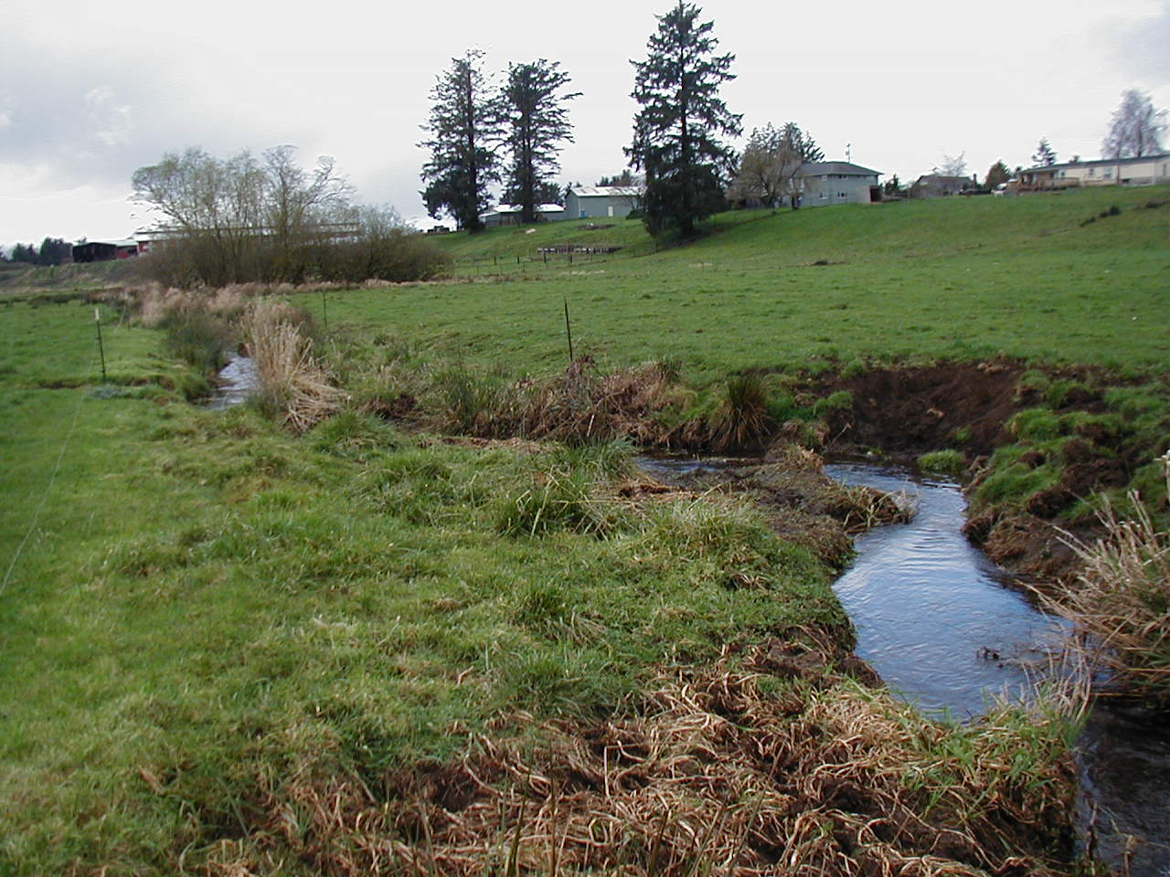
Riparian Restoration Components
Volunteer Landowner outreach
Recruitment
Development of project plans
Materials
Prep
Planting
Maintenance
Monitoring

Slide 13
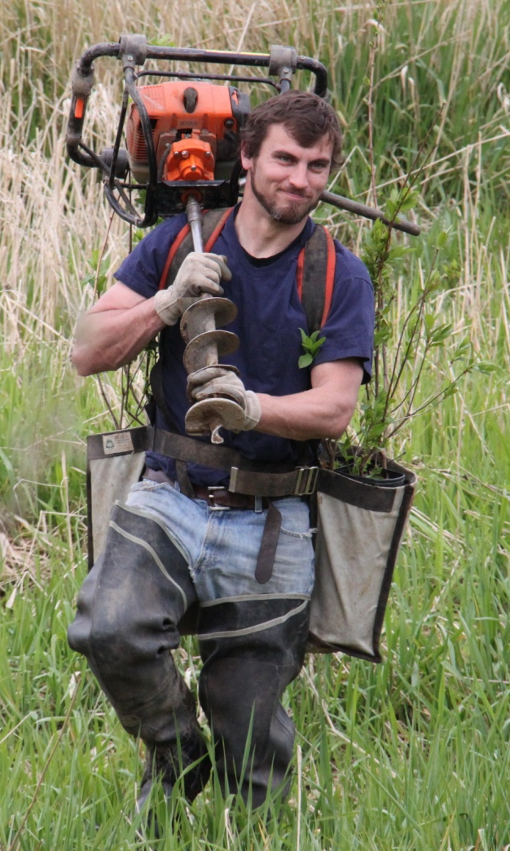
Project Implementation
Coordination/Project management
Contract labor
Companies
Temp Labor
Individuals
Oregon Youth Authority
Oregon Youth Conservation Corp
Schools
Materials: Equipment, Protection and Plants

Slide 14
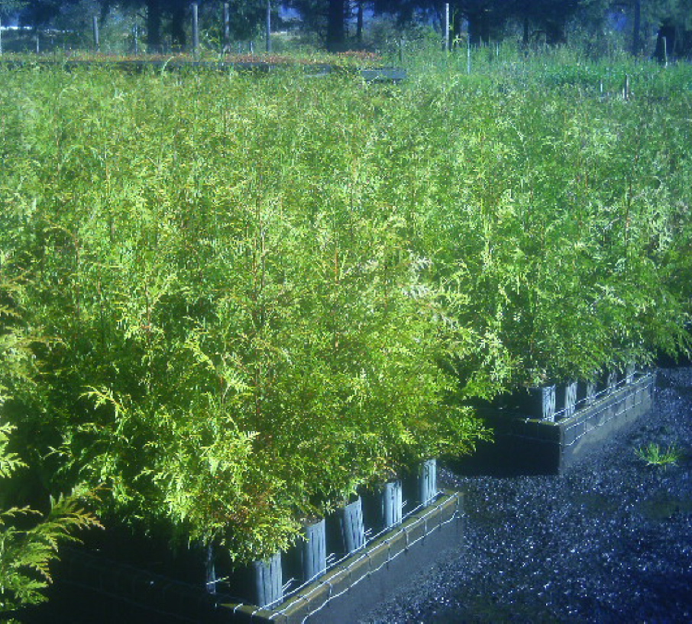
Organization / Structure
BLM – Native Plant Co-op
OYA/OYCC
Schools
ODFW – TA
NRCS – Landowner and TA
USFS – Materials and supplies
Work with Partners:
SWCD – TCCA and ODA

Slide 15
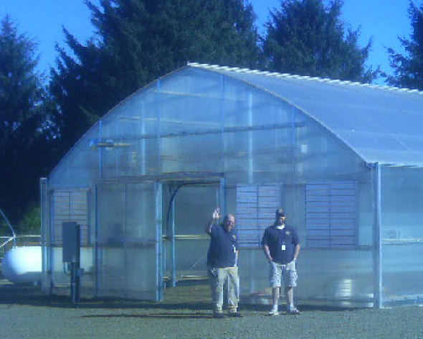
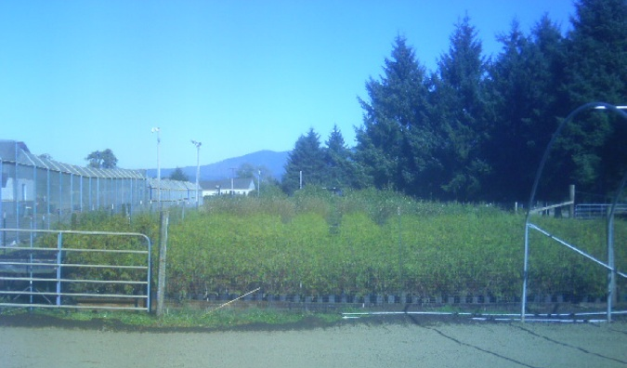
Innovations and Keys to Success…
Plant Co-op developed
Originally limited to bare-root conifer surplus
Evolved into:
Larger plants
Diverse species in greater supplies
Grown from local stocks
Wetland seed collections
Plants design to outcompete
Decreased maintenance

Slide 16
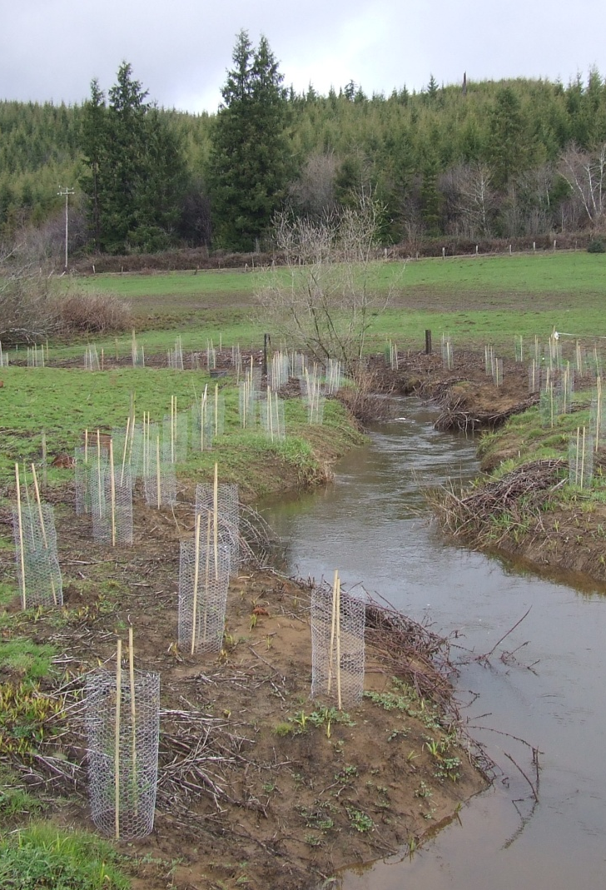
Innovations and Keys to Success…
Large local plant stock
Micro habitat per species
Minimum Buffer Width (2H+10)
Tree protection methodology
Cut, collection, and installation
Planting densities
Timing related to planting and maintenance (3 to 5 years)
319 funding is important to timing and cycling of long-term success

Slide 17
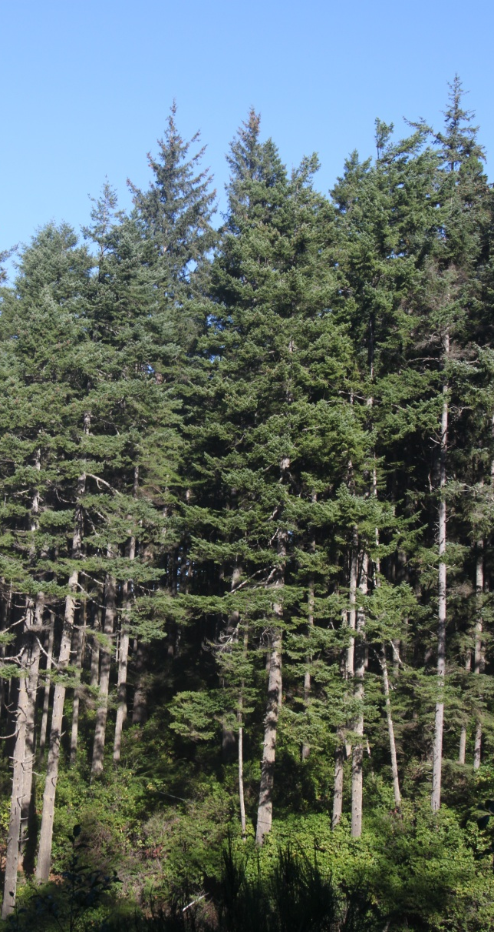
Summary – Project Results
Water Quality and Fish benefits
Riparian area relationship to water quality
Education and outreach
Community support of restoration
Voluntary program
Cooperation with landowners
Acceptance of agency involvement
Ecosystem health
Greater native vegetation diversity
Invasives control in riparian areas

Slide 18
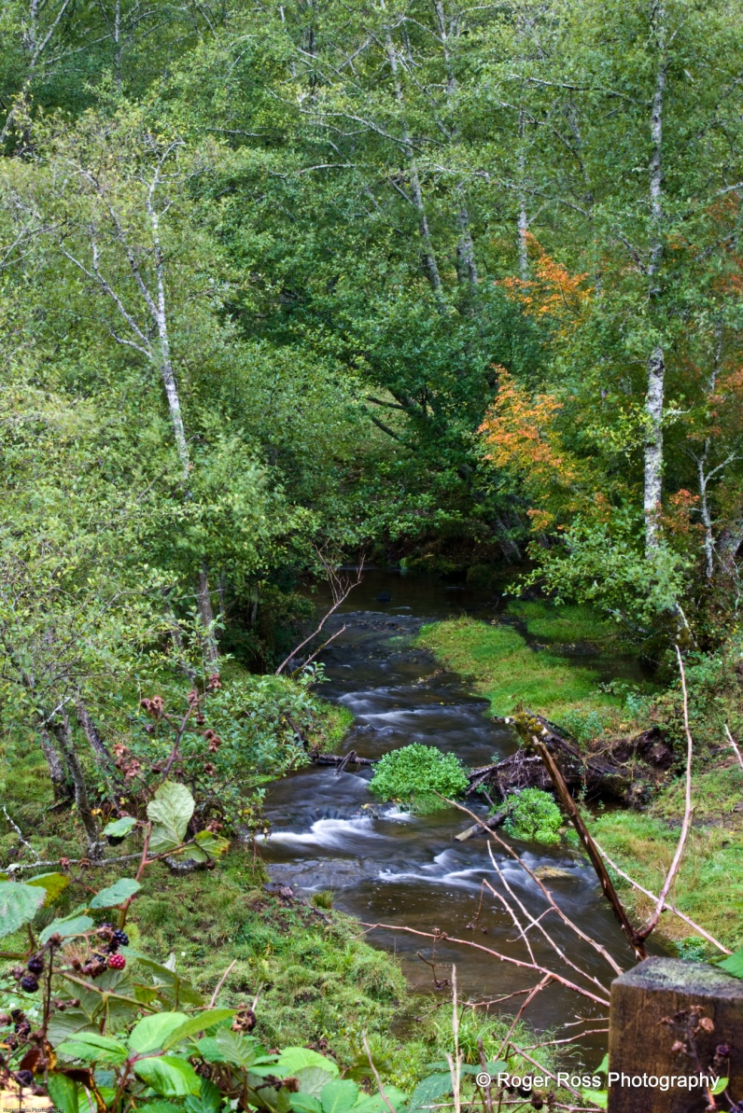
Summary – Project Results Cont.
Program Statistics - 2004 to 2012
72 miles of riparian restoration
35 foot average buffer width
12.5 miles of riparian fencing
220 cooperative landowners
88,000 trees
14,000 shrubs
83,000 cuttings
Plant survivability goal 66%
What it takes to succeed in riparian restoration

Slide 19
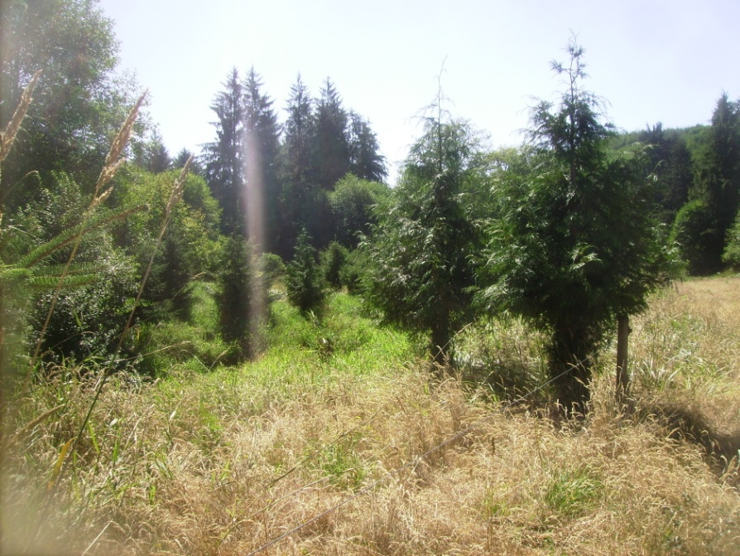
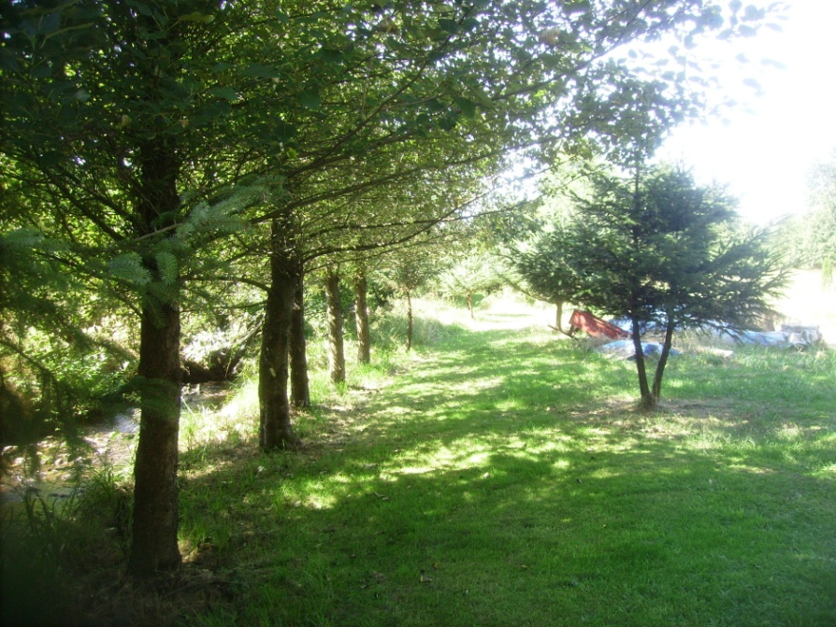
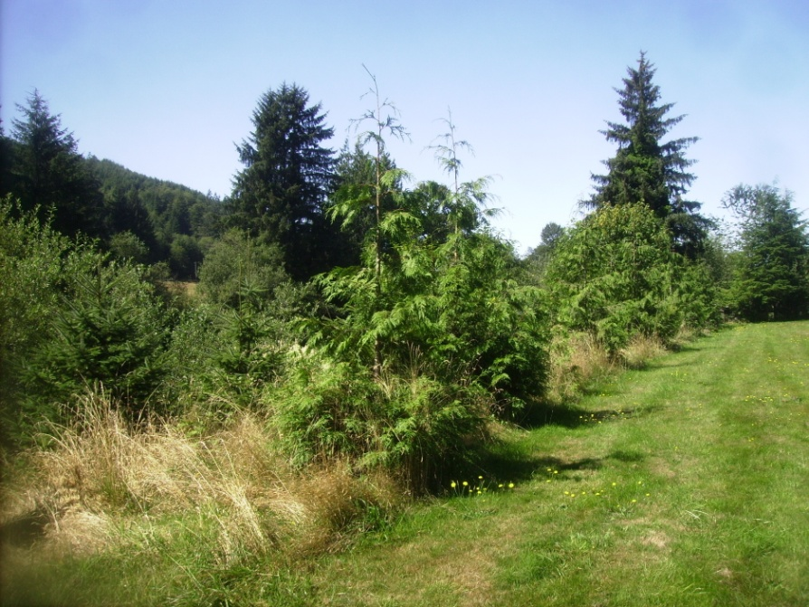
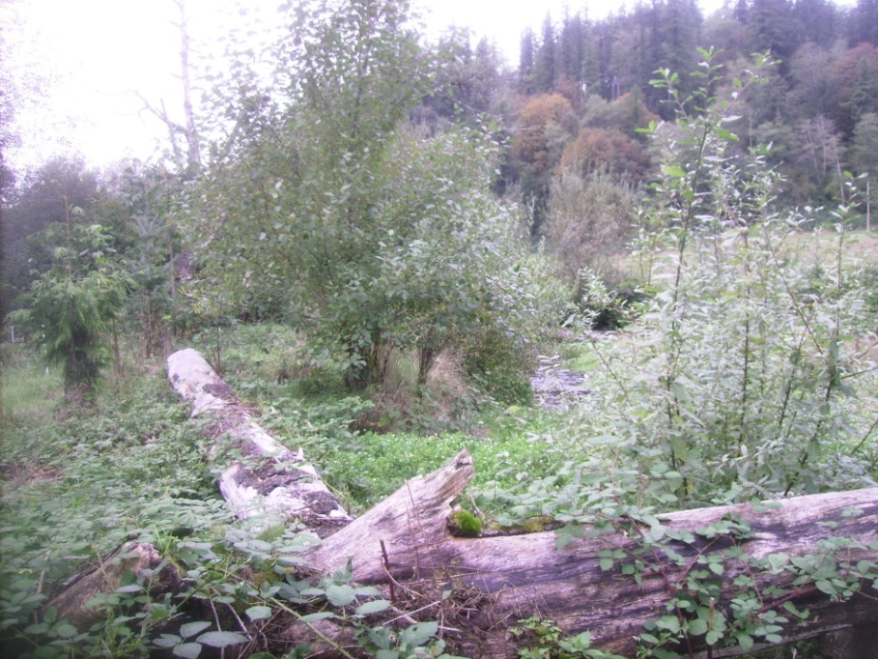
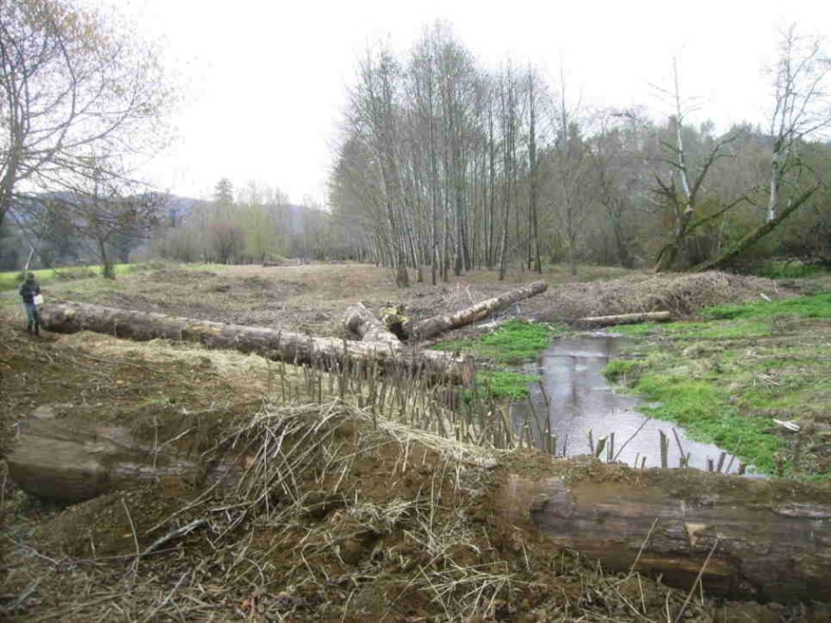
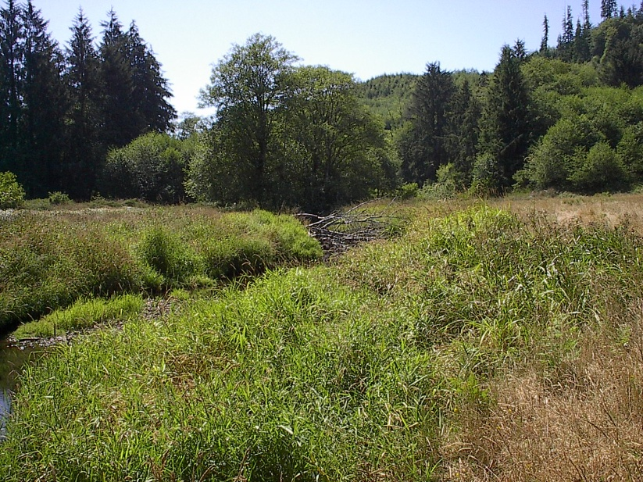
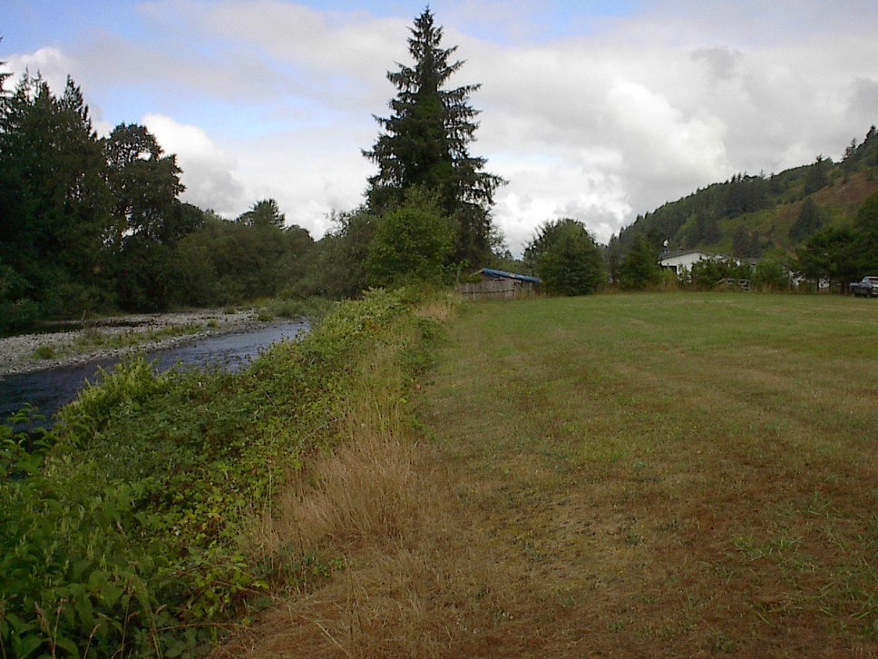
Restoration Photos: Before-After

Slide 20
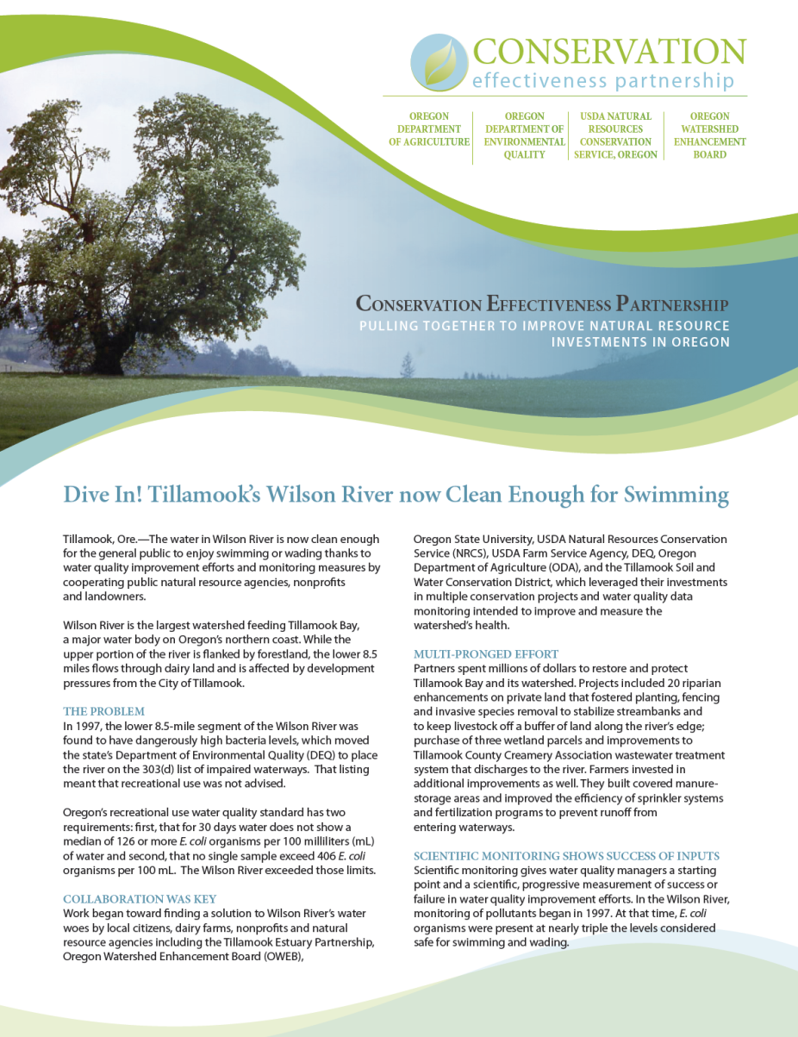
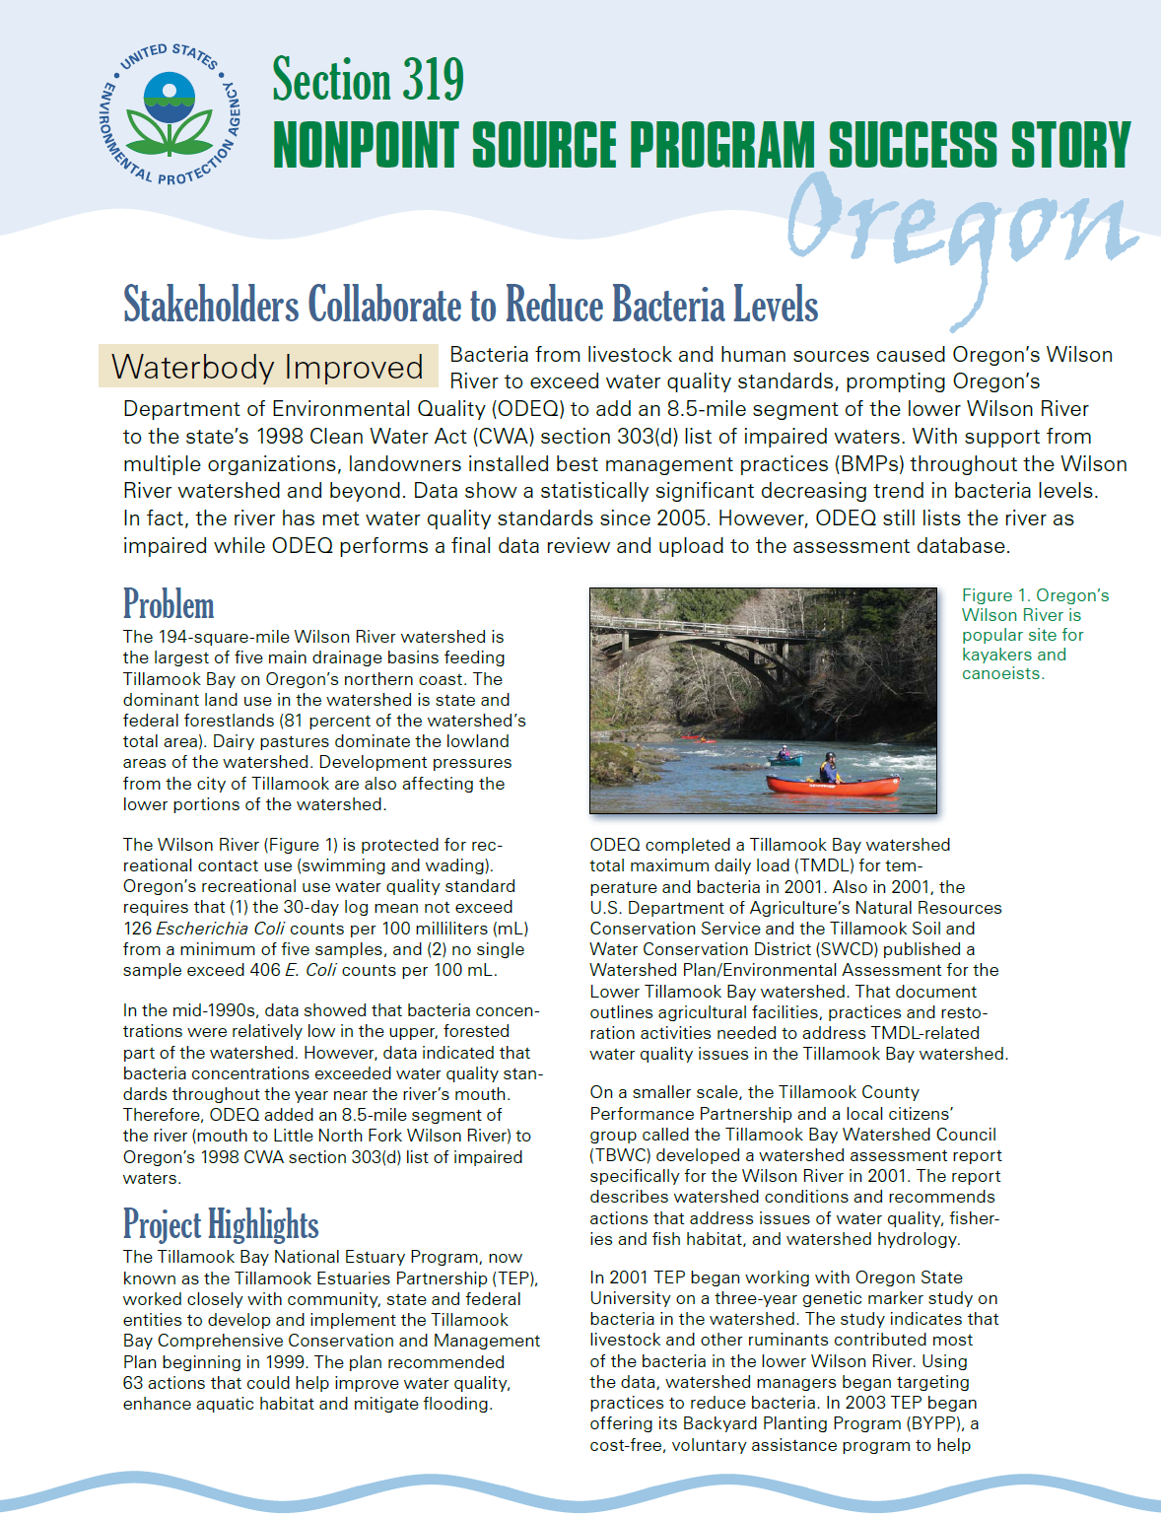
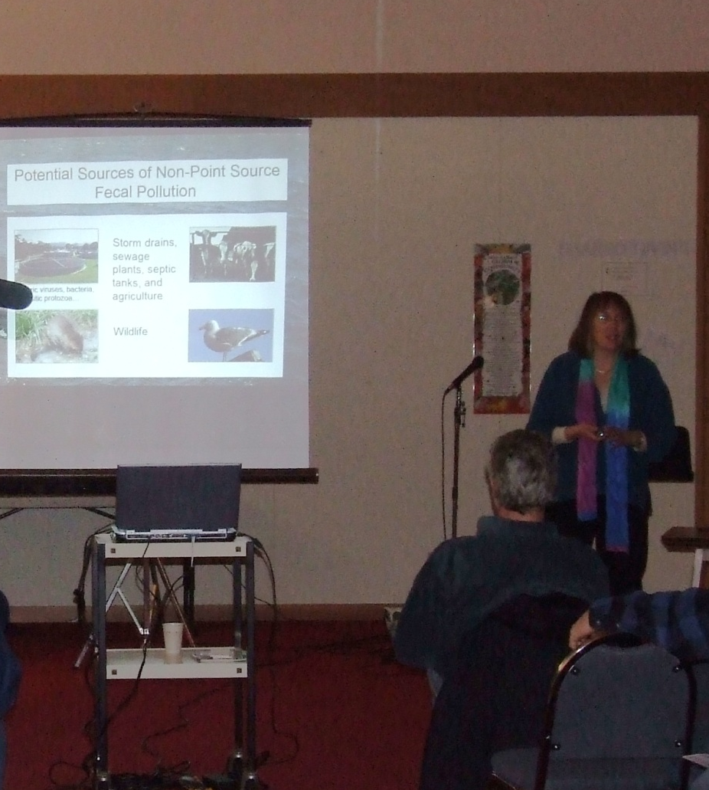
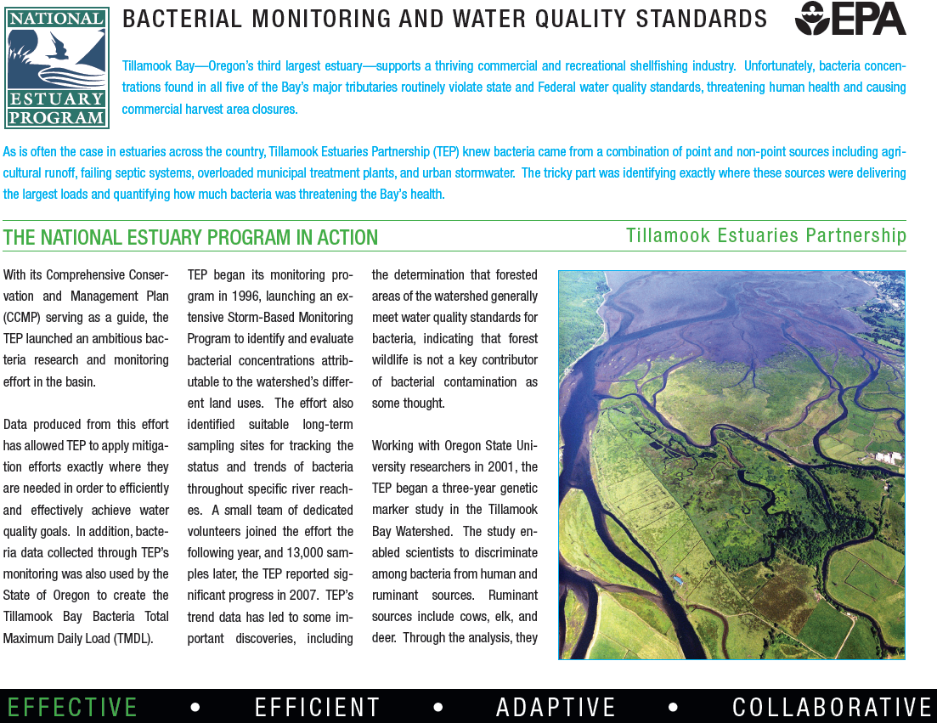

Outreach and Communication
Presentations
Public information
Partner guidance
Publications
Estuary Program
319 Fact Sheets
CEP Fact Sheet

Slide 21







Future Direction
Continue 319 program
New Coordinator
North Coast Watershed Approach
Data Summary
Action Plan
Expand monitoring
Grant for farm bacteria monitoring
Build DNA capacity

Slide 22
Questions
Contact Information:
York Johnson
Johnson.york@deq.state.or.us
(503) 322-2222
Tom McDermott
(541) 921-9755
tmcd@oregoncoast.com

