Slide 1
Environmental Quality Commission Information Item, Stakeholder Panel and Public Comment:
Portland Air Toxics Solutions
June 21, 2012
Nina DeConcini
Sarah Armitage

Slide 2
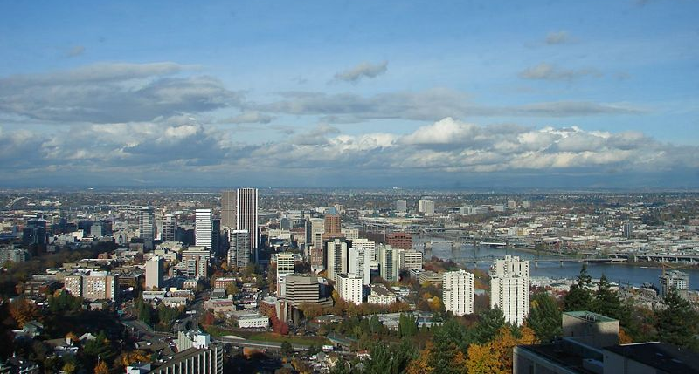
Portland Air Toxics Solutions
A geographic approach to understanding
and reducing air toxics

Slide 3
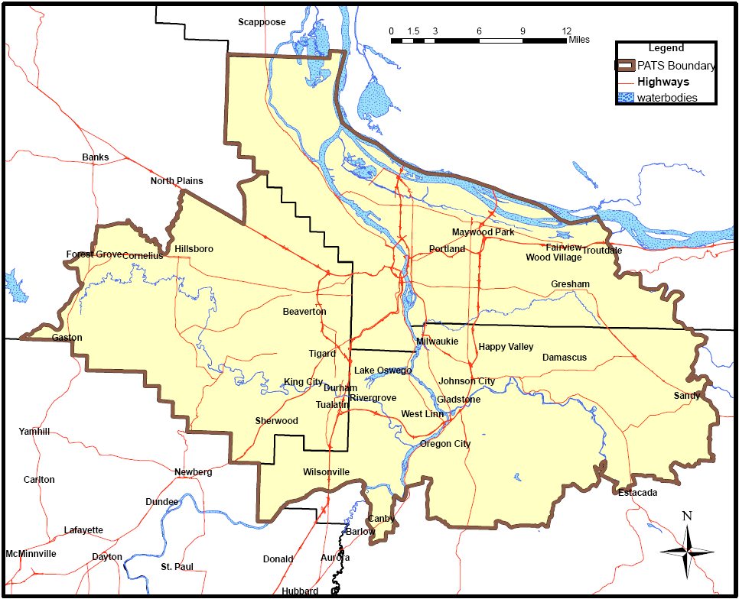
Portland Air Toxics Solutions
Project study area

Slide 4
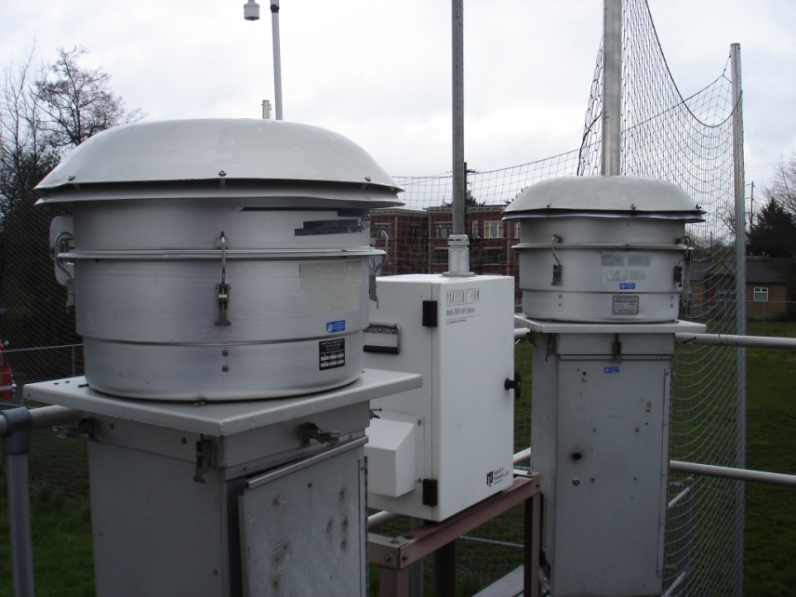
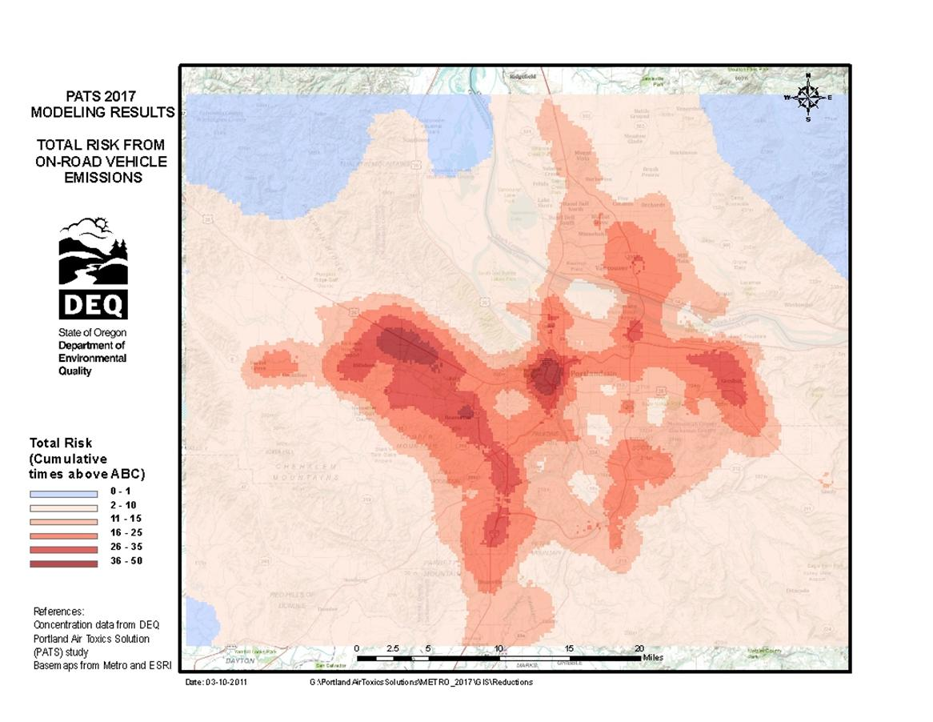
Portland Air Toxics Solutions
How does DEQ evaluate air toxics levels?
Air Toxics Monitoring Equipment in North Portland
Modeling Map
Estimated Air Toxics from Cars and Trucks in the Portland Area

Slide 5
Portland Air Toxics Solutions
PATS Emission Inventory

Slide 6
Portland Air Toxics Solutions
What are ambient benchmark concentrations?
Clean air health goals
Measurement tools
Annual levels of air toxics that people, including more sensitive groups such as children or the elderly, could breathe continuously for a lifetime without adverse health effects or increasing their risk of cancer by more than one chance in a million.

Slide 7
Pollutants above benchmarks and general locations
Portland Air Toxics Solutions

Slide 8
Portland Air Toxics Solutions
Environmental Justice Analysis
Disproportionate impact from all sources:
Higher Lower
Higher Lower
Disproportionate impact by source category:
Hispanic/Latino | Asian | African American/Black | Below Poverty
Residential Wood Burning | Cars and Trucks | Commercial Solvent and Fuel Use | Cars and Trucks
Construction and Non Road Engines | Construction and Non Road Engines | Construction and Non Road Engines | Commercial Solvent and Fuel Use
On-Road Mobile | Residential Wood Burning |  | Permitted Industrial Facilities
Commercial Solvent and Fuel Use | Commercial Solvent and Fuel Use

Slide 9
Portland Air Toxics Solutions
Five priority categories for reduction:
Residential wood combustion
Cars and trucks
Heavy duty vehicles
Construction equipment
Industrial metals facilities

Slide 10
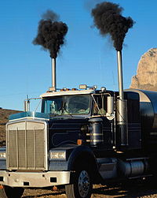
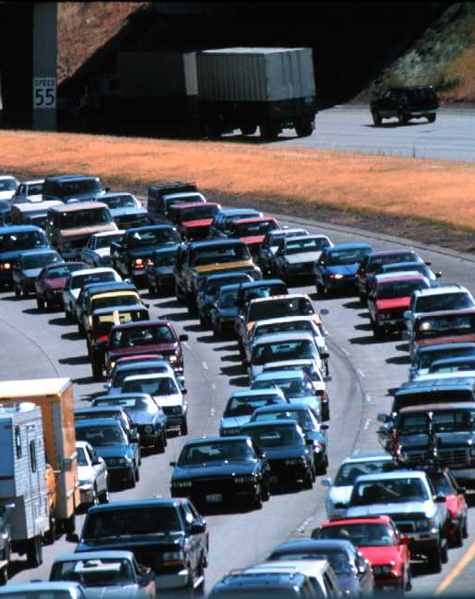
Portland Air Toxics Solutions
Reducing emissions from cars and trucks

Slide 11
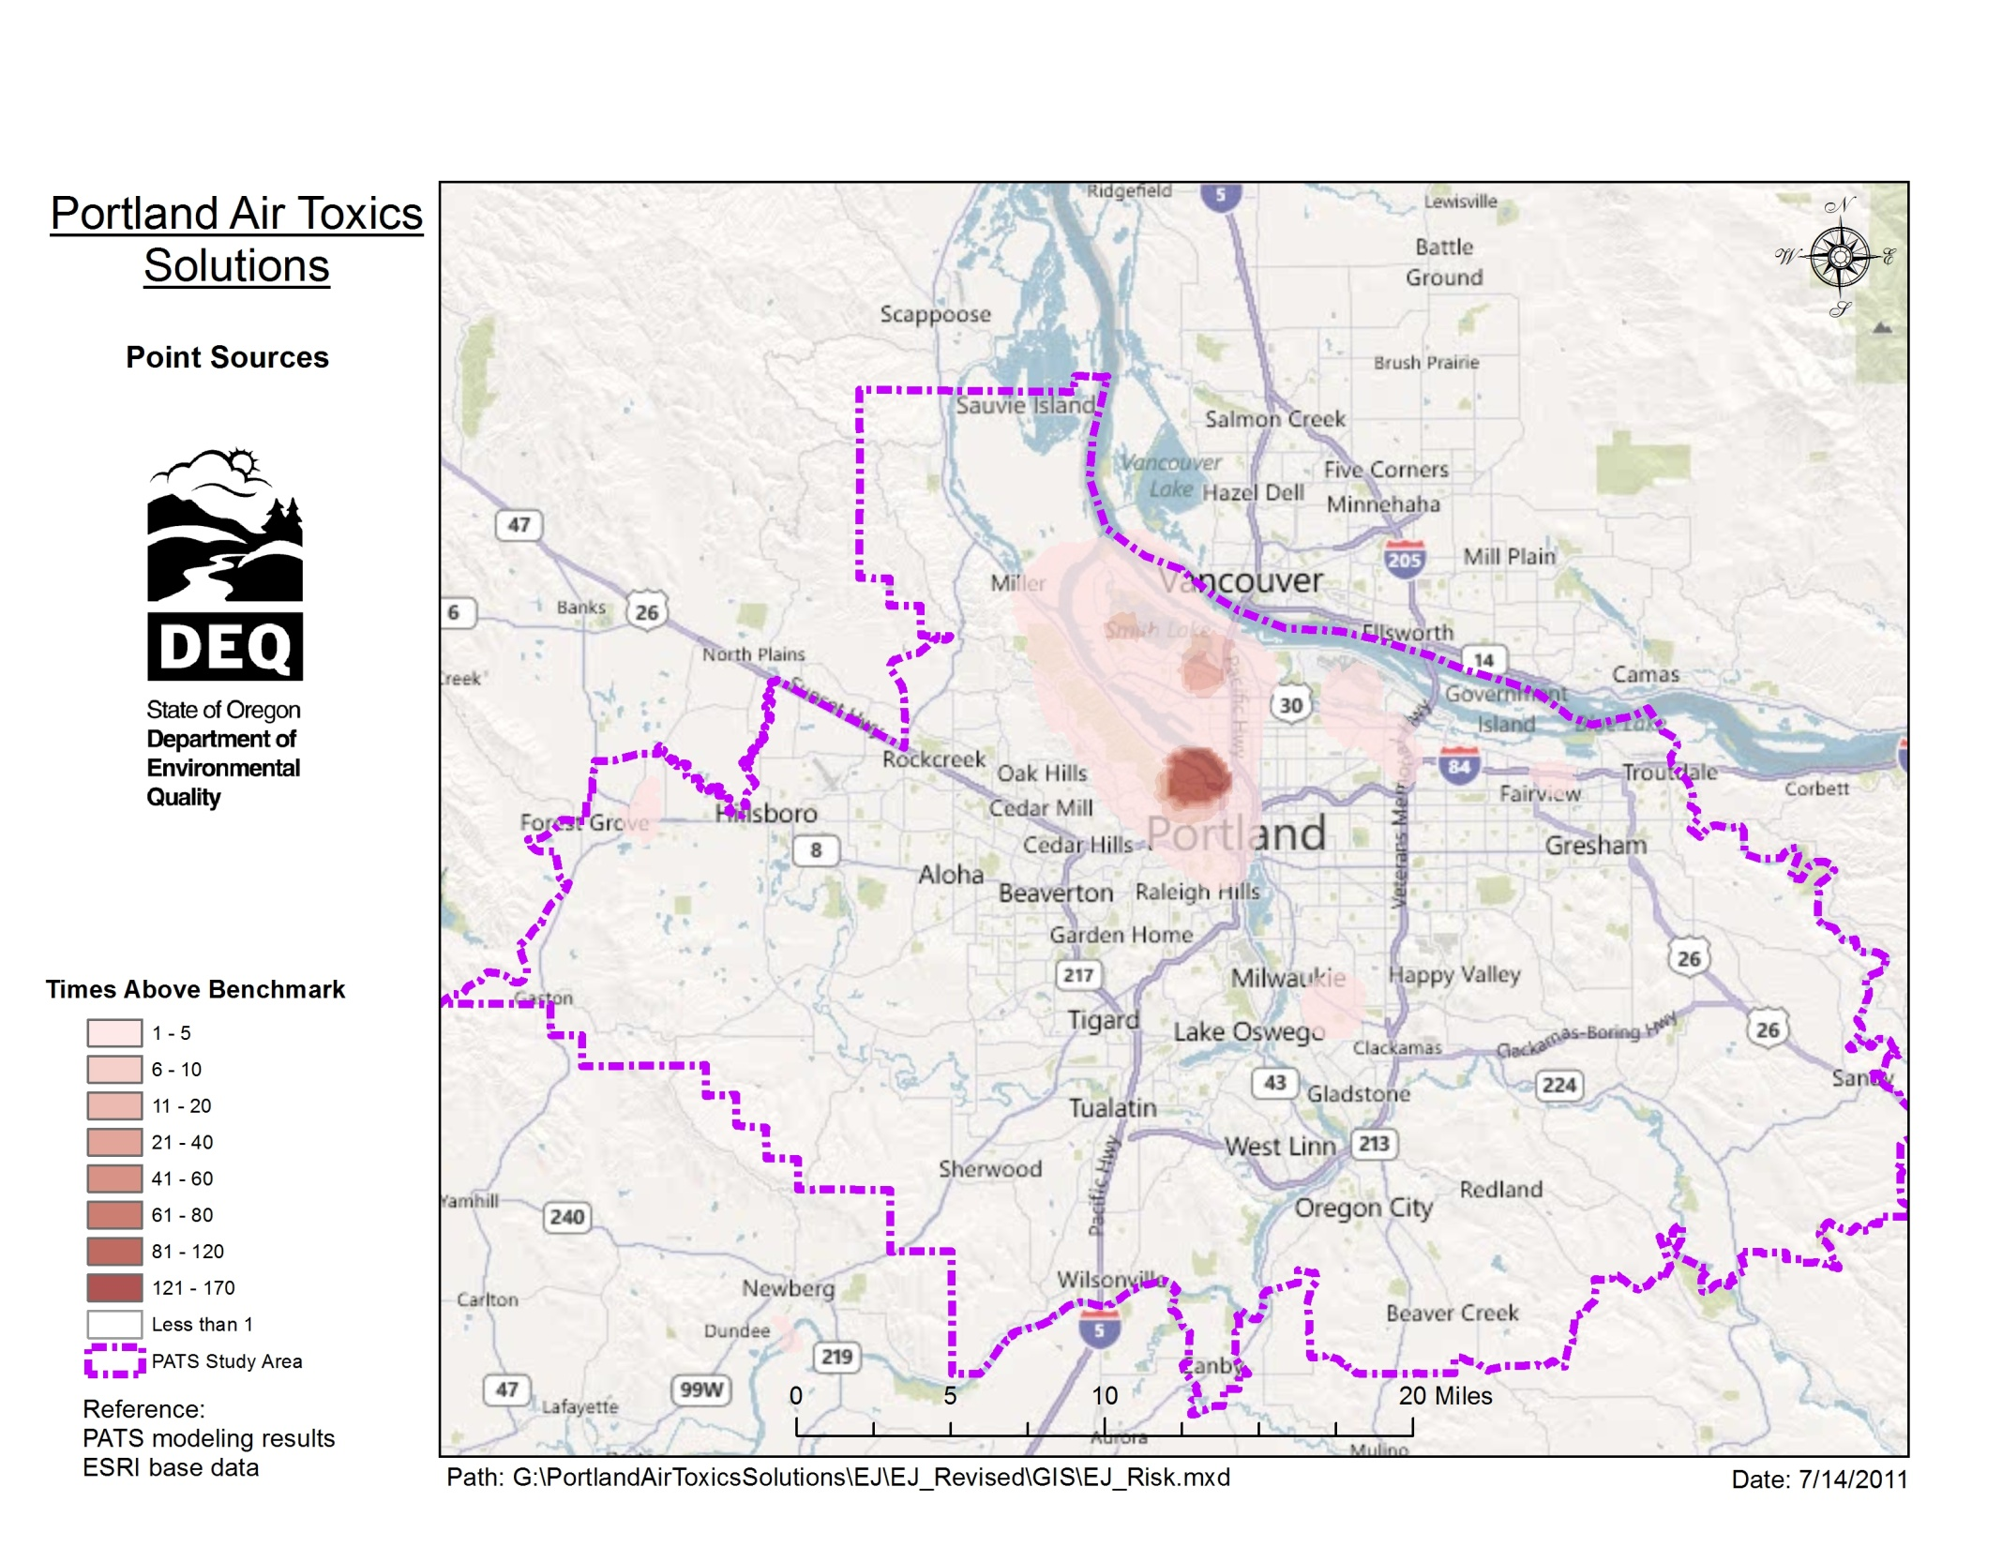
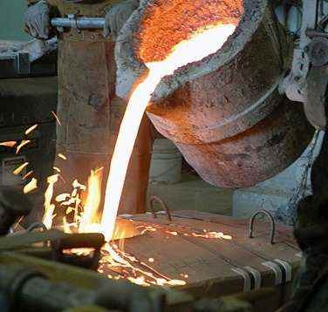
Reducing emissions from industrial metals facilities
Portland Air Toxics Solutions

Slide 12
How will DEQ move ahead on the high priority categories?
Portland Air Toxics Solutions
Incorporate strategies into ongoing ozone, particulate, clean diesel and green house gas reduction work
Coordinate with local government partners to bring current air toxics considerations into the transportation and land use planning process

Slide 13
- Questions and Discussion - PATSAC Panel - Public Comments
Portland Air Toxics Solutions

Slide 14
Additional Information
Portland Air Toxics Solutions

Slide 15
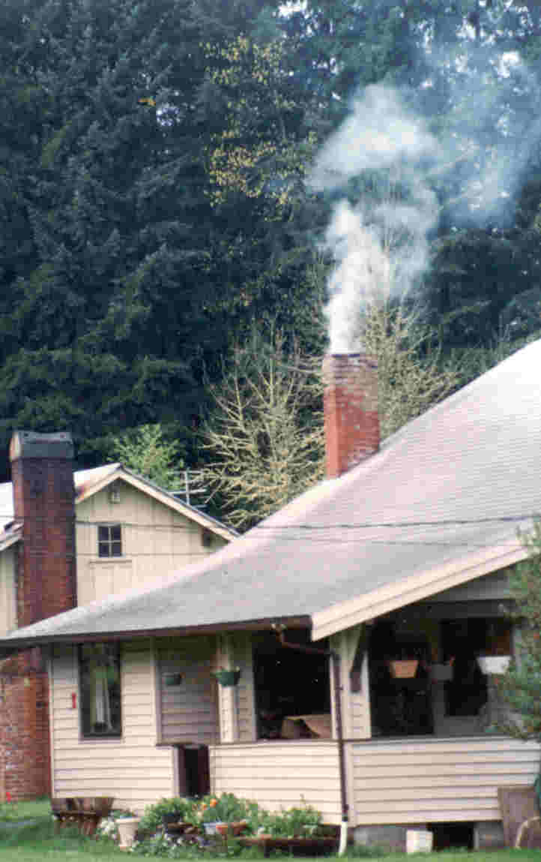
Portland Air Toxics Solutions
Reducing emissions from residential wood burning

Slide 16
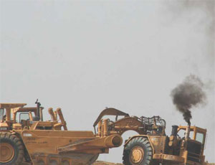
Portland Air Toxics Solutions
Reducing emissions from construction equipment

