Slide 1
Clean Water State Revolving Fund
Advisory Committee Recommendations
Oregon Environmental Quality Commission
June 21, 2012
Portland, Oregon
Judy Johndohl, Manager, Community and Program Assistance
Manette Simpson, CWSRF Program Coordinator
Mary Wahl, CWSRF Advisory Committee Member

Slide 2
Presentation Overview
CWSRF program background
Rulemaking plan
Advisory committee
Advisory committee recommendations
Program actions
Rulemaking next steps

Slide 3
CWSRF Program Background
Created by 1987 Clean Water Act amendments
Replaced federal construction grants program
Loans available in Oregon to public agencies only
Funding assistance to municipal wastewater facilities, nonpoint source and estuary protection projects
States have flexibility to “customize” loan terms
Interest rates from zero percent to market rate
Frequency of payments
Repayment terms up to 20 years

Slide 4
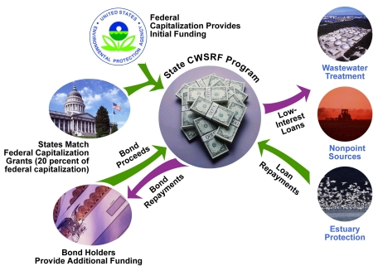
Program Funding
Source: EPA

Slide 5
Oregon’s Program
First loan made September 1990 to City of Portland for new collector sewers
Loan amounts have ranged from $7,000 to $69 million
City of Merrill de-chlorination upgrade ($7,000)
City of Albany wastewater plant upgrade ($69 million)
Program has loaned to 146 different public agencies, including municipalities, sanitary districts, counties, and irrigation districts

Slide 6
Oregon’s Program (cont.)
Program loans out an average of $60 million per year
Borrowers repay to program an average of $48 million per year
Other program funding sources include treasury account interest and annual federal capitalization grant
Total amount loaned to date is about $952 million
Total amount disbursed to date is about $803 million

Slide 7
Loan History 1991 – 2011 (state fiscal years)

Slide 8
Why Rulemaking is Necessary
Review possible new program approaches to funding point source and nonpoint source projects
93.5% point source projects
6.5% nonpoint source pollution control projects
Align project ranking criteria with water quality goals
Ensure funding approaches maintain long-term financial integrity of the program
Oregon 2008 Clean Watersheds Needs Survey at $4.9 billion for wastewater, stormwater and nonpoint source
Clarify regulatory process for loan applicants and borrowers

Slide 9
CWSRF Rulemaking Plan
March 15
Final Advisory Committee meeting
June 21
EQC meeting Informational Item
Sept 4 - 6
Public hearings
at multiple locations
Dec 6 - 7
EQC meeting
Propose rules for adoption
Draft Rulemaking Package
Finalize Rulemaking Package
Rule Implementation
July 13 Secretary of State Bulletin
August 1 Begin Public Notice
September 14 End Public Notice
2012
April
May
June
July
August
September
October
November
December

Slide 10
Advisory Committee Members
Emily Ackland, Environmental Coordinator & Policy Manager, Association of Oregon Counties
Brett Arvidson, Manager Planning and Engineering, Special Districts Association of Oregon
Robert Ault, Program and Policy Coordinator,
Infrastructure Finance Authority
Raymond J. Bartlett, Principal, Economic and Financial Analysis
April Snell, Executive Director, Oregon Water Resources Congress
Tom Elliott, Energy Analyst, Oregon Department of Energy
Chris Marko, Rural Development Specialist-Environmental, Rural Community Assistance Corporation
Todd Miller, Assistant Project Manager, League of Oregon Cities
Tom Salzer, District Manager, Oregon Association of Conservation District
Mary Wahl, Oregon Environmental Council
Sam Goldstein, Community Programs Director, USDA Rural Development
Doug Waugh, Financial Services Manager,
Oregon Association of Clean Water Agencies
Jason Green, Executive Director, Oregon Association of Water Utilities
Joe Whitworth, President, The Freshwater Trust

Slide 11
Advisory Committee Approach to Recommendations
Members developed program and issues list
Incorporated issues identified by DEQ program staff
10 rulemaking guiding principles essential to recommendations, specifically
Encourage and incentivize a watershed approach
Encourage and provide incentives for a sustainable project approach
Rank projects based on foundation of Clean Water Act, maintain and restore our nation’s waters

Slide 12
Advisory Committee Overarching Themes
Small communities need as much assistance as possible
CWSRF funded projects should achieve the best solutions for water quality improvement and protection whether point source or nonpoint source related
Projects should provide multiple water quality benefits, and integrate traditional “gray” infrastructure with “green” or natural infrastructure

Slide 13
Project Eligibility
Current eligibility rule limits projects to those listed
Ensure rule language includes all types of water quality improvement projects and allows for other projects not specifically identified in rule
Point and nonpoint source projects equally important
CWSRF funded projects should achieve as many water quality benefits as possible
DEQ should pursue regulatory changes that allow the purchase of water quality trading credits under the CWSRF program

Slide 14
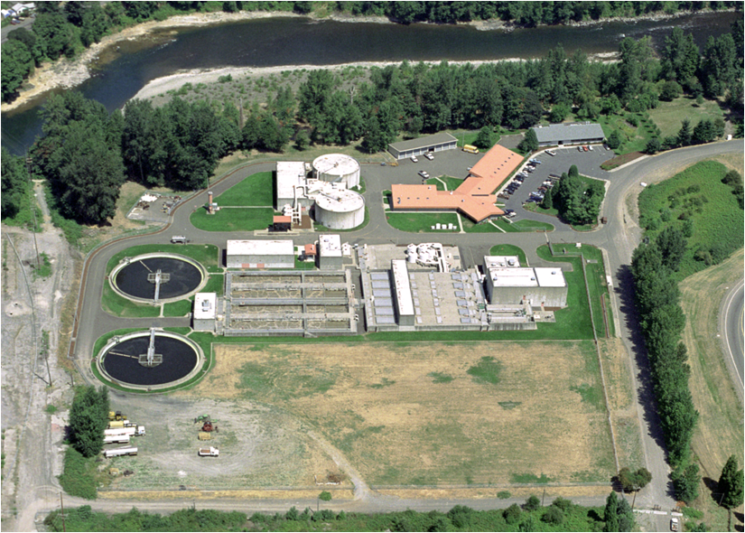
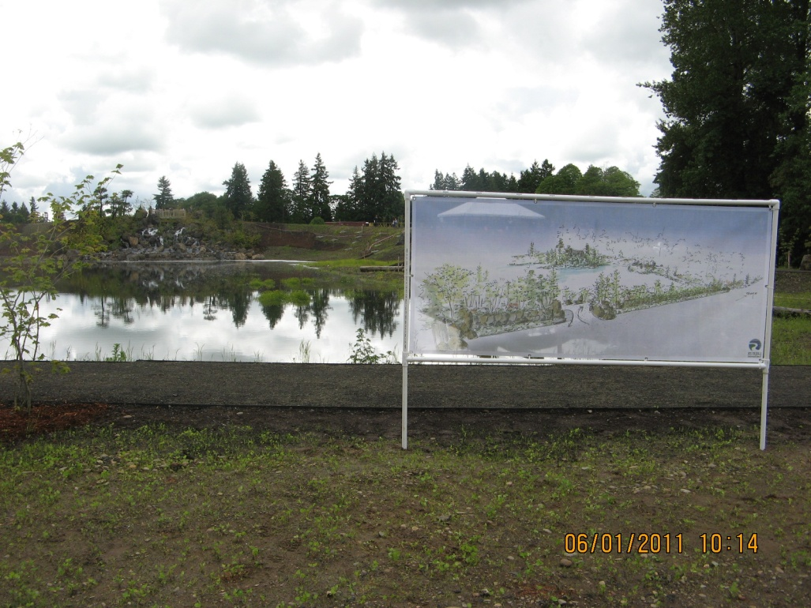
Wastewater Treatment
Traditional and Constructed Wetlands
Tri-City WWTP, Clackamas County
Talking Water Gardens, Albany-Millersburg

Slide 15
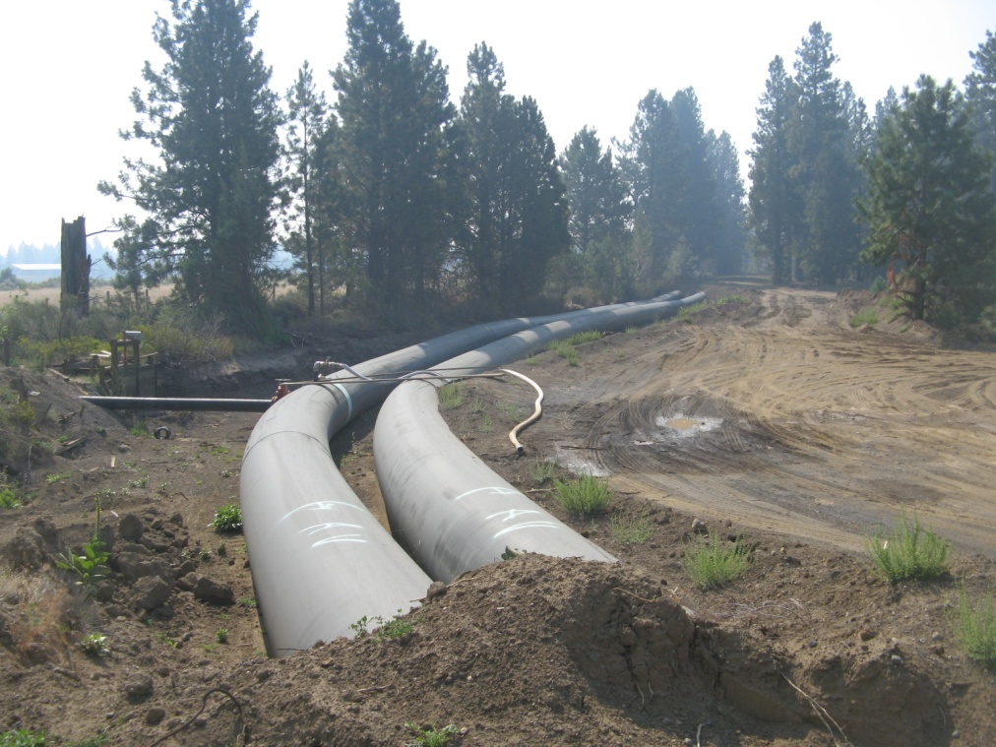
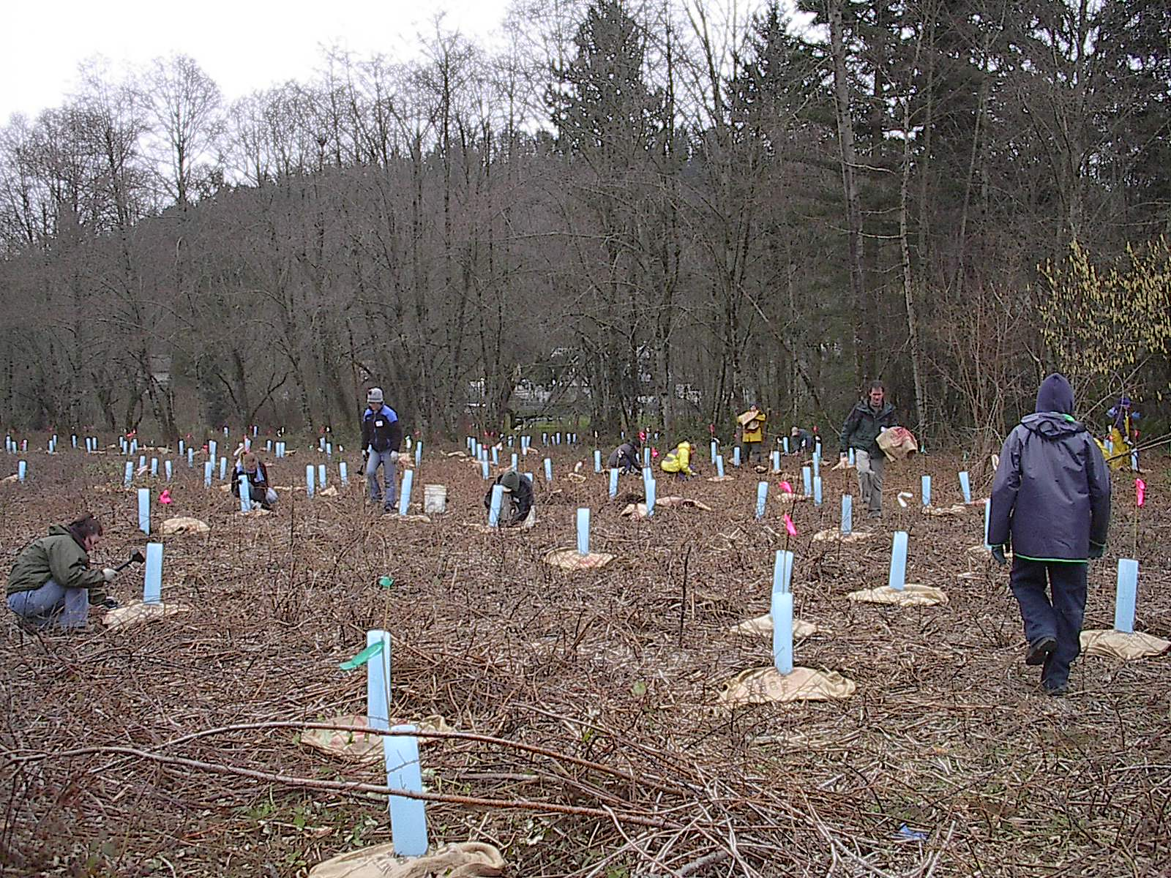
Nonpoint Source
Three Sisters Irrigation District
Johnson Creek Riparian Area

Slide 16
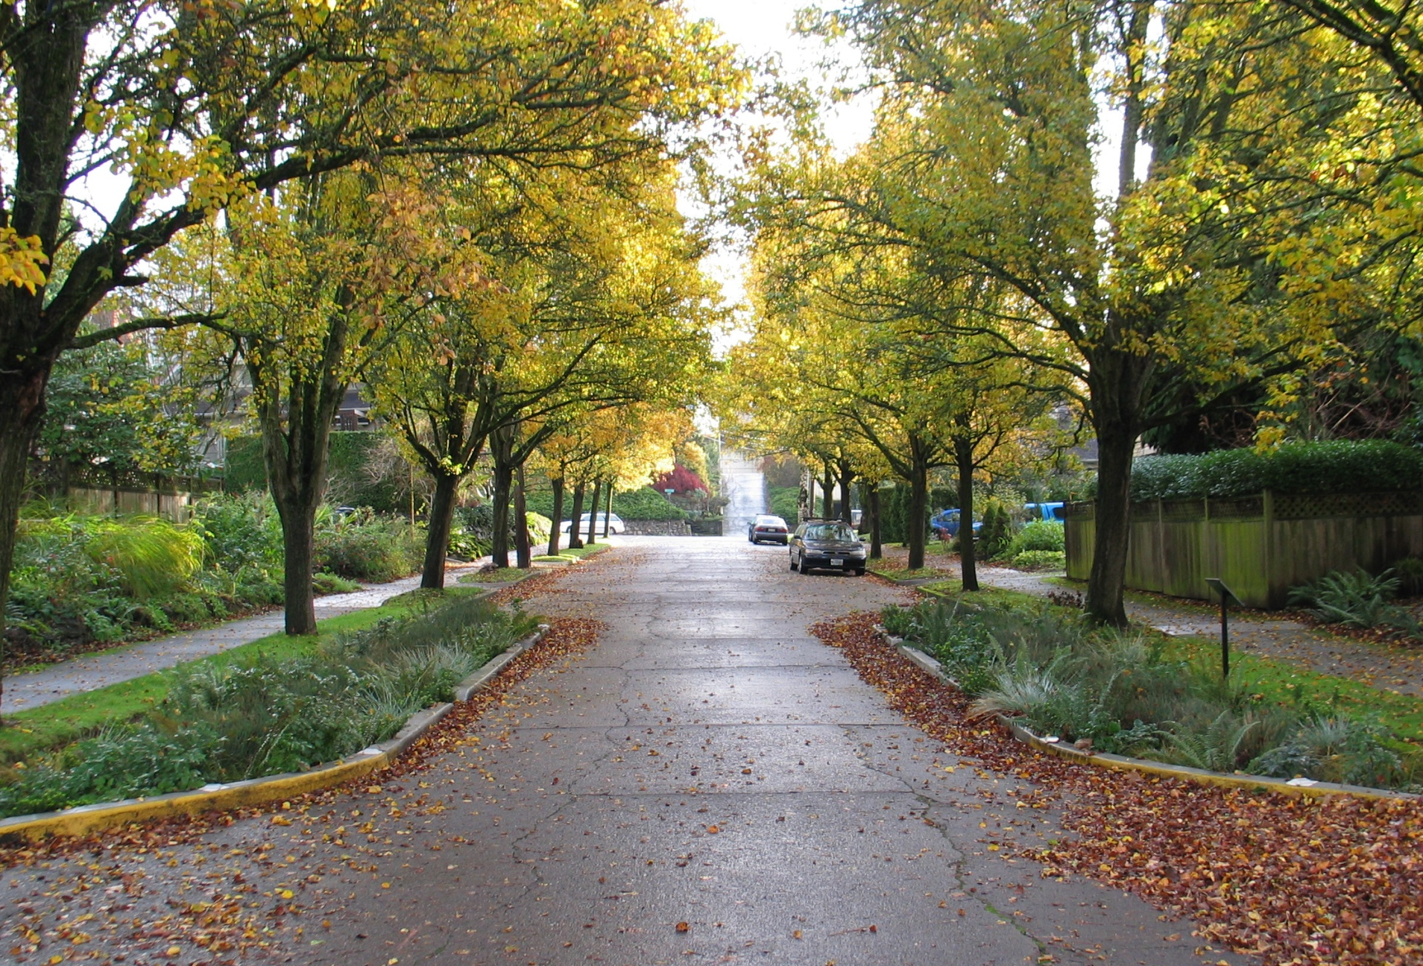
Gray and Green Infrastructure
Sanitary and Storm Flows Tunnel System, Portland
Stormwater Curb Extensions, Portland

Slide 17
Project Ranking Criteria
Shift project ranking criteria to encourage projects addressing multiple water quality benefits
Shift emphasis from permit compliance or non-compliance to proactive approaches to improving, protecting and restoring water quality
Encourage projects to integrate sustainable, natural solutions with gray infrastructure
Encourage project planning efforts
Use a standardized scoring system

Slide 18
Funding Allocation and Financial Provisions
Eliminate the expedited loan reserve
Increase planning loan initial maximum from $150,000 to $250,000
Re-define small community from 5,000 or less to 10,000 or less population
Increase small community reserve from 15 percent to 25 percent of total available funds
Continue to prioritize funding for current projects and requested increases, then new projects

Slide 19
Annual Fee
Separate account for program administration only
Reduce annual fee account balance to align more accurately with program administration expenditures
Reduce fee temporarily from 0.5 percent to 0.25 percent for 2013 and 2014, then return to 0.5 percent
Continue to analyze account balance, then re-evaluate after three years

Slide 20
Interest Rates and Extended Term Financing
Interest rate and repayment term are crucial for project affordability
Reduce interest rates for all borrowers
Small community with less than statewide median household income from 65% to 40% of base rate
For all others from 65% to 55% of base rate
DEQ should pursue regulatory changes to allow extension of repayment term from 20 to 30 years
Affordability
An option, not required

Slide 21
Principal Forgiveness
Allocate minimum amount required by EPA capitalization grant
Prioritize by awarding first to small community with less than statewide median household income for:
Current planning, then new loans
Current design and construction, then new loans
Award next to small community with more than statewide median household income for all current loans, then new loans

Slide 22
Advisory Committee Additional Considerations
DEQ should review and evaluate effectiveness of rule changes
2 years after implementation for financial conditions
3 years after implementation for other program issues
Pursue regulatory changes for using CWSRF funds to purchase water quality trading credits

Slide 23
Program Actions
DEQ agrees with advisory committee recommendations and is developing proposed rules
DEQ is evaluating whether to keep the discretionary loan option
DEQ appointed a new CWSRF advisory committee
12 of 14 original members continuing

Slide 24
CWSRF Rulemaking Plan – Next Steps
March 15
Final Advisory Committee meeting
June 21
EQC meeting Informational Item
Sept 4 - 6
Public hearings
at multiple locations
Dec 6 - 7
EQC meeting
Propose rules for adoption
Draft Rulemaking Package
Finalize Rulemaking Package
Rule Implementation
July 13 Secretary of State Bulletin
August 1 Begin Public Notice
September 14 End Public Notice
2012
April
May
June
July
August
September
October
November
December

Slide 25
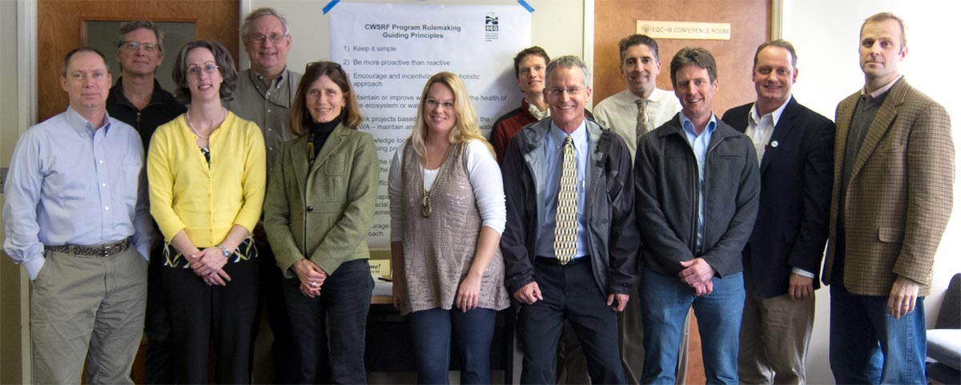
Questions?
CWSRF Advisory Committee
Back row from left: Doug Waugh, Brett Arvidson, Todd Miller and Sam Goldstein.
Front row from left: Tom Salzer, April Snell, Mary Wahl, Emily Ackland, Tom Elliot, Robert Ault, Chris Marko and Joe Whitworth. Not pictured: Ray Bartlett and Jason Green.

