Slide 1
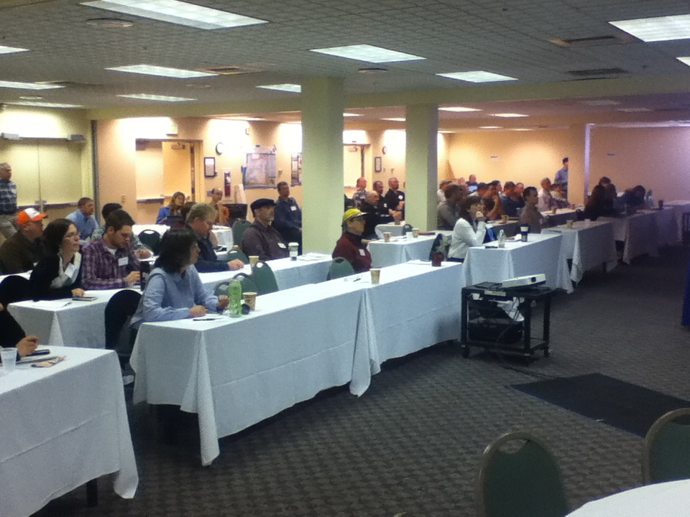

John Day, Umatilla and Grande Ronde Monitoring Summit
November 13: Sharing what we know and defining what we don’t know?
November 14: Working Together
Oregon Department of Environmental Quality (ODEQ)
Oregon Department of Agriculture (ODA)
Oregon Department of Fish and Wildlife (ODFW)
Oregon Department of Forestry (ODF)
Oregon State University (OSU)
Oregon Institute of Natural Resources (INR)
Public Health Division
Oregon Watershed Enhancement Board (OWEB)
Oregon Water Resources Department (OWRD)
United States Geological Survey (USGS)
United States Environmental Protection Agency
United State Forest Service (USFS)
Bureau of Land Management (BLM)
Confederated Tribes of the Umatilla
Confederated Tribes of Warm Springs
Nez Perce Tribes
Wallowa Soil and Water Conservation District
Monument Soil and Water Conservation District
Oregon Cattlemen’s Association
Oregon Natural Desert Association
The Native Fish Society
North Fork John Day Watershed Council
Umatilla Watershed Council
Walla Walla Watershed Council
Presented by: Aaron Borisenko
Oregon Environmental Quality Commission
Thursday December 12, 2013

Slide 2
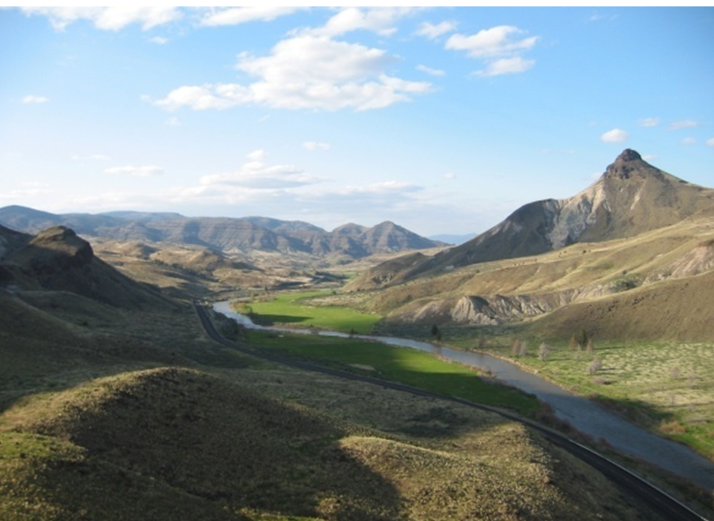
Why did we hold the summit ?
This summit was a direct outcome of the Statewide Summit we held in February of 2012
People were interested in data and information at a the Basin or Watershed scale
DEQ was suggested to lead future collaborative monitoring discussions
To share and describe DEQ’s efforts on Basin Assessments
To nurture the “Enterprise Approach” to monitoring
To see how well a regional gathering to discuss water monitoring would work

Slide 3
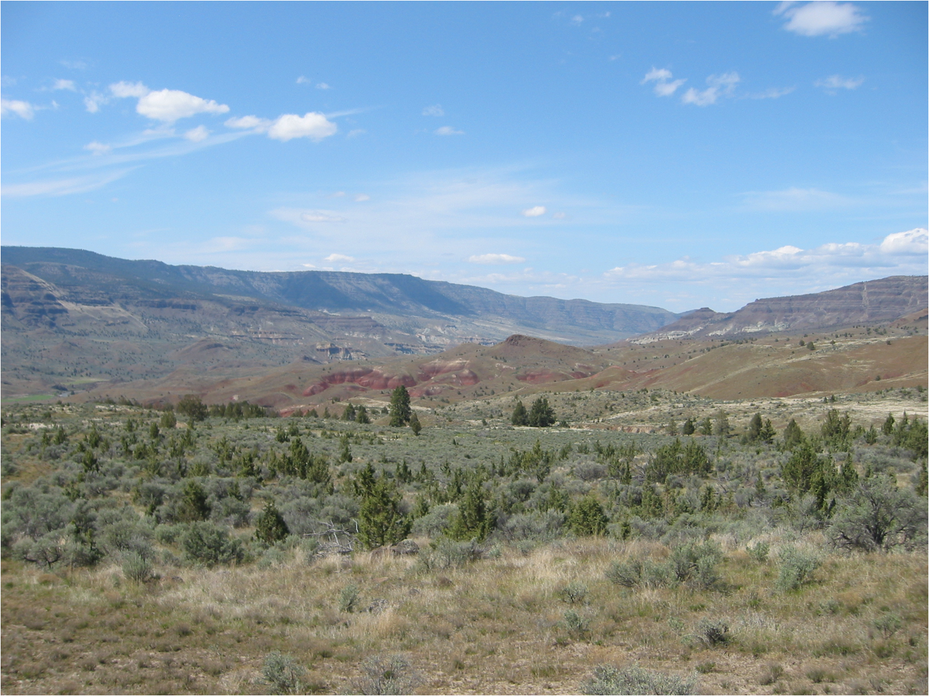
Summit goals
….to share our values around clean water
….to focus on the issues and the science
….to network and share data and information on monitoring
….to share information on DEQ’s Basin Assessments and watershed approach
….to describe the “Enterprise Monitoring” approach
….to define monitoring roles, commitments and priorities
….to better understand where the data gaps are and discuss how we can fill them.
….to think about ways to track monitoring activities in the region
….to discuss ways to share data and information.
….actively listen and learn from each other
….to respect different perspectives in the room
….to have fun

Slide 4

Enterprise Monitoring is needed concept because:
……our natural resource agencies share a common goal to identify environmental issues and implement solutions.
……understanding watershed health is not based on jurisdictional boundaries.
…...coordinated monitoring activities reduces cost and can provide more comprehensive data and information.
…..it allows different state agencies to contribute to the overall understanding of environmental conditions in their specific areas of expertise.
….. it helps to fill data gaps with fewer available resources.
….. it more fully utilizes capacities and capabilities to meet data needs.
...shared environmental data and information can indentify new issues and suggest new solutions we hadn’t thought of.

Slide 5
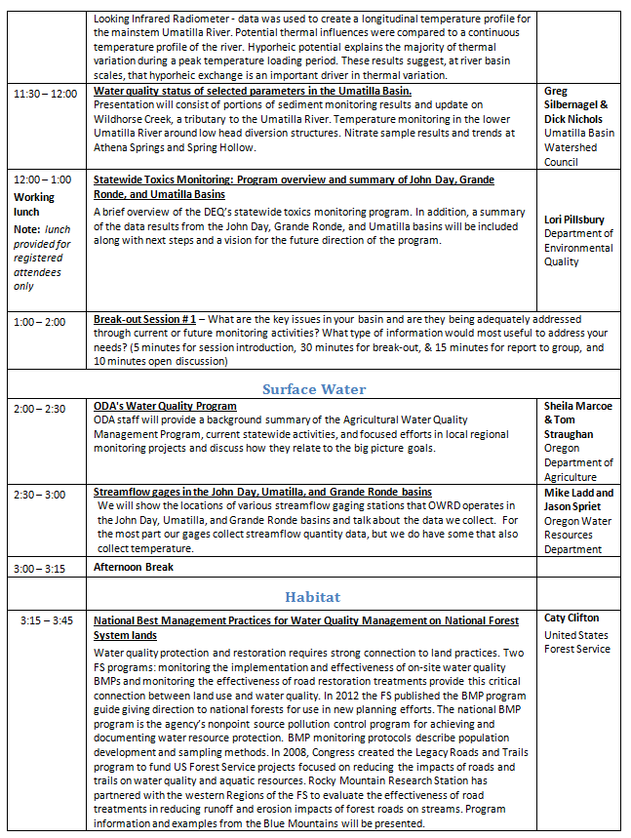
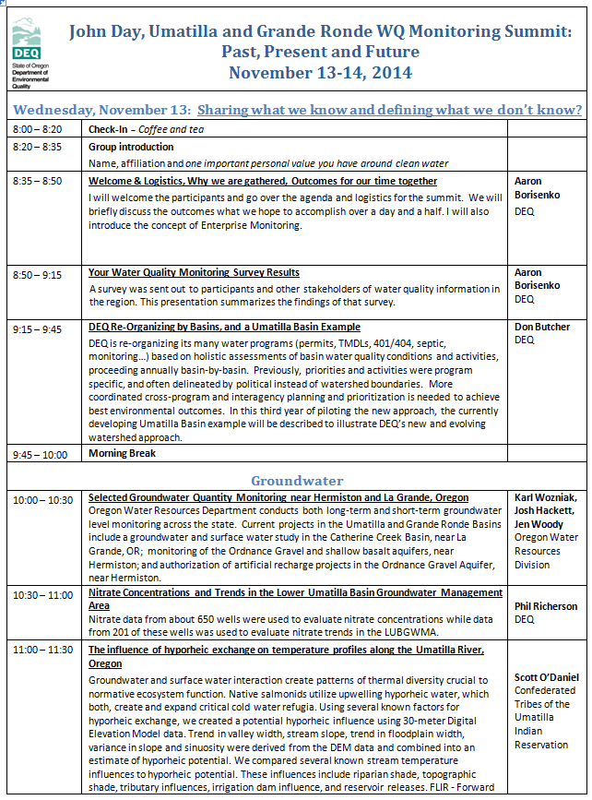
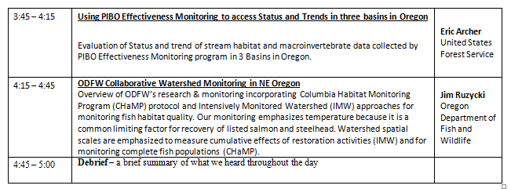
Agenda – Day 1

Slide 6
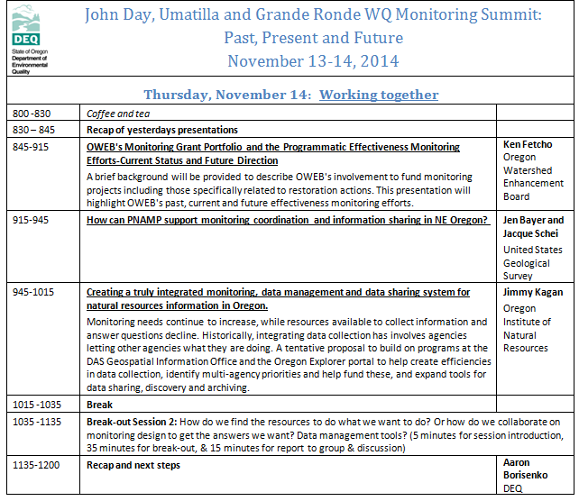
Agenda – Day 2

Slide 7
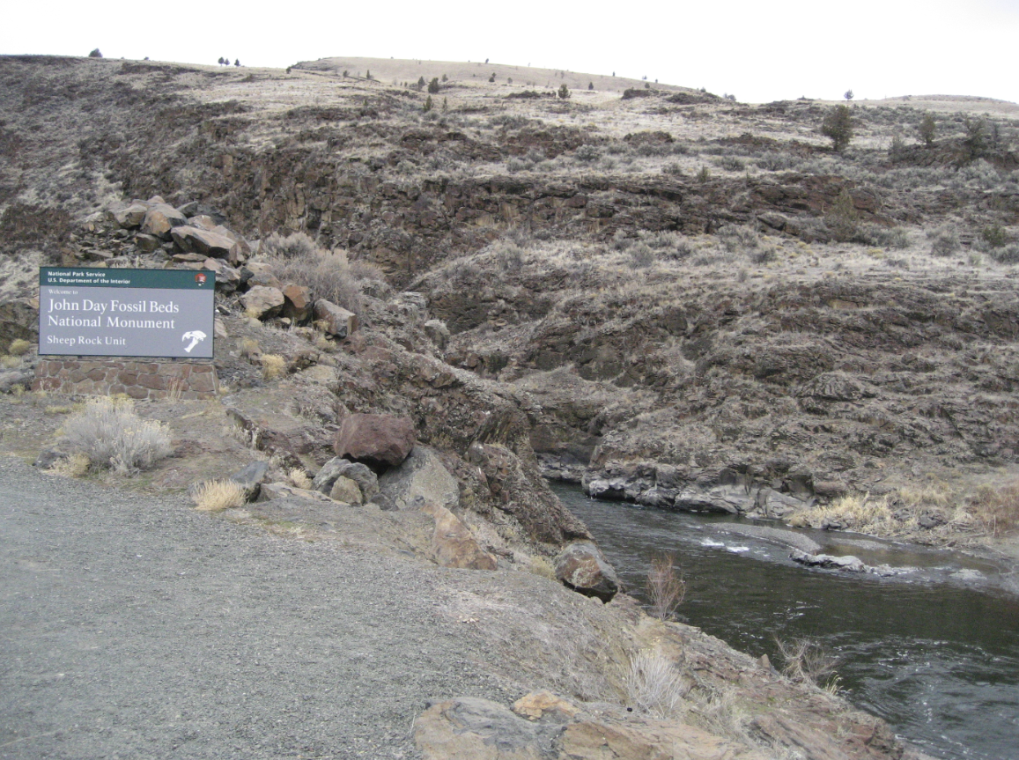
Post Summit Survey Results

Slide 8
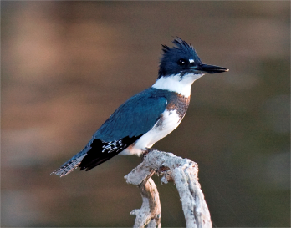
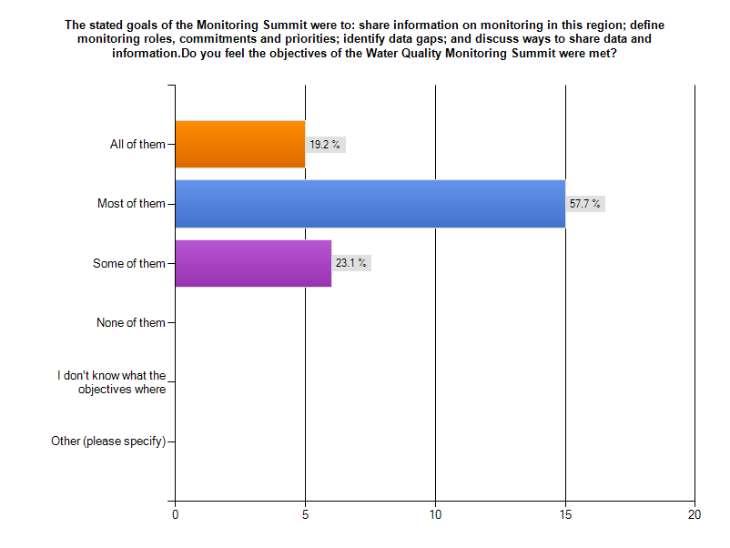
1.

Slide 9
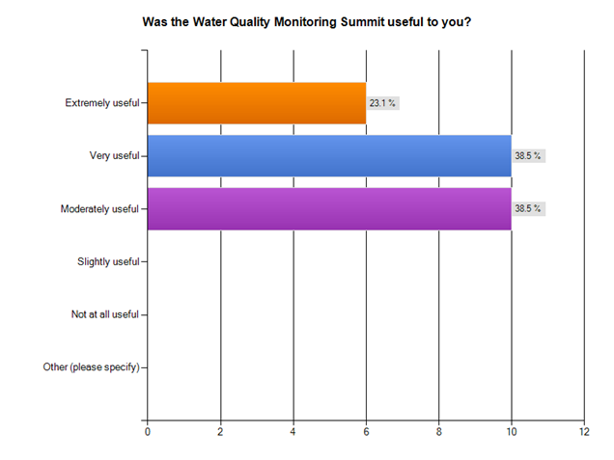
2.

Slide 10
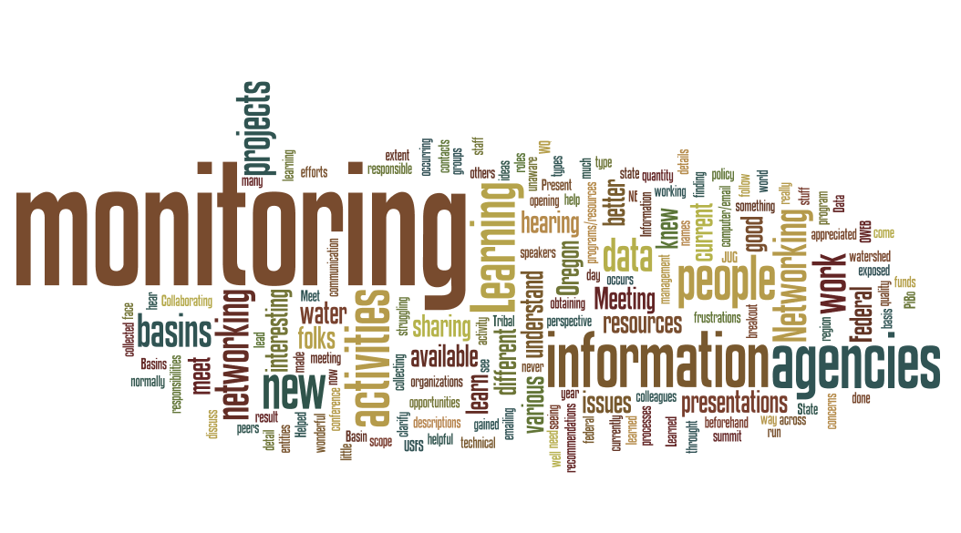
Take home message:
Participants really appreciated sharing information
3. What was the value of the summit to you?
“Making connections with experts other than my usual grantees. And, also connecting with grantees to talk about monitoring needs they are experiencing.”
“To meet many of the people we only see through the computer/email”
“Very interesting to hear of the work on the USFS on PiBo. Was unaware of the extent of monitoring that is ongoing by the various state and federal agencies.”
“Networking opportunities learning about what types of monitoring and where it is occurring. Learning about some of the issues in the JUG Basins Present information about what monitoring projects OWEB funds.”
“Helped clarify roles and responsibilities in these basins, and current activities.”
“Learned some interesting stuff.”
“Networking.”
“To better understand the scope and detail of the monitoring currently under way in the 3 basins and to discuss the details of different monitoring efforts.”
“It was very helpful to understand current activities in NE Oregon and to meet people responsible for these activities.”
“Meeting other people working on watershed issues in the region, hearing about some of the work that's being done, learning about new resources”
“Networking, descriptions of programs/resources at other agencies”
“Meet people, learn about different projects, and learn about available resources.”
“Learning what other monitoring occurs in my Basin. Collaborating with other and seeing that others have the same frustrations, concerns.”
“I was exposed to the world of water quality monitoring through this conference, something that I knew little about beforehand. For me, there was so much new information that I found myself struggling to follow some of the more technical presentations.”
“Hearing about various monitoring activities in the basins, networking with colleagues and meeting new folks.”
“Information sharing.”
“Learning new ideas for monitoring projects and processes.”
“Data sharing”
“I really appreciated networking with folks that I don't normally come across on a daily basis.”
“Hearing what other agencies are doing”
“I learned of other agencies and organizations that have been obtaining monitoring information that I never knew
about. I now know if I need information that their information is available.”
“Meeting staff from other agencies that are collecting data and finding out what type of data is being collected.”
“Networking with peers’
“I gained a very good perspective on all the WQ and water quantity monitoring activity in Oregon. I made some
wonderful contacts that will help me do my work. The conversations we had in breakout groups has lead to making
recommendations on some Federal policy that should result in better data management. That 1.5 day summit did more for opening communication between Federal, State, and Tribal entities than a year of emailing 'face less' names. Very good presentations and speakers. Very well run program.”

Slide 11
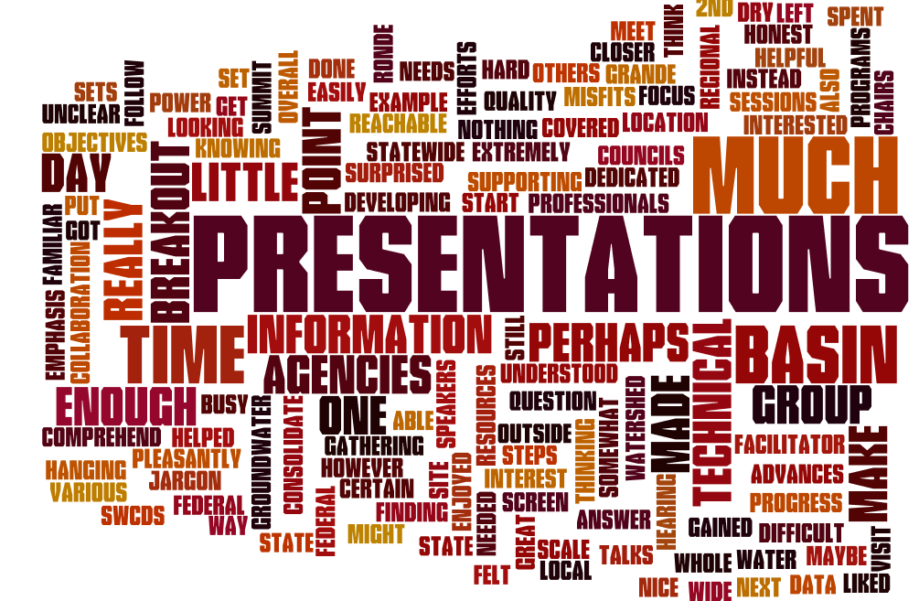
Take home message:
Rethink breakout sessions. More informal?
4. What didn't you like about the summit?
“I am not sure I got much value from the breakout sessions, as intended. I did get value from my group's informal conversation tangents.”
“Some of the information was too much power point and not enough set question and answer.”
“Some presentations were extremely technical and somewhat difficult to comprehend. However, overall most of the speakers' presentations were easily understood.”
“Perhaps more emphasis on what needs to be done to meet basin wide objectives would have been helpful.”
“Not able to make 2nd day, busy time”
“Too much focus on State and Federal agencies and not enough on local Watershed Councils and SWCDs.”
“Macs.”
“Needed more breakout time. I felt to a certain point we were left hanging knowing information was out there, but not much closer to finding a way to put it all in one reachable location.”
“I think a few of the presentations maybe got a little too technical.”
“I'm still thinking ... can't really say.”
“I really liked it.”
“The summit was a great start to supporting regional scale collaboration. It was a little unclear as to what next steps might be.”
“To be honest, some of the presentations were dry and hard to follow - for example, there was jargon I wasn't familiar with in some of the groundwater talks”
“I didn't get much from the breakout sessions. Perhaps if our group (Grande Ronde 2) had a facilitator it would have helped. Also, the makeup of the group was a gathering of 'misfits' in that only I was the only one with any dedicated interest in the basin. The others were interested in statewide programs or developing resources for water quality professionals as a whole, not in the basin. So, there was nothing gained that wasn't covered in the presentations.”
“Enjoyed hearing of the progress made by all the various state and federal agencies in their efforts to consolidate data sets, and was pleasantly surprised at the advances that have been made.”
“It would have been nice to have do a site visit or spent some time outside instead of in chairs looking at a screen for most of the day.”

Slide 12
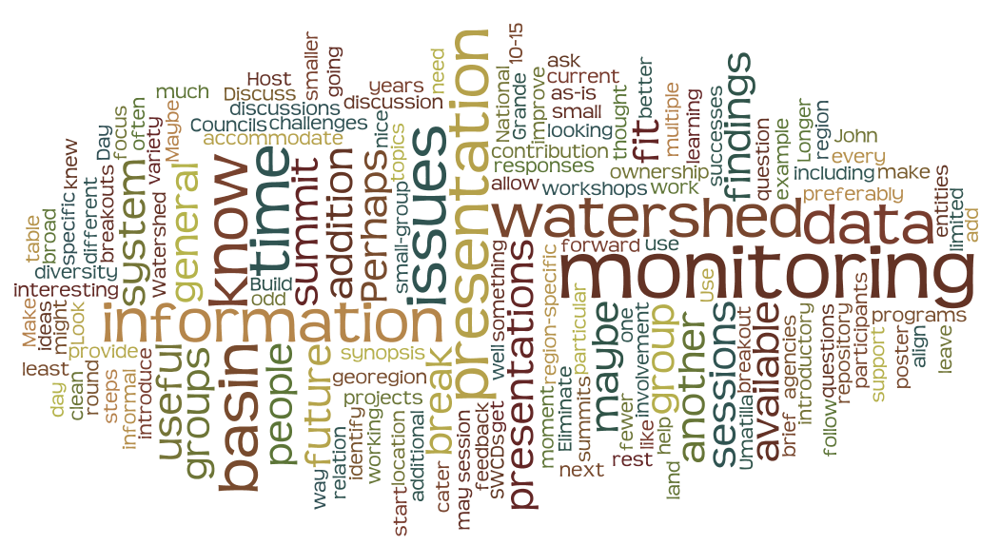
5. How do you think future summits could be improved?
Take home message:
A variety of communication methods work best.
“Happen more often.”
“We need to have these more often once every couple of years to better align all agencies working on projects in the region”
“Maybe fewer presentations and allow more time for each presentation.”
“Have an introductory presentation on each watershed and identify land use, ownership, 303 (d) impairments. Can be a brief 10-15 presentation to introduce broad watershed information = what do we know about the basin, what are those issues and who are the entities doing monitoring.”
“Build on successes from the summit, including round up of basin work group findings in relation to monitoring programs, who what where when...”
“More time for breakout sessions; different groups if having multiple breakout sessions; more focus on next steps”
“More local involvement. (Watershed Councils, SWCDs)”
“It would be nice to know at the start of future summits what support might be available as follow up after the summit.”
“The small-group discussion (at least, the one the first day) was odd because only a few people at the table knew what the issues were for a particular georegion. The rest of us could only provide limited feedback. I don't know how the people were selected, but maybe have some region-specific questions and a more general question? Or maybe leave as-is. It was interesting learning what the specific issues were, but I couldn't make much in the way of a contribution.”
“Longer group time.”
“Make them more interactive.”
“Eliminate break out groups and add more presentations on current findings.”
“Perhaps we could ask what the participants would find most useful and cater to the responses.”
“More breakouts. Have a list or something of who is there and what monitoring they have available with a general location, like watershed, preferably smaller than John Day, Umatilla, or Grande Ronde. That would help in the future if I'm looking for information. It would be a small step forward.”
“Don't have any ideas at this moment.”
“Host some example data entry workshops. Use a National data repository. Look at a variety of data, some that may not be a clean fit to the system. Discuss how to improve the system to accommodate such challenges.”
“Perhaps the addition of a poster session or another informal path to get additional discussions started. That said, the diversity of topics and information was well fit to the audience. I thought that a synopsis of the monitoring going on in each basin would have been another useful addition.”

Slide 13

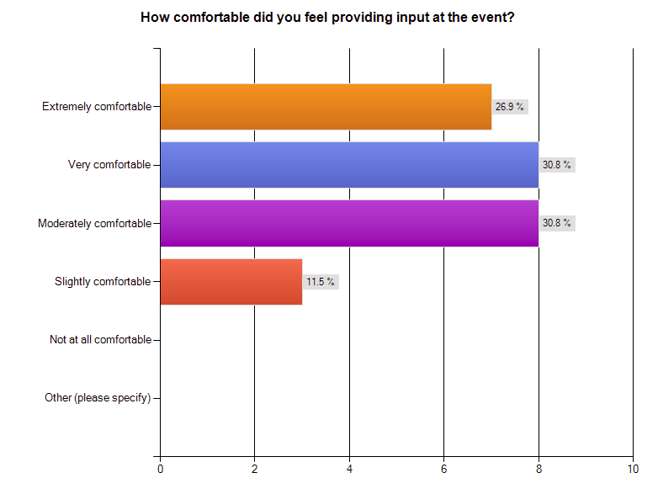
6.

Slide 14
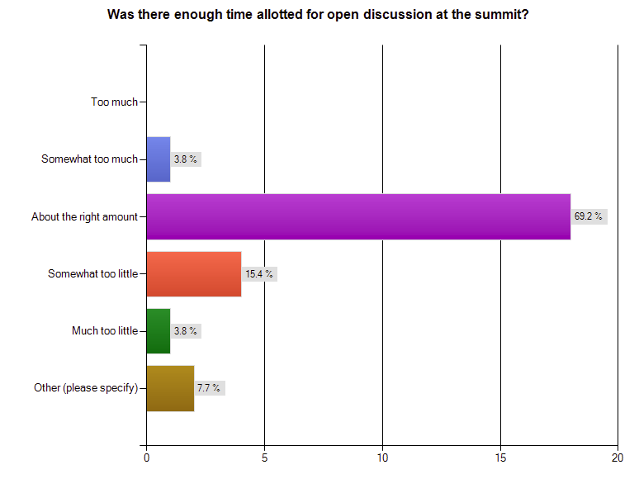
7.
“I would like to have had more time but I don't know if it was the right amount or not.”
“There could have been more time for networking set aside.”

Slide 15
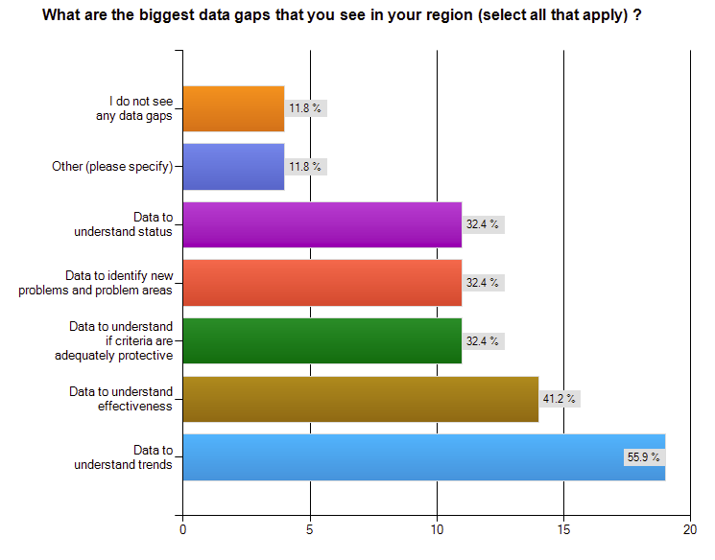
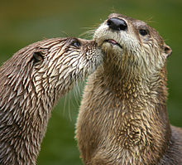
From pre-summit survey

Slide 16
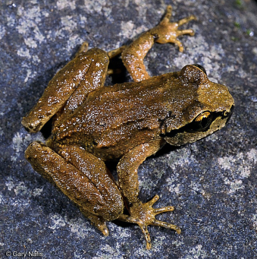
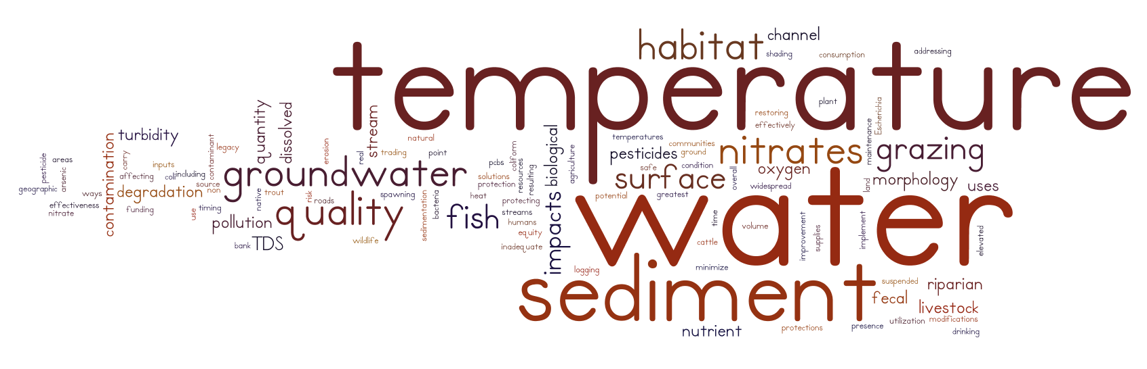
From pre-summit survey
What do consider the three most important water quality issues in your geographic area?

Slide 17
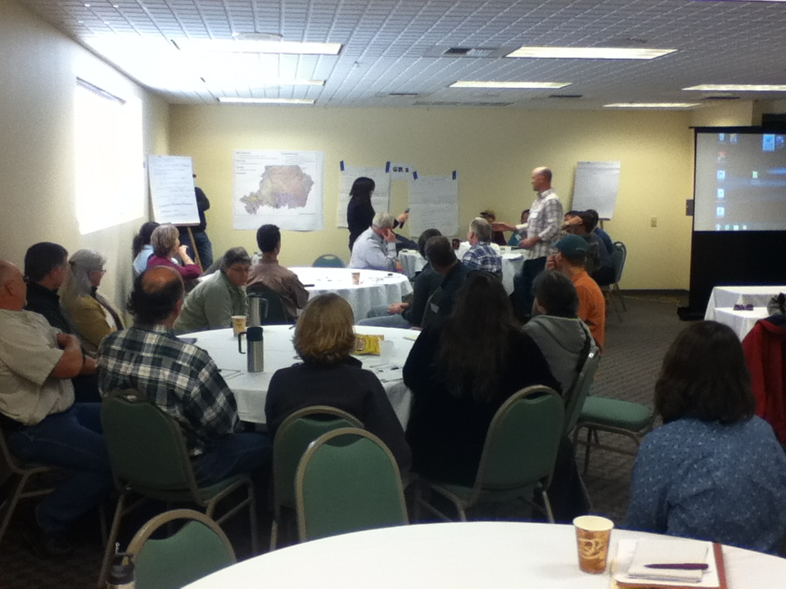
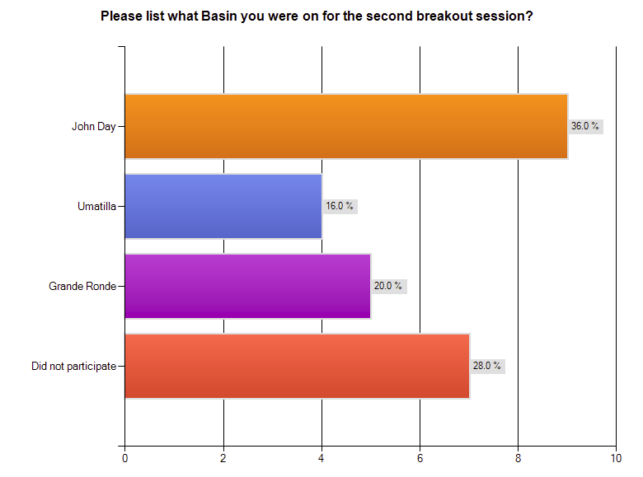
Break-out Session # 1: Break-out Session # 1 – What are the key issues in your basin and are they being adequately addressed through current or future monitoring activities? What type of information would most useful to address your needs?

Slide 18
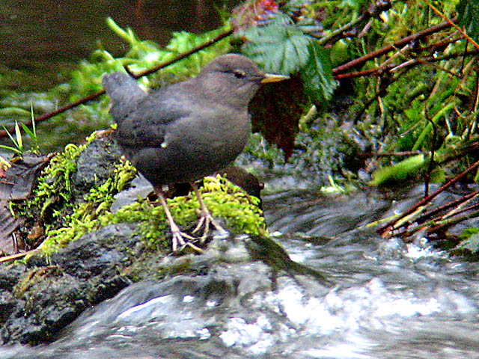
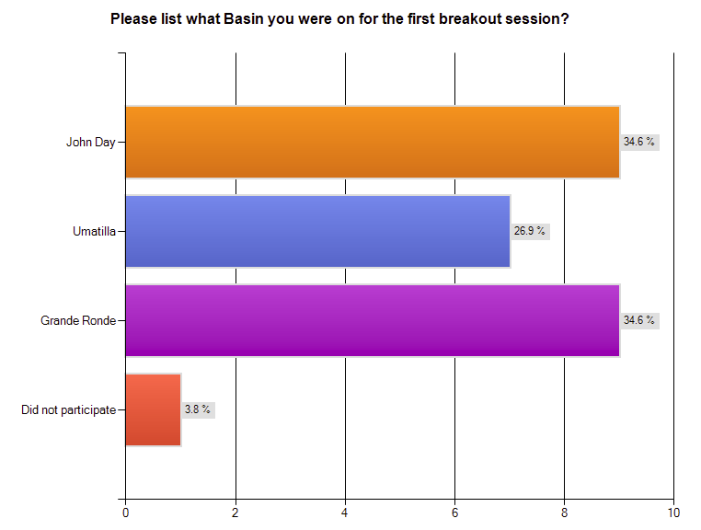
8.

Slide 19
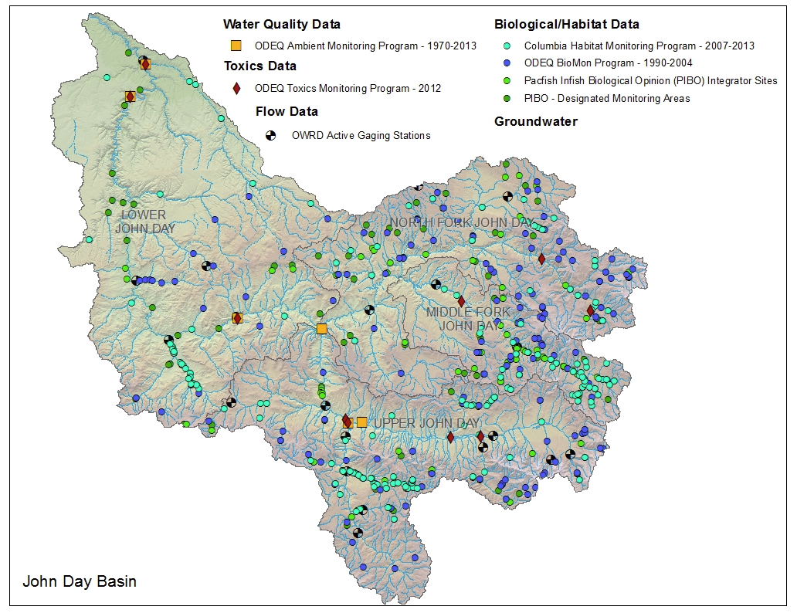
John Day
What do you see as the biggest information gap in the basin?
Take home themes:
Better coordination.
More water temperature data.
Data management systems.
Flow.
“Biggest gap was trying to coordinate across the different monitoring entities due to values and size of watershed. We didn't seem to dig into identifying specific data gaps that I can recall.
“Lack of widespread flow monitoring in the John Day River tributaries.”
“GIS type overview of who is doing what monitoring in the basin.”
“Water temperature was identified as a key limiting factor for ESA listed fish and that there was insufficient information on temperature.”
“Collaboration. I believe there is plenty of data collected in the John Day, but that data sits on too many computers.”
“Need for a central repository for data collected to avoid redundant monitoring.”

Slide 20
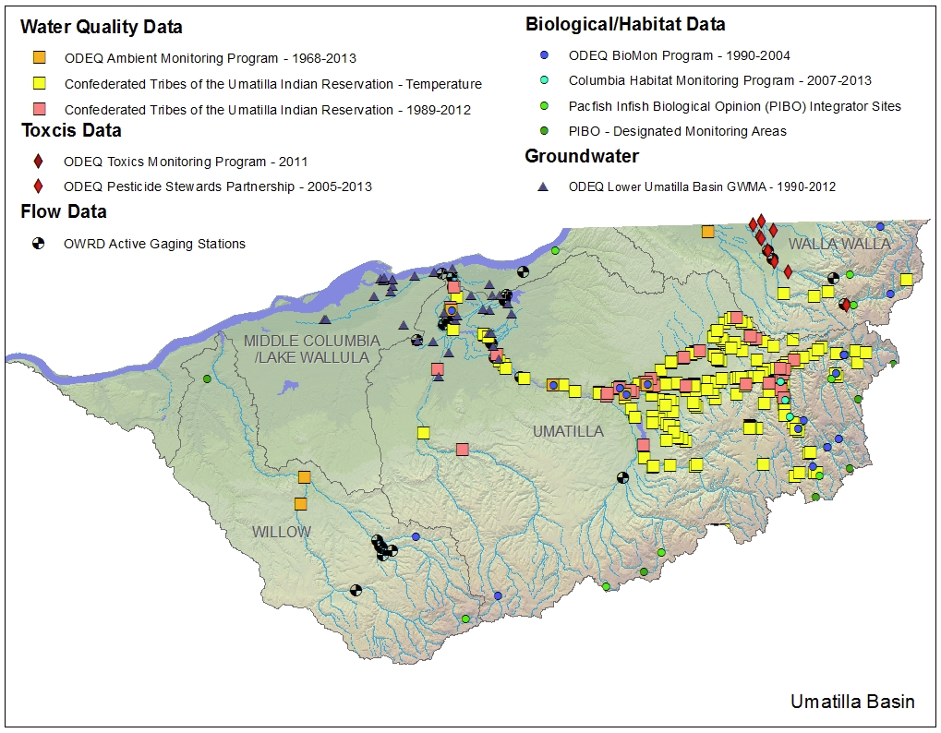
Umatilla
What do you see as the biggest information gap in the basin?
Take home themes:
Better collaboration.
Data management systems.
Land use and climate information.
“Collaboration across the region - although Umatilla is doing a far better job at that than John Day. But still there were areas and entities that weren't aware of what was happening in other parts of the region.”
“Still an information data collection central. That we can all understand”
“Lack of land use and weather data.”
“I believe riparian/fish habitat data is the biggest information gap in the basin.”
“Lots of information, needs platforms for sharing different agency efforts and findings. Emerging knowledge on toxins seems to be a gap difficult and expensive to fill, and trends in land use still somewhat of an unknown and/or an after-thought.”
“The biggest 'information gap' results from none of the agencies or tribes having persons dedicated solely to working at keeping their efforts integrated with everybody else. Balkanization is inevitable, although I'm impressed with how far we have come.”

Slide 21
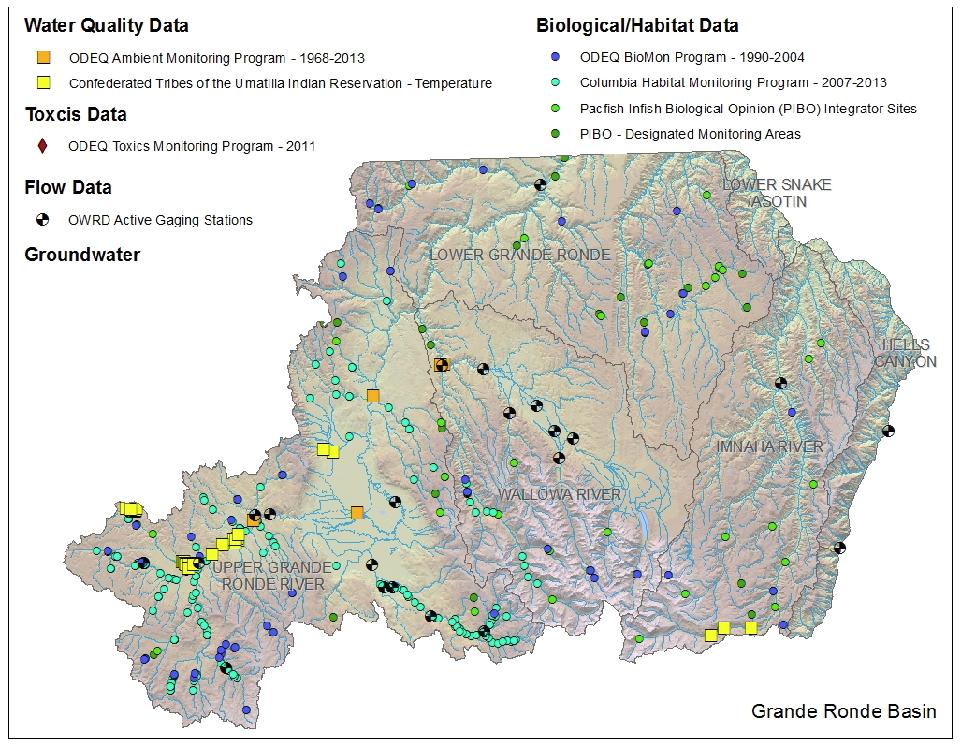
Grande Ronde
What do you see as the biggest information gap in the basin?
Take home themes:
Better coordination.
Data management systems.
Toxics .
“There is not a lot of coordination between the various entities collecting water quality data. An umbrella group which would help to better coordinate the efforts and meet periodically may be beneficial.”
“There were people there that were saying they have been monitoring in our basin and even after coming back I have yet to talk to anyone that heard of them, let alone knew they had data. So, our issues start as basic as not even knowing all the entities that collect some type of data and that is a huge issue.”
“The lack of suspended sediment data.”
“Documentation of what is happening in basin (or what should be happening - i.e., recommendations) and sharing of that information.”
“We have lots of temperature and flow data but we need water quality data on pesticides, pharmaceuticals, hormones, etc.”

Slide 22
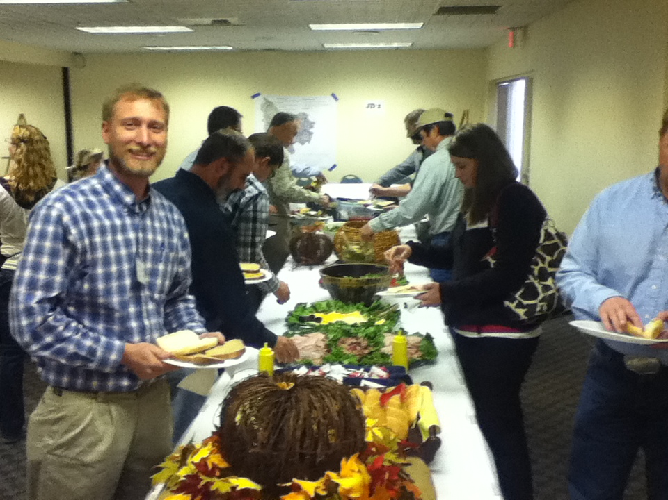
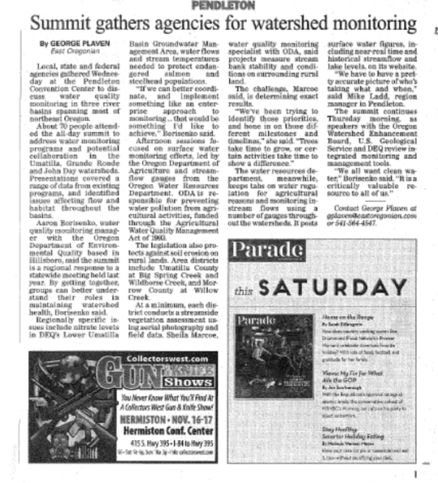
The way to a participants heart is food!

Slide 23
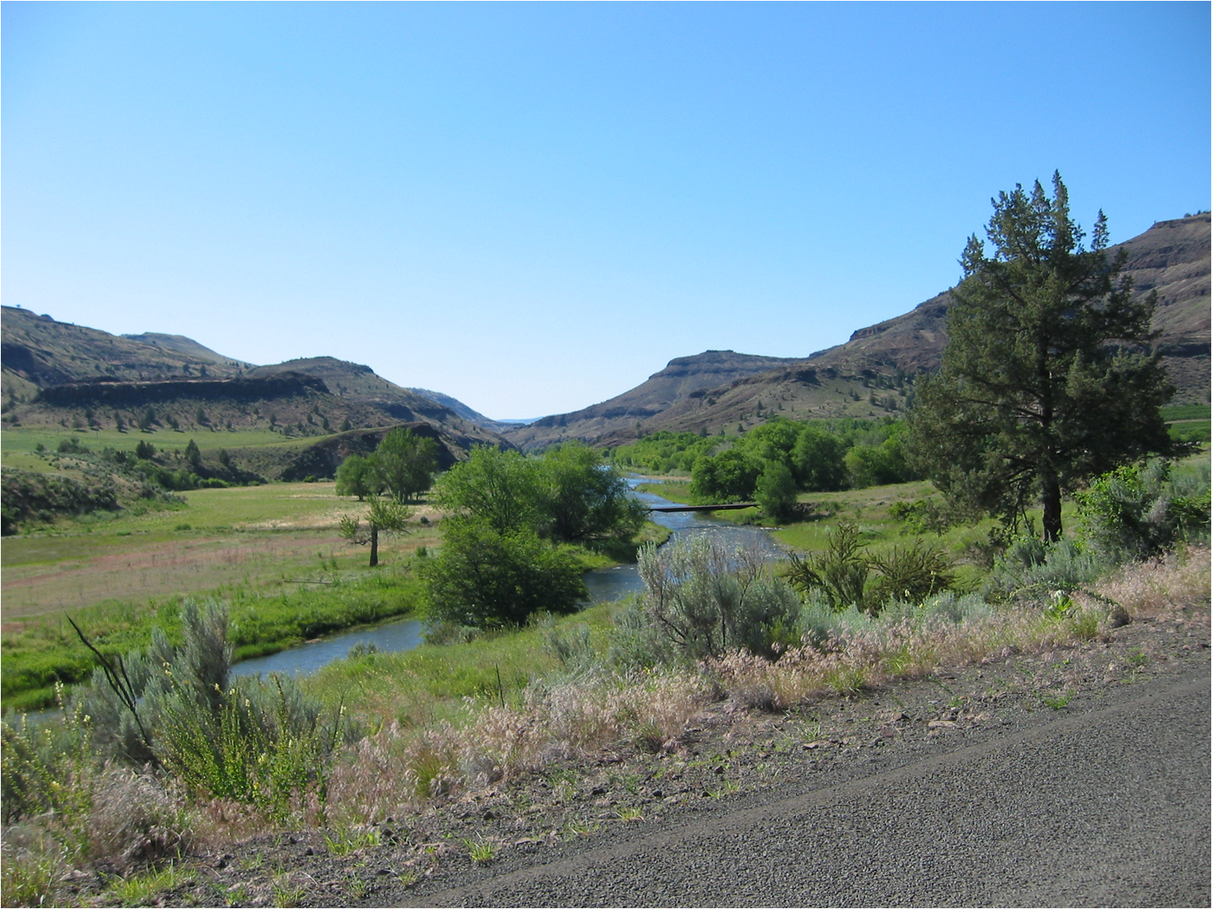
Break-out Session 2: How do we find the resources to do what we want to do? Or how do we collaborate on monitoring design to get the answers we want? Data management tools?

Slide 24

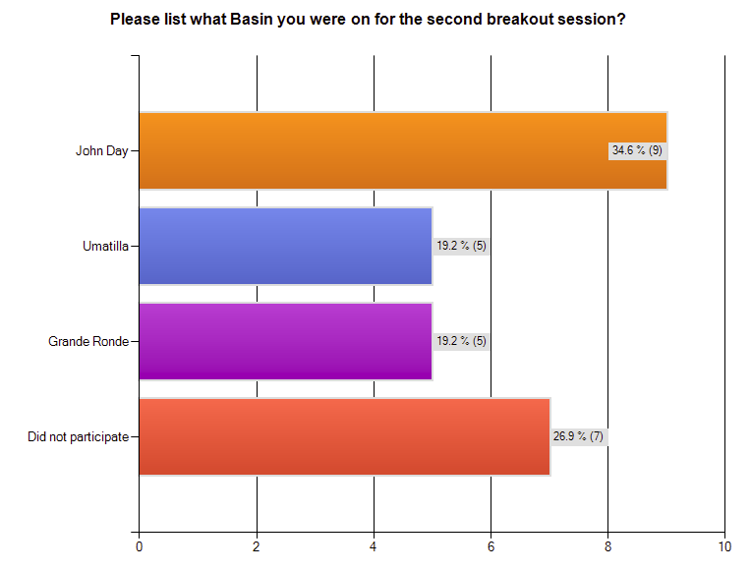
9.

Slide 25
John Day
What do you think were best ideas for increasing collaboration?
Take home themes:
Develop interagency work groups.
2. Establish a lead role for collaboration.
“State and Federal agencies should fund local groups (Watershed Councils, SWCDs) to conduct monitoring rather than maintaining large agency staffs. Utilize the local on-the-ground people who have access to private ground.”
“It will be somewhat challenging but somehow try to get the various watershed councils and SWCD's to coordinate on the monitoring that they are doing.”
“The group felt that support for sub-basin scale interagency work groups would be very helpful (4 or 5 would be needed for the JD basin).”
“Reinvigorate regional efforts to pull stakeholders together more regularly so that everyone can be on the same page with regards to greatest needs for the basin.”
“Establishing a point or person to go to and see who is doing what monitoring and where it is being done. Also, that it would be current. Increased: Communication and coordination resulting in efficient effective collaboration”

Slide 26
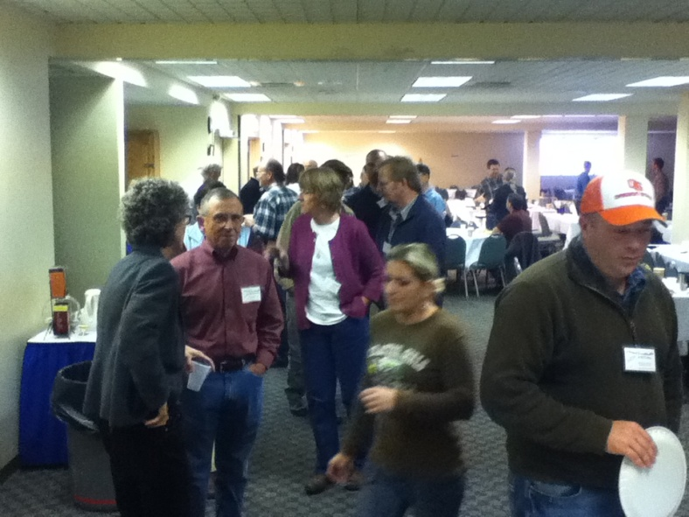
Umatilla
What do you think were best ideas for increasing collaboration?
Take home themes:
More regular collaboration.
“More small meetings.”
“Regular gathering of interdisciplinary natural resource group.”

Slide 27
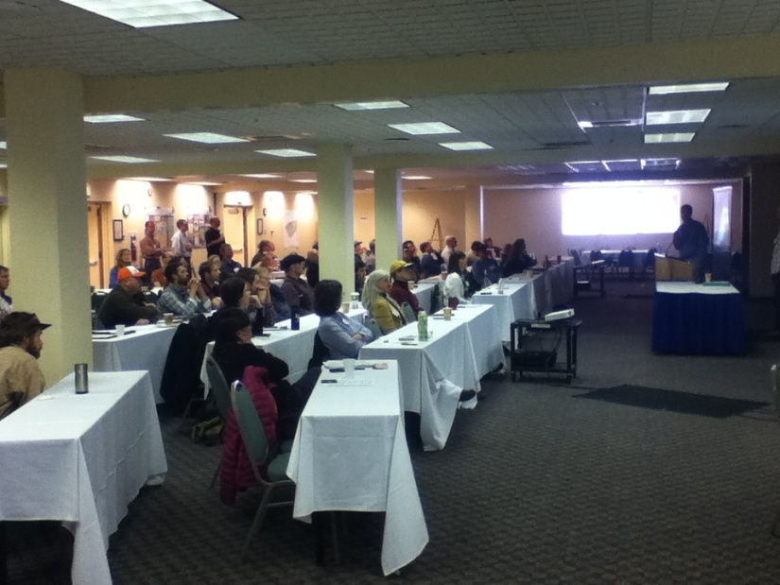
Grande Ronde
What do you think were best ideas for increasing collaboration?
Take home themes:
Knowing who to call.
“Missed latter half of discussion”
“Simply being able to attain each others contact information.”

Slide 28
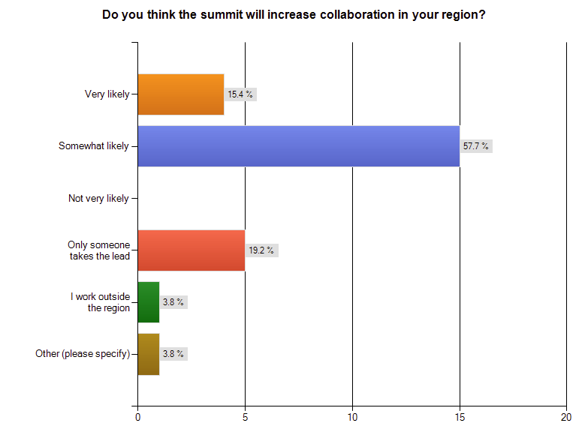
12.
“I work in Salem, this summit allows me to increase understanding of who to collaborate with in the future.”

Slide 29
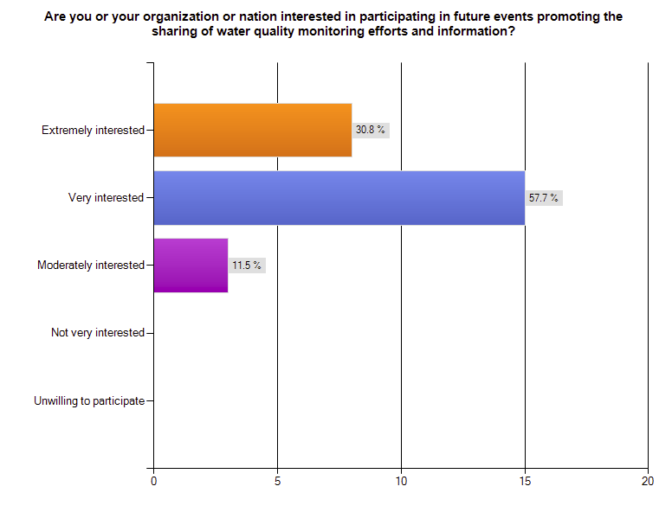
13.

Slide 30
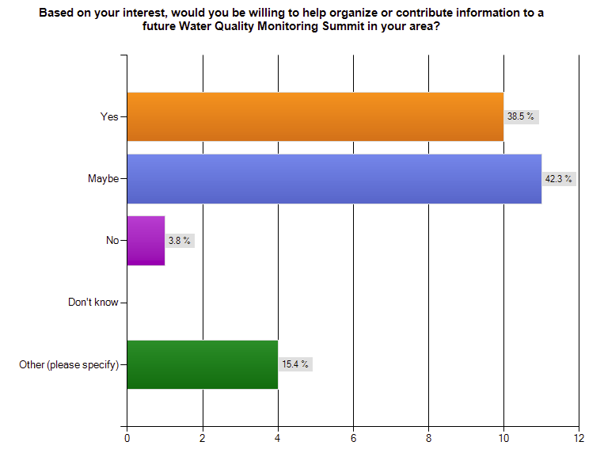
14.
“…I would be happy to help any way I can.”
“That would be monitoring section from my organization, which I am not a part of.”
“Yes, but I would have to obtain permission from my board and Manager before I could officially say yes.”
“PNAMP would be interested in supporting future events”

Slide 31
15. What do see as the most important follow up actions after attending this summit?
“Better collaboration”
“Have a core group meet to gather local personnel involved in data collection. Then determine what is being monitored by whom, when and with what frequency and duration to ensure that both gaps are filled and efforts are not being duplicated.”
“Need to better understand what conservation/restoration actions and monitoring projects OWEB is funding and how those are contributing to improvements and/or unforeseen consequences.”
“Round up of work session findings, results from pre and post surveys, participant and interest area (geography and issue) network.”
“Follow up on any near term next steps identified start documenting/sharing information broadly, in easily accessible formats and locations.”
“Send out meeting presentations.”
“Continue contact with interested folks...don't let them fade...”
“Sharing contact information and starting a list of who has what information. Just basic like the contact name, a more narrowed down area like Wallowa River vs Grande Ronde Basin, what they collected, and years. That would at least help people planning or conducting monitoring to have the basic information of who to contact.”
“Internal communication within my organization. Focused on future policy and Federal and State agreements.”
“Continue discussion with new contacts from the meeting and include them in future monitoring efforts where relevant.”
“Pick one pilot idea like stream temperature to focus collaboration around -support continued work groups at local/subbasin scale.”
“Sharing the presentations and products of networking with others in the basin who did not attend.”
“Continue our efforts to work together, for those of us in the Umatilla that means continued participation in the working groups we have, and inter-group participation when possible.”
“Taking personal responsibility to coordinate and plan monitoring activities better.”
“Making sure the John Day collaborators make a point of meeting on a regular basis.”

Slide 32
16. Please identify something you plan to follow up on based on discussions at the summit.
“Work that OWRD is doing”
“I plan to talk with the entities and clarify roles and responsibilities in regards to the John Day Basin.”
“Work with Shannon Hubler and Aaron Maxwell to figure out ways to analyze macroinvertebrate data that is being collected as part of the MF John Day River IMW.”
“Still thinking about it.”
“Utilization of unknown resources such as sample design tools within monitoirngmethods.org.”
“Talk to Monument SWCD about project opportunities.”
“Follow up on documentation efforts in PNAMP's Monitoring Explorer”
“Pursuing state and federal partnership/funding for local monitoring.”
“Contacting other partners in the basin for data sharing.”
“Tom S. with ODA will continue to work locally.”
“I would like to start contacting various entities and seeing what data they have collected.”
“Explore resurrecting the Natural Resources Discussion Group in the Umatilla Basin.”
“Policy language in Federal and State agreements that address managing data generated using Federal funds.”
“Coordination with ODFW in GR basin.”
“PNAMP will work with OWEB and ODEQ to continue to share monitoring location information via the PNAMP Monitoring Explorer.”
“I intend to spend more time checking out some of the online resources that were discussed, especially Monitoring Explorer.”
“Make info available to organizations not present (watershed councils, SWCDs, USFS, etc.)”
“I have already supplied a paper to the OWEB team (Ken) that might be of use to one of his efforts.”
“Plan my future monitoring project protocols by first checking PNAMP and other resources.”
“I hope to rejoin the lower John Day working group to stay apprised of water quality issues in the basin.”

Slide 33
17. Is there anything else you would like to mention?
“Overall a great workshop/ really needed”
“The meeting was run extremely smoothly! Great job keeping folks on time and Q/A to the appropriate allotted time amount.”
“Overall, I think this attempt to communicate and set the stage for coordination was excellent.”
Great Job, I really enjoyed attending!
“No.”
“Yes, hats off to the DEQ staff Aaron, Shannon and Don and whomever else behind the scenes...for organizing this workshop, I found it very productive, well organized, good content, worth my time. Thanks for the invite to participate. I am only sorry I could not come 2nd day, it was a crazy busy week for me. Thanks again!”
“I think this is a worth-while event and I would be happy to help keep it going statewide!”
“Great Job!”
“Thanks to DEQ for putting together the summit, it was done very well.”
“The Organizers for this conference did a wonderful job. It contributed to a very productive and synergistic environment.”
“The summit was very well organized! Thanks for inviting us!”
“Good venue”
“We don't seem to have a shortage of topics that can be talked about, so an extra half to full day might be useful. However, many of the programs we participate in make incremental headway over periods of years, and hearing the same thing every year for three or four years isn't very productive. Be careful with the frequency with which these meetings, or the topics therein, are held. I would also have liked to shift between basins as the meeting progressed; my work ranges from local to regional and so to my interest in what's going on.”
“Had a great time. Thanks”
“Aaron, Don, and Shannon did a terrific job!”

Slide 34
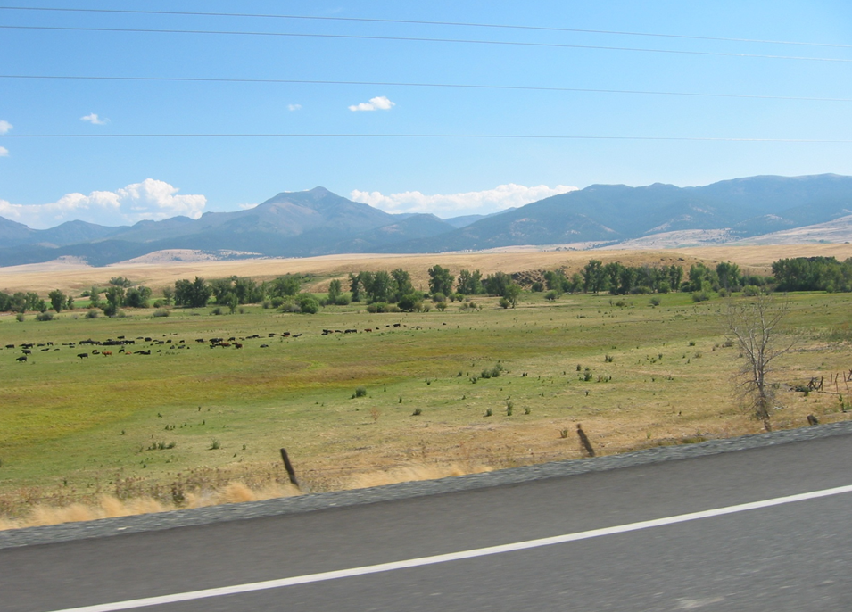
What did I learn
Focusing on shared values at the beginning of a conference is very important for a constructive process.
People enjoy and see value in collaborating but it doesn’t happen without concerted effort, time and resources.
Monitoring partners need better tools and training to share data and information.
Someone needs to take the lead on coordination and collaboration of monitoring. It doesn’t happen on its own. An interagency natural resource monitoring team like the Strategic Enterprise Approach to Monitoring (STREAM Team) could be a good way to accomplish this!

Slide 35
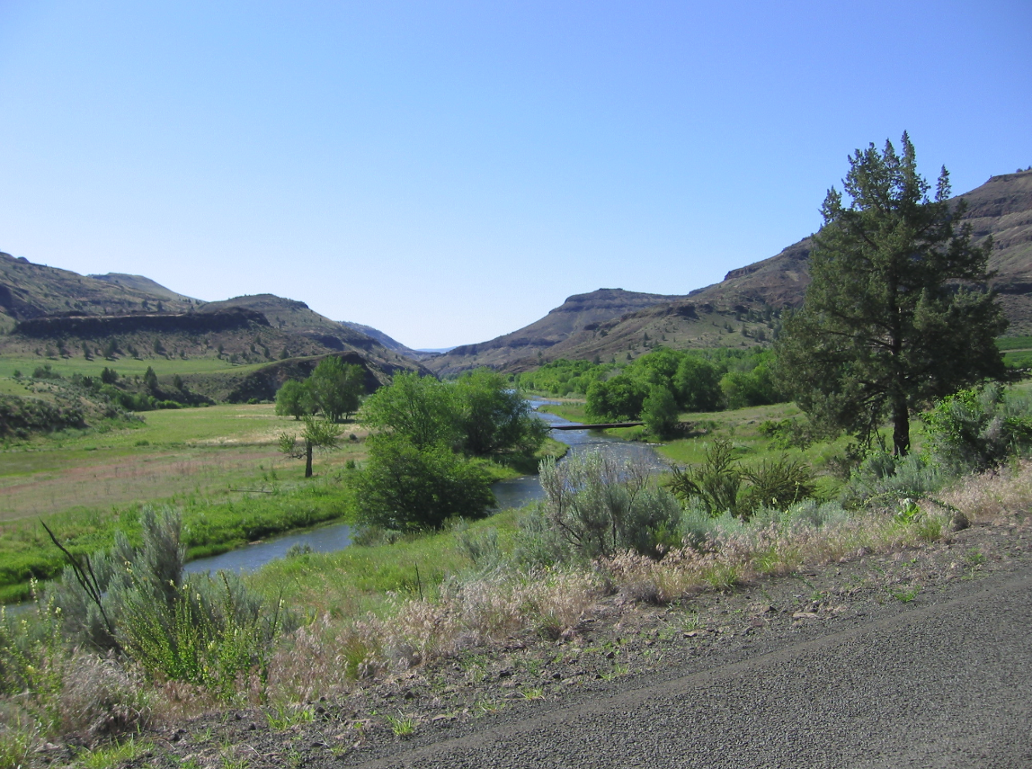
What comes next?
Make summit presentation available.
Share participant list with contact information.
Identify and share tools for data management and sharing
Send out a post summit survey and share results with the participants.
? Discuss whether a monitoring summit in another part of Oregon would be useful.

Slide 36
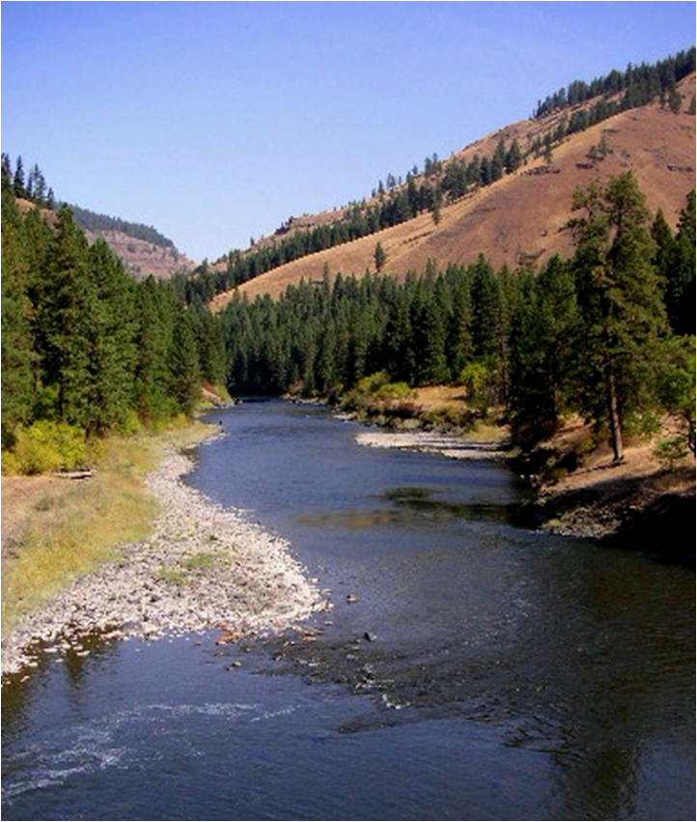
Thanks!
Shannon Hubler
Don Butcher
Greg Pettit
Eric Nigg
Linda Hayes-Gorman/EMT
Presenters
Participants

