Slide 1
Hermiston Foods Study Oregon Environmental Quality Commission 12/11/2013
Christine Kelly
Associate Dean
College of Engineering
Oregon State University

Slide 2

Scope
Industry Best Practices
Survey of the best practices for odor management within the context of water reuse and application to agricultural sites.
Experimental Study
Assess odor from HF waters under a variety of conditions
Measurements include odor, biological oxygen demand, chemical oxygen demand, dissolved oxygen, pH, T
Conditions include time, water type, aeration, inoculum, pH, temperature and vegetable solids.

Slide 3

Industry best practices
Survey of the literature, including research articles, state publications, books, and interviews with experts (extension agents, etc.)
Sources include animal agriculture, food processing and wastewater facilities,
Focused on land application of wastewaters and solids.
Best Practices Categories (basis of survey)
Air Processing
Waste Water Processing and Redistribution Methods
Methods of Sprinkler Movement
Dust/Odor Reduction
Storage Basin or Lagoon Odor Removal Methods

Slide 4
Survey of Pacific NW companies
>100 PNW companies that use process water for irrigation or land application were surveyed by phone
43 companies chose to participate
Survey instrument summarizes methods described in the Best Practices document.

Slide 5
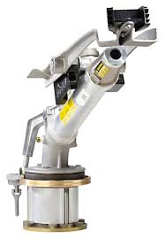
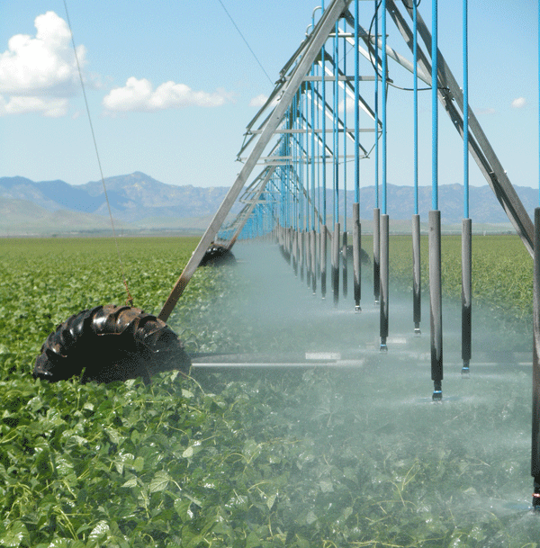
Best practices
Waste Water Processing and Redistribution Methods
 | “Big gun” sprinkler with large bore opening
 |  | Stationary
 |  | Traveling
 |  | Center pivot/linear movement
 | Impact sprinkler with small bore opening
 |  | Stationary
 |  | Center pivot/linear movement
 | Drop nozzle
 |  | Center pivot/linear movement
 |  | Boom sprayer
 | Low drift drop nozzle
 |  | Center pivot/linear movement
 |  | Hose drag sprayer
 | Large diameter, low pressure, discharge hose
 | Boom sprayer
 | Hose drag sprayer
 | Tanker wagon
 | Drip emitter at or below ground surface

Slide 6
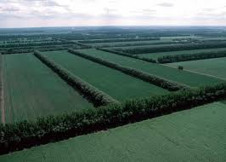
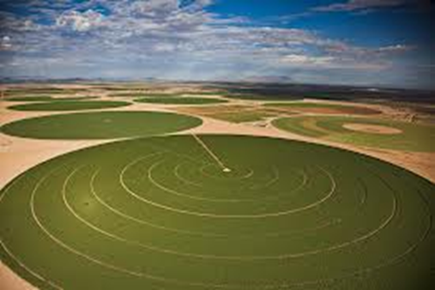
Best practices
Methods of Sprinkler Movement
 | Center pivot
 | Linear movement
Dust/Odor Reduction
 | Windbreak walls
 | Shelter belts
 | Washing walls (odor control via evaporative cooling)
 | Oil sprinkling in animal pens
 | Diet manipulation via introduction of synthetic amino acids and crude protein to feed
 | Dry activated carbon sources in animal bedding
 | Manure additives
Air Processing
 | Packed tower wet scrubbers
 | Fine mist wet scrubbers
 | Activated carbon odor adsorbers
 | Bio-filters
 | Thermal oxidizers
 | Diffusion into activated sludge basins
 | Odor masking agents

Slide 7
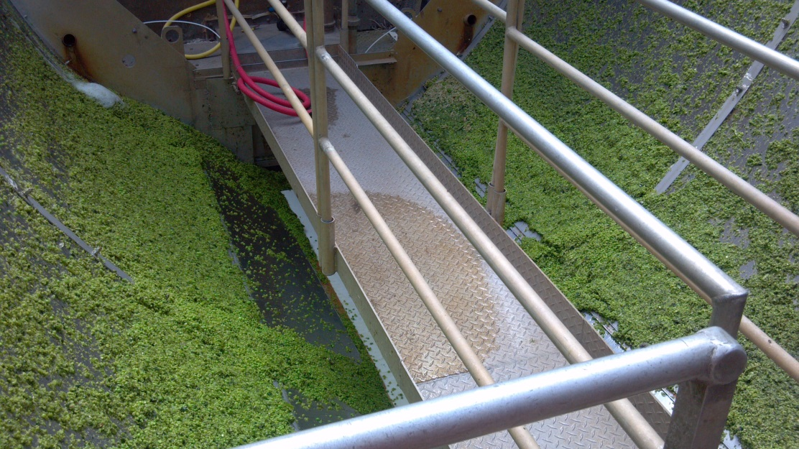
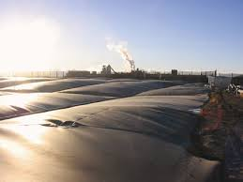
Best practices
Storage Basin or Lagoon Odor Removal Methods
 | No cover
 | Impermeable cover
 | Geotextile cover
 | Granular foam cover
 | Fixed foam and geotextile cover
 | Straw bio-cover
 | Permeable synthetic or organic bio-cover
 | Mechanical screens
 | Centrifuges
 | Sedimentation via gravity
 | Ultrafiltration

Slide 8
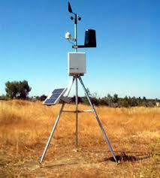
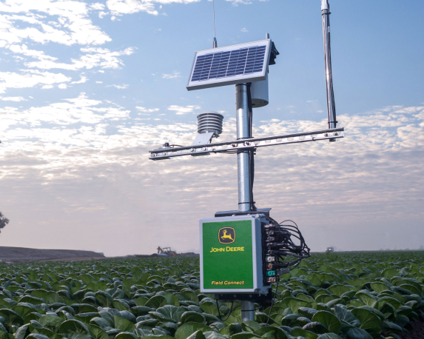
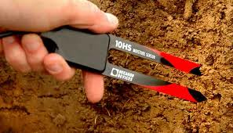
Best Practices
Considerations Taken into account Because of Odor Control/Nuisance
 | Wind speed
 | Wind direction
 | Temperature
 | Pre-application pH
 | Aerobic vs. anaerobic activity in soil
 | Pre-application chemical conditions of soil
 | Time of day
 | Season
 | Humidity
 | Location (with regard to neighboring homes or businesses)

Slide 9
Survey of Pacific NW companies
Of the 43 PNW companies surveyed that use process water for irrigation or land application
13 used taper bore nozzles (none due to odor concerns).
3 used ponds or basins to store waste water
0 were covered or treated due to odor
1 acknowledged odors
7 used drip irrigation/irrigation canals to supply water to fields.
0 indicated that it routinely made decisions based on odor control based on environmental conditions
0 indicated the use of air processing methods for odor control
Methods in the Best Practices document probably do not represent common practices within the agricultural industry in the Northwest. In contrast, at the Hermiston Foods facility a host of operating practices and design strategies are enacted with the explicit intent of reducing odor generation and exposure to neighboring land.

Slide 10
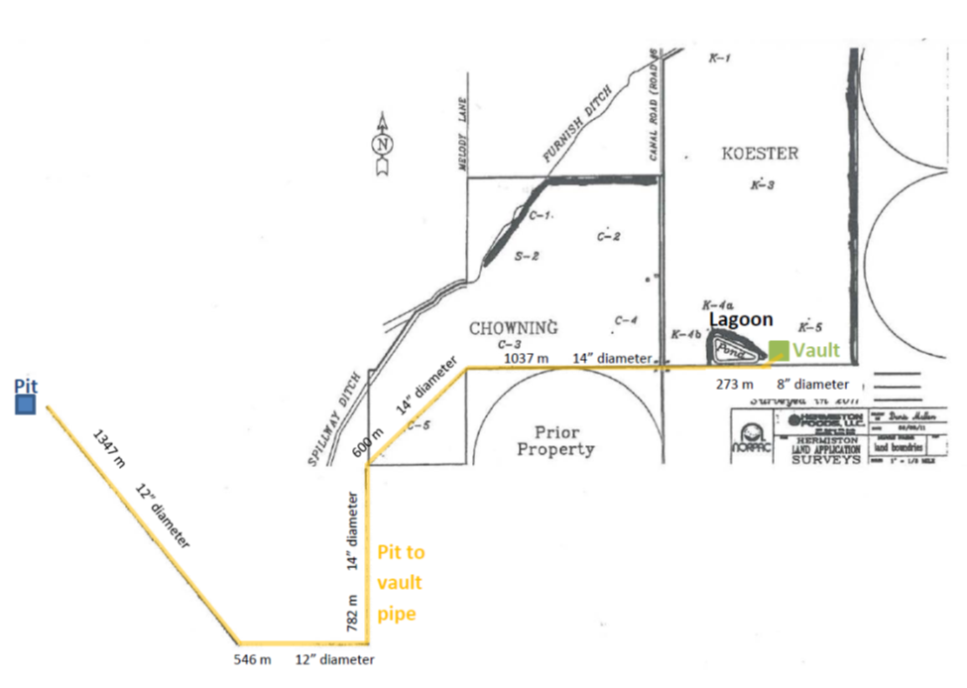
Experimental study
COD
Pea/carrot 1000s
Asparagus 100s
pH
Pea 4.0
Carrot 6.0
Asparagus 6.7
Types of water
Pit
Vault
Lagoon
Pivot
Ditch
gpm hr
450 ave 3.8
253 min 6.7
2000 max 0.9
Flow rates, odor and characteristics of water from the facility vary with time. All samples taken for the study are snapshots of the system.

Slide 11
Quantifying odor is difficult
Methods require a panel of 5-7 researchers
Dilution method: dilute sample to threshold detection, resource intensive
Ranking method: rank the undiluted samples, cannot measure magnitude of differences, less research intensive, less resource intensive
Rating method: panelists rate the odor 1-10

Slide 12
Odor results
Odor increased with time in cold storage
Raising the pH to neutral tended to decrease odor
Rigorous aeration (open to atmosphere) decreased odor due to volatilization and removal from the water phase
Solids removal tended to decrease or not affect odor
Aerobic incubation in a closed vessel generally decreased sample odor
pH Neutralization

Slide 13
Odor results
Anaerobic conditions significantly increased odor in pit water samples

Slide 14
conclusions
On the occasions that odor develops, it may be due to anaerobic metabolism that occurs in the 3-mile long underground pipe.
In some samples a significantly lower pH is measured at the vault than at the pit. In June 2012 this was observed (pit 6.6 pH, vault 4.6 pH) when there was a strong offensive odor at the vault. This is evidence for the formation of organic acids by anaerobic metabolism.
Oxygen consumption rates indicate that dissolved oxygen can be completely consumed in minutes, compared to the multiple hour residence time in the pipe.
pH adjustment to neutral reduced odor in the ranking odor panels. This supports the hypothesis that odor causing acids were present in vault water.
Intense and offensive odor was consistently formed from pit water by incubation under anaerobic conditions.

