Slide 1

TRENT WALDERN, General Manager
DANIEL CLARK, Irrigation Supervisor
12/11/2013

Slide 2
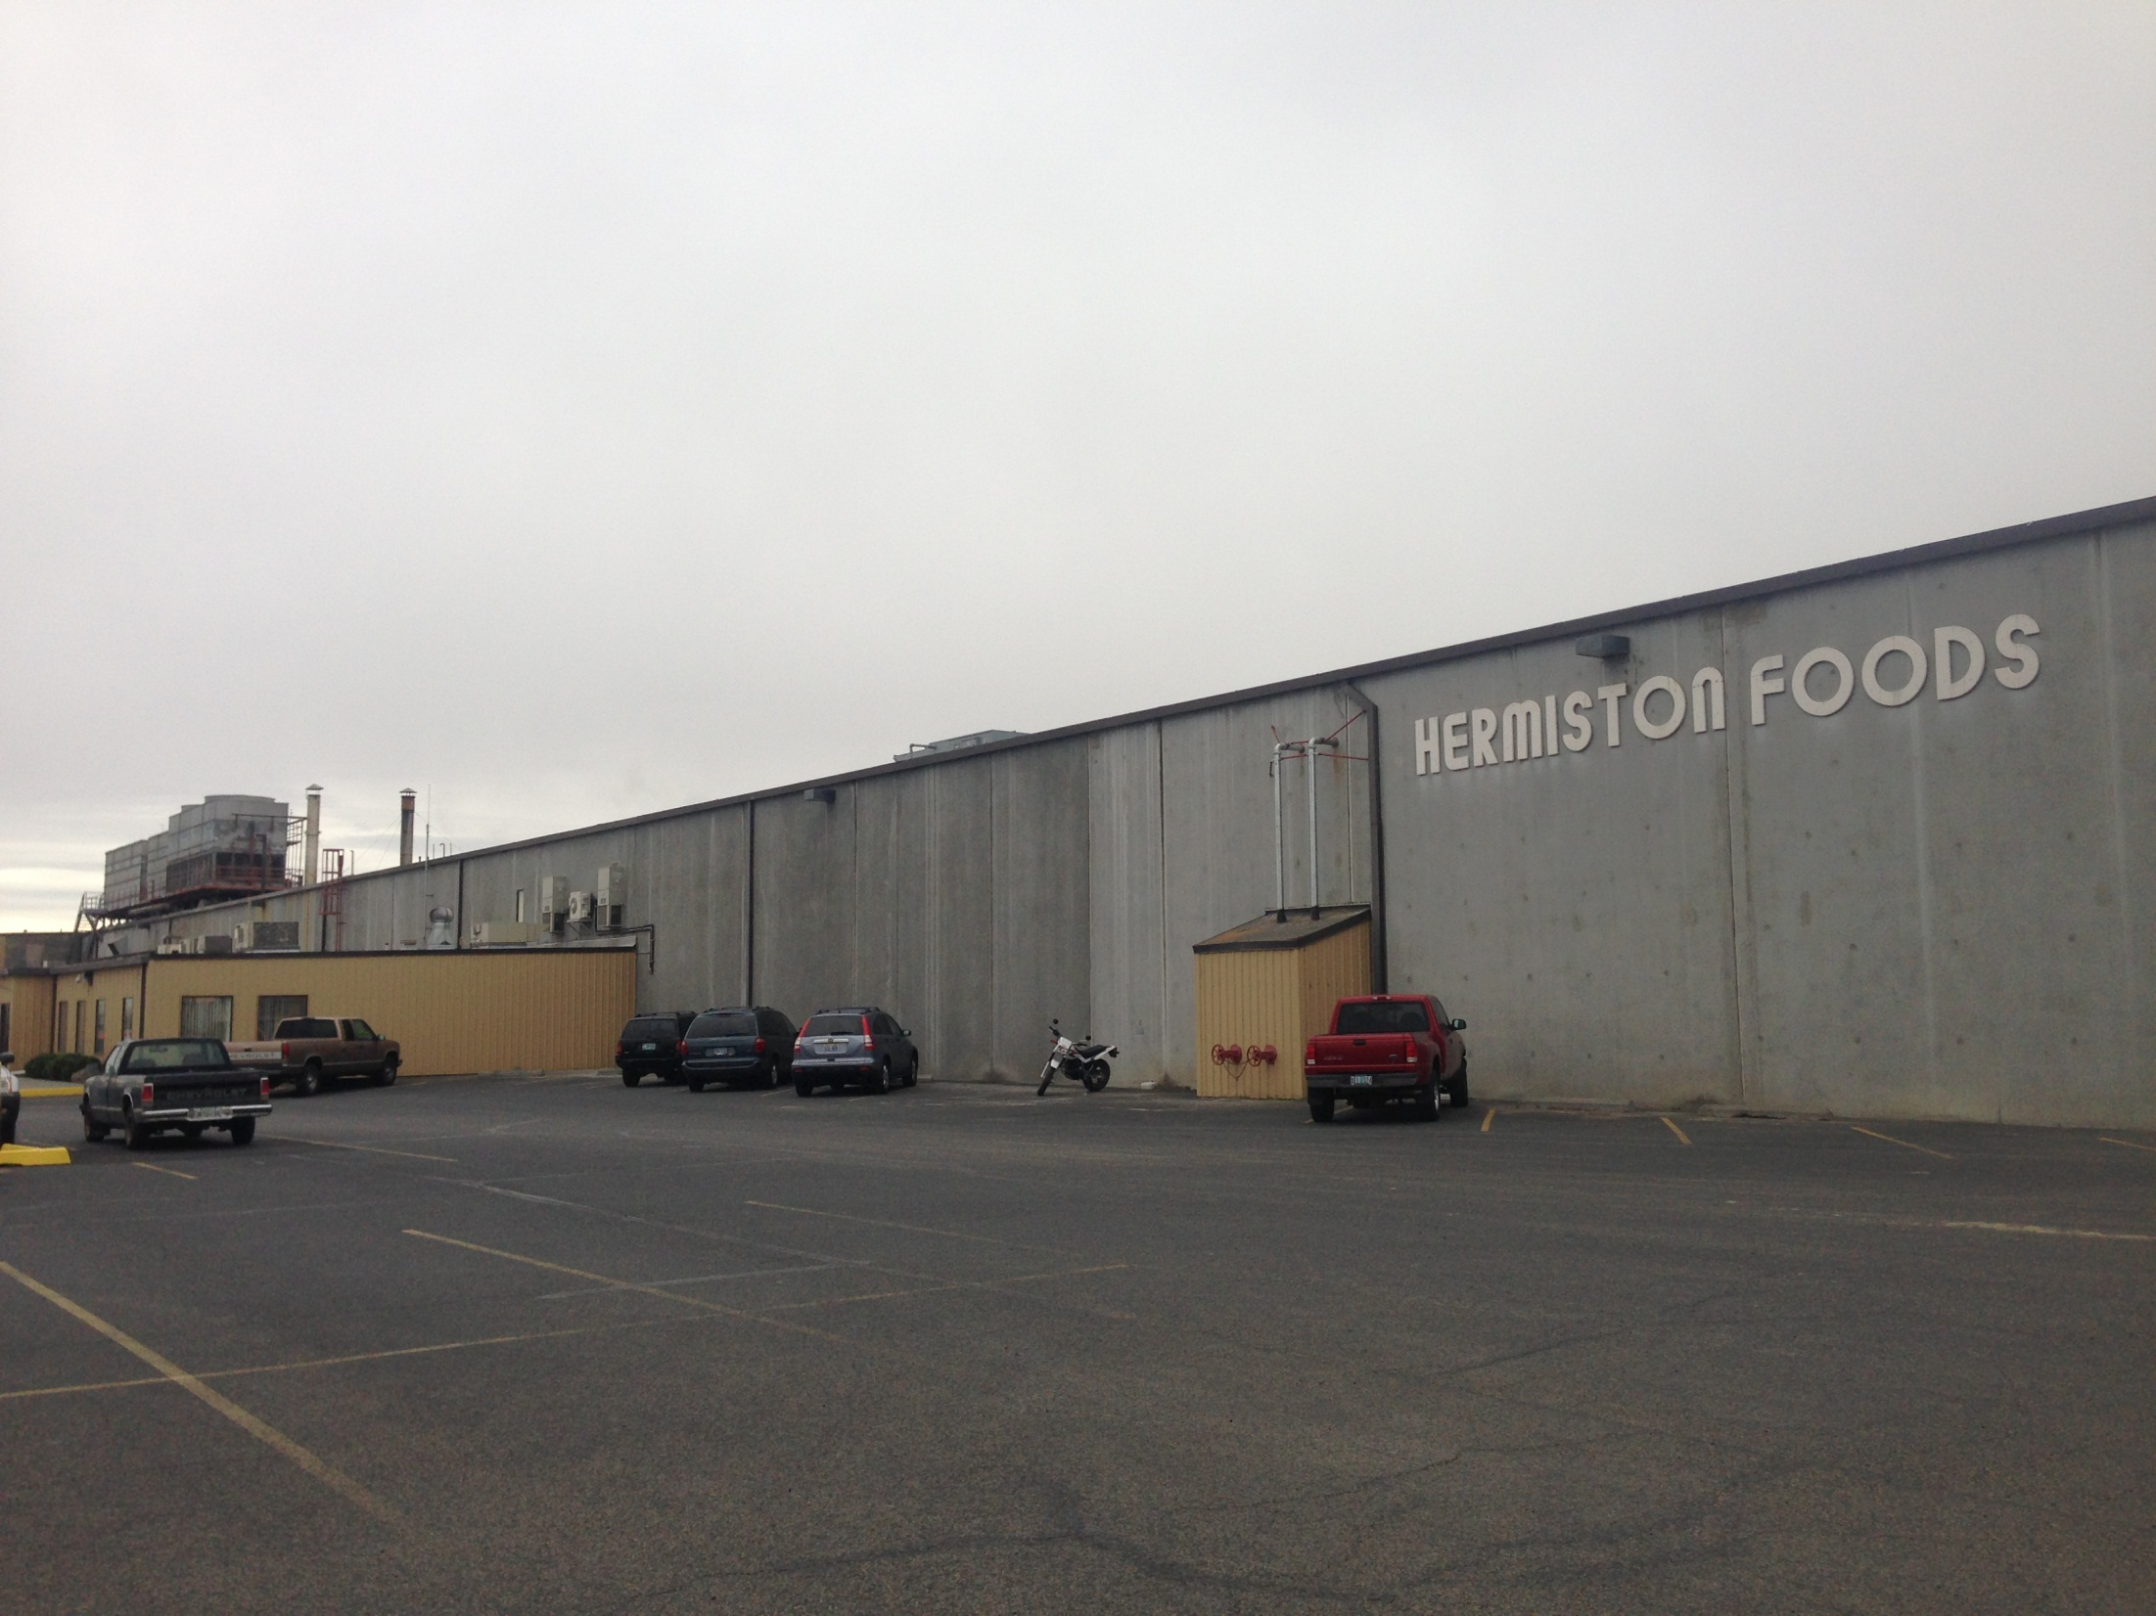
Hermiston Foods ,built in 1989,is a subsidiary of Norpac Foods
Hermiston Foods processes 60-70 Million pounds of vegetables annually with a staff of 40 full-time and 250 seasonal employees.

Slide 3
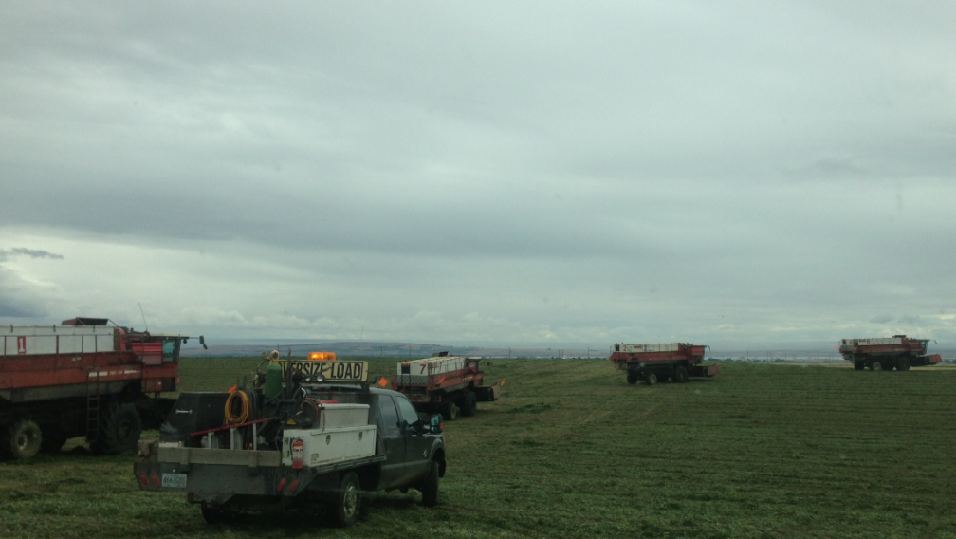
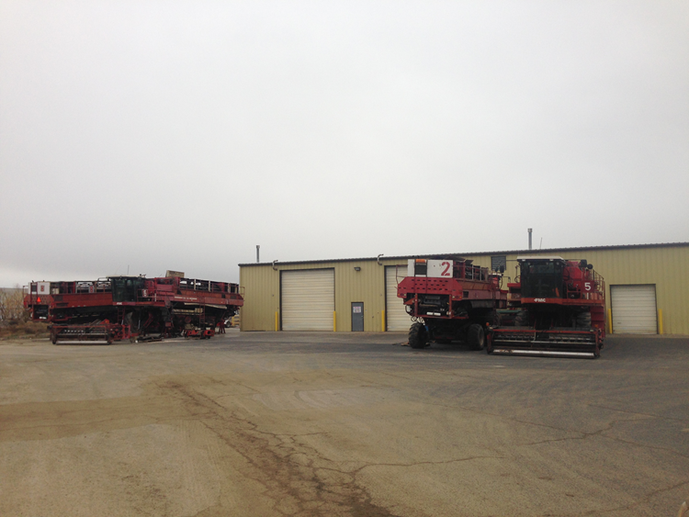
Our Growers:
Hermiston Foods contracts over 6,500 acres with local farmers to grow: Asparagus, Edamame, Peas, Sugar snaps, Lima beans, and Carrots.
Hermiston Foods offers its growers different options for crop rotation and assists them with seeding and harvesting.

Slide 4
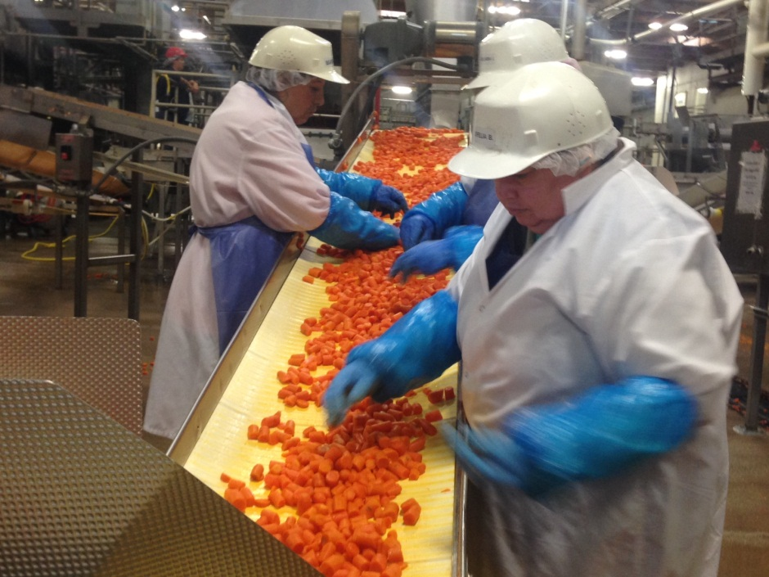
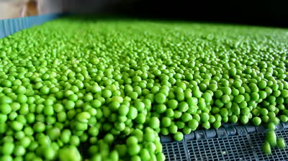
Water Use for Processing:
Water is an essential part of vegetable processing. Water is used for cleaning, heating, cooling and transporting finished product. Water is also necessary for plant sanitation and byproduct removal.
Hermiston Foods has land applied process water to crops since opening the plant in 1990. NORPAC views this practice as a contribution to sustainable agriculture and a wise use of a limited resource.
Notes:
Speak on our efforts to recycle as much water as we can. Water has a cost.We have a performance indicator for this – gallons per lbs. of finished product – monitored.

Slide 5
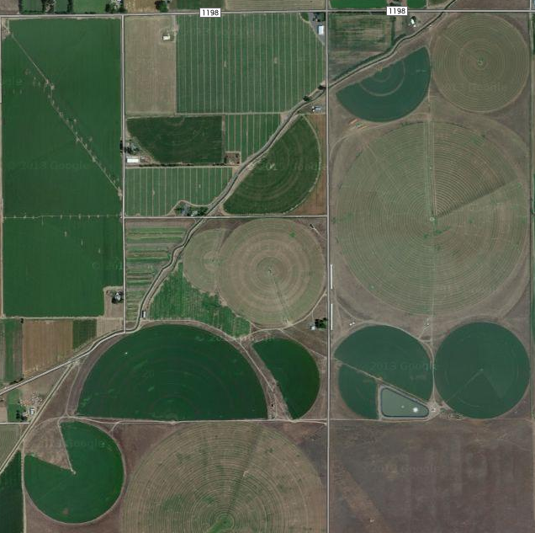
Process Water Farm
K2
In 2010 Hermiston Foods moved its process water irrigation site to a 450 acre farm that it purchased. Process water is applied to 376 acres on this site.
DEQ required Hermiston Foods to adopt an Operations, Maintenance and Monitoring (OM&M) Plan to prevent leaching and spray drift, and to manage nitrate levels and odors.
K1
K3
C1
C2
SS
K4a
C3
C4
K5
K4b
C5
Notes:
Clarify what letters and numbers are. This site is adjacent to our previous site.

Slide 6
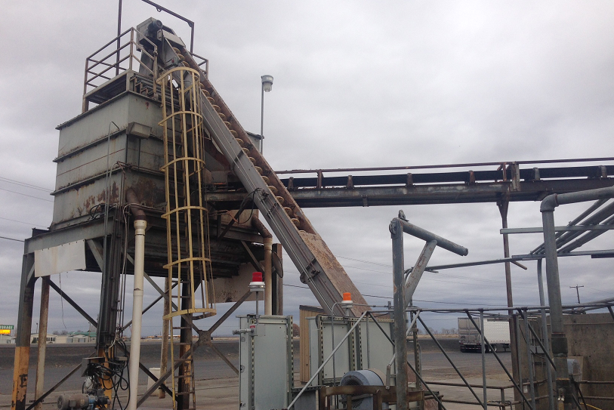
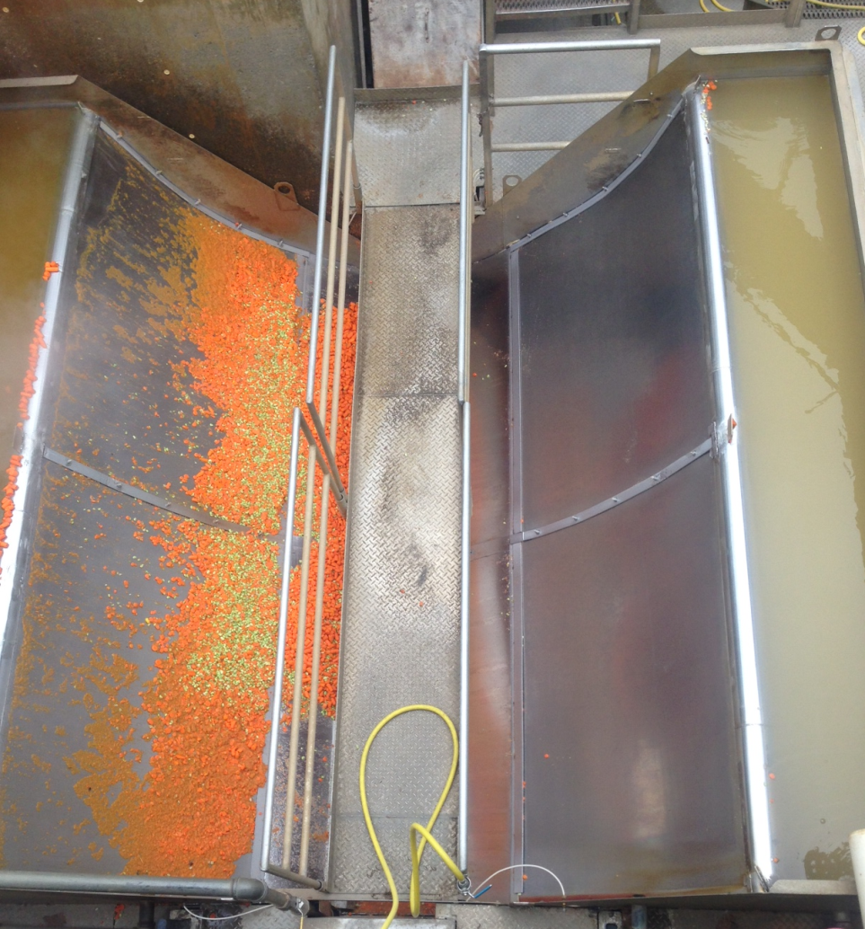
Approximately 100 million gallons of process water is generated by the HF plant annually. Before the water leaves the plant, solids are screened out. Byproduct solids are then sold as animal feed.
Hermiston Foods invested in new equipment to ensure that we complied with our DEQ permit. Finer screening was installed at the plant to remove more solids from the process water stream. Process water from the plant is transported over 2 miles to the process water farm. Two 75 HP pumps are needed to move the water to the irrigation site.

Slide 7
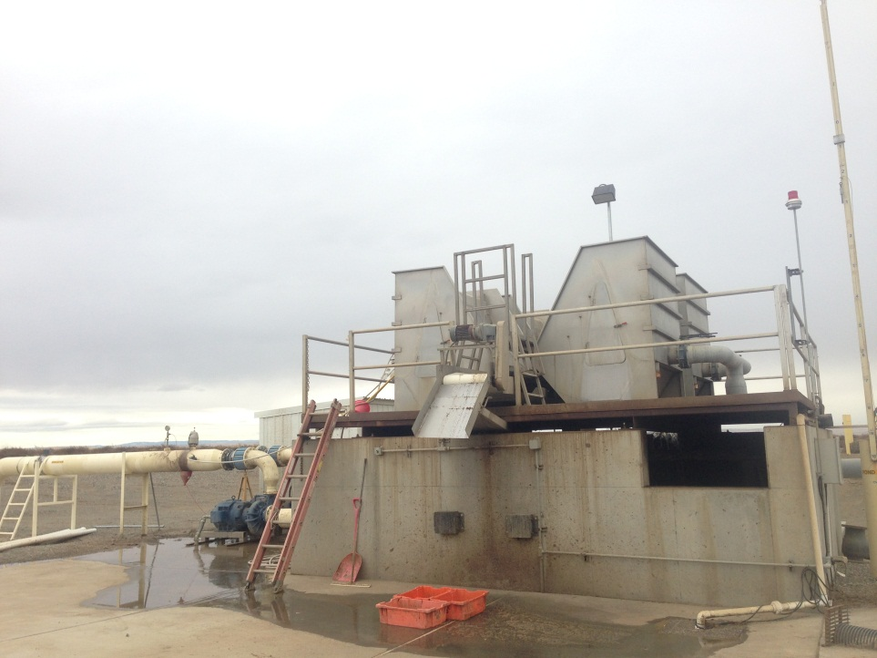
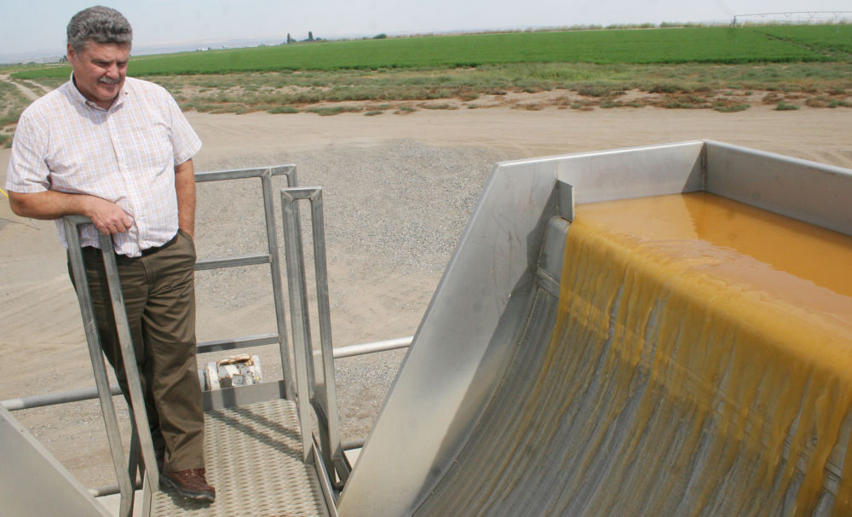
Mixing Vault:
For 150 days of each year, an average process water flow of 700,000 gallons per day is transported through a pipeline to the farm. It takes about 2 hours for each gallon to reach the first stop on the farm, a mixing vault.
At the vault, the process water is rescreened and mixed with enough pond water, well water, and irrigation district water to meet the daily
irrigation requirements of the crop.
Mixing water at the vault helps minimize odors.

Slide 8
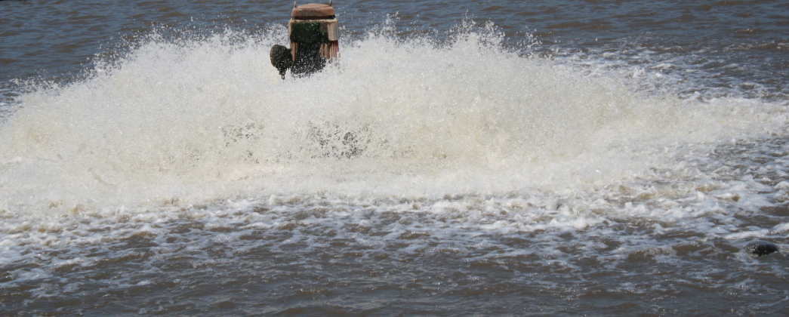
Holding Pond:
Hermiston Foods built a 10 million gallon holding pond next to the mixing vault. The pond is capable of storing process water when the recommended irrigation is less than the output from the plant.
The holding pond is also connected to well and irrigation district water. This is an aid to odor reduction by diluting the pond or flushing it with water that is going to be irrigated.
The holding pond is equipped with two aerators that keep it aerobic.

Slide 9
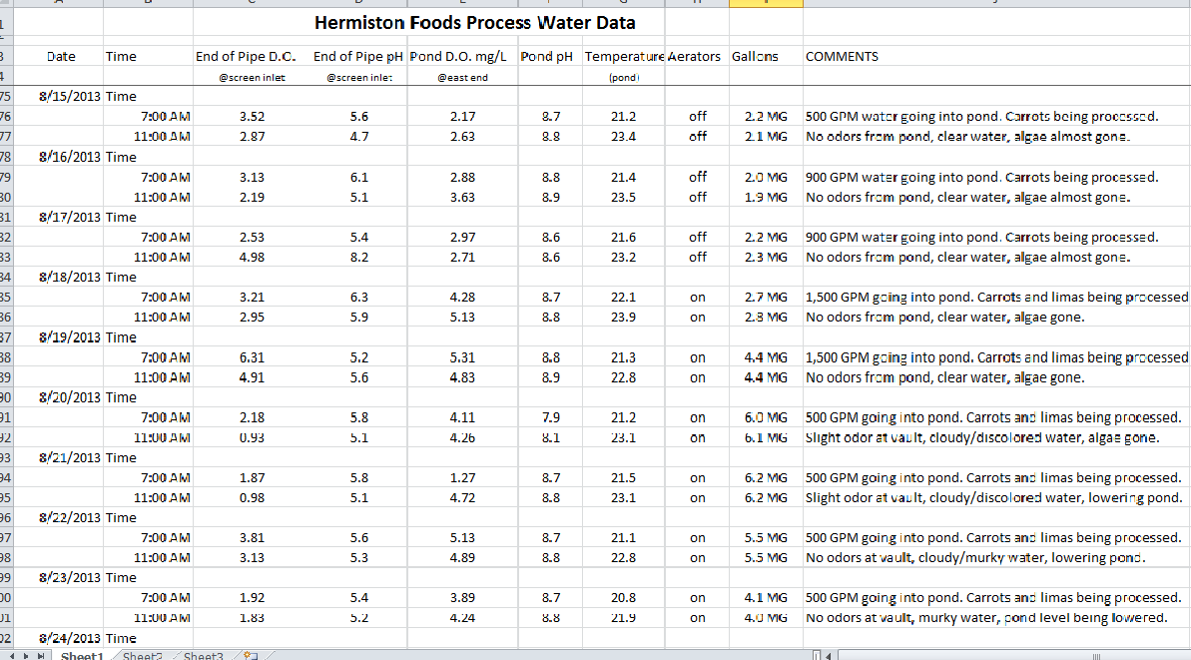
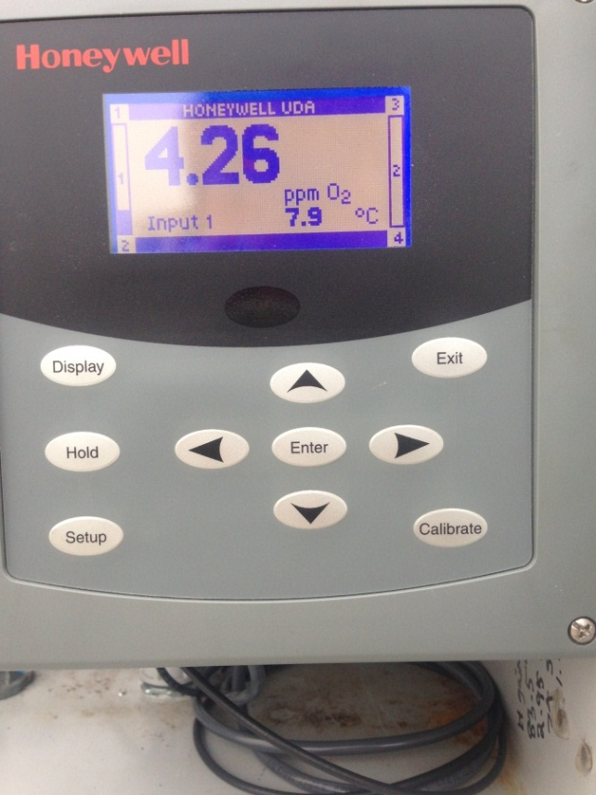
Automated systems:
Hermiston Foods checks dissolved oxygen(DO) and pH levels twice a day. This data is recorded and sent to DEQ. The probe readings are taken from the deep end of the pond. Our studies have shown that D.O. levels are quite consistent throughout the pond. D.O. and pH levels of the water coming from the plant are also taken at the vault twice a day.
Our D.O. levels ranged from 0.5-9 ppm with an average of 2.35 ppm this season.
We use the readings to manage our pond and vault to minimize odors.
Notes:
Table represents DO and pH readings during August of this year.

Slide 10
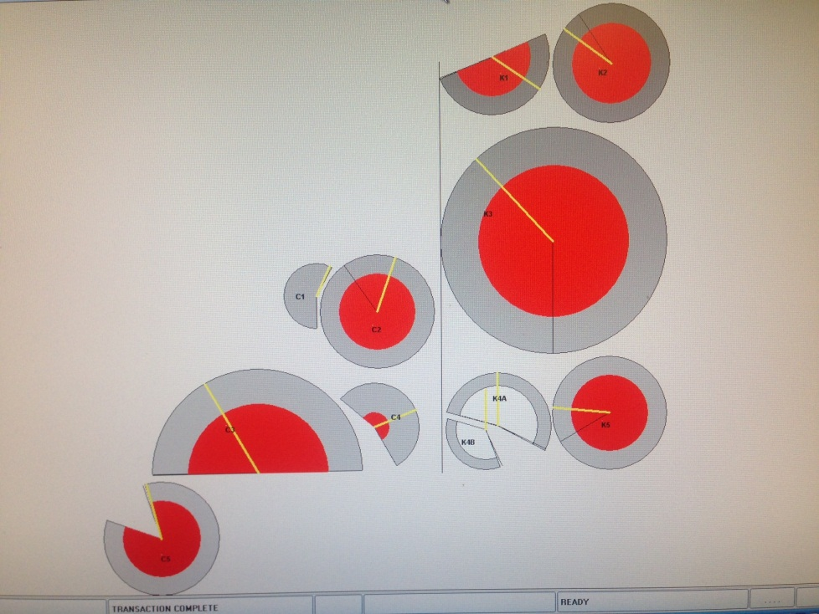
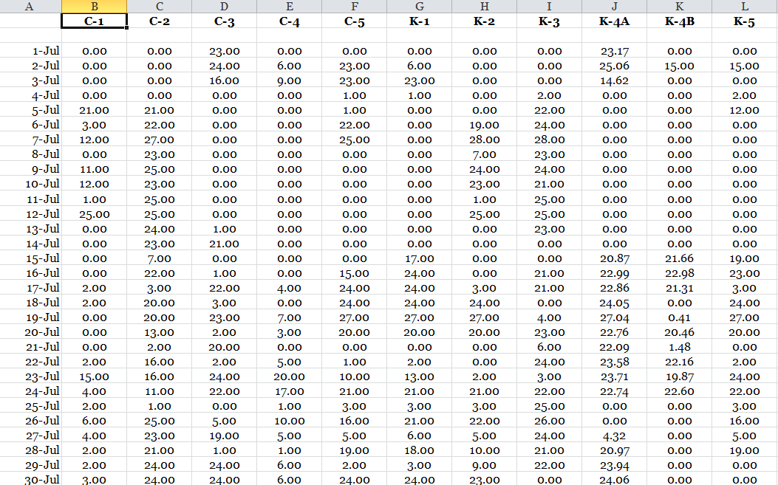
Automated Pivots
In 2011 Hermiston Foods invested in automating our irrigation system. This system monitors: wind speed, water pressure, application rates, pivot location and other parameters.
We are able to program a pivot to run at designated times and on specific areas of the field and to shut down in high wind.
Electronic valves are installed on each pivot to ensure that irrigation is discontinued if a problem occurs. The system will then send our irrigator a text message showing him an error code.
System shows how many hours a pivot has run and the data is recorded.
Notes:
Table is a record of irrigation hours. Top is a map of pivot circles.Red color indicates pivots are “off” and not operating. Yellow line from from center to circumference illustrates where the actual pivot is on the field.

Slide 11
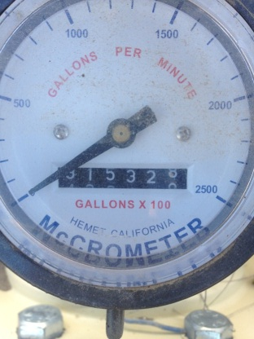
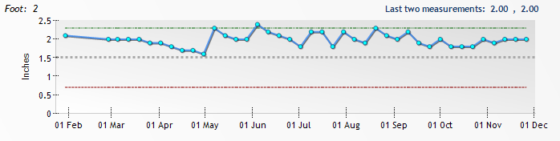
Managing the Process Water Farm – Hydraulic Loading
Data from soil probe measurements and weather forecasts are used by IRZ, a third party irrigation/environmental consulting company, to calculate weekly irrigation hours for each of our fields
Our permit requires us to monitor the first 5 feet of our soil profile. The graph on this slide represents the change in moisture content of one of our fields throughout the season
We record the amounts of process,well,pond and Water District water we use on a daily basis. We also measure volumes going to each field.
C1 Soil Moisture Graph
Notes:
Elaborate on this. Field is C!. Graph shows soil moisture contained in the second foot and each point is a weekly reading.Top line is the fill point,middle line stress point and bottom line wilt point.We receive readings and graphs such as this down to the 5th foot. We pay particulat attention to 4th and 5th foot for leaching.

Slide 12
Nitrogen(Nitrate) Management
Loading limits for nitrogen are approved by DEQ to stay within the primary permit objective of not increasing nitrate in the groundwater under our site.
We test for nitrogen in the soil, process water, and crop tissues.
Each individual circle has nitrogen soil testing done before and after each irrigation season.
We have an independent lab run nitrogen tests on our process water twice a month and we test our harvested crop for dry matter and nitrogen content after each harvest.

Slide 13
Nitrogen Management (continued)
Information from the individual tests is combined with hydraulic loading rates to calculate actual nitrogen loading rates on each of our fields
Additional fertilizer nitrogen can be added to the crop if the nitrogen contribution from Process and supplemental water
does not exceed our permit approved levels.
A number of groundwater monitoring wells are used at various locations on our Process water site to sample for quality.

Slide 14
System Improvements:
2010: First year of operation.
Decreased screen opening size to remove more solids.
Removed end guns on pivots.
Lowered sprinkler heads and changed spray nozzles to increase droplet size.
Introduced drag tubes to the outside sections of pivots.
Reduced irrigation pressure from 55 PSI to 42 PSI.
Installed an aerator in holding pond.
Initiated a neighbor odor complaint procedure.
Logged and analyzed odor complaints.
Moved or shortened several pivots

Slide 15

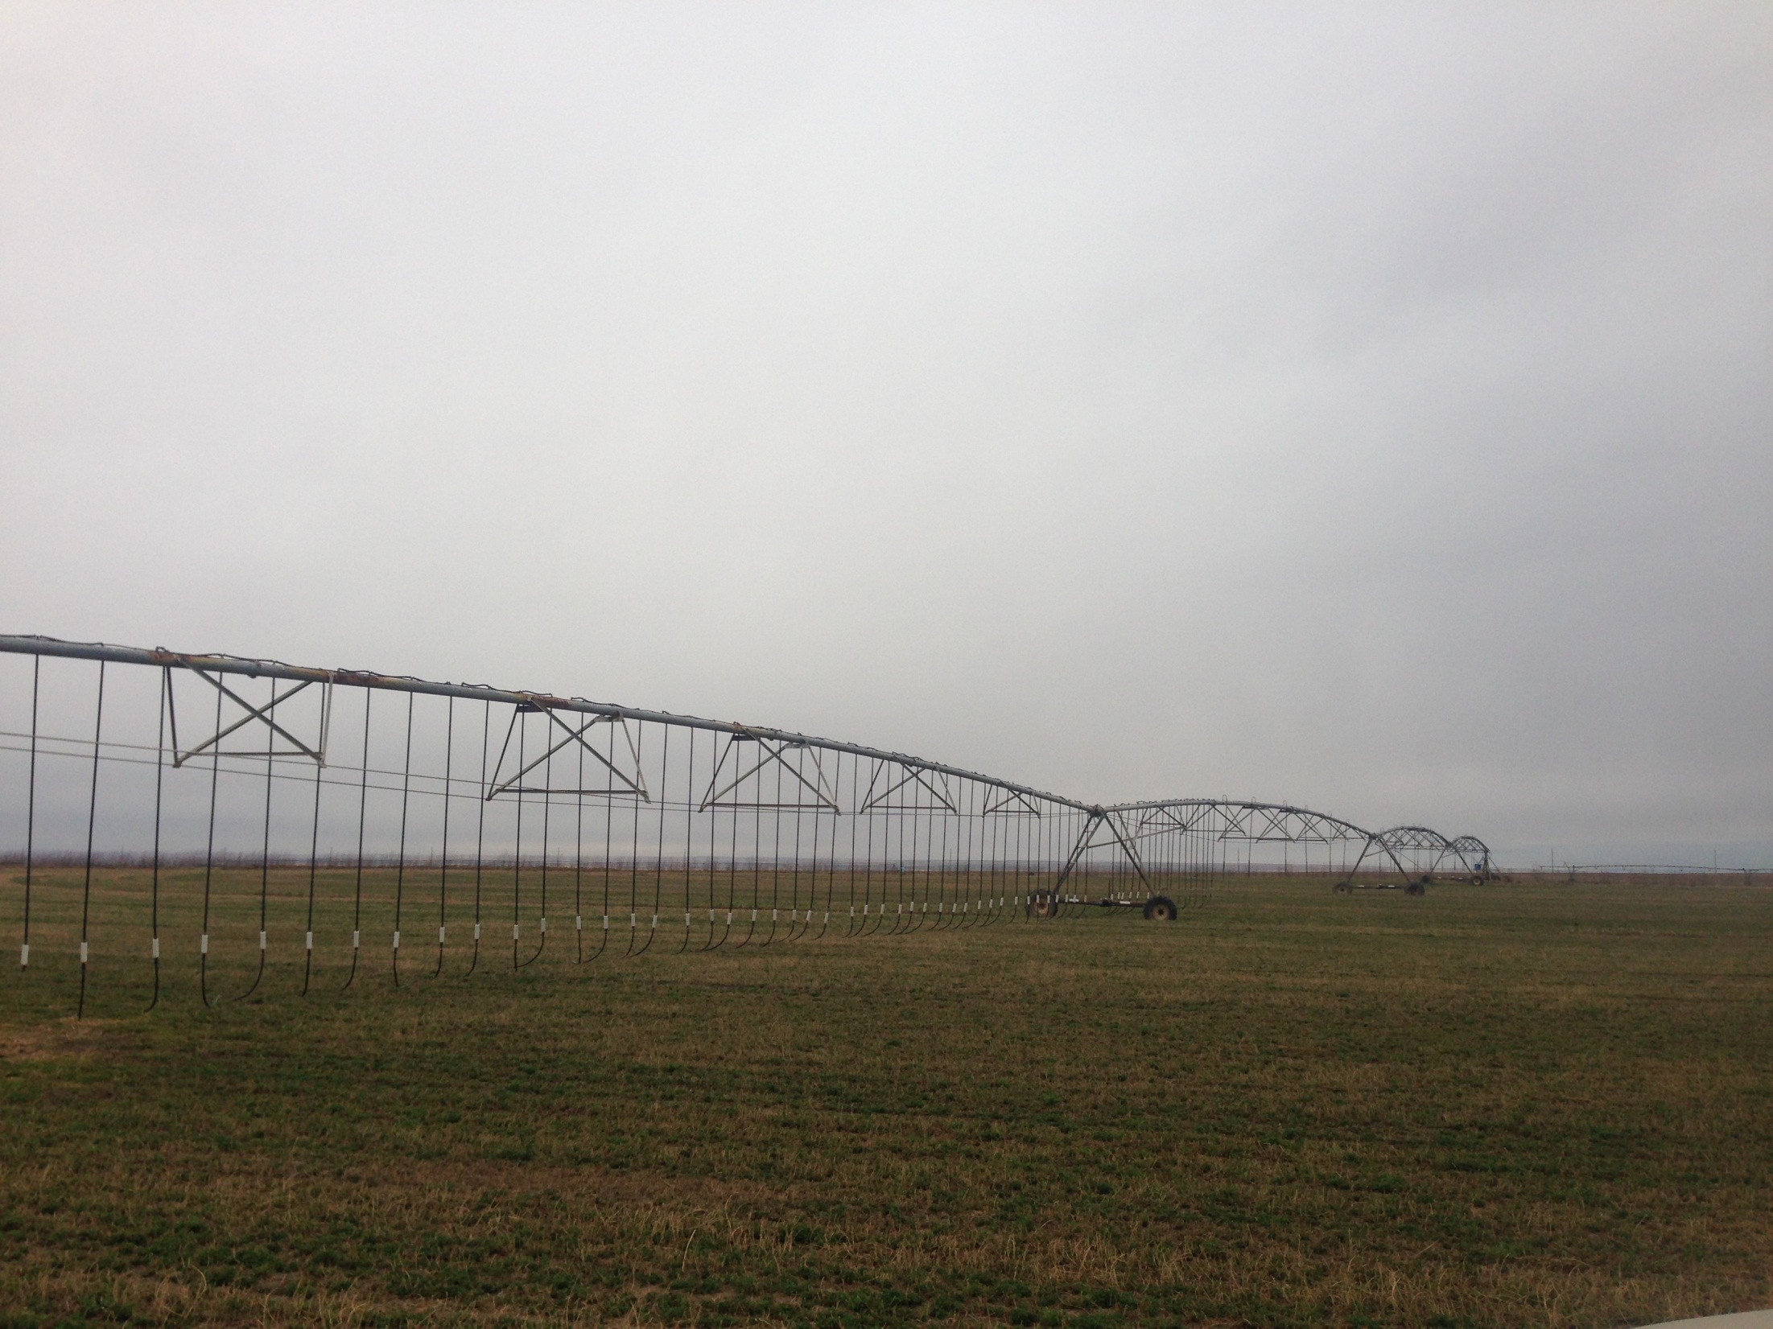
2011 Improvements:
Hired fulltime irrigation supervisor to monitor site.
Changed cropping plans to grow more alfalfa and rotate crops which helped maintain constant irrigation.
Planted trees around perimeter of farm to help block odor.
Began installing automated irrigation system. Four pivots were completed in 2011.
Added a second aerator to the holding pond.
Co-funded an odor study with DEQ and ODA which was performed by OSU.
We modified the permit to monitor soil moisture instead of ET.

Slide 16
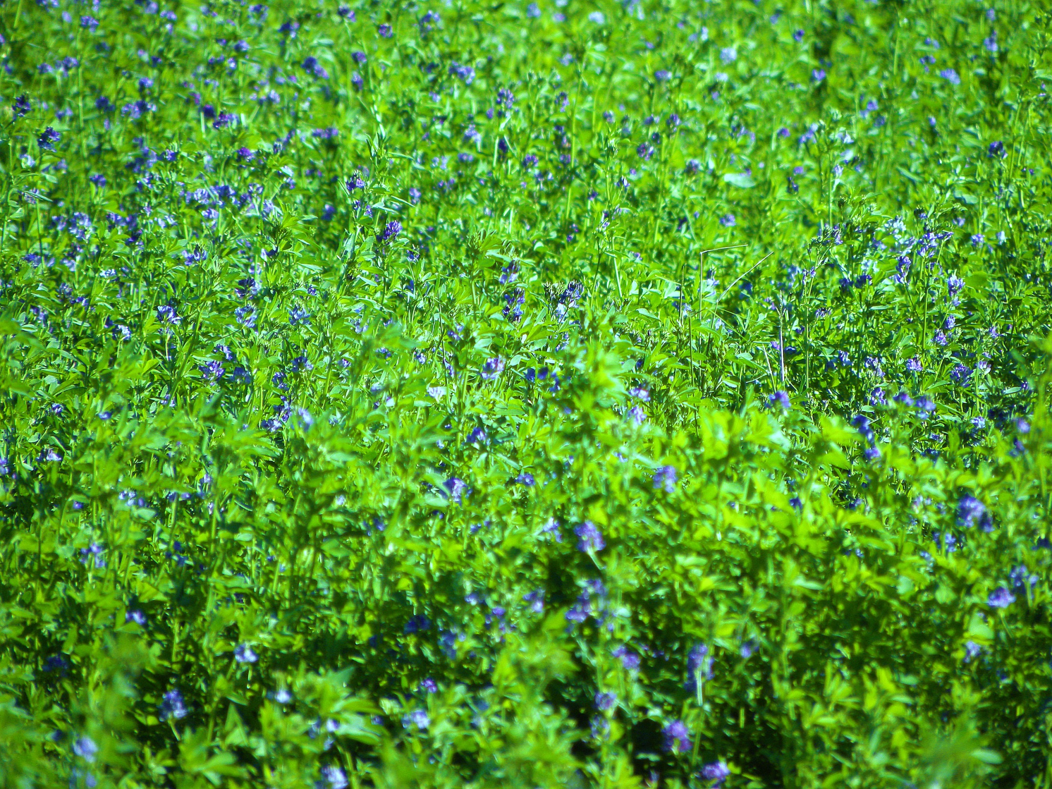
2012/2013 Improvements:
Increased the number of drag-tubes on pivots.
Changed style of drag-tube system.
Placed five more pivots on the automated system.
Expanded tree plantings around the property.
Began adding isolation valves to the irrigation system to give us the ability to continue irrigation while repairing part of the system.

Slide 17
Questions From Previous EQC Meeting
Q#1 : Why did odors decline during July 10 to August 21, 2013?
A: Our experiences with odors, neighbors complaints, and
information from OSU studies has helped us better
manage our process water farm to minimize odors. We
have found that the most important management practice
to reduce odors is to irrigate the process water as quickly
as possible.
Typically through the months of July-September we can
irrigate all our process water and must add millions gal
supplemental water to meet crop irrigation requirements.
This added water reduces odors. However, other events
such as cool weather,precipitation, or harvesting will
reduce the volume of water that can be irrigated. To
adhere to our operating permit during these particular
times we may send process water to our storage holding
pond.

Slide 18
Q#2: What about land use issues?
A: Land application of vegetable processing water is an allowed use on EFU zoned land.
Notes:
This topic of zoning came up at last EQC meeting in August. We were not sure of the question but took a guess at what it was.

Slide 19
Q#3 : What is in the process water?
A: The main ingredients in our process water are dissolved solids from our vegetables. Hermiston Foods does not add any chemicals to its products, but uses cleaning agents and sanitizers that are approved for use on food equipment. The primary cleaning agents used are alkaline detergents, phosphoric acid, peroxacetic acid, and quaternary ammonium. These agents react immediately with food particles and break down to more basic components that provide crop nutrients. These components are measured by our water and soil testing. The Nitrogen, phosphorus, and potassium contained in both the vegetable juices and the cleaners meet about a third of the fertilizer requirements of typical crops.

Slide 20
Q#4 : Is the pipe from the application site pressurized?
A: Yes, as discussed earlier, process water must be pumped from the plant to the vault to overcome an uphill gradient and friction in the pipelines.
Q#5 : What is the procedure for flushing lines?
A: The pipeline from the plant to the vault is flowing continuously throughout the season. We test the D.O. levels of this pipe water daily and it remains well oxygenated. At the end of the process season we do a major plant cleanup with city water that flushes the pipe line.

Slide 21
Q#6: Are crops odor specific?
A: Yes, most of us agree that process water from the different vegetables we process smells differently. By virtue of the fact that their compositions are different their decomposition products yield different odors.
Q#7: Why did the trees on the old application site die?
A: Trees were grown on the old application site as an experimental crop. The trees were infested with insects which caused some of the trees to die. At that point irrigation was terminated by DEQ request, which resulted in the death of the remaining healthy trees.

Slide 22
Q#8: What is wrong with the trees on the east property line of our current Process Water site ?
A: Our boundary trees are all drip irrigated with well water. We had difficulties with our pump supplying the eastern border trees.It shut off several times during the season which resulted in the trees becoming water stressed. We
are correcting pump deficiencies with this system presently that will ensure adequate water for these trees during the coming season.

Slide 23
Questions?

