Slide 1
EQC Information Item Agenda item H
December 11, 2013
Update on
Review of the Oregon Smoke Management Plan
Brian Finneran
DEQ Senior Air Quality Specialist

Slide 2
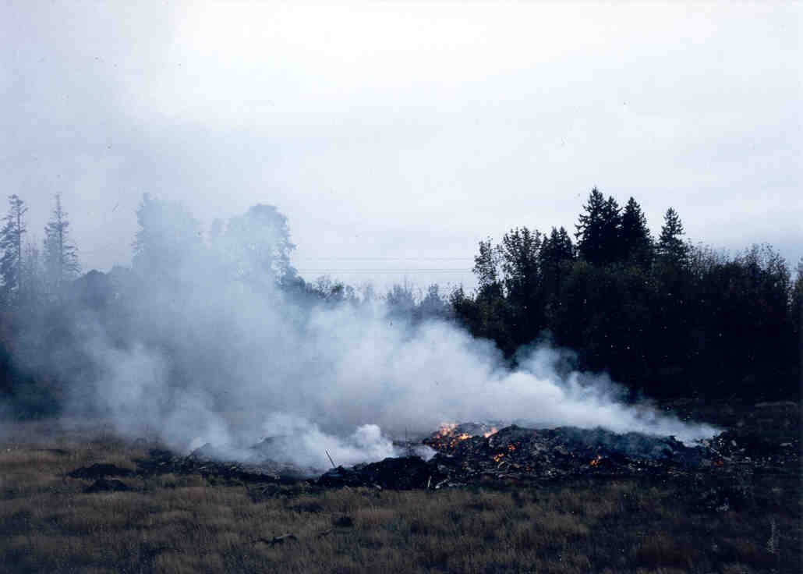
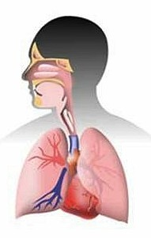
What’s in Smoke?
Fine particulate matter (PM2.5)
Polycyclic aromatic hydrocarbons (PAHs)
Carbon monoxide
Aldehydes
Nitrates / Sulfates
VOCs
Mercury
1

Slide 3
High Risk Groups
Asthmatics
Children
Pregnant women
Elderly (age > 65 years)
Smokers
Individuals with pre-existing conditions
2

Slide 4
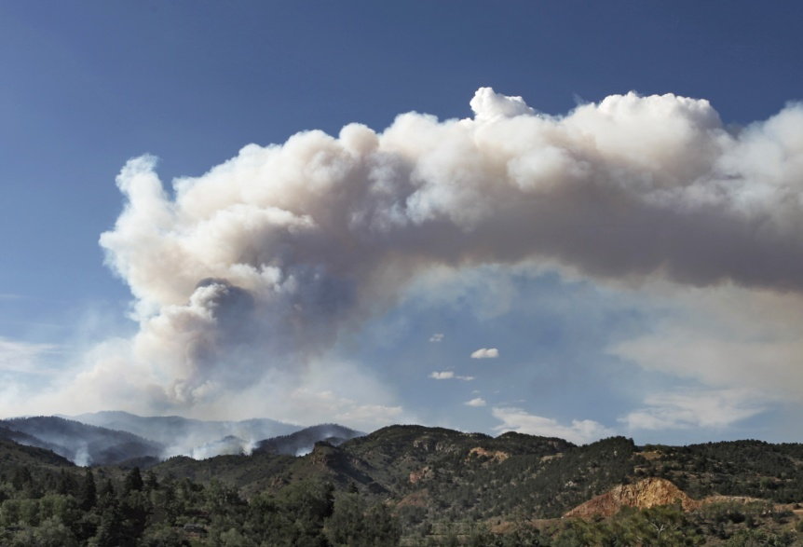
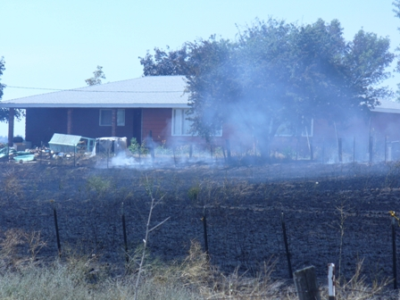
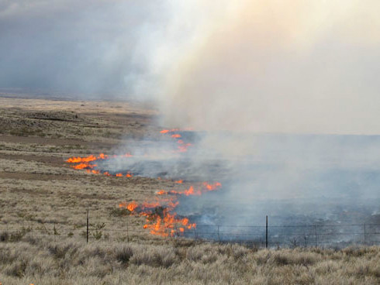
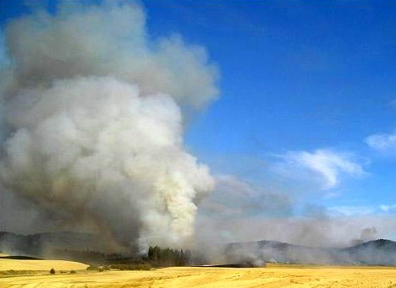
Oregon major burning sources Total PM emissions
Forestry
Outdoor/
Backyard
Forestry
O/B
Ag
Range
Rangeland
Agricultural
3

Slide 5
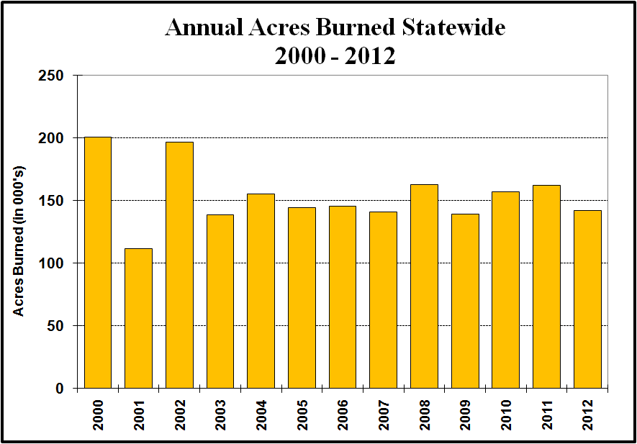
How much forestry burning occurs each year?
About 150,000 acres burned annually
4

Slide 6
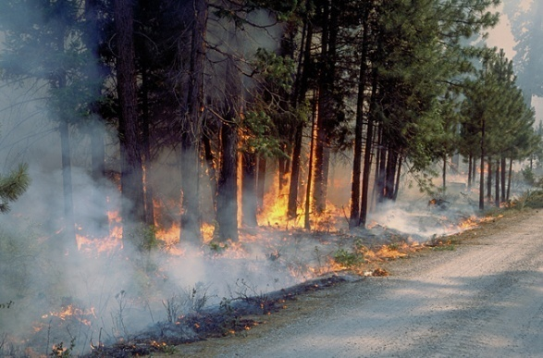
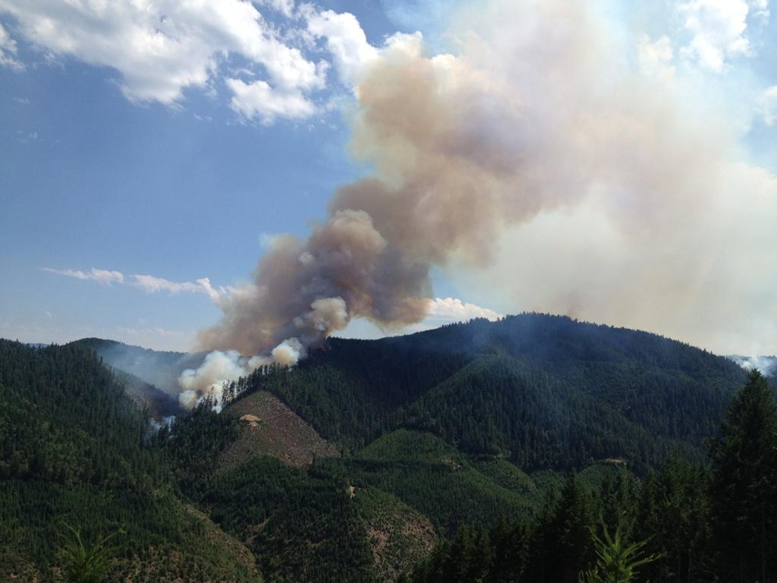
Why is smoke management needed?
Protect AQ health standards (NAAQS).
Protect high-risk and smoke sensitive groups.
Protect visibility in national parks/wilderness areas.
5

Slide 7
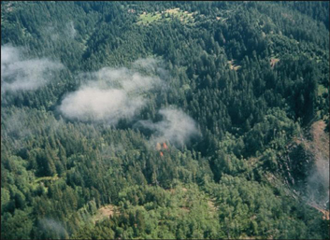
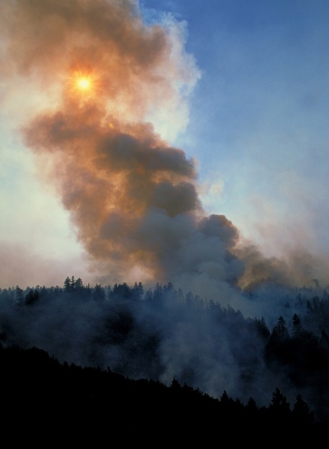
Oregon Smoke Management Plan
1972 adopted as regulatory program.
Covers state, federal and private forestlands.
Plan consists of rules and guidance.
5 objectives:
Protect smoke sensitive areas (SSRA’s)
Maximize burning, minimize emissions
Meet state/federal AQ and visibility requirements
Protect public health
Promote alternatives to burning and alternative burning practices.
6

Slide 8
OSMP Regulatory Authority
ORS 477.013 requires State Forester and DEQ to jointly approve the OSMP.
To implement the Plan, Oregon Dept of Forestry operates a smoke management program.
ORS 477.552 cites need to “minimize emissions from prescribed burning consistent with federal Clean Air Act and DEQ’s State Implementation Plan (SIP).”
Plan is part of DEQ SIP - any changes require EQC approval as a SIP revision, then submit to EPA.
7

Slide 9
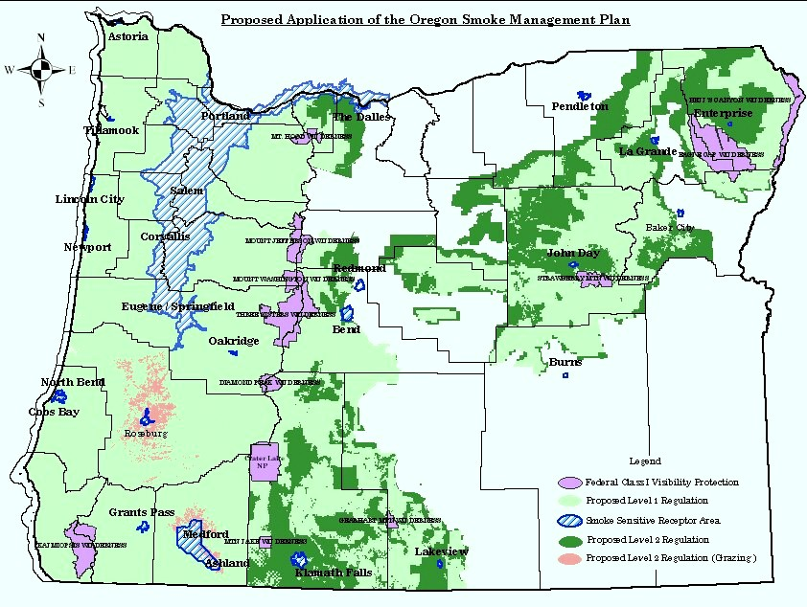
Protected areas under OSMP
LEGEND
Forest lands
SSRAs
Class I Areas
8

Slide 10
SSRA and SPZ protection
SSRA – Smoke Sensitive Receptor Area. Designated areas that receive year-round smoke management protection from prescribed burning.
SPZ – Special Protection Zone. Extra smoke management protection for certain SSRAs with history of NAAQS violations. Applies only in winter months. Restricts prescribed burning within 20 miles on “green”, “yellow” and “red” woodstove curtailment days.
9

Slide 11
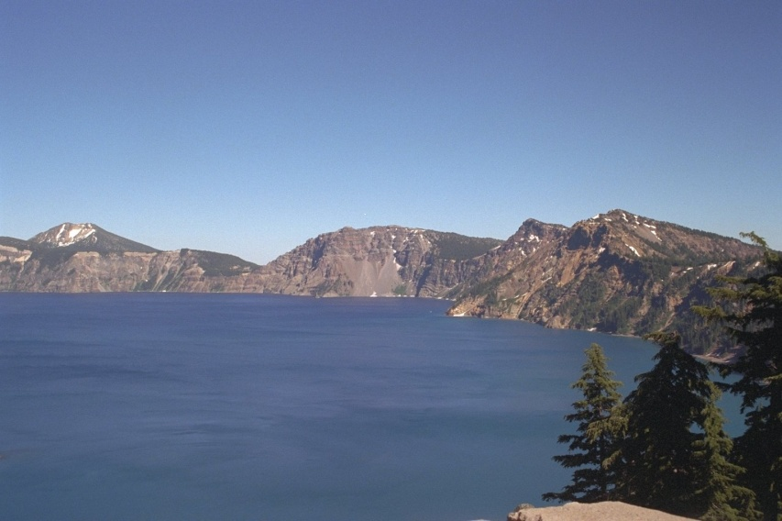
Class I area protection
12 Class I areas in Oregon
Prescribed burning one of largest sources contributing to haze (visibility).
Current smoke management protection focused on avoiding major plume impacts from nearby burns.
Crater Lake National Park
10

Slide 12
What is DEQ’s role?
Oversee ODF smoke management program:
Track air quality, respond/refer smoke complaints to ODF, review smoke intrusion reports.
Consult with ODF in periodic Plan review:
Participate in review, work with ODF advisory committee in evaluating SMP effectiveness.
ODF lead agency in this review. Plan changes must be approved by Board of Forestry.
DEQ (thru EQC) must also approve any changes.
11

Slide 13
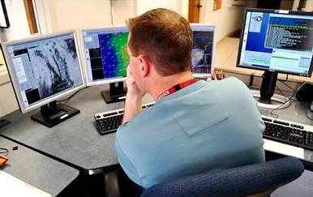
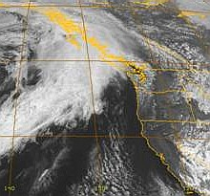
How smoke management program works
ODF conducts daily weather forecasts to determine areas suitable for burning.
ODF issues “daily burning instructions” that specify:
size limits (in tons), spacing, distance from SSRAs, mixing height, transport winds, etc.
Forest districts select actual burn units. Report back to ODF on burning accomplished.
12

Slide 14
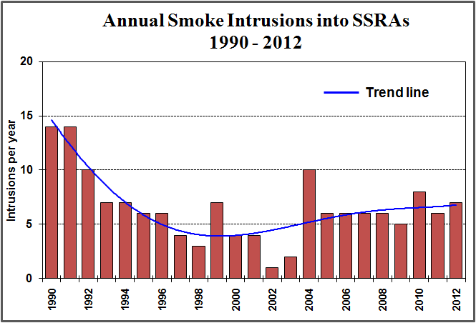
How frequently do smoke intrusions occur?
Total of 5-10 intrusions/year into SSRAs
13

Slide 15
Periodic Review of OSMP
Takes place every 5 yrs to assess effectiveness, and identify improvements.
Many operational and technical improvements to SMP since adoption.
Last Plan review was 2007:
Improvements included adopting new SSRAs, Class I visibility protection, encouraging greater use of alternatives to burning and ERTs.
14

Slide 16
Current OSMP periodic review
Conducted from May 2012 to May 2013
8 committee meetings
ODF and DEQ did not identify any major changes.
Committee recommended several minor changes
Recommendations supported by DEQ
15

Slide 17
Proposed OSMP changes
Additional smoke management protection for Crater Lake and Kalmiopsis wilderness Class I areas – to reduce haze and improve visibility.
Encourage greater use of alternatives to burning and emission reduction techniques. Document in ODF annual reports.
Two SPZ changes - remove La Grande SPZ and reduce size of Medford SPZ. Outreach conducted with both communities in advance.
16

Slide 18
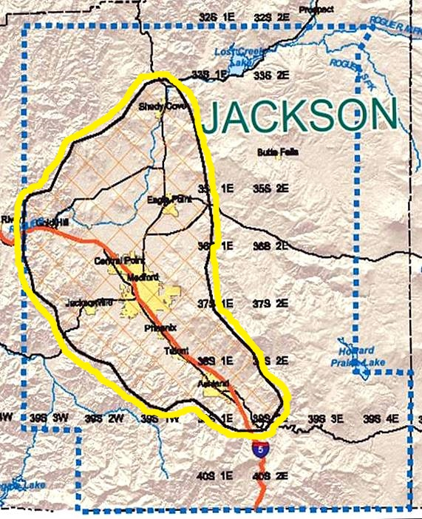
Proposed SPZ changes
Eliminate La Grande SPZ:
No longer needed - AQ levels well below NAAQS
Very little wintertime burning
Reduce Medford SPZ: (see map):
Winter protection still needed
New boundary based on terrain & local “airshed”
Burning outside new boundary will be closely managed on “red days”
MEDFORD SPZ
17

Slide 19
Proposed OSMP changes
Allow ODF to regulate burning outside forest districts, which now fall under DEQ open burning rules. Affects very little burning.
Require smoke monitoring for burning operations over 2000+ tons.
6. Misc ODF rule changes – includes clarification OSMP review will be every 5 yrs, unless both agencies agree to less frequency.
18

Slide 20
Next Steps
No EQC action needed at this time.
Rulemaking to follow:
ODF seeking comment on changes to the OSMP.
DEQ seeking comment on adopting OSMP changes into the SIP.
Joint DEQ/ODF rulemaking/public hearings
ODF/DEQ seek final approval at June 2014 Board of Forestry/EQC meetings.
19

Slide 21
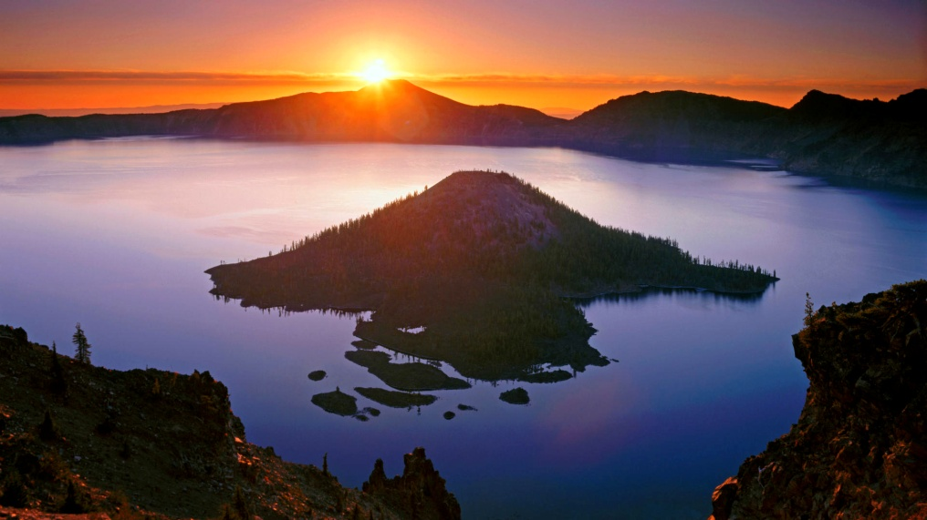
Questions?
20

