Slide 1
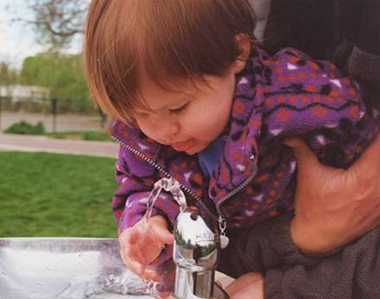
Groundwater the Hidden Resource
EQC Meeting
December 12, 2013
Greg Pettit
Notes:
Let me tell you a little bit about myself so you will know why the Laboratory Administrator is talking to you about Groundwater. From 1986 through 1991 I was the Groundwater Protection Coordinator in the Water Quality Division. And it was during that time we developed and adopted the Administrative Groundwater Quality Protection rules and the Oregon Groundwater Quality protection Act was developed and became law. Our groundwater Quality monitoring programs at Laboratory and Environmental Assessment provide a constant reminder of the extent and magnitude of groundwater contamination and the problems it causes in Oregon.
This presentation is presentation is an update to one given to the EQC in 2010 intended to provide background information to the EQC and our new commissioners
DEQ’s mission is to be a leader in restoring, maintaining, and enhancing the quality of Oregon’s air, land and water
When most people think of water they think of Oregon’s rivers, streams, lakes and coastal waters. Most people don’t think of groundwater, it’s a case of out of site, out of mind.
One of the questions facing the agency and the commission, is how do we prioritize our limited resources to most effectively accomplish our agency mission. While there are many factors to be considered, a priority should be given to the magnitude and extent of risks posed by pollution. Under that criteria, groundwater contamination ranks high.

Slide 2
What I would like you to know about Groundwater Quality
Groundwater is a critical natural resource vital to the public health, economy and environment of Oregon
Groundwater is vulnerable to contamination from a variety of sources and that contamination can ruin it for future beneficial uses
Groundwater contamination creates real health risk or concerns to a significant number of Oregonians
DEQ and EQC are responsible for overseeing the protection of groundwater quality
Programs for preventing, detecting, and remediating groundwater contamination exist and are effective for point sources and spills
As with surface water, programs for preventing, detecting, and remediating groundwater contamination from nonpoint sources are less direct and far more challenging

Slide 3
Presentation Outline
Groundwater Basics
Groundwater Quality in Oregon and Sources of Pollution
Regulatory Processes Mechanisms for Addressing Groundwater Quality
Conclusions

Slide 4
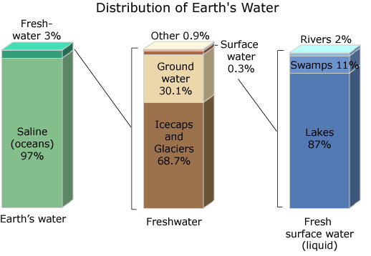
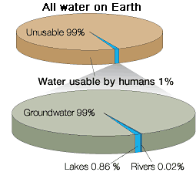
Water usable by Humans
From USGS
Notes:
Only 3% of the worlds water is freshwater
68% of freshwater is locked up in icecaps and glaciers
Only 0.3 percent is surface water
30%, 100 times more is groundwater
Of all the water on earth, only 1% is usable by humans
99% of that 1% is groundwater
Use pointer to illustrate points

Slide 5
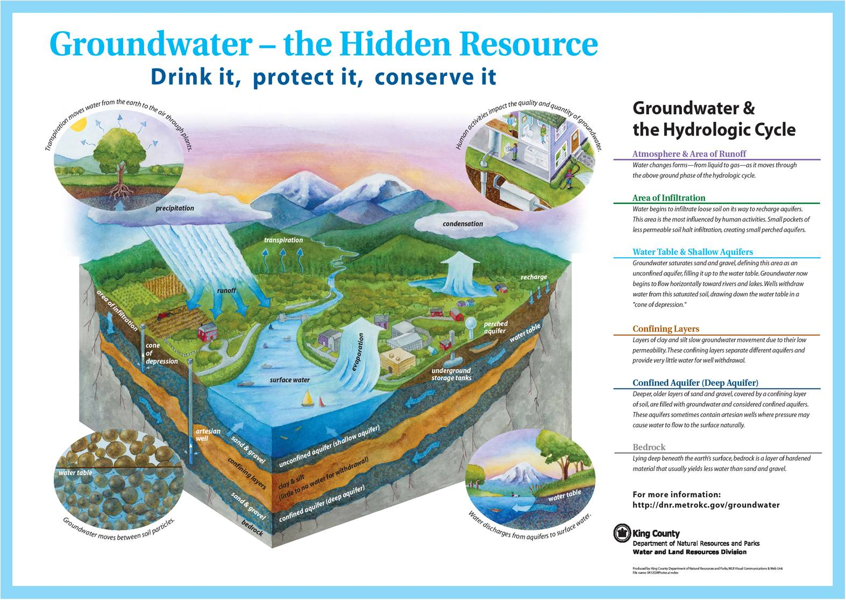
Notes:
Water changes from liquid to gas, moves through the air
Water precipitates as rain or snowfall eventually infiltrating into ground moves through the unsaturated zone and recharges aquifers. This is the zone most influenced by human activities small pockets of less permeable soils halt infiltration creating perched aquifers
Water builds up on more continuous impermeable layers, saturating pores in sand, or gravel or cracks in rock. This creates a unconfined aquifer. Water begins to flow downhill toward rivers, lakes, or wetlands.
Deeper layers of less permeable material separate layers creating confined aquifers

Slide 6
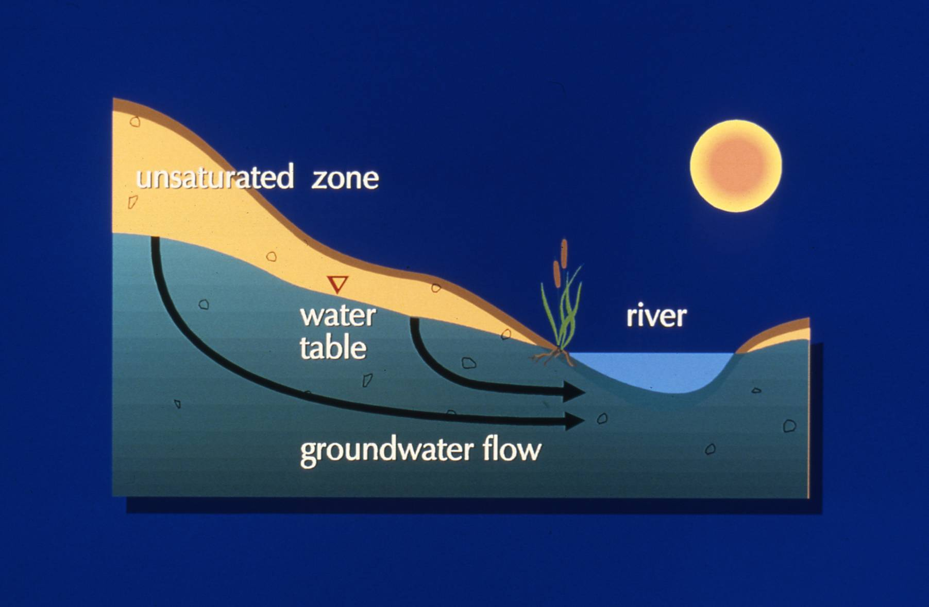
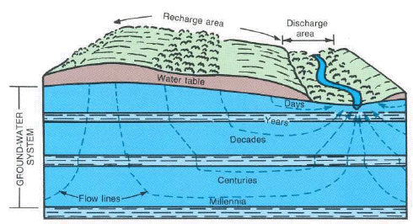
Groundwater Flow
Notes:
Groundwater typically moves very slowly
It moves from recharge areas to discharge areas
This journey can take any where from days to millennia

Slide 7
Why is Groundwater so important to Oregonians
Groundwater makes up 99% of available freshwater resources
Surface water supplies are almost completely allocated so future water needs must be met by groundwater
Drinking water source -over 70% of all Oregonians get their drinking water solely or in part from groundwater
90% of public water supplies get their water from groundwater
700,000+ Rural Oregonians not on public water supplies are almost completely dependent on groundwater

Slide 8
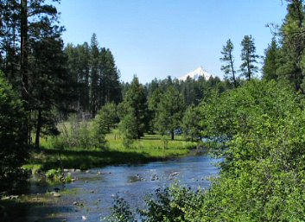
Why is Groundwater so important to Oregonians
Groundwater provides the base flow for rivers, streams, lakes and wetlands
Groundwater is important to maintain stream temperatures that can support cold water fish populations
Groundwater provides critical water supplies for agriculture and for industry including high tech
Notes:
Explain Base Flow
FLIR data confirms temperature significance of groundwater

Slide 9
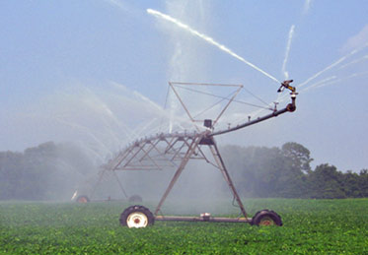
Groundwater Contamination
Groundwater is vulnerable to contamination
Once contaminated groundwater is very difficult , very expensive and sometimes impossible to clean-up
Because groundwater moves slowly contamination may persist for tens, hundreds, or even thousands of years
Notes:
Drill holes in central Oregon

Slide 10
Health Risks from GW contamination
Arsenic – Increased risk of several cancers, skin, peripheral nervous system, gastrointestinal, cardiovascular, and circulatory effect – Primarily naturally occurring contaminant
Nitrate – Methemoglobinemia (Blue Baby Syndrome), increased risk of insulin dependent diabetes, some epidemiological studies indicate increased risk of some cancers and birth defects
Pesticides – Increased risk of Parkinson’s Disease, Cancer

Slide 11
Point Sources of groundwater contamination
Landfills
Wastewater Lagoons
Land application of waste (liquid, biosolids, solids)
Chemical Leaks and Spills
Underground Injection Wells
Underground Storage Tanks
Point source contamination – limited geographical extent, often at higher concentrations, and often in areas where alternative water supplies are available

Slide 12
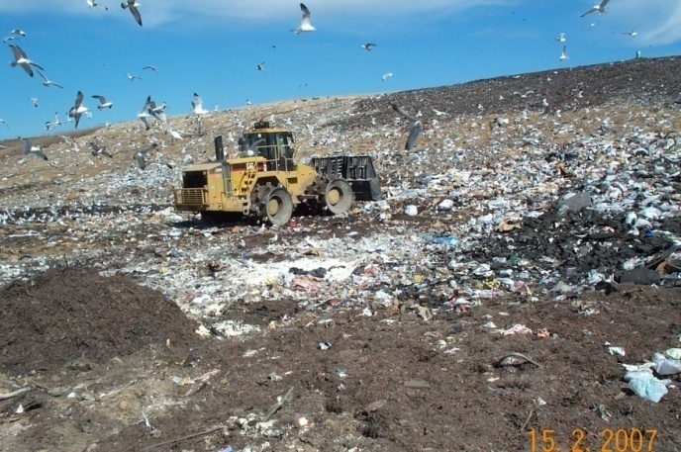
Groundwater Quality – Landfills
17 Monitored industrial landfills
  10 have evidence of groundwater quality impacts
  7 no evidence of groundwater quality impacts
45 Monitored municipal landfills
  34 have evidence of groundwater quality impacts
  11 no evidence of groundwater quality impacts

Slide 13
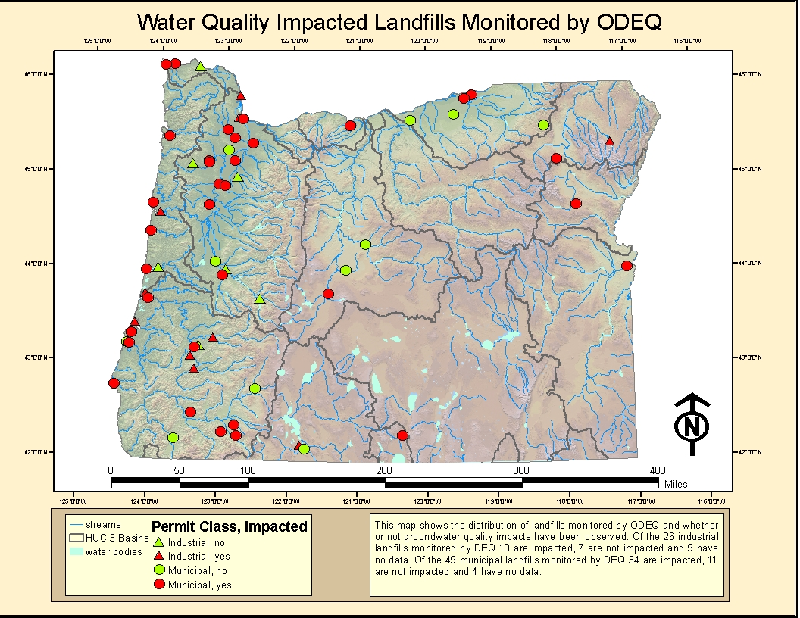

Slide 14
Spills and Leaks (estimates)
Number of sites assessed under the Cleanup program -1929
Number of those sites with groundwater contamination – 1,163
Number of sites with groundwater cleanups underway 369
Number of sites with completed cleanups – 443
Common contaminants at cleanup sites: petroleum, chlorinated solvents, metals
Number of Orphan sites with groundwater cleanups underway - 23

Slide 15
Nonpoint Sources of Groundwater Contamination
Onsite sewage disposal – nitrate, fecal bacteria, pharmaceuticals and personal care products
Agriculture – nitrate (fertilizer, animal waste), pesticides
Affects large areas, often in low concentrations, and often in areas where people are dependent on individual private wells for their water supplies
Notes:
Agriculture includes the use of pesticides, fertilizers and animal waste such as cafo’s
Agriculture activities that impact groundwater are not well regulated

Slide 16
Groundwater Quality Monitoring in Oregon – Early Studies
Regional Groundwater Quality Assessments were conducted from the late 1970’s to approximately 2000
Early Assessments focused on areas of concern about on-site sewage disposal.
  Santa Clara/River Rd (nitrate, fecal coliform)
  Clatsop Plain (nitrate)
  Florence (drinking water protection – nitrate)
  S. Deschutes/Upper Klamath (nitrate)
  East Multnomah County (nitrate, VOCs)
EQC adopted policies and geographic rules to address each of these on-site groundwater quality issues.

Slide 17
Groundwater Quality Monitoring – Ag Chemicals Study
Assessment of Oregon’s Groundwater for Agricultural Chemicals
  1985-1986
  Cooperative study: DEQ, EPA, USGS, OSU, OSHD, WRD, ODA
  380 public and private drinking water wells sampled
  Pesticides detected in drinking water supplies: EDB, DCPA, Bromacil, Dinoseb, Aldicarb, 1,2–dichloropropane
  Nitrate was frequently found to exceed the drinking water standard (10 mg/l) and was found as high as 89 mg/l
  Ultimately provided foundation for the Oregon Groundwater Quality Protection Act of 1989
Notes:
This study provided the foundation for what eventually became the Oregon Groundwater Protection Act of 1989

Slide 18
Groundwater Quality – Regional Assessments
1986 -2000
45 Regional Assessments conducted
Areas selected based on vulnerability to contamination from nonpoint sources
Areas targeted typically 100 to 400 sq miles
20-40 wells drinking water wells sampled per survey

Slide 19
Groundwater Quality – Regional Assessments (Results)
Significant groundwater contamination detected in 35 out of 45 regional assessments
17% of 1010 wells sampled for arsenic exceeded the MCL of 10 parts per billion
16% of 3199 sampled for nitrate exceeded the MCL of 10 parts per million
67% of wells sampled in Malheur County contained the pesticide Dacthal with concentrations up to 32 times the health advisory level
Random sampling indicates 33 % of rural drinking water wells in Willamette Valley contain detectable pesticide contamination with up 15 different pesticides detected
Notes:
Health based criteria have been lowered by EPA
99% drinking water wells

Slide 20
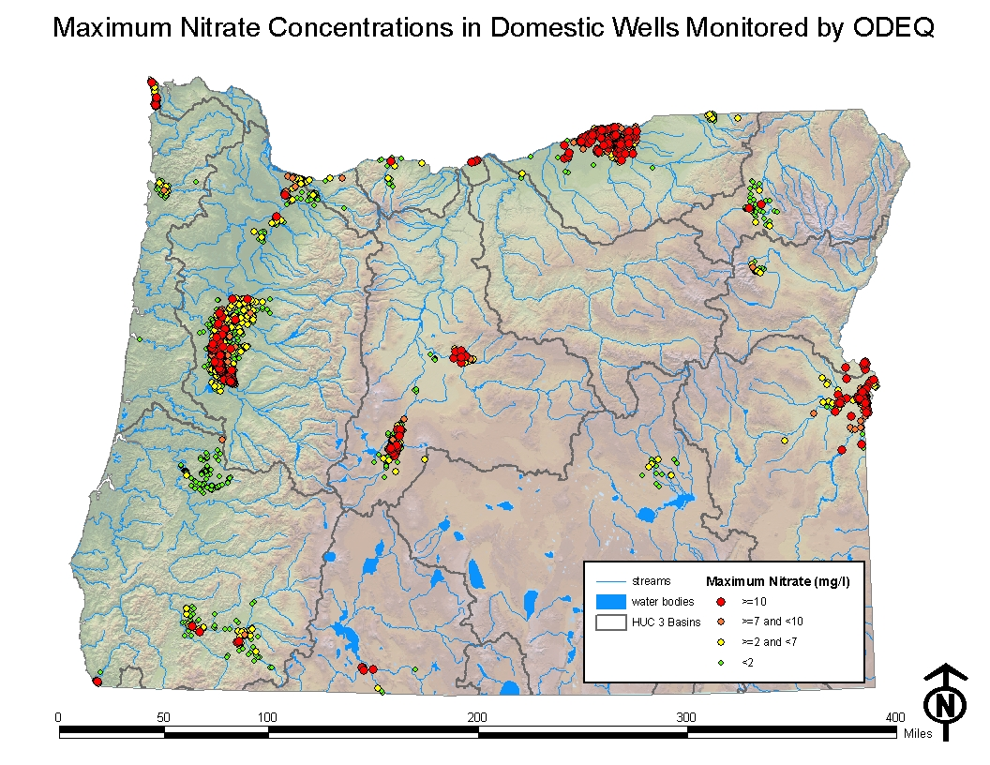

Slide 21
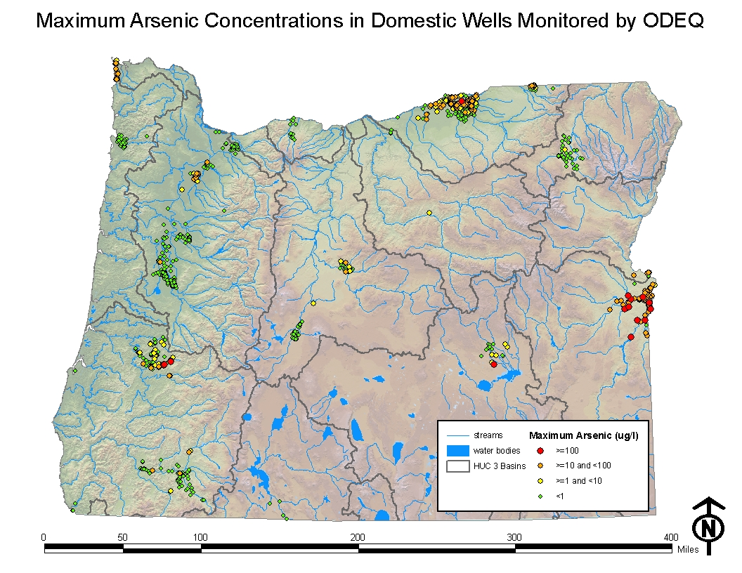
Notes:
Arsenic is primarily naturally occurring
This is really a well owner awareness issue more then a contamination issue

Slide 22
Groundwater Quality – Real Estate Transaction Data
Requirement stems from the Groundwater Quality Protection Act of 1989
Property with domestic well must have well tested at time of property transfer
Originally nitrate and coliform bacteria, arsenic and capability to add region specific analytes added to law in 2009
No real enforcement – voluntary compliance
Notes:
Results must be reported to DHS and buyer within 90 days

Slide 23
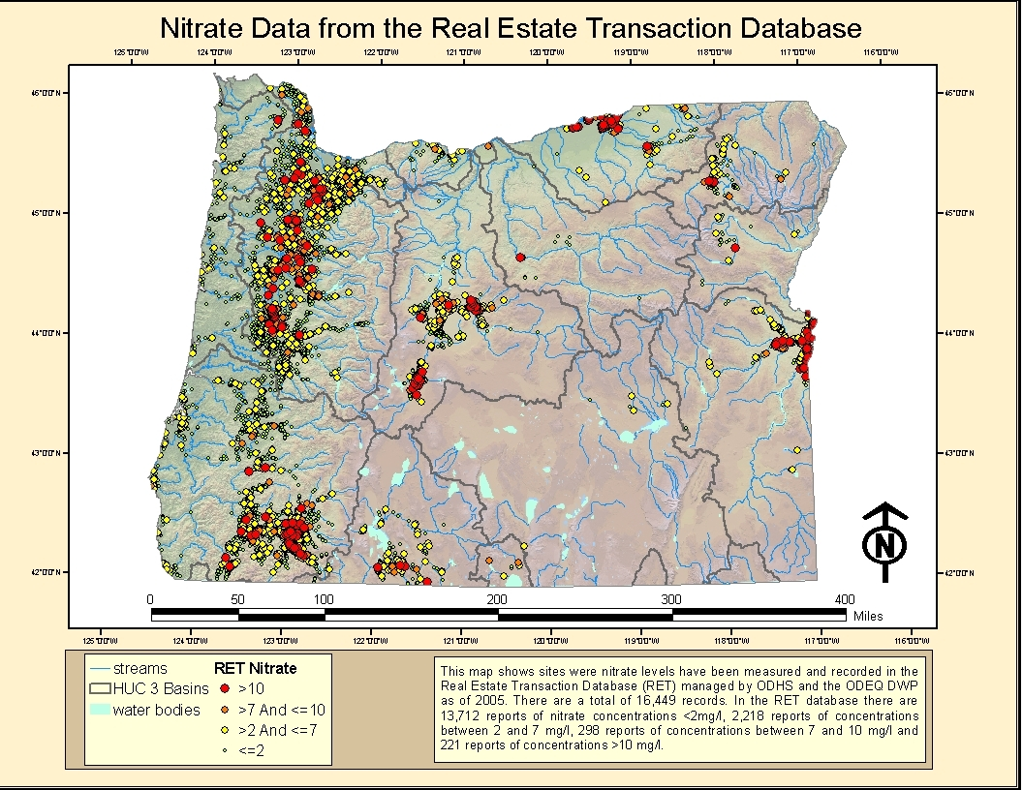

Slide 24
Regulatory Framework - Federal
  CWA – GW included but few protections, no listing requirements, no TMDLs
  RCRA – prevents the release of listed hazardous waste
  CERCLA – Primary federal driver – risk based groundwater clean-up
  SDWA – Public Water Supplies only, source water protection program, Underground Injection Control Program

Slide 25
Regulatory Framework - State
  Groundwater Protection Act of 1989, ORS 468B.150 to ORS468B.190 and others
  Groundwater Quality Protection Oregon Administrative Rule 340-40
  Spill and Clean-up Laws; ORS 466.605 et.seq, OAR 340-122, ORS465.200 et. Seq. and OAR 340-142
  Underground Injection Control Program OAR 340
  Division 44
  Handout - History of Oregon Groundwater Protection

Slide 26
Oregon Groundwater Protection Act of 1989
Developed to address increasing evidence of non-point source gr0undwater contamination
Consensus legislation
  Farm Bureau
  Most agricultural groups
  Oregonians for Food and Shelter
  Environmental groups
State Agencies (ODA, WRD, OHA, DEQ) Focused on prevention of contamination
Notes:
We currently do not have any Groundwater Areas of Concern, but we do have several areas that would certainly fit the criteria

Slide 27
Oregon Groundwater Protection Act of 1989
Goal – “To prevent contamination of groundwater while striving to conserve this resource and to maintain the high quality of Oregon’s groundwater resource for present and future beneficial uses.”
How is this accomplished?
  Public education
  Requires all state programs be consistent
  Statewide groundwater quality monitoring and assessment
  Prevent groundwater contamination through the use of Best Management Practices (BMPs)
  Set levels for contaminants to trigger response actions
  Protect groundwater quality to allow present and future beneficial uses

Slide 28
Groundwater Protection Act of 1989
Maximum Measurable Levels of Contaminants in Groundwater
Groundwater Management Areas (GWMA)
Groundwater Areas of Concern
Funding provided was sufficient to implement two GWMAs and statewide groundwater quality monitoring program
Notes:
Many areas of the state could be GWAC but currently are not due to lack of funds to implement programs.

Slide 29
Groundwater Quality Protection Rules (OAR 340-040)
Establish mandatory minimum groundwater quality protection requirements
Clean-up program exempted
Policies
  Because of difficulty of clean-up anti-degradation policy
  All groundwater protected whether currently used or not
  Point sources use highest and best practical methods

Slide 30
Groundwater Quality Protection Rules (OAR 340-040)
Groundwater monitoring requirements for permitted sources
Process for setting concentration limits for compliance points
Concentration limit variance process (alternative concentration limit)
Remedial investigation and feasibility study
Selection of remedial action
Notes:
Also includes : non-permitted activities, on-site sewage disposal, wellhead protection rules, standards

Slide 31
Current Activities
Funding for implementation of groundwater program has been reduced several times since the mid 1990’s
DEQ current work limited to three GWMAs:
  Northern Malheur County – Nitrates, (Dacthal)
  Lower Umatilla Basin – Nitrates
  Southern Willamette Valley – Nitrates
Developing Statewide Ambient Groundwater Quality Monitoring – New Funding 2013 LAB
Integrated Water Resource Strategy Implementation
Pesticide Stewardship Partnerships

Slide 32
Groundwater Management Areas
(GWMA)
Oregon’s Groundwater Protection Act requires DEQ to declare a GWMA if groundwater contamination (resulting from nonpoint source activities) exceeds certain trigger levels.
In most cases, the trigger level is 50% of a federal drinking water standard.
In the case of nitrate, the trigger level is 70% of the 10 ppm federal drinking water standard (i.e., 7 ppm).

Slide 33
How Does an Oregon GWMA Work?
An Action Plan is developed by a local Citizen Advisory Committee with DEQ and ODA oversight.
The Action Plan details a voluntary program led by a “lead agency”.
The goal of the plan is to reduce nitrate to less than 7 mg/l.
If the goal is not met, regulatory measures may be considered.

Slide 34
How Does an Oregon GWMA Work?
GWMA’s use monitoring and research to implement adaptive management
Making Improvements is a slow process because:
  Developing and proving BMPs takes time
  Groundwater moves slow and it may take decades to see improvements

Slide 35
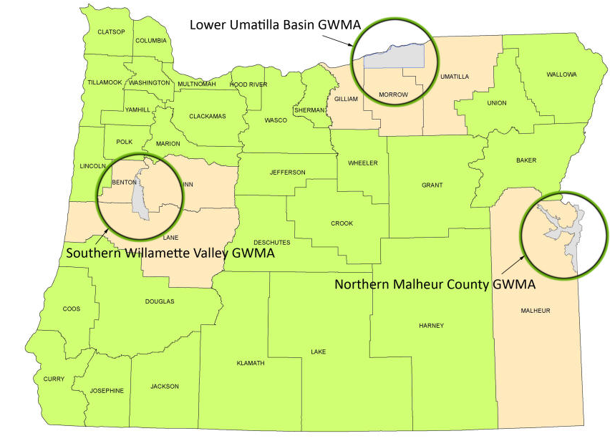
Oregon's Groundwater Management Areas
Notes:
Northern Malheur County Declared in 1989
Lower Umatilla Basin Declared in 1990
Southern Willamette Valley declared in 2004

Slide 36
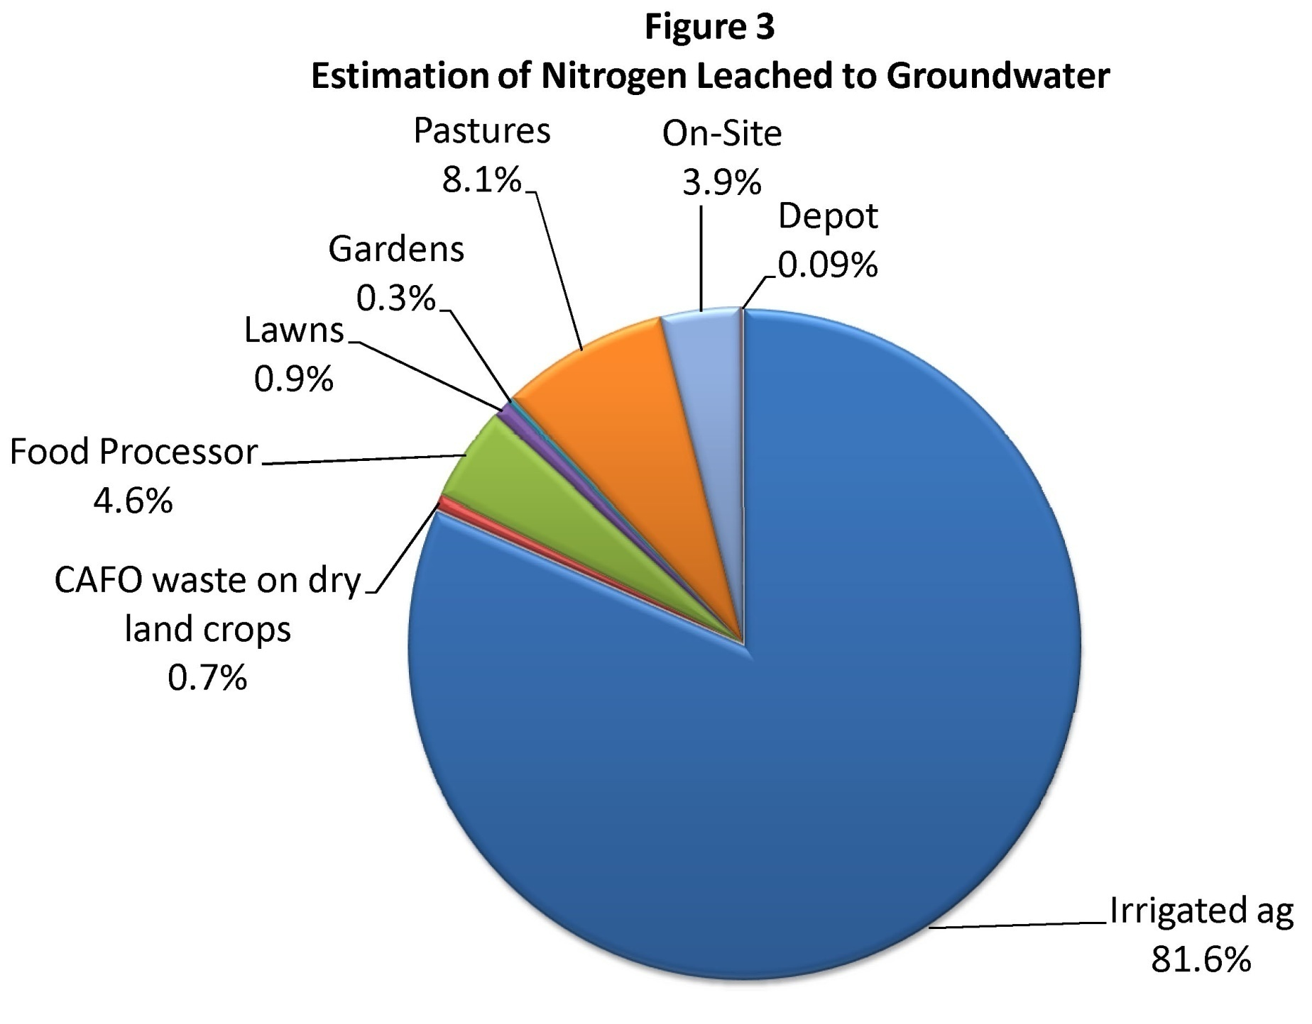
Source of Nitrogen
All three GWMAs – Primarily Agriculture

Slide 37
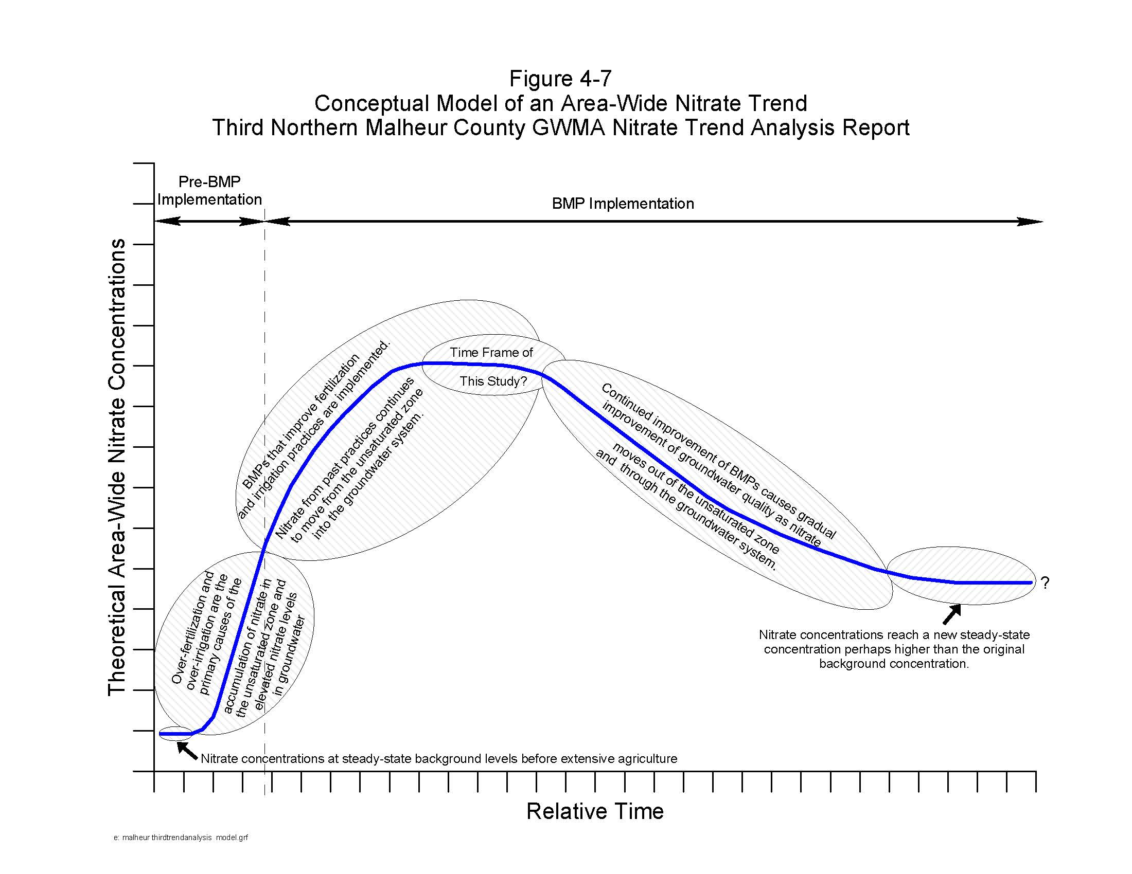

Slide 38
Northern Malheur County GWMA
Nitrate concentrations are decreasing (improving trends)
Credit goes to OSU Experiment Station, OSU Extension, SWCD, Watershed Councils, and the local growers
They have developed and promoted BMPs to reduce nitrate loss to groundwater
  Soil testing for residual nitrogen
  Reduced fall fertilization
  Decreased use of side dressing
  Less nitrogen applied via irrigation water
  Total nitrogen applications reduced by 9.5%

Slide 39
Lower Umatilla Basin
Area-wide nitrate trend is consistently increasing
Irrigated agriculture is largest potential source of nitrogen
The LUB GWMA Committee approved:
the Nitrogen Loading Estimate
the Third Food Processor Trend Analysis
the Analysis of Groundwater Nitrate Concentrations
the Third Evaluation of Action Plan Success
The LUB GWMA Committee is currently working on
  the next Action Plan
  an Outreach / Communications Plan

Slide 40
Southern Willamette Valley GWMA
Newest GWMA so less time for results
Nitrate concentrations trending down
Primary source of nitrate is agricultural use of fertilizers
Action Plan addressing
  CAFOs
  Onsite
  Ag BMPs
  Residential use of fertilizers

Slide 41
GWMAs - Common Elements for Successf
Engage stakeholders early and maintain their interest
                Identify key research needs early and pursue vigorously
Cooperative research (Malheur Experiment Station, RARE project SWV GWMA)
Emphasize public education and sharing
  Recent well attended workshops LUB and SWV
  Schools (400 children each year educated in SWV through partners in public education)
  Clean water festivals , Rural living basics class,)
Use water and fertilizer more efficiently

Slide 42
Conclusions
Groundwater is a critical natural resource and needed to meet present and future water needs
Groundwater contamination is expensive, difficult and sometimes impossible to remove and can ruin groundwater for future beneficial uses
DEQ and EQC are responsible for overseeing the protection of groundwater quality
Groundwater contamination is found in vulnerable areas throughout the state

Slide 43
Conclusions
Groundwater is the primary source of drinking water for the majority of Oregonians
Private domestic wells are the most vulnerable to contamination and the least likely to be tested thus exposing their owners to unknown risk
Groundwater contamination is a significant health risk
We have effective regulatory programs for preventing contamination from point sources, spills, and leaks; those programs includes assurances of contamination detection and processes for remediation

Slide 44
Conclusions
Nonpoint source contamination represents the biggest risks to the public because of the area affected and size of population exposed to contaminated drinking water
The processes for reducing nonpoint source contamination of groundwater are less effective as they also are for surface water
The GWMA process is showing positive results, given the limited resources available there is lot of work to reduce contamination occurring in all three GWMAs
There are many areas of the state with significant contamination that are not being addressed due to lack of money to implement program and inadequate regulatory drivers
DEQ is the authorized agency to take the lead for these issues.
Notes:
Improving trends in two

Slide 45

Visit the DEQ website for more information on groundwater Quality
Go to DEQ –WQ- Groundwater Program for more info
http://www.deq.state.or.us/wq/groundwater/groundwater.htm

