Slide 1
Temporary Rulemaking Proposal:
Oregon Clean Fuels Program
Environmental Quality Commission
December 11, 2013
Cory-Ann Wind
Air Quality Planning

Slide 2
Proposed Rule Changes
Objective - To make the Oregon Clean Fuels Program more efficient by eliminating requirements that:
are unnecessary at this point in the program and
can reduce the burden on smaller businesses participating in the program.
Proposed temporary rule amendments in December 2013
Proposed permanent rule amendments in June 2014

Slide 3
Status of Program
Adopt Phase 1
Registration
Recordkeeping
Reporting
Defer Phase 2
Carbon Intensity Standards
Generation of Credits and Deficits
Fuel Supply and Price Deferrals

Slide 4
Salem
> 90% via Olympic Pipeline

Slide 5
Phase 1 Outreach
All ODOT Licensed Fuel Suppliers, ODEQ Greenhouse Reporters & ODEQ Certified Transporters - 284 Surveyed
220 Not Regulated: Purchase fuels in-state Exempt fuels | 2 Oregon Producers: Corn ethanol Used cooking oil biodiesel | 62 Importers: Terminals Bulk plants Distributors Marketers

Slide 6
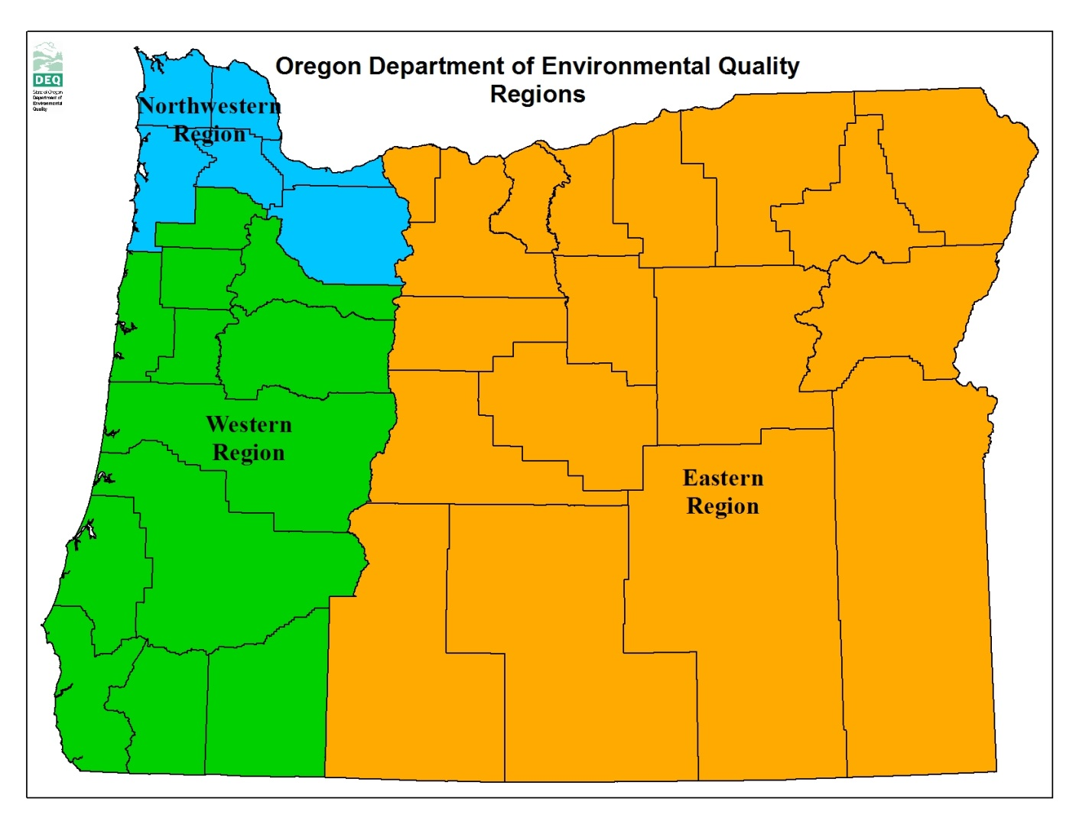
Umatilla
Portland
Eugene
Ontario
Bend
NWR - 32
ER - 25
Medford
WR - 7

Slide 7
Phase 1 Implementation
Registration – beginning January 1, 2013
Company Information
Fuel Types
Recordkeeping – beginning July 1, 2013
Product Transfer Documents
Fuel Types & Volumes
Reporting
Annual Report – due April 30, 2014
Quarterly Report – first one due May 31, 2014
Approval of Carbon Intensity Values

Slide 8
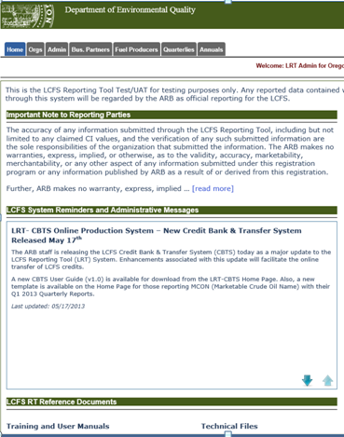
Oregon Clean Fuels Program
Reporting Tool
Adopt California’s Low Carbon Fuel Standard Reporting Tool
Web-based
Customized for Oregon’s program

Slide 9
Building a More Efficient Program
Recordkeeping Requirements
Initial Importers
Alignment with Compliance Tools
Assigning New Carbon Intensity Values
Update Definitions

Slide 10
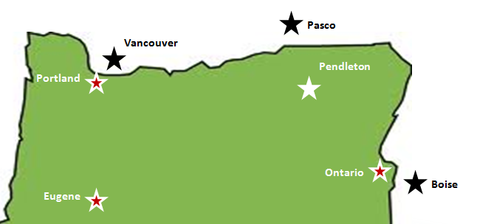

Importer of Finished Fuels

Slide 11
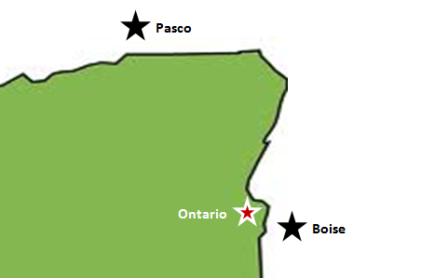

Importer of Blendstocks
Vancouver
Portland
Eugene

Slide 12

Proposed Rule Change:
Recordkeeping Requirements
Parameter | Small Importers of Finished Fuels
# of companies | 13
%age of total fuel | < 1%
Individual carbon intensity value | exempt
Large Importers of Finished Fuels
32
14%
exempt (default)
Oregon Producers & Importers of Blendstocks
19
85%

Slide 13
2. Proposed Rule Change: Initial Importers
Transporter
Retail Station
Bulk Plant
All recordkeeping and reporting retained by the initial importer
Initial importer

Slide 14
3. Proposed Rules: Alignment with Compliance Tools
Registration form
Recordkeeping template
Web-based reporting tool

Slide 15
4. Proposed Rules:
Assigning New Carbon Intensity Values
Fuel Type | Carbon Intensity Value (gCO2e/MJ)
Blended gasoline (E10) | 89.59
Blended diesel (B5) | 87.95
Clear gasoline | 92.34
Clear diesel | 91.53
Ethanol from corn (dry mill, coal) | 92.46

Slide 16
5. Proposed Rules: Update Definitions
Amends | Removes | Adds
Biomass-based diesel | Actual PADD5 | Physical pathway
Blendstock | Large Oregon importer
Fuel pathway | Statutory PADD5
Import
Importer
Oregon producer
Criteria for exempt status

Slide 17
What Comes Next
Legislative Action
Decision about sunset
Consider Phase 2
Fuels availability assessment
Economic analysis
Phase 2 Rulemaking
Modify program design
Fiscal and economic impact
EQC Consideration

Slide 18


