Slide 1

Air Quality Program
Proposed Permanent
Colored Art Glass Manufacturing (CAGM) Rules
Sept. 29, 2016
Jaclyn Palermo and George Davis | Oregon Department of Environmental Quality
Notes:
(1 min.)
Good morning Chair O’Keeffe, Commissioners, my name is Jaclyn Palermo and I manage the Air Quality Operations Section at the Department of Environmental Quality.
With me today is George Davis, engineer and senior permit writer for DEQ’s northwest region. David Farrer from Oregon Health Authority is also here and will be able to answer any toxicology related \. Feel free to ask \ questions during the presentation. We left room at the end of the presentation for the three of us to answer your questions.
We are here today to present to you a proposal for permanant rules that would apply to colored art glass manufacturers.
We proposed rules temporary glass rules at the Commission’s meeting on April 21 2016, which the Commission adopted. We are here today to present the proposed rules, which would replace the temporary rules and make the requirements permanent. If no action is taken, the temporary rules will expire on Oct. 18, 2016.

Slide 2
Outline of Today’s Presentation
Brief history
Summary of public comments
Summary of changes from the temporary art glass rules
Recommendations
Notes:
(1 min.)
Here is an outline of what we will discuss today.
First we will provide you with a brief refresher of the history of the temporary glass rulemaking.
Then we will discuss the comment process for this proposed rule as well as the nature and categorization of the public comments received;
Next we will walk you through the proposed rule and the changes from the temporary glass rulemaking adopted in April 2016; along with the rationale for making the changes.
Finally, we will make our recommendation to you.

Slide 3
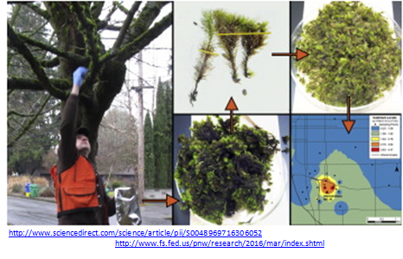
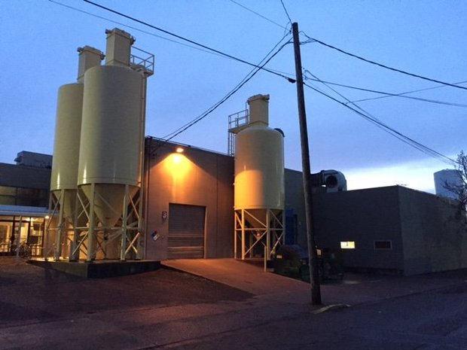
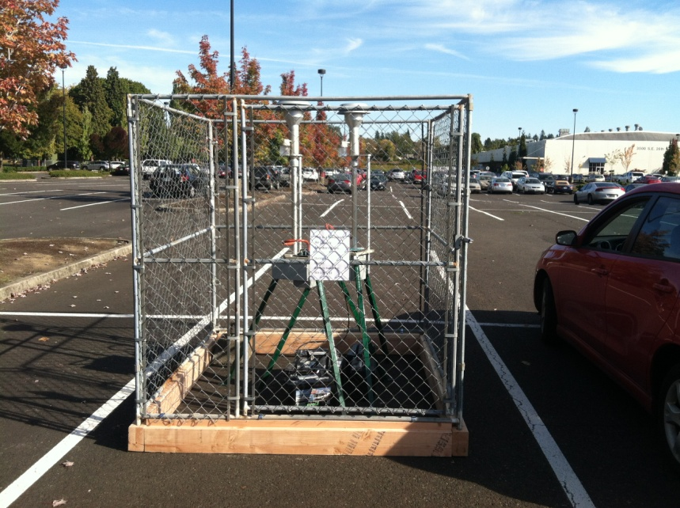
History
Glass facility
DEQ Monitor
Notes:
(1 min.)
I give an abridged history of this proposed rule. George will then give the technical basis and rationale.
Elevated levels of hazardous air pollutants were found in the air around two glass manufacturing facilities in Portland. After a moss study and subsequent air monitoring in October 2015, DEQ confirmed that a glass company was the likely source. DEQ also identified a second area of concern near a glass company in North Portland.
The glass companies were operating in compliance with the current laws at the time. To address this regulatory gap and the elevated levels of hazardous air pollutants, DEQ proposed an art glass manufacturing temporary rulemaking, which was approved on April 21, 2016.

Slide 4
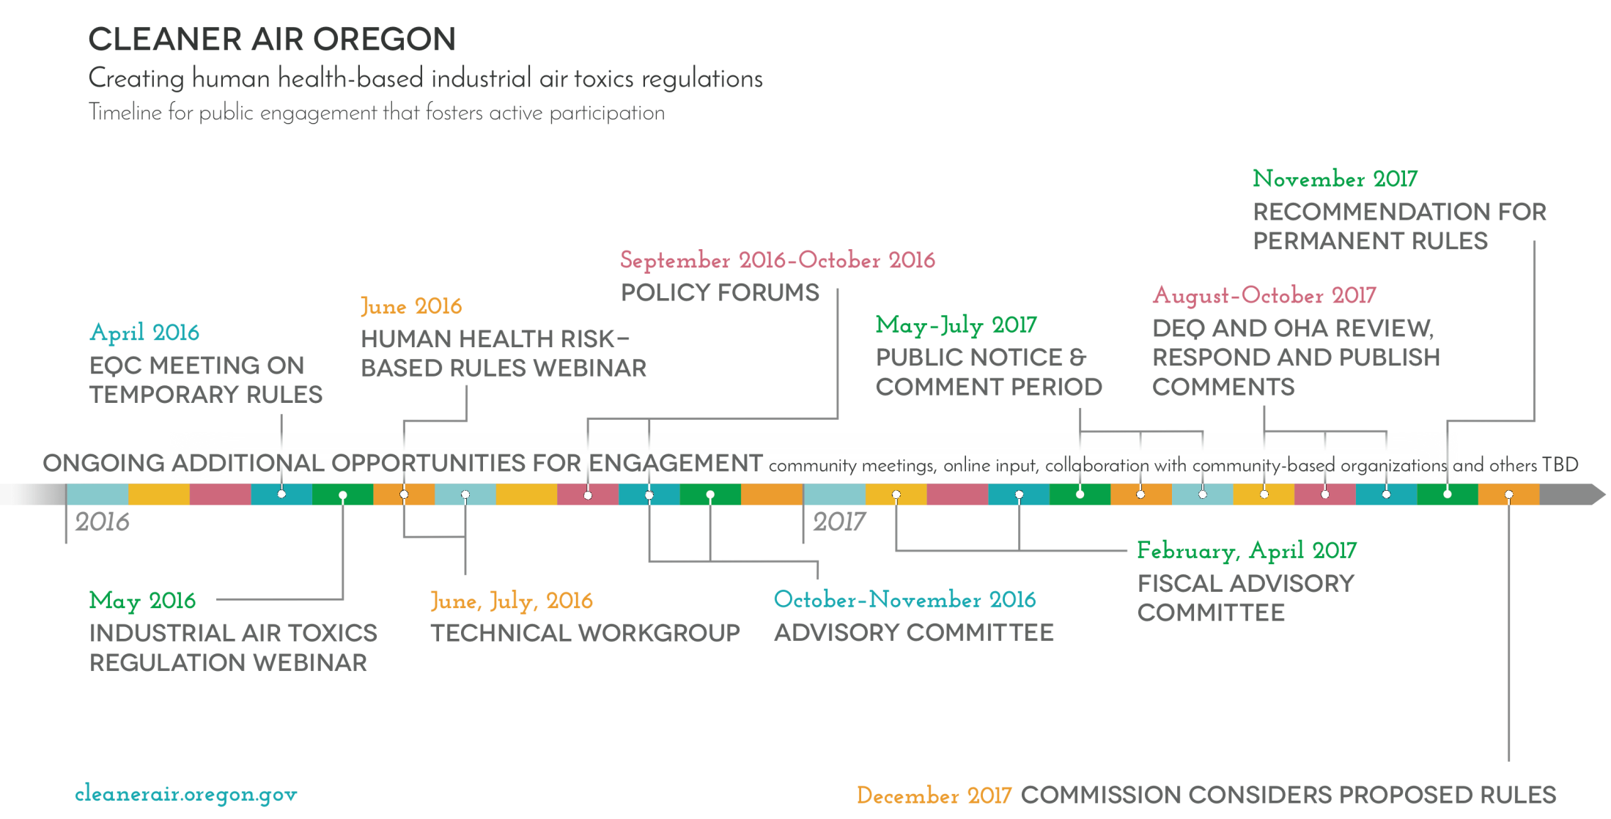
History continued
Proposed Permanant Art Glass Rulemaking:
Improve on and memorialize the temporary art glass rulemaking, and make it permanent to address the regulatory gap and elevated levels of hazardous air pollutants from art glass manufactures.
Cleaner Air Oregon Regulatory Reform:
An initiative to reform industrial air toxics regulations and align them with public health.
Notes:
(1 min.)
The intended scope of the temporary and this proposed rulemaking is worth noting.
The temporary rules were designed to address emissions solely from colored art glass manufacturers and was not intended to address industrial toxics from other sources. In order to do that, we need more time and a much larger stakeholder and public involvement process, otherwise known as the Cleaner Air Oregon regulatory reform.
The purpose of this proposed permanent rulemaking is to improve on the temporary art glass manufacturing rulemaking.

Slide 5
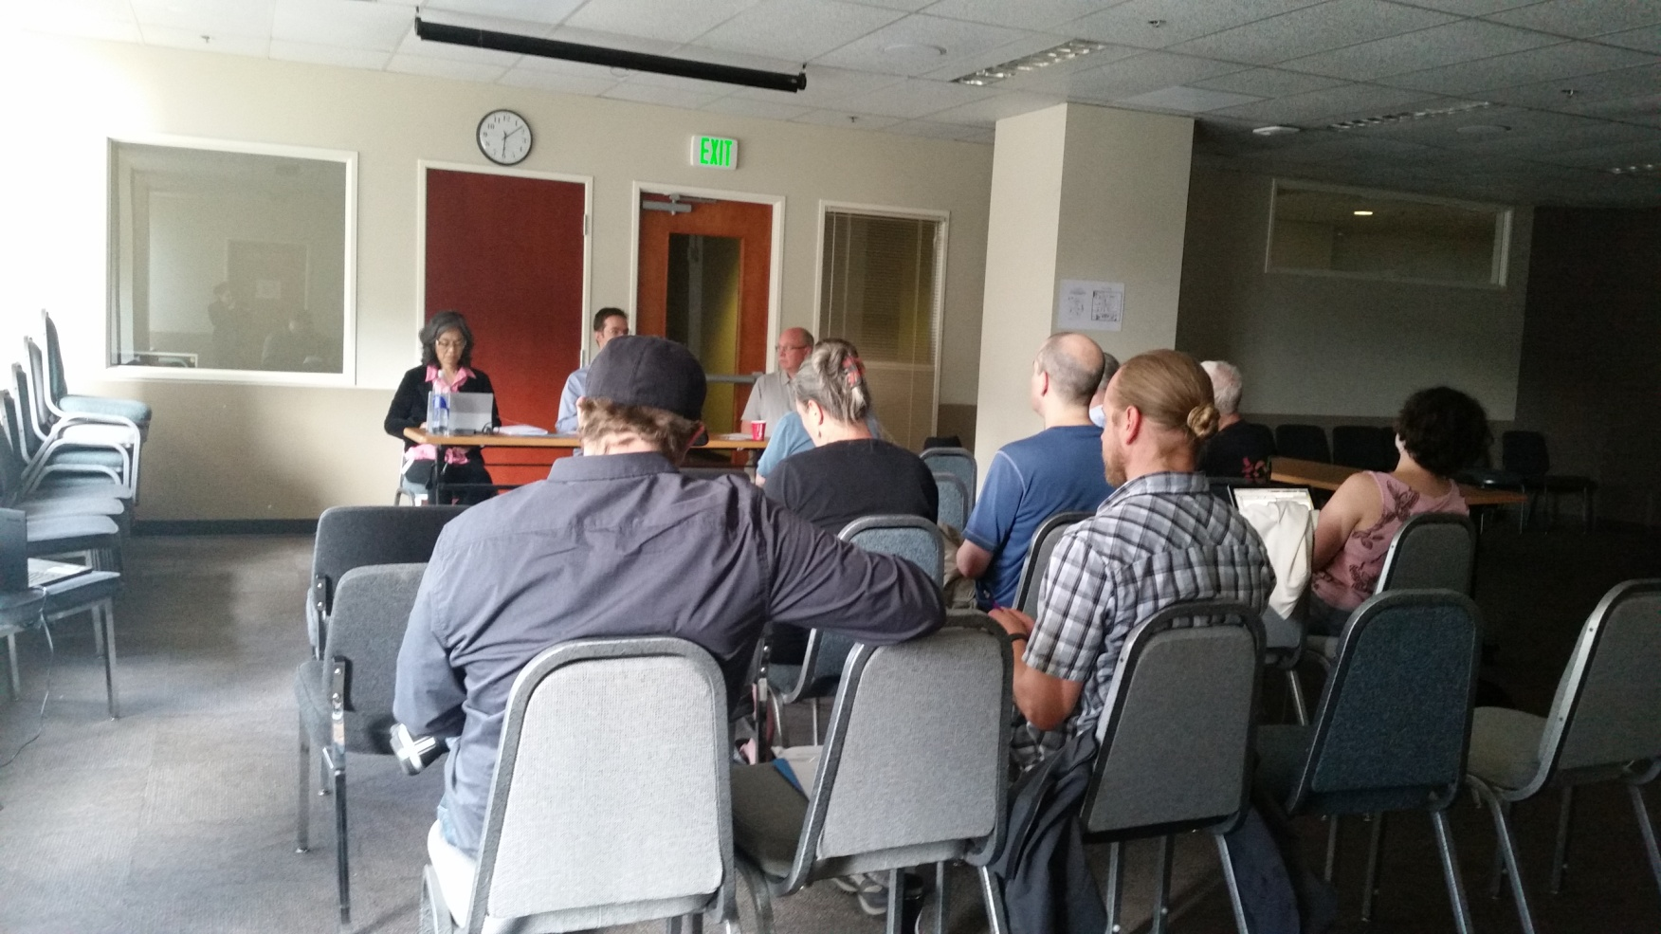
Public Comment
Public Notice Questions
Should the rule be modified to apply to sources that make less than 10 tons per year of colored art glass?
Should the rule be modified to apply statewide, rather than only in the Portland Air Quality Maintenance Area?
The temporary rule requires control devices be shown to capture at least 99.0 percent of incoming particulate matter. Should that standard be replaced with one based on the particulate matter at the outlet of the control device?
July 19, 2016 public hearing
Notes:
(1 min.)
In addition to holding two fiscal committee meetings, DEQ held a public hearing on July 19, 2016 and accepted public comments from June 15, 2016 thru July 29, 2016.
DEQ’s public notice for this rulemaking included proposed rule language that was unchanged from the temporary rule, along with a request from DEQ for comments on several possible changes that were identified during the fiscal committee meetings. The three questions that were included in the public notice were:
Should the rule be modified to apply to sources that make less than 10 tons per year of colored art glass?
Should the rule be modified to apply statewide, rather than only in the Portland Air Quality Maintenance Area?
Should the test to show that the control device is working properly be changed from the 99.0% control efficiency test to another method or methods that can also show the control device is working properly?

Slide 6



Public Comment continued
41% From Oregon
136 commenters, which includes businesses & organizations
47% elsewhere in the US
7% outside of the US
Notes:
This is a high level depiction of the public comments.
DEQ received 151 comments from the 136 individuals and organizations.
41% of the commenters were from Oregon
54% were from parties outside of Oregon
5% of the commenters did not state where they reside.
As you can imagine, there are many perspectives expressed by those comments. Each of the changes in this proposed rule were all informed by public comments.
We consider all of the comments we receive, no matter how many people made the comment.

Slide 7
Public Comment continued
 | 10 Categories | 60 Subcategories
151 comments by 136 commenters, organized into 10 categories and 60 subcategories | Rule Applicability | 10
 | Enforcement | 2
 | General Rulemaking | 4
 | Health | 7
 | Other Pollution Sources | 2
 | Permitting | 2
 | Pollution Control Devices | 7
 | Public Outreach | 6
 | Rule Requirements | 14
 | Source Testing | 6
Notes:
(1 min.)
To review and respond effectively, we have organized the comments into the above 10 categories and further into 60 subcategories and that is also how we responded to them. Therefore you’ll see in your materials that we have 60 responses to comments.
In this proposed permanant rule, we have included some aspects of a human health and risk based program and are also using some aspects of a technology based program. You’ll hear more about those as we go through some of the changes we made in response to comments. You will now hear from George Davis. He will be discussing the changes and the associated rationale.

Slide 8
TEMPORARY RULES | PROPOSED PERMANENT RULES
(1) Rules applied at 10 tons per year of glass using glassmaking HAPs | Apply at 5 tons per year
(2) Rules applied in Portland AQMA only | Apply statewide
(3), (5) and (7) Test to show 99.0% particulate matter (PM) control efficiency (Tier 2) Test chromium at control device inlet; calculate chromium emissions using PM control efficiency | Test to show 0.005 gr/dscf; Install bag leak detection system; Install HEPA afterfilter (Tier 2) Test chromium emissions at Control device outlet
(4) Arsenic, cadmium, chromium, lead, manganese, nickel | Add selenium
(6) Set 24-hr health benchmark for chromium VI to 36 nanograms per cubic meter | 5 nanograms per cubic meter
(8) No compliance extensions | Compliance extensions to install emission controls; up to 1 year Tier 1
Notes:
Thank you, Jaclyn.
Chair O’Keefe, Commissioners,
This slide summarizes the most significant differences between the proposed permanent glassmaking rules and the temporary rules. All of the changes are based on comments that were received during the public comment period.
Eight changes are listed on pages 3 and 4 in the staff report, but the third, fifth and seventh changes are closely related so they’ve been combined for this presentation. The numbers in the first column correspond to the list in the staff report. I’ll quickly go down the list, and will then provide more information on each item in the following slides.
Change the rule applicability threshold from 10 tons per year of glass to 5 tons per year.
Make the rules apply statewide instead of only in the Portland area.
(3), (5) and (7) Replace the 99.0% particulate matter control efficiency test with three other options, and test for chromium emissions at the control device outlet instead of at the inlet.
(4) Add selenium to the list of glassmaking hazardous air pollutants regulated under this rule.
(6) Lower the 24-hour health benchmark for chromium VI from 36 ng/m3 to 5 ng/m3.
(8) Allow Tier 1 facilities to request compliance extensions of up to 1 year for reasons beyond their control.
In addition to the more significant changes listed here, a number of other changes were made, such as giving facilities outside the Portland area additional time to comply with the rules, to help clarify parts of the rules that some people found confusing, and for general housekeeping.

Slide 9
Temporary rule requirements
Tier 1 (smaller) | Tier 2 (larger)
Three options: Install emission controls; or Test/model to show exempt; or Permit limit prohibiting use of one or more glassmaking HAPs | Install emission controls Limit chromium usage Test/model to establish chromium usage limits
Test emission control device to show 99.0 percent particulate matter (PM) control efficiency
George Davis and Jaclyn Palermo | Oregon Department of Environmental Quality
Notes:
Some of the proposed changes are relatively straightforward, but for others we believe it will be helpful to review parts of the temporary rule to put the changes into context.
The temporary colored art glass manufacturer rules were intended to regulate 5 colored art glass manufacturing facilities in the Portland area. The five facilities were split into two tiers based on how much glass they made and the type of glassmaking furnaces they used.
The 3 smaller Tier 1 facilities were given three compliance options: install emission controls; or do emissions testing and modeling to demonstrate that the ambient impacts of their emissions were below specified protective levels; or request permit prohibitions on the use of one or more of the glassmaking hazardous air pollutants.
The 2 larger Tier 2 facilities were required to install emission controls, and the rules required that usage limits be established for the use of chromium. Associated with the chromium usage limitation was a requirement to perform emissions testing and modeling to determine the chromium usage limit.
Both Tiers were required to test their emission control devices and show that the emissions controls could meet a 99.0 % control efficiency.

Slide 10
Items (3), (5) and (7)
Tier 1 (smaller) | Tier 2 (larger)
Three options: Install emission controls; or Test/model to show exempt; or Permit limit prohibiting use of one or more glassmaking HAPs | Install emission controls Limit chromium usage Test/model to establish chromium usage limits
Test emission control device to show 99.0 percent particulate matter (PM) control efficiency
George Davis and Jaclyn Palermo | Oregon Department of Environmental Quality
Notes:
The changes listed as 3, 5 and 7 in the staff report are all related to the two parts of the temporary rules shown in bold text on this slide, and these items require the most explanation, so I’d like to start with them. I’ll then cover the remaining items.
Testing for chromium and for control device efficiency, are linked together and were put into the temporary rules for particular reasons. We’ve learned some things since the temporary rules were adopted, and based on what we’ve learned, DEQ is proposing changes.
In the next few slides, I’ll explain how and why these items were linked, and what changes DEQ is proposing.

Slide 11
Link between Cr VI and PM control efficiency
Oct. 2015 ambient data showed high
total chromium – did not include Cr VI
Question: How much Cr emitted as Cr VI?
Test for Cr VI
Test at inlet
Doesn’t give Cr VI emissions
George Davis and Jaclyn Palermo | Oregon Department of Environmental Quality
Notes:
When the temporary rules were proposed, the only ambient data DEQ had near a glassmaking facility was from monitoring in SE Portland in October of 2015.
This data included ambient total chromium levels, but it did not include ambient Cr VI levels. As you know, Cr VI is the toxic form of chromium, so there was a lot of interest in figuring out how much of the chromium being emitted was in the Cr VI form.
This led to a requirement to do an emission test for Cr VI. To help ensure that a large enough sample would be obtained to give a good analytical result, the rules required that the test samples be taken at the baghouse inlet. This was done because the concentration of pollutants is higher at the baghouse inlet, before any filtration has occurred.
However, testing at the baghouse inlet doesn’t tell us how much Cr VI is being emitted. To answer that question, one alternative was to also require Cr VI testing at the baghouse outlet. Another alternative was to use the baghouse control efficiency to calculate the Cr VI emissions. Chromium VI testing is difficult and expensive, so the temporary rules used the second alternative.

Slide 12
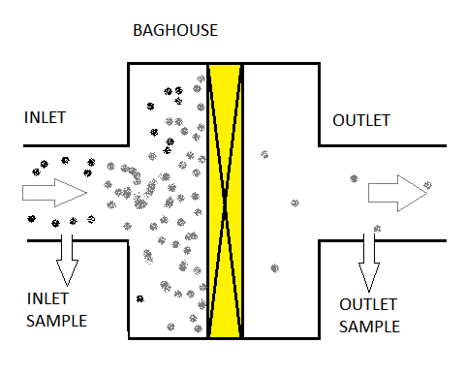
Control efficiency
CE = Amt_{IN} - Amt_{OUT}
Amt_{IN}
George Davis and Jaclyn Palermo | Oregon Department of Environmental Quality
Notes:
This is a general illustration of a baghouse. The yellow area represents the filters inside the baghouse. Dusty air enters at the inlet, gets filtered, and the filtered air exits from the outlet.
Control efficiency, or CE, is calculated as the amount of pollutant coming into the baghouse minus the amount of pollutant leaving at the outlet, divided by the amount coming in. To calculate control efficiency, it’s necessary to test at both the inlet and outlet.

Slide 13
Algebra and assumption
Eqn 1: CE = Amt_{IN} - Amt_{OUT}
Amt_{IN}
Eqn. 2: Amt_{OUT} = Amt_{IN} x (1 – CE)
Test PM in and out, calculate CE for PM
Assume CE for chromium = CE for PM
If we know Amt_{IN} for chromium
Can use CE for PM to calculate Amt_{OUT}
for chromium using Eqn. 2
George Davis and Jaclyn Palermo | Oregon Department of Environmental Quality
Notes:
The equation for control efficiency from the previous slide is shown on this slide as equation 1.
With a little algebra, equation 1 can be rearranged to give equation 2. Using this equation, if we know the amount of pollutant coming into the baghouse and the control efficiency, we can calculate the amount of pollutant being emitted.
The temporary rules made use of equation 2 and the assumption that the control efficiency for chromium is the same as the control efficiency for particulate matter. Using the simpler particulate matter testing at the inlet and outlet, the control efficiency, CE, could be calculated. The facility could then do the more difficult chromium VI testing only at the baghouse inlet to determine the amount in, and then use equation 2 to calculate the chromium VI emission rate.
This is one of two reasons for requiring the particulate matter control efficiency test. The other reason for the control efficiency test is to indicate that the baghouse is performing as it’s supposed to.

Slide 14
Lessons learned, changes
Bullseye performed test this year
  Indicated that 100% of Cr emitted as Cr VI
  Indicated CE for chromium < CE for particulate matter
Use simpler test for chromium, assume 100% is Cr VI
Test at outlet → Direct measure of emissions
No longer need PM control efficiency to calculate Cr VI emissions
George Davis and Jaclyn Palermo | Oregon Department of Environmental Quality
Notes:
Bullseye performed the chromium VI and control efficiency tests this year, and some things were learned from that test.
First, 100 percent of the chromium was emitted as Cr VI. This doesn’t prove that the chromium emissions will always be 100% Cr VI, but if we go with this result and assume the chromium is 100% Cr VI, then a simpler, less expensive test can be used for chromium.
Second, one test run was made for chromium at both the inlet and outlet. The result indicates that the control efficiency for chromium is less than the control efficiency for particulate matter.
We only have one data point for this and it shouldn’t be considered definitive, but this result does not support the assumption that the chromium control efficiency is equal to the particulate matter control efficiency.
These results led DEQ to change the chromium test method; to drop the assumption that the control efficiencies are equal; and to move the chromium testing from the baghouse inlet to the outlet. With these changes, we no longer need control efficiency to calculate chromium emissions, which eliminates one of the reasons for requiring it in the first place.

Slide 15
Alternatives to control efficiency test
PM CE test was also required to demonstrate baghouse is working properly
DEQ expected relatively simple, inexpensive testing
Test cost estimates far exceed DEQ’s expectations
Other options? Three alternatives identified
George Davis and Jaclyn Palermo | Oregon Department of Environmental Quality
Notes:
As I mentioned earlier, the other reason for the particulate matter control efficiency test was to show that the baghouse is working properly.
Staff expected this test to be relatively simple and inexpensive, but estimates for testing at some facilities are well over $100,000. This is because emissions will be so low that extraordinarily long test times will be required to collect enough sample to get a valid result.
Staff considered whether there are other ways to provide assurance that the emission control systems are working properly, and identified 3 alternatives, which are shown on the following slides.

Slide 16
Alt. 1: Outlet test for 0.005 gr/dscf
Option 1: 0.005 gr/dscf
Gen. std. 0.10 - 0.17
Sample outlet only
Good result possible with short sampling time
George Davis and Jaclyn Palermo | Oregon Department of Environmental Quality
Notes:
One alternative to the 99.0% control efficiency test is to simply test at the outlet to show that emissions are below a specified level.
The proposed level of 0.005 grains per dry standard cubic foot was suggested by EPA staff during the comment period, and would be a good indicator that the emission control device is working properly.
Oregon’s air quality rules include a general particulate matter standard that ranges from 0.10 to 0.17 grains per dry standard cubic foot. The proposed level is well below this.
Emissions sampling would only be required at the outlet, and a good result can be obtained with a much shorter sampling time.
(Short explanation of why sampling time is so long requires 5 sentences, total of 89 words).

Slide 17
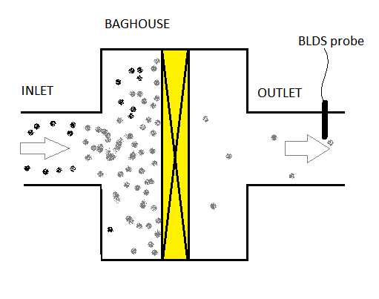
Alt. 2: Bag Leak Detection System
George Davis and Jaclyn Palermo | Oregon Department of Environmental Quality
Notes:
A second alternative is a bag leak detection system. A probe that can sense particulate matter is installed in the outlet duct and is connected to an electronic monitoring and recording system.
These systems are very sensitive and can detect leakage in a baghouse that is too small to be detected by other means.

Slide 18
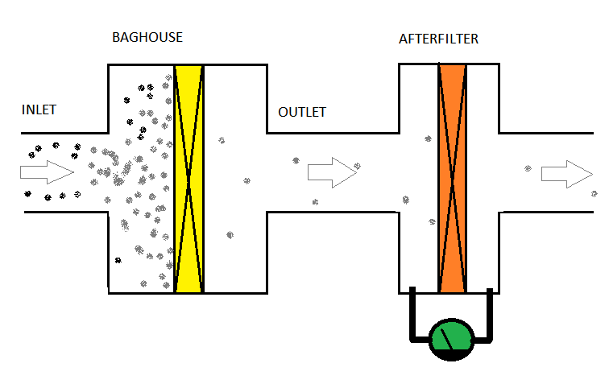
Alt. 3: HEPA Afterfilter
George Davis and Jaclyn Palermo | Oregon Department of Environmental Quality
Notes:
A third alternative is a HEPA afterfilter, which is installed on the baghouse outlet and provides additional filtering.
HEPA stands for High Efficiency Particulate Arrestance, and HEPA filters are so fine that they would plug up rapidly if used as the primary filters.
However, this tendency to plug up makes them work like a leak detection system.
If the primary filter begins to leak, the HEPA filter will rapidly plug up, restricting air flow and increasing pressure across the filter, which gives an indication that there is a leak in the baghouse.
Further, even though the baghouse may be leaking, the HEPA filter will continue to provide filtration to minimize emissions.

Slide 19
(3) & (5) Test to show 0.005 gr/dscf;
Bag leak detection system;
HEPA afterfilter
  Tier 1 – test for 0.005 grains/dry std. cubic foot OR
  install BLDS OR
  install HEPA afterfilter
  Tier 2 – test for 0.005 grains/dry std. cubic foot AND
  {install BLDS OR install HEPA afterfilter}
George Davis and Jaclyn Palermo | Oregon Department of Environmental Quality
Notes:
Based on the preceding discussion, for items 3 and 5, DEQ is proposing that the smaller Tier 1 facilities have the option of testing for 0.005 gr/dscf, or installing a bag leak detection system, or installing a HEPA afterfilter.
However, the larger Tier 2 facilities would be required to test for 0.005 gr/dscf, and would then have the option of installing either a bag leak detection system or a HEPA afterfilter.

Slide 20
(7) Test chromium emissions at control device outlet (Tier 2)
Temporary rules required testing for chromium VI at control device inlet
Use this result and PM control efficiency to calculate chromium VI emissions (at control device outlet)
Testing indicates this is a poor assumption
DEQ recommends testing directly at outlet
George Davis and Jaclyn Palermo | Oregon Department of Environmental Quality
Notes:
With respect to Item 7, DEQ is proposing that chromium be tested directly at the control device outlet using a simpler, less expensive test method.
However, this test method cannot differentiate between chromium VI and other forms of chromium, so the proposed rule also specifies that if this test method is used, the facility must assume that 100% of the chromium is in the +6 form.
The facilities may use the more expensive chromium VI test if they choose to, but they are not required to use it.

Slide 21
(1) Apply at 5 tons per year or more of glass using glassmaking HAPs
Requested input in public notice
Many comments suggested lower threshold
DEQ agrees, but rules should not apply to individual artists/hobbyists
George Davis and Jaclyn Palermo | Oregon Department of Environmental Quality
Notes:
Going back to Item 1, DEQ is proposing to lower the rule applicability threshold from 10 tons per year of glass to 5 tons per year. Only glass made using glassmaking hazardous air pollutants is counted toward the threshold.
Some commenters suggested making the rules apply if any amount of glass were made using hazardous air pollutants, but DEQ is instead seeking an appropriate balance between under- and over-regulating colored art glass manufacturers.
Staff estimated that producing 5 tons of glass per year would require two small glass making furnaces, each making 50 pounds of glass two times per week.
DEQ considers this level of production to reasonably represent a level that defines a manufacturing operation, but is high enough to exclude artists and hobbyists who might make their own glass for special purposes.

Slide 22
(2) Apply statewide
Requested input in public notice
Many comments suggest statewide applicability
LRAPA agrees
George Davis and Jaclyn Palermo | Oregon Department of Environmental Quality
Notes:
Regarding Item 2, many comments suggested making the rules apply statewide.
Since the rules are intended to reduce the possible health threat from colored art glass manufacturers, DEQ agrees that the rules should apply statewide.
Staff have discussed the rules with the Lane Regional Air Protection Agency, and Lane Regional agrees with making the rules apply statewide.

Slide 23
(4) Add selenium to glassmaking HAPs
Original list of glassmaking HAPs:
arsenic, cadmium, chromium, lead, manganese and nickel
Comments suggested adding more/all HAPs
High levels of selenium monitored during the summer in SE Portland
George Davis and Jaclyn Palermo | Oregon Department of Environmental Quality
Notes:
For item 4, commenters suggested that more hazardous air pollutants should be regulated under this rule.
Staff recommend adding selenium to the list of glassmaking HAPs regulated under this rule because relatively high levels of selenium were monitored in SE Portland several times during the summer.
Phase in of selenium requires extending some compliance dates, since affected facilities have only learned about this change very recently.
Staff do not recommend regulating all HAPs under this rule because the temporary rule was originally narrowly focused to solve a particular problem, and staff recommend keeping these rules narrowly focused. In addition, DEQ is working to develop a broader set of Cleaner Air Oregon rules to regulate toxic air emissions from all industrial sources, which is expected to regulate a larger number of hazardous air pollutants. DEQ does not know how these proposed rules may relate to the future Cleaner Air Oregon rules, but it’s reasonable to assume that if these rules are retained, DEQ will propose changes if that’s necessary to make them consistent with Cleaner Air Oregon.

Slide 24
(6) Set 24-hour health benchmark for chromium VI to 5 nanograms per cubic meter
24-hr health benchmarks were established in addition to the annual Ambient Benchmark Concentrations
Are under review by OHA and DEQ at this time
OHA recommended lowering to 5 ng/m3
George Davis and Jaclyn Palermo | Oregon Department of Environmental Quality
Notes:
Item 6, DEQ is proposing that the 24-hour health benchmark for chromium VI be lowered from 36 ng/m3 to 5 ng/m3.
24-hour health benchmarks were established in the temporary rule, and were based on a survey of other states’ regulations.
The 24-hour health benchmarks are under review by OHA at this time, with chromium VI being one of the first to be reviewed. Based on this review, OHA recommended lowering the level to 5 ng/m3 and DEQ agrees with this recommendation.

Slide 25
(8) Compliance extensions up to 1 year for Tier 1
DEQ recommends allowing compliance extensions for delays beyond a facility’s control
Facility must request extensions if needed
George Davis and Jaclyn Palermo | Oregon Department of Environmental Quality
Notes:
And finally, item 8. Rules that require installation of emission control systems typically include a provision for facilities to request compliance extensions if installation is delayed for reasons beyond their control.
This can occur, for example, because of a strike at the control system manufacturer’s facility, or if delivery is delayed because of bad weather, or for a number of other reasons.
Without a provision for granting compliance extensions, facilities could find themselves in violation of the rules despite making a good faith effort to comply.
DEQ therefore recommends including a provision for granting compliance extensions of up to 1 year for reasons beyond the facilities’ control.
This concludes DEQ’s presentation. We’ll now like to make our recommendation to the commission.

Slide 26
Recommendation
DEQ recommends that the Environmental Quality Commission:
adopt the proposed permanent rules in Attachment A of the staff report as part of Chapter 340 of the Oregon Administrative Rules.
George Davis and Jaclyn Palermo | Oregon Department of Environmental Quality
Notes:
(1 min.)
DEQ recommends that the Environmental Quality Commission:
adopt the proposed permanent rules in Attachment A of the staff report as part of Chapter 340 of the Oregon Administrative Rules.

