Slide 1
Solid Waste Disposal Fees:
Amending Rules under
SB 245 - 2015
February 2-3, 2016
Salem, Oregon
Materials Management Program | Oregon Department of Environmental Quality
Notes:
Hello Chair O’Keeffe and fellow commissioners. I am here today to tell you about the solid waste disposal fee rulemaking.

Slide 2

Outline of Today’s Presentation
Goals of Rulemaking
Public Notice Process
Summary of Rulemaking
Questions
Recommended Adoption of Proposed Rulemaking
Notes:
I want to start by giving you an outline of today’s presentation:
I’ll tell you about the goals of the rulemaking
I’ll explain public notice process and tell you about the comments we received
I’ll summarize the proposed rulemaking
And we’ll have time for questions at the end.
I’ll finish by recommending adoption of the proposed rules

Slide 3
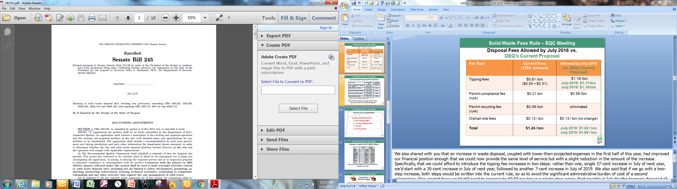
Goals of Rulemaking
Align rules with Senate Bill 245 by:
              Increasing per-ton permit and tipping fees
              Providing rebates to most distressed counties
              Updating grant rules
Notes:
As you recall, the EQC adopted the Materials Management in Oregon: 2050 Vision and Framework for Action in 2012. DEQ then worked with stakeholders to develop Senate Bill 245 that was passed in the last legislative session. SB 245 strengthens DEQ’s authority to fully implement the 2050 Vision and provides necessary funding.
The goals of the proposed rulemaking are to align our rules with SB245.
We are proposing to increase the per-ton permit and tipping fees for solid waste disposal facilities. The fees were last increased in 1994.
We are proposing to establish rebates of the tipping fees for Oregon’s nine most economically distressed counties; and
We are proposing changes to the grant rules, again to align them with the provisions of Senate Bill 245.

Slide 4
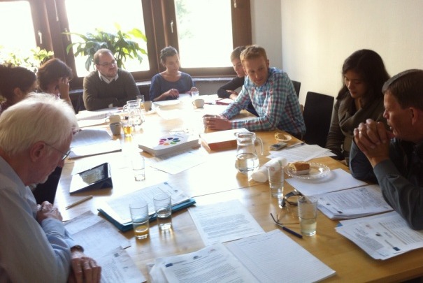



Public Involvement
2 advisory committee meetings
7,203 Notifications – email/postcard
5 supporters + 2 clarifications
7 Commenters
Notes:
Now I would like to explain our public involvement process for this rulemaking:
Two advisory committee meetings were held, in August and September of 2015, to discuss rulemaking options and review the draft rules
When we placed the rules on public notice on October 15, 2015, we sent out 7,203 notices in addition to posting information on our website
We received comments from 7 individuals and/or organizations
5 commenters were in support of the proposed rule changes and two asked for clarifications

Slide 5
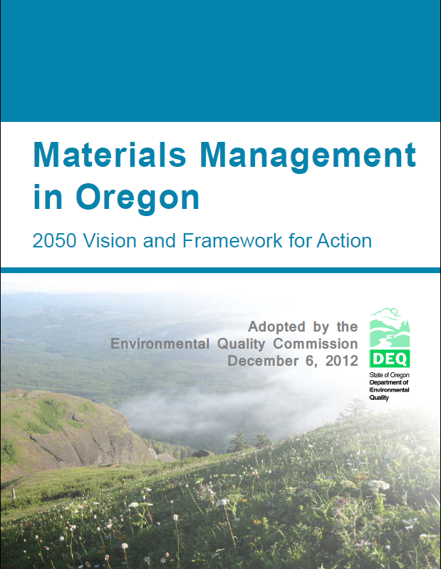
Post-SB 245 Use of Fees
Permit Compliance Fee:
  Oversight of disposal facilities and related costs only
Tipping Fee:
  Implement Materials Management Plan
  Reduce impacts of material at any stages of lifecycle
    Can fund disposal site oversight but phasing out
Notes:
Currently we have 4 fees, two permit fees and two tipping fees, all of which have statutorily defined uses, along with the orphan site fee that is not changing. SB245 combines these 4 fees into two fees and clarifies them.
SB 245 also changes the use of these fees and these are the changes.
Formerly the permit compliance fee could be used for a variety of activities. Now it will be limited to the oversight of disposal facilities and related costs such as rulemaking, training, or planning, activities associated with disposal. It cannot be used for recycling related work or work that is unrelated to disposal sites.
SB245 allows very broad use of the tipping fee. It can be used to implement the statewide material management plan and specifically, anything that reduces the impact of materials at any stage of the life cycle. This means we can use the tipping fee fund oversight at disposal facilities but we plan to phase this out. The intent is that the permit compliance fee should cover the cost for overseeing disposal facilities and the tipping fees should cover all other program costs.

Slide 6
Disposal Fees Allowed by SB245
Fee Type | Current Fees (1994 - present) | Allowed by SB245
Tipping fees | $0.81 /ton ($0.50 + $0.31) | $1.18 /ton
Permit compliance fee (rule) | $0.21 /ton | $0.58 /ton
Permit recycling fee (rule) | $0.09 /ton | Eliminated
Orphan site fees | $0.13 / ton | $0.13 / ton (no change)
Total | $1.24 / ton | $1.89 / ton
Notes:
In the next few slides I’ll explain in detail the changes in the fee structure.
This table will compare the current fees (in the center column) against the new fees (on the right) allowed by SB245.
CLICK The permit compliance fee of 21¢/ ton pays for the oversight of the facility. Landfills also pay a recycling fee of 9¢. CLICK Facilities pay a tipping fee of 81¢ a ton, which is a combination of the original 50¢ tipping fee and the 31¢ tipping fee surcharge. CLICK Again, the orphan site fee of 13¢/ton is not changing so the total fees currently paid are $1.24/ton.
Commitments made to stakeholders during the development of SB245 included raising the permit fees in an amount necessary to maintain current service levels and to fully fund the permitting program solely through permit fees. CLICK We estimated this would require an increase in permit fees from a combined 30¢/ton today to 58¢/ton, a 28¢ increase, first payable July 1 of this year. Some of this increase is necessary to fully fund the permitting program and phase out the use of the tipping fees, to end what is sometimes called the subsidy of the permitting program by the tip fees. Some of it is just to keep the permitting program whole in the presence of ongoing and anticipated future inflation. Based on best projections of disposal tonnage, the 28¢/ton increase would keep the permitting program whole through at least June of 2021.
We committed to fund 12 new positions to implement the non-permitting side of the 2050 Vision, in areas such as recycling, waste prevention, sustainable production and toxics reduction. We also committed to increase funding for grants and contracts by the 2019-2021 biennium. We said we would not jump immediately to that service level but ramp up to it. And consistent with that, our legislatively approved budget for the current biennium provides for 7 of these new 12 positions while the remaining 5 positions need to be requested in budget in subsequent biennium. We restarted the grants program and the household hazardous waste collection services in communities that lack that service last fall. CLICK To fund the 12 new positions, we estimated this would require an increase in tipping fees from 81¢/ton today to $1.18/ton, a 37¢ increase. Adding the orphan site fee CLICK makes the proposed total fees paid $1.89/ton, a total increase of 65¢/ton.

Slide 7
Disposal Fees Allowed by SB245
vs.
DEQ’s Proposed Rules
(vs. DEQ’s Proposed Rules)
July 2016: $1.11/ton
July 2019: $1.18/ton
July 2016: $1.82 / ton
July 2019: $1.89 / ton
Fee Type | Current Fees (1994 - present) | Allowed by SB245
Tipping fees | $0.81 /ton ($0.50 + $0.31) | $1.18 /ton
Permit compliance fee (rule) | $0.21 ton | $0.58 /ton
Permit recycling fee (rule) | $0.09 /ton | eliminated
Orphan site fees | $0.13 / ton | $0.13 / ton (no change)
Total | $1.24 / ton
Notes:
An increase in waste disposal, coupled with lower-than-projected expenses in the first half of 2015, have improved our financial position enough that we can now provide the same level of service but with a slight reduction in the amount of the increase authorized by SB245. We can afford to introduce the tipping fee increases in two steps. CLICK Rather than one single 37¢ increase in July of this year, we’d start with a 30-cent increase in July of this year, followed by another 7-cent increase in July of 2019. We discussed the one step or two step increase options with our advisory committee. Some members expressed concern about having to go out again for a second increase and others wanted the two step increase to stay competitive. In the end, all advisory committee members supported the two step tipping fee increase and a one step permit fee increase.
There are 35 solid waste disposal facilities that pay these fees directly to DEQ and will pass them on to all users such as households. We estimated that each household can expect to pay 4 to 7¢ /month more for their garbage. (not 47¢ but four to seven)

Slide 8
Current and Proposed Permit Fees
Facility Type | Current Permit Fees | Proposed Permit Fee
Municipal Solid Waste & Construction & Demolition Landfills, and Solid Waste Treatment Facilities | $0.30/ton ($0.21 + $0.09) | $0.58
Energy Recovery Facilities | $0.22/ton ($0.13 + $0.09) | $0.58*
Conversion Technology Facilities | $0.19/ton ($0.10 + $0.09) | $0.58*
Industrial Captive Landfills | $0.21/ton | $0.58
Industrial Non-Captive Landfills | $0.30/ton ($0.21 + $0.09) | $0.58
* For energy recovery facilities and conversion technology facilities, no permit fee on subsequent disposal of ash or residue from conversion technology.
DEQ will continue policy requiring entities to pay only once on each ton of material disposed
Notes:
We are also trying to simplify things by having a single permit fee. Currently different facilities have different permit fees. Most facilities, solid waste disposal facilities, Municipal Solid Waste landfills, Construction & Demolition landfills and Solid Waste Treatment facilities pay both the 21¢/ton permit compliance fee and the 9¢/ton recycling for a 30¢/ton total. But energy recovery facilities, of which we have only one in the state, only pay 22¢/ton. There was concern that if they paid 30¢/ton on all the waste going into the burner and then paid 30¢/ton on the ash going out, they would be paying more than other facilities. Back when the original fees were adopted, we did some calculations and figured out that if we adjusted the fee down to 22¢/ton then they would pay about the same amount as the 30¢/ton on the initial disposal.
When SB245 legislated that all the recycling related work be paid for by the tipping fee, we thought it made sense to say that a ton is a ton is a ton for permit compliance. We should have the same permit compliance fee on all the different facilities, with two exceptions for conversion technology and energy recovery facilities, such as the waste incinerator in Marion County that takes solid waste and turns it into energy, while producing another waste, the ash, that must be disposed of. What we are proposing for the these facilities, is that we would charge 58¢ a ton on the waste going into the facility but we would not charge on the ash or other waste products going to landfill. This avoids charging twice for the same waste.
So that’s the history of why there are different permit fees for different types of facilities and our proposal to raise those fees. Do you have any questions?

Slide 9

Questions required by ORS 183
Will the rules have a significant adverse impact on small businesses (<50 employees)?
Expected minimal impact since the fee increase is a small increase in a relatively small cost of doing business.
Notes:
One of the questions we asked the advisory committee was whether the proposed fee increases will have an adverse impact on small businesses. Small businesses are defined as those with 50 employees or less.
DEQ expects the impact on small businesses to be minimal because the fee increases are a small increase in a relatively small cost of doing business.
Based on that information, DEQ believes the proposed fee increase will not have an adverse impact on small businesses and our advisory committee agreed.
So for example, producing $1 of sales in “eating and drinking places” in Oregon requires about $0.0036 in spending on “waste management and remediation” in Oregon.
In-state waste management and remediation services are about 0.19% of the cost of doing business for the average Oregon business. If solid waste disposal costs are 30% (a rough guess) of the total cost of “waste management and remediation services” (which also includes solid waste collection, hazardous waste collection and disposal, spill response, and cleanup), and DEQ fees result in solid waste disposal costs increasing by 1% (an average of Jackson County and Metro #s), then the average Oregon business sector will see their overall costs increase by about 0.00057%

Slide 10
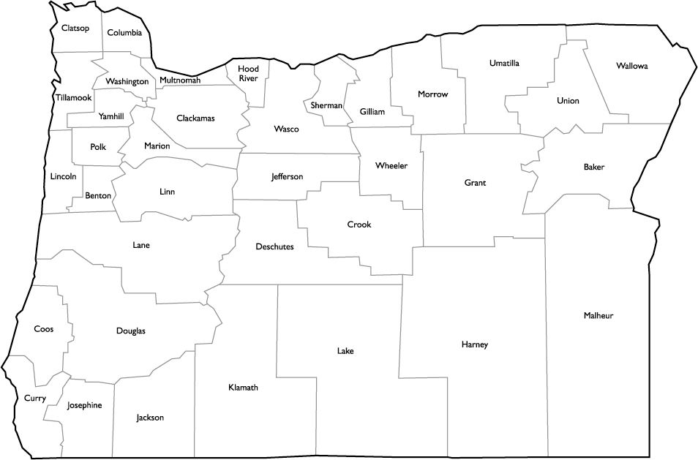
Distressed County Index
Index based on:
  OR unemployment
  county unemployment
  income
  county payroll
Notes:
The next part of the rulemaking I want to discuss with you is the distressed county rebate.
There was concern in rural Oregon regarding the fee increases because there are counties that have difficulty funding basic services.
SB 245 requires DEQ to give a partial rebate of the tipping fee increase to the 9 most economically distressed counties each year
This rebate can be up to $0.28 of the $0.37 maximum tip fee increase or roughly 75% of the increase
The rebated is based on municipal solid waste generated in the county
We are proposing use of the “Distressed County Index” calculation used by Business Oregon which includes Oregon and county unemployment, income and county payroll.

Slide 11
Rebates if paid in 2015 @ $0.28/ton
Ranking | County | Distressed Index | Tons MSW 2014 | Rebate $0.28/ton
1 | Malheur | 0.5621 | 20,201 | $5,656
2 | Curry | 0.5877 | 15,885 | $4,448
3 | Klamath | 0.5944 | 49,603 | $13,889
4 | Grant | 0.6131 | 3,730 | $1,044
5 | Jefferson | 0.6137 | 10,883 | $3,047
6 | Harney | 0.6200 | 3,576 | $1,001
7 | Crook | 0.6221 | 14,736 | $4,126
8 | Josephine | 0.6569 | 58,277 | $16,318
9 | Douglas | 0.6668 | 74,219 | $20,781
 | Total |  | 251,109 | $70,311
10 | Gilliam | 0.6712
11 | Baker | 0.6715
12 | Lake | 0.6783
13 | Wallowa | 0.7041
Notes:
This slide gives you an idea of how much money we’re talking about for the rebates. Once again, SB 245 requires DEQ to give a partial rebate of the tipping fee increase to the 9 most economically distressed counties each year
These are the 9 most distressed counties in Oregon in 2015 and the amount of the rebates if we paid them in 2015 based on 2014 tonnages. The $70,311 is approximately 0.6% of DEQ’s solid waste budget.
I also included the counties that rank 10-13 of distressed counties but again, SB245 requires rebates to only the 9 most economically distressed counties.

Slide 12

Grant Rules
SB 245 Changes
TOPIC | EXISTING | PROPOSED
GRANTEE | Local governments only | Person – as defined in statute
GRANT FUNDED ACTIVITIES | Recycling and solid waste planning activities | All activities to implement the 2050 Vision
GRANT PREFERENCES | None specified | Activities that reduce waste generation and exceed requirements
Notes:
The last part of this rulemaking I want to update you on is the changes we are proposing to the grant rules. The grant program funds projects that prevent, recover or reuse solid and household hazardous wastes. We had to stop the grant program in 2008 because of budget cuts but with the passage of SB245, we are happy to reestablish the grant program to help achieve the goals of the 2050 Vision.
Prior to Senate Bill 245, DEQ was authorized to give grants only to local governments. In practice, many local governments would apply on behalf of local non-profits or businesses, and then pass grant funds through to them. This created a lot of extra work for the cities and counties. Senate Bill 245 lifts the restriction on who can receive grants. The proposed rules allow any “person,” as defined in our Solid Waste laws (ORS 459.005), to receive grants directly from DEQ - including businesses and non-profits as well as local governments. We did receive a comment on the grant rules requesting notification of non-governmental applications to local jurisdictions. Some grant proposals may affect no jurisdictions and others may affect several. Because it is difficult to write rules to cover every situation, we will use the application process to require this notification whenever applicable . [Optional – may want to hold for Qs: We also plan to engage local governments in the grant process in ways that serve their interests and support the process.]
Senate Bill 245 also authorizes grants for activities that implement the 2050 Vision.
The current rules don’t include any preferences for particular activities in awarding grants. Senate Bill 245 includes a new provision directing DEQ, in awarding grants, to give preference to activities that reduce waste generation and exceed statutory requirements. That preference is also included in the proposed rules. Oregon Refuse and Recycling Association requested this provision in part to help local governments transition to changes in Oregon’s Opportunity to Recycle Act in Senate Bill 263, also recently adopted and signed into law.

Slide 13

Questions for us?

Slide 14
Recommendation
DEQ recommends that the Environmental Quality Commission adopt the proposed amendments to OAR 340-083 and 340-097 in attachment A1.
Notes:
I’d like to finish by recommending ………………
Thank you very much for your time.

