Slide 1
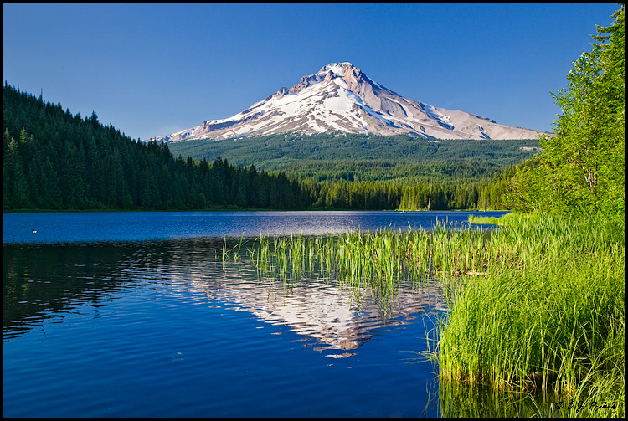
DEQ Mission
To be a leader in restoring, maintaining and enhancing the quality of Oregon’s air, land and water.

Slide 2
DEQ Vision
(Discussion Draft 4/19/2017)
  We are protecting human health and the environment by controlling air emissions
  We are protecting human health and the environment by controlling water pollution
  We are reducing the environmental impacts of the use of materials and products
  We are cleaning up contaminated properties and returning them to productive use
  We are engaging the public in decision-making by providing clear and accurate information
  We are assisting communities by helping them solve problems in ways that are economically and environmentally sustainable

Slide 3
DEQ Values
(Discussion Draft 4/19/2017)
  Our strength is our people
  We believe our best work is done through teamwork inside the agency and partnerships externally
  We are strong believers in public service
  We base our work on sound science, integrity and excellence
  We listen to and engage Oregonians in decisions about their environment
  We believe a diverse workforce is a stronger workforce
  We believe that decisions about Oregon’s environment should consider effects on communities that may be affected by those decisions, particularly minority, low-income and other traditionally under-represented communities
  We believe that a healthy environment supports a healthy economy

Slide 4
Key Goal #1
(Discussion Draft 4/19/2017)
Strengthen and Restore Public Confidence that We Are Identifying and Responding to Significant Threats to Public Health and the Environment
Strategies
Enhanced monitoring resources
Complaint response resources
External Communications/Engagement Plan and Implementation

Slide 5
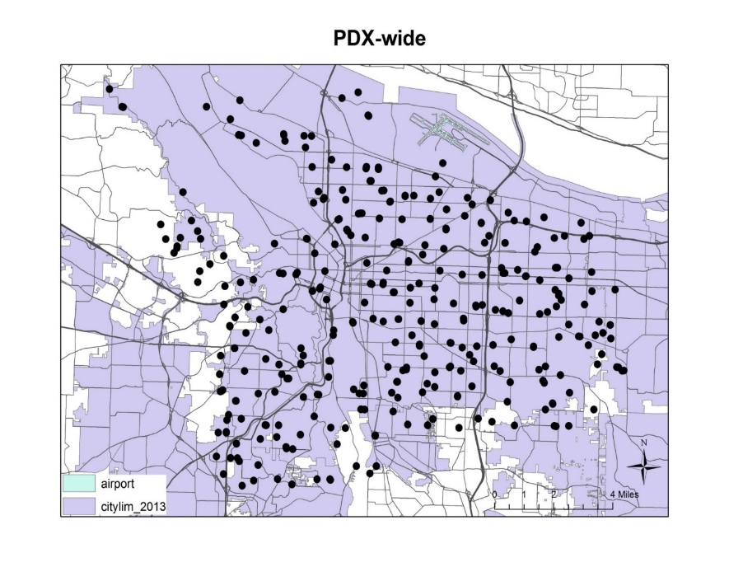
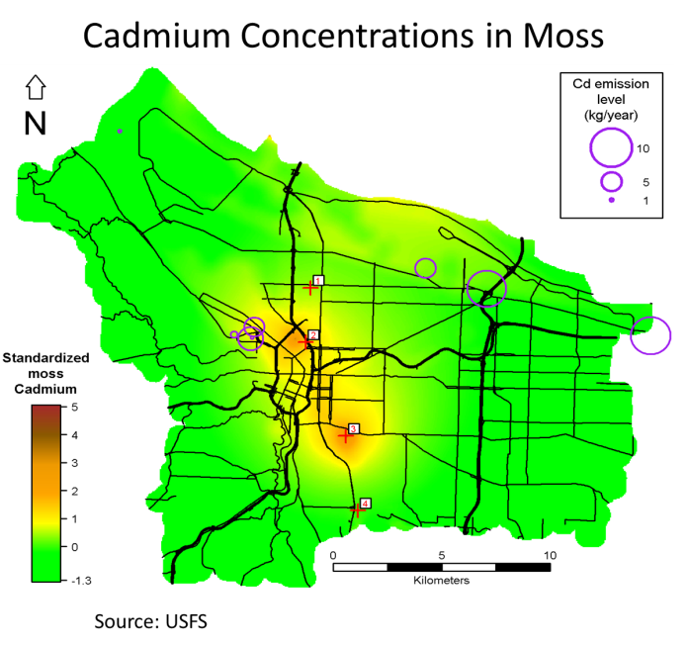

Initial moss sampling - 2013
Portland moss study and the partnerships
Moss samples = 346 in 2013
Air quality monitor
Source: USFS

Slide 6
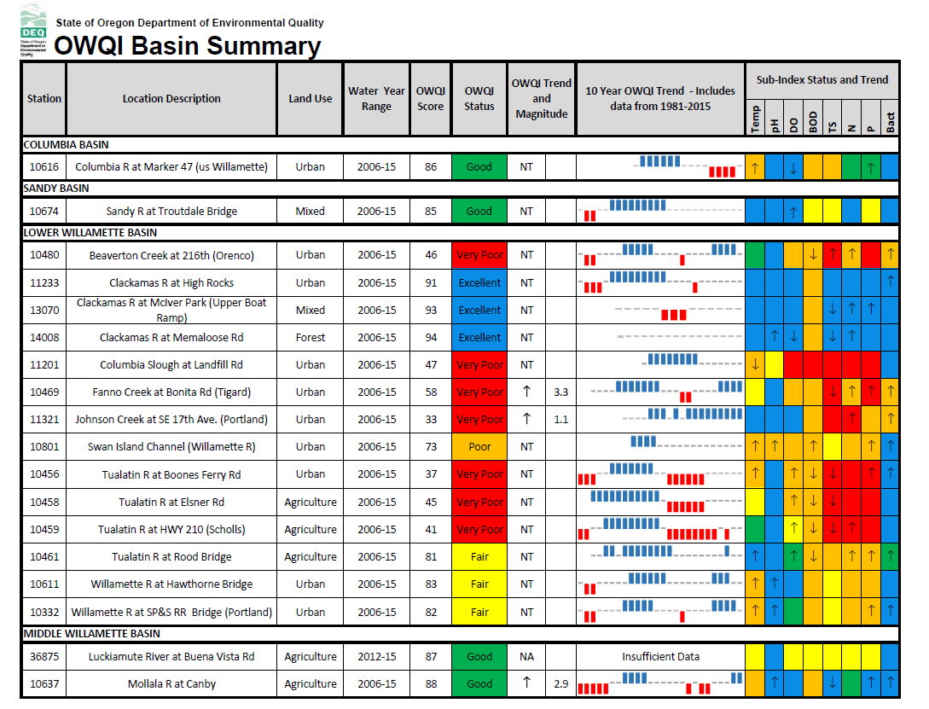
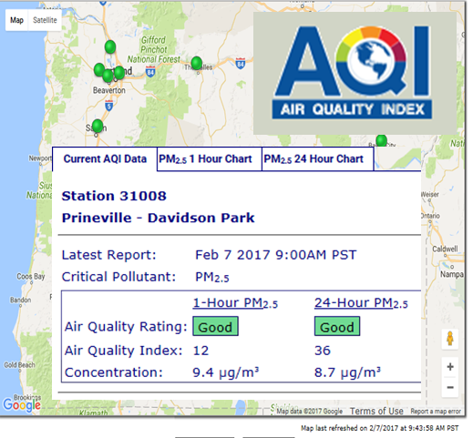
From the field to the public
Communicating DEQ’s science

Slide 7
Key Goal 2
(Discussion Draft 4/19/2017)
Build DEQ’s Organizational Health
Strategies
Succession planning
Workforce diversity
Develop ways to stabilize funding
Fund core agency-wide functions differently

Slide 8
Key Goal #3
(Discussion Draft 4/19/2017)
Provide Clarity Externally and Internally for How Decisions are Made at DEQ
Strategies
Reorganization of Headquarters – Back to Air, Water and Land Divisions (end of 2017)
Re-energize DEQ’s Leadership Team
Update relationships between Regions and Headquarters (continuing through 2018)
Develop and Implement Internal Communications Plan

Slide 9
Key Goal 4
(Discussion Draft 4/19/2017)
Develop/Enhance Systems to Incorporate Environmental Justice into Agency Processes and Decision-Making
Strategies
Build expertise and capacity
Examine best practices from other states and EPA
Gather input from partners, including EJ Task Force
Implement on pilot basis beginning in one or two specific programs

Slide 10
Key Goal 5
(Discussion Draft 4/19/2017)
Modernize and Improve Business Processes and Data Management (EDMS)
Strategies
Begin business process analysis with water permitting program
Then move to analysis of invoicing and management of accounts receivable
Acquire off-the-shelf products to the maximum extent practicable, and adapt processes (Lean) as well as products.
E-reporting/permitting

Slide 11
Key Goal 6
(Discussion Draft 4/19/2017)
Return Oregon’s Water Quality Program to a Sustainable Foundation
Strategies
Address necessary changes to Clean Water Plans (TMDLs), and better integrate standards and permitting
Develop additional tools for compliance
Expand technical and financial resources
Reset expectations for permit issuance (default)
Process improvements and organizational change

Slide 12


Slide 13
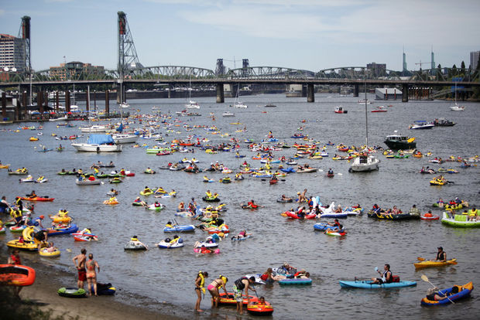
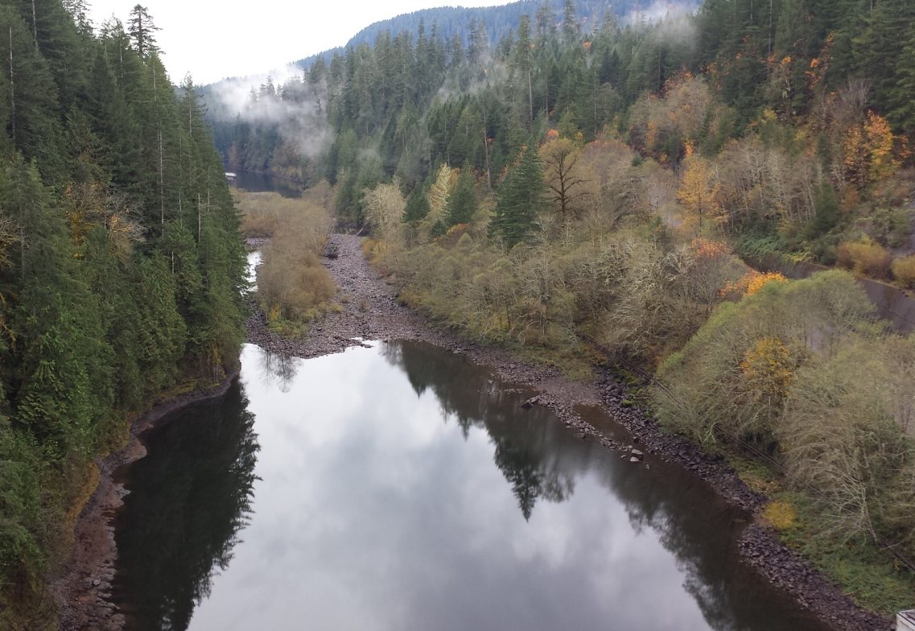
Water Quality
    Ensure Oregon’s waters are drinkable,
    fishable and swimmable

Slide 14
Key Goal #7
(Discussion Draft 4/19/2017)
Identify and Control Localized Effects of Air Toxics Emissions (Cleaner Air Oregon)
Strategies
Emissions Inventory
Develop health risk-based standards
Develop systems for evaluating facilities and permits
Implement and adjust program over time, beginning with the highest priority areas/sites

Slide 15
Key Goal #8
(Discussion Draft 4/19/2017)
Reduce Diesel Emissions and Help Oregon Get Back on Track for Meeting its Existing GHG Reduction Goals
Strategies
Implement VW Settlement
Implement Clean Fuels Program
Work with Partners to Accelerate Turnover of Diesel Fleets

Slide 16
Oregon Greenhouse Gas Trends
1990 transportation emissions

Slide 17
Oregon Greenhouse Gas Trends
57% increase in diesel GHG emissions
(1990 – 2015)

Slide 18
Measures and Outcomes
(Discussion Draft 4/19/2017)
Continue/Update DEQ’s Outcome-based management system
Update KPMs to align with Key Goals and OBM
Involve EQC in Quarterly Management Reports

