Slide 1
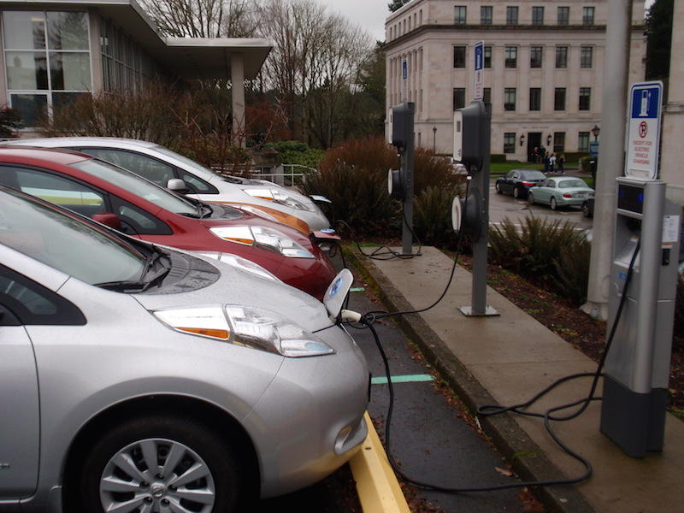

Air Quality
Zero Emission and Electric Vehicle Rebate Program – Temporary rules
Sept. 27, 2019
EQC meeting
Item B
Rachel Sakata | Oregon Department of Environmental Quality

Slide 2
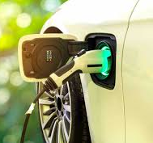
Background
House Bill 2017 (2017) directed DEQ to implement a zero emission electric vehicle rebate program in Oregon
EQC adopted rules in May 2018
House Bill 4059 (2018) clarified rebate requirements
EQC adopted rules in January 2019
House Bill 2592 (2019) made additional revisions to increase access to rebates

Slide 3

Rebate program funding
Funding for the program is generated via a “privilege tax” imposed on car dealers
Receive $12 million annually
Program implementation delayed due to lawsuit regarding “privilege tax”
Oregon Supreme Court ruled in favor of funding in August 2018

Slide 4
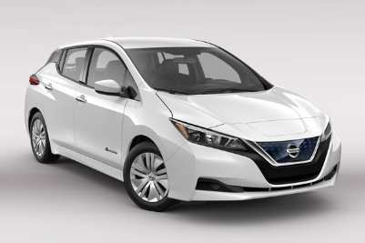
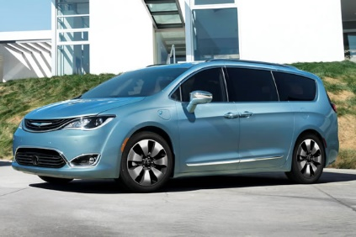

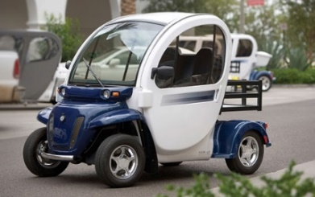
Standard rebates
Rebates offered for purchase or lease of new zero emission or electric vehicle
Must have base MSRP less than $50,000
$2500 if battery capacity > 10kWh (e.g., battery electric vehicle - BEV)
$750 for electric motorcycle
$1500 if battery capacity <10kWh (e.g., plug-in hybrid electric vehicle - PHEV)
$750 for neighborhood electric vehicle
Nissan Leaf
Chrysler Pacifica PHEV

Slide 5
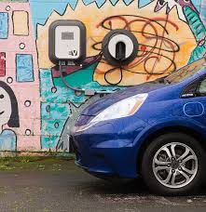
Charge Ahead rebates
Rebates of $2500 offered for purchase or lease of new or used battery electric vehicle
Be a low or moderate income household
Can be combined with standard rebate
Potential savings up to $5K when purchasing new battery electric vehicle

Slide 6
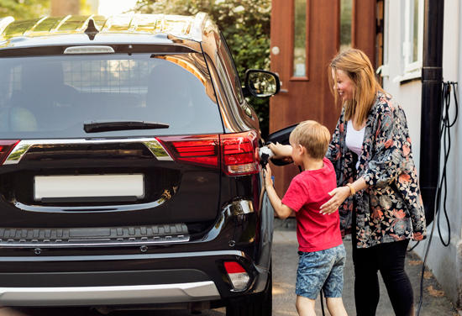
Proposed temporary rule changes
Charge Ahead Rebate Program
Allow plug-in hybrid electric vehicles to qualify for the Charge Ahead rebate
Request information that the person has not previously owned or leased the vehicle for which it is now requesting a Charge Ahead rebate
Definition of “household” for income verification purposes
6

Slide 7

Proposed temporary rule change
Vehicle Ownership Provision
If car is sold or has lease terminated prior to 24 months, the rebate recipient must reimburse DEQ for a prorated amount
Based on the number of months the recipient owned or leased the vehicle
DEQ may waive the reimbursement requirement

Slide 8
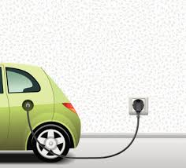
Proposed temporary rule change
Additional 6-month window for certain program participants to apply for a rebate
Allows people who purchased or leased an eligible vehicle between Jan. 1, 2018, and Aug. 2, 2018, to apply for and receive a rebate.
Application must be submitted between Sept. 29, 2019, through March 30, 2020.
If DEQ has already received an application no need to reapply

Slide 9
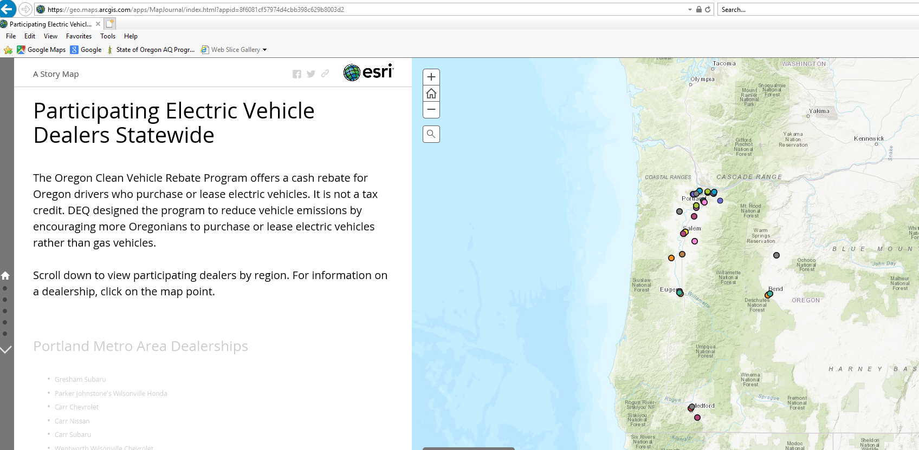
Proposed temporary rule change
Application Review Process
Allows DEQ to process dealer applications on a priority basis
Rules currently require DEQ to process applications on a first-come, first-serve basis

Slide 10
Rebate Amounts
Rebates must be set annually by DEQ
Type of rebate | Amount allowed by statute | Current rebate amount
Standard rebate
Plug-in hybrid or battery electric vehicle with battery capacity less than 10kWh | $750 - $1500 | $1500
Plug-in hybrid or battery electric vehicle with battery capacity more than 10kWh | $1500 - $2500 | $2500
Electric motorcycle | $375 - $750 | $750
Neighborhood electric vehicle | $375 - $750 | $750
Charge Ahead rebate | $1250 - $2500 | $2500
DEQ recommends keeping rebate amount the same

Slide 11
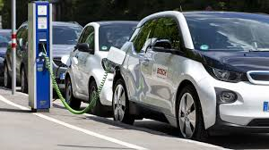
Advisory Committee
Advisory Committee meeting – Sept. 10, 2019
Review of rebate amounts and rule language
Definition of household
11

Slide 12
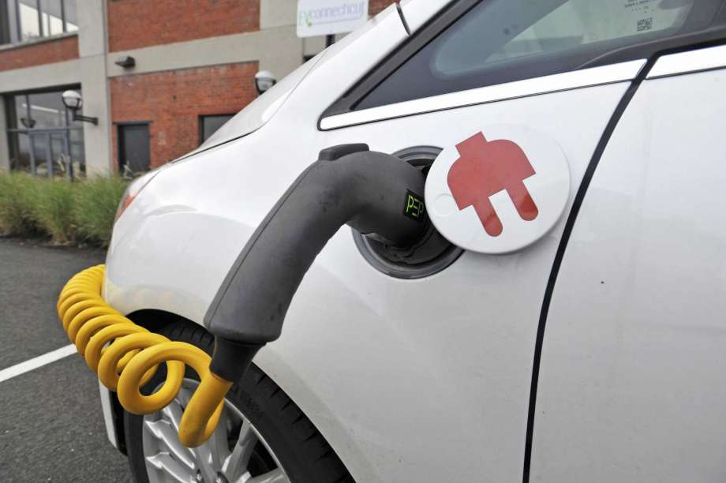
Requested EQC Action
DEQ recommends that the Environmental Quality Commission make the determinations as stated on page two of the staff report for this item and approve the temporary rules as seen in Attachment A for this item
12

