Slide 1
General Fund History Budget & Actual FY 08-09 through FY 15-16

Slide 2
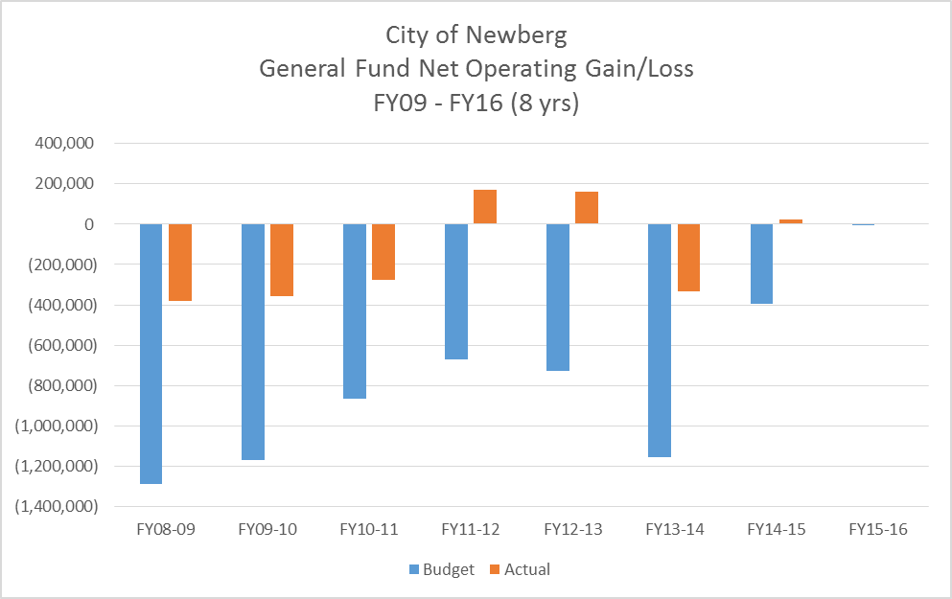

Slide 4
 | FY08-09 |  | FY09-10 |  | FY10-11 |  | FY11-12
 | Budget | Actual | Budget | Actual | Budget | Actual | Budget | Actual
Beg Fund Balance | 3,015,840 | 3,516,106 | 2,478,956 | 3,137,137 | 2,141,239 | 2,778,800 | 1,796,531 | 2,503,809
Net Operating Gain/(Loss) | (1,289,000) | (378,969) | (1,171,427) | (358,337) | (865,821) | (274,991) | (670,989) | 170,557
Ending Fund Balance | 1,726,840 | 3,137,137 | 1,307,529 | 2,778,800 | 1,275,418 | 2,503,809 | 1,125,542 | 2,674,366

Slide 5
 | FY12-13 |  | FY13-14 |  | FY14-15 |  | FY15-16
 | Budget | Actual | Budget | Actual | Budget | Est Actual | Budget | Actual
Beg Fund Balance | 1,975,146 | 2,674,366 | 2,396,605 | 2,835,747 | 2,249,309 | 2,504,199 | 2,528,414
Net Operating Gain/(Loss) | (728,420) | 161,381 | (1,156,832) | (331,548) | (397,267) | 24,215 | (6,393)
Ending Fund Balance | 1,246,726 | 2,835,747 | 1,239,773 | 2,504,199 | 1,852,042 | 2,528,414 | 2,522,021 | 0

