Slide 1
IRAM and Data Gaps Discussion
Lss/retia USA inc.
Erm inc.

Slide 2
Agenda
GWET Update
IRAMs
IRAM 1 – Acid Plant Area ISS
Scope and schedule
Key design issues and performance evaluation
Bench scale work
IRAM 4 – Acid Plant Area In Situ Injections
Alternatives evaluation, design basis, and schedule
Bench scale work
IRAM 2 – Chlorate Area In Situ Injections
Schrödinger's plume
Design basis, schedule
IRAM 3 – Direct Exposure Hot Spot Removal
Alternatives evaluation and design basis
Schedule and phasing
Data Gap Investigation
Data collection objectives –
Groundwater - Screening Criteria development, current hot spot and trespass plume delineation, IRAM Design
Soil - Screening Criteria development, current hot spot and trespass plume delineation
Waste disposal area delineation
MNA data gaps
COC specific data gaps – 2,4’- isomers, PCBs
PFAS
VI Risk
Next Steps
Administrative directive?
Workplans

Slide 3
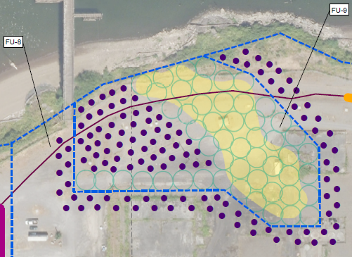
IRAM #1 vs. Approach Outlined in the FS
IRAM #1 and FU-9 approach do not align entirely
From ODEQ: IRAM 1 – Acid Plant Soil/NAPL (ISS) and Groundwater ISCR – Insitu Solidification and Stabilization (ISS) possibly combined with ISCO/ISCR in soil and groundwater (located within Acid Plant Area (functional unit [FU]-4 and FU-9). The FS recommends ISS of NAPL and enhanced ISCR/ISCO as the remedial action for Acid Plant groundwater and coincident ISS of NAPL in Acid Plant soil. (Note. the FS recommends implementing this action as part of the first phase of the remedial action [Section 9.4 #2].)
Implementation of ISS in DNAPL area
IRAM #1 does not include the proposed injection program (IRAM #4)

Slide 4
ISS Design & Implementation Timeline
To meet the goal timeline of Summer 2025 implementation, some aggressive review timelines will be needed:
Requires ~1-month turnaround from ODEQ
Submit PDI WP to DEQ
April 2024
DEQ Approval of PDI WP
May 2024
Solicit Bids for Implementation
End Feb. 2025
Award Bid
End April 2025
DEQ Approval May 2025
SPLP/LEAF Results
End 2024
Feb 22nd DEQ Meeting
Summer 2025 implementation
*timeline not to scale
PDI Implementation Planning
Execution of PDI Begins Mid-June
Any additional plume delineation complete
Pre-Design Report End January 2025
DEQ Comments End of Feb 2025
FDR April 2025
This timeline will require:
Coordination between DQ and LSS on approach for each submittal
Quick turnaround of regulatory reviews
Early communication with vendors on approach and timing
Requires ~1-month turnaround from ODEQ
Notes:
Phase 1 and 2 testing: 28 weeks – SPLP, LEAF
Internal development and review of PDI work plan 6 weeks
LSS review and approval of PDI work plan 2 weeks
Obtain vendor quotes 4 weeks (concurrent with above)
DEQ review and approval of PDI work plan 4 weeks
Execute work plan 1 week
SPLP and LEAF testing 28 weeks
Analytical testing (if needed) 4 weeks (concurrent with SPLP/LEAF)
Complete plume data analysis and visualization (if needed) 1 week (concurrent with SPLP/LEAF)
Complete SPLP and LEAF data analysis and visualization 1 week (contingent on SPLP/LEAF)
42 weeks

Slide 5
IRAM #1 Pre-design Investigation
IRAM#1 Questions To Be Answered
Further delineation of plume needed?
Execute IRAM 1 only where NAPL is observed or to include a minimal buffer area around NAPL plume
Considerations if NAPL is in riverbank soil from in-water investigations?
Data Gaps work will be conducted simultaneously – how does the Pre-design work fit in?
Can efficiencies be gained from conducting some data gaps work concurrently with PDI work?
How does current in water/riverbank work impact our approach?
What does agency/stakeholder review process look like? Necessary content of submittals?
How can we expedite DEQ/EPA/Tribes review of workplans and design deliverables, and address concerns quickly?
Will public comment be required? Per DEQ guidance IRAMs do not require public participation.
Are there components of submittals that we can remove for efficiency of timeline?
Notes:
(how aggressive do we want IRAM #1 to be)?

Slide 6
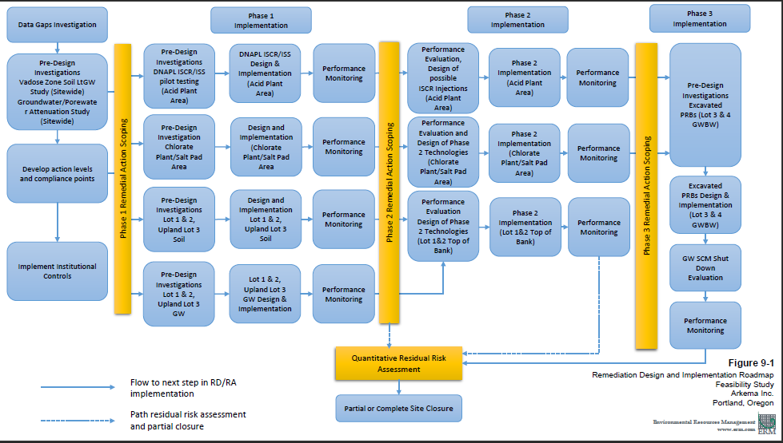
IRAM #4 – Approach Outlined in the FS
IRAM #4 can only be implemented after the completion and assessment of IRAM #1’s success
IRAM #4 - Enhanced ISCR of dissolved chlorinated VOCs and perchlorate located within Northern Groundwater Barrier Wall Area (FU-8) and Acid Plant (FU-9) groundwater. The FS recommends ISCR injections and enhanced ISCR to address chlorinated VOCs these areas. (Note. the FS recommends implementing this action in Acid Plant groundwater (FU-9) as part of the first phase of the remedial action [Section 9.4 #2] and in Northern Groundwater Barrier Wall Area groundwater (FU-8) as part of the second phase of remedial action [Section 9.5].)
Section 9.4 clearly outlines ISCR/ISS (i.e. IRAM #1) as part of the first phase approach and continues to say that “Treat or Immobilize via ISCR Injection Programs in Groundwater in FU-8 pending the results of the Phase 1 performance evaluation.”
IRAM #4 design basis will come from IRAM #1 performance monitoring
Bench scale testing for amendment selection will be necessary (ISCO/ISCR)
IRAM #1
IRAM #4

Slide 7
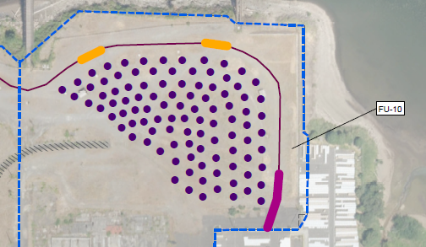
IRAM #2 – Approach Outlined in the FS
IRAM #2 (Previously FU-10) scoping is based on HSE data set, concentrations have decreased based on Q1 2021 data
From ODEQ: Enhanced ISCR of perchlorate and hexavalent chromium located within Chlorate Plant Area/Salt Pads (FU-10). (Note. the FS recommends implementing this action as part of the first phase of the remedial action [Section 9.4 #4].)
The FS recommends implementing this action after a Data Gaps Investigation has been completed. Recent results from a Q1-2021 sampling event indicated:
1. No detections exceeding hot spot criteria for CrVI
2. No detections exceeding hot spot criteria for perchlorate in both the shallow and intermediate zones where measured.
In both cases, some data gaps may exist on the uplands portion on the southern side of Lot 4 that can be addressed during the DGI.
IRAM #2 does NOT include PRB installation (excavated or injected)
Implementation of ISCR injections
Notes:
It appears likely that IRAM #2 will not be needed because current data indicate that the hot spots are largely gone.

Slide 8
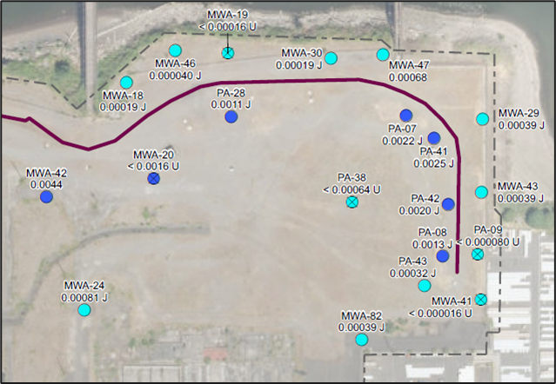
Changes in Detections of Chromium VI Observed on Lot 4 in Shallow Groundwater
Example decreases in concentrations could lead to a less active remedial approach based on results of a data gaps investigation.
HSE Figure GW-29 – Chromium VI in Shallow Groundwater on Lot 4
Updated Shallow Zone Chromium VI Figure using Q1-2021 data
2006 - 2010
2021

Slide 9
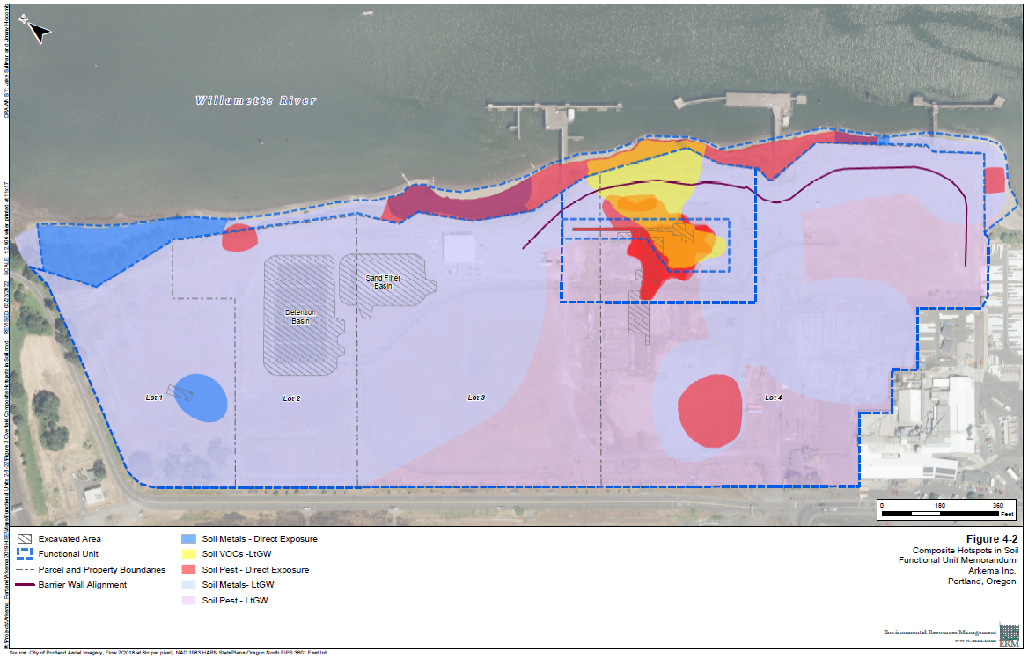
IRAM #3 – Approach Outlined in the FS
IRAM #3 (Previously part of FU-2, FU-3, and FU-4) scoping is based on HSE data set, and could be based off flawed data
From DEQ: Remove all currently known human health direct contact hot spots not addressed by other IRAMs. Per Hot Spot Eval - Lot 1 Arsenic, D/F, and DDX.
IRAM #3 calls for “removal” of “all” direct exposure hot spots if not addressed elsewhere
Some direct exposure hot spots are the result of limited data near hot spot threshold concentrations

Slide 10
Draft IRAM #3 Pre-design Process Questions to-be answered
Inflexibility in the way the IRAM text is written can lead to an unoptimized approach
Other methods could be used to mitigate risk:
- Capping, as recommended in the FS
- Additional engineering controls, such as signage and additional fencing
- Institutional controls, such as a dedicated soil management plan upon site closure
Recommendation:
- Address direct contact hot spots in Revised FS after completion of other IRAMs.
Notes:
LSS believes that IRAM #3 may not be necessary.

Slide 11
End of Section #1
Lunch break

Slide 12
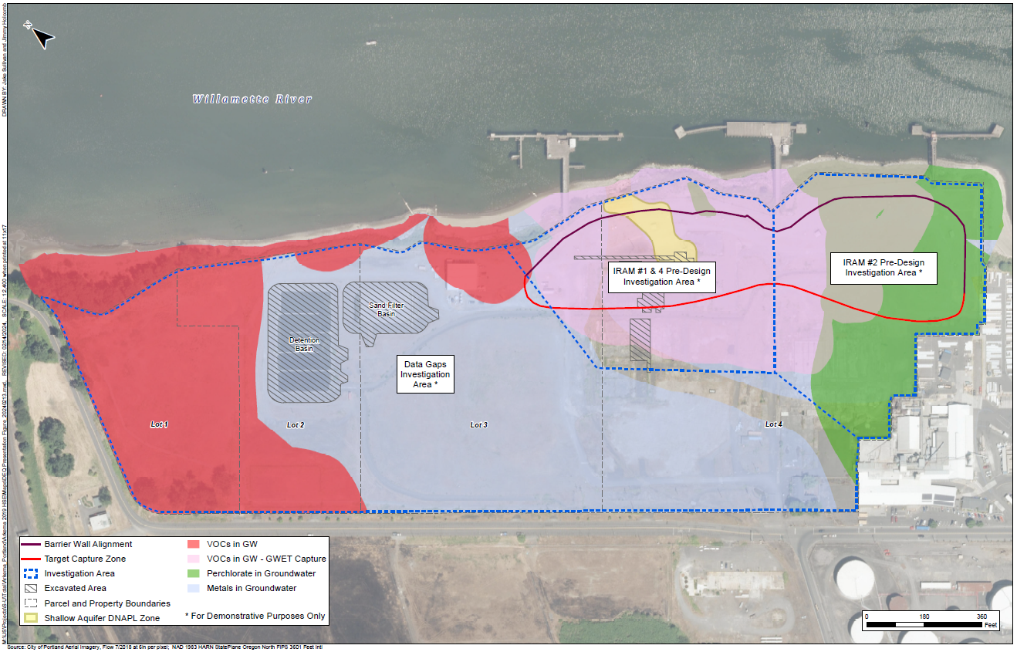
Data Gaps vs. Pre-design Investigation Data Collection

Slide 13
Data Gaps Investigations (other than pre-design investigations for IRAMs 1, 2, and 4)
DEQ 19 January 2024 Letter
5. Completing a robust FS data gaps investigation in parallel with the IRAM consisting of...
DEQ stated data gaps objectives (paraphrase):
5a. Collect additional data to refine understanding of COCs on Lots 1 and 2.
5b. Refine hot spots to reflect contemporary data and fate and transport analysis to establish groundwater points of compliance and actions levels.
5c. Collect data to support monitored natural attenuation as a viable remedial action.
5d. Investigate data gaps for DDx isomers, PCBs, and PFAS.
5e. Investigate vapor intrusion risk.
LSS objective:
Collect additional data, as necessary, to refine trespass plumes.
Notes:
Slides summarize DEQ-identified data gaps.

Slide 14
Data Gaps Investigations, DEQ 5a (other than pre-design investigations for IRAMs 1, 2, and 4)
DEQ 19 January letter: FS data gaps investigation in parallel with the IRAM consisting of…
5a.Collecting additional data to refine the understanding of the nature and extent of contamination in Lots 1 and 2. Sampling in Lots 1 and 2 must include investigation of historical waste disposal areas, including the brine waste piles and brine residue ponds, asbestos pond and trenches, and DDT trench. The FS recommends conducting additional investigation of soil and groundwater in Lots 1 and 2 as part of the first phase of the remedial action.
LSS does not see the need for additional investigation in these areas.
2005 RI Report:
Brine Residue Pile. 1989 excavated visible residue and over-excavated an additional 6 inches.
Brine Residue Pond. 1992 excavated visible residue. 1995 and 1996 testing of fresh brine detected only very low lead or ND for TCLP metals.
Asbestos Pond and Trenches. 1992 excavated visible residue and over-excavated additional 6 inches. Asbestos is not a COC in the HSE or the FS. Future revised FS will propose a CMMP to protect workers.
DDT Trench on Lot 1. 1994 excavated the DDT Trench. Future revised FS will propose a CMMP to protect workers. LSS may propose additional focused investigation of DDT on Lots 1 and 2 to assess the extent of trespass DDT.
Notes:
This section generally follows the DEQ’s 19 January letter.

Slide 15
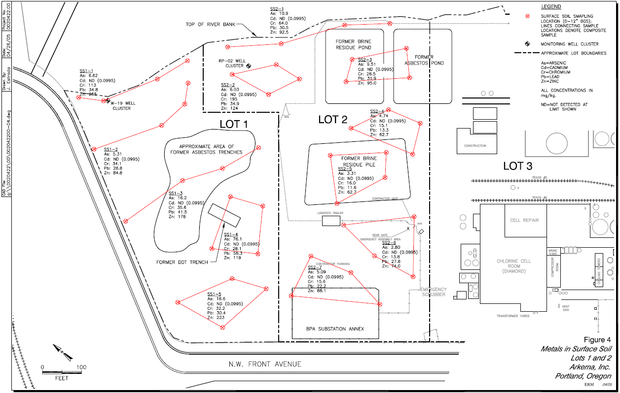
Waste Disposal Areas - Previous Investigations
Historical samples have already been taken to determine risk
Lot 1 & 2 Soil Sampling
2005 RI Report
Data included in HSE
Composite results reported in HSE as single location in center of individual locations.

Slide 16
Data Gaps Investigations, DEQ 5b
DEQ 19 January letter: FS data gaps investigation in parallel with the IRAM consisting of…
5b. (paraphrase) Refine hot spots and establish POCs (and action levels) to incorporate sediment, transition zone water, and porewater results from in-water PDI.
LSS agrees, as proposed in the HSE and FS:
Pre-design/datagaps sampling to assess contemporary concentrations.
Supplemental assessment of leaching from soil to groundwater and transport to a point of exposure in the river.
EPA partitioning model is limited by standard assumptions and input leading to conservative LtGW hot spots.
Refine leaching-to-groundwater estimate to refine hot spot concentrations (e.g., EPA model → VLEACH → lab study).
Model or sample transport, flux, and attenuation of COCs in groundwater over time and distance to estimate concentrations at a point of exposure (porewater or water column).
Review in-water PDI and possible in-water remedies to achieve in-water criteria.
The analysis will be iterative. Preliminary screening will identify target COCs and areas.
A work plan will describe the details. The testing and results will inform the IRAM designs and a future revised FS.

Slide 17
Data Gaps Investigations, DEQ 5c
DEQ 19 January letter: FS data gaps investigation in parallel with the IRAM consisting of…
5c. Collecting data to support monitored natural attenuation as a viable remedial action for groundwater in Lots 3 and 4-Shallow/Intermediate (FU-7), Lots 3 and 4-Deep/Basalt (FU-11), and Lots 1 and 2 Deep/Basalt (FU-12).
EPA superfund guidance and the FS define “natural attenuation.”
Contemporary groundwater data and additional testing will demonstrate the rates of contaminant attenuation over time. Attenuation rates and the conceptual model will inform calculations and modeling or COC concentrations at the POC.
The Trespass Memo indicates that COCs in the Gravel/Basalt unit (FU-11 and FU-12) are trespass plumes from Rhone Poulenc. Accordingly, COCs in the Gravel/Basalt units would attenuate by treatment of the upgradient sources.
Monitored natural attenuation is recommended for FU-7, -11, and -12 because COC concentrations are low; treatment in upgradient, downgradient, or overlying FUs will further reduce the concentrations; and slow contaminant flux over long transport distances allow for attenuation.
A datagaps work plan will further describe the process and methods to assess natural attenuation of COCs for FUs -7, -11, and -12, consistent with the state of the practice and EPA and DEQ guidance.
Notes:
as in situ processes including sorption, volatilization, biodegradation, oxidation, reduction, advection, dispersion, and dilution that will reduce the concentration, toxicity, and mobility of contaminants in soil and groundwater to restore the beneficial use over time.

Slide 18
Data Gaps Investigations, DEQ 5d
DEQ 19 January letter: FS data gaps investigation in parallel with the IRAM consisting of…
5d. Conducting a sitewide investigation to resolve data gaps in current dataset for COIs/COCs, such as a lack of data for the 2,4’DDD, DDE and DDT isomers, PCB congener, and per-and polyfluoroalkyl substances (PFAS).
DDX 2,4’- isomers
Historical analyses of DDD, DDE, and DDT included only 4,4’-isomers.
2009 BERA established a regression to calculate 2,4’ DDx.
The HSE used the surrogate for the 2,4’ isomers to calculate DDx totals.
Future analyses will include 2,4’ isomers.
PCBs
The HSE and FS did not identify PCB hot spots in soil or groundwater.
The Trespass Memo identified high PCB concentrations in RP source areas and upgradient of Arkema.
Future detections of PCBs in groundwater on Arkema would be attributed to RP.
PFAS
PFAS have never been used in any processes at the Site.
Pre-IRAM groundwater sampling will include PFAS.
What are the PFAS screening criteria?
What happens when there are detections?

Slide 19
Data Gaps Investigations, DEQ 5e
DEQ 19 January letter: FS data gaps investigation in parallel with the IRAM consisting of…
5e. Conducting additional investigation to assess vapor intrusion risk.
HHRA identified vapor intrusion as a possible human exposure route.
HSE screened COCs against DEQ VI RBCs and hot-spot concentrations for chloroform and dichlorobenzene.
The FS identified no indoor worker (vapor intrusion) hot spots.
IRAMs and later remedies will address chloroform and dichlorobenzene concentrations in soil.
A residual risk assessment will identify risk of residual contamination.
LSS believes that no additional investigation of vapor intrusion risk is necessary now.
Notes:
The highest concentrations of chloroform onsite were less than 40% of the hot spot criteria for VI.

Slide 20
Next Steps!
Strategy for upcoming work administratively
FSWP is current administrative vehicle, whereas ODEQ’s January 19th letter is not a directive
Comments were provided by ERM on February 14th
Structure of upcoming IRAM work plans and submittal organization
Does the ODEQ have any preferences for how IRAM workplans and reports are submitted (together or separately)?

Slide 21
Brendan Robinson, PE (OR)
Sarah Seekins
David Weymann, PE (OR)
Josh Hancock
Andrew Gardner

Slide 22
Background
Roadmap for overall IRAM implementation as outlined in the January 19th letter, with some modifications
Insert box/path for determining upland GW criteria
* Red lines represent proposed dependencies
IRAM 1 Pre-Design Investigation
IRAM 1 Design
IRAM 1 Implement
IRAM 1 Perf. Mon.
2023 Feasibility Study and Hot Spot Evaluation
IRAM 4 Pre-Design Investigation
IRAM 4 Design *
IRAM 4 Implement
IRAM 4 Perf. Mon.
Refreshed Feasibility Study
IRAM 2 Pre-Design Investigation
IRAM 2 Design
IRAM 2 Implement
IRAM 2 Perf. Mon.
IRAM 1 – Acid Plant Area Soil and Groundwater ISS
IRAM 2 – Enhanced ISCR of Perchlorate and CrVI in Chlorate Plant Area
IRAM 3 – Removal of Human Health Direct Contact Hot Spots
IRAM 4 – Enhanced ISCR of Acid Plant Vicinity
Data Gaps Investigation
IRAM 3 Perf. Mon.
IRAM 3 Pre-Design Investigation
IRAM 3 Design
IRAM 3 Implement
Sitewide Soil Leaching Study
Soil Leaching Remedy? GW remedy? (e.g., Capping, MNA as part of FS?)
Continued SCM O&M and Perf. Monitoring
Notes:
Here is the overall proposed roadmap that Todd outlined in his response to the DEQ letter – red lines are dependencies that we’d like to propose in the 2/22 meeting.
- IRAM 4 fundamentally depends on IRAM 1 since they are going to be conducted in the same area. Additionally, the success of IRAM will inform how aggressive IRAM 4 will need to be. This is why it was considered phase II in the FS.
- IRAM 2 is in a portion of the site that is also lacking in data and the currently proposed remedy is based on the old data set. Recent sampling events and a more comprehensive sampling event in Q1 2021 indicates that site conditions have improved substantially. Additionally, the GW SCM has been progressing towards inward gradient since GEE implementation. Could indicate that only funnel and gate approach is necessary. More information is needed.
- IRAM 3 states “removal” – current portions of the site are completely capped by gravel fill and mitigate worker exposure.

Slide 23
Background
Roadmap for overall IRAM implementation as outlined in the January 19th letter, with some modifications
IRAM 1 Pre-Design Investigation
* Red lines represent dependencies
IRAM 1 Design
IRAM 1 Implement
IRAM 1 Perf. Mon.
2023 Feasibility Study and Hot Spot Evaluation
IRAM 4 Pre-Design Investigation
IRAM 4 Design *
IRAM 4 Implement
IRAM 4 Perf. Mon.
Feasibility Study
IRAM 2 Pre-Design Investigation
IRAM 2 Design
IRAM 2 Implement
IRAM 2 Perf. Mon.
IRAM 1 – Acid Plant Area Soil and Groundwater ISS
IRAM 2 – Enhanced ISCR of Perchlorate and CrVI in Chlorate Plant Area
IRAM 3 – Removal of Human Health Direct Contact Hot Spots
IRAM 4 – Enhanced ISCR of Acid Plant Vicinity
Data Gaps Investigation
IRAM 3 Perf. Mon.
IRAM 3 Pre-Design Investigation
IRAM 3 Design
IRAM 3 Implement
Sitewide Soil Leaching Study
Soil Leaching Remedy? GW remedy? (e.g., Capping, MNA as part of FS?)
Continued SCM O&M and Perf. Monitoring
Notes:
Here is the overall proposed roadmap that Todd outlined in his response to the DEQ letter – red lines are dependencies that we’d like to propose in the 2/22 meeting.
- IRAM 4 fundamentally depends on IRAM 1 since they are going to be conducted in the same area. Additionally, the success of IRAM will inform how aggressive IRAM 4 will need to be. This is why it was considered phase II in the FS.
- IRAM 2 is in a portion of the site that is also lacking in data and the currently proposed remedy is based on the old data set. Recent sampling events and a more comprehensive sampling event in Q1 2021 indicates that site conditions have improved substantially. Additionally, the GW SCM has been progressing towards inward gradient since GEE implementation. Could indicate that only funnel and gate approach is necessary. More information is needed.
- IRAM 3 states “removal” – current portions of the site are completely capped by gravel fill and mitigate worker exposure.

