Slide 1
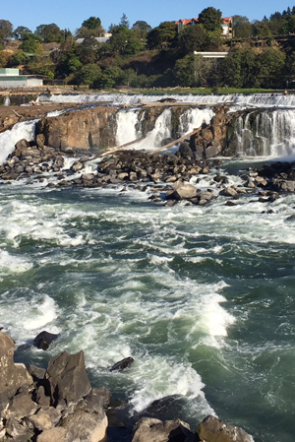
Water Quality Standards
Willamette Basin Mercury Variance Rulemaking
EQC Presentation
November 15, 2018
Photo credit Andrea Matzke
Aron Borok | Oregon Department of Environmental Quality
Notes:
Good afternoon, everyone. My name is Aron Borok. I am a water quality standard specialist with the Oregon Department of Environmental Quality. With me are Debra Sturdevant, Standards Program lead and Spencer Bohaboy from DEQ’s permitting program.

Slide 2
What is a variance?
Clean Water Act tool
Water quality based effluent limits not attainable
Time limited standard change for specified discharger(s)
Requires progress toward the standard
Effective upon EPA approval
Notes:
Variances are a tool provided by the Clean Water Act to address situations where dischargers cannot feasibly attain permit limits based on water quality standards. Variances are considered changes to the water quality standards for a specified limited time period and for specific dischargers or waterbodies. Variances do not change the underlying standard. The variance must be evaluated with each permit renewal to determine whether progress toward the standard has been accomplished and pollution reductions can continue.
There are two “types” of variances – DEQ can grant wastewater dischargers individual variances for a single facility if they meet requirements in Oregon’s water quality standards. DEQ also has the option of developing a rule for a multiple discharger variance, in cases where DEQ finds that there are likely multiple facilities with similar operations that cannot attain permit limits for a specific pollutant. Because it is a rule, it will require EQC adoption. In addition, any variance, individual or multiple discharger, is only effective after EPA approves it under the Clean Water Act.

Slide 3
Why an MDV?
Standard is unattainable (for now)
Effluent limits unachievable (for now)
Source reduction or treatment is available (for now)
Need for variance
Notes:
A multiple discharger variance is appropriate if an agency believes that there are multiple entities that won’t be able to achieve permit limits for the same reason. In this case, through the TMDL process, we have information indicating that a large portion of the mercury in the Willamette come from air deposition from global sources of pollution or erosion of local soil high in mercury. We estimate that less than 3% comes from point source dischargers. It will take decades to reduce mercury through implementation of the TMDL; in the meantime, there are no technologies that point sources can use to achieve effluent limits. In some cases, it may be more environmentally harmful to upgrade technologies to reduce mercury further, due to generation of sludge and the energy that it would take to operate advanced treatment. Meanwhile, implementing a source reduction plan, which would be a requirement of the variance, provides the ability for dischargers to reduce the amount of mercury coming into (and coming out of) the treatment facility.
At some point in the future, if DEQ determines that the standard is still unattainable and opportunities for mercury reduction are not available, the agency has the option of developing a site-specific criterion for mercury. However, for now, the variance is the right tool to provide dischargers with the ability to meet effluent limits and still require actions to reduce mercury.

Slide 4
Rulemaking – Objectives
EPA approvable variance
Mercury reductions
Achievable effluent limits
Application process
Conform state and federal variance rules
Notes:
DEQ’s goal for the rulemaking are to:
Have a variance that EPA can approval. We are working closely with EPA Region 10 on this and the Clean Water Services variance to ensure that we can work out any concerns ahead of time.
Have a process that will lead to mercury reductions, whether through treatment or source reduction.
Ensure that dischargers have effluent limits that are achievable based on current or planned future treatment technology
Ensure that the variance application process is as straightforward as possible.
In addition, DEQ may propose amendments to the variance rule to ensure that it conforms to the federal rule, which was amended in 2015.

Slide 5
Variance Rulemaking – Key Dates
Milestone | Date
Advisory Committee | Oct. 2018 – Feb. 2019
Public Notice & Comment Period | Apr. – May 2019
Public Hearings | May 2019
EQC Presentation | September 2019
EPA Submittal | September 2019

Slide 6
Advisory Committee
Four meetings
Members
Dischargers (municipal and industrial)
Environmental & fishing groups
Tribes
EPA (agency advisor)

