Slide 1
Water Quality Standards and Assessment
Rulemaking: Willamette Basin Mercury Multiple Discharger Variance and Variance Rule Amendments
January 24, 2020
Hillsboro, OR
Aron Borok | Oregon Department of Environmental Quality

Slide 2
Today’s action
Here today to recommend that the EQC take action on 2 proposed rule amendments:
1.
2.
How are we going to set up the actions? Do the full presentation and then come back to each action?

Slide 3

Outline
Variance Basics
Willamette Basin MDV
  Justification
  Term and Eligibility
  Requirements
  Public comments
Variance Rule Amendments
Questions
Notes:
First, provide an overview and answer questions, then come back to recommended actions of the Commission.

Slide 4
Variance - definition
Time-limited alternative standard for specified discharger(s) or waterbody.
For purpose of wastewater discharge permits & 401 certifications only
Does not change underlying standard for other purposes.
Feasible progress toward standard.
Effective upon EPA approval.
Notes:
Variances are a tool under the Clean Water Act to address situations where dischargers cannot feasibly attain permit limits based on water quality standards. Variances are changes to water quality standards for a specified limited time period which apply to specific dischargers or waterbodies. Variances do not change the underlying standard for other purposes, such as TMDLs or water quality assessments. Variances are appropriate if actions can be taken to reduce the pollutant loading and reasonable progress can be made toward the water quality standard. Variances are only effective upon EPA approval.
There are three “types” of variances – DEQ can grant individual variances for a single wastewater discharger. DEQ also has the option of developing a rule for a multiple discharger variance, in cases where DEQ finds that there are likely multiple facilities with similar operations that cannot attain permit limits for a specific pollutant for similar reasons. Finally, DEQ can develop a rule for waterbody variance that applies to an entire waterbody, instead of specific dischargers. In this case, DEQ would specify an alternative temporary instream criterion for the waterbody. But again, the alternative criterion may only to be used for purposes of NPDES permitting and 401 certifications.
------------

Slide 5
Variance - purpose
Notes:
Last slide was definition, this one can be purpose/objective

Slide 6

Background on the mercury standard
Human health mercury criterion
0.14 ng/L water column concentration.
Notes:
First, I’d like to provide a bit of background about why the Willamette Basin Multiple Discharger Variance is needed. In 2011, DEQ adopted the current human health criterion for methylmercury and for other toxic pollutants. These are among the most stringent human health criteria in the country. This was done to ensure that Oregonians that consume high amounts of fish are adequately protected from methylmercury and other toxic pollutants. At the time these criteria were adopted, DEQ and stakeholders recognized that dischargers would have a difficult time meeting permit limits based on some of the criteria. So, at that time, DEQ revised or adopted a number of tools, such as variances, that would provide DEQ a means to issue permits while making progress toward the standard.

Slide 7
Willamette Basin Mercury Multiple Discharger Variance
Willamette and many other basins are not attaining methylmercury criterion.
Permit limits based on TMDL unattainable dischargers throughout basin.
Variance needed to issue permits and reduce mercury from point sources.
Notes:
Unlike other toxic substances, the methylmercury criterion is expressed as a fish tissue concentration. The fish tissue concentration is exceeded in most fish sampled across the state. Through TMDL development in 2006 and recently, DEQ has a way of translating this fish tissue concentration into a corresponding concentration in water that can be used as the basis for permit limits. However, as I’ll be describing in a few slides, permit limits based on the water quality standard this water concentration value are not attainable. As a result, a variance is needed in order to have a way of issuing individual wastewater permits with limits that are attainable for our dischargers, while still finding ways to reduce the amount of mercury coming into the Basin waters. The variance provides a transparent process for DEQ to do so.

Slide 8

The Need for the Variance Factor
“Human-caused conditions or sources of pollution prevent the attainment of the use and cannot be remedied or would cause more environmental damage to correct than leave in place.”
Notes:
The need for a Variances must be based on demonstrated using one of seven factors outlined in federal and state rules. The Willamette Basin MDV is based primarily on what is called Factor 3 – that human-cause conditions of mercury prevent the waterbody from meeting the standard and cannot be remedied. In order to justify the variance to EPA, we have to provide sufficient evidence that this is the case during the term of the variance. We also recognize that a portion of the mercury in the basin comes from natural sources.

Slide 9
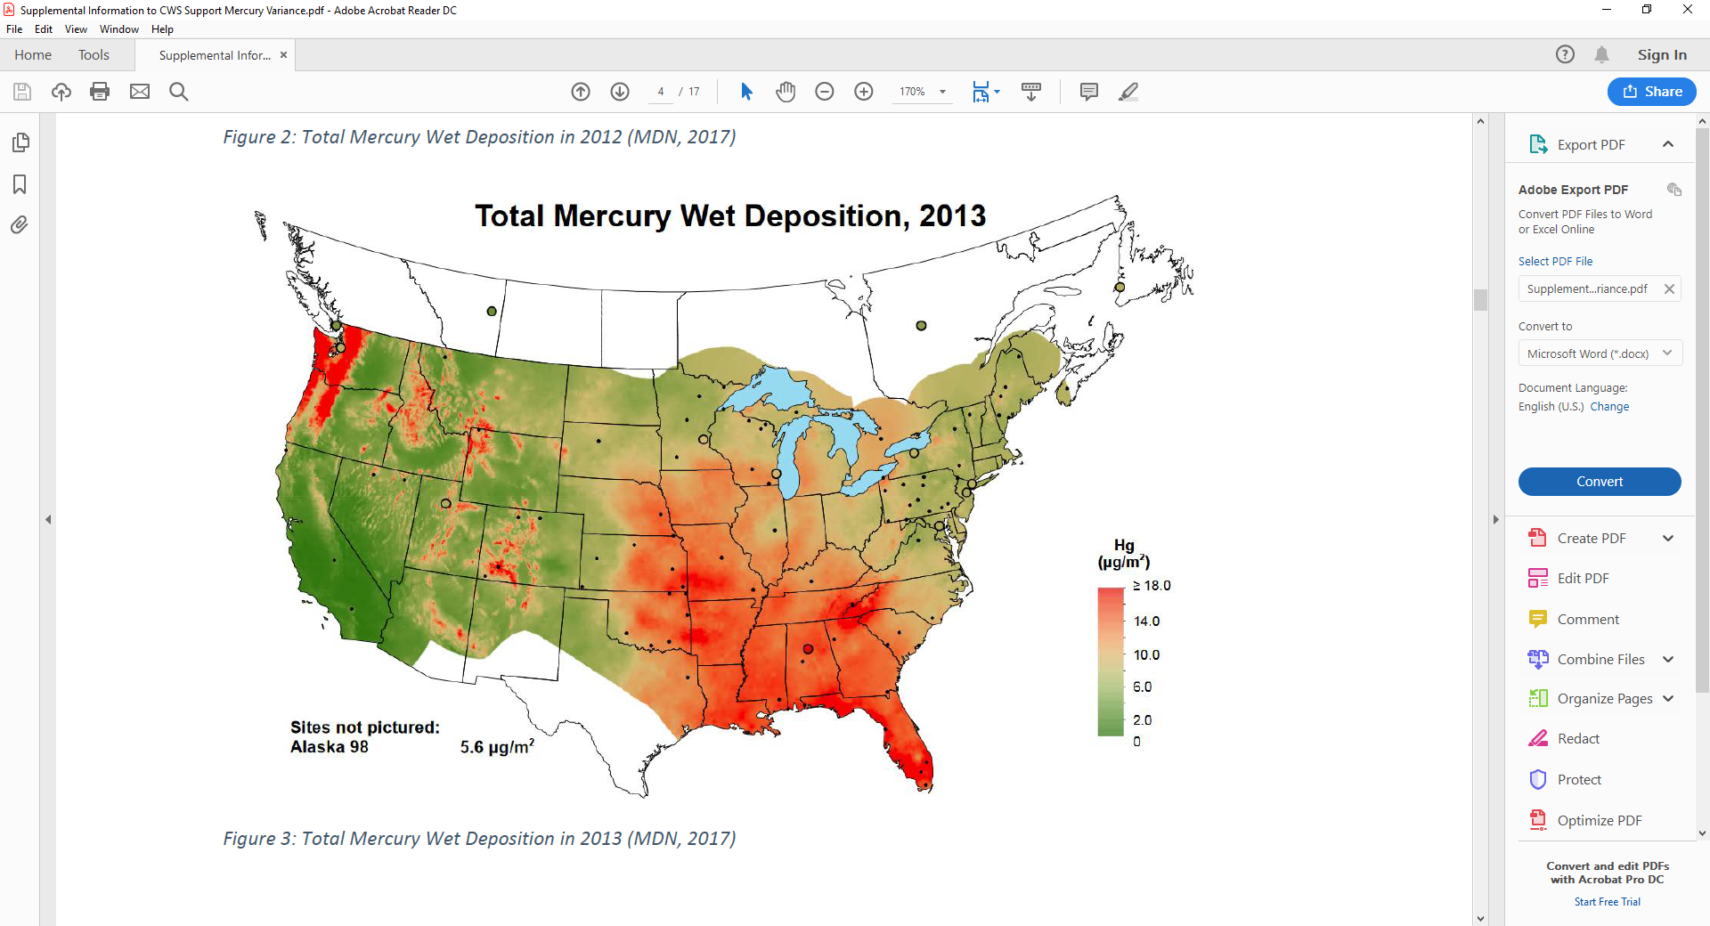
Atmospheric Mercury Deposition
Notes:
As has been discussed with the Commission previously, the majority of mercury found in Oregon fish comes from atmospheric deposition. There’s a reservoir of mercury in the atmosphere that comes from sources around the globe – from combustion, cement manufacturing, fires, volcanos and other sources. Some of this reservoir is deposited when it rains. Some is deposited directly to water; some falls onto land, but then enters into waters due to natural and human caused runoff. Because we get so much rain here, we tend to have high wet deposition rates get much more mercury than much of the rest of the country. As a result, the waters of the Willamette Basin have higher concentrations of mercury than the criterion, and the vast majority of this mercury comes from global sources. While the State can control movement of much of this mercury into the watershed through erosion control and other programs, such efforts will take decades to accomplish.

Slide 10
Technology cannot achieve criterion
Treatment Technology | Effluent Volume Range of Known Uses | Treatment Ability | Current Standard
Current Treatment (Secondary, Advanced Secondary, Tertiary) | Up to 25 MGD | 1-20 ng/L | 0.14 ng/L
Membrane Filtration | Low volume | Bench scale to 0.26 ng/L
Ion Exchange | 0.015 MGD | 1 ng/L
Precipitation and filtration | Low volume | Bench scale to 0.17 ng/L; full scale to 25 ng/L
Adsorption | Low volume | Bench scale to 0.08 ng/L; full scale to 25 ng/L
Notes:
A small amount of mercury entering to the basin waters comes from wastewater treatment plants. While wastewater treatment facilities remove much of the mercury in their effluent – usually 90% or more, technology isn’t designed to specifically remove mercury, which leads to varying concentrations of mercury in effluent over time and among treatment plants. Moreover, there is no proven technology that can achieve that very low level of mercury equivalent to the water quality standard – 0.14 ng/L. As a result, dischargers need a variance.

Slide 11
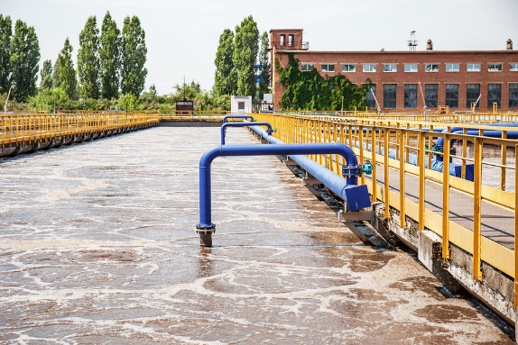
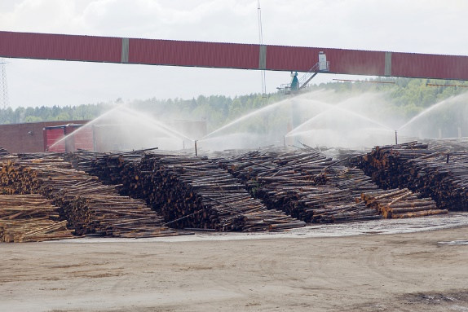
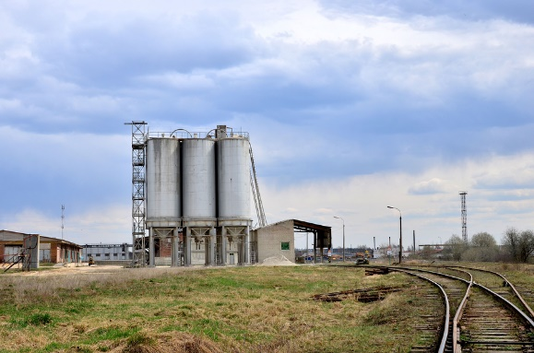

Eligible Dischargers
64 individual NPDES permit holders listed in rule.
  Major wastewater treatment plants.
  Minor WWTPs which may become “major” during term of variance.
  Industrial facilities in industries likely to discharge mercury.
Notes:
Dischargers that are eligible for the variance include holders of individual wastewater permits that would otherwise have a permit limits for mercury based on the water quality standard. These facilities are listed in the proposed rule and in supporting documentation. This includes any municipal wastewater treatment plants that DEQ classifies as “major” – with flows of 1 MGD – 27 of these. In addition, it includes industrial facilities in sectors likely to discharge mercury, including pulp and paper, cement manufacturing and some electronics manufacturing. Finally, DEQ has included as eligible many minor wastewater treatment plants, in case these facilities graduate to a “major” facility during the term of the variance.

Slide 12
What will the variance require?
Effluent mercury levels achievable with current treatment system plus mercury minimization plan.
  Effluent limits based on recent data, which will decrease as mercury levels decrease.
Mercury minimization program
  Minimum MMP elements included in rule.
Monitoring and reporting
How do requirements relate to TMDL implementation for individual point sources?
Notes:
For the variance, requirements must reflect what is called the Highest Attainable Condition. In this case, DEQ has concluded that the most appropriate expression is an effluent condition reflecting current technology plus implementation of a mercury minimization plan. This approach to reducing mercury is consistent with 2010 EPA guidance on the methylmercury criterion which suggests source control as the preferred approach to reducing mercury levels.
I’d like to briefly mention how the variance relates to the TMDL. DEQ is pursuing an approach in which it would implement TMDL wasteload allocations for point sources through MMP implementation, consistent with the approach in the MDV. If that is the case, the variance may not be needed. However, if implementation of the TMDL is delayed for any reason, we are developing the MDV to ensure that DEQ has a means to issue permits in the Willamette Basin .

Slide 13
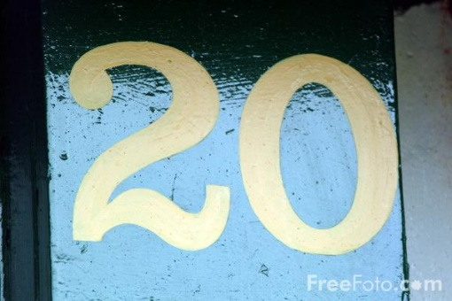

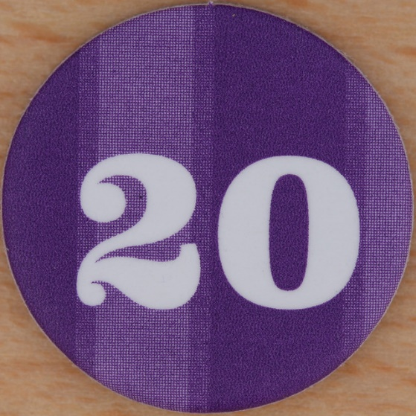
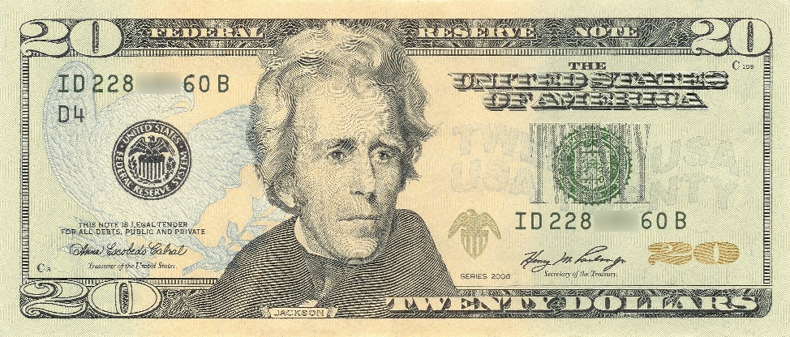

Term of the variance
Provides time for dischargers to implement required mercury minimization activities.
Provides time to collect and evaluate data.
DEQ will assess path forward at end of variance.
This Photo by Unknown Author is licensed under CC BY-SA
This Photo by Unknown Author is licensed under CC BY-NC-ND
This Photo by Unknown Author is licensed under CC BY-SA
This Photo by Unknown Author is licensed under CC BY-SA-NC
This Photo by Unknown Author is licensed under CC BY-SA-NC
Notes:
DEQ is proposing a 20-year term for this variance. DEQ does not expect that the water quality standard will be attained during this term. In other words, DEQ could justify a longer term. However, DEQ has concluded that a 20-year term will provide time for dischargers to implement required mercury minimization activities, and to collect data and evaluate progress in reducing mercury levels. Dischargers that have been implementing mercury minimization activities for many years must continue to do so, but also have the option of addressing nonpoint mercury sources under their control that will reduce mercury in the receiving stream, even though they may not further reduce their effluent levels. as well as implementing or funding nonpoint source activities outside of their control.

Slide 14
Five-year re-evaluation
Progress in achieving reductions.
Re-evaluate feasibility of mercury removal technology
Public comment and
EPA submittal.
Notes:
Because the term of the variance is greater than 5 years, DEQ is required to re-evaluate the requirements of the variance every five years. DEQ expects this The re-evaluation to will have two main components. DEQ will evaluate progress that dischargers have achieved in reducing mercury under the variance. DEQ also will re-evaluate the feasibility of mercury removal technology. After this re-evaluation, DEQ also will re-calculate permit limits for mercury for each discharger as their permit comes up for renewal.
As required by federal rule, DEQ will give the public an opportunity to comment on the re-evaluation. Once this has happened, DEQ will make any needed revisions, then submit the final evaluation to EPA, as required under federal variance rules.

Slide 15
Major comments
Multiple discharger variance vs. waterbody variance.
  DEQ clarified that this is a MDV.
  Included list of eligible facilities in rule.
Activities the state is implementing to make progress toward methylmercury criterion.
  No new requirements, but acknowledges existing programs.
Notes:
DEQ received 26 comments on the MDV and made a number of clarifications. I will highlight two major comments here.
First, there were a few comments either suggesting that the variance was a waterbody variance or asking for clarification as to whether the proposed variance is a waterbody or multiple discharger variance. Under a waterbody variance, DEQ must, in supporting documentation, identify best management practices for nonpoint sources that can make progress toward the water quality standard. This is not required for a multiple discharger or individual variance. DEQ has clarified that it is proposing a multiple discharger variance. DEQ’s intent is to address all sources of mercury through implementation of any effective TMDL. The variance is solely to address individually permitted point sources of mercury.
EPA also requested that DEQ list in the variance rule a list of activities being implemented by the state that will make progress toward the methylmercury criterion. DEQ agreed to include a list of existing programs that address mercury in order to facilitate the EPA approval process.

Slide 16
Changes to draft variance authorization rule
Purpose:
  Consistency with 2015 federal regulations
  Clarity
Types of variances and authorization.
  Individual
  Multiple discharger and waterbody
Notes:
I will now discuss changes that DEQ is proposing to the variance authorization rule. DEQ last amended this rule in 2011. Since then, EPA promulgated its own variance rules. DEQ is amending its rule to make it consistent with the federal rule and to clarify requirements.
One of the major changes is that the previous rule only anticipated DEQ granting refer to individual variances. The proposed language clarifies that the EQC is delegating the authority to the DEQ Director to continues to give DEQ the authority to issue individual variances, but and clarifies that the Commission can retains the authority to grant multiple discharger and waterbody variances through rule.

Slide 17
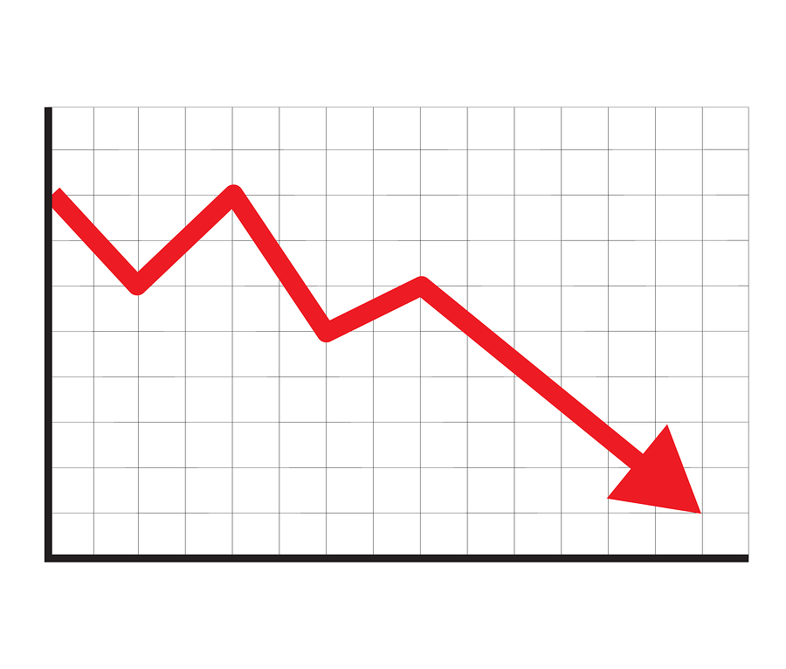
Changes to draft variance authorization rule
Removes provision regarding ESA species and human health risk.
Removes section regarding variance renewals.
Notes:
The current rule prohibits variances if they would result in jeopardy to species listed as threatened or endangered under the Endangered Species Act or if the variance will result in unreasonable risk to human health. DEQ is proposing to remove these provisions.
DEQ is proposing to remove the provision related to ESA-species because the decision as to whether a variance results in jeopardy to endangered species should be made by the federal fisheries services, who will be consulted prior to EPA approval of for any variance to an aquatic life criterion.
DEQ is proposing to remove the provision related to human health, as variances do not result in an increased risk to human health. Variances are only allowed if it is demonstrated that the progress can be made toward the criterion. In the case of human health criteria, variances can only work if they result in decreased risk.
DEQ also is proposing to remove the section regarding variance renewals. Under federal rules, each variance is considered a new variance; thus, it does not make sense to include the section on variance renewals.

Slide 18
summary
Reiterate purpose of variances
Objectives of mercury MDV
Repeat recommendations:
Language that can be made into motions.

Slide 20

Questions

