Slide 1
Water Quality Standards and Assessment
Rulemaking: Willamette Basin Mercury Multiple Discharger Variance and Variance Rule Amendments
January 24, 2020
Hillsboro, OR
Aron Borok | Oregon Department of Environmental Quality

Slide 2
Today’s action
Here today to recommend that the EQC take action on 2 proposed rule amendments:
Adopt proposed amendments to the State Variance Authorization Rule at OAR 340-041-0059 and associated definitions at OAR 340-041-0002.
Adopt proposed amendments to OAR 340-041-0345 establishing a multiple discharger variance for mercury for the Willamette Basin.

Slide 3

Outline
Background and Variance Basics
Willamette Basin MDV
  Justification
  Term and Eligibility
  Requirements
  Public comments
Variance Rule Amendments
Questions
Notes:
First, provide an overview and answer questions, then come back to recommended actions of the Commission.

Slide 4
Methylmercury Criterion
Protects high level of fish consumption.
Expressed as fish tissue concentration.
For permits, implemented through mercury minimization programs.
Notes:
In 2011, the Commission adopted the current human health criterion for methylmercury and for other toxic pollutants. These are among the most stringent human health criteria in the country. This was done to ensure that Oregonians that consume high amounts of fish are adequately protected from methylmercury and other toxic pollutants. It’s important to note that at the time these criteria were developed, DEQ and stakeholders understood that permitted dischargers would not be able to achieve permit limits based on some of these criteria immediately. So, at that time, DEQ revised or adopted a number of tools allowed under the Clean Water Act, such as variances.
Unlike other toxic substances, the human health methylmercury criterion is expressed as a fish tissue concentration. This is different from other human health criteria that are expressed as a water column concentration. This means that the criterion generally cannot be used as the base for numeric permit limits. Instead, EPA and state guidance suggests that permitted facilities, such as municipal wastewater treatment plants and industrial facilities, reduce mercury that they discharger through developing and implementing mercury minimization programs.

Slide 5
Mercury in the Willamette Basin
TMDL: ~0.14 ng/L water column target.
Permit limits based on standard unattainable dischargers throughout basin.
Variance needed to issue permits and reduce mercury from point sources.
Relationship to TMDL
Notes:
In the Willamette Basin, through TMDL development DEQ has a way of translating this fish tissue concentration into a corresponding target concentration in water that can be used as the basis for permit limits. However, there is no current treatment that can attain permit limits based on this water concentration target. As a result, a variance is needed in order to have a way of issuing individual wastewater permits with limits that are attainable for our dischargers, while still finding ways to reduce the amount of mercury coming into Basin waters. The variance provides a transparent process for DEQ to do so.
I’d like to briefly mention how the variance relates to the TMDL. DEQ is pursuing an approach in which it would implement TMDL wasteload allocations for point sources through implementation of mercury minimization programs, consistent with the approach in the MDV that I’ll talk about in this presentation. However, because the outcome of the TMDL process is still uncertain, we are developing the MDV to ensure that DEQ has a path forward for issuing permits that are up-to-date and make progress in reducing mercury loading to the Willamette.

Slide 6
Variance - definition
Time-limited alternative standard for specified discharger(s) or waterbody.
For purpose of wastewater discharge permits & 401 certifications only.
Does not change underlying standard.
Effective upon EPA approval.
Notes:
Now I’d like to talk about what variances are and why they are adopted. Variances are a tool under the Clean Water Act to address situations where dischargers cannot feasibly attain permit limits based on water quality standards. Variances are changes to water quality standards for a specified limited time period which apply to specific dischargers or waterbodies. Variances do not change the underlying standard for other purposes, such as TMDLs or water quality assessments. Variances are appropriate if actions can be taken to reduce the pollutant loading. Variances are only effective upon EPA approval.

Slide 7
Variance - purpose
Appropriate Clean Water Act tool to:
  Provide a path for issuing permits
  Make feasible progress in reducing pollutant loadings.
  Ensure that the process is transparent.
Notes:
In summary, the variance is an appropriate tool under the Clean Water Act so that States have a way to issue permits when permit limits based on water quality standards are not attainable, but provides a path to making progress in reducing pollution and making the process transparent.

Slide 8

The Need for the Variance
“Human-caused conditions or sources of pollution prevent the attainment of the use and cannot be remedied or would cause more environmental damage to correct than leave in place.”
Notes:
Now I’ll talk about the proposed multiple discharger variance. The need for variances must be demonstrated using one of seven factors outlined in federal and state rules. The Willamette Basin MDV is based primarily on what is called Factor 3 – that human-cause conditions of mercury prevent the waterbody from meeting the standard and cannot be remedied. In order to justify the variance to EPA, we have to provide sufficient evidence that this is the case during the term of the variance. We also recognize that a portion of the mercury in the basin comes from natural sources.

Slide 9
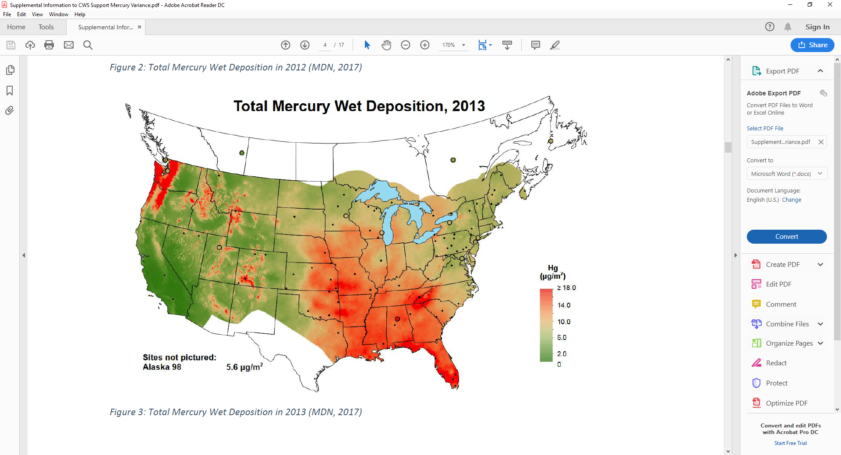
Atmospheric Mercury Deposition
Notes:
As has been discussed with the Commission previously, the majority of mercury found in Oregon fish comes from atmospheric deposition and natural mercury sources. There’s a reservoir of mercury in the atmosphere that comes from sources around the globe – from combustion, cement manufacturing, fires, volcanos and other sources. Some of this reservoir is deposited when it rains; some also is deposited when it is dry. Some is deposited directly to water; some falls onto land, but then enters into waters due to natural and human caused runoff. As we can see in the chart, because we get so much rain here, we tend to have high wet deposition rates. As a result, the waters of the Willamette Basin have higher concentrations of mercury than the criterion, and the vast majority of this mercury comes from global sources. While the State can control movement of much of this mercury into the watershed through erosion control and other programs, such efforts will take decades to accomplish and see corresponding reductions in fish tissue mercury concentrations.

Slide 10
Technology cannot achieve criterion
Treatment Technology | Effluent Volume Range | Treatment Ability | In-stream Target
Current Treatment (Secondary, Advanced Secondary, Tertiary) | Up to 25 MGD | 1-20 ng/L | 0.14 ng/L
Membrane Filtration | Low volume | Bench scale to 0.26 ng/L
Ion Exchange | 0.015 MGD | 1 ng/L
Precipitation and filtration | Low volume | Bench scale to 0.17 ng/L; full scale to 25 ng/L
Adsorption | Low volume | Bench scale to 0.08 ng/L; full scale to 25 ng/L
Notes:
A small amount of mercury enters basin waters from wastewater treatment plants. While wastewater treatment facilities remove much of the mercury in their effluent – usually 90% or more, there is no demonstrated technology that can achieve that very low target – 0.14 ng/L at the scale of a treatment plant. As a result, dischargers need a variance.

Slide 11
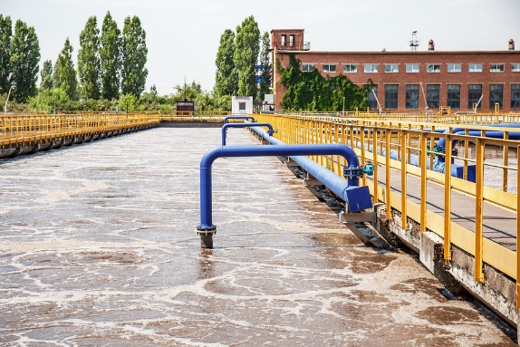
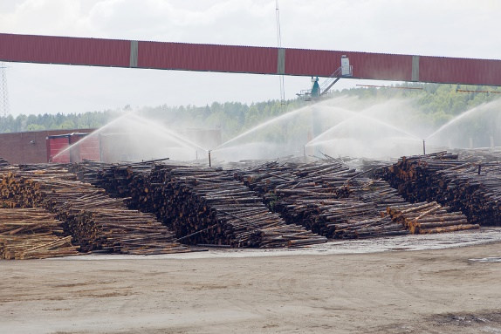
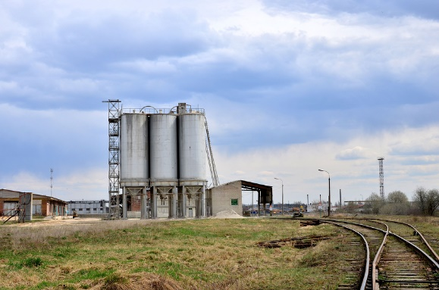
Dischargers Subject to Variance
64 individual NPDES permit holders listed in rule.
  Major wastewater treatment plants.
  Minor WWTPs when they would otherwise obtain permit limit based on water quality standard.
  Industrial facilities in industries likely to discharge mercury.
Notes:
Dischargers subject to the variance include holders of individual wastewater permits that would otherwise have a permit limits for mercury based on the water quality standard. These facilities are listed in the proposed rule and in supporting documentation. This includes any municipal wastewater treatment plants that DEQ classifies as “major” – with flows of 1 MGD – 27 of these. In addition, it includes industrial facilities in sectors likely to discharge mercury, including pulp and paper, cement manufacturing and some electronics manufacturing – 8 of these. Finally, DEQ has included as eligible many minor wastewater treatment plants, in case these facilities would otherwise obtain permit limits based on the water quality standard during the term of the variance.

Slide 12
What will the variance require?
Meet effluent mercury limits achievable with current treatment system based on recent data.
Implement mercury minimization program, with minimum elements included in rule.
Monitoring and reporting
Notes:
Under the variance, DEQ will require dischargers to meet effluent limits that are achievable with their current treatment system based on recent data. These dischargers also will be required to develop and implement a mercury minimization program. This includes such activities as implementing the statewide dental amalgam rule, as well as identifying and inspecting facilities that are likely to have mercury, such as laboratories, schools and hospitals. Industrial facilities would be required to identify potential substitute materials used in their manufacturing process that may have less mercury. Finally, all facilities will have minimum monitoring and reporting requirements.

Slide 13
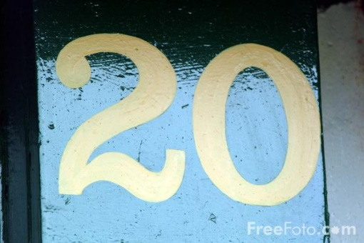

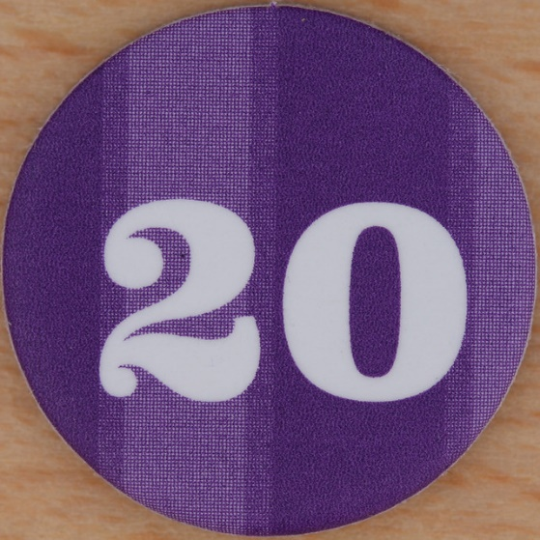
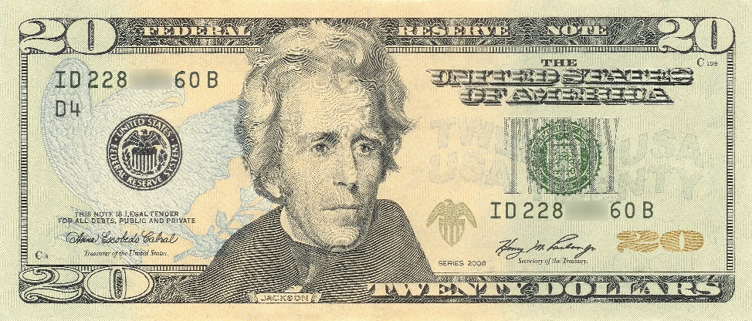

Term of the variance
Provides time for dischargers to implement required mercury minimization activities.
Provides time to collect and evaluate data.
DEQ will assess path forward at end of variance.
This Photo by Unknown Author is licensed under CC BY-SA
This Photo by Unknown Author is licensed under CC BY-NC-ND
This Photo by Unknown Author is licensed under CC BY-SA
This Photo by Unknown Author is licensed under CC BY-SA-NC
This Photo by Unknown Author is licensed under CC BY-SA-NC
Notes:
DEQ is proposing a 20-year term for this variance. DEQ does not expect that the water quality standard will be attained during this term. However, a 20-year term will provide time for dischargers to implement mercury minimization activities, and to collect data and evaluate progress in reducing mercury levels.

Slide 14
Five-year re-evaluation
Progress in achieving reductions.
Re-evaluate feasibility of mercury removal technology
Public comment and EPA submittal.
Notes:
Because the term of the variance is greater than 5 years, DEQ is required to re-evaluate the requirements of the variance every five years. The re-evaluation will have two main components. DEQ will evaluate progress that dischargers have achieved in reducing mercury under the variance. DEQ also will re-evaluate if the feasibility of mercury removal technology has changed. After this re-evaluation, DEQ also will re-calculate permit limits for mercury for each discharger as their permit comes up for renewal.
As required by federal rule, DEQ will give the public an opportunity to comment on the re-evaluation. Once this has happened, DEQ will make any needed revisions, then submit the final evaluation to EPA, as required under federal variance rules.

Slide 15
Major comments
Multiple discharger variance vs. waterbody variance.
  DEQ clarified that this is a MDV.
  Included list of facilities in rule.
Activities the state is implementing to make progress toward methylmercury criterion.
  No new requirements, but acknowledges existing programs.
Notes:
DEQ received 26 comments on the MDV and made a number of clarifications. I will highlight two major comments here.
First, there were a few comments either suggesting that the variance was a waterbody variance or asking for clarification as to whether the proposed variance is a waterbody or multiple discharger variance. Under a waterbody variance, DEQ must identify best management practices for nonpoint sources that can make progress toward the water quality standard. This is not required for a multiple discharger or individual variance. DEQ has clarified that it is proposing a multiple discharger variance and that the purpose of the variance is to provide an appropriate and transparent pathway to issue NPDES permits with requirements that are feasible and will reduce mercury loadings.
EPA also requested that DEQ list in the variance rule activities being implemented by the state that will make progress toward the methylmercury criterion. DEQ agreed to include a list of existing programs that address mercury in order to facilitate the EPA approval process.

Slide 16
Changes to draft variance authorization rule
Purpose:
  Consistency with 2015 federal regulations
  Clarity
Types of variances and authorization.
  Individual
  Multiple discharger and waterbody
Notes:
I will now discuss changes that DEQ is proposing to the variance authorization rule. DEQ last amended this rule in 2011. Since then, EPA promulgated its own variance rules. DEQ is amending its rule to make it consistent with the federal rule and to clarify requirements.
The proposed language clarifies that the EQC is delegating the authority to the DEQ Director to issue individual variances, but the Commission retains the authority to grant multiple discharger and waterbody variances through rule.

Slide 17
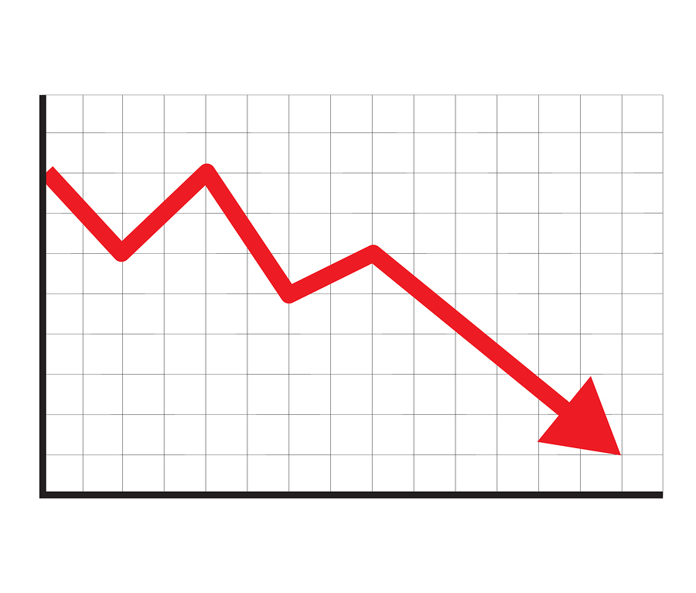
Changes to draft variance authorization rule
Removes provision regarding ESA species and human health risk.
Removes section regarding variance renewals.
Notes:
The current rule prohibits variances if they would result in jeopardy to species listed as threatened or endangered under the Endangered Species Act or if the variance will result in unreasonable risk to human health. DEQ is proposing to remove these provisions.
DEQ is proposing to remove the provision related to ESA-species because the decision as to whether a variance results in jeopardy to endangered species should be made by the federal fisheries services, who will be consulted prior to EPA approval of any variance to an aquatic life criterion.
DEQ is proposing to remove the provision related to human health, as variances do not result in an increased risk to human health. Variances are only allowed if it is demonstrated that the progress can be made toward the criterion. In the case of human health criteria, variances can only work if they result in decreased risk.
DEQ also is proposing to remove the section regarding variance renewals. Under federal rules, each variance is considered a new variance; thus, it does not make sense to include the section on variance renewals.

Slide 18
Proposal
Adopt proposed amendments to the State Variance Authorization Rule at OAR 340-041-0059 and associated definitions at OAR 340-041-0002.
Adopt proposed amendments to OAR 340-041-0345 establishing a multiple discharger variance for mercury for the Willamette Basin.
Notes:
To briefly summarize the main points, a variance is a change to the water quality standard for the purposes of permitting and are only appropriate if actions can be taken to reduce the pollutant. For point source dischargers to Willamette Basin waters listed in the proposed rule, the MDV is an appropriate to tool to provide a path forward for permitting and which will allow the dischargers to make progress in reducing mercury loads in a transparent manner over the next 20 years. We request the Commission adopt the proposed amendments as provided in the Staff Report. We are happy to answer any additional questions.

Slide 19

Questions

