Slide 1
Water Quality Standards and Assessment
Rulemaking: Willamette Basin Mercury Multiple Discharger Variance and Variance Rule Amendments
January 24, 2020
Hillsboro, OR
Aron Borok | Oregon Department of Environmental Quality
Notes:
[Connie introduction}
Chair George, member of the commission. My name is Aron Borok and I am the variance specialist with the Water Quality Standards and Assessment Program.

Slide 2
Today’s action
Here today to recommend that the EQC take action on 2 proposed rule amendments:
Adopt proposed amendments to the State Variance Authorization Rule at OAR 340-041-0059 and associated definitions at OAR 340-041-0002.
Adopt proposed amendments to OAR 340-041-0345 establishing a multiple discharger variance for mercury for the Willamette Basin.
Notes:
I’m here to day to recommend that the EQC take action on two proposed rule amendments. The first is to adopt proposed amendments to the state variance authorization rule. The second is to adopt proposed amendments to Basin-specific Criteria for the Willamette Basin that would establish a multiple discharger variance for mercury that would apply to 64 listed wastewater dischargers in the Willamette Basin.

Slide 3
Outline
Background and Variance Basics
Willamette Basin MDV
Justification
Types of dischargers
Requirements
Term of the variance
Public comments
Variance Rule Amendments
Questions
Notes:
Here is the outline for today. First, I’d like to provide a brief overview of the mercury standard and why DEQ is proposing the mercury variance, followed by a brief discussion of what a variance is. Then, I’ll talk more specifically about the variance, what the variance will require and highlight a few comments received during the public comment period. I’ll then briefly go over the amendments to the variance rule and provide time for questions.

Slide 4
Methylmercury Criterion
Protects high level of fish consumption.
Expressed as fish tissue concentration.
For permits, implemented through mercury minimization programs.
Notes:
First, I’ll provide a brief overview for context. In 2011, the Commission adopted the current human health criterion for methylmercury and for other toxic pollutants. These are among the most stringent human health criteria in the country. This was done to ensure that Oregonians that consume high amounts of fish are adequately protected from methylmercury and other toxic pollutants. It’s important to note that at the time these criteria were developed, DEQ and stakeholders understood that permitted dischargers would not be able to achieve permit limits based on some of these criteria immediately. So, at that time, DEQ revised or adopted a number of tools allowed under the Clean Water Act, such as variances.
Unlike other toxic substances, the human health methylmercury criterion is expressed as a fish tissue concentration. Other human health criteria are expressed as a water column concentration. This means that the criterion generally cannot be used as the base for numeric permit limits. Instead, EPA and state guidance suggests that permitted facilities, such as municipal wastewater treatment plants and industrial facilities, reduce mercury in their discharge through developing and implementing mercury minimization programs.

Slide 5
Why a Mercury Variance for the Willamette Basin?
TMDL: ~0.14 ng/L water column target.
Permit limits based on standard unattainable dischargers throughout basin.
Variance needed to issue permits and reduce mercury from point sources.
Relationship to TMDL.
Notes:
In the Willamette Basin, DEQ has a way of translating this fish tissue concentration into a corresponding target concentration in water that can be used as the basis for permit limits. This target concentration is 0.14 ng/L. As I’ll be discussing in a minute, there is no current treatment that can attain permit limits based on this target. As a result, a variance is needed in order to issue individual wastewater permits with limits that are attainable for our dischargers, while still reducing the amount of mercury coming into Basin waters to the extent feasible. The variance provides a transparent process for DEQ to do so.
I’d like to briefly mention how the variance relates to the TMDL. DEQ is pursuing an approach in which it would implement TMDL wasteload allocations for point sources through implementation of mercury minimization programs, consistent with the approach to reducing mercury under the variance, which I’ll discuss in a minute. However, because the outcome of the TMDL process is still uncertain, DEQ proposes to adopt the variance to ensure that DEQ has a path forward for issuing permits that are up-to-date and make progress in reducing mercury loading to the Willamette River.

Slide 6
Variance - definition
Time-limited alternative standard for specified discharger(s) or waterbody.
For purpose of wastewater discharge permits & 401 certifications only.
Does not change underlying standard.
Effective upon EPA approval.
Notes:
I’d like to talk about what variances are and why they are adopted. Variances are a tool under the Clean Water Act to address situations where dischargers cannot feasibly attain permit limits based on water quality standards. Variances are changes to water quality standards for a specified limited time period only for the purpose of water quality permits or 401 certifications. Variances do not change the underlying standard for other purposes, such as TMDLs or water quality assessments. Variances are appropriate if actions can be taken to reduce the pollutant loading. Variances are only effective upon EPA approval, as they are considered a change to a water quality standard..

Slide 7
Variance - purpose
Appropriate Clean Water Act tool to:
Provide a path for issuing permits
Make all feasible progress in reducing pollutant loadings during the variance.
Ensure that the process is transparent.
Notes:
In summary, the variance is an appropriate and transparent tool under the Clean Water Act to issue permits when permit limits based on water quality standards are not attainable, but where it is possible to make progress in reducing pollution.

Slide 8
Mercury Variance - Need
“Human-caused conditions or sources of pollution prevent the attainment of the use and cannot be remedied or would cause more environmental damage to correct than leave in place.”
Notes:
Now I’ll talk about the proposed multiple discharger variance for mercury for dischargers to Willamette Basin waters. The need for variances must be demonstrated using one of seven factors outlined in federal and state rules. The Willamette Basin variance is based primarily on what is called Factor 3 – that human-caused conditions prevent attainment of the mercury standard and cannot be remedied during the term of the variance. In order to justify the variance to EPA, we have to provide sufficient evidence that this is the case.

Slide 9
Atmospheric Mercury Deposition
Notes:
The majority of mercury found in Oregon fish comes from atmospheric deposition and natural mercury sources. There’s a reservoir of mercury in the atmosphere that comes from sources around the globe – from combustion, cement manufacturing, fires, volcanos and other sources. Some of this reservoir is deposited when it rains; some also is deposited when it is dry. Some is deposited directly to water; some falls onto land, but then enters into waters due to natural and human caused runoff. As we can see in the map, the coast range and the Cascades tend to have high wet deposition rates. As a result, the waters of the Willamette Basin have higher concentrations of mercury than the criterion, and the majority of this mercury comes from global sources. While the State can control movement of some mercury into the watershed through erosion control and other programs, such efforts will take decades to accomplish and even longer to see corresponding reductions in fish tissue mercury concentrations.

Slide 10
Technology cannot achieve criterion
Treatment Technology | Effluent Volume Range | Treatment Ability | In-stream Target
Current Treatment (Secondary, Advanced Secondary, Tertiary) | Up to 25 MGD | 1-20 ng/L | 0.14 ng/L
Membrane Filtration | Low volume | Bench scale to 0.26 ng/L
Ion Exchange | 0.015 MGD | 1 ng/L
Precipitation and filtration | Low volume | Bench scale to 0.17 ng/L; full scale to 25 ng/L
Adsorption | Low volume | Bench scale to 0.08 ng/L; full scale to 25 ng/L
Notes:
Only a small portion of mercury that enters basin waters comes from wastewater treatment plants. One step in the process of doing a variance is evaluating what technology is available and what mercury levels they can achieve in discharge. DEQ found that, while wastewater treatment facilities remove most of the mercury in their effluent – usually 90% or more, there is no demonstrated technology that can achieve that very low target – 0.14 ng/L at the scale of a treatment plant. As a result, dischargers need a variance.

Slide 11
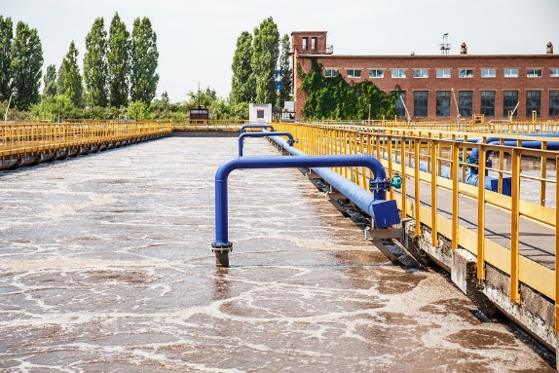
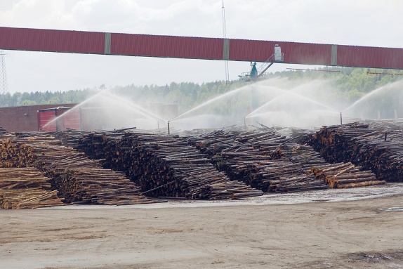
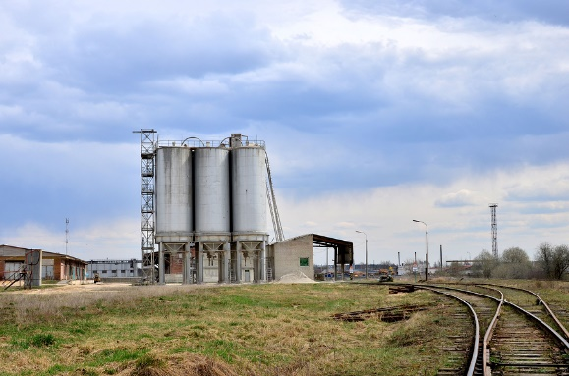
Dischargers Subject to Variance
64 individual NPDES permit holders listed in rule.
Major wastewater treatment plants.
Minor WWTPs that would otherwise obtain permit limit based on water quality standard.
Industrial facilities in industries likely to discharge mercury.
Notes:
Dischargers subject to the variance include holders of individual wastewater permits that would otherwise have permit limits for mercury based on the water quality standard. These facilities are listed in the proposed rule and in supporting documentation. This includes any municipal wastewater treatment plants that DEQ classifies as “major” – with minimum flows of 1 MGD – 26 of these. In addition, it includes industrial facilities in sectors likely to discharge mercury, including pulp and paper, cement manufacturing and some electronics manufacturing – 8 of these. Finally, DEQ has included many minor wastewater treatment plants, in case these facilities would otherwise obtain permit limits based on the water quality standard during the term of the variance - 30.

Slide 12
What will the variance require?
Meet effluent mercury limits achievable with current, well-operated and maintained treatment system.
Implement mercury minimization program, with minimum elements included in rule.
Monitoring and reporting
Notes:
Under the variance, DEQ will require dischargers to meet effluent limits that are achievable with their current treatment system based on recent data. These dischargers also will be required to develop and implement a mercury minimization program in order to reduce the amount of mercury in their discharge. For municipal wastewater treatment plants, this includes such activities as implementing the statewide dental amalgam rule and targeting mercury reductions from mercury from laboratories, schools and hospitals. Industrial facilities will be required to identify opportunities to substitute materials used in their manufacturing process to materials that have less mercury. All facilities must ensure that their treatment facility is well maintained and operated to minimize mercury. Finally, all facilities will have minimum monitoring and reporting requirements.

Slide 13
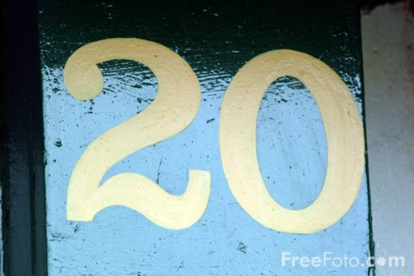
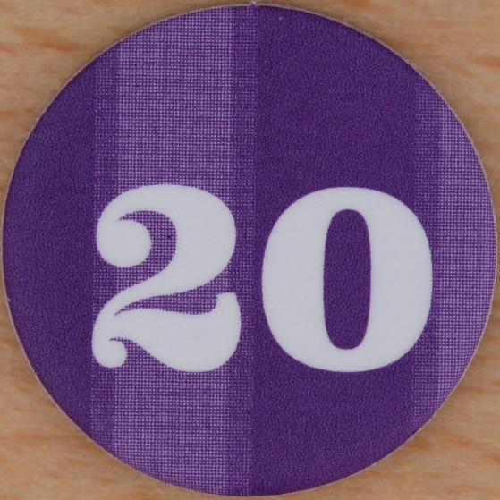
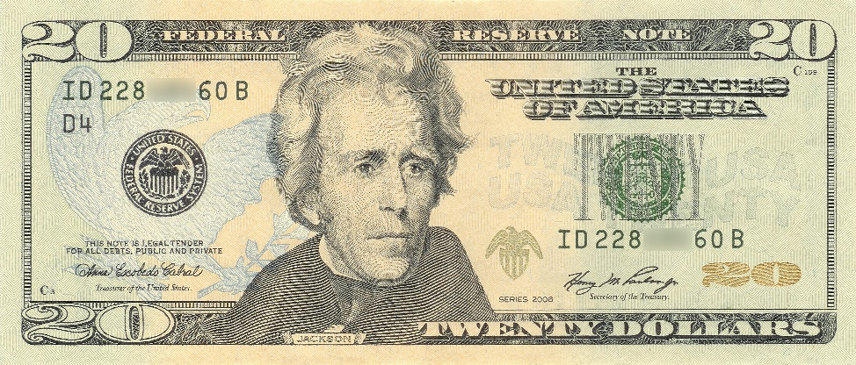
Term of the variance
Provides time for dischargers to implement required mercury minimization activities.
Provides time to collect and evaluate data.
DEQ will assess path forward at end of variance.
This Photo by Unknown Author is licensed under CC BY-SA
This Photo by Unknown Author is licensed under CC BY-NC-ND
This Photo by Unknown Author is licensed under CC BY-SA
This Photo by Unknown Author is licensed under CC BY-SA-NC
This Photo by Unknown Author is licensed under CC BY-SA-NC
Notes:
DEQ is proposing a 20-year term for this variance. DEQ does not expect that the water quality standard will be attained during this term. However, a 20-year term will provide time for dischargers to implement required mercury minimization activities, and to collect data and evaluate progress in reducing mercury levels.

Slide 14
Five-year re-evaluation
Progress in achieving mercury reductions.
Re-evaluate feasibility of mercury removal technology.
Public comment and EPA submittal.
Notes:
Because the term of the variance is greater than 5 years, DEQ is required to re-evaluate the requirements of the variance every five years. The re-evaluation will have two main components. DEQ will evaluate progress that dischargers have achieved in reducing mercury under the variance. DEQ also will re-evaluate if the feasibility of mercury removal technology has changed. After this re-evaluation, DEQ will re-calculate permit limits for mercury for each discharger as their permit comes up for renewal. As mercury concentrations decrease, permit limits will decrease correspondingly, ensuring that mercury reductions continue.
As required by federal rule, DEQ will give the public an opportunity to comment on the re-evaluation. Once this has happened, DEQ will make any needed revisions, then submit the final evaluation to EPA, as required under federal variance rules.

Slide 15
Major comments
Multiple discharger variance vs. waterbody variance.
DEQ clarified that this is a MDV.
Included list of facilities in rule.
Activities the state is implementing to make progress toward methylmercury criterion.
No new requirements, but acknowledges existing programs.
Notes:
DEQ received a number of comments on the MDV and made several clarifications. I will highlight two major comments here.
First, there were a few comments about whether the proposed variance is a waterbody or multiple discharger variance. Under a waterbody variance, DEQ must identify best management practices for nonpoint sources that can make progress toward the water quality standard. This is not required for a multiple discharger or individual variance. The TMDL is the appropriate Clean Water Act tool to address the full range of mercury sources, including non-point sources. In the response to comments, DEQ clarified that it is proposing a multiple discharger variance and that the purpose of the variance is to provide an appropriate and transparent pathway to issue NPDES permits with requirements that are feasible and will reduce mercury loadings. DEQ also incorporated a list of facilities subject to the variance in the rule to clarify any confusion regarding the type of variance.
EPA also requested that DEQ list in the variance rule activities being implemented by the state that will make progress toward the methylmercury criterion. DEQ agreed to include in the rule a list of existing state programs that address mercury.

Slide 16
Changes to draft variance authorization rule
Purpose:
Consistency with 2015 federal regulations
Clarity
Types of variances and authorization.
Individual
Multiple discharger and waterbody
Notes:
I will now discuss changes that DEQ is proposing to the variance authorization rule. DEQ last amended this rule in 2011. Since then, EPA promulgated its own variance rules. DEQ is amending its rule to make it consistent with the federal rule and to clarify requirements.
The proposed language clarifies that the EQC has delegated the authority to the DEQ Director to issue individual variances, but the Commission retains the authority to grant multiple discharger and waterbody variances through rule. The 2011 state variance did not discuss multiple discharger or waterbody variances.

Slide 17
Changes to draft variance authorization rule
Removes provision regarding ESA species and human health risk.
Removes section regarding variance renewals.
Notes:
The 2011 state rule prohibited variances if they would result in jeopardy to species listed as threatened or endangered under the Endangered Species Act or if the variance will result in unreasonable risk to human health. DEQ is proposing to remove these provisions.
DEQ is proposing to remove the provision that prohibits variances if they would result in jeopardy to species listed under the Endangered Species Act. During the approval process for any variance to an aquatic life criterion, EPA will consult with the federal fisheries services as required by the Endangered Species Act. Therefore, it does not make sense to have DEQ make that determination about jeopardy when there already is an existing federal process to do so.
DEQ also is proposing to remove the provision related to human health. Variance requirements must reflect the highest attainable condition – in other words, the best effluent condition for the pollutant during the term of the variance. What this means is that the variance will result in as much reduction to the pollutant as is feasible, thereby decreasing human health risk.
DEQ also is proposing to remove the section regarding variance renewals. Under federal rules, each variance is considered a new variance; thus, it does not make sense to include the section on variance renewals.

Slide 18
Proposal
Adopt proposed amendments to the State Variance Authorization Rule at OAR 340-041-0059 and associated definitions at OAR 340-041-0002.
Adopt proposed amendments to OAR 340-041-0345 establishing a multiple discharger variance for mercury for the Willamette Basin.
Notes:
To briefly summarize the main points, a variance is a temporary change to the water quality standard for the purposes of permitting and are only appropriate if actions can be taken to reduce the pollutant. For point source dischargers to Willamette Basin waters listed in the proposed rule, the MDV is an appropriate to tool to provide a path forward for permitting and which will allow the dischargers to make progress in reducing mercury loads in a transparent manner over the next 20 years. We recommend that the Commission adopt the proposed amendments as provided in the Staff Report. We are happy to answer any additional questions.

