Slide 1

Land Quality – Hazardous Waste
Hazardous Waste Delisting
2019
F006 Wastewater Treatment Sludge
Precision Cast Technologies, Inc.
Nov 2019
Portland, OR
Brian Fuller, Dan Lobato & Seth Sadofsky | Oregon Department of Environmental Quality
Notes:
Good morning, Chair George and commissioners, my name is Brian Fuller—I manage DEQ’s Materials Management and Hazardous Waste program out of our Western Region—we are here today to present the proposed Pacific Cast Technologies, Inc. hazardous waste delisting rulemaking for your consideration.
I am joined by my colleagues (turn to Dan and Seth for them to introduce themselves). Both Dan and Seth provided technical expertise on the proposed delisting.

Slide 2
Documents can be provided upon request in an alternate format for individuals with disabilities or in a language other than English for people with limited English skills. To request a document in another format or language, call DEQ in Portland at 503-229-5696, or toll-free in Oregon at 1-800-452-4011, ext. 5696; or email deqinfo@deq.state.or.us.

Slide 3
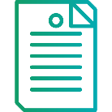





Timeline
Nov 2018
Feb 2019
Apr 2019
July 2019
July
2019
Aug 2019
Today
Notes:
This proposed rule is Oregon’s second delisting. Last November the EQC adopted the state’s first rulemaking to delist Selmet, Inc.’s F006 chemical etching and milling sludge.
In late 2018, DEQ began working with ATI Products of Albany, OR on a sampling and analysis plan for their facility’s similar chemical etching and milling wastewater treatment sludge.
DEQ staff with backgrounds in RCRA and risk assessment worked with ATI to sample and analyze the facility’s sludge to determine if it met risk-based standards. DEQ approved ATI’s sampling and analysis plan in February 2019 and in April 2019, ATI submitted a petition for a hazardous waste delisting.
Following DEQ’s petition review and public notice on July 15th, 2019 ATI sold their Albany facility that’s subject to the delisting to Consolidated Precision Products. The facility will now use the name Pacific Cast Technologies, Inc. While the facility has changed ownership, the production process and waste that is the subject of this proposed rule remains the same.
DEQ held a public comment period for this proposed rulemaking from July 15th to August 20 and a public hearing in Albany, OR on August 19th
DEQ consulted with EPA Region 10 and DOJ throughout this process.
If you approve of this rulemaking today, Pacific Cast Technologies, Inc.’s waste would not be considered a hazardous waste in Oregon. The delisting does not apply beyond Oregon, nor does it apply to other facilities that generate similar waste.
Now, I’d like to hand this over to my colleagues, Dan and Seth, who will give background on DEQ’s hazardous waste program, relevant definitions and regulatory background, and details on this proposed rulemaking.
Our goal is to explain why Pacific Cast Technologies, Inc’s waste is currently classified as hazardous F006 waste and how DEQ determined it’s appropriate to delist and manage it as a non-hazardous waste in Oregon.
-------------------------------------------------------------------------------------------------
Icon Author Credits:
Report/rule icon by Smalllikeart for www.flaticon.com
Magnifying icon made by Freekpik for www.flaticon.com: <div>Icons made by <a href="https://www.flaticon.com/authors/freepik" title="Freepik">Freepik</a> from <a href="https://www.flaticon.com/" title="Flaticon">www.flaticon.com</a> is licensed by <a href="http://creativecommons.org/licenses/by/3.0/" title="Creative Commons BY 3.0" target="_blank">CC 3.0 BY</a></div>
Microphone icon by By Flat Icons for www.flaticon.com: <div>Icons made by <a href="https://www.flaticon.com/authors/flat-icons" title="Flat Icons">Flat Icons</a> from <a href="https://www.flaticon.com/" title="Flaticon">www.flaticon.com</a> is licensed by <a href="http://creativecommons.org/licenses/by/3.0/" title="Creative Commons BY 3.0" target="_blank">CC 3.0 BY</a></div>
Decision icon by Icongeek26 for www.flaticon.com: <div>Icons made by <a href="https://www.flaticon.com/authors/icongeek26" title="Icongeek26">Icongeek26</a> from <a href="https://www.flaticon.com/" title="Flaticon">www.flaticon.com</a> is licensed by <a href="http://creativecommons.org/licenses/by/3.0/" title="Creative Commons BY 3.0" target="_blank">CC 3.0 BY</a></div>
Pen icon by KiranShastry for www.flaticons.com” <div>Icons made by <a href="https://www.flaticon.com/authors/kiranshastry" title="Kiranshastry">Kiranshastry</a> from <a href="https://www.flaticon.com/" title="Flaticon">www.flaticon.com</a> is licensed by <a href="http://creativecommons.org/licenses/by/3.0/" title="Creative Commons BY 3.0" target="_blank">CC 3.0 BY</a></div>
Nametag icon by Pixel perfect for www.flaticon.com: <div>Icons made by <a href="https://www.flaticon.com/authors/pixel-perfect" title="Pixel perfect">Pixel perfect</a> from <a href="https://www.flaticon.com/" title="Flaticon">www.flaticon.com</a> is licensed by <a href="http://creativecommons.org/licenses/by/3.0/" title="Creative Commons BY 3.0" target="_blank">CC 3.0 BY</a></div>

Slide 4
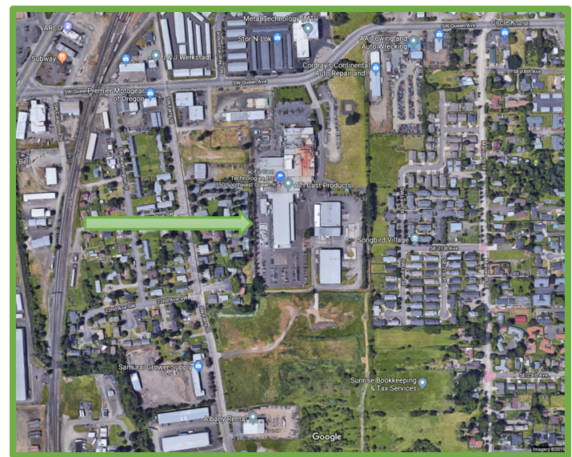
Notes:
NOTE: I hid this slide because I think we’ve covered the topic in other slides. Delete if you agree and add it back in if you don’t. -EM
NOTE- I unhid this because this is a nice short presentation and it’s nice to know where you are – SJS – I’m open to discussion if folks disagree.
------------------------------------------------------
This proposed rulemaking applies only to the facility on Queen Ave SW in Albany – seen here (POINT). This rule does not apply to any other facility or any other waste stream or process at this facility. The rule will only apply to the wastes produced at this facility as long as the manufacturing process does not change. This facility manufactures Titanium parts for the aerospace industry.

Slide 5
Outline
Background
Definitions
Statutes and Rules
Rule Background
Process
Sampling and Analysis
Rule Overview
Notes:
Jennifer mentioned that this outline didn’t add much to the Public Hearing presentation. What do you think about removing it from the EQC presentation since Brian will have already explained what the presentation will cover in the previous slide?
I agree that we should delete? Seth
--------------------------------------------------------
Tonight’s presentation will cover background on DEQ’s hazardous waste program, relevant definitions and regulatory background, and details on our proposed ATI F006 hazardous waste delisting rulemaking.
Our goal is to explain why ATI’s waste is currently classified as hazardous F006 waste and how DEQ determined it’s appropriate to delist and manage it as a non-hazardous waste in Oregon.

Slide 6
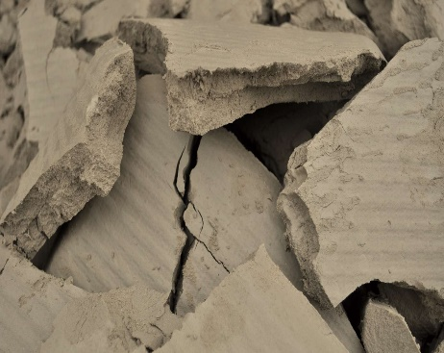
Definitions
Hazardous Waste
Characteristic - Ignitable, corrosive, reactive, or toxic.
Listed - Wastes from specific industrial processes which are assumed to be hazardous.
  F006 - Wastewater treatment sludges from electroplating operations like chemical etching and milling.
Delisting
A generator may file a petition demonstrating that a waste is not hazardous.
Chemical etching and milling filter cake from dewatered sludge. Photo by D. Lobato
Notes:
When we talk about hazardous waste and delisting there are some important terms and definitions to keep in mind, Here are some of the common terms we’ll use during the presentation.
In 1976, the United State Congress passed what’s known as RCRA– or the Resource Conservation and Recovery Act.
RCRA defines hazardous waste as a solid waste (including liquid or gas) which may significantly contribute to an increase in mortality or in serious illness OR pose a substantial hazard to human health or the environment when it’s mis-managed.
Hazardous waste can be:
“characteristic,” meaning that the waste exhibits one of the four hazardous waste characteristics which include ignitability, corrosivity, reactivity, and toxicity; or
“listed,” meaning the waste is derived from a process specifically named in the regulations.
F-listed wastes come from common industrial and manufacturing processes from circuit board manufacturing to automobile production.
In Pacific Cast Technologies, Inc.’s case, their Albany Queen Avenue facility performs an industrial metal finishing process known as chemical etching and milling that uses chemical solutions to dissolve metal layers from a part. EPA considers that waste that comes from this process to be F006-listed waste – or wastewater treatment sludge from electroplating operations like chemical etching and milling.
Not all facilities use the same manufacturing process and facilities in Oregon that produce listed hazardous waste have the opportunity to petition DEQ to exclude or “delist” their waste from the list of hazardous wastes if they can demonstrate the waste in question does not contain chemicals that pose a hazard.
In other words, when it comes to delisting, in order to fully protect human health and the environment, a listed waste is considered to be a hazardous waste until and unless a facility can demonstrate that it does not pose a risk to human health and the environment when it’s managed as a non-hazardous waste.
F006 is one of the more commonly delisted wastes in the country.

Slide 7
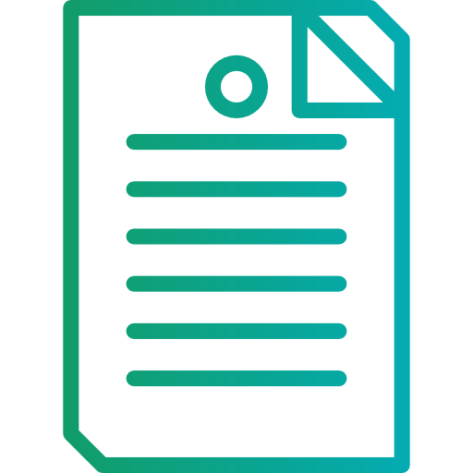
Statutes and Rules
50 Federal Register 52629: Federal to state program delegation
40 Code of Federal Regulations sections 260.20 and 260.22: Federal hazardous waste rules
Oregon Administrative Rule 340-100-0020, -0022: State hazardous waste rules including delisting
Oregon Revised Statute 466.075(3): Exceptions to listing
Notes:
As a RCRA authorized state, DEQ may delist a hazardous waste under federal and state authorities that you see here (point to slide).
------------------------------------------------------------------------------------------------
Report/rule icon by Smalllikeart for www.flaticon.com

Slide 8
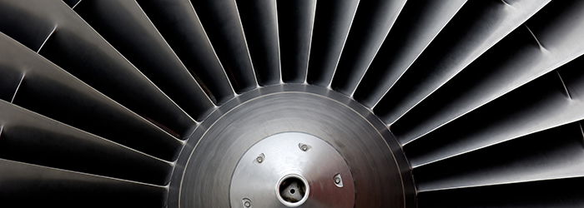
Pacific Cast Technologies, Inc. F006 Delisting Background
Photo from https://www.atimetals.com/
Notes:
Now we’ll move to the specifics about ATI and their waste.
Pacific Cast Technologies, Inc. manufacturers titanium alloy castings and machined parts for the aerospace industry in their Queen Ave. SW facility in Albany, OR.
As a part of the manufacturing process, Pacific Cast Technologies, Inc. performs chemical etching and milling, which the EPA defines as an electroplating process that produces a regulated F006 hazardous waste, for reasons that we discussed in the previous “Definitions” slide.
Between 1995 and 2017, it was DEQ’s practice to consider chemical etching and milling sludge in facilities across the state to be non-hazardous because it did not contain the chemicals the US EPA listed F006 waste for – for example, cadmium, complex cyanides, chromium and nickel-- above risk-based concentrations.
But in 2017, DEQ examined this practice and made a decision to make the state position match EPA’s position that listed wastes must be managed as hazardous until facilities can demonstrate through petition and rulemaking that they’re not hazardous.
As a result, DEQ communicated to facilities like Pacific Cast Technologies, Inc. that they would need to manage their chemical etching and milling sludge as a hazardous waste unless DEQ approves them to handle the waste as non-hazardous through a delisting petition like the one we’re discussing today.
Now, I’d like to hand this over to my colleague, Seth, who’ll give you more information about how DEQ reviewed Pacific Cast Technologies, Inc.’s waste for potential delisting and the petition review process.

Slide 9
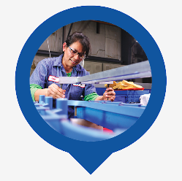
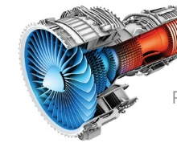
Example Process
Cleaning
Rinse
Chemical Etching and Milling
Rinse
Sludge Settling and Dewatering
Acid Neutralization
Precipitation
Sludge
Treated Water
Pictures from: https://www.atimetals.com/businesses/aticastproducts/pages/default.aspx
Notes:
Facilities that manufacture precision metal parts follow a number of steps to create the finished product and wastes associated with production.
In this diagram, solid lines represent metal parts travelling through the production process. After a part is cast and milled it goes through a series of cleaning steps, inspection, and chemical baths to remove the outermost oxidized layer.
The dotted lines, represent the path of the waste water as it goes to the wastewater treatment system.
All wastewaters from the production process go to a treatment system that produces two residues:
One residue is water that is treated to meet water quality standards and sent to the city sewer.
The other residue is waste sludge. Some facilities, including Pacific Cast Technologies, Inc. will send their sludge to a filter press that dries the sludge into a “filter press cake” that’s easy to transport. Before delisting petitions are approved, a facility will send their sludge to a hazardous waste landfill. However, if you approve this petition to delist the sludge, the facility would have DEQ approval to send the sludge to a state-permitted, non-hazardous waste landfill.
Pacific Cast Technologies, Inc. must meet very specific production requirements for their customers and their production process is consistent from day-to-day, week to week and month-to-month.
-------------------------------------------------------------------------------------------------------------------------------------------------------------------------
Diagram generously borrowed from McCoy RCRA Unraveled section 3.4.2 on F006 wastes Source: McCoy and Associates, Inc.

Slide 10
Waste Sampling and Analysis
Chemicals Analyzed
F006
Cadmium | Nickel
Hexavalent Chromium | Cyanide
Other Potential Hazardous Constituients
Chromium | Fluoride
Manganese | Molybdenum
Silver | Vanadium
Zirconium
Notes:
Prior to preparation of this petition, DEQ worked with Pacific Cast Technologies, Inc. to review the materials that may enter their chemical etching and milling waste stream and developed a list of chemicals to test for, including contaminants for which EPA lists F006 waste (Cadmium, Chromium, Nickel, and Cyanides) and any other potentially underlying hazardous constituents that may be present in the wastes (POINT).
Through its April 2019 delisting petition, Pacific Cast Technologies, Inc. asked to demonstrate their chemical etching and milling waste stream does not contain chemicals above concentrations above EPA-set standards designed to protect human health and the environment.
The facility must also demonstrate that their waste does not exhibit characteristics of a hazardous waste– meaning it is not ignitable, corrosive, reactive or toxic. This includes providing data from accredited laboratories to assure DEQ that no toxic chemicals are present at levels that could impact human health or the environment.

Slide 11

Waste Sampling and Analysis
Waste
Up to 9,000 cubic yards per year.
Samples
4 sampling events, 1 week apart.
Chemical etching and milling filter cake from dewatered sludge. Photo by D. Lobato
Photo Credit: Google Earth
Notes:
The previous slide was about what chemicals to look for and these next few slides are all about how we evaluate them.
Pacific Cast Technologies, Inc. conducted four sampling events approximately one week apart to show that, as expected, there isn’t much variability in the process and waste.
During each of the four sampling events, they extracted 5 samples of sludge from a random grid in the filter press cake and then combined the five samples into one composite sample for analysis. This procedure provides a good average of a batch of filter press cake. During the first event, they duplicated the process and sent a second sample to be analyzed.
Independent, accredited laboratories analyzed PCT’s sludge samples.

Slide 12
Notes:
Now, I’ll walk you through how we do the risk assessment part of the delisting process.
To determine if Pacific Cast Technologies, Inc.’s waste is safe to dispose in a permitted, non-hazardous landfill, we compare the lab data to screening levels established using EPA’s delisting risk assessment software. This tool evaluates potential dangers to human health or the environment that the waste could cause if disposed of outside of a hazardous waste landfill. The model considers the total volume of waste that may be disposed, toxicity data for each chemical, potential exposure pathways to human or ecological receptors, planned disposal location, risk levels chosen by the state to be similar to other land quality programs, and then produces screening levels for the waste.
Here we compare the screening levels for total concentration of the chemicals for which F006 is written with the data from Pacific Cast Technologies.
For each chemical, starting here in the upper left with Cadmium (POINT), we have sample results from the facility’’s waste, in mg/kg or ppm, represented as bars, then we have a threshold for the total concentration in the waste (POINT) which in all cases is several orders of magnitude above the sample data (note the logarhythmic scale).
You can see that nothing rises above the totals.

Slide 13
Notes:
Landfills are dynamic chemical environments where materials can react and dissolve. This is called leaching and the water that drains from a landfill as a result is called leachate.
In addition to comparing Pacific Cast Technologies, Inc.’s sludge against a total concentration for hazardous waste, we look at whether we need to test for leaching. This level is derived by the same tool that I described in the last slide.
Here you see the same data as the previous slide, but now we’re looking to see if we need to do a leaching test. So the red bar is different and the scale is differtent.
You can see (POINT) that Cadmium requires leaching tests for several of the samples, and the other three chemicals do not..
The leaching test is called the toxicity characteristic leaching procedure (or TCLP), and it is a standard test used to characterize hazardous waste.
Samples 2, 3, and 4 were put through TCLP and tested after leaching and Cadmium was not detected in the leachate.
I’m not going to take you through the rest of the chemicals right now, but the results are similar. - Note, make these slides and put in back of presentation.
As a result of the sampling and analysis Pacific Cast Technologies, Inc. conducted in consultation with DEQ, we are satisfied the facility’s chemical etching and milling sludge meets the criteria for a hazardous waste delisting and is safe to dispose of in a permitted, non-hazardous waste landfill.
-----------------------------------------
NOTE – Instead of including the next slide in the public hearing, can we just say that the labs followed a similar testing process for all of the other chemicals that might be present in the waste? Then we can include the next slide in the EQC presentation where they’ll likely be interested in hearing more of the technical details…

Slide 14
Rule Overview
Amend Oregon’s hazardous waste regulations
Require annual testing
Notify DEQ about changes
Notes:
DEQ proposes amending Oregon’s hazardous waste regulations in Chapter 340, Division 101 of the Oregon Administrative Rules to incorporate the delisting of Pacific Cast Technologies, Inc., or its corporate successor’s, F006 hazardous waste, as long as certain conditions are met.
DEQ gave careful consideration to this rulemaking to make sure Pacific Cast Technologies, Inc.’s waste is properly handled now and in the future. This delisting is only valid as long as the facility’s waste meets specific conditions in the rule that are meant to ensure the waste does not present a danger to human health and the environment:
Pacific Caste Technologies, Inc. must conduct annual testing to ensure that their waste meets the conditions specified in rules.
If Pacific Cast Technologies, Inc. makes significant changes to their chemical etching and milling manufacturing process, the chemical inputs into that process, or both, the facility must notify DEQ within 30 days of the change and then handle the waste as hazardous until they are able to submit data (as described in the rule) to DEQ and receive DEQ approval to dispose of the waste in a permitted, non-hazardous waste landfill.
--------------------
Report/rule icon by Smalllikeart for www.flaticon.com

Slide 15

Recommendation
DEQ recommend the Environmental Quality Commission approve the rule delisting Pacific Cast Technologies, Inc.’s F006 waste.
Notes:
In conclusion, DEQ recommends the EQC approve the rule delisting Pacific Cast Technologies, Inc.’s F006 waste.
Chair George and commissioners, thank you for your consideration of this proposed rule. We look forward to answering any questions that you might have.

