Slide 1
Land Quality – Hazardous Waste
Hazardous Waste Delisting
2019
F006 Wastewater Treatment Sludge
Pacific Cast Technologies, Inc.
Nov 2019
Portland, OR
Brian Fuller, Dan Lobato & Seth Sadofsky | Oregon Department of Environmental Quality
Notes:
Good morning, Chair George and commissioners, my name is Brian Fuller—I manage DEQ’s Materials Management and Hazardous Waste program out of our Western Region—we are here today to present the proposed Pacific Cast Technologies, Inc. hazardous waste delisting rulemaking for your consideration.
I am joined by my colleagues (turn to Dan and Seth for them to introduce themselves)..
My name is Dan Lobato, I am an Inspector with the Western Region Hazardous Waste Program.
My name is Seth Sadofsky, I am a Hydrogeologist with the Western Region Materials Management program.
Back to Brian
Both Dan and Seth provided technical expertise on the proposed delisting, along with Eileen Naples, who is no longer with the agency.

Slide 2
Outline
Background
Definitions
Statutes and Rules
Process
Sampling and Analysis
Rule Overview
Notes:
We’d like to cover background on hazardous waste, relevant definitions and regulatory background, and details on our proposed Pacific Cast Technologies F006 hazardous waste delisting rulemaking.
Our goal is to explain why PCT’s waste is currently classified as hazardous F006 waste and how DEQ determined it’s appropriate to delist and manage it as a non-hazardous waste in Oregon.
DO WE NEED TO SAY MORE HERE?

Slide 3
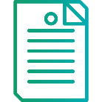
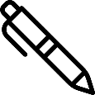
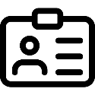
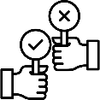
Timeline
Nov 2018
Feb 2019
Apr 2019
July 2019
July
2019
Aug 2019
Today
Notes:
This proposed rule is Oregon’s second hazardous waste delisting. Last November the EQC adopted the state’s first hazardous waste delisting for Selmet’s chemical etching and milling sludge.
In late 2018, DEQ began working with Pacific Cast Technologies of Albany, OR to determine if their F006 waste could be delisted. PCT was owned by ATI Ladish LLC at this time and is now owned by Consolidated Precision Products.
DEQ approved a sampling and analysis plan in February 2019 and in April 2019, the facility submitted a petition for a hazardous waste delisting.
DEQ held a public comment period for this proposed rulemaking from July 15th to August 20 and a public hearing in Albany, OR on August 19th. We received 4 comments and the responses are included in the staff report.
DEQ consulted with EPA Region 10 and DOJ throughout this process.
-------------------------------------------------------------------------------------------------
Icon Author Credits:
Report/rule icon by Smalllikeart for www.flaticon.com
Magnifying icon made by Freekpik for www.flaticon.com: <div>Icons made by <a href="https://www.flaticon.com/authors/freepik" title="Freepik">Freepik</a> from <a href="https://www.flaticon.com/" title="Flaticon">www.flaticon.com</a> is licensed by <a href="http://creativecommons.org/licenses/by/3.0/" title="Creative Commons BY 3.0" target="_blank">CC 3.0 BY</a></div>
Microphone icon by By Flat Icons for www.flaticon.com: <div>Icons made by <a href="https://www.flaticon.com/authors/flat-icons" title="Flat Icons">Flat Icons</a> from <a href="https://www.flaticon.com/" title="Flaticon">www.flaticon.com</a> is licensed by <a href="http://creativecommons.org/licenses/by/3.0/" title="Creative Commons BY 3.0" target="_blank">CC 3.0 BY</a></div>
Decision icon by Icongeek26 for www.flaticon.com: <div>Icons made by <a href="https://www.flaticon.com/authors/icongeek26" title="Icongeek26">Icongeek26</a> from <a href="https://www.flaticon.com/" title="Flaticon">www.flaticon.com</a> is licensed by <a href="http://creativecommons.org/licenses/by/3.0/" title="Creative Commons BY 3.0" target="_blank">CC 3.0 BY</a></div>
Pen icon by KiranShastry for www.flaticons.com” <div>Icons made by <a href="https://www.flaticon.com/authors/kiranshastry" title="Kiranshastry">Kiranshastry</a> from <a href="https://www.flaticon.com/" title="Flaticon">www.flaticon.com</a> is licensed by <a href="http://creativecommons.org/licenses/by/3.0/" title="Creative Commons BY 3.0" target="_blank">CC 3.0 BY</a></div>
Nametag icon by Pixel perfect for www.flaticon.com: <div>Icons made by <a href="https://www.flaticon.com/authors/pixel-perfect" title="Pixel perfect">Pixel perfect</a> from <a href="https://www.flaticon.com/" title="Flaticon">www.flaticon.com</a> is licensed by <a href="http://creativecommons.org/licenses/by/3.0/" title="Creative Commons BY 3.0" target="_blank">CC 3.0 BY</a></div>

Slide 4
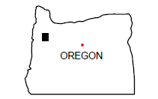
Notes:
If you approve of this rulemaking today, it applies only to the Pacific Cast Technology facility on Queen Ave SW in Albany – seen here (POINT) which manufactures Titanium parts for the aerospace industry. This rule does not apply to any other waste stream or process at this facility. The rule will only apply to the wastes produced at this facility as long as the manufacturing process does not change.
Pacific Cast Technologies, Inc.’s waste would not be considered a hazardous waste in Oregon. The delisting does not apply beyond Oregon, nor does it apply to other facilities generating similar waste.
Now, I’d like to hand this over to Dan Lobato, who will share relevant definitions, regulatory background, and details on this proposed rulemaking.
Note-need to rewrite a bit-At least look at what I did-S

Slide 5
Definitions
Hazardous Waste
Characteristic -
Ignitable
Corrosive
Reactive
Toxic
Listed - Wastes from specific industrial processes which are assumed to be hazardous.
Delisting - A generator may file a petition demonstrating that a waste is not hazardous.
Notes:
When we talk about hazardous waste and delisting, there are some important terms and definitions to keep in mind.
In 1976, the United State Congress passed the Resource Conservation and Recovery Act, RCRA for short .
RCRA defines hazardous waste as a solid waste (including liquid or gas) that may significantly contribute to an increase in mortality or in serious illness OR pose a substantial hazard to human health or the environment when it’s mismanaged.
Hazardous waste can be:
“characteristic,” meaning that the waste exhibits one of the four hazardous waste characteristics which are ignitability, corrosivity, reactivity, and toxicity; or
“listed,” meaning the waste is derived from a process specifically named in the regulations.
Not all facilities use the same manufacturing process and facilities in Oregon that produce listed hazardous waste have the opportunity to petition DEQ to exclude or “delist” their waste from the list of hazardous wastes if they can demonstrate the waste in question does not contain chemicals that pose a hazard.
In other words, when it comes to delisting, in order to fully protect human health and the environment, a listed waste is considered to be a hazardous waste until and unless a facility can demonstrate that it does not pose a risk to human health and the environment when it’s managed as a non-hazardous waste.

Slide 6
Definitions
F006 - Wastewater treatment sludges from electroplating operations.
F006 is one of the more commonly delisted wastes in the country.
Chemical etching and milling filter cake from dewatered sludge.
Photo D. Lobato
Notes:
F-listed wastes come from common industrial and manufacturing processes from circuit board manufacturing to automobile production.
In Pacific Cast Technologies, Inc.’s case, their Albany Queen Avenue facility performs an industrial metal finishing process known as chemical etching and milling that uses chemical solutions to dissolve metal layers from a part. EPA considers that waste that comes from this process to be F006-listed waste – or wastewater treatment sludge from electroplating operations like chemical etching and milling.
Between 1995 and 2017, it was DEQ’s practice to consider chemical etching and milling sludge from titanium production facilities across the state to be non-hazardous because the waste did not contain the chemicals which EPA initially listed F006 waste for at concentrations above risk-based levels .
In 2017, DEQ re-examined this practice and made a decision to make the state position match EPA’s position that chemical etching and milling meets the definition of electroplating.
As a result, DEQ communicated to facilities like Pacific Cast Technologies, Inc. that they would need to manage their chemical etching and milling sludge as a hazardous waste unless DEQ approves them to handle the waste as non-hazardous through a delisting petition like the one we’re discussing today.
F006 is one of the more commonly delisted types of hazardous waste in the country.

Slide 7
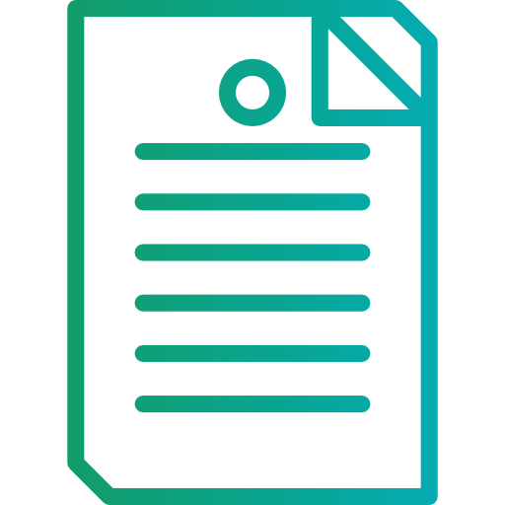
Statutes and Rules
50 Federal Register 52629: Federal to state program delegation
40 Code of Federal Regulations sections 260.20 and 260.22: Federal hazardous waste rules
Oregon Revised Statute 466.075(3): Exceptions to listing
Oregon Administrative Rule 340-100-0020, -0022: State hazardous waste rules including delisting
Notes:
A facility seeking to exclude waste from hazardous waste regulations must petition either EPA or their RCRA authorized state for a regulatory amendment.
As a RCRA authorized state, DEQ may delist a hazardous waste under federal and state authorities that you see here (point to slide).
EPA and authorized states like Oregon may grant delisting petitions on a facility-by-facility basis.
------------------------------------------------------------------------------------------------
Report/rule icon by Smalllikeart for www.flaticon.com

Slide 8
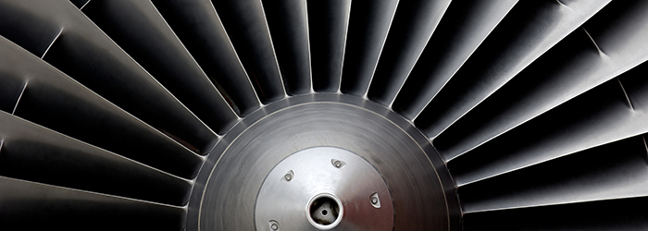
Pacific Cast Technologies, Inc. F006 Delisting Background
Photo from https://www.atimetals.com/
Notes:
Pacific Cast Technologies, Inc. manufacturers titanium alloy castings and machined parts for the aerospace industry in their Queen Ave. facility in Albany, OR.
As a part of the manufacturing process, Pacific Cast Technologies, Inc. performs chemical etching and milling, which the EPA defines as an electroplating process that produces a regulated F006 hazardous waste, as we discussed in the previous slide.
Now, I’d like to hand this over to my colleague, Seth Sadofsky, who’ll give you more information about sampling and analysis and risk screening.

Slide 9
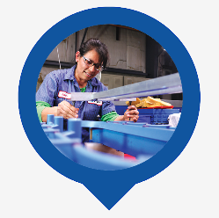
Example Process
Cleaning
Rinse
Chemical Etching and Milling
Rinse
Sludge Settling and Dewatering
Acid Neutralization
Precipitation
Pictures from: https://www.atimetals.com/businesses/aticastproducts/pages/default.aspx
Sludge
Treated Water
Notes:
Facilities that manufacture precision metal parts follow a number of steps to create the finished product and also create associated wastes.
In this diagram, solid lines represent metal parts travelling through the production process. After a part is cast and milled it goes through a series of cleaning steps, inspection, and chemical baths to remove the outermost oxidized layer or selectively etch specific areas.
All of the various steps in the process create waste waters which follow the dotted lines, and go to a wastewater treatment system.
This wastewater treatment system produces two residues:
One residue is water that is treated to meet appropriate standards and sent to the city sewer.
The other residue is waste sludge. Some facilities, like this one send the sludge to a filter press that dries the sludge into a “filter press cake” that’s easy to transport. Currently, the facility sends their sludge to a hazardous waste landfill. However, if you approve this petition to delist the sludge, the facility would have DEQ approval to send the sludge to a state-permitted, non-hazardous waste landfill.
-------------------------------------------------------------------------------------------------------------------------------------------------------------------------
Diagram generously borrowed from McCoy RCRA Unraveled section 3.4.2 on F006 wastes Source: McCoy and Associates, Inc.

Slide 10
Waste Sampling and Analysis
Chemicals Analyzed
F006
Cadmium | Nickel
Hexavalent Chromium | Cyanide
Other Potential Hazardous Constituients
Chromium | Fluoride
Manganese | Molybdenum
Silver | Vanadium
Zirconium
Notes:
Prior to preparation of this petition, DEQ worked with Pacific Cast Technologies, Inc. and their representatives to review the materials that may enter their chemical etching and milling waste stream, including all processes that lead to the wastewater treatment system, and developed a list of chemicals to test, including contaminants for which EPA lists F006 waste (Cadmium,, Nickel, hexavalent Chromium, and Cyanides) and any other potentially hazardous chemicals that may be present in the wastes (POINT).
Through the delisting petition, Pacific Cast Technologies is attempting to demonstrate their chemical etching and milling waste stream does not contain chemicals for which F006 was written above concentrations designed to protect human health and the environment.
The facility must also demonstrate that their waste does not exhibit characteristics of a hazardous waste– meaning it is not ignitable, corrosive, reactive or toxic. This includes providing data from accredited laboratories to assure DEQ that no other toxic chemicals are present at levels that are likely to impact human health or the environment.

Slide 11
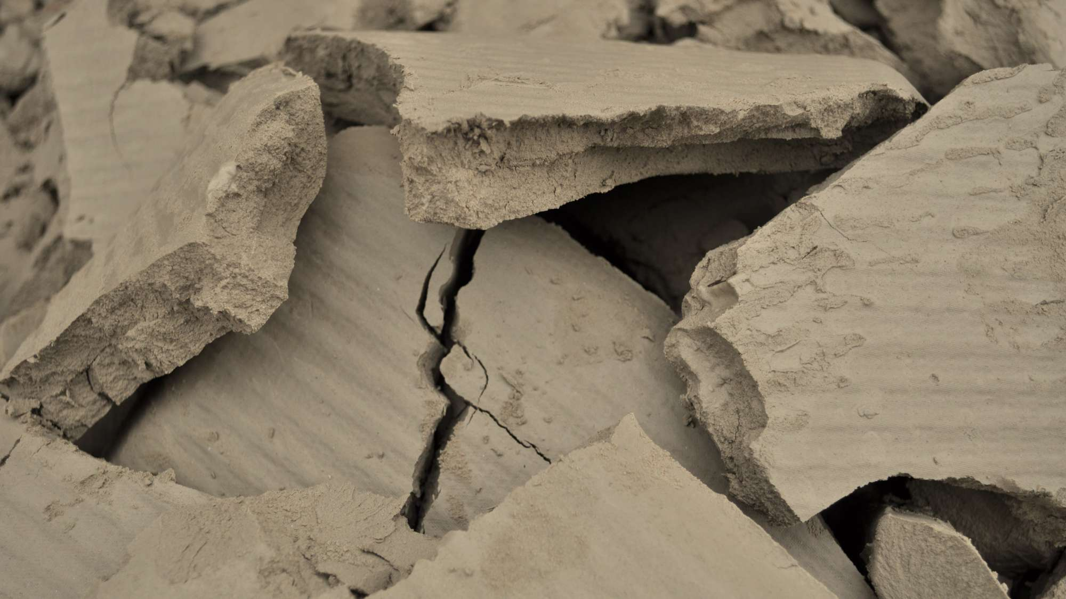
Waste Sampling and Analysis
Waste
Up to 9,000 cubic yards per year.
Samples
4 sampling events, 1 week apart.
Chemical etching and milling filter cake from dewatered sludge. Photo by D. Lobato
Photo Credit: Google Earth
Notes:
The previous slide was about what chemicals to look for and these next few slides are all about how we evaluate them.
Pacific Cast Technologies, Inc. must meet very specific production requirements for their customers and their production process is consistent from day-to-day, week to week and month-to-month. They conducted four sampling events approximately one week apart to show that, as expected, there isn’t much variability in the process and waste.
During each of the four sampling events, they extracted 5 samples of sludge from a random grid in the filter press cake and then combined the five samples into one composite sample for analysis. This procedure provides a good average of a batch of filter press cake. During the first event, they duplicated the process. And prepared a second sample for quality control.
Independent, accredited laboratories analyzed PCT’s sludge samples for the chemicals chosen.

Slide 12
Notes:
Now, I’ll walk you through how we do the risk assessment part of the delisting process.
To determine if PCT’s wastewater treatment sludge is safe to dispose in a permitted, non-hazardous landfill, we compare the lab data to screening levels established using EPA’s delisting risk assessment software. This tool evaluates potential dangers to human health or the environment that the waste could cause if disposed of outside of a hazardous waste landfill. The model considers the total volume of waste that may be disposed, toxicity data for each chemical, potential exposure pathways to human or ecological receptors, type of disposal location, risk levels chosen by the state to be similar to other land quality programs, and then produces screening levels for the waste.
Here we compare the screening levels for total concentration of the chemicals for which F006 is written with the data from Pacific Cast Technologies.
For each chemical, starting here in the upper left with Cadmium (POINT), we have sample results from the facility’s waste, in mg/kg or ppm, represented as bars, then we have a threshold for the total concentration in the waste (POINT) which in most cases is several orders of magnitude above the sample data (note the logarythmic scale).
You can see that nothing rises above the totals.

Slide 13
Notes:
However, Landfills are dynamic chemical environments where materials can react and dissolve. This is called leaching and the liquid that drains from a landfill as a result is called leachate.
In addition to comparing Pacific Cast Technologies, Inc.’s sludge against a total concentration for hazardous waste, we look at whether we need to test for leaching. This level is derived by the modelling software that I described in the last slide.
Here you see the same data as the previous slide, but now we’re looking to see if we need to do a leaching test. So the red bar is at a different level and the scale is different.
You can see (POINT) that Cadmium requires leaching tests for several of the samples, and the other three chemicals do not..
The leaching test is called the toxicity characteristic leaching procedure (or TCLP), and it is a standard test used for waste characterization.
These three samples that exceed the potential the leaching threshold for cadmium were put through TCLP and tested after leaching and Cadmium was not detected in the leachate.
I’m not going to take you through the rest of the chemicals unless you ask me to, but the results are similar.
As a result of the sampling and analysis that Pacific Cast Technologies conducted in consultation with DEQ, we are satisfied the facility’s chemical etching and milling sludge meets the criteria for a hazardous waste delisting and is safe to dispose of in a permitted, non-hazardous waste landfill.
Now I would like to go back to Brian to finish our discussion.

Slide 14
Rule Overview
Amend Oregon’s hazardous waste regulations
Require annual testing
Notify DEQ about changes
Minor associated housekeeping on OAR 340-101-0004 Exclusions
Notes:
Back to Brian
DEQ proposes amending Oregon’s hazardous waste regulations in Chapter 340, Division 101 of the Oregon Administrative Rules to incorporate the delisting of Pacific Cast Technologies, Inc., F006 hazardous waste, as long as certain conditions are met.
DEQ gave careful consideration to this rulemaking to make sure Pacific Cast Technologies, Inc.’s waste is properly handled now and in the future. This delisting is only valid as long as the facility’s waste meets specific conditions in the rule that are meant to ensure the waste does not present a danger to human health and the environment:
Pacific Cast Technologies, Inc. must conduct annual testing to ensure that their waste meets the conditions specified in rules.
If Pacific Cast Technologies, Inc. makes significant changes to their chemical etching and milling manufacturing process, the chemical inputs into that process, or both, the facility must notify DEQ within 30 days of the change and then handle the waste as hazardous until they are able to submit data (as described in the rule) to DEQ and receive DEQ approval to dispose of the waste in a permitted, non-hazardous waste landfill.
--------------------
Report/rule icon by Smalllikeart for www.flaticon.com

Slide 15
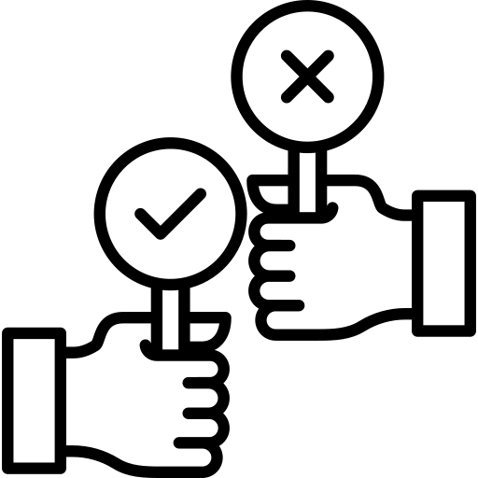
Recommendation
DEQ recommends that the Environmental Quality Commission adopt the proposed rules in Attachment A as part of Chapter 340 of the Oregon Administrative Rules, excluding Pacific Cast Technologies, Inc.’s sludge from classification as a F006 hazardous waste
Proposed Motion Language
“I move that the commission adopt the proposed rule amendments in Attachment A as part of chapter 340 of the Oregon Administrative Rules.”
Notes:
In conclusion, DEQ recommends that the EQC adopt the proposed rules in Attachment A excluding Pacific Cast Technologies, Inc.’s sludge from classification as a F006 hazardous waste.
Chair George and commissioners, thank you for your consideration of this proposed rule. We look forward to answering any questions that you might have for us.

Slide 16
Slides for questions

Slide 17
Total Limit 2600
Fluoride
Silver
Manganese
Molybdenium
Vanadium
Total concentration limits above or close to 1,000,000 parts per million in the waste based on the DRAS calculations
Notes:
When we look at the total concentrations for Chromium (note the log scale) and Zirconium, you can see that the total concentrations are well below the total DRAS limits.
The other chemicals either do not have total limits, or have total limits that are so high as to be meaningless. Milligrams per kilogram are parts per million, and once you get close to a million parts per million it gets meaningless.

Slide 18
Chromium – Leaching limit for hexavalent chromium
Zirconium – No leaching limit
Notes:
I haven’t plotted chromium or zirconium here, chromium is covered with the hexavalent chromium chart see earlier, and zirconium has no leaching limit. Silver, manganese, and fluoride are all consistently well below the limits required for leachibility testing.
Molybdenium and vanadium exceed the limits for leachibility testing, but the tested leachates did not exceed limits.

