Slide 1
Heating Oil Tank Program Fee Increases
2019 Rulemaking
Oregon Environmental Quality Commission Meeting
Nov. 14-15, 2019
Oregon DEQ, 3rd Floor Conference Room
700 NE Multnomah St.
Portland, OR 97232
Heating Oil Tank Program | Oregon Department of Environmental Quality

Slide 2
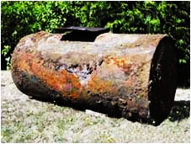
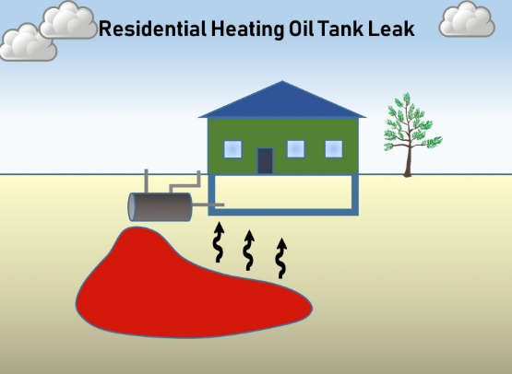
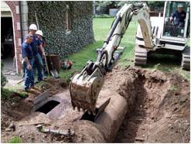

Slide 3
Notes:
Mike -

Slide 4
OAR 340-177-0065
Three cleanup options:
  Soil Matrix: Removes contamination above threshold (usually 500 milligrams/kilogram total petroleum hydrocarbons)
    Considered relatively “Simple” in complexity
  Generic Remedy: Allows leaving up to 10,000 mg/kg TPH if less than 65 cubic yards in volume
    Considered relatively “Intermediate” in complexity
  Risk-Based: Allows leaving larger areas of contamination if detailed testing shows no risk of significant exposure
    Considered the most complex of the cleanup options

Slide 5
Heating Oil Tank Projects (2018)
Complexity of Cleanups
DEQ received and reviewed 1,930 project certifications in 2018.
The HOT Program is designed to function with 4.3 FTE.
Current fees only fund 3.2 FTE.
Clean
Decommissions
Cleanups

Slide 6
Current Fees
Report Filing Fees
  Last updated in 2007
  Clean Decommission Report: $75/project
  Cleanup Report: $200/project (regardless of complexity)
Licensure Fees
  Established in 1999
  Service Provider License: $750/year
  Service Provider Supervisor License: $75/year

Slide 7
Senate Bill 40 – Statutory Amendments
Modifies license fees for HOT regulatory program
Modifies HOT decommissioning certification fees and HOT corrective action certification fees
Requires the Environmental Quality Commission to define Simple, Intermediate and Complex corrective actions by rule
Applies to fees assessed on and after January 1, 2020
Passed by Senate and House in June 2019

Slide 8
Rule Language (Differences Underlined)
Certified Reports, OAR 340-177-0095 (3)
  Current language: Certified reports submitted to the Department must be accompanied by the required filing fee of $50 for decommissioning of a tank with no confirmed release and $125 for decommissioning of a tank with a confirmed release. Filing fees are non-refundable.
  Proposed language with table: Certified reports submitted to the Department must include the required filing fee. Table 2 below specifies the fee amounts for each type of project. Filing fees are non-refundable.
OAR 340-177-0095 Table 2 Report Submission Fees
Type of Project | Fee
Decommissioning, no confirmed release | $100
Decommissioning, with confirmed release, using Soil Matrix Option (Simple Complexity) | $250
Using Generic Remedy Option (Intermediate Complexity) | $350
Using Risk-Based Option (OAR 340-163-0060(1)) (Complex) | $450

Slide 9
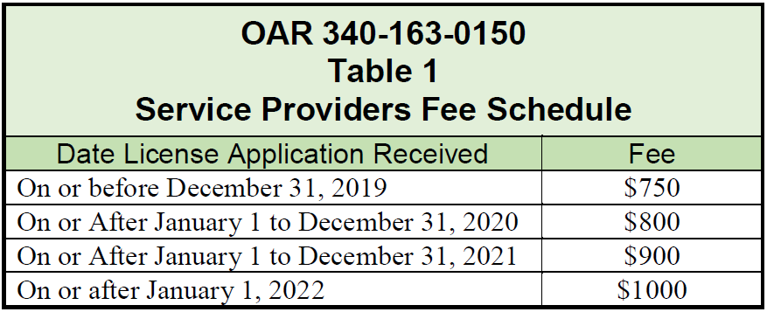
Rule Language (Differences Underlined)
Fees, OAR 340-163-0150 (1)
  Current language: Heating oil tank service providers must pay a non-refundable license fee of $750 for a twelve (12) month license.
  Proposed language with table: Heating oil tank service providers must pay a non-refundable license fee for a twelve (12) month license as listed in Table 1.

Slide 10
Rule Language (Differences Underlined)
Fees, OAR 340-163-0150 (2)
  Current language: Heating oil tank supervisors must pay a non-refundable license fee of $150 for a twenty-four (24) month license.
  Proposed language: Heating oil tank supervisors must pay a non-refundable license fee for a twenty-four (24) month license according to the following schedule:
  $150 for license applications received on or before December 31, 2019;
  $200 for license applications received January 1, 2020 or later.

Slide 11
Heating Oil Tank Fees
DEQ recommends the Environmental Quality Commission adopt the proposed rules in Attachment A as part of Chapter 340 of the Oregon Administrative Rules.

