Slide 1

Hazardous Waste
Hazardous Waste Fee Increase EQC Proposal
July 18, 2019
Enterprise, OR
David Livengood & Jeannette Acomb | Oregon Department of Environmental Quality
Notes:
Good morning Chair George and commissioners, my name is David Livengood. I manage DEQ’s Hazardous Waste and Tanks program from headquarters in Portland.
Today, I am joined by my colleague, Jeannette Acomb, whom you met in January when she presented background on the Hazardous Waste Program’s structure and budget outlook in preparation for today’s rulemaking presentation.
Jeannette and I are here to present proposed rules to increase these hazardous waste generator and Treatment, Storage and Disposal fees in Oregon for the first time in approximately 20 years. Throughout the process of developing this proposed rule, we have been aware of the potential impact on our stakeholder community. In fact, we asked for feedback and received ideas from a number of stakeholders.

Slide 2
Hazardous Waste Program Background - Funding
Notes:
As we presented during our January EQC pre-inform presentation, like other programs at DEQ, our Hazardous Waste Program is largely supported by fees.
Annually, DEQ Hazardous Waste Program receives approximately $3.5 million from multiple sources. Of that total, approximately 80% are in fees -- and 20% in federal grant dollars.
Today’s proposed rule changes represent in-depth staff analyses, as well as Advisory Committee input.
For the purposes of this rulemaking we used these figures.
(CLICK)
Today, we are proposing to only increase the Generator and TSD Fees, highlighted in green.
For many years, we have run a lean program by seeking efficiencies and cost-saving measures, including: Shifting more to electronic reporting and invoicing, delaying hiring, eliminating positions, and reducing overhead expenses.
Now, we are operating at a deficit and eroding our ending fund balance. Without additional revenue, the program will continue to experience an annual deficit and will need to consider further reductions by December 2019.
Several factors contributed to this deficit:
First, most of our program fees have remained unchanged for over a decade without adjustment for inflation or increased program costs, which include, salaries, benefits and information technology updates. These proposed Generator and TSD Fees have remained unchanged since the late 1990’s.
Second, the program has experienced decreases in funding. For example, since 2004, the Hazardous Waste Program tipping fee has decreased by approximately 60%. And, since 2008, DEQ’s EPA grant has decreased by 7%.
And third, we have experienced a significant change in state revenue. The program received $1.2 million in state General Funds in 1999. Since then, the amount of General Fund allocation steadily declined until its elimination in 2015. [CLICK]
--------------------------
Potential Questions:
Is Land Quality interested in receiving general funds again? Ans: It is an agency allocation decision for those state funds received. In the past, other programs in air and water have had higher priority funding needs.
Is this an urgent concern, why were we not made aware of the issue earlier? Are we being asked to rubber stamp a fee increase? Ans: Trend towards fee-based programs. Many entities pay fees associated with several DEQ programs (e.g. land, air , water) and DEQ had to make tough decisions about which fee increases to prioritize to not overburden the regulated community. Now, due to program need, it’s Hazardous Waste Program’s time to request fee increases. No, we are not asking for a rubber stamp, but your help in address this issue.
What is the relationship between hazardous waste work/fees and GHG goals for waste reduction? Direct to Director Whitman.

Slide 3
Proposed Hazardous Waste Fee Increases
Background – Hazardous Waste Program Fees
Projected $1.2-$1.5 million revenue deficit in revenue
Fee increases needed as program operating costs increase
Federal and state statutes authorize fee increases to implement program
David Livengood | Oregon Department of Environmental Quality
Notes:
Today, we face a projected $1.2 to $1.5 million deficit in the Hazardous Waste Program revenue for the 2019-2021 biennium.
DEQ last increased the Hazardous Waste fee cap and per metric ton fees in 2007. However, the fees we are proposing have not increased since 1998.
This shortfall threatens DEQ’s ability to ensure safe management and disposal of hazardous waste and greatly reduces compliance assistance to small businesses.
Also, the deficit potentially impacts Oregon’s ability to maintain the state’s status as a federally-authorized hazardous waste program.
We are looking to regain our legislatively approved budget service level, and not adding staff in this rulemaking.
~~~~`~~(add people slide)
The two types of fee increases that we are proposing today will help support and meet our core commitments to Oregon and EPA:
First, we are proposing increases to two existing hazardous waste generator fees:
Annual hazardous waste generators activity verification fees, and
Annual hazardous waste generators management method fee factors
[PAUSE]
If implemented, these proposed fee increases will impact the approximately 500 businesses and organizations in Oregon that currently pay hazardous waste fees. To moderate the impact on our fee-paying generators, we are proposing to phase in these fee increases over several years.
Second, we are proposing to change the permitted fees for Treatment Storage and Disposal (TSD) fee structure.
~~~~~~~~~~
Notes
Both 2007 fees increased 18%: Cap from $27,500 to current $32,500 & Metric ton from $110 to current $130 per metric ton

Slide 4
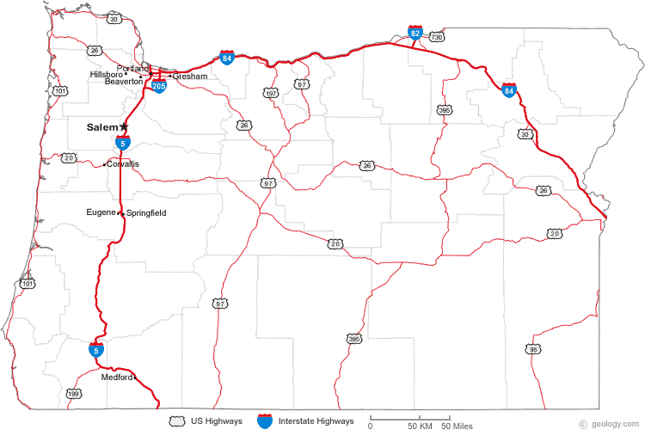


Hazardous Waste Program Background - Staff
Headquarters
Northwest
Western
Eastern
TA Inspection Permit Administration
Notes:
Jeannette Acomb
DEQ’s Hazardous Waste Program once had as many as 60 full time staff in the 1990’s, back when we had more than 900 generators. Today, we have 19 regional and headquarters staff working with approximately 500 generators.
The program is legislatively approved for 25 staff. However, due to current funding levels, the program is carrying 3.5 vacancies. These vacancies include 2 field inspectors, 1 permitting staff and a half-position for a program analyst. (LAB 2019-2021 25.44)
On the map we have highlighted our hazardous waste staff offices, and by color, identified the different types of work. Our program has four areas of focused work.
(Compliance and Enforcement): We have 6.5 staff (identified in blue) who inspect each of Oregon’s generators every three years. Our program receives an average of 163 complaints and conducts approximately 140 inspections annually, with 50 percent of those leading to at least one enforcement action per visit. (20% complaint-related site visits annually).
(Technical Assistance): We have 4 technical assistance staff (identified in green) who work with businesses of all sizes throughout the state to implement regulatory requirements and reduce wastes and toxic chemicals. Annually, our technical assistance staff provide over 20 workshops, perform 30 plus compliance site visits, and field 2,000+ telephone calls.
(Permitting and Corrective Action): We have 2 staff (identified in orange) who are responsible for permitting, corrective action, and compliance activities in Oregon. Oregon has 7 permitted sites, including 2 operating TSD facilities that handle waste from Oregon and out-of-state generators. Program staff also coordinate with the Cleanup Program and work on 22 sites in various stages of cleanup.
(Program Administration): 6.5 staff (identified in purple) who coordinate the program, perform mandatory tracking and reporting of data to EPA, invoicing, policy analysis and implementing state rules such as the federal rule adoptions and the recent delisting.
---------------------------------------------------------------------------------------------------
Potential Questions & Notes:
What would happen if we chose to inspect every 5 years (EPA requirement), instead of every 3 years (DEQ standard)?
You have more program administration staff than other types of core staff. Is it possible to put more FTE towards technical assistance and inspection work and less staff towards program administration?
7 permitted sites – Baron Blakeslee (Portland), Evanite Fiber Corp (Corvallis), Lockheed (The Dalles), Permapost Products Co (Hillsboro), Tektronix Inc (Beaverton)
2 Operating TSDs – Chemical Waste of Northwest, Safety-Kleen, Inc
corrective actions sites - Boeing of Portland, Cascade Wood Products, Columbia Helicopters, Evraz Oregon Steel, JH Baxter & Co. – Eugene, Marion County Road Dept., Mew Data Arms (MDA), NW Industries Pacific Fabricators, Potter Manufacturing, Roseburg Forest Products – Dillard, Safety-Kleen – Springfield, Taylor Lumber & Treating Inc., Teledyne Wah Chang Albany, Univar, Velco, Inc. (Former)
(It is worth noting that while we only have two operating permitted TSDs, DEQ’s data shows sometimes it can cost up to $140,000 in staff hours per complex permit modification.)

Slide 5
Proposed Hazardous Waste Fee Increases
Today’s Fee Increase Proposal:
Generator Fees: Phased in from 2019 to 2024
Permitting Fees: One increase in 2019
David Livengood | Oregon Department of Environmental Quality
Notes:
Today, we face a projected $1.2 to $1.5 million deficit in the Hazardous Waste Program revenue for the 2019-2021 biennium.
DEQ last increased the Hazardous Waste fee cap and per metric ton fees in 2007. However, the fees we are proposing have not increased since 1998.
This shortfall threatens DEQ’s ability to ensure safe management and disposal of hazardous waste and greatly reduces compliance assistance to small businesses.
Also, the deficit potentially impacts Oregon’s ability to maintain the state’s status as a federally-authorized hazardous waste program.
We are looking to regain our legislatively approved budget service level, and not adding staff in this rulemaking.
~~~~`~~(add people slide)
The two types of fee increases that we are proposing today will help support and meet our core commitments to Oregon and EPA:
First, we are proposing increases to two existing hazardous waste generator fees:
Annual hazardous waste generators activity verification fees, and
Annual hazardous waste generators management method fee factors
[PAUSE]
If implemented, these proposed fee increases will impact the approximately 500 businesses and organizations in Oregon that currently pay hazardous waste fees. To moderate the impact on our fee-paying generators, we are proposing to phase in these fee increases over several years.
Second, we are proposing to change the permitted fees for Treatment Storage and Disposal (TSD) fee structure.
~~~~~~~~~~
Notes
Both 2007 fees increased 18%: Cap from $27,500 to current $32,500 & Metric ton from $110 to current $130 per metric ton

Slide 6
Proposed HW Generator Fee Increases
Fee Category | Current Fees | 3-year Phase-in Final 2021 Increase
Annual Generator Fees
Large Quantity Generator Fee | $525 | $945
Small Quantity Generator Fee | $300 | $540
Fee Category | Current Factors | 6-year Phase-in Final 2024 Increase
Management Method Fee Factors
Various Factors | 0.50 – 2.00 | 0.85 – 3.40
David Livengood | Oregon Department of Environmental Quality
Notes:
This table illustrates our hazardous waste annual generator fee and management method fee factors.
DEQ is proposing to increase the annual base fee that all hazardous waste generators pay over three years – from the current fee of $300 per year for small quantity generators and $525 per year for large quantity generators to $540 for Small and $945 for Large quantity generators by 2021.
This phased-in fee increase will impact less than 500 small and large quantity generators in Oregon. As of Oct 2018 we had 197 Large and 272 Small generators
[PAUSE]
Wordy Revise? Next, DEQ is proposing to increase the management method fee factors that we apply to fee calculations for small and large quantity generators depending on which method they use to dispose of their hazardous waste. The management method factors reflect Oregon’s environmental hierarchy of preferred management methods, ranging from a preference for recovery of valuable materials like metals and solvents to less environmentally-preferable options such as land disposal.
You can find a full description of the management method fee factors reflects how well the process factors are scaled to protect the environment. The lower fee factors have more environmental benefit. enend their impact on our hazardous waste generator fee structure on pages 13 and 16, respectively, of our of our Hazardous Waste Fees 2019 Staff Report.
The current management method factors range from .5 to 2. By 2024, our management method fee factors will range from .85 to 3.4 for the various management methods.
The fee increases will phase-in as six annual increases to moderate the overall impact to generators.
[PAUSE]
Together, fee increases will bridge our projected deficit and support safe management and disposal of wastes in Oregon by keeping our staffing at current levels. [CLICK]

Slide 7
Proposed HW Permitting Fee Increases
Fee Category | Current Fees | One Increase 2019
Annual Compliance Determination Fees
Storage | $18,750 | $24,500
Multi- Treatment | $75,000 | $98,500
Multi- Disposal | $150,000 | $196,500
Permit Modification Fees
Class 1 | $2,800 | $4,500
Class 2 | $20,000 | $31,800
Class 3 | $31,000 | $49,300
Operating Permitted Disposal Administrative Fee
Annual Reported Metric Tons | $0 | $5.50
David Livengood | Oregon Department of Environmental Quality
Notes:
You can find a full description of the proposed permitting fee increases and the potential impacts on our hazardous waste generator fee structure on pages 14 and 16, respectively, of our Hazardous Waste Fees 2019 Staff Report.
This table shows Treatment, Storage and Disposal (or, TSD) fee categories – from Annual Compliance Determination, to Permit Modification Fees, as well as a new proposed category of Operating Permitted Disposal Administrative Fee. We propose to implement all of the fee increases in 2019.
All permitted hazardous waste TSD facilities with operating hazardous waste units are subject to Annual Compliance Determination fees. We propose increasing the annual compliance determination base fees for storage, treatment and disposal. We list here the three annual compliance determination fee increases DEQ currently charges annually. Where more than one hazardous waste management activity occurs at a single facility, DEQ charges a fee for each activity as reflected here in the chart. Of our two operating permitted TSD facilities in Oregon: one facility stores hazardous waste only and the other treats, stores and disposes of hazardous wastes and the applicable fees apply.
[PAUSE]
Also, we propose to increase the Permit Modification fees for Classes 1, 2 and 3 modifications. This proposal streamlines the current multiple permit modification classifications to just one fee per class. The range is Class 1 as the simplest permit modification to class 3 as the most complex requiring significant review. These fees are an inconsistent source of revenue since we only assesses fees when permittees request a modification.
[PAUSE]
Finally, we propose to add a new Operating Permitted Disposal Administrative fee of $5.50 per metric ton for waste accepted at the permitted TSDs in Oregon. This new fee affects only our only operating permitted disposal facility in Oregon.
Approximately 90,000 tons annually are land dispose in Oregon. This number has been consistent over the last few years. At $5.50 per ton this fee could potentially bring in $400, 000 annual in additional revenue.
Together, these proposed fee increases will help align our hazardous waste permit fees with the Consumer Price Index and our needs to administer the program. [CLICK]
~~~~~~~~~~~~~~~~~~~
Fee increases including:
An increase in annual compliance determination fees (TSD annual base fee for treatment, storage and disposal activities)
An increase to Permit Modification fees, and
An addition of an operating permitted disposal administrative fee for permitted facilities disposing solid and hazardous wastes in Oregon Detail , either by land unit such as in a permitted SW or HW landfill or surface impoundment such as a permitted surface lagoon.
These TSD fees will apply to two operating treatment, storage and disposal facilities in Oregon, and we are proposing one fee increase in 2019. [CLICK]

Slide 8




Hazardous Waste Fee Increase 2019
Consult
First Advisory Committee
Meeting
Consult
Third Advisory Committee
Meeting
Consult and Inform
Public Hearing and EQC pre-inform meeting
Aug. 2018
Sept. 2018
Oct.
2018
Dec. 2018
Jan.
2019
July
2019
Consult
Second Advisory Committee
Meeting
Inform
Public Notice and Open Public Comment
Present
Present Rulemaking to the EQC
Notes:
This calendar reflects our work-to-date for this rulemaking. The blue circles represent our public engagement process, and the blue paper stacks represent documents we developed in support of this rulemaking.
As mentioned earlier, from the beginning, we were aware of many of the potential impacts this rulemaking would have on businesses producing hazardous waste, as well as the permitted facilities in Oregon that treat, store and dispose hazardous waste.
During the past year, we have sought stakeholder input on primarily from 9=member advisory committee on the types of fees , the breadth of fees, and current service to help us better understand impacts. WE got stakeholder support and agreement on our current service level, and on which fees to change and how to change them and moderate the impacts. (add all 3 next bullets below into this)
In fall 2018, we received input on the rulemaking from a nine-member advisory committee comprised of statewide stakeholders, including representatives of small and large businesses, business advocates, education, and environmental interests.
The advisory committee met three times (in Aug, Sept, and Oct) to discuss the pros and cons associated with the proposed rules, as well as the anticipated fiscal impacts on Oregon’s businesses.
While there will be impacts, the Committee did not identify significant adverse impacts on Oregon small businesses as a result of our proposed fee increases. The committee expressed support for the proposed fees increase to maintain DEQ Hazardous Waste Program’s current service level. The Committee also supported the concept of phasing-in fee increases for those affected hazardous waste generators.
We published public notice for the proposed rulemaking on December 14, 2018.
On January 17, 2019, we held a public hearing in Portland . The public comment period ended January 22, 2019, and we received no comments.
Because we did not receive comments during the public comment period, we did not make changes to the proposed rules.
This is phase 1 rulemaking seeking your approval today
Phase 2 would a law change followed by additional rulemaking with a goal of secure funding by 2026
If approved today, we will send out invoices within a month.
--------------------------------------------------------------------------------------------------------------------------------------------------------------
Notes: (6-8 pm Hearing)
We notified 23,744 interested people by GovDelivery bulletins, emails and US mail about the advisory committee meetings, public comment period and public hearing. Our distribution list for this information
Includes notification of 1,014 hazardous waste generators who reported to DEQ within the last three years
DEQ held a public hearing on Jan 17, 2018. 2 interested people attended the public hearing in person and an unknown number by phone.
Potential Question: Be prepared to answer what we may propose to change via statute:
hazardous waste generator fee cap $32,500: Est 1992 1997 Cap $15,000 to $22,500
2003 Cap $22,500 to $27,500
2007 Cap $27,500 to $32,500
per metric ton fee $130 : Est 1992 1997 $60 to $90
2003 $90 to $110
2007 $110 to $130
In addition to the elements to this rulemaking timeline [point to/glance at screen], we would also like to note that today’s proposed rulemaking is the first phase of an anticipated multi-phase effort to fully address our funding deficit. The phases will help fund the program to at least 2026.
To secure long-term, stable funding, including the fees increases proposed in this rulemaking package, we must seek legislative changes -- ideally during 2021 legislative session. This would help build the next phase of our funding bridge, allowing us to continue the current level of service covering our hazardous waste generators and permitted businesses in Oregon.

Slide 9
Increase Generator & Permit Fees
RECOMMENDATION
DEQ recommends the Environmental Quality Commission adopt Phase One of the proposed rules in Attachment A as part of chapter 340 of the Oregon Administrative Rules.
David Livengood | Oregon Department of Environmental Quality
Notes:
In conclusion, DEQ recommends the Environmental Quality Commission adopt the proposed rules in Attachment A as part of chapter 340 of the Oregon Administrative Rules.
Chair George and Commissioners, thank you for your consideration of the information we presented today, and for addressing the Hazardous Waste Program’s funding needs.
We welcome any additional questions you may have about the program, rulemaking background, and our plans moving forward. (PAUSE)
(Wait for EQC actions)
Thank you, Commissioners.

Slide 10
Contacts
David Livengood, Project Sponsor
Livengood.david@deq.state.or.us
503.229.5769
Jeannette Acomb, Project Lead
Acomb.Jeannette@deq.state.or.us
503.229.6303

Slide 11
Increase Hazardous Waste Fees
PUBLIC INVOLVEMENT, COMMENTS and RESPONSES
The proposed rules were placed on public notice on December 14, 2018.
DEQ held a public hearing in Portland on January 17, 2019.
The public comment period ended on June 22, 2019.
No comments were received.
No changes to the proposed rules were made based on the comments.
David Livengood | Oregon Department of Environmental Quality
Notes:
In addition to the outreach activities that I mentioned on the previous slide, we also notified 23,744 interested people by GovDelivery bulletins, emails and US mail about the advisory committee meetings, public comment period and public hearing. Our distribution list for this information included 1,014 hazardous waste generators who reported to DEQ within the last three years.
DEQ held a public hearing on Jan 17, 2018. 2 interested people attended the public hearing in person and an unknown number by phone.
NO comments were received.
No changes were made in the proposed rules.
We look forward to your comments and questions on this proposed hazardous waste fee increase rulemaking, and we would also like to note that today’s proposed rulemaking is the first phase of an anticipated multi-phase effort to fully address our funding deficit by 2026.
To secure long-term, stable funding, in addition to increasing fees by rulemaking, we must also seek additional changes under statutory authority within the next several years in order to completely bridge our projected deficit and allow us to continue the current level of service to our hazardous waste generator and TSD community in Oregon.
Chairman George and commissioners, thank you for your time.

Slide 12
Generator
Notes:
David
--clarify that from here on out we are addressing both permits and generators

Slide 13
Proposed Changes to Generator Fee Formula
[Annual Hazardous Waste Generation Fee (metric tons x $130 x management method factor)*] + Activity Verification Fee
* Subject to $32,500 cap
HW Rules Team | Oregon Department of Environmental Quality
Notes:
Killian Condon
To be clear, given DOJ’s recent input, this proposed rulemaking seeks to change the management method factor and the Activity Verification Fee.
The management method factor remains subject to the cap as part of the total Annual Hazardous Waste Generation calculation.
The Activity Verification is increased on a flat basis for both small and large quantity generators.

Slide 14
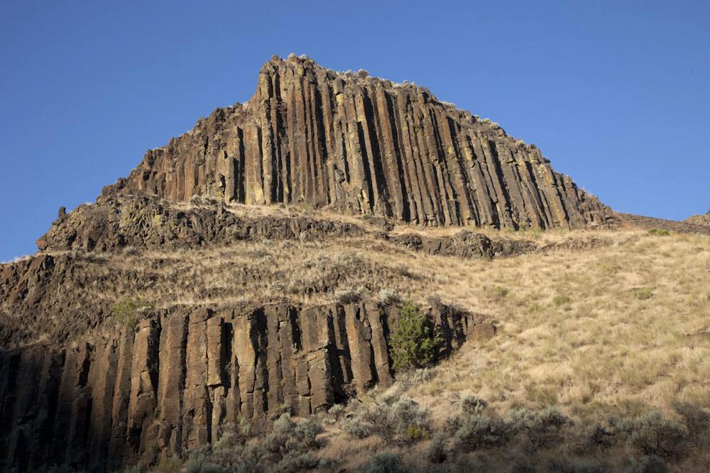
Reminder: Generator Fee Cap
Statute last increased in 2008
Currently $32,500
Affects approximately 18 currently capped LQGs plus 10 additional LQGs by 2024.
Source: http://www.marlimillerphoto.com/110806-17m.html
HW Rules Team | Oregon Department of Environmental Quality
Notes:
Killian Condon
We want to keep in mind the fee cap is a core component we will need to factor in as we consider changes to generator fees – now and in the future.
Although it is out of scope for this rulemaking we would like to consider it for a possible change in the next rulemaking, our phase 2, where we can address changes in statute.
The generator fee cap was last increased in 2008 from $27,500 to the current cap of $32,500.
Effects approximately 18 capped LQGs currently (this is a change in an earlier meeting where we said currently 15 LQGs are capped based on as all 2018 reporting data is received.
~~~~~~~~~~~~~~~~~~~~~~~~~~~~~~~~~~~~~~~~~~~~~~~~~~~~~~~~~~~~~~~~~~~
If we were to apply an inflation factor = 19%
Options
Cap: $32,500 current to $45,221 in 8 yrs ~ $5,653 yearly
Effects approximately 15 capped LQGs
Ex: LQG 2015 invoice = $.5M but paid $32,500
Revenue jumps $487,500 to $678,315 = 3.02 to 4.2 FTE
Adds approximately $190K in additional revenue annually
Risks
Assumes generator numbers remain static
Increase is steep
Requires stakeholder involvement

Slide 15
Other Management Factors – Continued
Management method | Code | Current factor | Proposed final factor 70%
Metals recovery | H010 | 0.50 | 0.85
Solvent recovery | H020 | 0.50 | 0.85
Other recovery | H039 | 0.50 | 0.85
Elementary Neutralization (WWTU) | H121 | 0.50 | 0.85
Incineration | H040 | 1.00 | 1.70
Energy Recovery (reuse as fuel) | H050 | 0.75 | 1.28
Fuel Blending prior | H061 | 0.75 | 1.28
Aqueous Inorganic treatment | H070 | 1.00 | 1.70
Aqueous Organic treatment | H081 | 1.00 | 1.70
Aqueous Combined | H120 | 1.00 | 1.70
Sludge treatment | H100 | 1.00 | 1.70
Other treatment | H129 | 1.00 | 1.70
Stabilization | H110 | 1.00 | 1.70
Neutralization (offsite) | H121 | 0.75 | 1.28
Land disposal | H132 | 1.50 | 2.55
Management method unknown | - | 2.00 | 3.40
Notes:
Killian Condon
Here are the 16 management factors we are proposing to increase by 70% over time.
The proposed final factor is what the factor would be in 2024 for the last increase.
The factors will stay as the purple column as approved until changed by a future rulemaking.
Our intent is to be able to address all parts of the current calculation you saw just a few slides back, when we are able to change the statute.
~~~~~
What does the CWM ORU2 code used? H039?
Consider in messaging around this facility political

Slide 16
Generator Invoice -Current Example
CAP
HW Rules Team | Oregon Department of Environmental Quality
Notes:
Killian Condon
We wanted to show you how the previous calculation looks in a current generator invoice.
As you can see each item or management method factor is identified and based on reported quantity is multiplied….
~~~~~~~~~~~~~~~~~~~~~~~~~~~~~~
Notes:
Based on unofficial 2017 generator data.
~~~~~~~~~~~~~~~~~~~~~~~~~~~~~~~~~~~~~~~~~~
Older material
2017 base fees total $187,125 (293 SQG x $300 & 189 LQG X $525)
Option 2 is 549% increase from current base fee.

Slide 17
Generator Invoice Example
CAP
HW Rules Team | Oregon Department of Environmental Quality
Notes:
Killian Condon
Here is an example of what the invoice might look like with the fully implemented increase for management method factors.
Bearing in mind that 70% percent does not translate to a 70% increase in revenue because
a) larger generators may run into the cap; (we’ve gone to 18 to 28 facilities that are capped with the increase that happens by 2024); and
a facility may chose to change its management method.
And here’s how this might look in the invoice:
Recovery Factor changed from 0.75 to 0.85
Incineration Factor changed from 1.00 to 1.70
Energy Recovery Factor changed from 0.75 to 1.28
Land Disposal Factor changed from 1.50 to 2.55
Off-site Neutralization factor changed from 0.75 to 1.28

Slide 18
Management Method Factor Proposal
Increase all factors incrementally through 2024.
Year | Factor increase | Additional Revenue Generated | Total Revenue Generated
Jul - 2019 | 12% | $166,999 | $166,999
Jul - 2020 | 17% | $264,768 | $431,767
Jul - 2021 | 5% | $91,111 | $522,878
Jul - 2022 | 8% | $153,067 | $675,945
Jul - 2023 | 7% | $144,648 | $820,593
Jul - 2024 | 7% | $154,774 | $975,367
HW Rules Team | Oregon Department of Environmental Quality
Notes:
Killian Condon
The management method factor that you see here reflects the Advisory Committee’s input from previous meetings in two specific ways:
While we initially proposed to change only 4 fee factors, we heard your input on avoiding political choices, and now we are proposing to change all of the factors proportionally.
We also heard that our regulated community will need time to adjust to the increased fees, so we’re proposing phasing in the increase over a period of six years, through 2024; however in order to meet budgetary needs, we propose to frontload the management method increase after a softer start in 2019 and 2020.
In order to meet budget needs, DEQ proposes front loading the steepest increases in 2019 and 2020. This initial increase is intended to stabilize funding and the increases thereafter are intended to roughly keep pace with inflation until DEQ is able to address inflation through statute in a future phase.
If the management method factor changes are implemented as proposed, when the revenue from the management method fee factor increase is combined with revenue from the annual activity verification, we estimate that DEQ will have an additional $975,367 or ~ 1 million in additional revenue annually.
----------------------------------------------
Killian Condon
Knowing this might be an additional option to add into the suite of proposals, and knowing it will not generate sufficient funding we are still proposing changes.
With the caveat that this option could potentially reduce the other earlier options.
The purpose for this approach is to incentivize good behavior and disincentive bad behavior.

Slide 19
New Management Factor – Continued
Management method | New factor
RCRA-Exempt (CU or Brownfield) | 0.00
Grant-funded government environmental cleanup of a Brownfield or orphaned industrial property involving hazardous waste residues for off-site treatment and/or landfill disposal.
Notes:
Killian Condon
Based on what we heard from the last meeting, we are proposing this change…. Note the strike through of the word government.
The committee recommended we remove the Government portion and identify with Brownfield only
This proposal will encourage all grant-funded cleanups of brownfields or orphaned industrial .
~~~~~~~~~~~~~~~~~
Notes:
Would need to ensure the reporting a G code to indicate remediation – then Mary would be able to uncheck the waste from applying fees.

Slide 20
Generator Fees Funding
$3.57M
$3.57M
Goal of the program by 2026
100% -
90% -
80% -
70% -
60% -
50% -
40% -
30% -
20% -
10% -
0% -
100% -
90% -
80% -
70% -
60% -
50% -
40% -
30% -
20% -
10% -
0% -
Need:
27% $823K
Need:
57% $2.02M
+$975,367 Management Factors
+$152,160 Annual Fees
Current
43%
$1.55M
43%
$1.55M
43%
$1.55M
Notes:
Ed Note: add a different color on the bar to illustrate what we’re proposing
Killian Condon
Just as a recap:
DEQ hazardous waste program receives approximately $1.5 million annually in generator fees
In looking at making generator fees self-sufficient, we would need a total of $3.57 million in annual fees
Currently, we are about 43% of our goal in annual revenue, to fully support the generator compliance work.
DEQ determined we need 7 FTE for generator inspection geographically across the state. We recently had this number of staff about 6 mos ago.
Click
Our goal is $3.57 million annually by 2026
Which means we will need an additional $2.022 million in funding annually.
As you heard in our first meeting we have streamlined program costs by not filing vacancies and implementing efficiencies

Slide 21
Permitting
Notes:
Note: there will be one permit stakeholder on the phone. Check in with this person regularly.
Rich Duval
Recap of Advisory Committee 2 make-up meeting and outcome
Due to logistical issues we were not able to hold our last permitting discussion the same day as our second Advisory Committee meeting.
However, DEQ has subsequently discussed permitting fee proposals with the members of our Advisory Committee who represent that sector, and we wanted to share the outcomes of our conversation with you.
The permitting fee proposals that we are presenting here today are an important piece of the whole picture when it comes to increasing the revenue stream to fund DEQ’s hazardous waste work.

Slide 22
Sample Permitting Annual Fee Proposal
Current fees
Storage Fee $ 18,750
Treatment - Multi Tech Fee $ 75,000
Disposal - Multi Unit Fee $ 150,000
$ 243,750
Proposed Increase
Storage Fee $ 24,500
Treatment - Multi Tech Fee $ 98,500
Disposal - Multi Unit Fee $ 196,500
Difference $75,750 or 31% $ 319,500
*Note that this chart represents one of two permitted facilities. The second permitted facility pays storage fee only.
Notes:
Rich Duval
As you can see, when the fee proposals are combined for one facility, they total ~ $319,500 per year, or an increase of $75,750 difference from current fees. This is a 31% increase for this facility.
The other facility would see an increase in storage fees only – from 18,750 to 24,500 for an increase of $5,750 annually

Slide 23
Permit Annual Funding
$838K
100% -
90% -
80% -
70% -
60% -
50% -
40% -
30% -
20% -
10% -
0% -
Goal of the program by 2026
100% -
90% -
80% -
70% -
60% -
50% -
40% -
30% -
20% -
10% -
0% -
$838K+
Need:
57% $475.5K
Need:
0%
+$495K Admin
+ $81K Annual
Current
+$33K Mod
43%
43%
$362.5K
$362.5K
Notes:
Rich Duval
The program’s permitting revenue is about $362,500, which includes $262,500 in annual TSD fees and about $100,00 in cost recovery for post closure and corrective action work.
Currently, we are about 43% of our goal in annual revenue, to fully support the permitting work.
DEQ determined we need 3 FTE for permit work to maintain the current permitting program.
Our goal is $838,000 annually.
Which means we will need an additional $475,500 funding annually to maintain our current service level.
As you heard in our first meeting we have streamlined the permitting process and squeezed as many savings as possible - which include not filing vacancies.
Bear in mind the current revenue is supported by generator fees as a stop-gap measure.

Slide 24
Fiscal Impacts
Notes:
David

Slide 25
DEQ’s Fiscal Impact Statement
DEQ’s Fiscal Impact Statement - Generators
Annual Activity Verification Fee
Management Method Factor
Generator Type | Current Fee | Proposed Fee | # Generators | # Small Businesses
SQG | $300 | $540 | 291 | 118
LQG | $525 | $945 | 196 | 71
1. Increase the SQG base fee from $300 to $560 and increase the LQG base fee from $525 to $980 over a three-year phase-in period. This 80% increase would result in a $152,160 annual increase from current funding by 2021.
Generator Type | Current Fee | Proposed Fee | #Generators | # Small Businesses
SQG | $296 | $503 | 291 | 118
LQG | $6,654 | $11,322 | 196 | 71
HW Rules Team | Oregon Department of Environmental Quality
Notes:
Killian Condon
Annual Hazardous Waste Activity Verification Fee
The Annual Hazardous Waste Activity Verification Fee is a phased-in increase of the Small Quantity Generator base fee from $300 to $540 by 2021, and the Large quantity Generator Fee from $525 to $945 by 2021.
This represents an 80% increase that will result in an annual increase of $152,160 above the current revenue by 2021 and thereafter.
This will impact 291 SQGs, of which 118 are small businesses. And it will impact 196 LQGs, of which 71 are small businesses.
Management Method Factor
A six year phase-in to increase the management method factor for all management methods by 70% change starting in July 2019 would result in a $975,367 annual increase from the current funding by 2024.
This would increase the number of capped generators from 18 to 34 by 2024.
The current management method factor revenue averages $2,855 over 487 reporting facilities and the proposed increase would average approximately $4,907 for 487 reporting facilities by 2024

Slide 26
DEQ’s Fiscal Impact Statement
Permitted operating TSDs:
One facility increase = $5,750 annually
Second facility increase = $495,000 annually $ 75,750 for ACDP fee
    + $495,000 for new admin fee
Variable Mod fee depends on request
HW Rules Team | Oregon Department of Environmental Quality

Slide 27
DEQ’s Fiscal Impact Statement –
Permits
Facility 1 Increase
$5,750 annually for the Annual Compliance Determination Fee
Facility 2 Increase
$570,750 annually:
      $75,750 for Annual Compliance Determination fee and
      $495,000 for new Administrative fee
Modification fee will vary annually depending on requests.
HW Rules Team | Oregon Department of Environmental Quality
Notes:
Rich Duval/Jeannette Acomb
The proposed changes to the permit fee will impact two permitted operations Treatment, Storage and Disposal facilities.

Slide 28
Program Info
Notes:
Note: there will be one permit stakeholder on the phone. Check in with this person regularly.
Rich Duval
Recap of Advisory Committee 2 make-up meeting and outcome
Due to logistical issues we were not able to hold our last permitting discussion the same day as our second Advisory Committee meeting.
However, DEQ has subsequently discussed permitting fee proposals with the members of our Advisory Committee who represent that sector, and we wanted to share the outcomes of our conversation with you.
The permitting fee proposals that we are presenting here today are an important piece of the whole picture when it comes to increasing the revenue stream to fund DEQ’s hazardous waste work.

Slide 29
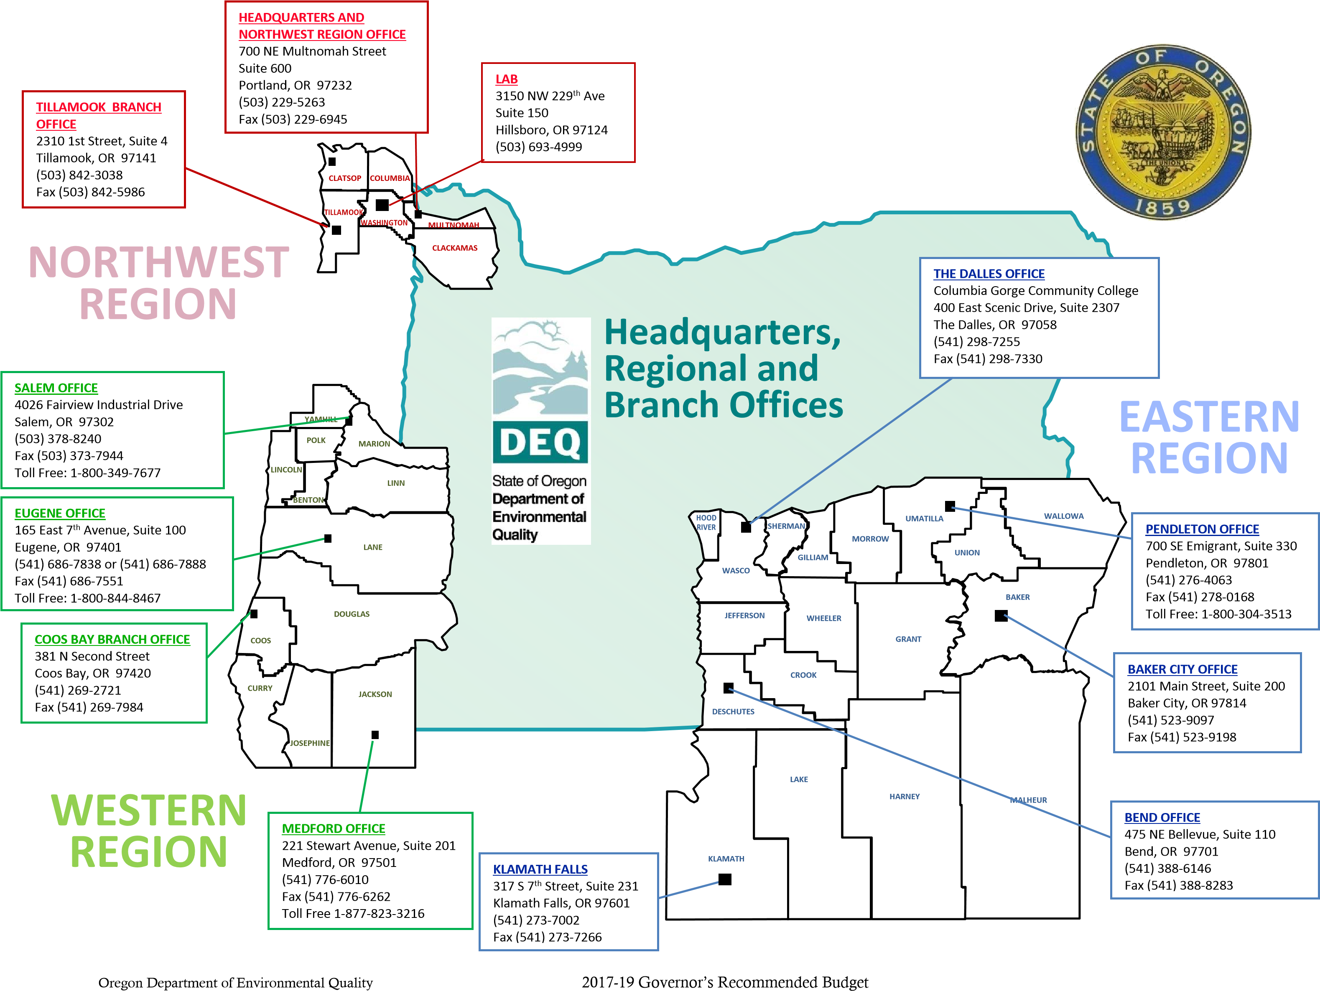
Notes:
Jeannette Acomb
DEQ is headquartered in Portland, with regional offices in
Bend,
Eugene, and
Portland,
and field offices in
Baker City,
Coos Bay,
Medford,
Pendleton,
Salem,
The Dalles,
Klamath Falls, and
Tillamook.
DEQ’s environmental laboratory operates in Hillsboro., and our vehicle inspection stations in Portland, and Medford
Sourced: DEQ Governor Budget 2018

Slide 30
Hazardous Waste Program Background - Staff
Headquarters
Northwest
Western
Eastern
TA Inspection Permit Administration
Notes:
Jeannette Acomb
DEQ’s Hazardous Waste Program once had as many as 60 full time staff in the 1990’s, back when we had more than 900 generators. Today, we have 19 regional and headquarters staff working with approximately 500 generators.
The program is legislatively approved for 25 staff. However, due to current funding levels, the program is carrying 3.5 vacancies. These vacancies include 2 field inspectors, 1 permitting staff and a half-position for a program analyst. (LAB 2019-2021 25.44)
On the map we have highlighted our hazardous waste staff offices, and by color, identified the different types of work. Our program has four areas of focused work.
(Compliance and Enforcement): We have 6.5 staff (identified in blue) who inspect each of Oregon’s generators every three years. Our program receives an average of 163 complaints and conducts approximately 140 inspections annually, with 50 percent of those leading to at least one enforcement action per visit. (20% complaint-related site visits annually).
(Technical Assistance): We have 4 technical assistance staff (identified in green) who work with businesses of all sizes throughout the state to implement regulatory requirements and reduce wastes and toxic chemicals. Annually, our technical assistance staff provide over 20 workshops, perform 30 plus compliance site visits, and field 2,000+ telephone calls.
(Permitting and Corrective Action): We have 2 staff (identified in orange) who are responsible for permitting, corrective action, and compliance activities in Oregon. Oregon has 7 permitted sites, including 2 operating TSD facilities that handle waste from Oregon and out-of-state generators. Program staff also coordinate with the Cleanup Program and work on 22 sites in various stages of cleanup.
(Program Administration): 6.5 staff (identified in purple) who coordinate the program, perform mandatory tracking and reporting of data to EPA, invoicing, policy analysis and implementing state rules such as the federal rule adoptions and the recent delisting.
---------------------------------------------------------------------------------------------------
Potential Questions & Notes:
What would happen if we chose to inspect every 5 years (EPA requirement), instead of every 3 years (DEQ standard)?
You have more program administration staff than other types of core staff. Is it possible to put more FTE towards technical assistance and inspection work and less staff towards program administration?
7 permitted sites – Baron Blakeslee (Portland), Evanite Fiber Corp (Corvallis), Lockheed (The Dalles), Permapost Products Co (Hillsboro), Tektronix Inc (Beaverton)
2 Operating TSDs – Chemical Waste of Northwest, Safety-Kleen, Inc
corrective actions sites - Boeing of Portland, Cascade Wood Products, Columbia Helicopters, Evraz Oregon Steel, JH Baxter & Co. – Eugene, Marion County Road Dept., Mew Data Arms (MDA), NW Industries Pacific Fabricators, Potter Manufacturing, Roseburg Forest Products – Dillard, Safety-Kleen – Springfield, Taylor Lumber & Treating Inc., Teledyne Wah Chang Albany, Univar, Velco, Inc. (Former)
(It is worth noting that while we only have two operating permitted TSDs, DEQ’s data shows sometimes it can cost up to $140,000 in staff hours per complex permit modification.)

Slide 31
Hazardous Waste Background – Program Portfolio
Compliance and enforcement
Technical Assistance
Permitting
Data Management
Policy

Slide 32
Business Case
Notes:
David
--clarify that from here on out we are addressing both permits and generators

Slide 33
Building a Business Case - Generators
Activity | 2018 | Jul-19 | Jul-20 | Jul-21 | Jul-22
% Increase |  | 13.84% | 17.70% | 7.13% | 6.88%
Revenue | $1,550,000
Annual Gen Fee |  | $47,550 | $47,550 | $57,060
Mgmt Factor |  | $166,999 | $264,768 | $91,111 | $153,067
Add'l revenue | 0 | $214,549 | $312,318 | $148,171 | $153,067
Projected Revenue | $1,550,000 | $1,764,549 | $2,076,867 | $2,225,038 | $2,378,105
Goal | $3,572,000 | $1,807,451 | $1,495,133 | $1,346,962 | $1,193,895
Difference | $2,022,000 | ($1,807,451) | ($1,495,133) | ($1,346,962) | ($1,193,895)
HW Rules Team | Oregon Department of Environmental Quality
Notes:
David Livengood
We put together a business case for generators…..

Slide 34
Business Case – Generators Continued
Activity | Jul-23 | Jul-24 | Jul-25 | Jul-26
% Increase | 6.08% | 6.14% | 5.78% | 5.46%
Revenue
Flat Fee
Factor | $144,648 | $154,774 | $154,774 | $154,774
Add’l revenue | $144,648 | $154,774 | $154,774 | $154,774
Projected Revenue | $2,522,753 | $2,677,527 | $2,832,301 | $2,987,075
Goal | $1,049,247 | $894,473 | $739,699 | $584,925
Difference | ($1,049,247) | ($894,473) | ($739,699) | ($584,925)
HW Rules Team | Oregon Department of Environmental Quality
Notes:
David Livengood
As you saw in the previous slide, we are now moving forward from the previous slide of July 22 forward to July 2026…..

Slide 35
Building a Business Case - Permitting
Activity | 2018 | Jul-19 | Jul-20 | Jul-21 | Jul-22
% Increase |  | 131.17% | 0.00% | 0.00% | 0.00%
Revenue | $362,500 | $838,000 | $838,000 | $838,000 | $838,000
ACDP |  | $162,750 | $162,750 | $162,750 | $162,750
Admin Fee |  | $312,750 | $312,750 | $312,750 | $312,750
Add'l revenue | 0 | $475,500 | $0 | $0 | $0
Goal | $838,000
Difference | $475,500 | $0 | $0 | $0 | $0
Projected Revenue | $362,500 | $838,000 | $838,000 | $838,000 | $838,000
HW Rules Team | Oregon Department of Environmental Quality
Notes:
David Livengood
We built a similar one for Permitting, however this is proposed as one set increase in 2019 without additional to make up for the inflation since 1997-1998.

Slide 36
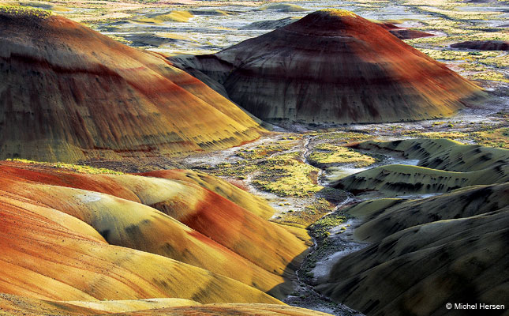
Statutory Authority
ORS 466.165 Annual Fees
ORS 466.045(5)
Source: https://www.outdoorphotographer.com/on-location/favorite-places/painted-hills-john-day-fossil-beds-national-monument-oregon/
HW Rules Team | Oregon Department of Environmental Quality
Notes:
David Livengood
We have had twists and turns along this process, and the time since our last meeting is no exception! Since we last met, we asked Oregon Department of Justice for advice about our different fee options, including the volume- and capacity-based fee structures – as well as using some economic index. DOJ reminded us the generators fees in statute are to “to pay the cost of carrying on the monitoring, inspection and surveillance program under ORS 466.195 and related administrative costs.
Even with such fee authority for, we are unable to include a new or revised generator fee in rule related in any way to volume or capacity unless we change statute. In short, this means the so-called flat fee option and management method factors are the only changes we can make via rule. This conclusion upholds the concern some of you held about having to volume-based charges.
While the advice directly affects our fee increase proposal for this first phase, this does not preclude us from seeking other options in the next phase when we will ask for statutory changes in a future Oregon legislature.
In our second phase work, we will revisit the volume-based and cap options, which means looking at:
Changing the volume-driven $130/metric ton charge;
Changing the current $32,500 cap; and
Possibly changing permitting fee limits.
We also asked advice about adding an economic index or inflation factor. We learned we would need a statute change and a subsequent rule to set it. Anytime we need to change it, we would have to change the rule. Therefore, for this rulemaking, this is not an option. We can revisit this when we hold our next advisory committee focused on statutory changes to make the program financially whole and stable in the future.
As I shared earlier during the permitting-specific discussion, we asked for Department of Justice questions about increasing cost recovery options and limits to the permit modification fee. We are unable to increase those due to limits in statute.
With all of these new developments and the need to make some strides in restoring program funding, we shaped our only clear proposals.
Now I will turn to Rich Duval to present our permitting proposal from earlier this morning.

