Slide 1

Hazardous Waste
Hazardous Waste Fee Increase EQC Proposal
May 17, 2019
Portland, OR
David Livengood | Oregon Department of Environmental Quality

Slide 2
Hazardous Waste Program Background - Funding
Notes:
Like other programs at DEQ, our Hazardous Waste Program is largely supported by fees.
Annually, DEQ receives approximately $3.5 million from multiple sources. Of that total, approximately 80% are in fees, and 20% in federal grant.
(CLICK) For our purposes today, we are especially interested in increasing the Generator and TSD Fees, now highlighted in green. Increases to both these fees is included in this rulemaking proposal.
For many years, we have run a lean program by seeking efficiencies and cost-saving measures including: delaying hiring, eliminating positions, and reducing overhead expenses.
Now, in spite of these efforts, we are operating at a deficit and eroding our ending fund balance. Without additional revenue, the program will continue to experience an annual deficit and will need to consider further cost reductions by December 2019.
Several factors contributed to this deficit:
First, most of our program fees have remained unchanged for over a decade without adjustment for inflation or increased program costs which include, salaries, benefits and information technology updates. The proposed Generator and TSD Fees have remained unchanged since the late 1990s.
Second, the program has experienced decreases in funding. For example, since 2004, the Hazardous Waste Program tipping fee has decreased by approximately 60percent. Another example, since 2008, DEQ’s EPA grant has decreased by 7%.
And third, we have experienced a significant change in state revenue. The program received $1.2 million in state General Funds in 1999. Since then, the amount of General Fund allocation steadily declined until its elimination from hazardous waste funding in 2015.
The proposed fee increases will help support our current staffing level and meet our core commitments until.
--------------------------
Potential Questions:
Is Land Quality interested in receiving general funds again? Ans: it is an agency allocation decision for those state funds received, in the past other programs such as air and water had high priority funding needs.
Is this an urgent concern, why were we not made aware of the issue earlier? Are we being asked to rubber stamp a fee increase? Ans: Trend towards fee-based programs. Many entities pay fees associated with several DEQ programs (e.g., land, air , water) and DEQ had to make policy decisions about which fee increases to prioritize in order to not overburden the regulated community. Now is the hazardous waste program time to request fee increases. No, we are not asking for a rubber stamp, but your help in address this issue.
What is the relationship between hazardous waste work/fees and GHG goals for waste reduction? Direct to Director Whitman.

Slide 3
Proposed Hazardous Waste Fee Increases
Background – Hazardous Waste Program Fees
Projected $1.2-$1.5 million deficit in revenue for 2019-2021 biennium.
Fee increases needed as program operating costs increase.
Federal and state statutes authorize fee increases to implement the program.
Today’s fee increase proposal:
Generator Fees: Phased in 2019-2024; invoice July 2019
Permitting Fees: One increase in 2019; invoice in July 2019
David Livengood | Oregon Department of Environmental Quality
Notes:
The proposed fees would address the forecasted $1.2 – 1.5 million deficit in hazardous waste program revenue for the 2019-2021 biennium. This shortfall threatens DEQ’s ability to ensure safe management and disposal of hazardous waste and greatly reduces compliance assistance to small businesses. It also potentially impacts Oregon’s ability to maintain state’s federally authorized Hazardous Waste Program.
Today’s fee proposes increases two areas:
The hazardous waste generators fees to be phased in starting in July 2019 through 2021 and 2024. This includes the:
Annual hazardous waste generators activity verification fees
Annual hazardous waste generators management method fee factors
These fees will affect ~ 487-500 fee payers generating hazardous wastes
And the permitted fees for Treatment Storage and Disposal (TSD) facilities will be a one year increase for the:
Annual compliance determination fees (base TSD annual fee for treatment, storage and disposal)
Permitting modification fees, and
Adds an operating permitted disposal administrative fee (for facilities disposing wastes in Oregon, either by land unit or surface impoundment)
These fees will affect two operating permitted treatment, storage and disposal facilities, and potentially a few of the 18 remedial cleanup sites which include nine closed sites that intermittently generate hazardous waste.
The proposed fees apply to all hazardous waste generators required to report. DEQ last increased general fees in 2007, however, the fees we are proposing have not increased since 1998.
Today’s proposal addresses those hazardous waste fees we can address by rule, or phase 1 of the multi-phase rulemaking.
We will be seeking a phase 2 for statutory fee increases in the near future.

Slide 4
Proposed HW Generator Fee Increases
Fee category | Current Fees | 2019 3-year Phase-in Final 2021 Increase
Annual Generator Fees
Large Quantity Generator Fee | $525 | $945
Small Quantity Generator Fee | $300 | $540
Fee category | Current Factors | 2019 6-year Phase-in Final 2024 Increase
Management Method Fee Factors
Various Factors | 0.50 – 2.00 | 0.85 – 3.40
David Livengood | Oregon Department of Environmental Quality
Notes:
The table before you shows the current hazardous waste generator fees for 2018, and the proposed fee increases starting in July 2019.
This proposal affects several different fee types, shown in the first column of the table.
First, DEQ is proposing to increase the annual base fee over a three year period starting in July 2019, which all HW generators pay, to be by 2021 $945 for large quantity generators, and $540 for small quantity generators.
Next, DEQ is proposing to increase the management method fee factors from the current range of 0.50-2.00 to 0.85 -3.40
These fee increases will help support implementing the hazardous waste generator program for safe management and disposal of hazardous waste in Oregon.

Slide 5
Proposed HW Permitting Fee Increases
Fee category | Current Fees | Proposed 2019 Fee | Difference
Annual Compliance Determination Fees
Storage | $18,750 | $30,375 | $11,625
Multi- Treatment | $75,000 | $121,500 | $46,500
Multi- Disposal | $150,000 | $243,000 | $93,000
Permit Modification Fees
Class 1 | $2,800 | $4,500 | $1,700
Class 2 | $20,000 | $31,800 | $11,800
Class 3 | $31,000 | $42,300 | $11,300
Operating Permitted Disposal Administrative Fee
Annual Reported Metric Tons | $0 | $5.50 | Varies
David Livengood | Oregon Department of Environmental Quality
Notes:
This table shows the current hazardous waste permitting fees for 2018, and the proposed 2019 fee increases.
This proposal affects several different fee types, shown in the first column of the table.
First, DEQ is proposing to increase the annual permitting base fee, which all permitted treatment, storage, and disposal facilities pay, to $30,375.
Next, DEQ is proposing to increase the permit modification fees for the three classifications: Class 1-3, with class 1 designed as the simplest permit modification, and class 3 as required significant changes and review.
Finally, DEQ is proposing an operating permitted disposal administrative fee that applies to land based disposal activity. Based on the annual reported metric tons disposed, a $5.50 fee is proposed.
These include fees for administrative permit amendments; simple, moderate and complex permit modifications; and permit compliance monitoring reviews.

Slide 6




Hazardous Waste Fee Increase 2019
Consult
First Advisory Committee
Meeting
Consult
Third Advisory Committee
Meeting
Consult and Inform
Public Hearing and EQC information meeting
Aug. 2018
Sept. 2018
Oct.
2018
Dec. 2018
Jan.
2019
May
2019
Consult
Second Advisory Committee
Meeting
Inform
Public Notice and Open Public Comment
Present
Present Rulemaking to the EQC
Notes:
The calendar that you see in front of you reflects our work-to-date on this rulemaking and our estimated timeline in preparation for the May EQC meeting. The blue circles denote our public engagement process, and the blue paper stacks are the developed documents in support of this rulemaking.
This past fall, we sought input on the rulemaking from a nine-member advisory committee comprised of statewide stakeholders including representatives of small and large businesses, business advocates, education and environmental interests.
The advisory committee met three times (in Aug, Sept, and Oct) to discuss pros and cons associated with the proposed rules, as well as the anticipated fiscal impact on Oregon’s businesses.
While there will be impacts, the Committee identified no significant adverse impacts on small businesses in Oregon. The committee was supportive of the proposed fee increase to maintain DEQ Hazardous Waste Program’s current service level. The Committee also supported the concept of phasing-in fee increases over six years for generators.
We published the public notice for the proposed rulemaking on December 14, 2018 and on January 17, we held a public hearing in Portland. The public comment period ended 4pm Jan 22, 2019 and we received no comments.
The proposed rulemaking is the first phase of an anticipated multi-phase effort to fully address our funding deficit.
To secure long-term, stable funding, we must also seek additional changes to current hazardous waste fees under statutory authority within the next several years.
(PAUSE)
--------------------------------------------------------------------------------------------------------------------------------------------------------------
Notes:
Potential Question: Be prepared to answer what we may propose to change via statute:
hazardous waste generator fee cap $32,500: Est 1992 1997 Cap $15,000 to $22,500
2003 Cap $22,500 to $27,500
2007 Cap $27,500 to $32,500
per metric ton fee $130 : Est 1992 1997 $60 to $90
2003 $90 to $110
2007 $110 to $130

Slide 7
Increase Hazardous Waste Fees
PUBLIC INVOLVEMENT, COMMENTS and RESPONSES
The proposed rules were placed on public notice on December 14, 2018.
DEQ held a public hearing in Portland on January 17, 2019.
The public comment period ended on June 22, 2019.
No comments were received.
No changes to the proposed rules were made based on the comments.
David Livengood | Oregon Department of Environmental Quality
Notes:
As you saw in the slide previous, we have had consistent public involvement throughout this rulemaking.
The proposed rules were placed on public notice in Dec 14, 2018.
DEQ notified 23,744 interested people by GovDelivery bulletins, emails and US mail about the advisory committee meetings, public comment period and public hearing. This included 1,014 hazardous waste generators who reported in the last three years.
DEQ held a public hearing on Jan 17, 2018. 2 interested people attended the public hearing in person and unknown by phone.
NO comments were received.
No changes were made in the proposed rules based on the comments received.

Slide 8
Increase Generator & Permit Fees
RECOMMENDATION
DEQ recommends that the Environmental Quality Commission adopt Phase One of the proposed rules in Attachment A as part of chapter 340 of the Oregon Administrative Rules.
David Livengood | Oregon Department of Environmental Quality
Notes:
In conclusion, DEQ recommends that the Environmental Quality Commission adopt Phase One of the proposed rules in Attachment A as part of chapter 340 of the Oregon Administrative Rules.
Chair George and commissioners, thank you for your consideration of the information we presented today, addressing the Hazardous Waste Program work needs in funding.
We welcome any additional questions you might have about the program, rulemaking background and our future plans moving forward. (PAUSE)
(Wait for EQC actions)
Thank you, Commissioners.

Slide 9
Proposed Annual Compliance Determination Fee
Notes:
Note: there will be one permit stakeholder on the phone. Check in with this person regularly.
Rich Duval
Recap of Advisory Committee 2 make-up meeting and outcome
Due to logistical issues we were not able to hold our last permitting discussion the same day as our second Advisory Committee meeting.
However, DEQ has subsequently discussed permitting fee proposals with the members of our Advisory Committee who represent that sector, and we wanted to share the outcomes of our conversation with you.
The permitting fee proposals that we are presenting here today are an important piece of the whole picture when it comes to increasing the revenue stream to fund DEQ’s hazardous waste work.

Slide 10
Management Method Factor Proposal
Increase all factors incrementally through 2024.
Year | Factor increase | Additional Revenue Generated | Total Revenue Generated
Jul - 2019 | 12% | $166,999 | $166,999
Jul - 2020 | 17% | $264,768 | $431,767
Jul - 2021 | 5% | $91,111 | $522,878
Jul - 2022 | 8% | $153,067 | $675,945
Jul - 2023 | 7% | $144,648 | $820,593
Jul - 2024 | 7% | $154,774 | $975,367
HW Rules Team | Oregon Department of Environmental Quality
Notes:
Killian Condon
The management method factor that you see here reflects the Advisory Committee’s input from previous meetings in two specific ways:
While we initially proposed to change only 4 fee factors, we heard your input on avoiding political choices, and now we are proposing to change all of the factors proportionally.
We also heard that our regulated community will need time to adjust to the increased fees, so we’re proposing phasing in the increase over a period of six years, through 2024; however in order to meet budgetary needs, we propose to frontload the management method increase after a softer start in 2019 and 2020.
In order to meet budget needs, DEQ proposes front loading the steepest increases in 2019 and 2020. This initial increase is intended to stabilize funding and the increases thereafter are intended to roughly keep pace with inflation until DEQ is able to address inflation through statute in a future phase.
If the management method factor changes are implemented as proposed, when the revenue from the management method fee factor increase is combined with revenue from the annual activity verification, we estimate that DEQ will have an additional $975,367 or ~ 1 million in additional revenue annually.
----------------------------------------------
Killian Condon
Knowing this might be an additional option to add into the suite of proposals, and knowing it will not generate sufficient funding we are still proposing changes.
With the caveat that this option could potentially reduce the other earlier options.
The purpose for this approach is to incentivize good behavior and disincentive bad behavior.

Slide 11
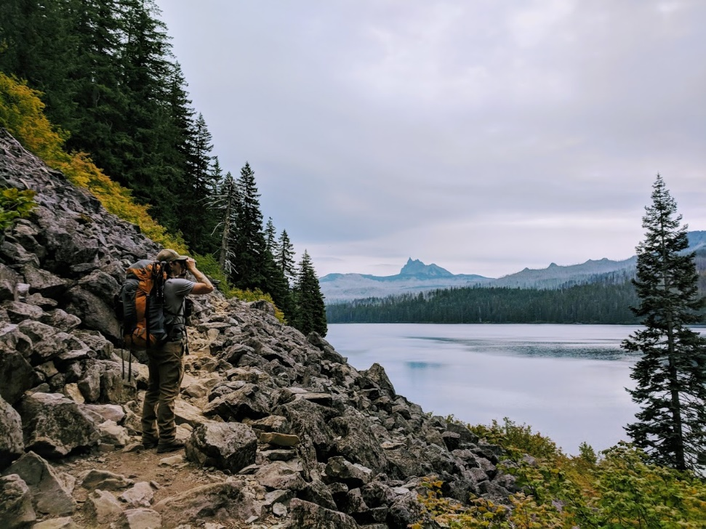
Introduce Permit Key Questions
What are the pros and cons associated with the permit proposal?
What else should DEQ know as we consider the permit proposal?
HW Rules Team | Oregon Department of Environmental Quality
Notes:
Ed Note: Summarize key questions, don’t read.
Sue Langston
Before we learn more about the fee proposals for permitting, I would like to give you today’s three key questions to keep in mind as we move forward with discussion [read questions]
We will have these questions posted throughout the meeting so you can refer to them.
With these questions in mind, I would like to see if there are any questions so far from the committee…….

Slide 12
Permit Annual Funding
$838K
Goal of the program by 2026
100% -
90% -
80% -
70% -
60% -
50% -
40% -
30% -
20% -
10% -
0% -
Need:
57% $476K
Current
43%
$362.5K
Notes:
Rich Duval
The program’s permitting revenue is about $362,500, which includes $262,500 in annual TSD fees and about $100,00 in cost recovery for post closure and corrective action work.
Click
Currently, we are about 43% of our goal in annual revenue, to fully support the permitting work.
DEQ determined we need 3 FTE for permit work to maintain the current permitting program.
Click
Our goal is $838,000 annually.
Click
Which means we will need an additional $476,000 funding annually to maintain our current service level.
As you heard in our first meeting we have streamlined the permitting process and squeezed as many savings as possible - which include not filing vacancies.
Bear in mind the current revenue is supported by generator fees as a stop-gap measure.

Slide 13
Permitting Annual Fee Proposal - #1
Increase compliance determination 62% to match CPI:
Fee Type | Current Fee | Proposed Fee Increase 2019 | Difference
Storage | $18,750 | $30,375 | $11,625
Multi-Treatment | $75,000 | $121,500 | $46,500
Multi-Disposal | $150,000 | $243,000 | $93,000
For additional ~ $162,750 revenue
HW Rules Team | Oregon Department of Environmental Quality
Notes:
Rich Duval
We have shown you previously the whole pie for each option, and other breakouts. However, based on new information we are proposing to adjust the permitting annual compliance determination fee to match the consumer price index, which is a 62% increase since 1997. We are proposing this increase start July 2019.
Here is what it would look like:
Increase annual compliance determination fee:
Storage fee from $18,750 to $30,375 = 62% increase
Multi-Treatment Fee from $75,000 to $121,500 = 62% increase
Multi-Disposal fee from $150,000 to $243,000 = 62% increase
The proposal will result in approximately $162,750 in additional revenue annually.
*Note Of the two operating permitted facilities, one pays all three categories and one only pays the storage fee.
~~~~~~~~~~~~~~~~~~~~~~~~~~~~~~~~~~~~~~
Previously
Increase annual compliance determination fee 181%:
Storage fee from $18,750 to $52,688
Multi-Disposal fee from $75,000 to $210,750
Multi-Treatment fee from $150,000 to $421,500
Would result in a $475,125 increase from current funding.

Slide 14
Permitting Annual Fee Proposal - #2
Increase compliance determination 31% to match CPI:
Fee Type | Current Fee | Proposed Fee Increase 2019 | Difference
Storage | $18,750 | $24,500 | $5,750
Multi-Treatment | $75,000 | $98,500 | $23,500
Multi-Disposal | $150,000 | $196,500 | $46,500
For additional ~ $81,500 revenue
HW Rules Team | Oregon Department of Environmental Quality
Notes:
Rich Duval
We have shown you previously the whole pie for each option, and other breakouts. However, based on new information we are proposing to adjust the permitting annual compliance determination fee to better match the consumer price index, which is a 62% increase since 1997. We are proposing this increase start July 2019.
Here is what it would look like:
Increase annual compliance determination fee:
Storage fee from $18,750 to $24,500 = 31% increase
Multi-Treatment Fee from $75,000 to $98,500 = 31% increase
Multi-Disposal fee from $150,000 to $196,500 = 31% increase
The proposal will result in approximately $81,500 in additional revenue annually.
*Note Of the two operating permitted facilities, one pays all three categories and one only pays the storage fee.
~~~~~~~~~~~~~~~~~~~~~~~~~~~~~~~~~~~~~~
Previously
Increase annual compliance determination fee 181%:
Storage fee from $18,750 to $52,688
Multi-Disposal fee from $75,000 to $210,750
Multi-Treatment fee from $150,000 to $421,500
Would result in a $475,125 increase from current funding.

Slide 15
Sample Permitting Annual Fee Proposal #2
Current fees
Storage Fee $ 18,750
Treatment - Multi Tech Fee $ 75,000
Disposal - Multi Unit Fee $ 150,000
$ 243,750
Proposed Increase
Storage Fee $ 24,500
Treatment - Multi Tech Fee $ 98,500
Disposal - Multi Unit Fee $ 196,500
Difference $75,750 or 31% $ 319,500
*Note that this chart represents one of two permitted facilities. The second permitted facility pays storage fee only.
Notes:
Rich Duval
As you can see, when the fee proposals are combined for one facility, they total ~ $319,500 per year, or an increase of $75,750 difference from current fees. This is a 31% increase for this facility.

Slide 16
Permit Modification Fee Increase
Notes:
Rich Duval
Processing and approving major permit modifications is a significant workload for ODEQ that is not captured in the EPA national reporting system.
Class 3 modifications at large Treatment, Storage, and Disposal Facilities with complex operations may include the same process and workload as permit renewals at smaller, simpler facilities.
The program has a limited budget for external support from the Attorney General’s Office for legal review of permits and for advice on permit issues that may make it difficult for the State to ensure all permit conditions are enforceable.
The following is a look at the revenue the program receives over the last couple of years….

Slide 17
Permitting Modification Fee Proposal
Increase all Modification Fees to High
$33,450 estimated potential revenue annually
based on 20-yr average of three mod requests
Mod Class # | Workload | Current | New 59% CPI | Difference
Class 1 | High | $2,800 | $4,500 | $1,700
Class 2 | High | $20,000 | $31,800 | $11,800
Class 3 | High | $31,000 | $49,300 | $18,300
HW Rules Team | Oregon Department of Environmental Quality
Notes:
Rich Duval
DEQ data shows it may cost DEQ ~ $140,000 in staff hours per complex permit modification.
Although it is not a reliable annual revenue we are proposing to increase the Permit modification Fees by 59% to adjust for the inflation since 1998.
Based on 20-year review of all past mod requests, it is anticipated DEQ could receive up to 3 mod requests a year.
Assumes we will receive 2-class1s and 1-Class 2 mod requests for = $33,450 increase based on twenty-year review
~~~~~~~~~~~~~~~~~~~~~~~~~~~~~~~~~~~~~~~~~~~~~~~~~~~~~~~~~~~~~~~~~~~~~~
SSummary change old to new: instead of low, med and high workload under current structure we’re removing low and medium for each class to streamline and reflect the actual cost of work.
-Remove current low and medium
-Anticipated question – Is this a fair way of doing business? What about differences in organizational size and resources?
ource is )breakdown with 181%
We recommend having the ability to increase the complex mods to $100,000.
We could charge an initial fee but having the ability to adjust upward
This new method of removing the low and medium workloads would equal = $40,704 annually or a 422% increase over the current revenue

Slide 18
New Administrative Fee
Notes:
This is a new proposed administrative fee for TSDs.

Slide 19
New Permit Annual Compliance Determination Fee Proposal - #1
Operating TSD Disposal administrative fee: $3.47 per metric ton
Estimated additional ~$312,750 revenue
Estimate base: CWM ~ 90,000 tons annually
Notes:
Rich Duval
In looking for additional revenue we considered the modification fee, however, it is not a reliable annual revenue source due to its episodic nature.
Therefore we are proposing a new annual administrative fee to support the cost of permit administration and permit compliance monitoring.
This proposal estimates additional revenue of $312,750 annually.
Of the known universe of approximately 90,000 metric tons annually, this breaks down to approximately $3.47 per metric ton.
We estimate that, of those 90,000 metric tons a year sent by generators, approximately 10-20% are from Oregon generators, with the remainder from out of state or approximately 80-90%.
This universe has remained fairly consistent the last few years.

Slide 20
New Permit Annual Compliance Determination Fee Proposal - #2
Operating TSD Disposal administrative fee: $5.50 per metric ton
Estimated additional ~$495,000 revenue
Estimate base: CWM ~ 90,000 tons annually
Notes:
Rich Duval
In looking for additional revenue we considered the modification fee, however, it is not a reliable annual revenue source due to its episodic nature.
Therefore we are proposing a new annual administrative fee to support the cost of permit administration and permit compliance monitoring.
This proposal estimates additional revenue of $495,000 annually.
Of the known universe of approximately 90,000 metric tons annually, this breaks down to approximately $5.50 per metric ton.
We estimate that, of those 90,000 metric tons a year sent by generators, approximately 10-20% are from Oregon generators, with the remainder from out of state or approximately 80-90%.
This universe has remained fairly consistent the last few years.

Slide 21
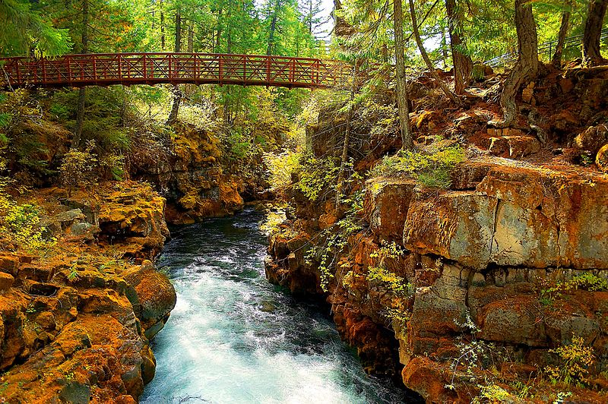
Permitting Summary
  Current annual ~ $362,500
  Need ~ $476,000 fully fund
  Proposed Phase 1 changes include:
    Annual fee increase
    Mod fee increase
    New Annual Compliance Determination fee
Source: https://en.wikipedia.org/wiki/File:Rogue_River_Oregon_USA.jpg
HW Rules Team | Oregon Department of Environmental Quality
Notes:
Rich Duval
As we mentioned, the permit program brings in $362,500 annually (includes annual TSD fees and variable cost recovery) and our need is $476K in additional funding annually to fully support the permitting program.
EPA has expressed concern that DEQ’s permitting program is not adequately staffed.
EPA is also concerned there are not enough permit staff to ensure full compliance.
For this rulemaking, we propose an annual fee increase, a mod fee increase and an administrative fee to bridge the gap between what we have and what we need.
We will wait for a future phase to consider a statute change to address tying these fee to an index.

Slide 22
Permit Annual Funding
$838K
100% -
90% -
80% -
70% -
60% -
50% -
40% -
30% -
20% -
10% -
0% -
Goal of the program by 2026
100% -
90% -
80% -
70% -
60% -
50% -
40% -
30% -
20% -
10% -
0% -
$838K
Need:
0%
+$495K Admin
Need:
57% $475.5K
+ $81K Annual
Current
+$33K Mod
43%
43%
$362.5K
$362.5K
Notes:
Rich Duval
The program’s permitting revenue is about $362,500, which includes $262,500 in annual TSD fees and about $100,00 in cost recovery for post closure and corrective action work.
Currently, we are about 43% of our goal in annual revenue, to fully support the permitting work.
DEQ determined we need 3 FTE for permit work to maintain the current permitting program.
Our goal is $838,000 annually.
Which means we will need an additional $475,500 funding annually to maintain our current service level.
As you heard in our first meeting we have streamlined the permitting process and squeezed as many savings as possible - which include not filing vacancies.
Bear in mind the current revenue is supported by generator fees as a stop-gap measure.

Slide 23
Discussion: Permit Key Questions
What are the pros and cons associated with the permit proposal?
What else should DEQ know as we consider the permit proposal?
HW Rules Team | Oregon Department of Environmental Quality
Notes:
Ed. Note: ETA 8:20 – 8:45
Sue Langston
Before we learn more about fee proposals, I would like to give you today’s three key questions to keep in mind as we move forward with discussion.
Following these questions, we will have a separate discussion on fiscal impact, so please keep that in mind as you consider your answers to these questions.
[read questions]
We will have these questions posted throughout the meeting so you can refer to them.
With these questions in mind, I would like to see if there are any questions so far from the committee…….

Slide 24
Fiscal Impacts
Notes:
David

Slide 25
DEQ’s Fiscal Impact Statement - #1
Permitted operating TSDs:
One facility increase = $11,625 annually
Second facility increase = $463,875 annually $162,750 for ACDP fee
    + $312,750 for new admin fee
Variable Mod fee depends on request
HW Rules Team | Oregon Department of Environmental Quality

Slide 26
DEQ’s Fiscal Impact Statement - #2
Permitted operating TSDs:
One facility increase = $5,750 annually
Second facility increase = $495,000 annually $ 75,750 for ACDP fee
    + $495,000 for new admin fee
Variable Mod fee depends on request
HW Rules Team | Oregon Department of Environmental Quality

Slide 27
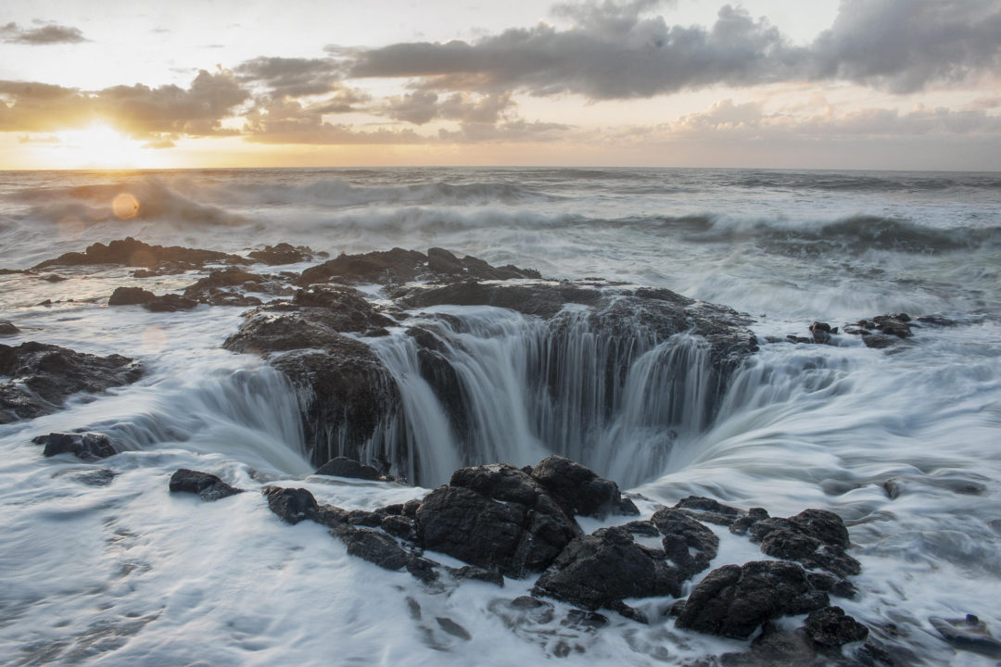
Fiscal Impacts
Will the rules have fiscal impacts?
  If so, what is the extent of the fiscal impacts?
Will the rule have a significant adverse impact on small businesses (<50 employees)?
  If so, how can DEQ reduce the economic impact of the rule on small businesses?
Source: https://theatlasheart.com/2016/11/19/14-stops-make-oregon-coast-road-trip/
HW Rules Team | Oregon Department of Environmental Quality
Notes:
Sue Langston
Per (ORS 183.333; 335; 540) A rulemaking advisory committee provides recommendations on:
Whether the rule will have a fiscal impact;
What the extent of that impact will be; and
Whether the rule will have a significant adverse impact on small businesses.
If the committee finds the rule will have a significant adverse impact on small businesses, the agency must seek the committee’s recommendations on how the agency may comply with ORS 183.540 (reducing fiscal impact on small businesses).
Here, we would like feedback from each advisory committee member.
Note – the rules don’t define “significant adverse impact” – that is what we are wanting to hear from you.
Note the less than 50 employees is defined in statute (for Oregon rulemaking process)
Would like feedback from each advisory committee representative.

Slide 28
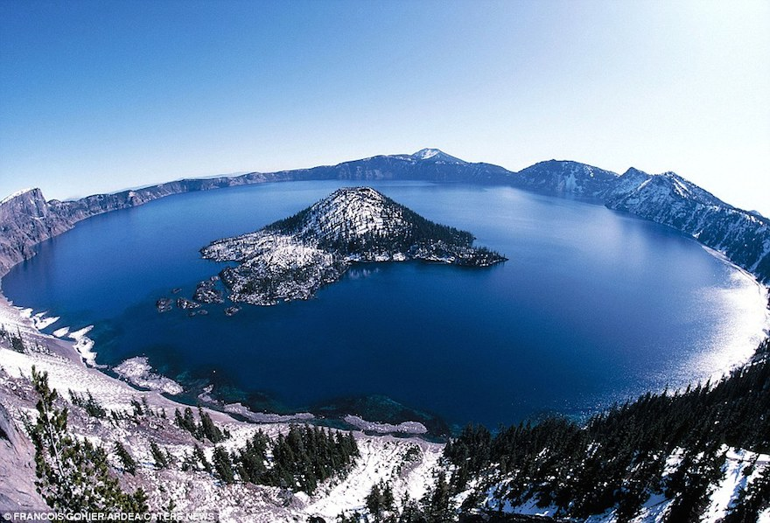
Mitigating Impacts to Small Business
Mitigation Examples:
Establishing differing compliance or reporting requirements or time tables for small business.
Clarifying, consolidating or simplifying the compliance and reporting requirements under the rule for small business.
Exempting small businesses from any or all requirements of the rule.
Other less intrusive or less costly alternatives applicable to small business?
Source: http://www.earthporm.com/15-beautiful-crater-lakes-around-world/
HW Rules Team | Oregon Department of Environmental Quality
Notes:
Sue:
This slide provides some generic policy considerations for mitigating the impact of rulemakings to small businesses.
Are there any other ways you can think to mitigate the impacts on small business? (recap impacts on small business)?

Slide 29
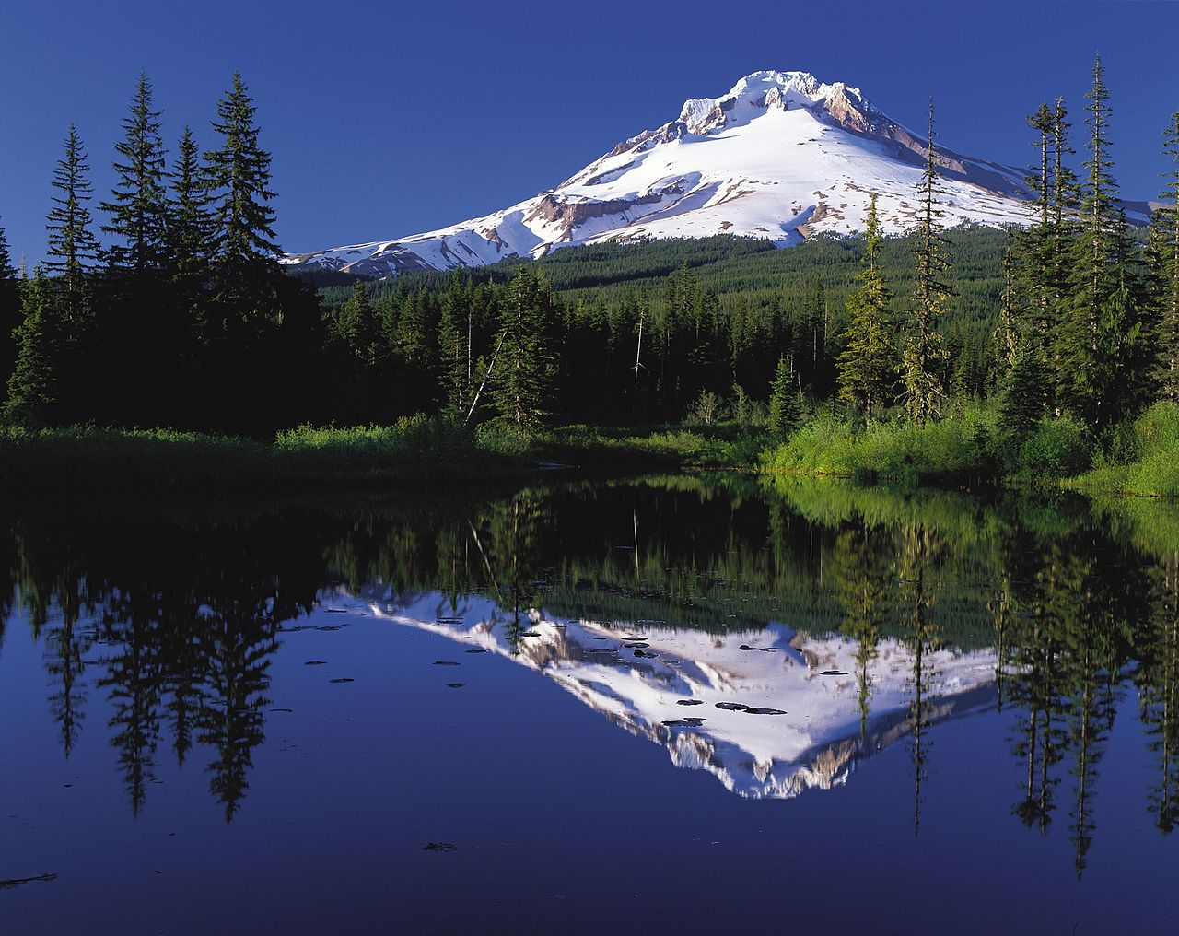
DEQ’s mission is to be a leader in restoring, maintaining and enhancing the quality of Oregon’s air, land and water.
Source: By Oregon's Mt. Hood Territory. - http://www.fhwa.dot.gov/byways/photos/62736., Public Domain, https://commons.wikimedia.org/w/index.php?curid=715348

Slide 30
Hazardous Waste Proposed
Fees Increase Rules
October 18, 2018
Portland HQ, 6th Floor
HW Rules Team | Oregon Department of Environmental Quality

Slide 31

Recap Committee Meetings 1 & 2
Impacts from declining revenue
Ideal service levels for DEQ’s Hazardous Waste Program?
Pros & Cons of:
  Proposals to maintain service level & future needs?
  Incremental or one single fee increase?
  Combine fee increases?
Source: https://www.telegraph.co.uk/travel/destinations/north-america/united-states/articles/neskowin-ghost-forest-oregon/
HW Rules Team | Oregon Department of Environmental Quality
Notes:
Sue Langston
Here is a recap from our first meeting on the two key questions we asked the committee.
During the first meeting, Committee Members discussed the impact from declining revenue on Oregon's hazardous waste management landscape.
During the second meeting, the Committee discussed a number of options to increase hazardous waste program revenue in order to meet current needs as well as projected future, or “ideal” needs.
In the process of holding these conversations, we’ve discussed ideal levels of service, as well as phased-in fee increases, among other points.
Today, we’ll draw on these discussions and the interesting questions you’ve raised and feedback that you’ve provided as we walk through our permit review and generator fee proposal.
First, I would like to turn to David to provide some background on recent developments that have shaped our permit and generator proposals.

Slide 32

Statutory Authority
ORS 466.165 Annual Fees
ORS 466.045(5)
Source: https://www.outdoorphotographer.com/on-location/favorite-places/painted-hills-john-day-fossil-beds-national-monument-oregon/
HW Rules Team | Oregon Department of Environmental Quality
Notes:
David Livengood
We have had twists and turns along this process, and the time since our last meeting is no exception! Since we last met, we asked Oregon Department of Justice for advice about our different fee options, including the volume- and capacity-based fee structures – as well as using some economic index. DOJ reminded us the generators fees in statute are to “to pay the cost of carrying on the monitoring, inspection and surveillance program under ORS 466.195 and related administrative costs.
Even with such fee authority for, we are unable to include a new or revised generator fee in rule related in any way to volume or capacity unless we change statute. In short, this means the so-called flat fee option and management method factors are the only changes we can make via rule. This conclusion upholds the concern some of you held about having to volume-based charges.
While the advice directly affects our fee increase proposal for this first phase, this does not preclude us from seeking other options in the next phase when we will ask for statutory changes in a future Oregon legislature.
In our second phase work, we will revisit the volume-based and cap options, which means looking at:
Changing the volume-driven $130/metric ton charge;
Changing the current $32,500 cap; and
Possibly changing permitting fee limits.
We also asked advice about adding an economic index or inflation factor. We learned we would need a statute change and a subsequent rule to set it. Anytime we need to change it, we would have to change the rule. Therefore, for this rulemaking, this is not an option. We can revisit this when we hold our next advisory committee focused on statutory changes to make the program financially whole and stable in the future.
As I shared earlier during the permitting-specific discussion, we asked for Department of Justice questions about increasing cost recovery options and limits to the permit modification fee. We are unable to increase those due to limits in statute.
With all of these new developments and the need to make some strides in restoring program funding, we shaped our only clear proposals.
Now I will turn to Rich Duval to present our permitting proposal from earlier this morning.

Slide 33

Permit Meeting Summary
Permitting needs an additional $476K annually:
Annual Compliance Determination Fee
  Propose 31% increase for additional $81,500
Permit Modification Fee
  Variable revenue stream, depending on requests.
Administrative Fee
  Propose $5.50/metric ton for additional $495,000
Source: https://www.mnn.com/earth-matters/wilderness-resources/blogs/capturing-beauty-columbia-river-gorge
HW Rules Team | Oregon Department of Environmental Quality
Notes:
Rich Duval
To summarize this morning’s conversation, the permitting program needs an additional $476,000 annually, for a total of $838,000 per year to fully fund the program at its current staff level (3 FTE).
We hope to achieve this through changing fee structures for the Annual Compliance Determination Fee and Permit Modification Fee, as well as adding a new Administrative Fees for operating TSDs.
We are proposing to implement this fee structure in 2019 for an additional $475,000 annually above the current revenue.
Any questions?
Back to Sue to introduce our generator key questions.

Slide 34
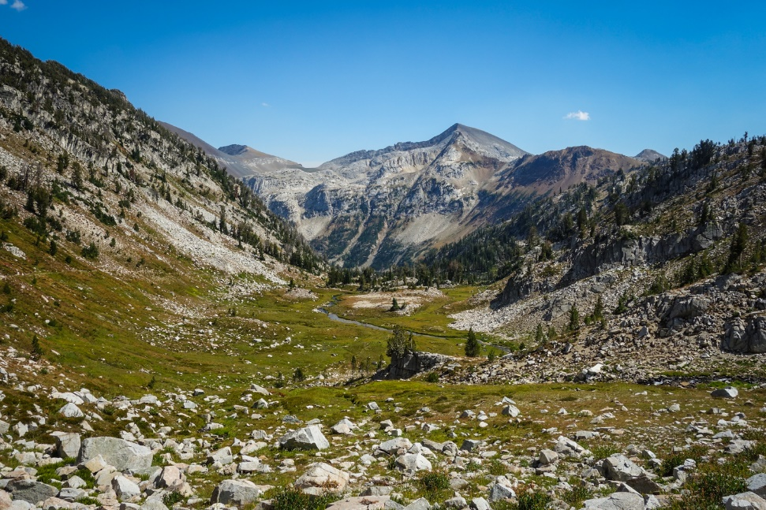
Generator Fee Key Questions
What are the pros and cons associated with our current proposal?
What else should DEQ know as we consider the generator fee proposal?
Source: http://www.cleverhiker.com/blog/wallowa-river-loop-backpacking-guide
HW Rules Team | Oregon Department of Environmental Quality
Notes:
Sue Langston
Here we have our key questions for today’s meeting – please keep these in mind as you’re listening to the generator fee increase proposal and we will discuss these questions, along with questions about fiscal impact, later today.
----------------------------------------------------------
Back pocket Q&A
Why didn’t DEQ pursue a statutory change to the volume-based metric ton fee and the $32,500 cap before looking for smaller changes to the generator status? A: HW is part of a broader DEQ agenda and due and there are other program with fee needs. Back pocket: we cannot commit to going to the legislature in 2023– we’ll be going to the legislature along with other DEQ program’s requests.
Why is DEQ proposing a change to the management method factor during the first rulemaking phase? Isn’t the management fee factor related to the volume-based metric ton fee that’s under consideration for the phase 2 statutory changes? A: For this phase of the hazardous waste fee update, DEQ is addressing everything that we can change by rule, not statute. We understand that while it is still subject to the cap, the management method factor is not set according to statute and we are therefore able to propose a rule changing this component of the generator fee.
A steep increase in the generator status is sure to impact the bottom line of Oregon’s small quantity generators. Why isn’t DEQ proposing to phase in the increase more gradually in order to give SQGs more time to prepare for the change? A: DEQ requires additional revenue in order to fund the hazardous waste program. DEQ listened to feedback from the Advisory Committee and is proposing to phase-in a gradual increase of generator annual activity verification fees over a three year period in order to give generators, especially small generators who may not have as much fiscal flexibility, time to adjust. DEQ is proposing to start the phased-in increase in July 2020, not 2019.
How will the proposed changes to the generator status flat fee and management method impact DEQ’s consideration of potential changes to the volume-driven metric ton fee and the $32,500 cap?
Does this mean that DEQ will propose a smaller change to these fees in the future because they’ve already made up funding with the flat fee? If so, doesn’t this approach favor large quantity generators?
When it comes time to make statutory changes, will DEQ consider changing the generator flat fees again to reflect more money coming in thanks to the increase in volume-based and cap fees?
A: For this phase of the hazardous waste fee update, DEQ is addressing everything that we can change through a rulemaking. In the future, if additional changes are made via statute, DEQ will evaluate the impact on those changes on the overall fee structure.

Slide 35
Generator Fees Funding
$3.57M
Goal of the program by 2026
100% -
90% -
80% -
70% -
60% -
50% -
40% -
30% -
20% -
10% -
0% -
Need:
57% $2.02M
Current
43%
$1.55M
43%
$1.55M
Notes:
Ed Note: add a different color on the bar to illustrate what we’re proposing
Killian Condon
Just as a recap:
DEQ hazardous waste program receives approximately $1.5 million annually in generator fees
In looking at making generator fees self-sufficient, we would need a total of $3.57 million in annual fees
Currently, we are about 43% of our goal in annual revenue, to fully support the generator compliance work.
DEQ determined we need 7 FTE for generator inspection geographically across the state. We recently had this number of staff about 6 mos ago.
Click
Our goal is $3.57 million annually by 2026
Which means we will need an additional $2.022 million in funding annually.
As you heard in our first meeting we have streamlined program costs by not filing vacancies and implementing efficiencies

Slide 36
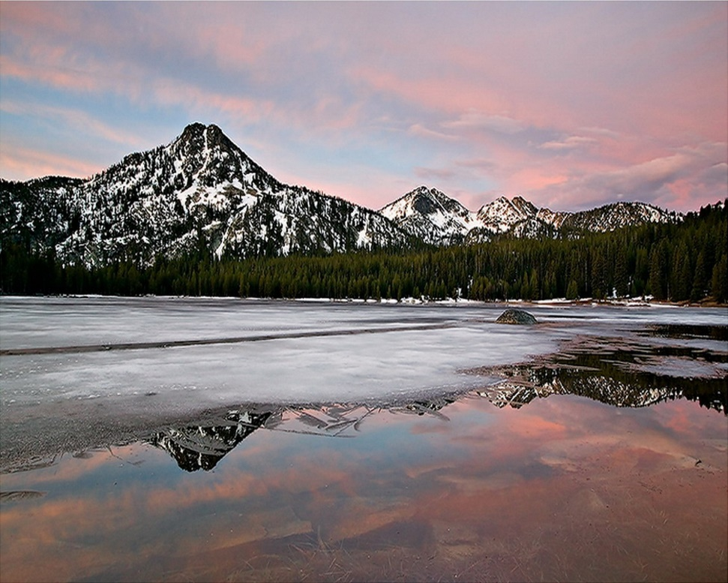
Proposed Generator Fee Increase
Generator annual activity verification fee
Management method factor
Source: http://amihines-geol308.blogspot.com/p/timeline.html
David Livengood | Oregon Department of Environmental Quality
Notes:
Ed note: if true, we should mention that none of the proposals for this rulemaking will make the program fiscally whole.
Killian Condon
With that background, the proposal that we’re going to share with you today is a combination of an increased generator annual activity verification fee for both small and large quantity generators, as well as an increase in the management method factor.
David’s provided an overview about why we aren’t proposing volume-based changes for this rulemaking, but we’ll keep in mind that this may be available through future statutory change and rulemaking.
As a reminder, this proposal is a draft and subject to further development before DEQ opens the proposed rule for public comment later this year.
Finally, as background context, I would like to note that, unlike previous options that we’ve discussed, the proposal that you’ll hear in just a minute will bring us closer to our 2026 funding goal, but it will not completely bridge the gap in funding.

Slide 37
Phased-In Annual Activity Verification Fee
Generator Category | Current Fee | Jul 2019 (+25%) | Jul 2020 (+20%) | Jul 2021 (+20%) | Annual Difference from Current
LQG (196) | $525 | $656 | $788 | $945 | $420
SQG (291) | $300 | $375 | $450 | $540 | $240
Increase | N/A | $47,550 | $47,550 | $57,060 | $152,160
Running Total (Current + Increase) | $190,200 | $237,750 | $285,300 | $342,360
This option would increase the generator annual base fee total to $342,360.
Beyond 2021, the fee will remain at the last increase amount (July 2021)
until changed through a future rulemaking.
HW Rules Team | Oregon Department of Environmental Quality
Notes:
Killian Condon
This slide represents how the phase-in will work through 2021.
Beyond 2021, the fee will remain at the last increase amount ($540 for SQGs and $945 for LQGs) until changed by a future rulemaking.
Once it’s fully implemented in 2021, this proposal will annually bring an additional $152,160 dollars above our current revenue.
~~~~~~~~~~~~~~~~~~~~~~~~~~~~~~~~
*Ed Note – would it make more sense to change this to a bar graph?

Slide 38
Current Generator Fee Formula
[Annual Hazardous Waste Generation Fee (metric tons x $130 x management method factor)*] + Activity Verification Fee
* Subject to $32,500 cap
HW Rules Team | Oregon Department of Environmental Quality
Notes:
Killian Condon
Currently, DEQ’s hazardous waste fee formula is based on 3 key factors:
An annual activity verification fee – are you a SQG or an LQG?
Annual Hazardous Waste Generation Fee – each generator’s fee is calculated by multiplying the base fee of $130 per metric ton by the weight of each hazardous waste stream and then adding this number to a management method factor that ranges from 0.00 to 2.00. This fee factor reflects Oregon’s environmental hierarchy of preferred management methods and offers financial incentives to responsibly manage and reduce hazardous waste.
The third key factor in the fee formula is that the total amount due per generator is capped at $32,500.
DEQ currently has 18 generators that meet the $32,500 cap.

Slide 39
Proposed Changes to Generator Fee Formula
[Annual Hazardous Waste Generation Fee (metric tons x $130 x management method factor)*] + Activity Verification Fee
* Subject to $32,500 cap
HW Rules Team | Oregon Department of Environmental Quality
Notes:
Killian Condon
To be clear, given DOJ’s recent input, this proposed rulemaking seeks to change the management method factor and the Activity Verification Fee.
The management method factor remains subject to the cap as part of the total Annual Hazardous Waste Generation calculation.
The Activity Verification is increased on a flat basis for both small and large quantity generators.

Slide 40
Generator Invoice -Current Example
CAP
HW Rules Team | Oregon Department of Environmental Quality
Notes:
Killian Condon
We wanted to show you how the previous calculation looks in a current generator invoice.
As you can see each item or management method factor is identified and based on reported quantity is multiplied….
~~~~~~~~~~~~~~~~~~~~~~~~~~~~~~
Notes:
Based on unofficial 2017 generator data.
~~~~~~~~~~~~~~~~~~~~~~~~~~~~~~~~~~~~~~~~~~
Older material
2017 base fees total $187,125 (293 SQG x $300 & 189 LQG X $525)
Option 2 is 549% increase from current base fee.

Slide 41

Phased-In Annual Activity Verification Fee
To support current funding, increase our annual activity verification fee over three (3) years, starting July 2019:
SQG base fee from $300 to $540 (80%); and
LQG base fee from $525 to $945 (80%)
For additional $152,160 revenue annually.
Source: http://www.oregonconservationstrategy.org/strategy-habitat/aspen-woodlands/
HW Rules Team | Oregon Department of Environmental Quality
Notes:
Phased in over three years, our proposal is to increase the annual activity verification fee, or flat fee as follows
This is a 80 percent increase over 3 years. As we heard from you, we are proposing to start with a small increase to give businesses time to accommodate their budget and minimize the impact to businesses…
This fee increase will bring in approximately $152, 160 by 2021 and will be combined with another fee change that progresses over time.

Slide 42
Other Management Factors – Continued
Management method | Code | Current factor | Proposed final factor 70%
Metals recovery | H010 | 0.50 | 0.85
Solvent recovery | H020 | 0.50 | 0.85
Other recovery | H039 | 0.50 | 0.85
Elementary Neutralization (WWTU) | H121 | 0.50 | 0.85
Incineration | H040 | 1.00 | 1.70
Energy Recovery (reuse as fuel) | H050 | 0.75 | 1.28
Fuel Blending prior | H061 | 0.75 | 1.28
Aqueous Inorganic treatment | H070 | 1.00 | 1.70
Aqueous Organic treatment | H081 | 1.00 | 1.70
Aqueous Combined | H120 | 1.00 | 1.70
Sludge treatment | H100 | 1.00 | 1.70
Other treatment | H129 | 1.00 | 1.70
Stabilization | H110 | 1.00 | 1.70
Neutralization (offsite) | H121 | 0.75 | 1.28
Land disposal | H132 | 1.50 | 2.55
Management method unknown | - | 2.00 | 3.40
Notes:
Killian Condon
Here are the 16 management factors we are proposing to increase by 70% over time.
The proposed final factor is what the factor would be in 2024 for the last increase.
The factors will stay as the purple column as approved until changed by a future rulemaking.
Our intent is to be able to address all parts of the current calculation you saw just a few slides back, when we are able to change the statute.
~~~~~
What does the CWM ORU2 code used? H039?
Consider in messaging around this facility political

Slide 43
Generator Invoice Example
CAP
HW Rules Team | Oregon Department of Environmental Quality
Notes:
Killian Condon
Here is an example of what the invoice might look like with the proposed 70% increased management method factors.
Bearing in mind that 70% percent does not translate to a 70% increase in revenue because
a) larger generators may run into the cap; (we’ve gone to 18 to 28 facilities that are capped with the increase that happens by 2024); and
a facility may chose to change its management method.
And here’s how this might look in the invoice:
Recovery Factor changed from 0.75 to 0.85
Incineration Factor changed from 1.00 to 1.70
Energy Recovery Factor changed from 0.75 to 1.28
Land Disposal Factor changed from 1.50 to 2.55
Off-site Neutralization factor changed from 0.75 to 1.28

Slide 44
Proposal Increase Summary
Proposal | Jul 2019 | Jul 2020 | Jul 2021 | Jul 2022 | Jul 2023 | Jul 2024 | Total Increase
Annual Activity Verification Fee | $47,550 | $47,550 | $57,060 | None | None | None | $152,160
Mgmt Method Factor | $166,999 | $264,768 | $91,111 | $153,067 | $144,648 | $154,774 | $975,367
Total Increase | $214,550 | $312,318 | $148,171 | $153,067 | $144,648 | $154,774 | $1,127,527
HW Rules Team | Oregon Department of Environmental Quality
Notes:
Killian Condon
In summary, we are proposing to increase the annual activity verification fee by 80% over three years, and the management method factor by 70% over six years.
The projected estimated revenue is based on 2018 reporting data.
The take away – we heard you and your recommendations, and given our limitation on what we can do during this rulemaking we are proposing the best options we have currently available.
this overview shows the phased-in approach of the proposal we’ve proposing which will result in ~1.1 million in additional projected revenue annually.
And we have built in considerations for our regulated community to prepare for the increase.
-we heard you.
~~~~~~~~~~~~~~~~~~~~~~~~~~~~~~~~~~~~~~~~~
annum based on the proposal that you’ve just seen, but we won’t get to this point until
~~~~~~~~~~~~~~~~~~~~~~~~~~~~~~
Notes:
To support current funding, we will need to increase the annual generator fees.
If we were to increase under the flat fee option, here is what it would look like (bearing in mind the whole pie so to speak):
SQG base fee from $300 to $2,762 (821%); and
LQG base fee from $525 to $6,421 (1,123%)
This option, it would generate $2.022 million of additional revenue above current funding to fully staff the program.
Bearing in mind we might want to combine this with another fee change and phased in over time.
~~~~~~~~~~~~~~~~~~~~~~~~~~~~~~~~~~~~~~~~~~
Older material
2017 base fees total $187,125 (293 SQG x $300 & 189 LQG X $525)
Option 2 is 549% increase from current base fee.

Slide 45
New Management Factor – Continued
Management method | New factor
RCRA-Exempt (CU or Brownfield) | 0.00
Grant-funded government environmental cleanup of a Brownfield or orphaned industrial property involving hazardous waste residues for off-site treatment and/or landfill disposal.
Notes:
Killian Condon
Based on what we heard from the last meeting, we are proposing this change…. Note the strike through of the word government.
The committee recommended we remove the Government portion and identify with Brownfield only
This proposal will encourage all grant-funded cleanups of brownfields or orphaned industrial .
~~~~~~~~~~~~~~~~~
Notes:
Would need to ensure the reporting a G code to indicate remediation – then Mary would be able to uncheck the waste from applying fees.

Slide 46
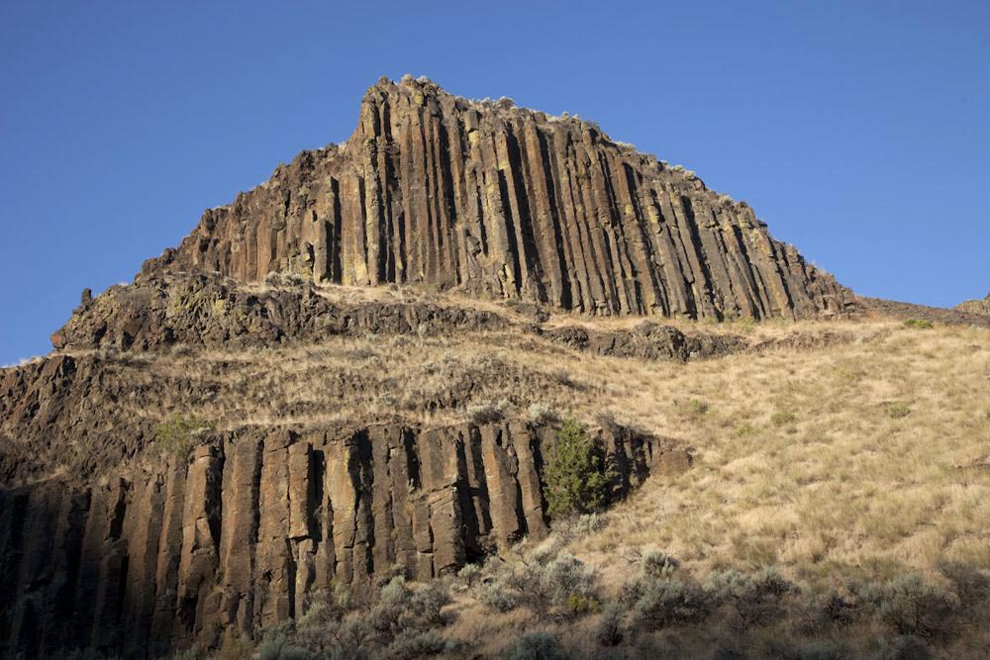
Reminder: Generator Fee Cap
Statute last increased in 2008
Currently $32,500
Affects approximately 18 currently capped LQGs plus 10 additional LQGs by 2024.
Source: http://www.marlimillerphoto.com/110806-17m.html
HW Rules Team | Oregon Department of Environmental Quality
Notes:
Killian Condon
We want to keep in mind the fee cap is a core component we will need to factor in as we consider changes to generator fees – now and in the future.
Although it is out of scope for this rulemaking we would like to consider it for a possible change in the next rulemaking, our phase 2, where we can address changes in statute.
The generator fee cap was last increased in 2008 from $27,500 to the current cap of $32,500.
Effects approximately 18 capped LQGs currently (this is a change in an earlier meeting where we said currently 15 LQGs are capped based on as all 2018 reporting data is received.
~~~~~~~~~~~~~~~~~~~~~~~~~~~~~~~~~~~~~~~~~~~~~~~~~~~~~~~~~~~~~~~~~~~
If we were to apply an inflation factor = 19%
Options
Cap: $32,500 current to $45,221 in 8 yrs ~ $5,653 yearly
Effects approximately 15 capped LQGs
Ex: LQG 2015 invoice = $.5M but paid $32,500
Revenue jumps $487,500 to $678,315 = 3.02 to 4.2 FTE
Adds approximately $190K in additional revenue annually
Risks
Assumes generator numbers remain static
Increase is steep
Requires stakeholder involvement

Slide 47
Generator Fees Funding
$3.57M
Goal of the program by 2026
100% -
90% -
80% -
70% -
60% -
50% -
40% -
30% -
20% -
10% -
0% -
Need:
57% $2.02M
Current
43%
$1.55M
43%
$1.55M
Notes:
Killian Condon
Just as a recap:
DEQ hazardous waste program receives approximately $1.5 million annually in generator fees
In looking at making generator fees self-sufficient, we would need a total of $3.57 million in annual fees
Currently, we are about 43% of our goal in annual revenue, to fully support the generator compliance work.
DEQ determined we need 7 FTE for generator inspection geographically across the state. We recently had this number of staff about 6 mos ago.
Our goal is $3.57 million annually by 2026
Which means we will need an additional $2.022 million in funding annually.
As you heard in our first meeting we have streamlined program costs by not filing vacancies and implementing efficiencies

Slide 48
Discussion: Generator Fee Key Questions
What are the pros and cons associated with our current proposal?
What else should DEQ know as we consider generator fee proposal?
Source: http://www.cleverhiker.com/blog/wallowa-river-loop-backpacking-guide
HW Rules Team | Oregon Department of Environmental Quality
Notes:
Sue Langston
at end, note that we will now turn from generators to discussions that cover both generators and permittees.
----------------------
Back Pocket Q&A for discussion:
Why didn’t DEQ pursue a statutory change to the volume-based metric ton fee and the $32,500 cap before looking for smaller changes to the generator status? A: HW is part of a broader DEQ agenda and due and there are other program with fee needs. Back pocket: we cannot commit to going to the legislature in 2023– we’ll be going to the legislature along with other DEQ program’s requests.
Why is DEQ proposing a change to the management method factor during the first rulemaking phase? Isn’t the management fee factor related to the volume-based metric ton fee that’s under consideration for the phase 2 statutory changes? A: For this phase of the hazardous waste fee update, DEQ is addressing everything that we can change by rule, not statute. We understand that while it is still subject to the cap, the management method factor is not set according to statute and we are therefore able to propose a rule changing this component of the generator fee.
A steep increase in the generator status is sure to impact the bottom line of Oregon’s small quantity generators. Why isn’t DEQ proposing to phase in the increase more gradually in order to give SQGs more time to prepare for the change? A: DEQ requires additional revenue in order to fund the hazardous waste program. DEQ listened to feedback from the Advisory Committee and is proposing to phase-in a gradual increase of generator annual activity verification fees over a three year period in order to give generators, especially small generators who may not have as much fiscal flexibility, time to adjust. DEQ is proposing to start the phased-in increase in July 2020, not 2019.
How will the proposed changes to the generator status flat fee and management method impact DEQ’s consideration of potential changes to the volume-driven metric ton fee and the $32,500 cap?
Does this mean that DEQ will propose a smaller change to these fees in the future because they’ve already made up funding with the flat fee? If so, doesn’t this approach favor large quantity generators?
When it comes time to make statutory changes, will DEQ consider changing the generator flat fees again to reflect more money coming in thanks to the increase in volume-based and cap fees?
A: For this phase of the hazardous waste fee update, DEQ is addressing everything that we can change through a rulemaking. In the future, if additional changes are made via statute, DEQ will evaluate the impact on those changes on the overall fee structure.

Slide 49
Fiscal Impact
Notes:
David Livengood
Now that we’ve discussed pros and cons, we’d like to focus the conversation on anticipated fiscal impacts associated with both our permit proposal that we reviewed at the beginning of this session, as well as the generator fee increase proposal.
I’ll offer a business case for the proposed changes, review DEQ’s proposed fiscal impact statement and then turn to each of you for feedback on anticipated fiscal impacts and potential mitigating factors for DEQ to consider as we move forward.

Slide 50
Business Case
Notes:
David
--clarify that from here on out we are addressing both permits and generators

Slide 51
Building a Business Case - Generators
Activity | 2018 | Jul-19 | Jul-20 | Jul-21 | Jul-22
% Increase |  | 13.84% | 17.70% | 7.13% | 6.88%
Revenue | $1,550,000
Annual Gen Fee |  | $47,550 | $47,550 | $57,060
Mgmt Factor |  | $166,999 | $264,768 | $91,111 | $153,067
Add'l revenue | 0 | $214,549 | $312,318 | $148,171 | $153,067
Projected Revenue | $1,550,000 | $1,764,549 | $2,076,867 | $2,225,038 | $2,378,105
Goal | $3,572,000 | $1,807,451 | $1,495,133 | $1,346,962 | $1,193,895
Difference | $2,022,000 | ($1,807,451) | ($1,495,133) | ($1,346,962) | ($1,193,895)
HW Rules Team | Oregon Department of Environmental Quality
Notes:
David Livengood
We put together a business case for generators…..

Slide 52
Business Case – Generators Continued
Activity | Jul-23 | Jul-24 | Jul-25 | Jul-26
% Increase | 6.08% | 6.14% | 5.78% | 5.46%
Revenue
Flat Fee
Factor | $144,648 | $154,774 | $154,774 | $154,774
Add’l revenue | $144,648 | $154,774 | $154,774 | $154,774
Projected Revenue | $2,522,753 | $2,677,527 | $2,832,301 | $2,987,075
Goal | $1,049,247 | $894,473 | $739,699 | $584,925
Difference | ($1,049,247) | ($894,473) | ($739,699) | ($584,925)
HW Rules Team | Oregon Department of Environmental Quality
Notes:
David Livengood
As you saw in the previous slide, we are now moving forward from the previous slide of July 22 forward to July 2026…..

Slide 53
Building a Business Case - Permitting
Activity | 2018 | Jul-19 | Jul-20 | Jul-21 | Jul-22
% Increase |  | 131.17% | 0.00% | 0.00% | 0.00%
Revenue | $362,500 | $838,000 | $838,000 | $838,000 | $838,000
ACDP |  | $162,750 | $162,750 | $162,750 | $162,750
Admin Fee |  | $312,750 | $312,750 | $312,750 | $312,750
Add'l reveune | 0 | $475,500 | $0 | $0 | $0
Goal | $838,000
Difference | $475,500 | $0 | $0 | $0 | $0
Projected Revenue | $362,500 | $838,000 | $838,000 | $838,000 | $838,000
HW Rules Team | Oregon Department of Environmental Quality
Notes:
David Livengood
We built a similar one for Permitting, however this is proposed as one set increase in 2019 without additional to make up for the inflation since 1997-1998.

Slide 54
Fiscal Impacts
Notes:
David
-anticipated impacts to Oregon businesses.

Slide 55
DEQ’s Fiscal Impact Statement –
Permits # 1
Facility 1 Increase
$11,625 annually for the Annual Compliance Determination Fee
Facility 2 Increase
$463,875 annually:
      $162,750 for Annual Compliance Determination fee and
      $312,750 for new Administrative fee
Modification fee will vary annually depending on requests.
HW Rules Team | Oregon Department of Environmental Quality
Notes:
Rich Duval/Jeannette Acomb
The proposed changes to the permit fee will impact two permitted operations Treatment, Storage and Disposal facilities.

Slide 56
DEQ’s Fiscal Impact Statement –
Permits #2
Facility 1 Increase
$5,750 annually for the Annual Compliance Determination Fee
Facility 2 Increase
$570,750 annually:
      $75,750 for Annual Compliance Determination fee and
      $495,000 for new Administrative fee
Modification fee will vary annually depending on requests.
HW Rules Team | Oregon Department of Environmental Quality
Notes:
Rich Duval/Jeannette Acomb
The proposed changes to the permit fee will impact two permitted operations Treatment, Storage and Disposal facilities.

Slide 57
DEQ’s Fiscal Impact Statement
DEQ’s Fiscal Impact Statement - Generators
Annual Activity Verification Fee
Management Method Factor
Generator Type | Current Fee | Proposed Fee | # Generators | # Small Businesses
SQG | $300 | $540 | 291 | 118
LQG | $525 | $945 | 196 | 71
1. Increase the SQG base fee from $300 to $560 and increase the LQG base fee from $525 to $980 over a three-year phase-in period. This 80% increase would result in a $152,160 annual increase from current funding by 2021.
Generator Type | Current Fee | Proposed Fee | #Generators | # Small Businesses
SQG | $296 | $503 | 291 | 118
LQG | $6,654 | $11,322 | 196 | 71
HW Rules Team | Oregon Department of Environmental Quality
Notes:
Killian Condon
Annual Hazardous Waste Activity Verification Fee
The Annual Hazardous Waste Activity Verification Fee is a phased-in increase of the Small Quantity Generator base fee from $300 to $540 by 2021, and the Large quantity Generator Fee from $525 to $945 by 2021.
This represents an 80% increase that will result in an annual increase of $152,160 above the current revenue by 2021 and thereafter.
This will impact 291 SQGs, of which 118 are small businesses. And it will impact 196 LQGs, of which 71 are small businesses.
Management Method Factor
A six year phase-in to increase the management method factor for all management methods by 70% change starting in July 2019 would result in a $975,367 annual increase from the current funding by 2024.
This would increase the number of capped generators from 18 to 34 by 2024.
The current management method factor revenue averages $2,855 over 487 reporting facilities and the proposed increase would average approximately $4,907 for 487 reporting facilities by 2024

Slide 58
Fiscal Impacts
Will the rules have fiscal impacts?
  If so, what is the extent of the fiscal impacts?
Will the rule have a significant adverse impact on small businesses (<50 employees)?
  If so, how can DEQ reduce the economic impact of the rule on small businesses?
Source: https://theatlasheart.com/2016/11/19/14-stops-make-oregon-coast-road-trip/
HW Rules Team | Oregon Department of Environmental Quality
Notes:
Sue Langston
Per (ORS 183.333; 335; 540) A rulemaking advisory committee provides recommendations on:
Whether the rule will have a fiscal impact;
What the extent of that impact will be; and
Whether the rule will have a significant adverse impact on small businesses.
If the committee finds the rule will have a significant adverse impact on small businesses, the agency must seek the committee’s recommendations on how the agency may comply with ORS 183.540 (reducing fiscal impact on small businesses).
Here, we would like feedback from each advisory committee member.
Note – the rules don’t define “significant adverse impact” – that is what we are wanting to hear from you.
Note the less than 50 employees is defined in statute (for Oregon rulemaking process)
Would like feedback from each advisory committee representative.

Slide 59
Mitigating Impacts to Small Business
Mitigation Examples:
Establishing differing compliance or reporting requirements or time tables for small business.
Clarifying, consolidating or
simplifying the compliance and
reporting requirements under the
rule for small business.
Exempting small businesses from any or all requirements of the rule.
Other less intrusive or less costly alternatives applicable to small business?
Source: http://www.earthporm.com/15-beautiful-crater-lakes-around-world/
HW Rules Team | Oregon Department of Environmental Quality
Notes:
Sue:
This slide provides some generic policy considerations for mitigating the impact of rulemakings to small businesses.
Are there any other ways you can think to mitigate the impacts on small business? (recap impacts on small business)?

Slide 60
Communicating to the Regulated Community
Notes:
Sue Langston/All
Please give us your advice on how we can most effectively reach out to the regulated community to communicate these proposed changes to permit and generator fees.

Slide 61
Multi-Phase Timeline
Phase I: 2018-2019
Change by Rule
    Generator & Permit annual base fees
    Management Method Fee
    Permit modification fee
Phase 2: 2021 or 2023
Increase by statute or rule
    Generator annual metric ton fee
    Generator reporting cap fee
    Inflation index
    Permit renewal fee or others
Phase 3: 2021-2026
Increase by rule or statute
    Any additional funding need
HW Rules Team | Oregon Department of Environmental Quality
Notes:
Sue Langston
DEQ is looking at a multi-year rulemaking
Phase I: Change by Rule
Generator & Permit annual fees
Phase 2: Increase by statute and or rule
Phase 3: will to ensure we have secure funding for the next six years which may include rule or statutory changes
Next we will discuss next steps….
~~~~~~~~~~~~~~~~~~~~~~~~~~~~~~~~~~~~~~~~~~~~~~~~~~~~~~~~~~~~~~~~
EDITORIAL NOTE: Create slide to address inflation and management fee earlier in presentation
Permit fees have remained the same since 1998 for the annual compliance fee and permit modification fee. Hazardous waste generator annual base fee has remained the same since 1997, and we have not changed the fee factors since established in 1992.
Sue Langston

Slide 62
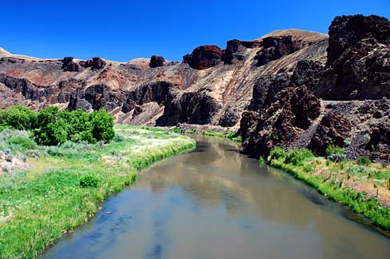
Next Steps
Consider today’s discussion
Draft key meeting notes
Share notes with Committee for review
Draft rulemaking
documents
Source: https://commons.wikimedia.org/wiki/File:Malheur_River_(Malheur_County,_Oregon_scenic_images)_(malDA0043a).jpg
HW Rules Team | Oregon Department of Environmental Quality
Notes:
Sue Langston
Our next steps include
We will consider our discussion here today
Draft the key notes from this meeting and post them on the web link that we’ve provided you.
And give the Committee an opportunity to review and approve notes before posting to our website
Identify if we need additional input from the committee
Start drafting proposal
Give Committee advance view of proposal prior to public notice
We are asking for a few volunteers, if you enjoyed participating in this process we would love to have you join us as we start developing our next phase of this rulemaking for additional fee increases.
I will now post the contact information for you
If you think of anything, please email David, Jeannette or me.
~~~~~~~~~~~~~~~~~~~~~
Other? Is this the last meeting? Draft Proposed Rule and Public Notice Next?
Ed note: Is this our last meeting and, if so, in addition to the steps listed, would our other next steps include Drafting the proposed rule and public notice? Will we seek the AC’s input again after October 18th? Will they have the opportunity to comment before the public notice or along with general public?

Slide 63
Hazardous Waste Fee Increase 2019
Consult
First Advisory Committee
Meeting
Consult
Third Advisory Committee
Meeting
Consult and Inform
Public Hearing and EQC information meeting
Aug. 2018
Sept. 2018
Oct.
2018
Dec. 2018
Jan.
2019
May
2019
Consult
Second Advisory Committee
Meeting
Inform
Public Notice and Open Public Comment
Present
Present Rulemaking to the EQC
Notes:
Jeannette Acomb
In recognition of our funding need, we propose increasing the annual Generator and TSD Fees. This would allow us to maintain our current service level and continue safely managing hazardous wastes in Oregon.
The calendar that you see in front of you reflects our work-to-date on this rulemaking and our estimated timeline in preparation for the May EQC meeting. The blue circles denote our public engagement process, and the blue paper stacks are the developed documents in support of this rulemaking.
This past fall, we sought input on the rulemaking from a nine-member advisory committee comprised of statewide stakeholders including representatives of small and large businesses, business advocates, education and environmental interests.
The advisory committee met three times (in Aug, Sept, and Oct) to discuss pros and cons associated with the proposed rules, as well as the anticipated fiscal impact on Oregon’s businesses.
While there will be impacts, the Committee identified no significant adverse impacts on small businesses in Oregon. The committee was supportive of the proposed fee increase to maintain DEQ Hazardous Waste Program’s current service level. The Committee also supported the concept of phasing-in fee increases over six years for generators.
We published the public notice for the proposed rulemaking on December 14, 2018 and on January 17, we held a public hearing in Portland. The public comment period ended 4pm Jan 22, 2019 and we received no comments.
The proposed rulemaking is the first phase of an anticipated multi-phase effort to fully address our funding deficit.
To secure long-term, stable funding, we must also seek additional changes to current hazardous waste fees under statutory authority within the next several years.
(PAUSE)
We have some exciting tasks ahead of us:
In addition to the Hazardous Waste Fees Rulemaking, other work continues at a fast pace. We anticipate coming to the EQC with work that includes a permit renewal and implementation of significant federal rules, such as the Generator Improvements Rule, the Definition of Solid Waste and the recently signed Pharmaceuticals rules. (PAUSE)
Chair George and commissioners, thank you for your consideration of the information we presented today, addressing the Hazardous Waste Program work, funding considerations, and important upcoming tasks.
We look forward to sharing more information with you in May. Until then, we welcome any additional questions you might have about the program, rulemaking background and our plans moving forward. (PAUSE)
--------------------------------------------------------------------------------------------------------------------------------------------------------------
Notes:
Potential Question: Be prepared to answer what we may propose to change via statute:
hazardous waste generator fee cap $32,500: Est 1992 1997 Cap $15,000 to $22,500
2003 Cap $22,500 to $27,500
2007 Cap $27,500 to $32,500
per metric ton fee $130 : Est 1992 1997 $60 to $90
2003 $90 to $110
2007 $110 to $130

Slide 64
Rulemaking Anticipated Timeline
Finalize committee notes/follow-ups Mid-Oct – Nov 2018
Draft Public Notice; redline rules Sept-Oct 2018
Planning for hearing (Ptld) Oct 2018
Internal Notice Review Nov 23, 2018
File Notice/Public Comment Opens Dec 7, 2018
Notice published in State Bulletin Jan 2019
Public Hearing Jan 10, 2019
Public Comment closed Jan 14, 2019
EQC Meeting May 7-8, 2019
Rules effective upon state filing May 2019
Generator Outreach/Communications May – Jul 2019
Published on Secretary of State Web Jun 1, 2019
HW Rules Team | Oregon Department of Environmental Quality
Notes:
Sue Langston
Our next steps include
We will consider our discussion here today
Draft the key notes from this meeting and post them on the web link that we’ve provided you.
And give the Committee an opportunity to review and approve notes before posting to our website
Identify if we need additional input from the committee
Start drafting proposal
Give Committee advance view of proposal prior to public notice
I will now post the contact information for you
If you think of anything, please email Jeannette or me.
~~~~~~~~~~~~~~~~~~~~~
Other? Is this the last meeting? Draft Proposed Rule and Public Notice Next?
Ed note: Is this our last meeting and, if so, in addition to the steps listed, would our other next steps include Drafting the proposed rule and public notice? Will we seek the AC’s input again after October 18th? Will they have the opportunity to comment before the public notice or along with general public?

Slide 65
Contacts
David Livengood, Project Sponsor
Livengood.david@deq.state.or.us
503.229.5769
Jeannette Acomb, Project Lead
Acomb.Jeannette@deq.state.or.us
503.229.6303
Notes:
Sue Langston
Thank you David,
As a wrap up here is the contact information as promised!
And again, if you have any questions or think of anything please email David, Jeannette or me.

Slide 66


Slide 67
Hazardous Waste Background – Program Portfolio
Compliance and enforcement
Technical Assistance
Permitting
Data Management
Policy

Slide 68
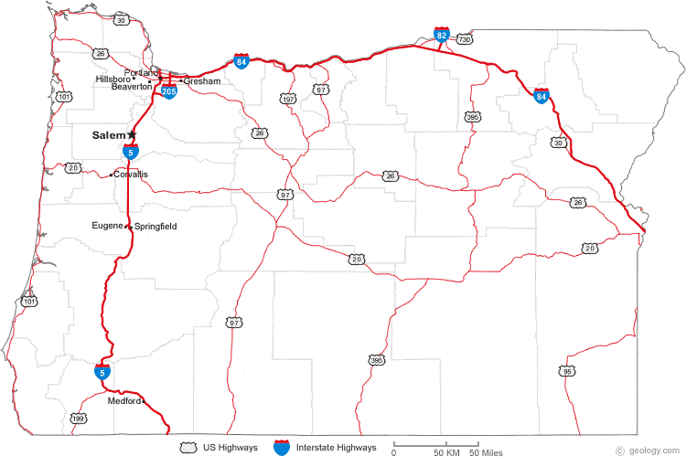


Hazardous Waste Program Background - Staff
Headquarters
Northwest
Western
Eastern
TA Inspection Permit Administration
Notes:
Jeannette Acomb
DEQ’s Hazardous Waste Program once had as many as 60 full time staff in the 1990’s, back when we had more than 900 generators. Today, we have 19 regional and headquarters staff working with approximately 500 generators.
The program is legislatively approved for 25 staff. However, due to current funding levels, the program is carrying 3.5 vacancies. These vacancies include 2 field inspectors, 1 permitting staff and a half-position for a program analyst. (LAB 2019-2021 25.44)
On the map we have highlighted our hazardous waste staff offices, and by color, identified the different types of work. Our program has four areas of focused work.
(Compliance and Enforcement): We have 6.5 staff (identified in blue) who inspect each of Oregon’s generators every three years. Our program receives an average of 163 complaints and conducts approximately 140 inspections annually, with 50 percent of those leading to at least one enforcement action per visit. (20% complaint-related site visits annually).
(Technical Assistance): We have 4 technical assistance staff (identified in green) who work with businesses of all sizes throughout the state to implement regulatory requirements and reduce wastes and toxic chemicals. Annually, our technical assistance staff provide over 20 workshops, perform 30 plus compliance site visits, and field 2,000+ telephone calls.
(Permitting and Corrective Action): We have 2 staff (identified in orange) who are responsible for permitting, corrective action, and compliance activities in Oregon. Oregon has 7 permitted sites, including 2 operating TSD facilities that handle waste from Oregon and out-of-state generators. Program staff also coordinate with the Cleanup Program and work on 22 sites in various stages of cleanup.
(Program Administration): 6.5 staff (identified in purple) who coordinate the program, perform mandatory tracking and reporting of data to EPA, invoicing, policy analysis and implementing state rules such as the federal rule adoptions and the recent delisting.
---------------------------------------------------------------------------------------------------
Potential Questions & Notes:
What would happen if we chose to inspect every 5 years (EPA requirement), instead of every 3 years (DEQ standard)?
You have more program administration staff than other types of core staff. Is it possible to put more FTE towards technical assistance and inspection work and less staff towards program administration?
7 permitted sites – Baron Blakeslee (Portland), Evanite Fiber Corp (Corvallis), Lockheed (The Dalles), Permapost Products Co (Hillsboro), Tektronix Inc (Beaverton)
2 Operating TSDs – Chemical Waste of Northwest, Safety-Kleen, Inc
corrective actions sites - Boeing of Portland, Cascade Wood Products, Columbia Helicopters, Evraz Oregon Steel, JH Baxter & Co. – Eugene, Marion County Road Dept., Mew Data Arms (MDA), NW Industries Pacific Fabricators, Potter Manufacturing, Roseburg Forest Products – Dillard, Safety-Kleen – Springfield, Taylor Lumber & Treating Inc., Teledyne Wah Chang Albany, Univar, Velco, Inc. (Former)
(It is worth noting that while we only have two operating permitted TSDs, DEQ’s data shows sometimes it can cost up to $140,000 in staff hours per complex permit modification.)

Slide 69
Hazardous Waste Program Background - Funding
Notes:
Jeannette Acomb
Like other programs at DEQ, our Hazardous Waste Program is largely supported by fees.
Annually, DEQ receives approximately $3.5 million from multiple sources. Of that total, approximately 80% are in fees, and 20% in federal grant.
(CLICK) For our purposes today, we are especially interested in increasing the Generator and TSD Fees, now highlighted in green. Both of these fees are under consideration for an increase via rulemaking.
For many years, we have run a lean program by seeking efficiencies and cost-saving measures including: delaying hiring, eliminating positions, and reducing overhead expenses.
Now, in spite of these efforts, we are operating at a deficit and eroding our ending fund balance. Without additional revenue, the program will continue to experience an annual deficit and will need to consider further cost reductions by December 2019.
Several factors contributed to this deficit:
First, most of our program fees have remained unchanged for over a decade without adjustment for inflation or increased program costs which include, salaries, benefits and information technology updates. The proposed Generator and TSD Fees have remained unchanged since the late 1990s.
Second, the program has experienced decreases in funding. For example, since 2004, the Hazardous Waste Program tipping fee has decreased by approximately 60percent. Another example, since 2008, DEQ’s EPA grant has decreased by 7%.
And third, we have experienced a significant change in state revenue. The program received $1.2 million in state General Funds in 1999. Since then, the amount of General Fund allocation steadily declined until its elimination from hazardous waste funding in 2015.
--------------------------
Potential Questions:
Is Land Quality interested in receiving general funds again? Ans: it is an agency allocation decision for those state funds received, in the past other programs such as air and water had high priority funding needs.
Is this an urgent concern, why were we not made aware of the issue earlier? Are we being asked to rubber stamp a fee increase? Ans: Trend towards fee-based programs. Many entities pay fees associated with several DEQ programs (e.g., land, air , water) and DEQ had to make policy decisions about which fee increases to prioritize in order to not overburden the regulated community. Now is the hazardous waste program time to request fee increases. No, we are not asking for a rubber stamp, but your help in address this issue.
What is the relationship between hazardous waste work/fees and GHG goals for waste reduction? Direct to Director Whitman.

