Slide 1

Land Quality – Hazardous Waste
Selmet Delisting 2018
November 15, 2018
Portland, OR
Dan Lobato & Seth Sadofsky | Oregon Department of Environmental Quality
Notes:
Good morning Chair George and commissioners, my name is Brian Fuller – I am a manager in DEQ’s Western Region – and I am here to present the proposed Selmet, Inc. hazardous waste delisting rulemaking for your consideration.
I am joined by my colleagues, Dan Lobato and Seth Sadofsky, who are hazardous waste inspectors in DEQ’s Western Region. Both Dan and Seth provided technical expertise on the proposed rulemaking that we are presenting today.
Before we dive into the presentation, we want to note that the proposed rule that we are here to discuss is the first proposed delisting in Oregon; however, US EPA has successfully completed this process in other parts of the country.

Slide 2
Outline
Hazardous Waste Background
Definitions
Oregon Statutes and Rules
Selmet Delisting Background
Timeline
Sampling and Analysis
  Current Process
  Evaporation Pond
Risk Screening
Conclusion
Dan Lobato & Seth Sadofsky | Oregon Department of Environmental Quality
Notes:
Today’s presentation will cover ground from brief background on DEQ’s hazardous program, relevant definitions and regulatory background, and specifics associated with Selmet, Inc’s proposed hazardous waste delisting rulemaking.

Slide 3
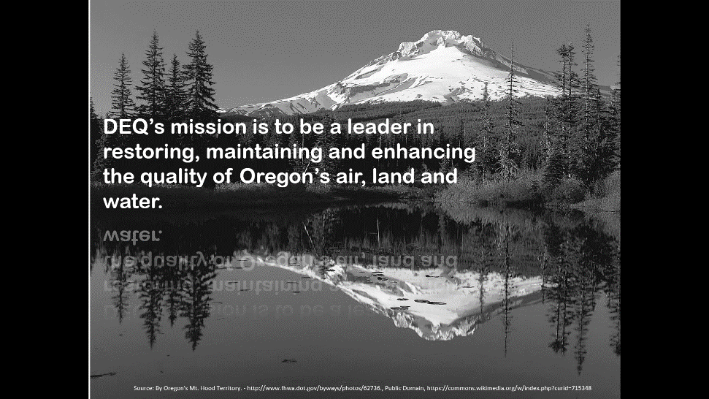
Hazardous Waste Background
DEQ strives to maintain balance between:
Regulatory compliance
Pollution reduction
Education and outreach
Results evaluation
Notes:
We know that it’s not common for DEQ’s Hazardous Waste program to bring proposed rulemakings for the EQC’s consideration, so before we get into the nuances of the delisting, we will briefly describe our hazardous waste work for context.
Like DEQ’s other programs, the Hazardous Waste program strives to maintain balance between regulatory compliance, enforcement and education to ensure that hazardous waste in Oregon is safely managed.

Slide 4
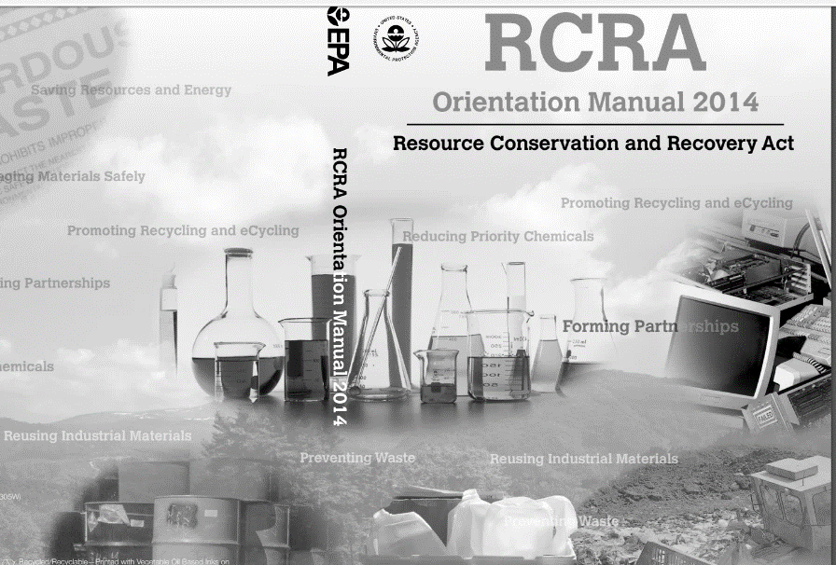
Hazardous Waste Background
Program Authorization:
  1976 Resource Conservation and Recovery Act (RCRA)
  1986 Oregon Authorization
Notes:
In 1976 Congress passed the Resource Conservation and Recovery Act to address increasing problems that the nation faced from our growing volume of municipal and industrial waste. The act, which is more commonly known as RCRA is our nation’s primary law governing the disposal of non-hazardous and hazardous waste.
The statute introduced the concept of “authorized state programs” in which states would develop programs and then apply to EPA for program authorization that would allow individual states to operate RCRA programs in lieu of the federal government.
State authorization reflects Congress’ intent that hazardous waste programs be state-run, under state laws and rules that are at least equivalent to the federal program, with oversight from EPA.
The basic requirement for obtaining RCRA authorization is that the state regulatory program must be equivalent to the federal program. State regulations may be more stringent than the federal program, but they may not be less stringent (40 CFR 271.1(i) and 40 CFR 271.4(b)).
In 1986, Oregon received its final RCRA authorization, giving DEQ the authority to operate the state’s hazardous waste program.

Slide 5
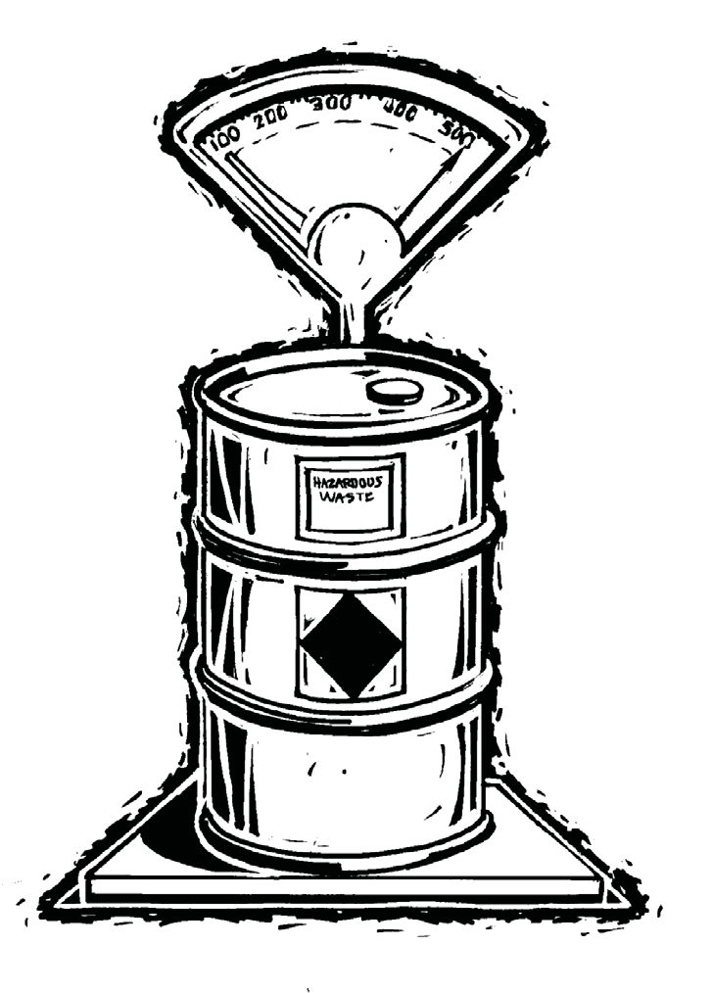
Hazardous Waste Background
HW Program includes:
Compliance assurance and monitoring
Corrective action
Enforcement
Facility Permitting
Policy and rule development
Technical assistance
Notes:
Today, DEQ has 19 hazardous waste staff, located throughout the state, who work with about 500 small quantity and large quantity generators of hazardous waste.
DEQ’s hazardous waste staff:
Conduct regular facility inspections, as well as compliance assistance and hazardous waste training;
Issue formal penalty assessments and information warnings, as needed;
Provide technical assistance site visits and regulatory trainings;
Oversee permitting and corrective action sites for treatment, storage and disposal facilities;
Identify and develop policy and rules; and
Collect and report data to EPA.
In consultation with EPA and Oregon’s Department of Justice, two of DEQ’s hazardous waste inspectors with backgrounds in hydrology, cleanup and RCRA facility compliance, as well as one policy expert, worked with Selmet, Inc. to sample and analyze two the facility’s waste streams to determine whether the wastes should continue to be managed as hazardous waste, or if they met stringent and risk-based standards that would allow Selmet to manage them as non-hazardous waste.
Collectively, DEQ staff working on this project drew from many years of experience with hazardous waste issues in Oregon to work with stakeholders, including Selmet, Inc, US EPA, and the public during the delisting process.
Now I’ll ask my colleague, Dan Lobato, to provide an overview of hazardous waste definitions and the regulatory framework that informs this process as context for the proposed delisting rulemaking.

Slide 6
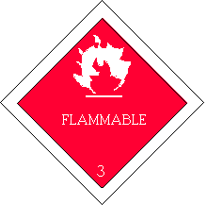
Definitions
Hazardous Waste:
Characteristic Waste - Ignitable, corrosive, reactive, or toxic.
Listed Waste: Wastes from specific industrial processes which are assumed to be hazardous and must be treated as such.
F006 Hazardous Waste: Wastewater treatment sludges from electroplating operations.
Delisting:
A generator may file a petition demonstrating that a waste is not hazardous.
Dan Lobato & Seth Sadofsky | Oregon Department of Environmental Quality
Notes:
Good morning Chair George and commissioners.
Before we jump into the specifics of the delisting, we will give an overview of some of the common terms you might encounter as we discuss our proposed rulemaking.
RCRA defines hazardous waste as a solid waste (including liquid or gas) which may significantly contribute to an increase in mortality or in serious illness OR pose a substantial hazard to human health or the environment when it’s improperly managed.
This definition of hazardous waste can be found in the United States Code of Federal Regulations (40 CFR 261.3), as well as in the Oregon Administrative Rules (OAR 340-101-033 and 001), which further define hazardous waste as either:
“characteristic,” meaning that the waste exhibits one of the four hazardous waste characteristics which include ignitability, corrosivity, reactivity, and toxicity; or
“listed,” meaning the waste is specifically named in the regulations,
It’s also worth noting that mixtures of non-hazardous waste and a listed or characteristic waste are also considered hazardous.
F-listed wastes are wastes from non-specific sources (as in manufacturing process wastes produced by a wide variety of industrial operations).
F006 wastes are a subset F-listed wastes that are wastewater treatment sludges from electroplating operations.
Electroplating processes include chemical etching and milling and cleaning and stripping. Chemical etching and milling processes utilize chemical solutions to dissolve metal layers from a part. Constituents associated with the process include cadmium, chromium, nickel and complexed cyanides.
Generators of listed hazardous waste have the opportunity to petition the RCRA implementing agency – either the EPA or an authorized state like Oregon– to exclude or “delist” their facility’s waste from the list of hazardous wastes if they can demonstrate the waste in question does not contain the constituents for which the waste was originally listed by EPA in concentrations that are greater than those identified by risk-based standards designed to protect human health.
In other words, when it comes to delisting, in order to fully protect human health and the environment, a listed waste is considered to be a hazardous waste by definition until a facility can demonstrate that it is non-hazardous.

Slide 7
Statutes and Rules
50 Federal Register 52629: Federal to state program delegation
40 Code of Federal Regulations sections 260.20 and 260.22: Federal hazardous waste rules
Oregon Administrative Rule 340-100-0020, -0022: State hazardous waste rules including delisting
Oregon Revised Statute 466.075(3): Exceptions to listing
Dan Lobato & Seth Sadofsky | Oregon Department of Environmental Quality
Notes:
A facility seeking to exclude waste from hazardous waste regulations must petition either EPA or their RCRA authorized state for a regulatory amendment.
As a RCRA authorized state, DEQ may delist a hazardous waste under federal and state authorities that you see here (point to slide).
EPA and authorized states like Oregon may grant delisting petitions on a facility-by-facility basis.
Today, we’re here to discuss the Selmet delisting petition to have their currently-listed F006 – wastewater treatment sludges from electroplating operations--delisted in Oregon regulations.
--------------------------------------------
NOTES:
So where does the Department of Environmental Quality’s legal authority come from to delist hazardous waste, such as Selmet’s F006 listed hazardous waste?
DEQ is authorized to delist a hazardous waste under federal and state authorities.
The US Environmental Protection Agency authorizes the state of Oregon to regulate hazardous waste generated in Oregon under the Resource Conservation and Recovery Act and EPA also authorizes Oregon to exclude, or “delist” specific hazardous substances from specific facilities. [50 Federal Register 52629, October 10, 1995 – EPA authority for Oregon to operate the hazardous waste program].
In this case, Selmet has petitioned Oregon’s Department of Environmental Quality, as an EPA-authorized state program, to delist F006 waste in the State of Oregon, listed here. (point to slide)
As if that weren’t complicated enough, a facility that petitions DEQ to delist a hazardous waste must comply with federal regulations that Oregon incorporates by references in our own regulations [40 CFR sections 260.20 and 260.22], and must demonstrate the waste in question does not contain the constituents for which the waste was originally listed by EPA in concentrations that are greater than those identified by risk-based standards designed to protect human health.

Slide 8
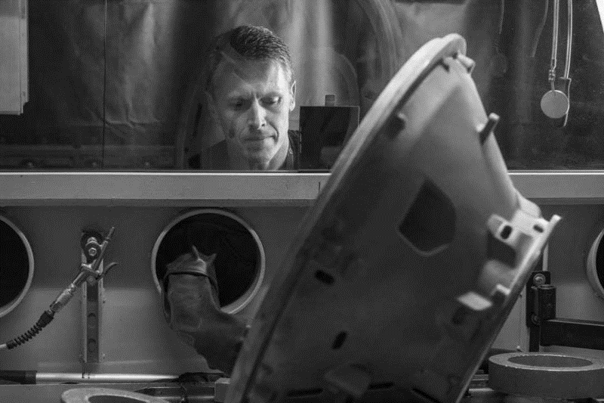
Selmet F006 Delisting Background
Photo Credit: Selmet, Inc via https://www.satellitetoday.com/business/2018/07/05/cpp-acquires-selmet-to-expand-titanium-casting-capabilities/
Dan Lobato & Seth Sadofsky | Oregon Department of Environmental Quality
Notes:
Who is Selmet, and why are they petitioning DEQ to delist their F006 waste?
Selmet manufacturers titanium alloy castings and machined parts for the aerospace industry.
Selmet is located in Albany, OR and has been in operation since 1969.
As a part of the manufacturing process, Selmet performs chemical etching and milling, which the US EPA defines as an electroplating process that is a regulated F006 hazardous waste, for reasons that we discussed in the previous “Definitions” slide.
Between 1995 and 2017, it was DEQ’s practice to consider wastewater treatment sludge from chemical etching and milling processes in facilities across the state to be non-hazardous because the sludge did not contain the constituents that F006 waste was listed for – for example, cadmium, complex cyanides and chromium-- above risk-based concentrations. However, in 2017, a statewide change in interpretation to better align with federal regulations, resulted in DEQ notifying Selmet and other facilities that they must treat waste from the electroplating process as F006 listed hazardous waste until they demonstrate to DEQ that the waste was non-hazardous through a delisting petition.

Slide 9
Delisting Timeline
2017
DEQ issues updated interpretation
2018
MARCH – DEQ approves Selmet sampling and analysis plan
MAY – Selmet petitions DEQ to delist waste
NOV - Selmet manages sludge as F006 waste.
JUNE – AUGUST – DEQ reviews petition
AUG 15 – Public notice
SEPT 17 – Public hearing
SEPT 21 – Public comment period closes
NOV 15-16 – Environmental Quality Commission Reviews and Votes
Dan Lobato & Seth Sadofsky | Oregon Department of Environmental Quality
Notes:
Which brings us to our current Selmet proposed delisting.
Before we get too much further into the content of Selmet’s petition and DEQ’s review and analysis of that petition, we wanted to give you an overview of the timeline associated with the delisting so that you have a better understanding of the process.
As we mentioned, in 2017, DEQ informed Selmet and other chemical etching and milling titanium casting facilities in Oregon that, due to an updated legal review and interpretation, their chemical etching and milling sludge should be managed as F006 listed hazardous waste.
In May 2018, Selmet submitted a petition to DEQ to delist the facility’s chemical etching and milling sludge.
After working with Selmet and US EPA to develop a waste sampling and analysis plan specific to Selmet, and reviewing the results of the plan, DEQ issued a proposed rulemaking to delist Selmet’s F006 waste in August 2018.
During a comment period from August 15 to September 21, 2018, DEQ received two comments from the public regarding the proposed rulemaking. You can find both comments, as well as DEQ’s response, in your EQC Staff Report.
Today, marks the final step in the proposed rulemaking process. If the Commission agrees with our recommendation and approves this rulemaking, Selmet will be authorized to send their F006 waste to a permitted (lined and monitored) non-hazardous waste landfill. Following delisting, Selmet must test their F006 sludge annually and they must also notify DEQ of any changes to the conditions described in their F006 petition.
Now I would like to introduce my colleague, Seth Sadofsky, who will review more specifics associated with the proposed Selmet F006 delisting.

Slide 10
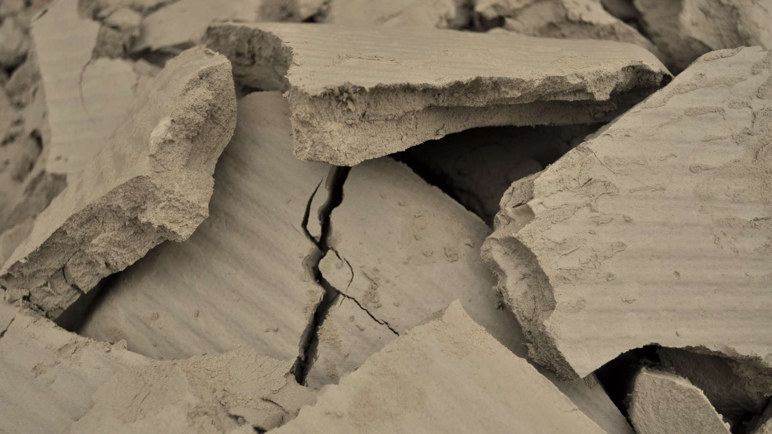
Waste Sampling and Analysis
Current Process
Current Process Waste
Produces 1,600 yards of F006 waste per year.
Sampling Process
4 sampling events spaced 2 weeks apart.
5 composite samples of waste collected per sampling event.
Photo Credit: Google Earth
Notes:
Good morning Chair George and commissioners.
Today, I will walk through the sampling and analysis process associated with both of Selmet’s two F006 waste streams. First, the F006 waste from Selmet’s current electroplating process. Second, Selmet’s waste from an evaporation pond that contains legacy waste from the facility’s historic electroplating operations.
As a reminder, by submitting the delisting petition, Selmet is seeking to demonstrate that their F006 waste from two sources does not contain listed waste in concentrations above risk-based standards designed to protect human health and the environment. Selmet is also seeking to demonstrate that their F006 waste does not exhibit characteristics of a hazardous waste– meaning it is not ignitable, corrosive, reactive or toxic.
This slide highlights sampling and analysis associated with Selmet’s current chemical etching and milling process, that produces 1,600 yards of filter cake waste-- similar to the waste depicted in this picture (point)– every year.
After closely consulting with DEQ team, Selmet developed a waste sampling and analysis plan to review all of the materials used in the company’s current process:
Selmet conducted four sampling events, and Selmet spaces each sampling event approximately two weeks apart to find any variation in the waste.
During each of the four sampling events, Selmet extracted 5 samples of filter cake from a random grid and then combined the five samples into one composite sample for analysis.

Slide 11
Waste Sampling and Analysis – Current Process
Current Waste Sampled for Analytes:
F006 Constituents
Cadmium | Chromium
Hexavalent Chromium | Nickel
Cyanide
Other Potential Underlying Hazardous Constituents
Fluoride | Manganese
Molybdenum | Silver
Vanadium | Zirconium
Dan Lobato & Seth Sadofsky | Oregon Department of Environmental Quality
Notes:
Selmet then sent the composite samples of its filter cake waste collected from Selmet’s current chemical etching and milling process to independent labs certified by the Oregon Environmental Laboratory Accreditation Program for analysis.
Based on review of Selmet’s current processes, DEQ and Selmet developed a list of hazardous waste to look for and measure, including contaminants for which US EPA lists F006 waste ( such as Cadmium, Chromium, and Cyanides) and any other potentially hazardous elements that may be present in the wastes.
Laboratory analysis determined that all of the samples of Selmet’s current process waste were below risk-based standards for listed and characteristic hazardous waste.
----------------------------------------------------------------------------------------------------------------------------------------------------
Note:
Laboratory reporting limits were all below appropriate screening levels.

Slide 12
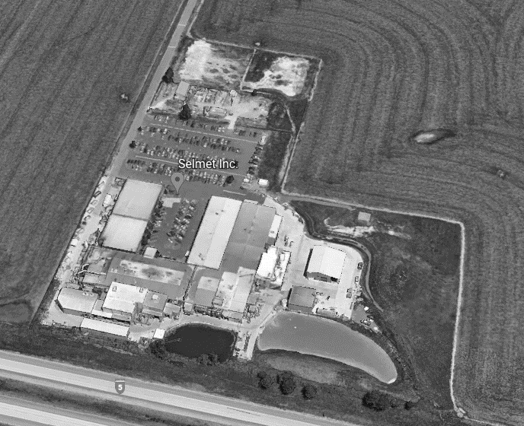
Waste Sampling and Analysis – Evaporation Pond
Evaporation Pond Waste
Approximately 1-2 meters thick and spread across 25,000 square feet.
Sampling Process
Pond was divided into 4 quadrants.
3 core samples randomly selected per quadrant.
Photo Credit: Google Earth
Notes:
This slide highlights sampling and analysis associated with Selmet’s evaporation pond, that contains waste from Selmet’s historic electroplating operations.
Selmet conducted waste treatment in the evaporation pond from the 1970s until 2017.
After closely consulting with DEQ team, Selmet developed a waste sampling and analysis plan to review all of the materials that might be present in Selmet’s evaporation pond, which is approximately 1 to 2 meters thick and distributed across approximately 25,000 square feet.
Selmet divided the evaporation pond into four quadrants and in each of the four quadrants, Selmet collected 3 random core samples and combined the 3 core samples into one composite sample for analysis. This process resulted in 4 composite core samples and together, they provide a representative sample of the waste present in Selmet’s evaporation pond.

Slide 13
Waste Sampling and Analysis – Evaporation Pond
Evaporation Pond Waste Sampled for Analytes:
F006 Constituents
Cadmium | Cyanide | Chromium
Hexavalent Chromium | Nickel
Other Potential Underlying Hazardous Constituents
Antimony | Arsenic | Barium
Beryllium | Cobalt | Copper
Fluoride | Lead | Manganese
Mercury | Molybdenum | Selenium
Silver | Thallium | Vanadium
Zinc | Zirconium
Poly Chlorinated Biphenyls (7 Analytes)
Volatile Organic Compounds (66 Analytes)
Semi-Volatile Organic Compounds (53 Analytes)
Notes:
Like the waste from Selmet’s current process, Selmet sent the evaporation pond waste samples to a certified laboratory for analysis.
Based on historical variations in Selmet’s chemical etching and milling process, DEQ and Selmet requested that the laboratory analyze the evaporation pond sediment for a longer list of potential constituents than the laboratories had analyzed the current process waste for.
This list includes both constituents for which EPA listed F006 waste, as well as other potential underlying hazardous constituents seen here (point).
Laboratory analysis determined that all of the samples of Selmet’s evaporation pond waste were below risk-based standards for listed and characteristic hazardous waste.

Slide 14
Notes:
As I just described, we have two waste streams for potential delisting, and an assortment of chemicals that Selmet tested for during the sampling and analysis process associated with this rulemaking.
This slide provides an example of the risk screening method that Selmet followed as it was testing for the chemical constituents and illustrates how Selmet tested for the presence of hexavalent chromium in its evaporation pond sediment.
Samples results for the evaporation pond’s four composite core samples are shown on this bar graph, which illustrates how the presence of hexavalent chromium in each of the four samples from Selmet’s evaporation pond compares to several screening resources, specifically:
First, EPA’s delisting model assumes that there will be some leaching, even in permitted non-hazardous landfills, and therefore addresses risk screening criteria that accounts for the destination of the leachate (for examples, drinking water and ecological exposure). EPA’s model considers both the concentration and volume of waste that will be disposed.
Second, the hazardous waste characteristic screening process is a procedure that is designed to predict whether a particular waste is likely to leach dangerous concentrations of chemicals into ground.
And thirdly, DEQ has risk-based cleanup program standards that measures, to the best of our ability to determine it, how much exposure is safe for someone like a construction worker who might come into direct contact with the waste.
In this example, as a result of comparing data from the evaporation pond to these three models, we see that the presence of hexavalent chromium in all four of the samples is below the screening model thresholds.
This screening process was repeated for each of the constituents from Selmet's current process and evaporation pond waste that we listed in the charts on the previous pages.
--------------------------------------------------------------------------------------------------------------------------------------------------------------------------------
NOTES:
Sample results are shown on this histogram:
Samples 1-4 are what I described in the last two slides.
In order to decide whether or not to recommend that you approve this delisting, we compare that data to several screening resources.
EPA’s Delisting model, which assumes that there will be some leaching in the landfill, and goes through all appropriate risk screening criteria for where it might end up and uses whatever turns out to be the most cautious (i.e., drinking water, ecological exposure…). This model takes into consideration not just concentration, but also the volume of waste that will be disposed.
This program allows differing risk tolerance, and we used one-in-a-million cancer risk for carcinogens and a hazard index of 1 for non-carcinogens.
Samples are also screened against characteristic hazardous waste concentrations. This is a bit crude in the diagram, but if the totals exceeded this concentration we would run leaching experiments. We don’t want concentrations that leach too much going into our regular municipal landfills.
We also screened the results against what our cleanup program would consider acceptable for exposure to a construction worker, there are no default exposure assumptions for a landfill worker but we believe this is appropriate.
So, we do this exercise for all of the analyzed constituents and both waste streams. And found no problems.

Slide 15
Risk Screening
There are no unacceptable risks for disposing of Selmet’s current process or evaporation pond wastes in a permitted, non-hazardous waste landfill.
Dan Lobato & Seth Sadofsky | Oregon Department of Environmental Quality
Notes:
After reviewing screening results for each of the hazardous waste constituents, DEQ determined that Selmet’s current process and evaporation pond wastes meets risk-based standards and are safe to dispose of in a permitted, non-hazardous landfill in amount described in Selmet’s delisting petition.
If it is approved, Selmet’s F006 delisting petition remains in effect only as long as Selmet maintains the same operating conditions and chemicals described in the delisting petition. If Selmet makes any changes to the process or the chemicals used in the process, they must notify DEQ of the change and handle the waste generated after the process change as a hazardous waste until DEQ is able to confirm in writing that the waste continues to meet the conditions described in the 2018 delisting.

Slide 16
Conclusion
DEQ recommends that the Environmental Quality Commission approve the rules delisting Selmet’s F006 wastes.
Dan Lobato & Seth Sadofsky | Oregon Department of Environmental Quality
Notes:
As a result of the sampling and analysis that was conducted in consultation with DEQ, DEQ is satisfied that Selmet’s chemical etching and milling sludge from both the current process and the evaporation pond meets the criteria for a hazardous waste delisting and can be safely disposed of in a permitted, non-hazardous landfill.
In conclusion, DEQ recommends that the EQC approve the rules delisting Selmet’s F006 wastes.
Chair George and commissioners, thank you for your consideration of this proposed rulemaking. We look forward to answering any question that you might have at this time.

Slide 17
Questions?
Dan Lobato & Seth Sadofsky | Oregon Department of Environmental Quality
Notes:
Can we ditch this slide?
They are technically our bosses, this seems more needed for the public.

